Slide 1
Updates on Production of NO_{x} by Lightning
Kenneth Pickering¹, Dale Allen¹
Eric Bucsela²
¹ Department of Atmospheric and Oceanic Science, University of Maryland
² SRI, International

Slide 2
Summary of CMAQ 5.2 Lightning NO_{x} Algorithm
CMAQ LNO_{x} algorithm (originally developed by Allen et al, 2012, ACP) contains three primary components:
1) Flash rates – two options in v5.2 – as modified by Daiwen Kang, EPA
- read in hourly gridded National Lightning Detection Network cloud-to- ground flash counts for retrospective runs
- estimate using regression relationships between WRF convective precipitation and NLDN flash rates for future runs
Estimate intracloud flashes from climatological IC/CG ratios
2) Mean NO_{x} production per flash – recommended value of 350 moles per flash for both CG and IC flashes
3) Specify vertical distribution of LNO_{x} emissions assuming they are proportional to pressure and to a climatological fractional profile of lightning channel segments (as in Koshak et al., 2014, Atmos. Res.) from Lightning Mapping Array observations.

Slide 3
Focus of this Talk
Production of LNO_{x} per flash:
Estimates based on NO₂ column observations from the Ozone Monitoring Instrument (OMI) on NASA’s Aura satellite and flashes from the World Wide Lightning Location Network (WWLLN) adjusted for detection efficiency
Estimates based on aircraft NO_{x} observations, Lightning Mapping Array data, and cloud-resolved modeling from the Deep Convective Clouds and Chemistry (DC3) field experiment

Slide 4
LNO_{x} Background
Lightning is responsible for approximately 5-15% of NO_{x} emissions globally. This is roughly 2 – 8 Tg N yr⁻¹ with a most likely value of 5 Tg N yr⁻¹ (or a mean of ~250 moles per flash) [Schumann and Huntrieser, 2007, ACP]. Much of uncertainty stems from little knowledge of NO_{x} production per flash or per unit flash length.
Most of lightning-produced NO_{x} (LNO_{x}) is injected into middle and upper troposphere, where the lifetime is longer than in the lower troposphere. NO_{x} in this region plays a key role in the chemistry of ozone, the importance of which as a greenhouse gas maximizes in the UT.
Globally, 60-70% of upper tropospheric NO_{x} and 35-45% of upper tropospheric O₃ is due to lightning, based on the NASA Global Modeling Initiative Chemical Transport Model (Allen et al., 2010, JGR)
Summer mean contribution of LNO_{x} to surface maximum 8-hour ozone average mixing ratio ranges from ~ 1 to 5 ppbv over CONUS (Allen et al., 2012, ACP)

Slide 5
Some Literature Estimates of LNO_{x} Production Per Flash
Method Moles NO/flash (Notes) Reference
Theoretical 1100 (CG), 110 (IC) Price et al., 1997
Laboratory ~103 Wang et al., 1998
A/C data, cloud model 345-460 (STERAO-A) DeCaria, et al., 2005
A/C data, cloud model 590-700 (CRYSTAL-FACE) Ott et al., 2010
500 (Mean midlat. model) Ott et al., 2010
A/C data, cloud model 500 - 600 (Hector) Cummings et al., 2013
Aircraft data 55-382 (CRYSTAL-FACE) Ridley et al., 2004
Aircraft data 70-210 (TROCCINOX) Huntrieser et al., 2008
Aircraft data 121-385 (SCOUT Darwin) Huntrieser et al., 2009
Aircraft data 70-179 (AMMA) Huntrieser et al., 2011
Aircraft data 117-332 (DC3) Pollack et al., 2016
LMA/Theoretical/Lab 604 (CG), 38 (IC) Koshak et al., 2014
Satellite (GOME) 32-240 (Sub-Tropical) Beirle et al., 2006
Satellite (OMI) 87-246 (TC4, trop marine) Bucsela et al., 2010
Satellite (SCIAMACHY) 33-50 max. (globally) Beirle et al., 2010
Satellite (OMI) 80 ± 45 (Gulf of Mexic0) Pickering et al, 2016

Slide 6
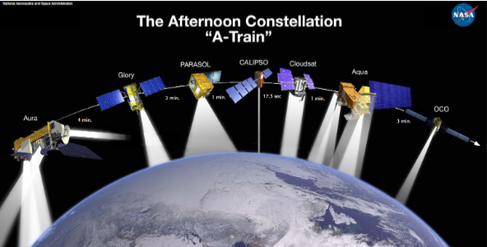
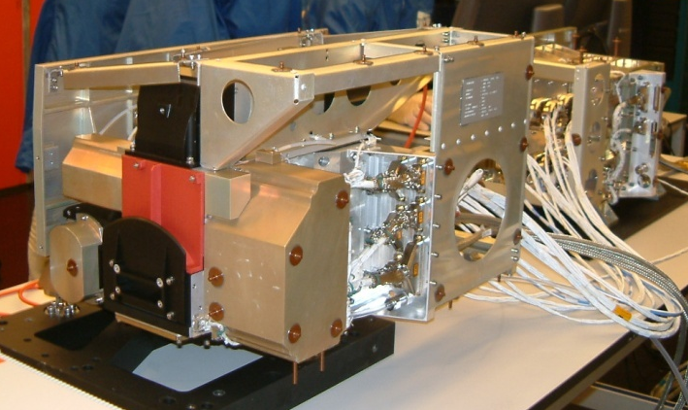
Aura/OMI
Ozone Monitoring
Instrument
Aura
2-dimensional CCD
Wavelength range: 270 – 500 nm
Sun-synchronous polar orbit;
Equator crossing at 1:30 PM LT
2600-km wide swath; horiz. res.
13 x 24 km at nadir
Global coverage every day
O₃, NO₂, SO₂, HCHO, aerosol,
BrO, OClO
wavelength
~ 580 pixels
~ 780 pixels
viewing angle
± 57 deg
flight direction
» 7 km/sec
13 km
(~2 sec flight))
2600 km
13 km x 24 km (binned & co-added)

Slide 7
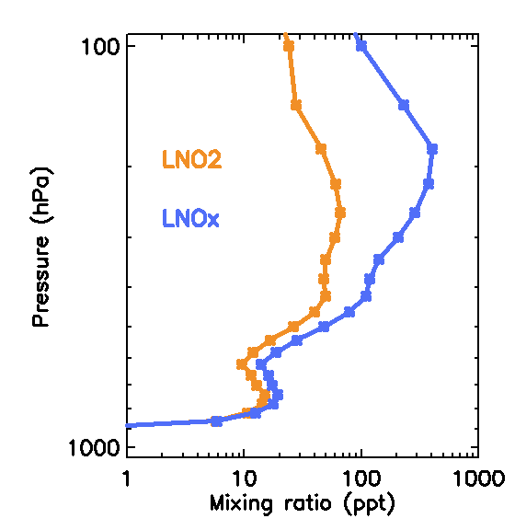
Algorithm
V = Vertical column amount; S = Slant column amount. Total slant
column NO₂ (S_{total}) from spectral fitting.
V_{strat}: Stratospheric NO₂ vertical column derived from OMI Standard Product and stratospheric Air Mass Factor (AMF_{strat})
V_{BG}: Tropospheric background column: estimate of contributions of sources other than recent lightning in the analysis grid cell. Multiple ways of handing this.
AMF_{LNOX} assumes a profile
shape appropriate for LNO_{x}. Converts the
slant column LNO₂ to vertical column LNO_{x}.
AMFs from radiative transfer modeling using
assumed profiles, cloud information, surface
albedo. Monthly profiles are from NASA’s Global
Modeling Initiative (GMI) chemical transport
model, selected from days with significant NO₂
from lightning

Slide 8
Analysis Methods
Daily analysis conducted on an array of 1 x 1 degree grid cells for June, July, August 2007 – 2011: Gulf of Mexico (Pickering et al., 2016, JGR); three mid-latitude continental regions; three tropical focus areas.
Analysis performed using OMI pixels with large values (≥ 0.97) of Cloud Radiance Fraction (CRF) and with Optical Centroid Pressure (OCP ≤ 500 hPa) sufficiently low to indicate deep convective cloud.
Analysis conducted only for grid cells with > specified minimum number (3) of OMI pixels meeting CRF and OCP criteria in order to reduce noise.
Analysis conducted only for grid cells with non-zero flashes in counting window (time period prior to OMI overpass ≤ median residence time for upper tropospheric air in grid cell). Gulf of Mexico: 3 hr; Mid-latitudes: 1 hr; Tropics: tested 3 to 6 hours
Two approaches: regression of moles LNOx vs. flashes; division of summation of LNO_{x} by summation of flashes. Upper tropospheric background: used OMI-based BG from same or nearby non-flashing grid cells.

Slide 9
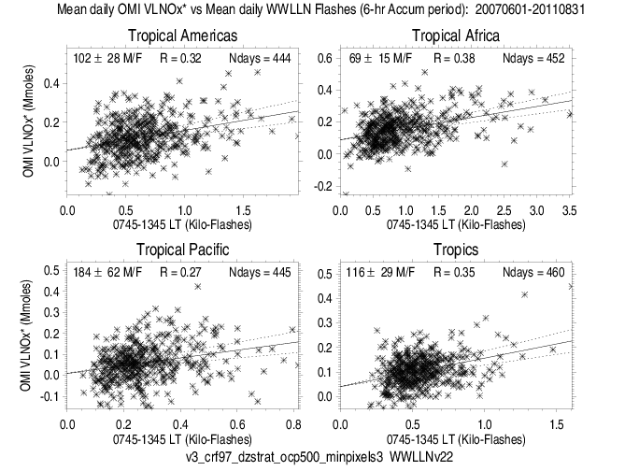
Tropical Analysis
102 ± 28
Moles/flash
69 ± 15
Moles/flash
184 ± 62
Moles/flash
116 ± 29
Moles/flash
OMI Version 3 with zonally-smoothed stratospheric NO₂ column
CRF > 97%; OCP < 500 hPa
Min of 3 pixels per grid cell
6-hour flash window
Background assumed to be accounted for by y-intercept in regression

Slide 10
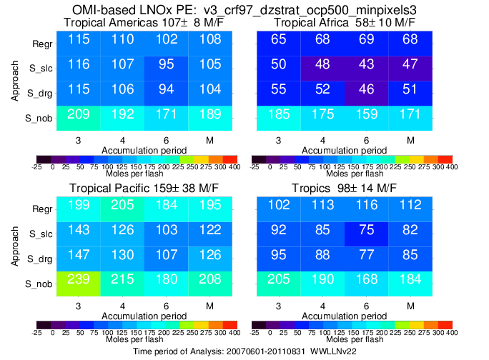
Regression (top line)
Summation with seasonal local BG (2nd line) – BG computed over JJA for 5 years for individual
grid cells when non-flashing and meeting CRF and OCP criteria
Summation with daily regional BG (3rd line) – BG from 10 nearest non-flashing grid
cells meeting CRF and OCP criteria on a daily basis

Slide 11
Tropics – Summary of LNOx PE (moles/flash) Estimates
Approach | Americas | Africa | Pacific | Tropics | Gulf of Mexico
Regression | 108 ± 38 | 68 ± 19 | 195 ± 85 | 112 ± 38 | 68 ± 22
Summation | 105 ± 9 | 49 ± 4 | 124 ± 18 | 84 ± 8 | 96 ± 13
Mean | 107 ± 48 | 59 ± 27 | 160 ± 72 | 98 ± 39 | 82 ± 37
Range | 59-155 | 32 - 86 | 88 - 232 | 59-137 | 45 - 119
Overall uncertainty is estimated to be 40-45%
Largest LNO_{x} PE in tropical Pacific (lowest flash rate) and smallest PE in Africa
(highest flash rate)
Value for Gulf of Mexico is similar to that obtained by Pickering et al.
(2016), which used OMI Version 2.1 and different methods for background and
stratosphere, and criterion value of OCP.

Slide 12
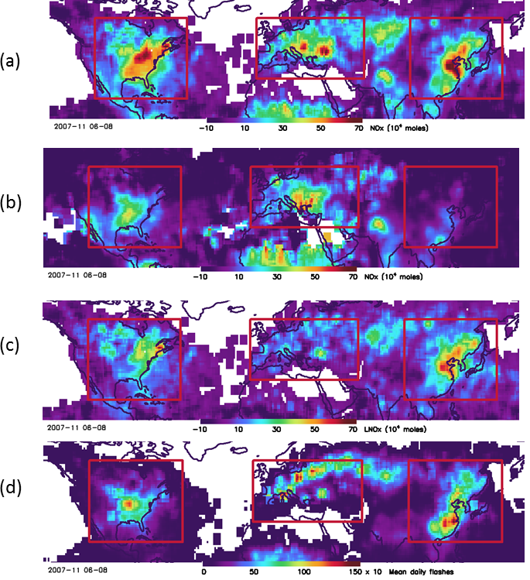
Mid-latitude Analysis
OMI Version 3:
V_{LNOx}*: vertical column
without background
removed
V_{BG}: tropospheric
background using V_{LNOx}*
from non-flashing boxes
(seasonal-local approach)
V_{LNOx}: vertical column of
of NOx from recent
lightning obtained by
subtracting b) from a)
WWLLN flashes in 1-hour
window prior to OMI
overpass; adjusted for
detection efficiency

Slide 13
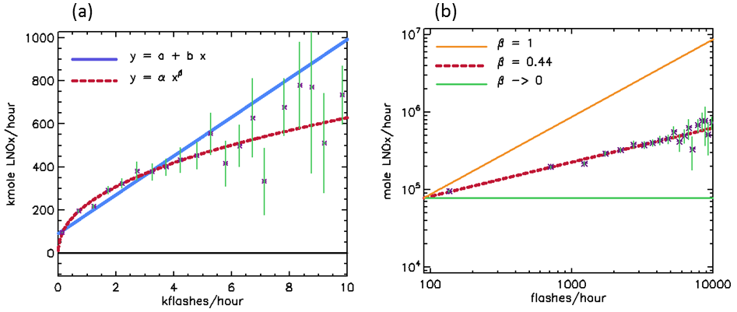
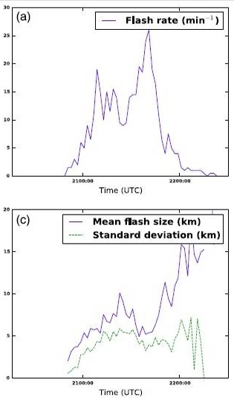
Regression of Binned Mid-latitude Data
b = 96 β = 0.44
Power law provides better fit to data than
linear regression; suggests lower LNO_{x} PE at
higher flash rates
Assuming lesser LNO_{x} production per flash with
smaller flash extent, this result is consistent with
data from ground-based Lightning Mapping
Arrays, which show inverse relation between
flash rate and flash extent.
Bruning and Thomas (2015)

Slide 14
Regression analysis of binned data from the 3 geographic regions separately and combined.
Region r b β χ2_{reduced} χ2_{reduced} PE_{avg}
(mole/flash) (linear) (power) (mole/flash)
---------------------------------------------------------------------------------------------
N. Amer. 0.61 95 ± 17 0.39± 0.04 2.41 0.76 360 ± 200
Europe 0.66 64 ± 22 0.39± 0.06 2.97 1.61 302 ± 220
E. Asia 0.75 99 ± 16 0.48± 0.03 4.67 1.54 296 ± 170
Combined 0.88 96 ± 14 0.44± 0.03 5.01 0.94 321 ± 180

Slide 15
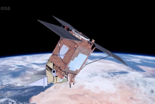
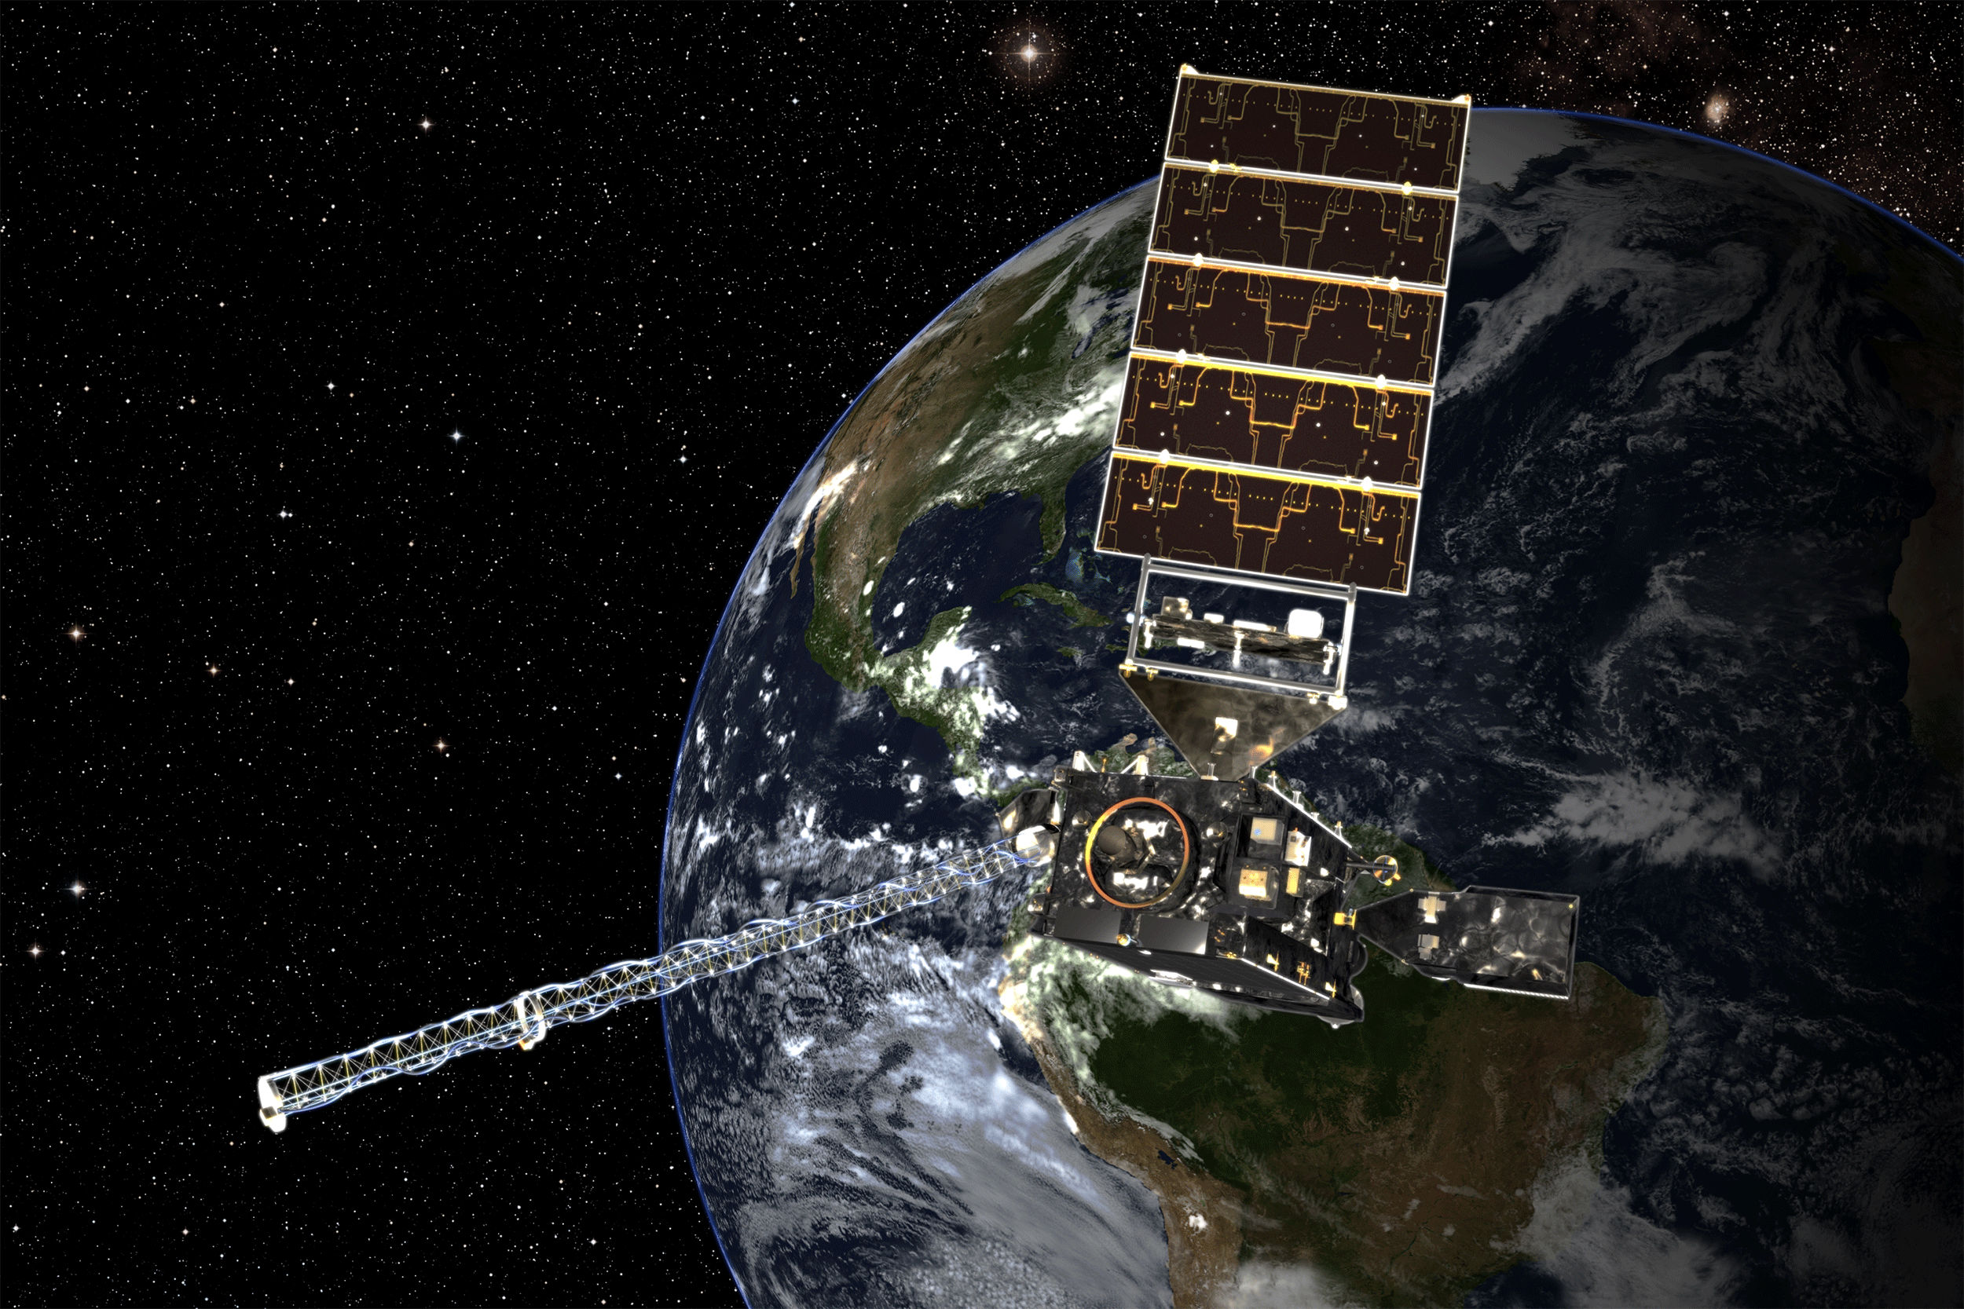
LNO_{x} PE from TROPOMI NO₂ and GOES-16/GLM Flash Observations
TROPOMI on Sentinel 5P satellite
launched October 13, 2017
NO₂ and cloud Level 2 3.5 x 7 km² products to be used in analyses similar to those performed with OMI data
Collaborators: Pepijn Veefkind, KNMI;
Diego Loyola, DLR;
GOES-16 Geostationary Lightning Mapper
(GLM) to provide gridded flash counts
(~10 km) as function of time.
High detection efficiency (70 -90%) expected.
Collaborator: William Koshak, NASA/MSFC

Slide 16
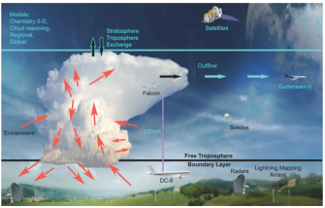
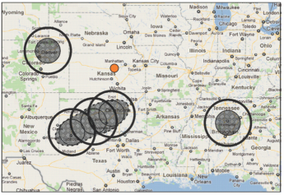
DEEP CONVECTIVE CLOUDS
& CHEMISTRY (DC3)
First campaign to simultaneously use extensive ground & airborne instrumentation to investigate midlatitude deep convection and chemistry
  May-June 2012
  3 sampling regions
  Focus on storm behavior, boundary layer inflow, lightning flash rates, LNO_{x}, anvil chemistry, and scavenging of chemical species
DC3 objectives:
  Investigate active convection and its outflow post-event (12-48 hrs)
  Study impact on composition and chemistry of upper troposphere
Experimental design (top); Sampling regions (bottom)
(Barth et al., 2015)

Slide 17
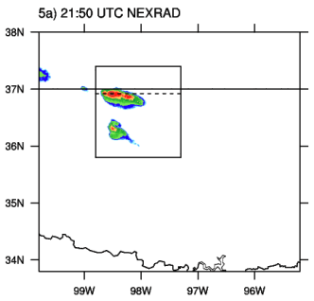
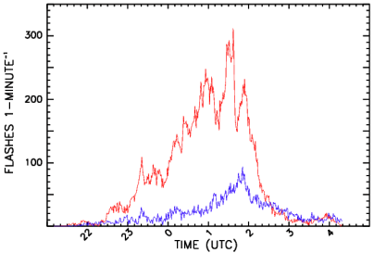
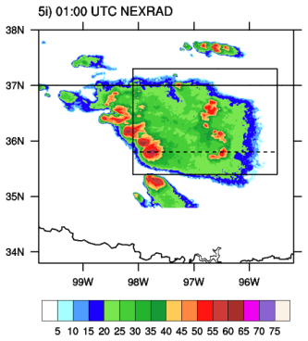
May 29-30, 2012 Oklahoma Severe Convective System
Observations
K. Cummings, 2017
21:50 UTC NEXRAD (dBZ)
Flash rates from Okla. Lightning Mapping
Array and NLDN
01:00 UTC NEXRAD (dBZ)
IC/CG = 2.73 ± 2.51
Cloud-Resolved Simulation:
WRF coupled with chemistry
(WRF-Chem; Grell et al., 2005)
Version 3.6.1 run at 1 x 1 deg.
Includes transport, deposition,
emissions, chemistry, aerosol
interactions, photolysis,
radiation. Flash rate density
= f(390 hPa upward cloud ice
flux) 14,419 flashes
15,060 LMA flashes
Tested several model LNO_{x}
production per flash
scenarios against anvil
aircraft NO_{x} obs.:
500 moles/flash
125
107 from Pollack et al., 2016
82
604 CG; 38 IC Koshak et al.
328 CC; 21 IC scaled to
yield mean of 82
Channel
segment
distributions
from OK LMA

Slide 18
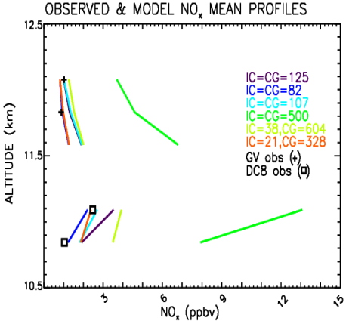
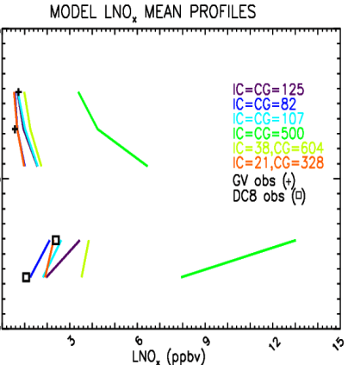
+
+
*
*
+
+
Est.
Est.
Mean NO_{x} over all 4 layers:
OBS = 1.36 ppbv
WRF = 1.30 ppbv
% Diff = -4.3%
Mean LNO_{x} over all 4 layers:
OBS = 1.21 ppbv
WRF = 1.15 ppbv
% Diff = -4.8%
82 moles per IC & CG flash bring observations & model in close agreement
K. Cummings, 2017

Slide 19
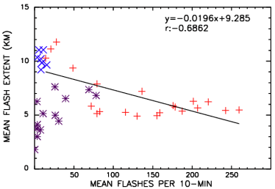
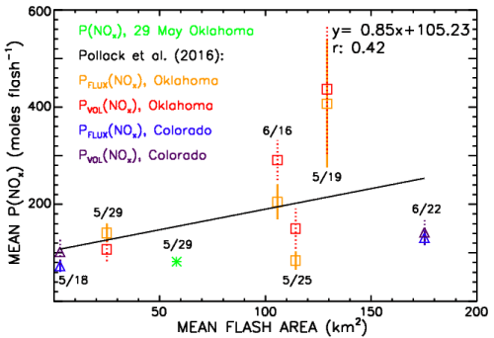
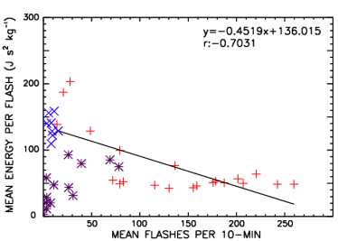
Relating LNO_{x} Production to Lightning Characteristics
29-30 May 2012
* 21:10-23:30 UTC
+ 23:40-03:00 UTC
X 03:10-04:20 UTC
29-30 May 2012
* 21:10-23:30 UTC
+ 23:40-03:00 UTC
X 03:10-04:20 UTC
Flash extent in DC3 storms ~6-15 km
Potential to develop parameterization scheme for LNO_{x} production per flash based on flash rate
Correlations based on data from 23:40-03:00 UTC (red +)
K. Cummings, 2017

Slide 20
Summary
Results from satellite-based observations suggest the CMAQ recommended mean LNOx production of 350 moles NO per flash is a reasonable value for mid-latitude regions such as the continental US.
However, at tropical latitudes LNO_{x} production per flash appears to be significantly less (69 to 184 moles/flash). CMAQ applications in such regions should use a value in this range.
Results from both satellite and aircraft data analyses suggest the LNO_{x} production per flash is inversely proportional to flash rate. Implementation of such a relationship in CMAQ should be considered to bring more realistic varlability to LNO_{x} emissions.

Slide 21
Acknowledgements
Support from:
NASA Aura Science Team
NSF Grant 1522551
Kristin Cummings supported by NASA Kennedy Space Center

