Slide 1


2017 Projections and Interstate Transport of Ozone in Southeastern US
Talat Odman & Yongtao Hu - Georgia Tech
Jim Boylan - Georgia EPD
16th Annual CMAS Conference
Chapel Hill, North Carolina
October 25, 2017

Slide 2
Modeling Objectives
Start with EPA proposed Transport Rule (CSAPR; December 2015)
  CAMx
Update modeling system
  TUV, WRFCAMx, CAMx super-stepping
Update 2017 EGU emissions based on feedback from SESARM states
  Calculate DVFs with updated 2017 EGU emissions
    CAMx and CMAQ
Calculate upwind state contributions to downwind state nonattainment and maintenance areas
  CAMx with APCA vs. CMAQ with brute force
  Compare significant contribution linkages ( ≥ 0.76 ppb)
    EPA proposed 2017 CSAPR modeling (CAMx with APCA)
    EPA final 2017 CSAPR modeling (CAMx with APCA)

Slide 3
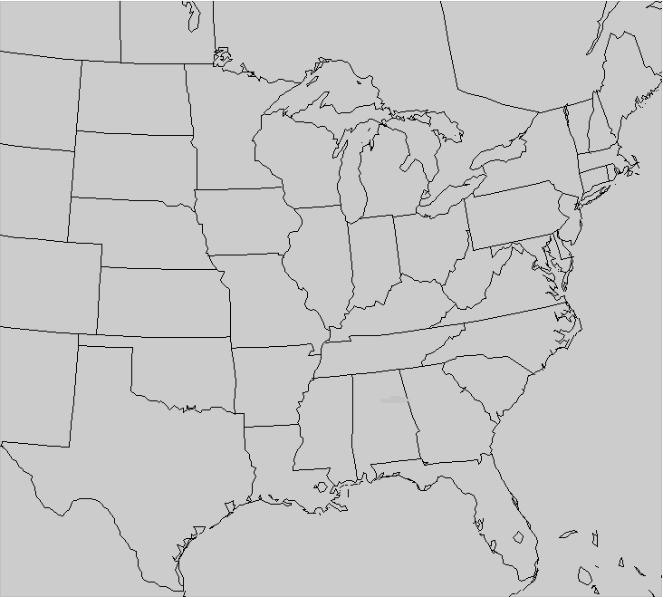
Modeling Overview
Used the EPA 2011/2017 modeling platform
  WRF 3.4 meteorology (PX, ACM2, KF, Morrison, RRTGM)
  2011 NEI and projected 2017 emissions (eh)
SESARM states revised point EGU emissions
  Conducted 2011 and 2017 annual modeling on 12US2
  CMAQ v5.02; CB05
  CAMx v6.11 (EPA-revised); CB6r2
  12US2 outputs used for LADCO12 IC/BCs
Conducted 2017 ozone season (April 1 – October 31) sensitivity modeling on LADCO12
  Source apportionment with CAMx-APCA
  Brute-force sensitivity runs with CMAQ
LADCO12
(269×242×25)
Notes:
We modified CMAQ v5.02 for online emissions reductions

Slide 4
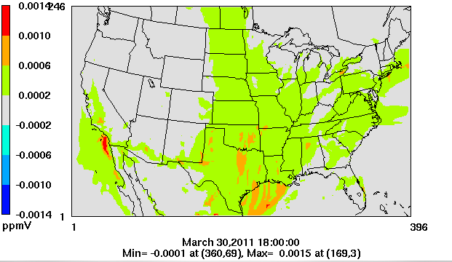
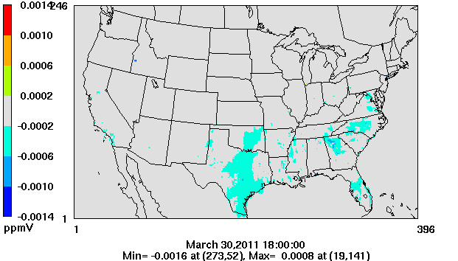
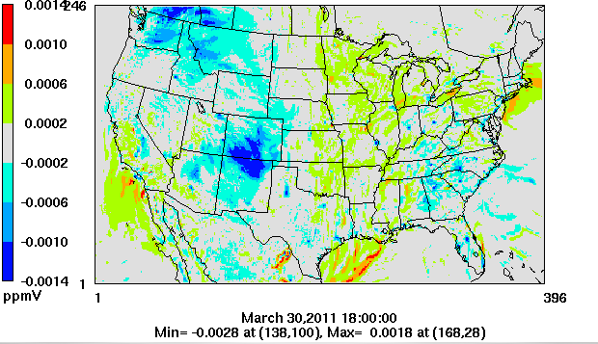
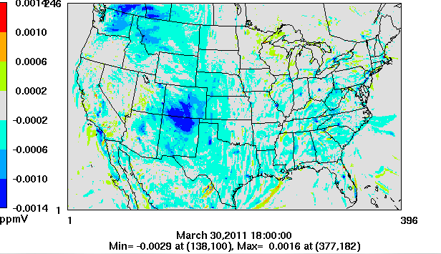
Ozone Benchmark – March 30 PM (18:00 GMT)
Photolysis
Meteorology
SEMAP-EPA Difference
Code

Slide 5
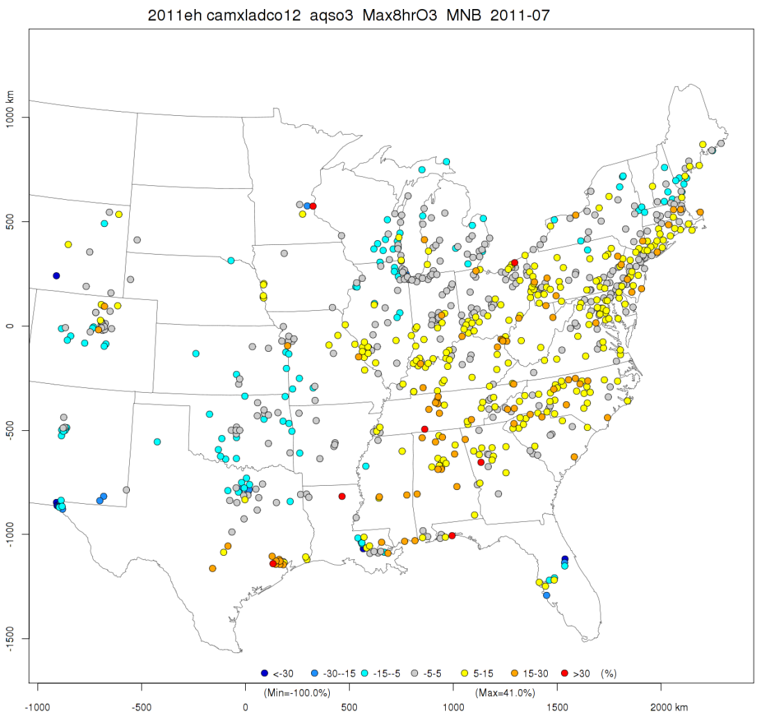
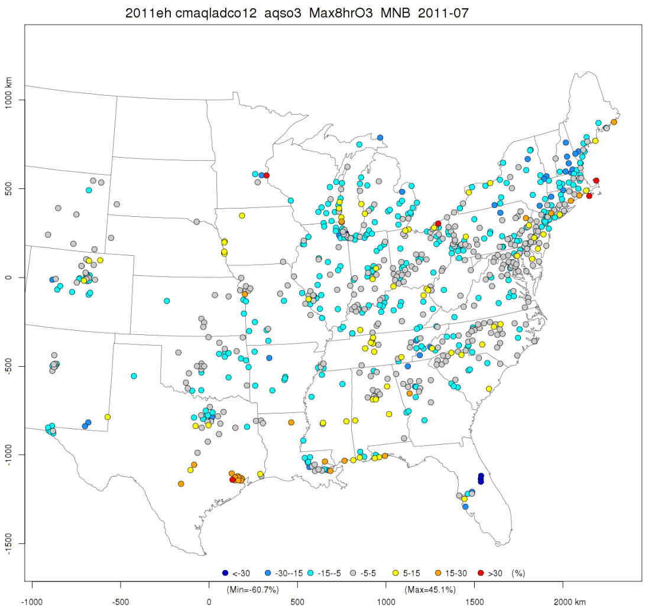
  Monthly Mean Normalized Biases (%): July 2011 (with 60 ppb cutoff)
CAMx
CMAQ

Slide 6
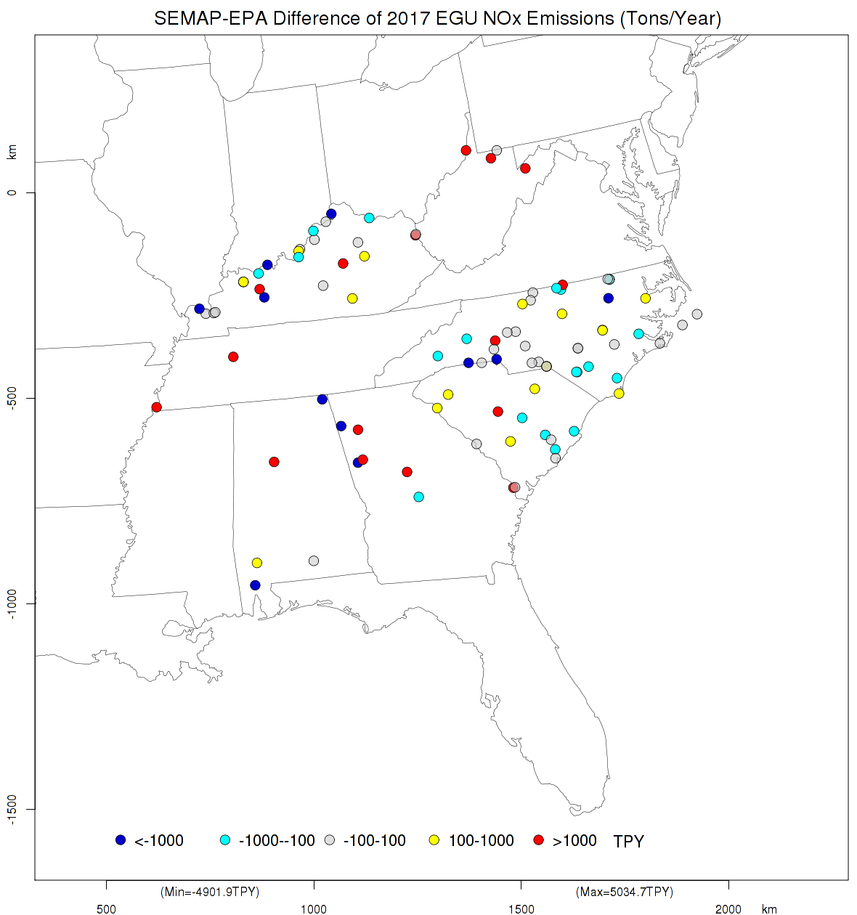
EGU Emission Revisions by Facility
< -1000 TPY
-1000 to -100
-100 to +1000
+100 to +1000
> +1000 TPY

Slide 7
Calculation of DVF
MATS 2.6.1 with 2011 as “baseline” and 2017 base-case as “forecast” to get RRFs
  RRF = 2017 / 2011
DVF = DVC × RRF
Modeled Attainment Test Software (MATS):
  Use of Model Data
    Monitor cell (1 x 1) and Max (3 x 3). EPA used Max (3 x 3)
  Current Design Values (DVC)
    5-year (2009-2013) weighted average and maximum of 5 years
  Relative Response Factor (RRF)
    For each site used top 10 days with maximum 8-hr ozone ≥ 60 ppb in 2017. If less than 10 days, used all days above 60 ppb if there are at least 5 days.

Slide 8
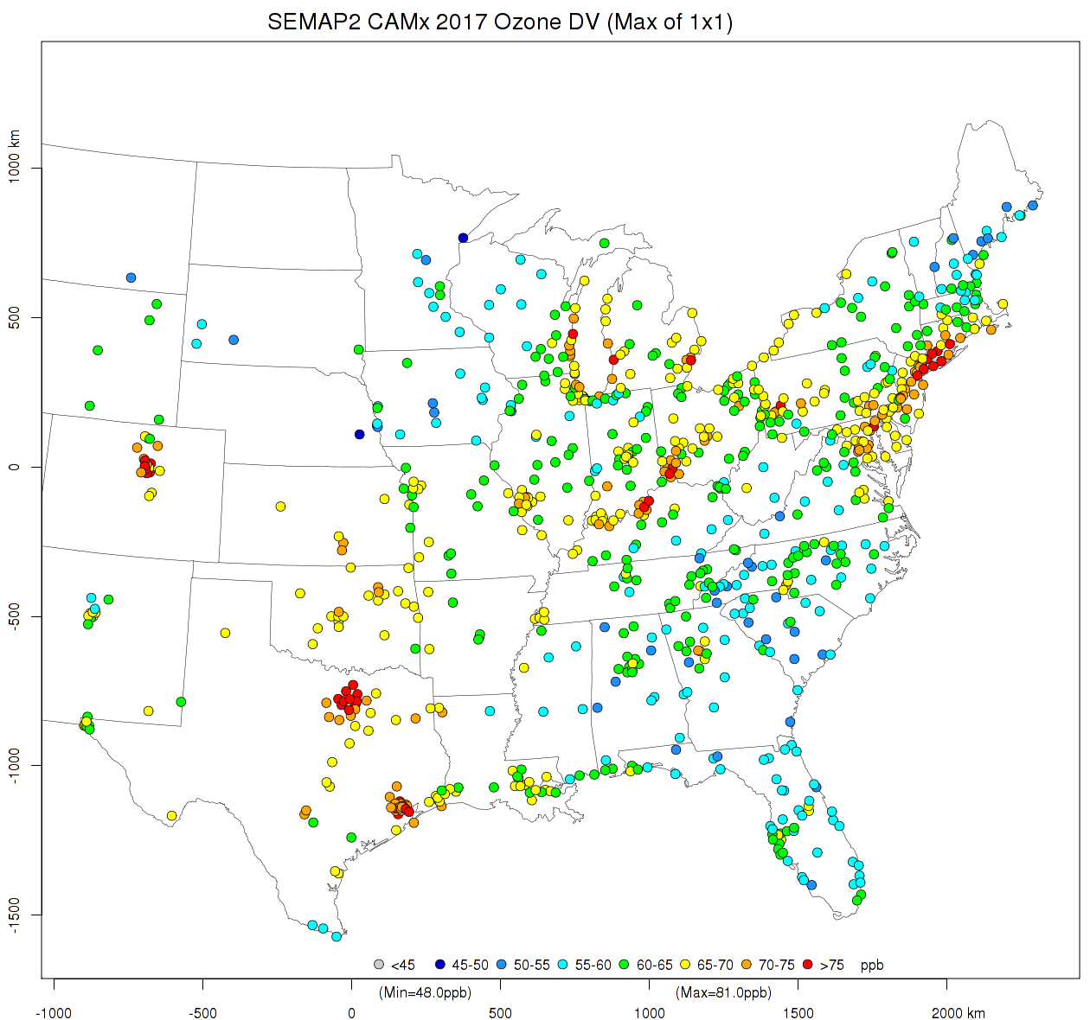

2017 DVFs with monitor cell (1 x 1)
CAMx
CMAQ
< 45 ppb
45 to 50
50 to 55
55 to 60
60 to 65
65 to 70
70 to 75
> 75 ppb

Slide 9
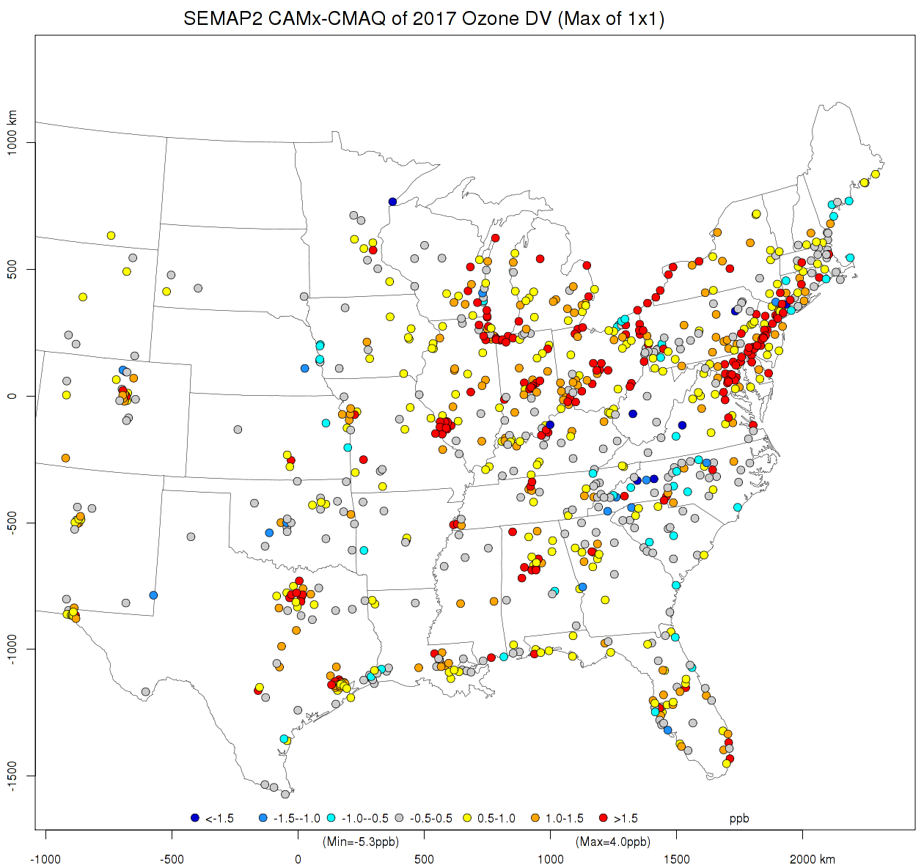
Difference in 2017 DVFs (CAMx – CMAQ)
< -1.5 ppb
-1.5 to -1.0
-1.0 to -0.5
-0.5 to +0.5
+0.5 to +1.0
+1.0 to +1.5
> +1.5 ppb

Slide 10
2017 Ozone “Nonattainment”
  Nonattainment: Average DVF ≥ 76 ppb
  Maintenance: Average DVF < 76 ppb but Max DVF ≥ 76 ppb
STATE | AIRS ID | EPA Proposed | EPA Final | SEMAP CAMx (3×3) | SEMAP CMAQ (3×3) | SEMAP CAMx (1×1) | SEMAP CMAQ (1×1)
CT | 90010017 | 75.8 | 74.1 | 76.5 | 79.1 | 79 | 83.8
CT | 90013007 | 77.1 | 75.5 | 77.6 | 77.4 | 77 | 77.5
CT | 90019003 | 78 | 76.5 | 78.7 | 83.3 | 76.6 | 75.3
CT | 90099002 | 77.2 | 76.2 | 77.6 | 76.1 | 76.4 | 75.7
KY | 211110067 | 75.8 | 76.9 | 78.9 | 77.6 | 79.3 | 77.3
KY | 211850004 | 73.7 | 71.5 | 74.1 | 75.8 | 75.5 | 76.8
MD | 240251001 | 81.3 | 78.8 | 81.2 | 79.5 | 79.5 | 78.1
NY | 360810124 | 75.7 | 73.8 | 75.7 | 78.5 | 75.6 | 73.8
NY | 360850067 | 76.3 | 75.8 | 76.4 | 76.9 | 75 | 73.9
NY | 361030002 | 79.2 | 76.8 | 79.3 | 80.6 | 79.2 | 78.1
 | Nonattainment
 | Maintenance
 | Attainment

Slide 11
2017 Ozone Nonattainment & Maintenance
  Nonattainment: Average DVF ≥ 76 ppb
  Maintenance: Average DVF < 76 ppb but Max DVF ≥ 76 ppb
 | EPA Final | EPA Proposed | SEMAP CAMx (3×3) | SEMAP CAMx (1×1) | SEMAP CMAQ (3×3) | SEMAP CMAQ (1×1)
Nonattainment | 10 | 16 | 20 | 24 | 19 | 16
Maintenance | 12 | 25 | 24 | 29 | 16 | 17

Slide 12
Contributions to Ozone with CAMx-APCA
  7 months (April-October) on LADCO12 grid
  Contributions of 30 sources (NO_{x} & VOCs):
  Point EGU CSAPR (10 SESARM states)
  Other anthropogenic (10 SESARM states)
  NO_{x} Budget Trading Program (NBTP) orphans
    Point non-EGU CAIR but not CSAPR (AL, KY, NC, SC, TN, VA, WV)
  Biogenic and dust
  Fires
  Other states, Canada & Mexico, and offshore
Contributions of IC/BCs
∑Contributions = Ozone Concentration

Slide 13
Sensitivities of Ozone to NO_{x} Zero-outs with CMAQ
  7 months (April-October) on LADCO12 grid
2017 baseline run
20 Sensitivity runs
  Statewide 100% emission reductions
    All anthropogenic NO_{x}
    EGU NO_{x}
  10 SESARM states
  20 model runs (2 sources × 10 states)
Sensitivity = Baseline ̶ Zero-out

Slide 14
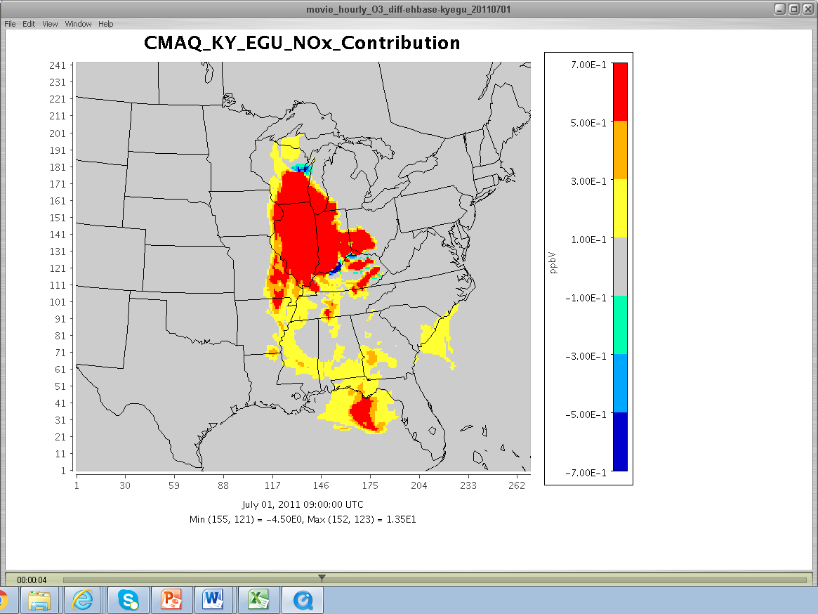
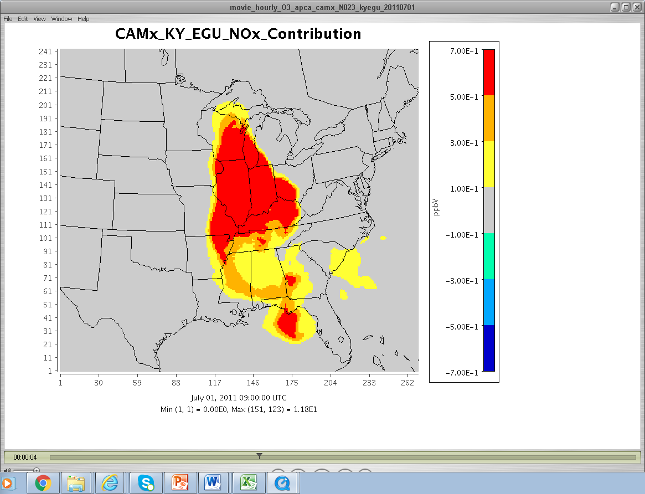
CMAQ Sensitivity vs.
CAMx Contribution

Slide 15
Contribution/Sensitivity Calculation (ΔDVF)
  Calculated pseudo ozone for CAMx-APCA
    CMAQ zero-out runs already yield ozone concentrations
  Modeled Attainment Test Software (MATS 2.6.1)
    2017 base case as “baseline” and 2017 sensitivity as “forecast”
    5-year weighted average DVC and monitor cell (1 × 1) or max (3 × 3) model data
    For each site used all days with maximum 8-hr ozone ≥ 76 ppb. If less than 5 days, used top 5 days above 60 ppb in 2017.
RRF = 2017_{sens} /2017_{base}
ΔDVF = DVF – (DVF*RRF) = DVF*(1-RRF)

Slide 18
Linkages of SESARM states to nonattainment sites (5-year average DVF ≥ 76 ppb)
 | AL | FL | GA | KY | MS | NC | SC | TN | VA | WV
Final CSAPR | 2 | 0 | 0 | 1+1 | 2 | 0 | 0 | 0 | 4 | 3
Proposed CSAPR | 2 | 0 | 0 | 3 | 2 | 0 | 0 | 1 | 6 | 6
CAMx-APCA (3×3) | 2 | 0 | 0 | 4+1 | 2 | 0 | 0 | 1 | 8 | 7
CAMx-APCA (1×1) | 2 | 0 | 0 | 3+1 | 2 | 0 | 0 | 2 | 6 | 5
CAMx-APCA (NOx) | 2 | 0 | 0 | 3+1 | 1 | 0 | 0 | 1 | 6 | 5
CMAQ (1×1) | 0 | 0 | 0 | 2+1 | 0 | 0 | 0 | 0 | 3 | 2

Slide 19
SEMAP CMAQ NO_{x} Sensitivities
 | Nonattainment |  | Maintenance |  | Significant impact |  | Self impact

Slide 20
SEMAP CMAQ EGU NO_{x} Sensitivities
 | Nonattainment |  | Maintenance |  | Significant impact |  | Self impact

Slide 21
Summary
Using monitor cell instead of Max (3×3) RRF caused larger differences from EPA proposed CSAPR than the model updates or EGU NO_{x} emission updates
CAMx DVF are generally larger than CMAQ DVFs (about 0.5 ppb on average)
CAMx contributions to ozone are larger than CMAQ sensitivities (responses to zero-outs)
  Recall CAMx ozone was larger than CMAQ ozone
  CAMx contributions span broader areas and are less detailed than CMAQ sensitivities
  CAMx contribution is always positive while CMAQ response can be negative and even turn from positive to negative along plume trajectory
  A significant impact according to CAMx may be insignificant according to CMAQ
VOC contributions are small compared to NO_{x} contributions
EGU NO_{x} contributions are 10% to 55% of total anthropogenic NO_{x} contributions for significant linkages.

Slide 22
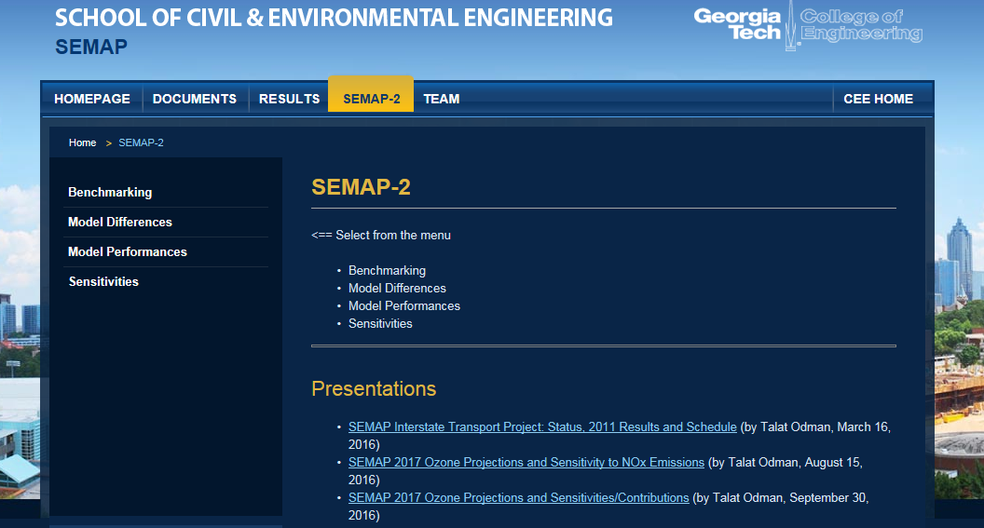
More Detailed Information
Final report
SEMAP website: http://semap.ce.gatech.edu

Slide 23
Supplemental SLIDES

Slide 24
EPA vs. SEMAP Platform
 | EPA | SEMAP
TUV | TUV4.8 (May 6, 2013 version)* | TUV4.8 (February 25, 2015 version)
WRFCAMx | WRFCAMx 4.0 beta | WRFCAMx 4.3
CAMx | CAMx 6.11 with modification for super-stepping routine for HMAX. | CAMx 6.11
*Ramboll-Environ confirmed that there was an error in NO3_NO2.PHF file in the May 6, 2013 version.

Slide 25
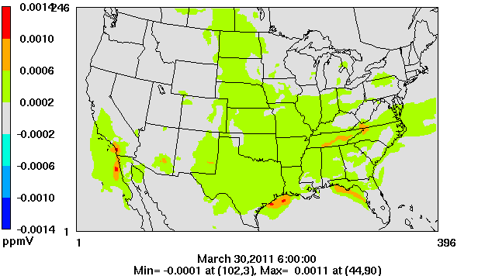
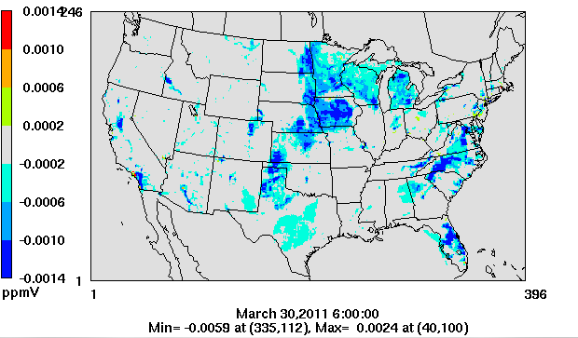
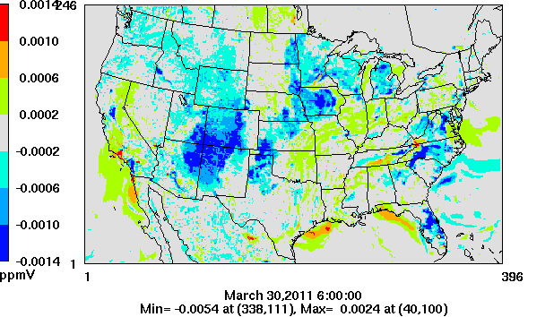
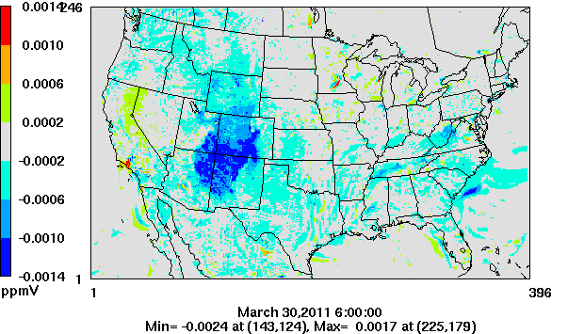
Ozone Benchmark – March 30 AM (6:00 GMT)
Photolysis
Meteorology
SEMAP-EPA Difference
Code

Slide 26
Ozone Performance Statistics
CAMx (with 60 ppb cutoff) |  |  |  |  |  |  |  | CMAQ (with 60 ppb cutoff)
 | mean MDA8 | # of Pairs | MB (ppb) | ME (ppb) | MNB (%) | MNE (%) |  |  | mean MDA8 | # of Pairs | MB (ppb) | ME (ppb) | MNB (%) | MNE (%)
Coastal SEMAP | 65.9 | 5869 | 3.48 | 6.97 | 5.46 | 10.6 |  | Coastal SEMAP | 65.9 | 5869 | -2.52 | 6.8 | -3.64 | 10.2
Interior SEMAP | 65.9 | 2178 | 1.85 | 6.99 | 3.06 | 10.6 |  | Interior SEMAP | 65.9 | 2178 | -4.88 | 7.67 | -7.22 | 11.5
Non- SEMAP | 67.3 | 19,613 | -2.31 | 7.91 | -3.23 | 11.7 |  | Non- SEMAP | 67.3 | 19613 | -4.65 | 8.17 | -6.68 | 12.0
MDA8: Daily maximum 8-hr average O₃
MB: Mean bias (in ppb)
ME: Mean error (in ppb)
MNB: Mean normalized bias (in %)
MNE: Mean normalized error (in %)

Slide 27
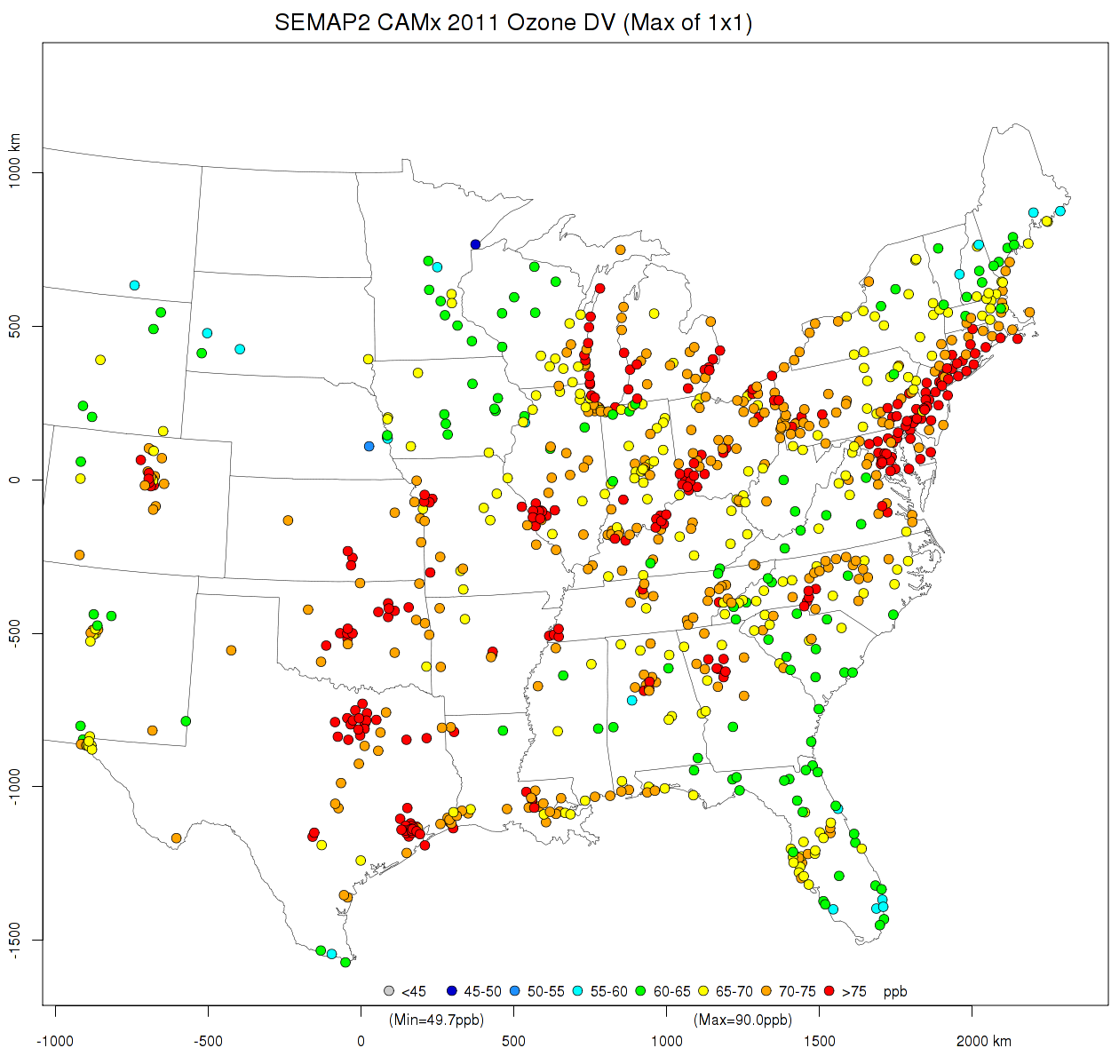
2011 DVCs (2009-2013)
< 45 ppb
45 to 50
50 to 55
55 to 60
60 to 65
65 to 70
70 to 75
> 75 ppb

Slide 28
Linkages of SESARM states to maintenance sites (Max DVF ≥ 76 ppb)
 | AL | FL | GA | KY | MS | NC | SC | TN | VA | WV
Final CSAPR | 0 | 0 | 0 | 3 | 0 | 0 | 0 | 2 | 4 | 5
Proposed CSAPR | 1 | 0 | 0 | 7+2 | 1 | 1 | 0 | 1 | 7 | 8
CAMx-APCA (3×3) | 1 | 0 | 0 | 9+1 | 1 | 2 | 0 | 2 | 6+1 | 9
CAMx-APCA (1×1) | 1 | 0 | 0 | 12+1 | 1 | 3 | 0 | 3 | 10+2 | 14
CAMx-No_{x} (1×1) | 1 | 0 | 0 | 12+1 | 1 | 3 | 0 | 3 | 10+2 | 13
CMAQ No_{x} (1×1) | 0 | 0 | 0 | 2 | 0 | 0 | 0 | 1 | 2 | 3

Slide 29
Proposed CSAPR Contributions
 | Nonattainment |  | Maintenance |  | Significant impact |  | Self impact

Slide 30
Final CSAPR Contributions
 | Nonattainment |  | Maintenance |  | Significant impact |  | Self impact

Slide 31
SEMAP CAMx Contributions
 | Nonattainment |  | Maintenance |  | Significant impact |  | Self impact

Slide 32
SEMAP CAMx NO_{x} Contributions
 | Nonattainment |  | Maintenance |  | Significant impact |  | Self impact

Slide 33
SEMAP CAMx EGU NO_{x} Contribs.
 | Nonattainment |  | Maintenance |  | Significant impact |  | Self impact

