Slide 1
Recent Performance of the NOAA Air Quality Forecasting Capability and the Impact of Driving Meteorology http://www.emc.ncep.noaa.gov/mmb/aq
Jeff McQueen, Jianping Huang, Ho-Chun Huang, Perry Shafran– NCEP/EMC
Amanda Sleinkofer – Millersville University
Pius Lee, Li Pan, Daniel Tong –NOAA/ARL
Ivanka Stajner, Sikchya Upadhaya – NWS/STI
October 25, 2017
Notes:
The web page you can see the daily updated veriication graphics you will see here.
NAQFC that predicts ozone and fine particluate matter
Joint project with NWS and OAR

Slide 2
Meteorological processes influencing air quality
Coastal sea/bay breeze flows
Complex topographical processes
→ mountain/valley flows; trapping, cold pools
Urban meteorology
urban boundary layer, in canyon, skim flows
Land surface/air-surface exchange
Deposition, biogenic emissions
Aerosol interactive radiative/cloud microphysical processes
Clouds and aqueous phase chemistry, wet deposition
Vertical mixing esp in stable boundary layers
Notes:
NAM-CMAQ system includes all of CONUS, Alaska and Hawaii. For case studies, we will show performance over coastal areas during ozone episodes and pm smoke predictions in valleys

Slide 3
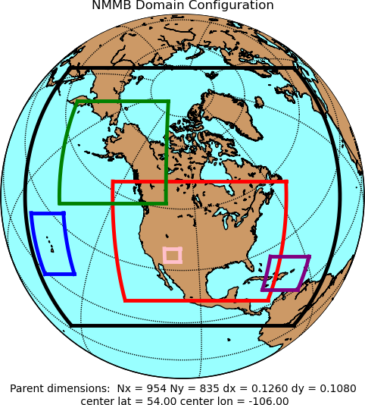
NAM Forecast System - Version 4 (March 2017)
Resolution Changes
CONUS (4 km) and Alaska (6 km) nests → 3 km
Sync AK and CONUS On-Demand Fire Weather nests → 1.5 km
Select Model Changes
Updated microphysics → Improved stratiform precip
Reduce incoming SW Rad under clouds: reduce warm season 2-m T warm bias
More frequent calls to physics → Physics/dynamics more in sync
Improve effect of frozen soil on transpiration and soil evaporation → Improve cold season 2-m T/Td biases
Adjustment to convection in 12 km NAM
Modify latent heat flux treatment → Improve visibility along CA coast
Data Assimilation
DA cycles for 3 km nests → Much less ‘spin-up’ time
Use of Lightning/Radar Refectivity-derived temperature tendencies
Improved short-term forecasts of storms at 3 km
New satellite radiances, satellite winds
DA
3 km
1.5 km
12 km
DA
DA: Data Assimilation Cycle
Courtesy Eric Rogers, EMC
Notes:
Now a 3 km conus nest along with AK and HI
Reducing incoming SW radiation under clouds probably the largest impact on ozone production as photolysis and overprediction would be reduced
We saw little improvement from improving 2m T//Td biases

Slide 4
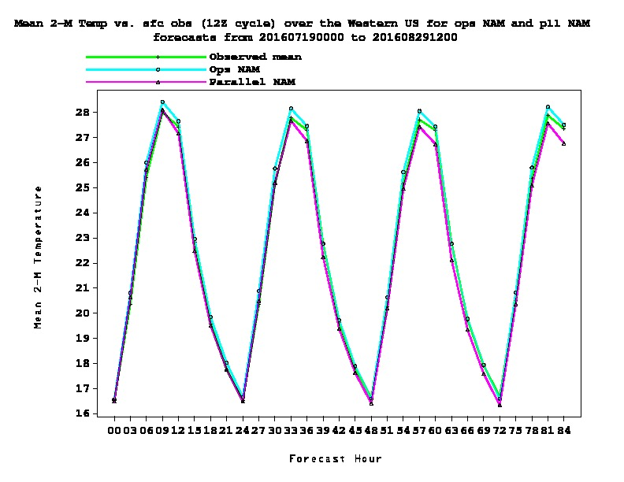
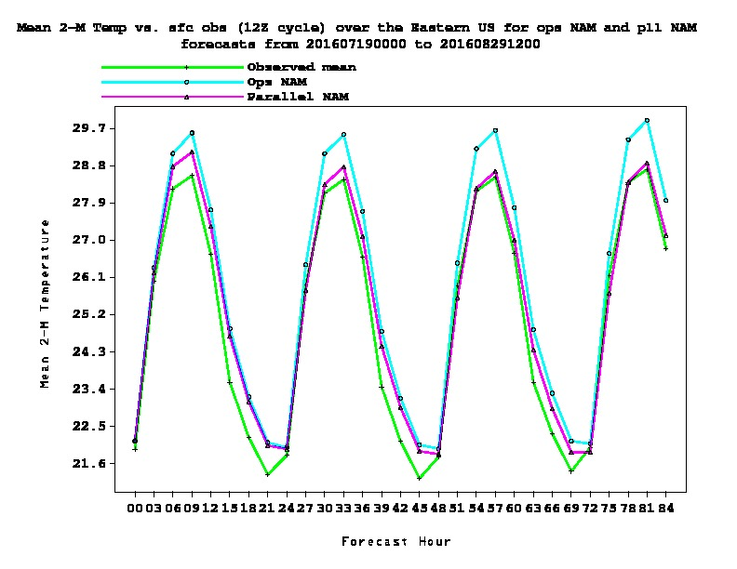
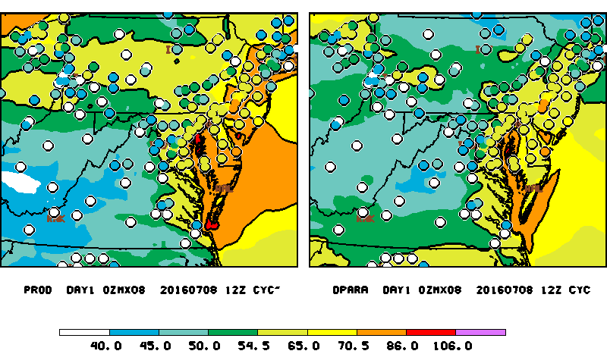
NAM March 21, 2017 Upgrade
WEST
EAST
2 m Temperature
NAM - CMAQ V4.7
NAM-V4 - CMAQ V4.7
Notes:
Green observed, pink is the old operational NAM
for the Eastern U.S. improved for both day and night time temperature esp the first 24 hours or so. Reduced warm bias.
Note improvements in overpredictions from CMAQ just by using NAM-V4 alone.
Here observations are plotted in parts per billion, colored circles vs color filll contoured model predictions. Key threshold is code orange…greater than 70 ppb also colored in orange. Note the impact of NAM-V4 alone strongly improves the over predictions pf code orange
And we believe it due to making more opaque clouds originally designed to improve warm season temperatures but having an important effect on downstream model.

Slide 5
July 2016 NRT CMAQ Prod vs V5.0.2 1 h avg Diurnal Ozone
WEST
EAST
CMAQ V5.0.2 NAM-V4: improvement in ozone over-prediction over the East
West
CMAQ V5.0.2 NAM-V4: Strongest underestimate over West
Meteorological impact nearly as large as CMAQ/Emissions upgrade
Notes:
More results of the v4.6l vs V5.l CMAQ for ozone
Look at the impact of Meteorology red solid vs red dashed
While blue vs red shows impact of CMAQ upgrade
July 2016 results Dashed red lines…updated CMAQ and NAMX shows good improvement compared to the observed black line. But more underprediction in the west (wild fire impact as we don’t emit gas emissions from wild fires again ??)
Comparing solid rad to dashed red lines show the impact of Met alone. It is almost as large as comparing blue to red solid lines for instance (the impact of cmaq upgrade).

Slide 6
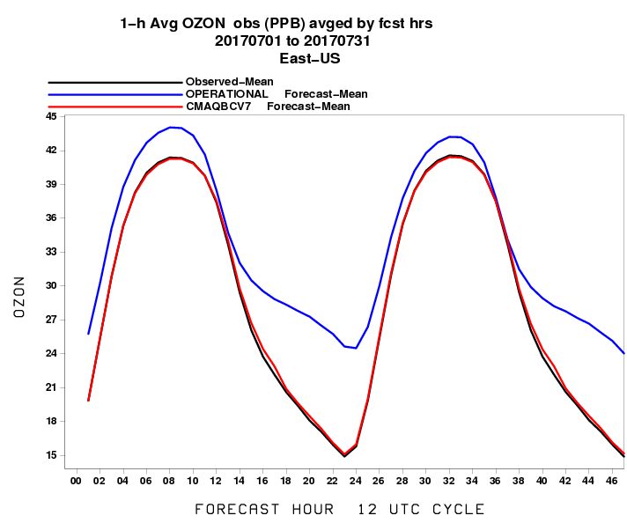
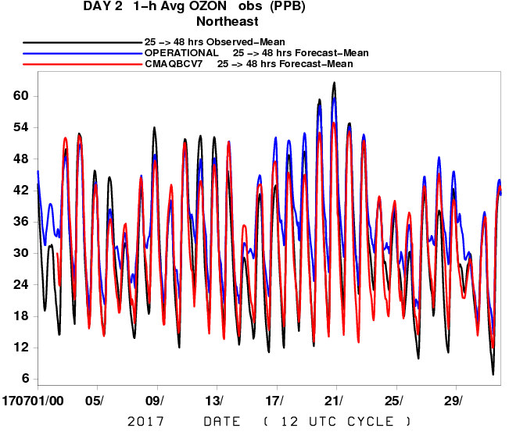
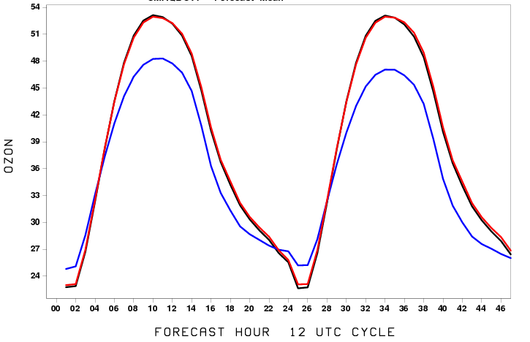
Ozone Errors: July 2017 Obs vs Raw vs Bias Corrected
NORTHEAST
EAST
WEST
East : Overprediction overall but
underprediction for July 10-12 exceedences
West: Continued underprediction
O3 BIAS CORRECTION:
Diurnal performance good, overcorrects some events (July 10-12, 18-21)
Jianping Huang, NCEP
Notes:
See a slight overprediction in daytime but strong at night in east
In west continued underprediction mainly due to coarse resolution not capturing mountain blocking (12 km)
Over NE, several exceedences from July 10-13 when 10-12 missed these

Slide 7
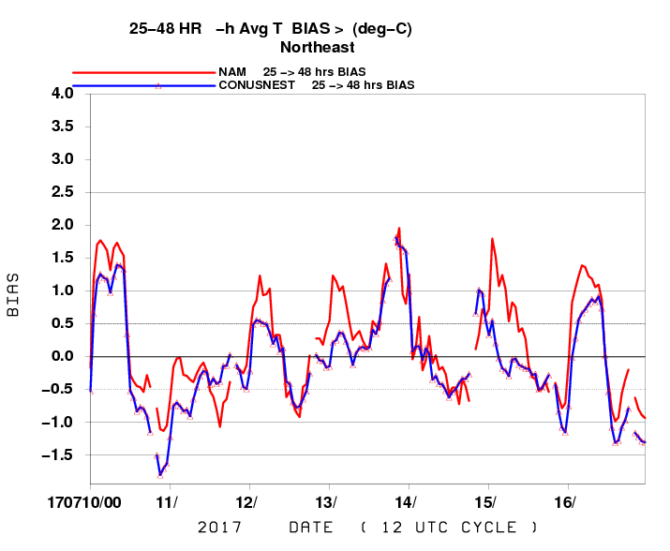
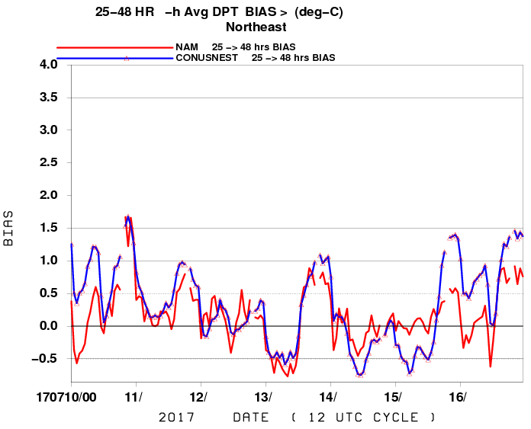
NE 25-48h T/Td Bias NE U.S. July 10-16, 2017
Temperature
Dew Point
Cool, moist biases on 11th and 12th coincides with ozone underprediction
Notes:
Red line is NAM 12 km parent temperature and dewpoint bias
Blue lines are the NAM 3 km NEST biases over the NE US
In dewpoint we see a moist bias, while temperatures were underpredicted for the first few days of the episode

Slide 8
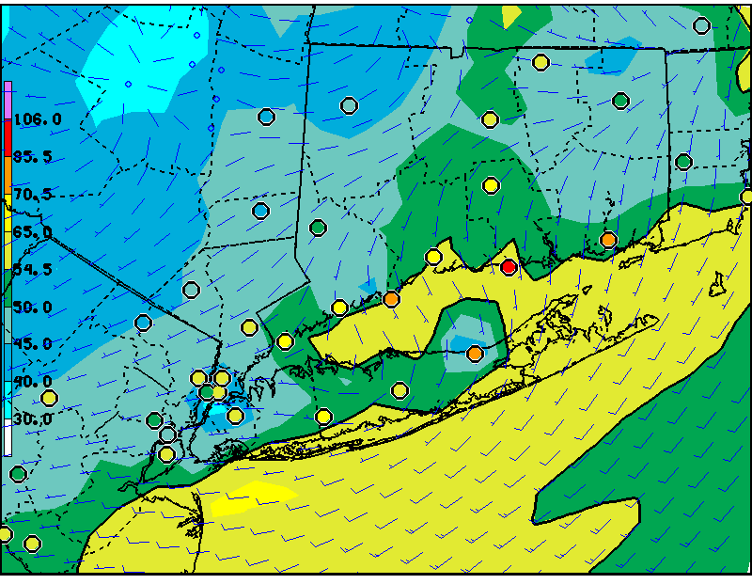
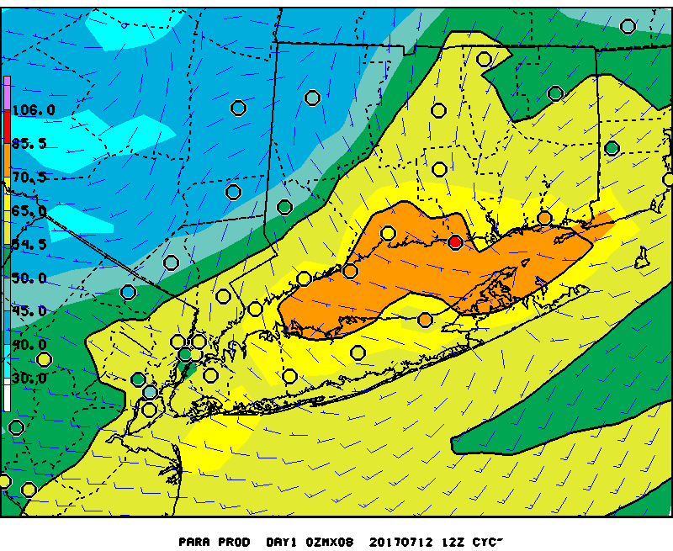
July 12, 2017 NAM-CMAQ V5 Performance
CMAQ 8h Ozone Max: Day 2
CMAQ 8h Ozone Max: Day 1
8h Ozone Max: Day 1 Mdl-Obs
Bias Corrected 8h Ozone Max: Day 2
- Continued less ozone predicted for day 2
- O3 Bias correction.improved over LI
Notes:
Looking at the july 12 case the day 2 (25-48 hour) prediction of ozone max is strongly overpredicted in CMAQ but not so in the Barons MAQSIP model also run at the same resolution.

Slide 9
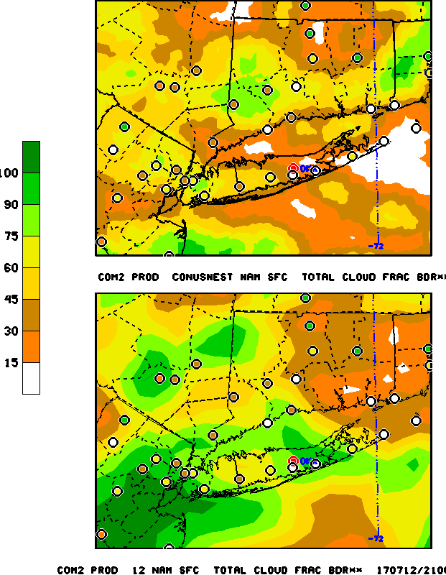
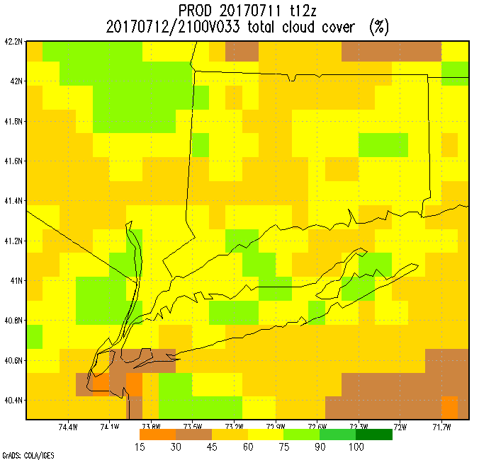
July 12, 2017 NAM-CMAQ V5 Performance NE U.S. NAM,Nest, CMAQ 7/11/ 12Z 33 h Cloud Cover
NAM Nest derived cloud cover
NAM derived cloud cover
CMAQ derived cloud cover
- NAM-12 cloud cover too high and extent too broad, CMAQ less
- NAM nest captures clearing along LIS and CT better
Notes:
Now, the impact of cloud cover is liely even more important since the incoming sw is more sensitivbe to it.
While overall, cloud cover change helped reduce the model ozone overprediction biases, it can lead us astray when there are errors
And Cloud cover is difficultl to forecast especiallly for the second day.
Limits of deterministic predictions are evident again.

Slide 10
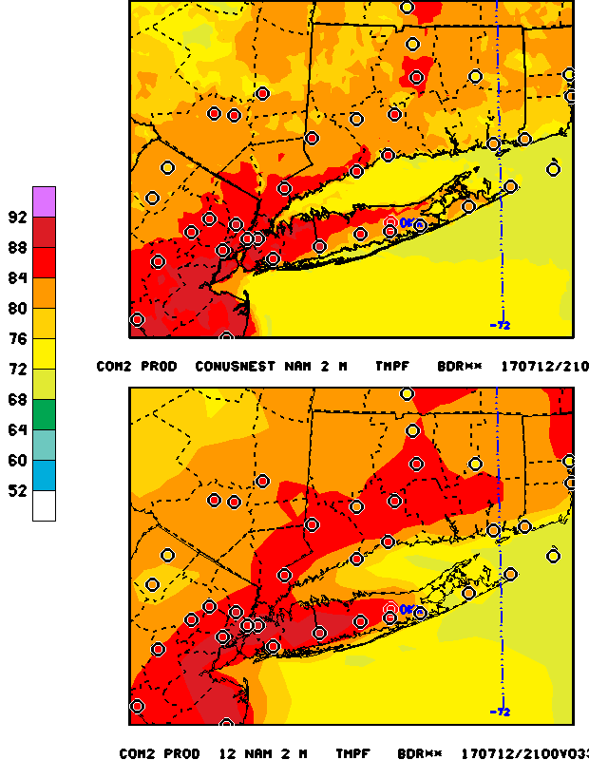
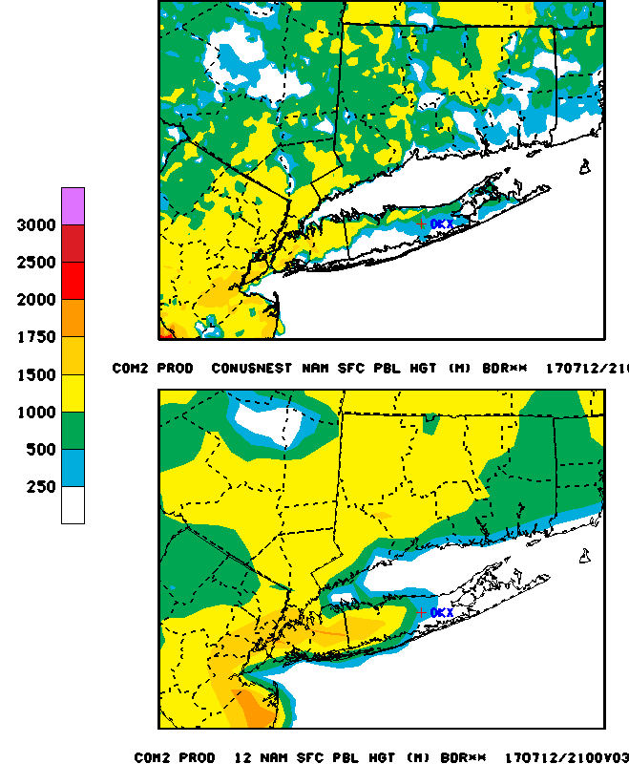
July 12, 2017 NAM-CMAQ V5 Performance NE U.S. NAM vs Nest 7/11/ 12Z 33 h forecast 2m temperature, PBLH
NAM 2 m Temperature
NAM PBLH
NAM: Temps too cool over CT coast, Nest better
Notes:
Temps too cool along CT coast. Improved with Nest. Did 12 km move marine PBL inland too far in W. Ct at least ??

Slide 11
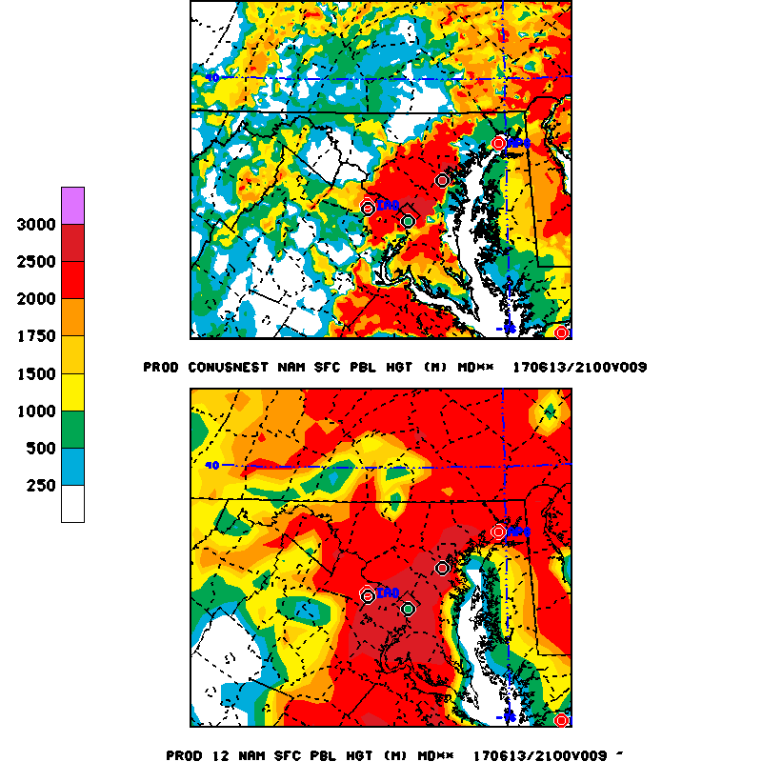
PBLH Evaluation
June 13, 2017, 21 UTC
PBLH
1 hr ozone
NEST 3km
Winds coming from the bay brought the marine air inland
The NAM NEST 3km tended to bring the MBL further inland in the northern Chesapeake bay area, especially north of Baltimore
NAM-12
Courtesy: Amanda Sleinkofer
Notes:
Just a note, we are finding the use of ceilometer data at various universities and hopefully at the NWS ASOS stations an emerging area to evaluate the boundary layer performance.
Heree we find the CMAQ underestimated ozone again sep north of the bay…..The NAM 12 km pbl is quite high impying the marine boundary laye and accomponying dirty air is not encroaching the area of high code orange ozone. However, the 3 km Nest does push the marine air northward implying better forecast could be possible if it were used to drive CMAQ.
On right, we see the ceilometer derived PBLH agree well with day 1 nam and nest predictions but for day 2 valid the same day, the forecast for the nest was not as good.We also see the lUfft data is not as useful at night as it only captures the top most pbl
June 13 Day 1 21Z
21Z is a transition time (5pm)
Ozone on the left, PBL, Temp, Wind
PBL: both models bring in the MBL
Missed exceedances in the north because the nam 12km did not capture the inland extent of the mbl, but the nest did
Left: BLTV
NEST D2 under predicted more than the NAM
Luft has overlap issues at the lower levels making it harder to capture
Top of residual layer
Right: BWI
Both models were fairly close to the BWI readings
NAM was the better of the two models being compared to BWI
NEST D2 under predicted more and the green dotted line correlates with model plot
High temps and the winds coming from the bay could have brought the MBL inland
The bay breeze brining in the MBL could be the cause of the higher ozone levels north of Baltimore
Jeff: What caused underestimated ozone north of Baltimore again (emissions, MBL??)?

Slide 12
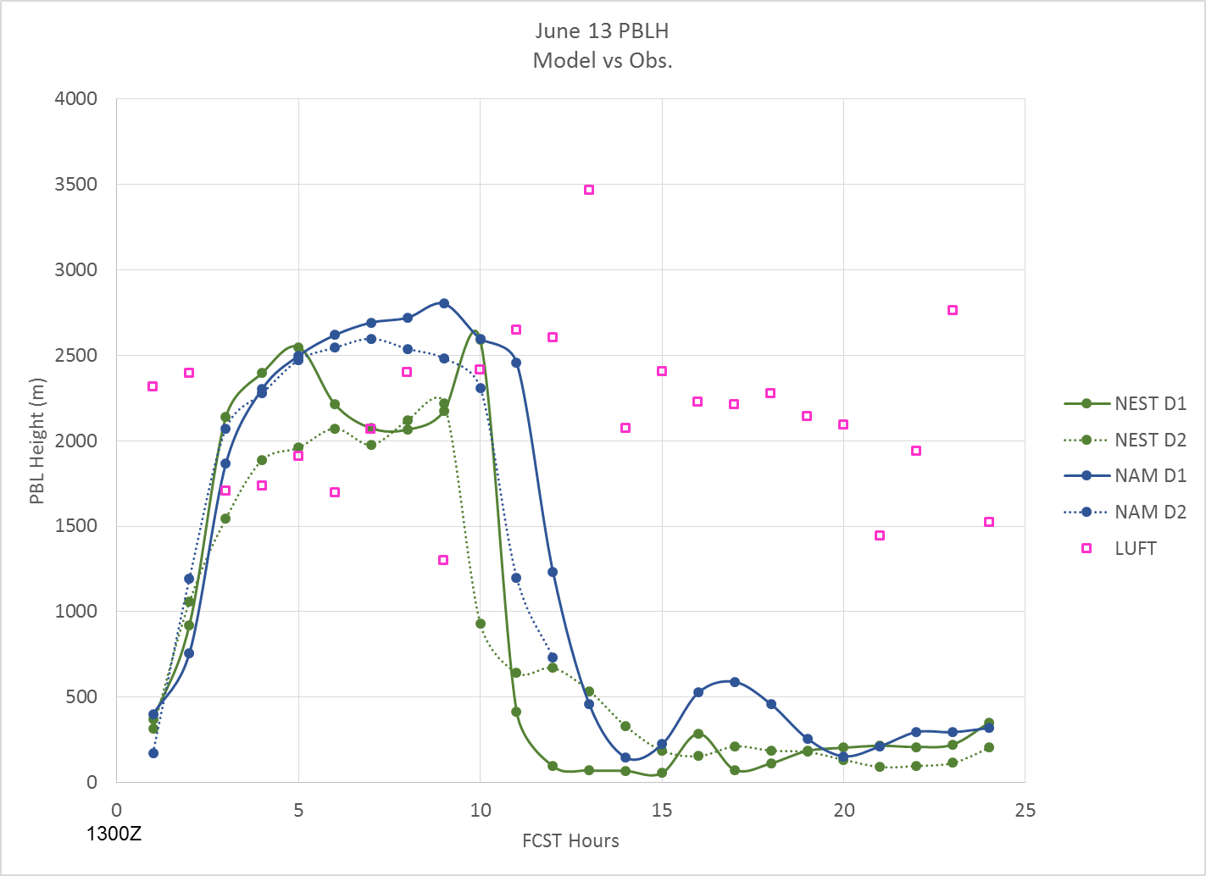
NAM-12 vs NAM-3 km nest vs
Howard U – Beltsville, Maryland
Lufft Ceilometer PBLH (June 13, 2017)
Day 1 (solid) & Day 2 (dashed) forecasts
Notes:
Nest predicted PBLH less than 12 km NAM, esp on Day 2
Nighttime ceilometer measurements are unreliable

Slide 13
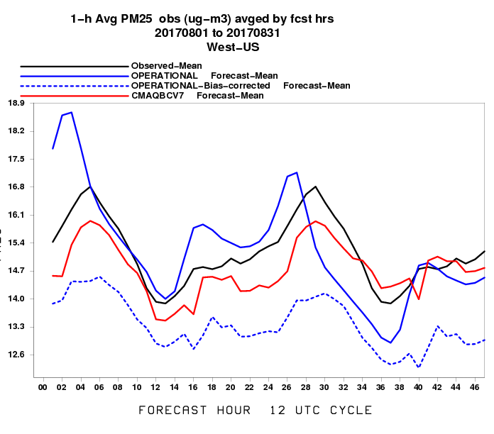
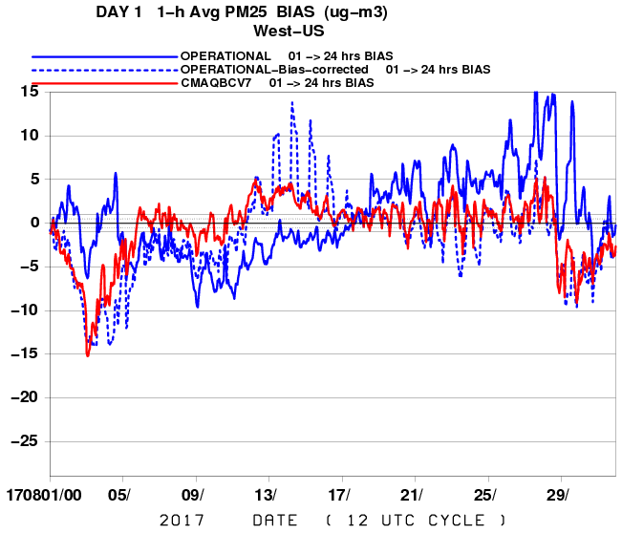
August 2017 PM Predictions 1 h avg PM BIAS
West
V5.0.2 Analogs
WEST: Underpredict PM transitions to overprediction.
Bias Correction w/ V5. analogs better than oper BC
- More consistent smoke event analogs ?
Notes:
Operational more over prediction esp during the fire season on day 1.
Note the parallel (red ) line follows observed diurnal pattern better
CBV7 uses CMAQ V5 analogs
FUTURE : remove operational BC

Slide 14
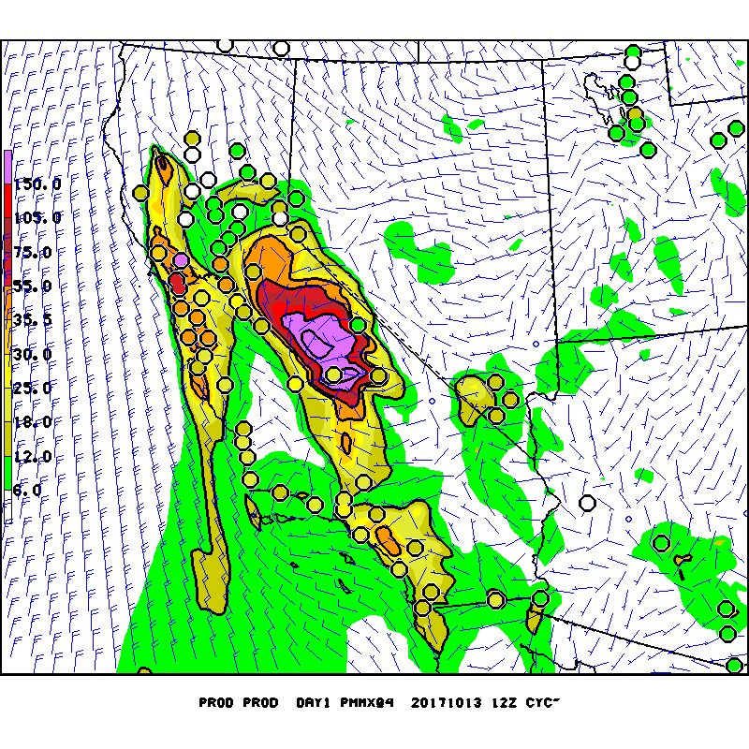
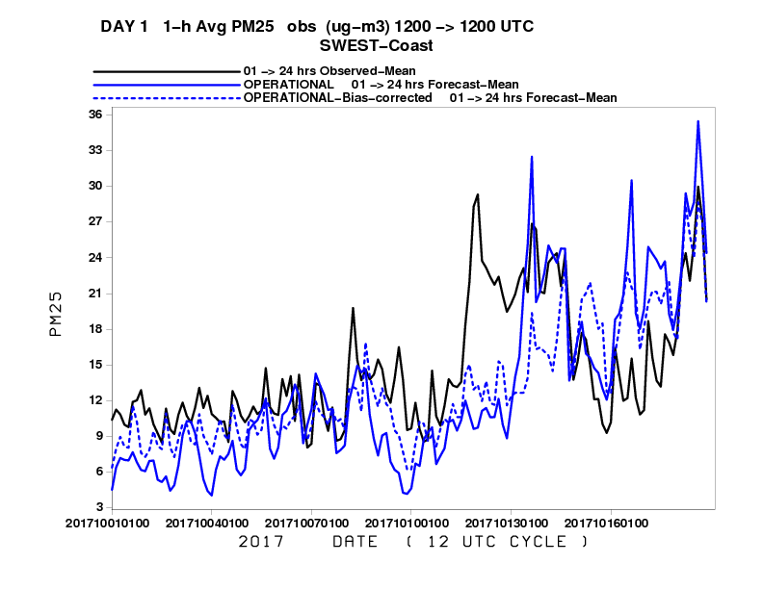
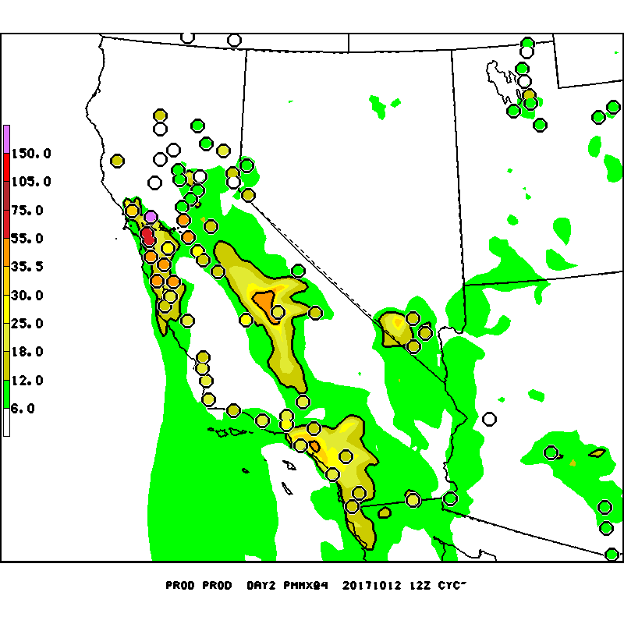
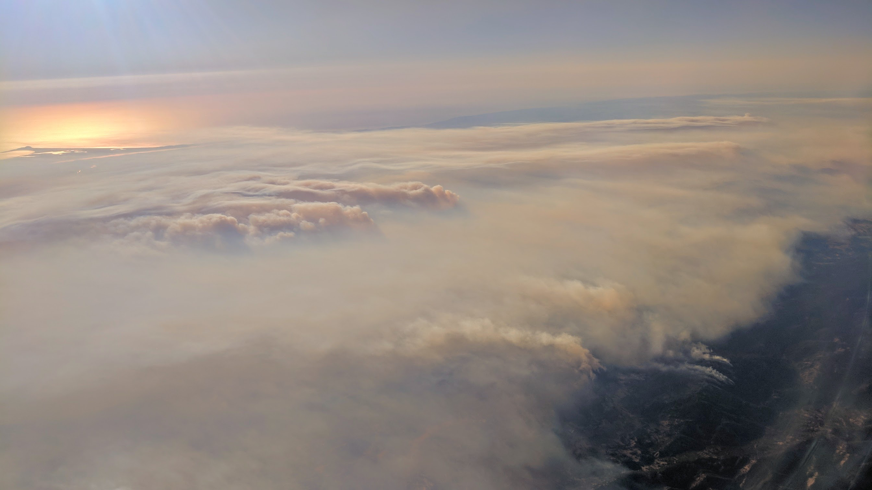
Northern California Fires October 13, 2017 PM 2.5 predictions
Day 1
Day 2
Notes:
Smoke trapped in valley…how does the smoke reduce boundary layer growth….model misses the day 2 forecast as we use 1 day old fire information from NESDIS HMS

Slide 15
Summary
V5.0.2 Ozone w/ NAM V4
Improvement correcting over-prediction esp along coasts
Long Island Sound (CT DEP analysis), Lake Erie/Michigan and Ohio Coastline
Improved for marginal or non-events
Still Missed exceedences in NE with overprediction of cloudiness
Remarkable overall improvement with KFAN ozone bias correction but overcorrects for episodes in East
PM
Large positive impact near forest fires :
Updated BlueSky and 24 h pre analysis run
Underprediction when external sources (Canadian fires) are impacting CONUS
Emission timing and ejection height uncertainties
Continued overprediction in Winter from raw predictions
Exp PM bias correction w/ V5 analogs improves performance (Summer)
Normally Updated NAM alone improves ozone overprediction forecast
Amount of incoming radiation under clouds critical

Slide 16
Future Emphasis
Extend to 72 hours, update emissions to 2014 base
Near real-time fire locations, strength, emissions
Canadian & external source impacts (testing)
Improved temporal profiles (testing) and plume rise algorithms
NGAC full aerosol boundaries
Unification of AQ systems
HYSPLIT smoke/dust → NGAC Aerosol
CMAQ ozone & total PM
HRRR-smoke
Bias Correction:
Implement Ozone Kalman Filter bias correction (testing)
PM: Use CMAQ V5 predictions as analogs (testing)
Improved Evaluations
Use of VIIRS/GOES-16/AERONET AOD, CALIPSO aerosols
Evaluate Operational models for field experiments (ESRL FireX 2019, FASMEE)
NGGPS ESRL/EPA FV3-CMAQ
- Inline allows for
High Resolution
Notes:
NGGPS project to support unification

Slide 17
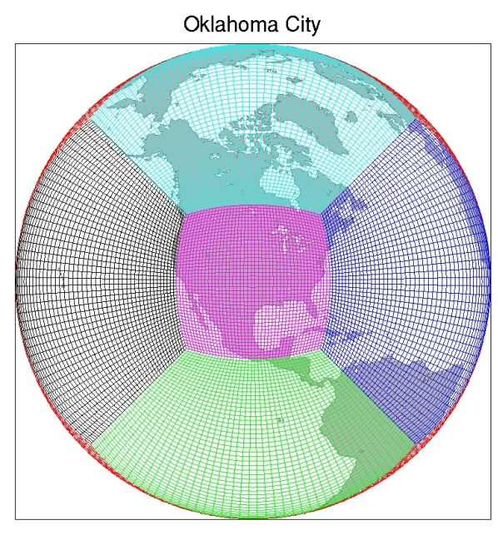
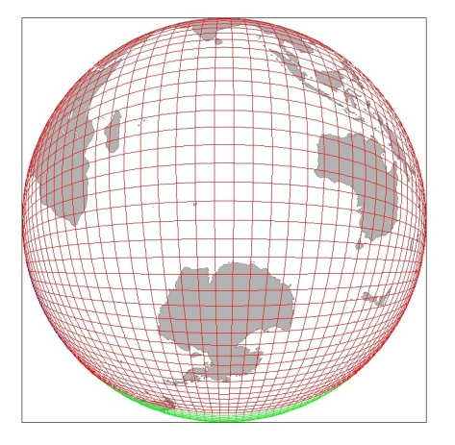
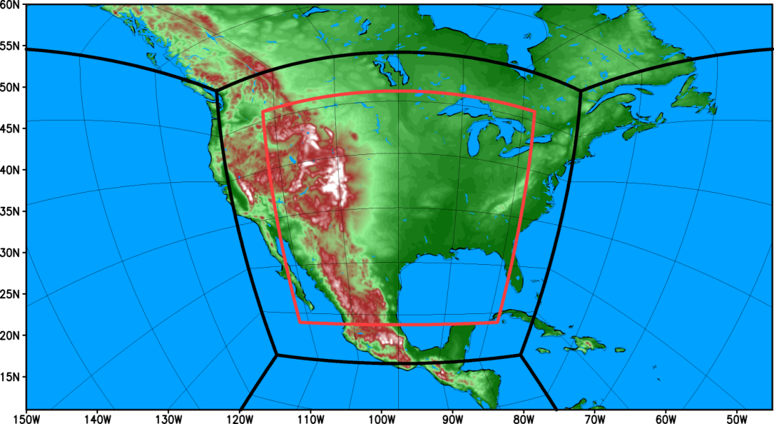
Thunderstorm-resolving resolution in a unified meso-global prediction system (FV3-GFS)
Grid stretching (smooth variation of grid spacing)
2-way nesting (Harris and Lin 2014)
FV3 is uniquely suitable for 2-way nesting, due to the application of two-time-level Finite-Volume transport scheme
Optimal combination of the “stretching” and “nesting”
FV3-GFS
FY19 Global : 9 km L64
Regional: 3km nest or stand alone
aerosol aware microphysics/radiation option
(red)
S.J. Lin, NOAA/GFDL

Slide 18
GFS-FV3 Comparisons (13 km) June- July 2017 Day1
2 m Temperature
Cloud cover
GFS-FV3 too warm and under-predicts clouds over North America

Slide 19
BACKUPS
BACKUPS

Slide 20
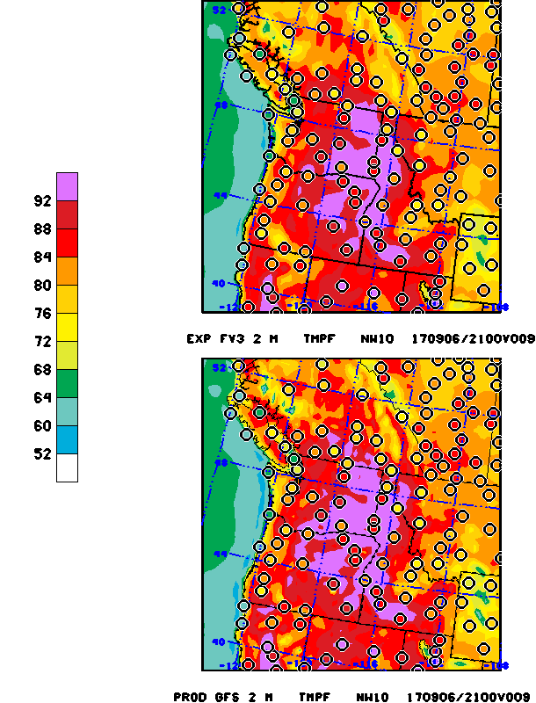
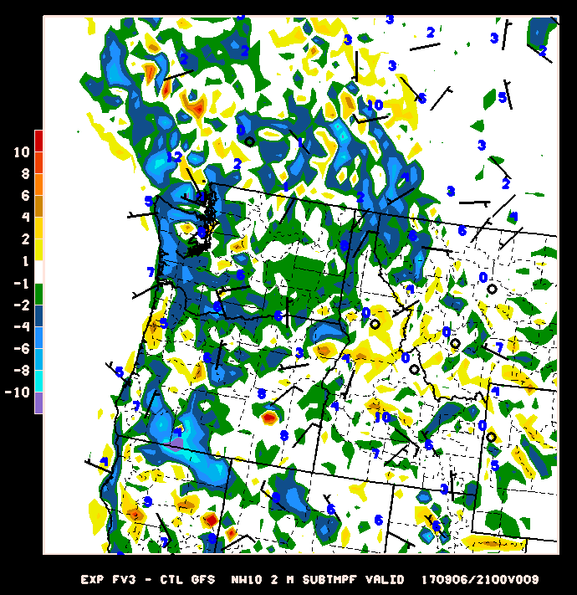
GFS vs FV3 2 m Temperature Sept. 5, 2017 : 9hr forecast
Semi-permanent day-time temperature over E. Washington high terrain typically warmer by as much as 10° F
Notes:
10 degrees warmer…permanent daytime feature over Eastern WA

Slide 21
Initial implementation configuration for FV3GFS in FY19
Planned/Projected FY19 FV3GFS configuration
Resolution: ~9 km 128 levels
Physics: New physics options implemented in FY18 tuned for FV3
Scale and aerosol aware Chikira-Sugiyama Convection Scheme with Arakawa-Wu extension
Unified representation of turbulence and shallow convection (SHOC)
Double moment microphysics
Upgraded LSM, radiation, GWD and Ozone Physics
DA configuration: Similar to FY18 NEMS/GSM GDAS with additional developments required for FV3 dynamic core, new datasets (GOES-R, JPSS etc.)
Run times optimized for production suite requirements
End-to-end system testing for stability, robustness of scientific and technical solutions, non-negative impact for downstream dependencies
Modern workflow (CROW* for development, T&E; ecflow for production)
*CROW: Community Research and Operational Workflow
Fanglin Yang, NCEP/EMC

Slide 22
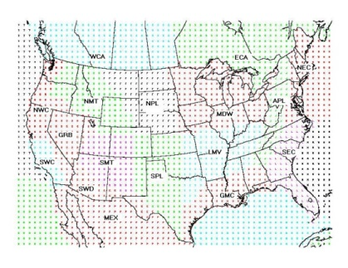
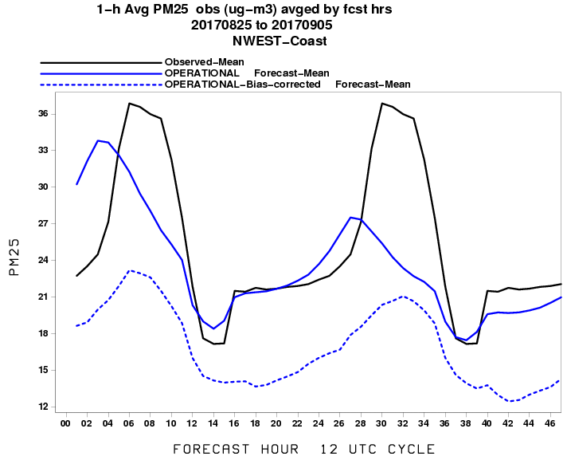
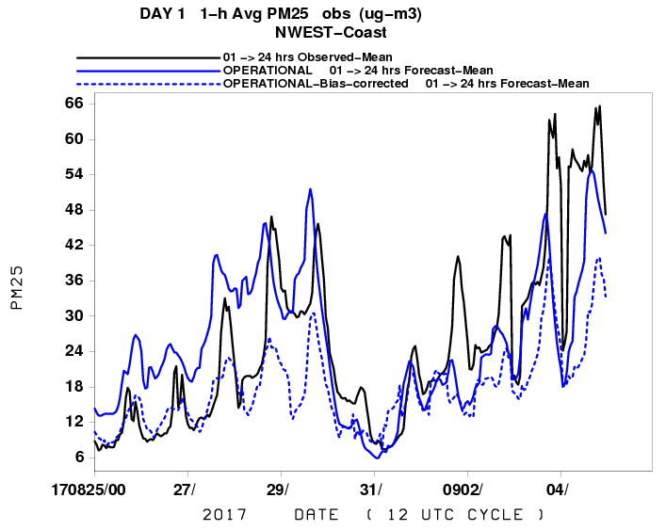
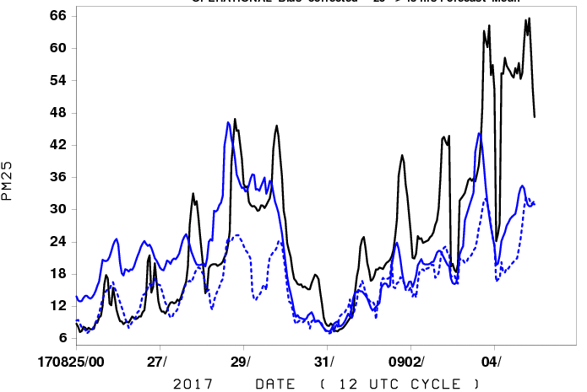
Aug 25-Sept 5 2017 PM Prediction 1 h avg PM : North West U.S. Fires
c
DAY 1
c
DAY 2
c
Underprediction for Day 2 in general BUT :
Day 1 Overprediction in early morning for smoke events
No diurnal emissions profile used
Oper Bias correction performs poorly for smoke
Notes:
What we see is some response from the raw model but poor performance with bias corrected pm (dashed blue)The overprediction primarily in the early morning when dumping too much smoke into a shallow boundary layer

Slide 23
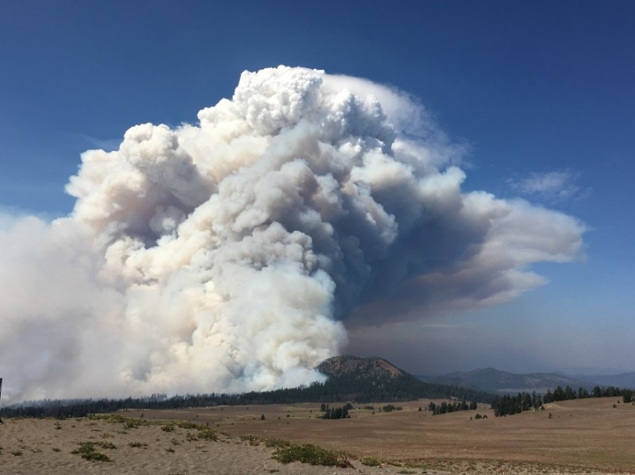
August 29, 2017 PM Predictions 1 h avg Max PM : North West U.S. Fires
Day 1
Day 2 EXP Bias Corrected
Day 2
Pyrocu lofting of smoke
Less PM predicted for day 2
CMAQ :75% fire reduction after analysis responsible ?
PM KFAN w/ V5 analogs overcorrects
Notes:
Reduction of PM for day 2 fires, likely due to 75% automatic reduction during the forecast period

Slide 24
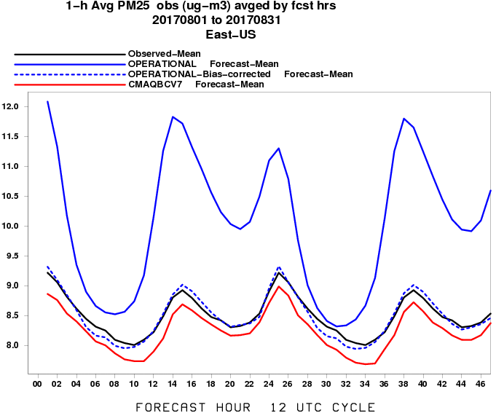
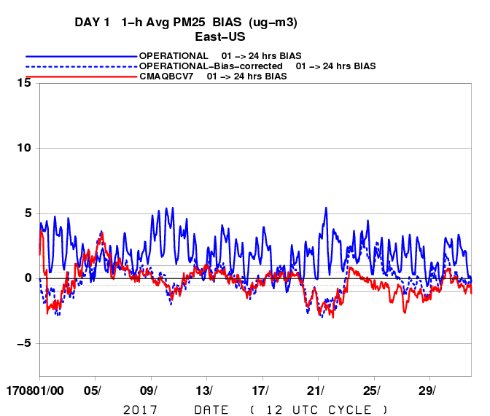
August 2017 PM Predictions 1 h avg PM BIAS
EAST
V5.0.2 Analogs
East: PM overprediction
Bias Correction w/ V5. analogs similar to oper BC
Notes:
Note the parallel (red ) line follows observed diurnal pattern better
BCV7 uses CMAQ V5 analogs

Slide 25
Web pages CMAQ V5.0.2
Real-time parallel runs (July 2016-Present
http://www.emc.ncep.noaa.gov/mmb/aq/cmaq/web/html/max.html
No NOx adj/NAM-X/4x-day cycling (Aug. 7-Sept 10)
http://www.emc.ncep.noaa.gov/mmb/aq/cmaqnox11/web/html/max.html
Gridpoint NOx adj/NAM-X/1x-day cycling (Aug. 1-Sept 10)
http://www.emc.ncep.noaa.gov/mmb/aq/cmaqnox/web/html/max.html
Verification statistics (prod,para, cmaqnox11, cmaqnox)
http://www.emc.ncep.noaa.gov/mmb/aq/fvs/web/html/regular.html

