Slide 1
Estimates of the shadow price of NO_{x} and PM_{2.5} Emissions Reductions from U.S. Manufacturing
Jenny thomas
Alexander Macpherson
Disclaimer: All authors are with U.S EPA Office of Air and Radiation. Although this work was reviewed by the U.S. EPA and approved for presentation, it does not reflect official Agency policy.

Slide 2
Background
Understand the costs of reducing emissions is important for policy analysis and decisionmaking.
Air pollution reductions result from a range of technology choices, such as:
production-level decisions,
end-of-pipe emissions controls,
energy efficiency measures,
fuel switching, and
input or process changes.
Characterizing emission reductions and costs from many of these measures can be quite challenging.
Additionally, policy analysis is often forward-looking, and forecasts of abatement costs are useful for better understanding future impacts of policy alternatives.

Slide 3
Our plan FOR THIS TALK
In this study, the shadow price represents the forgone revenue resulting from emissions reductions.
In the first stage of this analysis:
We update a 2003 study (Aiken and Pasurka, 2003) who drew on an analytical approach from the economics literature to estimate the shadow price of reducing SO₂ and PM₁₀ emissions from 1970 to 1996 for 19 manufacturing sectors.
In our update, we estimate the shadow price of reducing NO_{X} and PM_{2.5} emissions over the 1990 to 2014 timeframe for 17 manufacturing sectors. We compare our results to results in the literature.
In the second stage of this analysis:
We model the relationship between our estimates of the shadow price of reducing NO_{X} and PM_{2.5} and emission intensities (tons of emissions per million dollars in output).
Parameter estimates from this modeling are then combined with projected 2017 and 2025 NO_{X} and PM_{2.5} emission intensities to project the shadow price of NO_{X} and PM_{2.5} emissions reductions in these years.

Slide 4
17 Manufacturing sectors (3-digit naics level)
311,312. Food and Beverage and Tobacco Products
313,314. Textile Mills and Textile Product Mills
315,316. Apparel and Leather and Applied Products
321. Wood Products
322. Paper Products
323. Printing and Related Support Activities
324. Petroleum and Coal Products
325. Chemical Products
326. Plastics and Rubber Products
327. Nonmetallic Mineral Products
331. Primary Metals
332. Fabricated Metal Products
333. Machinery
334. Computer and Electronic Products
335. Electrical Equipment, Appliances, and Components
336. Transportation Equipment
337. Furniture and Related Products

Slide 5
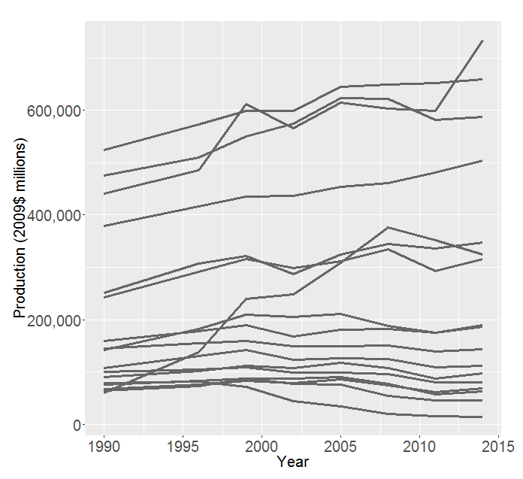
Economic data
Bureau of Labor Statistics “Major Sector Multifactor Productivity Database”
Inputs = cost of capital, labor, energy, materials, and purchased services
Good output = value of production
Used same years as NEI inventory years

Slide 6
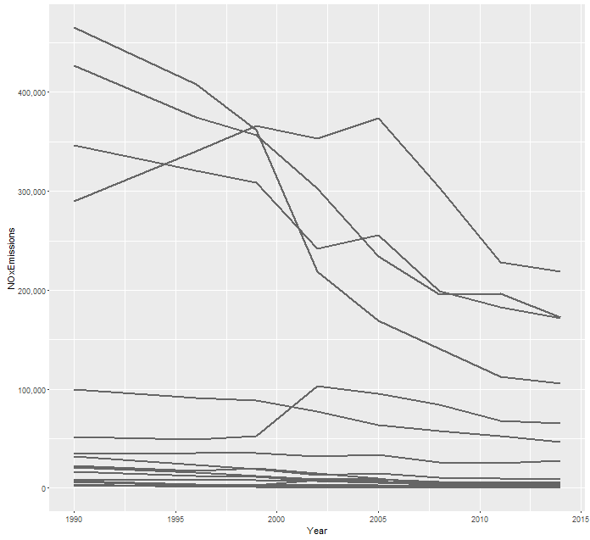
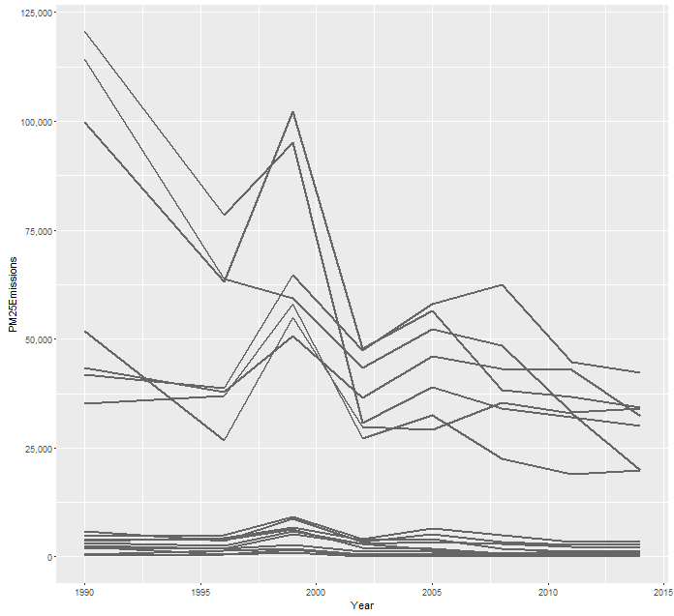
Emissions data
NEI point source NO_{X} and PM_{2.5} emissions (the bad output)
Used 1990, 1996, 1999, 2002, 2005, 2008, 2011, and 2014 inventories
SIC mapped to NAICS for earlier years
NO_{X} emissions
1990-2015
PM_{2.5} Emissions
1990-2015

Slide 7
Approach for Stage 1 (historical estimates)
In the economics literature, distance function production models have been used to estimate the shadow price of reducing emissions (Fare 1993, Aiken and Pasurka 2003, among others.)
The distance function productivity model jointly models the conversion of inputs into good and bad outputs. Following Aiken and Pasurka (2003):
Inputs = capital, labor, energy, material, and services.
Outputs include both “good” and “bad” outputs:
Good outputs = market goods and services,
Bad outputs = emissions that have detrimental effects on ambient air quality.
This output distance function approach is used rather than the more familiar single output production function as it has some valuable features:
It is a joint production model – which means that all outputs (both good and bad) are determined jointly.
This methodology allows us to calculate shadow prices of pollution based on production behavior of producers – we don’t need to know have any data about the specific mitigation approaches employed.

Slide 8
The Distance Function production model
$D_{o}\left(X, Q\right)=\min{ω \left\{ω: \frac{Q}{ω}∈G(X)\right\}}$
Output distance function characterizes feasible production outputs.
Input vector X includes capital, labor, and aggregate intermediate input
Output vector Q includes both good outputs (market goods) as well as bad outputs (pollutants)
G(X) is a set of feasible output vectors that can be produced from a given input vector X
$ω$ captures the efficiency of observed output, given a level of inputs and production technology
$D_{o}\left(X, Q\right)$parameterized and estimated as translog function.
The translog (“transcendental logarithmic”) production function is used heavily in econometrics.
When estimated as a translog function as we have done here, the model has a property referred to as weak disposability of outputs – you cannot decrease the bad output without decreasing the good output.
We estimate parameters of the function using linear programming

Slide 9
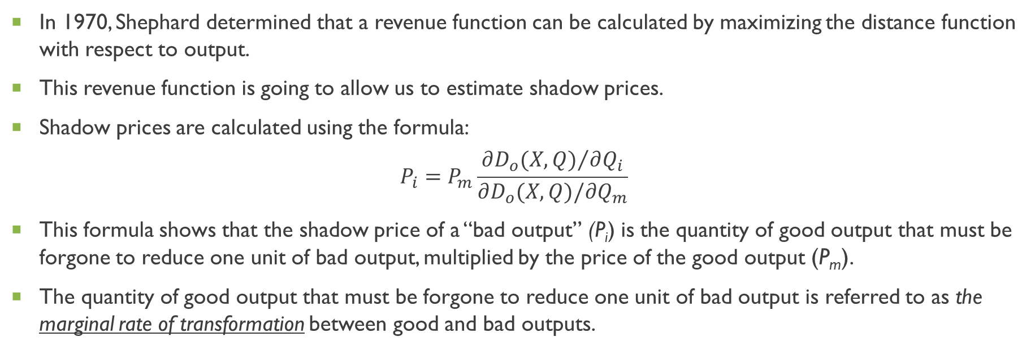
Shadow Price Calculation
In 1970, Shephard determined that a revenue function can be calculated by maximizing the distance function with respect to output.
This revenue function is going to allow us to estimate shadow prices.
Shadow prices are calculated using the formula:
$$P_{i}=P_{m}\frac{{∂D_{o}(X,Q)}/{∂Q_{i}}}{∂D_{o}(X,Q)/∂Q_{m}}$$
This formula shows that the shadow price of a “bad output” (P_{i}) is the quantity of good output that must be forgone to reduce one unit of bad output, multiplied by the price of the good output (P_{m}).
The quantity of good output that must be forgone to reduce one unit of bad output is referred to as the marginal rate of transformation between good and bad outputs.

Slide 10
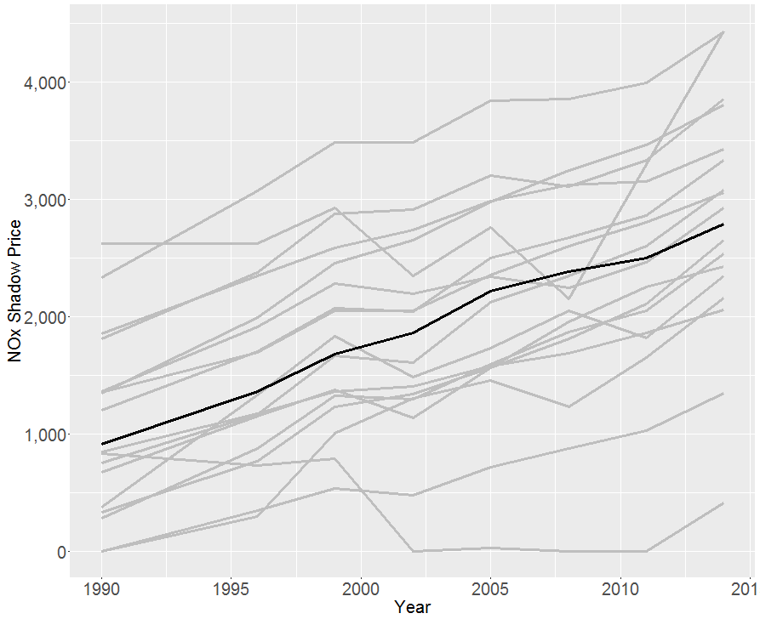
No_{x} Shadow Price (Preliminary Results)
Gray lines = sector-level estimates
Black line = tons-weighted average for all sectors
General trend that over time: as NO_{X} emissions decreased, the shadow price of reducing emissions increases.
Tons-weighted average shadow price of NO_{X} reduction in 2014: $2,800/ton in 2009 dollars.

Slide 11
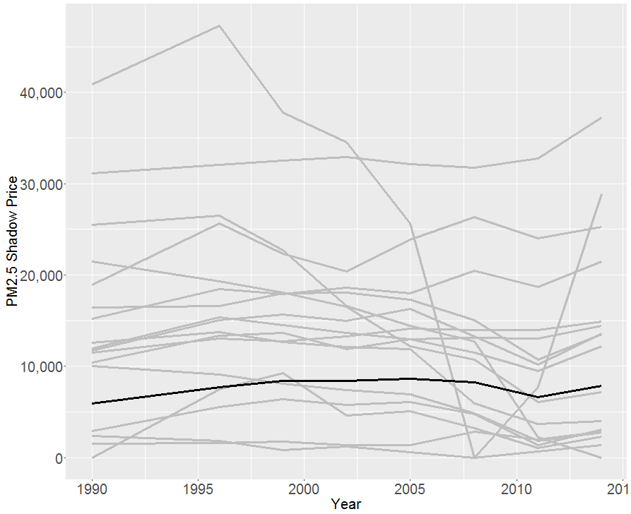
PM_{2.5} Shadow Price Preliminary Results
Gray lines = sector-level estimates
Black line = tons-weighted average for all sectors
PM_{2.5} shadow price more stable over time, but generally seems within a band up to $20,000/ton in 2009 dollars.
Tons-weighted average shadow price for PM₂₅ reduction in 2014: $7,900/ton in 2009 dollars.

Slide 12
Preliminary results For selected industries (1990 and 2014)
 |  | Shadow Price of NO_{X} (2009$/ton) |  | Shadow Price of PM_{2.5} (2009$/ton)
Industry | NAICS | 1990 | 2014 | 1990 | 2014
Paper Products | 322 | 1,400 | 3,100 | 1,500 | 2,900
Petroleum and Coal Products | 324 | - | 1,300 | 2,400 | 1,400
Chemical Products | 325 | 900 | 2,100 | 10,100 | 2,800
Plastics and Rubber Products | 326 | 300 | 2,500 | 12,000 | 12,200
Nonmetallic Mineral Products | 327 | 1,900 | 3,400 | 2,900 | 3,100
Primary Metals | 331 | 1,300 | 3,800 | 10,400 | 14,500
All Industries (tons-weighted average) |  | 900 | 2,800 | 6,000 | 7,900

Slide 13
Other Estimates in the literature (IN PROGRESS)
Will review to gather similar estimates in the literature:
Dang, T. and A. Mourougane (2014). Estimating Shadow Prices of Pollution in Selected OECD Countries, OECD Green Growth Papers.
Zhou, P., X. Zhou, et al. (2014). "On estimating shadow prices of undesirable outputs with efficiency models: A literature review." Applied Energy 130: 799-806.
Will break down estimates in literature by:
Pollutant
Industry
Estimation approach

Slide 14
Approach for Stage 2 (projecting estimates)
We model the relationship between our NEI-year estimates of the shadow price of reducing NO_{X} and PM_{2.5} and emission intensities (in terms of tons of emissions per million dollars in output) using a seemingly unrelated regression (SUR) equations approach.
Because reductions in emissions from an industry may be achieved jointly, we need to account for correlation across equations when estimating the relationship between shadow price and emissions intensity.
SUR is an generalized least squares approach that accounts for this correlation.
Parameter estimates from this regression modeling are then combined with projected NO_{X} and PM_{2.5} emission intensities to project shadow prices in 2017 and 2025 across 17 sectors.
Using NEI point source projections for 2017 and 2025.
Using 2016 Annual Energy Outlook manufacturing sector output projections for 2017 and 2025.

Slide 15
Preliminary projections For selected industries (2025)
 |  | NO_{X} |  |  |  | PM_{2.5}
 |  | 2025 Projected |  |  |  | 2025 Projected
Shadow Price (2009$/ton) | NAICS | 2.5% CI | Est | 97.5% CI |  | 2.5% CI | Est | 97.5% CI
Paper Products | 322 | 1,900 | 2,900 | 4,000 |  | 200 | 2,200 | 4,300
Petroleum and Coal Products | 324 | 700 | 1,100 | 1,500 |  | -500 | 800 | 2,000
Chemical Products | 325 | 1,600 | 2,000 | 2,400 |  | -19,000 | 3,800 | 26,500
Plastics and Rubber Products | 326 | 1,700 | 2,300 | 3,000 |  | 4,000 | 12,000 | 20,000
Nonmetallic Mineral Products | 327 | - | 3,900 | 7,900 |  | -800 | 4,300 | 9,400
Primary Metals | 331 | -400 | 2,500 | 5,400 |  | 5,300 | 12,800 | 20,300
All Industries (tons-weighted average) |  | 800 | 2,800 | 4,700 |  | 200 | 7,800 | 15,500

Slide 16
Insights and next steps
Results appear plausible and promising
Identify whether there are any emissions time series data to fill gaps
Explore adding third pollutant (SO₂)
Complete modeling and perform QA/QC
Consider writing manuscript for peer-reviewed journal

