Slide 1
AQ impact study for increase in
Shale Gas Productions since 2011
Pius Lee¹, Jeff McQueen², Ivanka Stajner², Daniel Tong¹, Li Pan¹, Youhua Tang¹, Hyuncheol Kim¹, and Barry Baker¹
¹NOAA/Air Resources Laboratory
²NOAA/National Weather Service
16th CMAS, Oct 23-25 2017

Slide 2
Proved
Natural gas proved reserve reserves
Trillion cubic feet
Production and imports
Trillion cubic feet
Natural gas production
Natural gas imports
Source: U.S. Energy Information Administration, Form EIA‐23L, Annual Report of Domestic Oil and Gas Reserves; U.S. Department of Energy, Office of Fossil Energy,
Natural Gas Imports and Exports
16th CMAS, Oct 23-25 2017

Slide 3
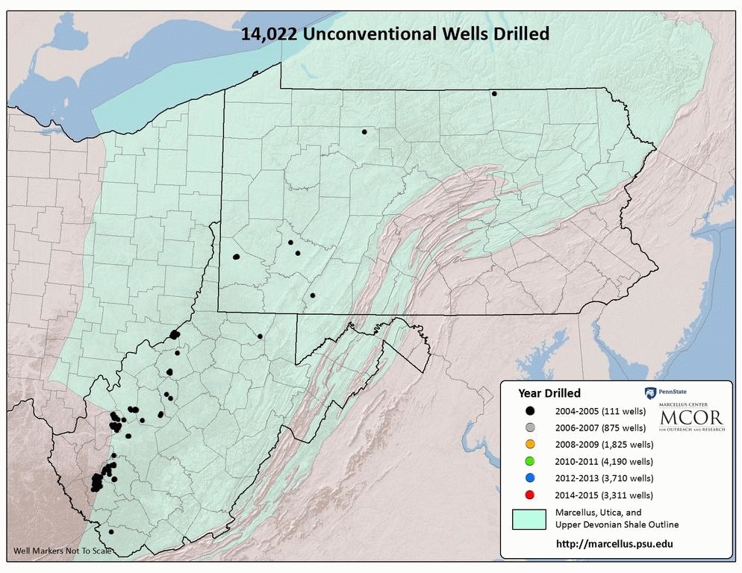
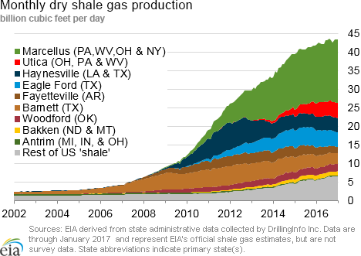
Shale Oil and Gas due to Marcellus Play
Marcellus Play is generally considered to be able to produce dry natural gas : > 95% CH₄
(Cox-Colvin 2017 ) www. coxcolvin.com /the-marcellus-and-utica-shale-
natural-gas-play-what-are-the-issues/
16th CMAS, Oct 23-25 2017
Notes:
1500 wells increase per year
Source EIA

Slide 4
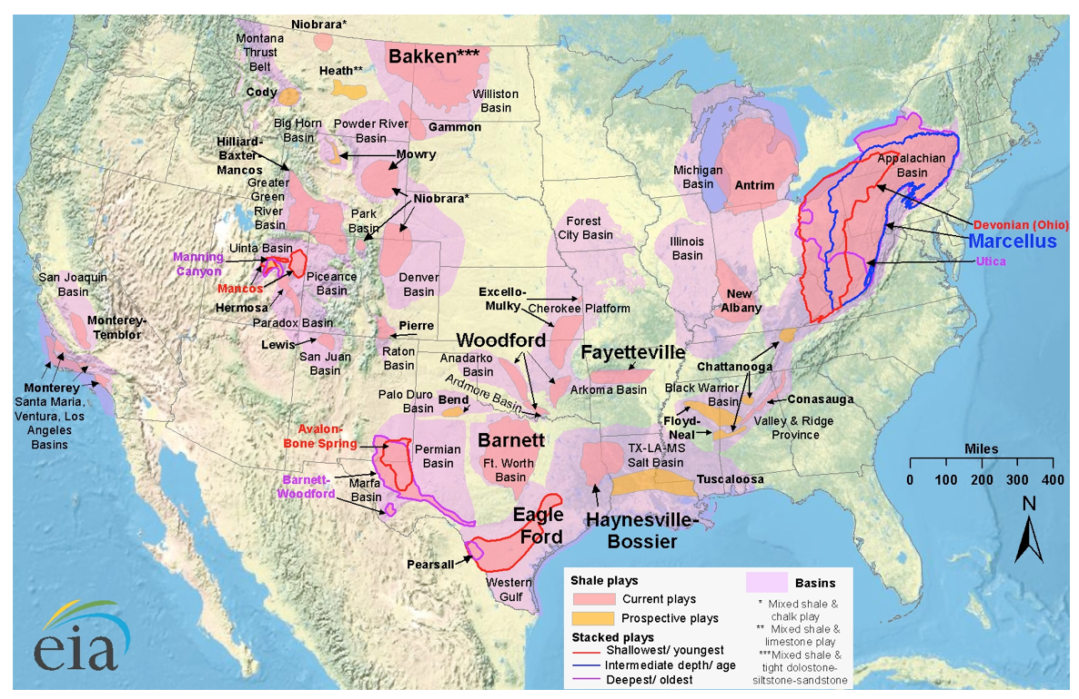
2014 Energy Information Administration on Shale Plays
Source: eia.gov/todayinenergy
16th CMAS, Oct 23-25 2017

Slide 5
Source: usenergydevcorp.com and Energy Information Administration (EIA)
Source:
16th CMAS, Oct 23-25 2017

Slide 6
Number of production wells
16th CMAS, Oct 23-25 2017

Slide 7
Cost cutting in fracking range of 10-30% in past decade
(1) Longer horizontal drills;
(b) Improved geo-steering accuracy;
(3) Minimized steel casing and liner;
(4) Clustered up drill-heads for multi-pad drilling;
(e) Experimenting lower cost proppants;
(6) Multiple-pad drilling usually resulted in a smaller emission
Increased efficiency => reduction in emission
Multiple-pad drilling => smaller emission since
centralized controls and abatement measures
16th CMAS, Oct 23-25 2017

Slide 8
Variation of state-wide top production rate and well-numbers between 2011 to 2016
 | Well numbers |  |  | Million cubic feet
Year | 2011 | 2016 | 2016/2011 | 2011 | 2016 | 2016/2011
Texas | 95,014 | 142,368 | 1.50 | 7,112,863 | 6,985,576 | 1.02
Pennsylvania | 44,500 | 68,536 | 1.54 | 1,310,592 | 5,263,973 | 4.02
Louisiana | 19,137 | 18,382 | 0.96 | 3,029,206 | 1,861,187 | 0.61
Colorado | 28,813 | 46,322 | 1.61 | 1,637,576 | 1,703,277 | 1.03
West Virginia | 52,498 | 47,938 | 0.91 | 394,125 | 1,375,108 | 3.49
Ohio | 34,931 | 26,599 | 0.76 | 78,858 | 1,466,854 | 18.60
North Dakota | 188 | 462 | 2.46 | 97,102 | 504,672 | 3.85
Utah | 6,075 | 8,739 | 1.44 | 457,525 | 367,251 | 0.79
California | 1,580 | 4,209 | 2.66 | 250,177 | 211,451 | 0.76
Ʃ | 282,736 | 363,555 | 1.29 | 14370035 | 19741365 | 1.38
16th CMAS, Oct 23-25 2017

Slide 9
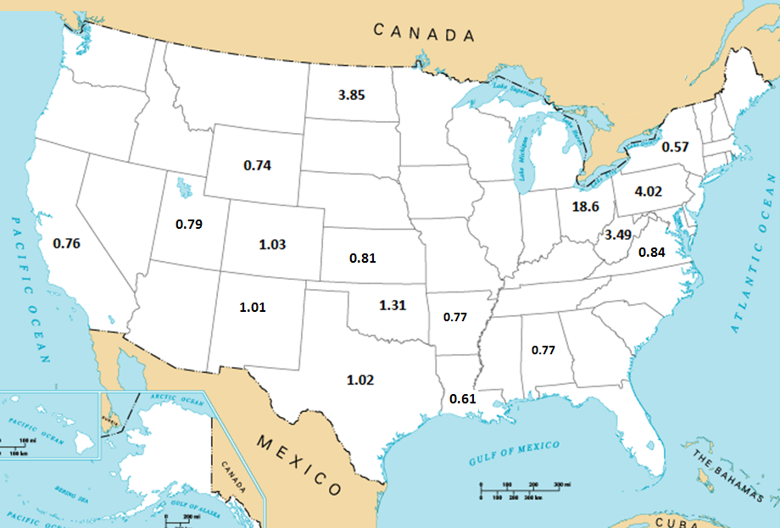
Adjustment factor applied to NEI2011 oil and gas area source sector
16th CMAS, Oct 23-25 2017

Slide 10
Species scaled to reflect enhanced emission from
increased oil and gas exploration/production due to fracking
CMAQ species | Species category | Activities attributed to emission
NOx +HONO | Nitrogen oxides | Compression, drilling, transportation
ALD, ALD2 | And other higher aldehydes | Processing and drilling
Alkane, alkene | Paraffin and Olefin & HC | Product and processing
XYL TOL TERP | VOC | Product and processing
Benzene | And other aromatics | Product and transportation
SO2, SULF | Sulfur compounds | Product and processing
PEC | Elemental carbon (soot) etc | Processing, drilling and compression
PMFINE | Other emitted particulate | Processing, compression, transportation
16th CMAS, Oct 23-25 2017
Notes:
MPAS (Model for Prediction Across Scales) Voroni (hexagonal meshes using c-grid staggering

Slide 11
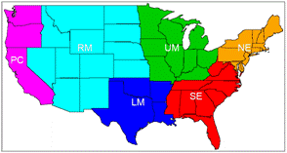
Score: PROD vs. O_n_Gas_refreshed for July 10-22 2017
MD8A O₃ Case |  | obs | mean | bias | rmse | correlation
CONUS (52200) | Base | 41.7 | 42.8 | 1.1 | 9.00 | 0.75
 | O_n_G |  | 43.5 | 1.8 | 9.11 | 0.76
Northeast (7900) | Base | 38.7 | 41.6 | 2.9 | 8.62 | 0.78
 | O_n_G |  | 42.4 | 3.7 | 9.01 | 0.78
Southeast (8500) | Base | 38.8 | 43.7 | 4.89 | 8.95 | 0.75
 | O_n_G |  | 44.4 | 5.58 | 9.21 | 0.77
Up Middle (11180) | Base | 41.5 | 42.5 | 0.96 | 7.10 | 0.81
 | O_n_G |  | 43.5 | 1.93 | 7.31 | 0.82
Low Middle | Base | 41.8 | 45.7 | 3.91 | 9.82 | 0.71
(5145) | O_n_G |  | 46.4 | 4.64 | 10.02 | 0.72
Rocky M. | Base | 48.4 | 46.0 | -2.43 | 8.93 | 0.71
(7600) | O_n_G |  | 46.7 | -1.78 | 8.56 | 0.73
Pacific Coast | Base | 47.5 | 43.8 | -3.63 | 11.48 | 0.75
( 7260) | O_n_G |  | 44.0 | -3.48 | 11.48 | 0.75
Daily Maximum 8 h average O3
Oil_n_Gas refreshed emission helped reduced O3 under-prediction
16th CMAS, Oct 23-25 2017

Slide 12
Score: PROD vs. O_n_Gas_refreshed for July 10-22 2017
24 h PM2.5 Case |  | obs | mean | bias | rmse | correlation
CONUS (35600) | Base | 11.2 | 11.9 | 0.69 | 12.75 | 0.72
 | O_n_G |  | 13.1 | 1.88 | 13.54 | 0.72
Northeast (5980) | Base | 8.3 | 9.06 | 0.73 | 4.59 | 0.57
 | O_n_G |  | 9.29 | 0.96 | 4.67 | 0.59
Southeast (4400) | Base | 9.0 | 10.71 | 1.71 | 5.15 | 0.55
 | O_n_G |  | 11.12 | 2.12 | 5.63 | 0.55
Up Middle (6100) | Base | 9.0 | 12.15 | 3.13 | 5.82 | 0.60
 | O_n_G |  | 12.61 | 3.58 | 6.18 | 0.62
Low Middle | Base | 9.5 | 10.74 | 1.26 | 5.02 | 0.54
(2780) | O_n_G |  | 11.39 | 1.91 | 5.58 | 0.56
Rocky M. | Base | 13.5 | 12.98 | -0.54 | 16.94 | 0.79
(5750) | O_n_G |  | 15.56 | 2.04 | 17.75 | 0.78
Pacific Coast | Base | 14.7 | 13.23 | -1.51 | 18.34 | 0.71
( 8530) | O_n_G |  | 15.20 | 0.46 | 19.46 | 0.71
Daily average PM2.5
Oil_n_Gas refreshed emission helped reduced PM2.5 under-prediction
16th CMAS, Oct 23-25 2017

Slide 13
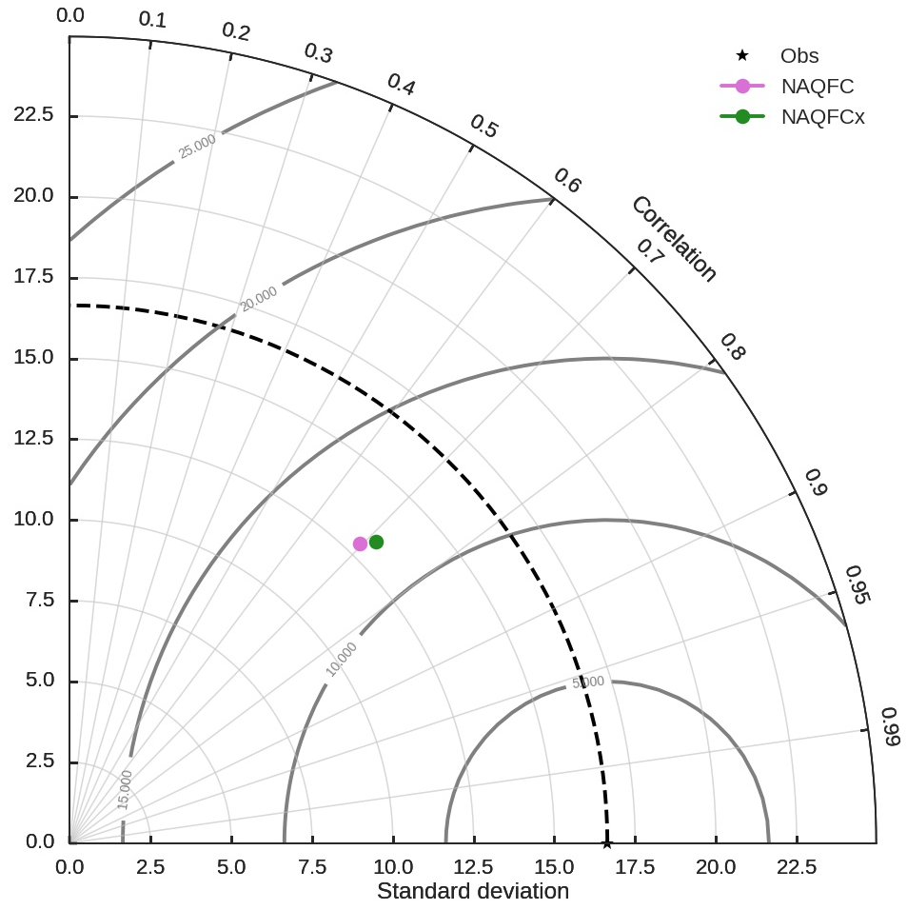
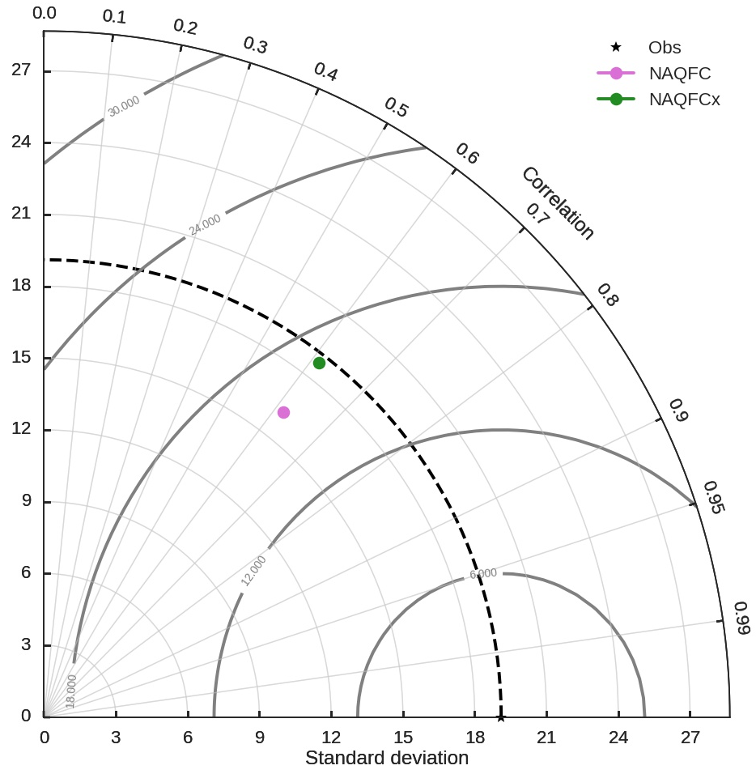
Taylor diagram for Base and O_n_G simulation between July 10-September 28 2017
hourly O₃ hourly PM_{2.5}
O_n_G
O_n_G
Correlation
Correlation
Standard Deviation
Standard Deviation
Standard Deviation
16th CMAS, Oct 23-25 2017
Notes:
MPAS (Model for Prediction Across Scales) Voroni (hexagonal meshes using c-grid staggering

Slide 14
Scale shale play production as oil/gas sector
Large plays: Barnett, Eagle Fort & Haynesville (TX) and Marcellus (PA)
Behavior is rather different between the various shale plays;
NEI2011 already accounted for that, therefore locale-spec scaling OK
Focus on the exceptional productive Marcellus Play
Large reserve as well as dry gas;
Good prospects for additional Marcellus-like plays: e.g. Mancos CO.
Sporadic wet gas signature -- Courtesy Prof. Russ Dickerson:
UMD flights had detected coal-bed associated emissions;
Nation wide Oil and Gas production trend: levelling off
Large reserves in multiple locations but price incentive is low;
Oil and Gas production can be a long term phenomenon;
State-specific scaling for Shale Play as Oil_n_Gas area source
July 20-Sep28 sensitivity run advantageous to capture concentrations;
Exceedance forecast improved;
However the over-prediction in O₃ elsewhere was exacerbated
O_n_G configuration with CMAQ5.2 is considered for NAQFC
16th CMAS, Oct 23-25 2017

