Slide 1
Lightning NOx Estimates from
Space-Based Lightning Imagers
Dr. William Koshak (NASA/MSFC)
16th Annual CMAS Conference, Chapel Hill, NC
25 October 2017

Slide 2

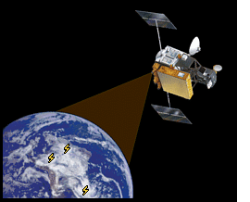
Basic idea:
Use observed optical energy to infer total flash energy E
… then multiply by thermo-chemical yield to get LNOx.
Koshak, NASA/MSFC

Slide 3
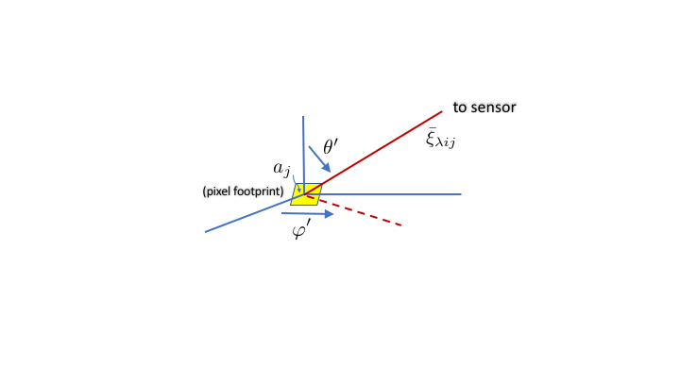
What to use for Flash Optical Energy?
Koshak, NASA/MSFC

Slide 4
to sensor
isotropy assumed
(pixel footprint)
Upward flux density from pixel footprint for i^{th} frame
Koshak, NASA/MSFC

Slide 5
Tiny Fraction of E Reaches Sensor
Koshak, NASA/MSFC

Slide 6
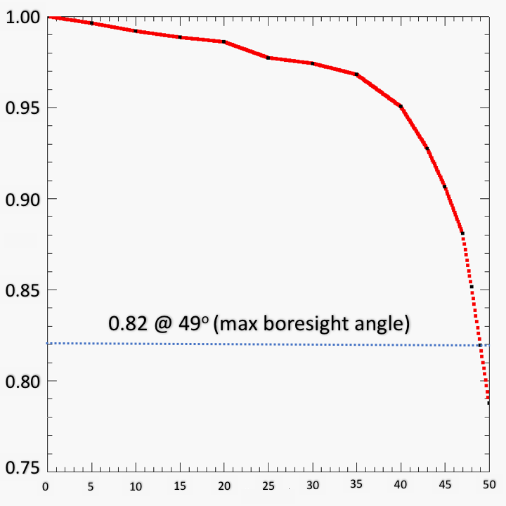
Correcting for LIS
sensitivity roll-off
In dataset
Off Boresight Angle (degrees)
Derived from: Boccippio, D. J., W. J. Koshak, R. J. Blakeslee, Performance assessment of the Optical Transient Detector and Lightning Imaging Sensor. Part I: predicted diurnal variability, J. Atmos. Oceanic Technol., 19, 1318-1332, 2002.
Koshak, NASA/MSFC

Slide 7
What do you do for GLM ?
LIS
[μJ m⁻² sr⁻¹ nm⁻¹]
GLM
[ μJ ]
Koshak, NASA/MSFC

Slide 8
LNOx production from k^{th} flash
Koshak, NASA/MSFC

Slide 9
LNOx Production for a region/period
this estimative term not needed
for GLM since GLM continuously monitors
(observed + unobserved)
Koshak, NASA/MSFC

Slide 10
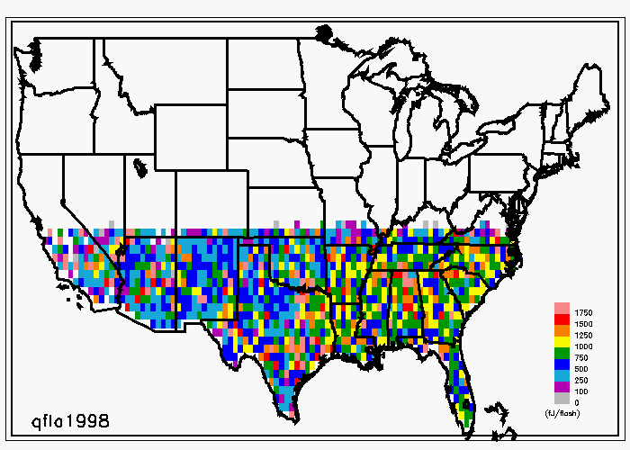
TRMM/LIS Mean Q per flash (fJ/flash)
drop mostly from orbit boost
drought year
2014 added to the record
2015 partial year + issues, so not used
Generally a downward trend (drop in 2001 mostly due to orbit boost)
Upward trend starting in 2011
Strong increase in 2012 drought (these are per flash results)
Koshak, NASA/MSFC

Slide 11
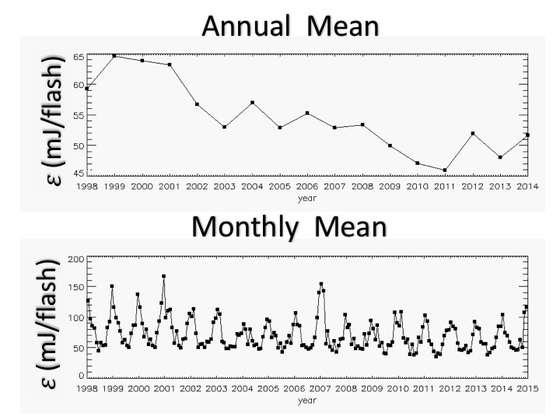
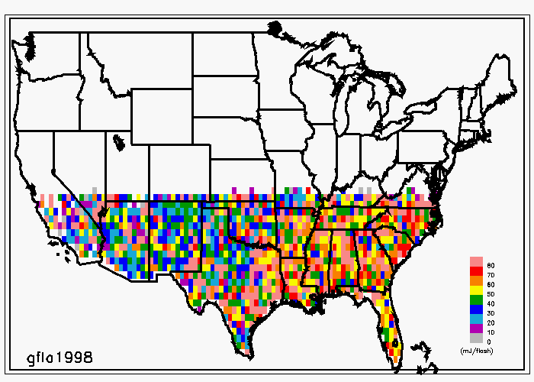
TRMM/LIS Mean 𝛤_{𝜆}𝛥𝜆 per flash ≡ ℇ (mJ/flash)
drought year
orbit boost
bias removed
Monthly Plots: Maxima occurs in January but this is all normalized (i.e. per flash values)
Jan max possibly indicative of large current +CGs and/or small vertical optical depth, common in winter thunderstorms.
Koshak, NASA/MSFC

Slide 12
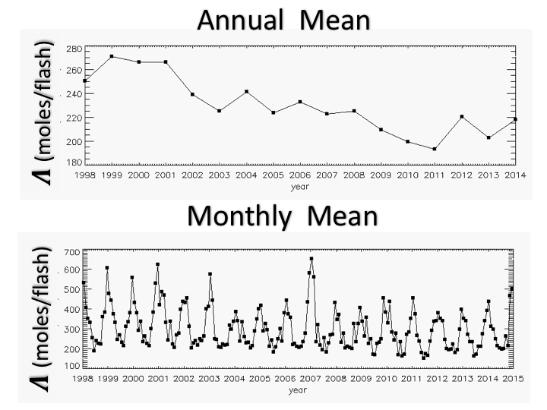
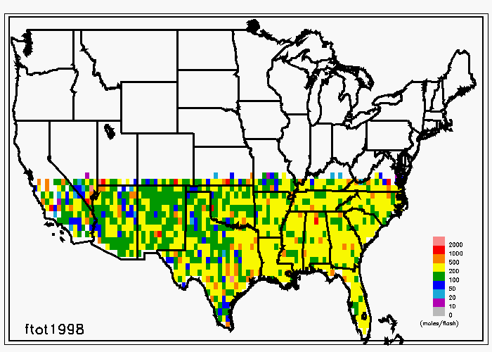
TRMM/LIS Mean LNOx Production per flash ≡ 𝜦 (moles/flash)
drought year
Koshak, NASA/MSFC

Slide 13
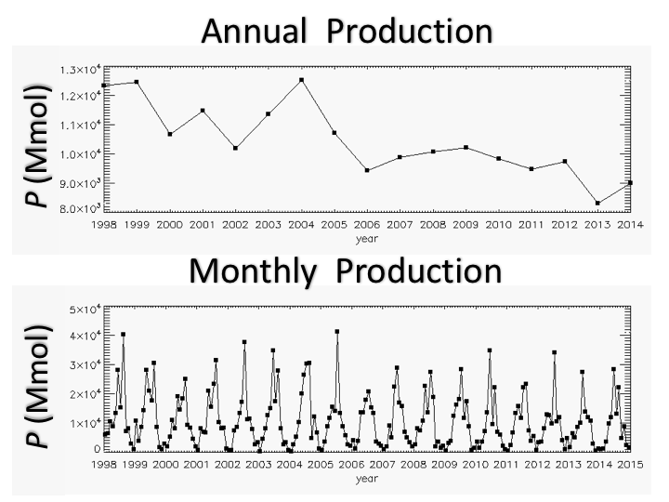
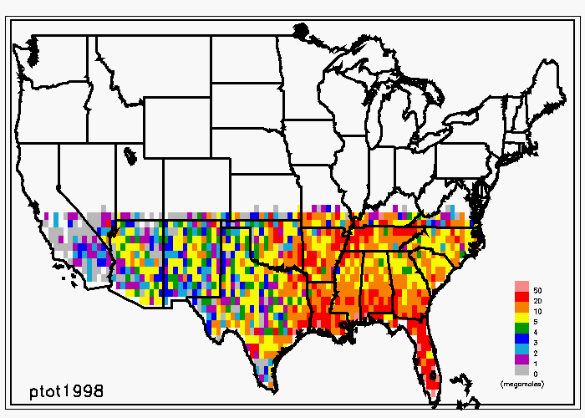
TRMM/LIS LNOx Production P (megamoles)
drought year
Since this is total LNOx production, time-series trends are now modulated by the flash count … so peaks are in the summer months (see monthly plot).
Previous plots were normalized wrt flash count.
Koshak, NASA/MSFC

Slide 14
Thank You
Koshak, NASA/MSFC

