Slide 1
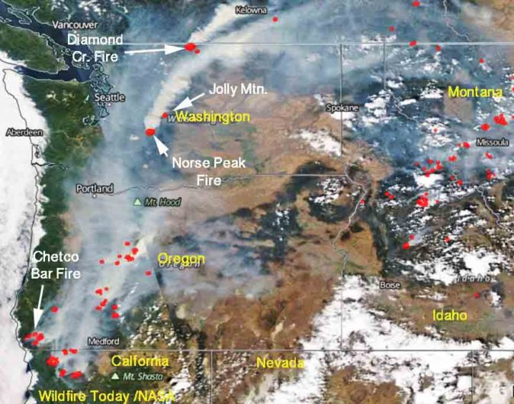
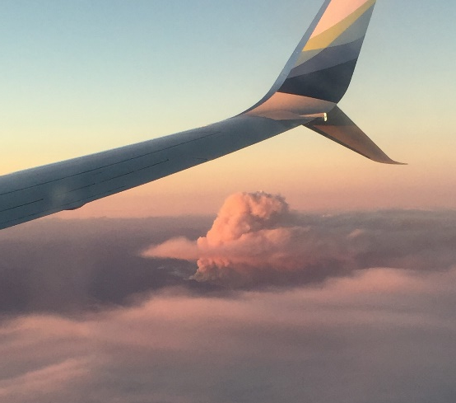
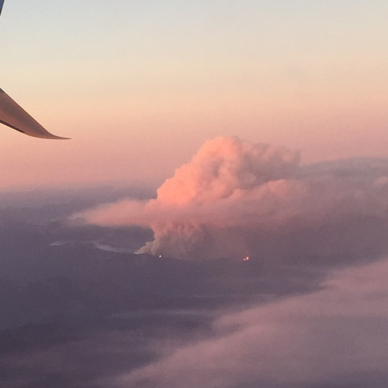
Implications of burned area approaches in emission inventories for modeling wildland fire pollution in the contiguous U.S
August 29, 2017
Regional smoke layer?
flames
Taken during descent into Seattle on September 1, 2017
Shannon Koplitz, Chris Nolte, and George Pouliot
USEPA
Disclaimer: The views of the author expressed herein do not necessarily state or reflect those of the United States Government.

Slide 2
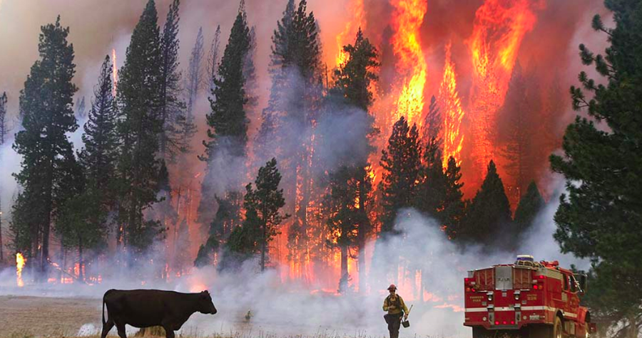
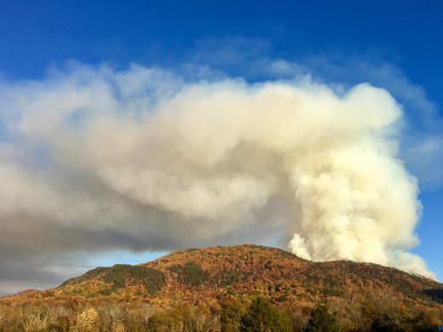
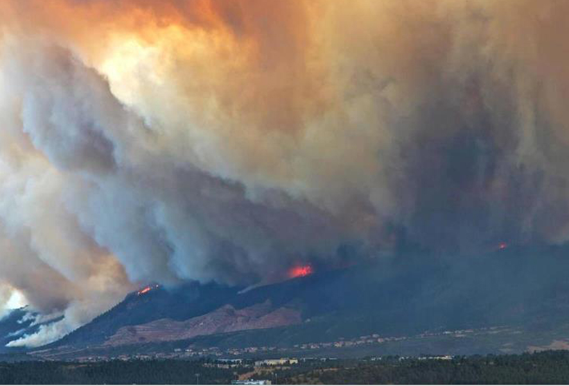
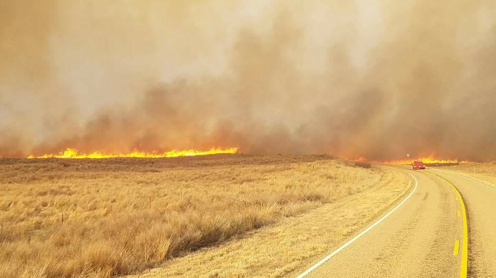
Wildland fires in the U.S. – a complex landscape
California 2013
Tennessee 2016
Photo: Dan Bartletti, Los Angeles Times (accessed from www.soperwheeler.com)
Colorado 2012
Photo: Saul Young/New Sentinel
Texas 2017
Photo: @PatrickSandusky (accessed from www.businessindsider.com)
Photo: Hoover Volunteer Fire Department (accessed from CNN.com)
Wildland fires can account for more than 30%* of total U.S. PM_{2.5} emissions.
* Based on NEI 2011

Slide 3
Fire emissions in global and regional models are estimated from four key variables
To estimate emissions E of chemical species s in grid cell i,j:
E_{s,i,j} = BA_{i,j} x FL_{i,j} x CC_{i,j} x EF_{s}
Burned area (i.e. fire size and location)
Combustion completeness (i.e. how much of the available biomass actually burns)
Emission factor per unit carbon combusted
Fuel load (i.e. how much biomass is there)
Burned area is usually quantified independently of the other three parameters, and can be estimated a variety of ways.

Slide 4
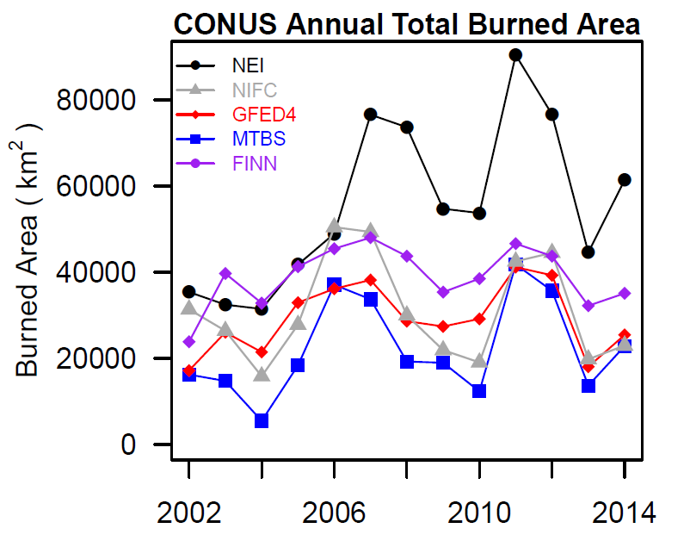
Burned area estimates for the U.S. can vary by more than 2x between inventories

Slide 5
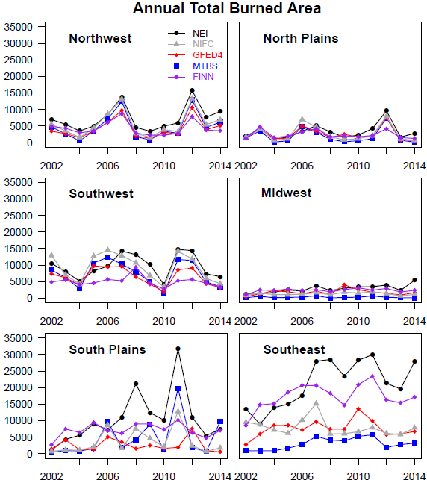
Burned area estimates for the U.S. can vary by more than 2x between inventories
Decent agreement in western U.S.

Slide 6
Burned area estimates for the U.S. can vary by more than 2x between inventories
2011
Agreement between burned area products varies widely by region.
Large differences in southern U.S.

Slide 7
Burned area estimates for the U.S. can vary by more than 2x between inventories
2011
What does this mean for modeling wildland fire pollution in the U.S.?
Agreement between burned area products varies widely by region.
Large differences in southern U.S.

Slide 8
Objective
To connect uncertainty in wildland fire emissions to modeled PM_{2.5} and ozone concentrations, in order to provide context for projecting and interpreting the air quality impacts of future wildland fire activity at regional and national scales.

Slide 9
Objective
To connect uncertainty in wildland fire emissions to modeled PM_{2.5} and ozone concentrations, in order to provide context for projecting and interpreting the air quality impacts of future wildland fire activity at regional and national scales.
Tasks
Implement three different wildland fire emission inventories – NEI, FINN, and GFED4s - into CMAQ (v5.1, 36km horizontal resolution).
Attribute changes in PM_{2.5} and ozone during one full year (2011) of atmospheric conditions to each inventory by subtracting out results from a “no fire” simulation.
Characterize spatial and temporal differences in modeled PM_{2.5} and ozone resulting from the use of each inventory.

Slide 10
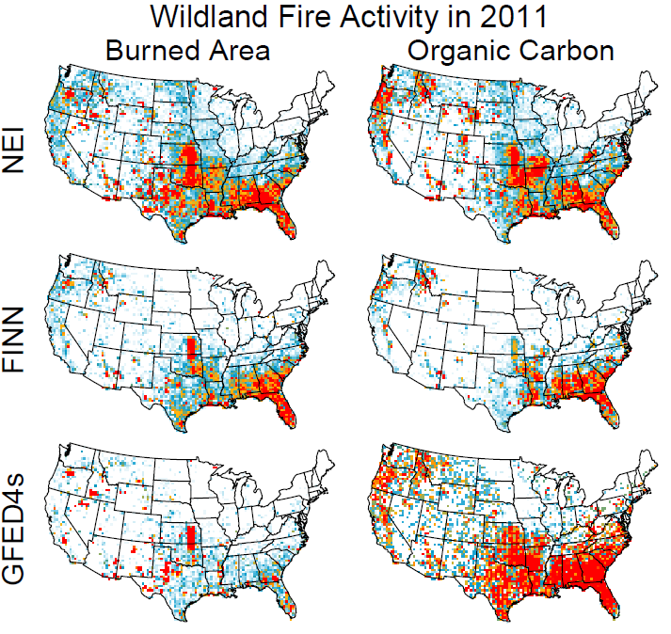
Emissions generally align with burned area patterns

Slide 11
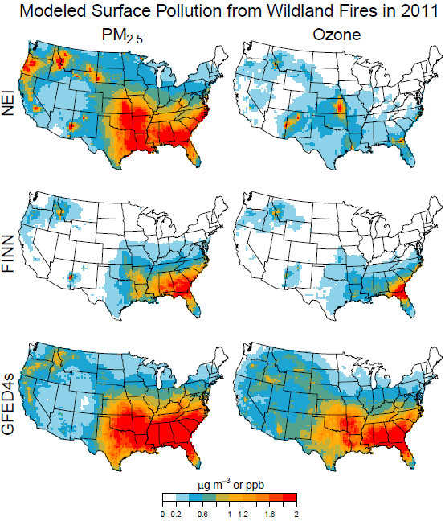
Modeled fire pollution varies by 300% nationally
Modeled Enhancements in PM_{2.5} and April-Sep MDA8 Ozone
0.85 µg m⁻³
0.28 ppb
0.33 µg m⁻³
0.22 ppb
0.93 µg m⁻³
0.74 ppb
GFED4s estimates of PM_{2.5} are generally more consistent with NEI than FINN, but ozone estimates are much higher.

Slide 12
Modeled fire pollution varies by 300% nationally
Modeled Enhancements in PM_{2.5} and April-Sep MDA8 Ozone
0.85 µg m⁻³
0.28 ppb
0.33 µg m⁻³
0.22 ppb
0.93 µg m⁻³
0.74 ppb
GFED4s estimates of PM_{2.5} are generally more consistent with NEI than FINN, but ozone estimates are much higher.

Slide 13
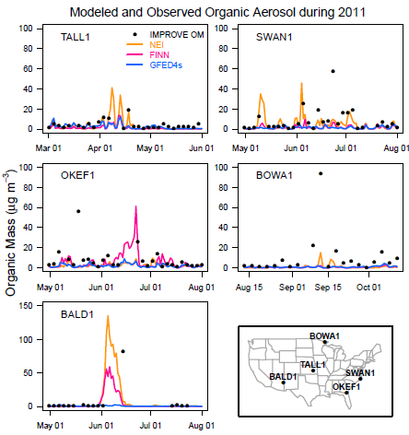
Individual fires demonstrate potential benefits of high spatial and temporal resolution
GFED4s appears to miss the Wallow Fire
High spatial and temporal resolution allow FINN to potentially capture acute pollution episodes from individual fires.

Slide 14
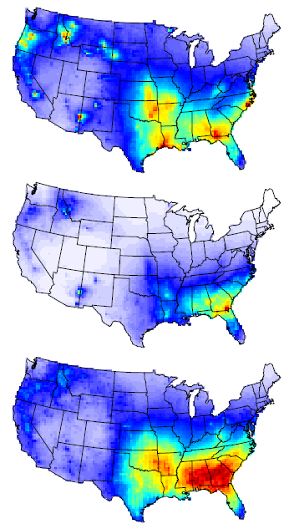
PM_{2.5} from wildland fires is comparable to contributions from other anthropogenic sectors
PM_{2.5} from Wildland Fires in 2011
NEI
PM_{2.5} from other Sectors in 2005*
FINN
GFED4s
(Caiazzo et al 2013)
*EGU emissions went down by over 70% between 2005 and 2016.
(This work)
µg m⁻³
As emissions from other sectors decrease, wildland fires will become an increasingly important source of PM_{2.5} for much of the country.

Slide 15
Summary
Differences in burned area estimates lead to large spatial and temporal differences in wildland fire emissions across inventories.
Modeled wildland fire PM_{2.5} and ozone pollution varies by 300% nationally for 2011 due only to the inventory used.
At seasonal and regional scales, results using GFED4s agree more closely with those produced with NEI, but for individual fire events FINN is better able to capture higher frequency changes in fire pollution levels compared to GFED4s.
Constraining estimates of burned area/wildland fire emissions will become increasingly important as emissions from other sectors decrease, and as fire activity changes in response to future climate.

Slide 16
Extra Slides

Slide 17
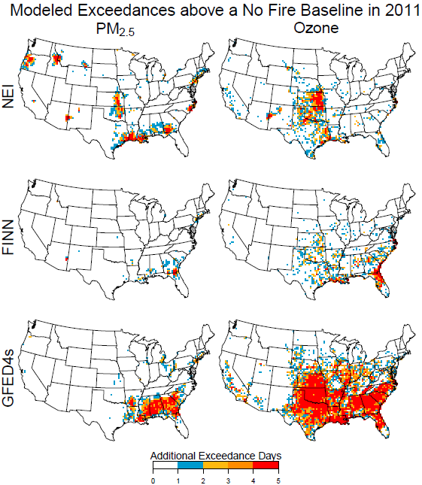
Modeled fire pollution varies by 300% nationally
Modeled Enhancements in PM_{2.5} and April-Sep MDA8 Ozone
Additional NAAQS Exceedances Compared to No Fire Case
0.85 µg m⁻³
0.28 ppb
0.33 µg m⁻³
0.22 ppb
0.93 µg m⁻³
0.74 ppb
GFED4s estimates of PM_{2.5} are generally more consistent with NEI than FINN, but ozone estimates are much higher.

Slide 18
Estimation methods include top-down and bottom-up approaches
Inventory | Method to estimate burned area
Global Fire Emissions Database (GFED) | Satellite-derived burn scars (MODIS)
Fire Inventory from NCAR (FINN) | Satellite-derived active fire detections (MODIS) combined with MODIS land cover product (VCF)
Monitoring Trends in Burn Severity (MTBS) | Satellite image processing (LANDSAT)
National Interagency Fire Center (NIFC) | Fire incident reports (federal and state data)
National Emission Inventory (NEI) | NOAA Hazard Mapping System (includes active fires from MODIS, AVHRR, GOES), perimeters from MTBS, incident reports
Table modified from Larkin et al. 2014
Different approaches can lead to significant variability in space and time between burned area estimates.

Slide 19
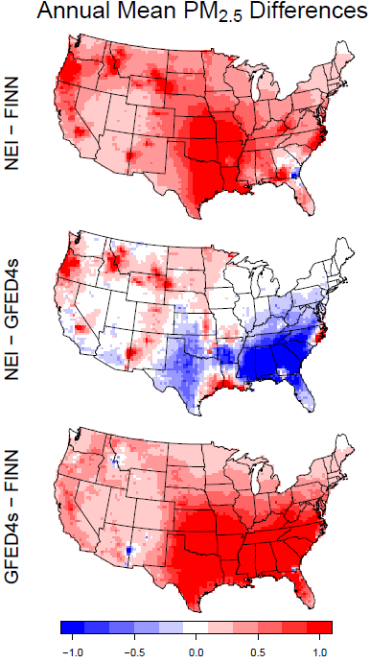
OMI Aerosol Index
NEI - FINN
NEI – GFED4s
GFED4s - FINN
µg m⁻³
Smoke from the Wallow Fire is visible in OMI Aerosol Index data from June 2011.

Slide 20
The Flint Hills burn signal is strong in the NEI compared to other inventories
OMI Aerosol Index
NEI - FINN
NEI – GFED4s
GFED4s - FINN
µg m⁻³
Despite the high modeled PM_{2.5} from Flint Hills in NEI during April 2011, no corresponding signal is evident in the OMI AI data.

Slide 21
The Flint Hills burn signal is strong in the NEI compared to other inventories
OMI Aerosol Index
NEI - FINN
NEI – GFED4s
GFED4s - FINN
µg m⁻³
NEI fire emission estimates rely heavily on HMS fire detections and average MTBS perimeters by land cover type – efforts to assess potential biases incurred from this approach are ongoing.

Slide 22
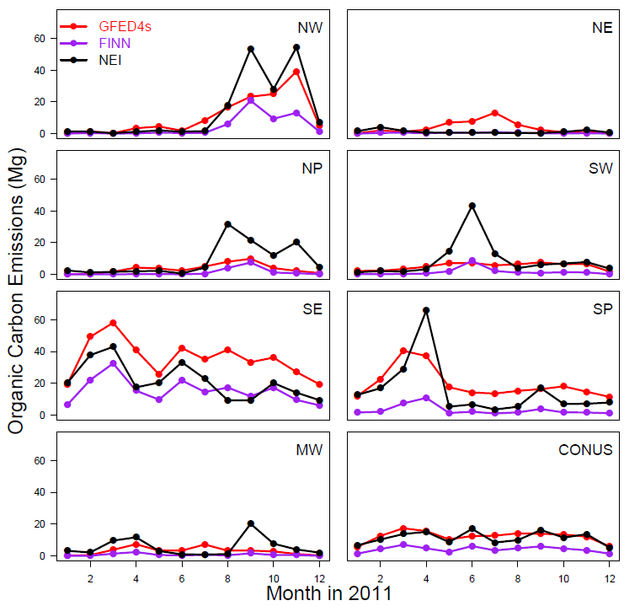
Regional differences in fire pollution seasonality are reflected in all three inventories
Monthly Wildland Fire OC Emissions by Region
Prescribed burning peaks in southern U.S. during winter-spring

Slide 23
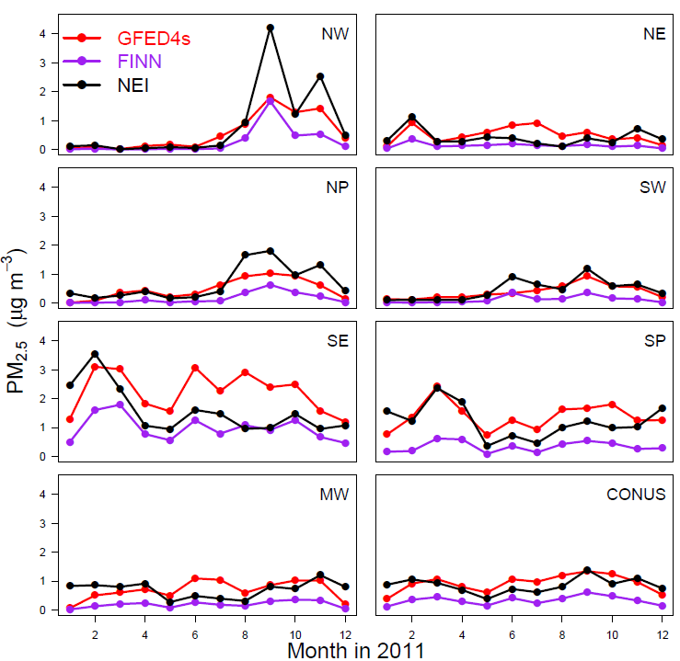
Regional differences in fire pollution seasonality are reflected in all three inventories
Monthly Wildland Fire OC Emissions by Region
Monthly Wildland Fire PM_{2.5} by Region
Prescribed burning peaks in southern U.S. during winter-spring
Relatively higher modeled pollution levels compared to local emissions in NE and MW

Slide 24
Heat flux assumptions affect plume rise and smoke transport downwind
In NEI:
HFLUX = Burned Area x Fuel Load

Slide 25
Heat flux assumptions affect plume rise and smoke transport downwind
In NEI:
HFLUX = Burned Area x Fuel Load
No fuel loading information carried directly with FINN or GFED, instead we scaled by PM_{2.5} emissions:
HFLUX = PM_{2.5} x Heat Content x Global Average Fuel Load/PM_{2.5}
(From Wiedinmyer et al. 2011)

Slide 26
Heat flux assumptions affect plume rise and smoke transport downwind
In NEI:
HFLUX = Burned Area x Fuel Load
No fuel loading information carried directly with FINN or GFED, instead we scaled by PM_{2.5} emissions:
HFLUX = PM_{2.5} x Heat Content x Global Average Fuel Load/PM_{2.5}
We also tested scaling FINN HFLUX by the median HFLUX/PM_{2.5} value from the NEI 2011 data:
HFLUX = PM_{2.5} x Median HFLUX/PM_{2.5}

Slide 27
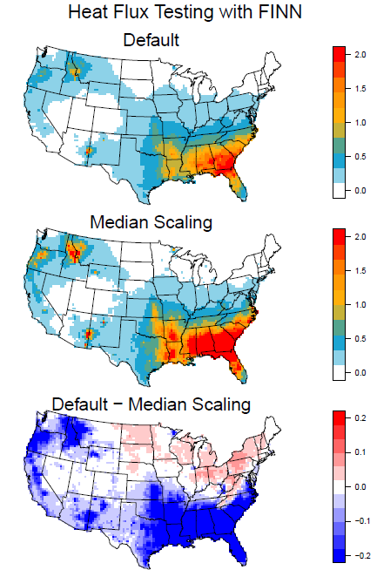
Heat flux assumptions affect plume rise and smoke transport downwind
In NEI:
HFLUX = Burned Area x Fuel Load
No fuel loading information carried directly with FINN or GFED, instead we scaled by PM_{2.5} emissions:
HFLUX = PM_{2.5} x {Heat Content x Global Average Fuel Load/PM_{2.5}}
We also tested scaling FINN HFLUX by the median HFLUX/PM_{2.5} value from the NEI 2011 data:
HFLUX = PM_{2.5} x Median HFLUX/PM_{2.5}
Wildland Fire PM_{2.5} with FINN
2.2e9
8.1e7
Using median HFLUX/PM_{2.5} derived from NEI to scale FINN HFLUX results in roughly double the fire-related surface PM_{2.5} enhancements near emitting areas, with some reductions in far field transport.

Slide 28
Emissions generally align with burned area patterns
Strong Flint Hills signal in NEI
Small fire correction greatly increases GFED4s emissions
FINN lower (in general) in the west

Slide 29
