Slide 1
Effects of Relative Reduction Factor Grid Cell Sampling Approaches on Model
Byeong-Uk Kim and Jim Boylan
Planning and Support Program
Georgia EPD - Air Protection Branch
2017 CMAS Conference
Chapel Hill, NC
October 23, 2017

Slide 2
RRF Approach
Projected Future Design Values (DV_{Future})
  DV_{Future} = DV_{Current} x Relative Response Factor (RRF)
  DV_{Current} is the average of three design values
    [(2009-2011 DV)+(2010-2012 DV)+(2011-2013 DV)]/3
    = [C₂₀₀₉ + (2*C₂₀₁₀) + (3*C₂₀₁₁) + (2*C₂₀₁₂) + C₂₀₁₃]/9
    Where, C_{yyyy} is the annual 4th highest daily max 8-hour O₃ concentration in the year of yyyy.
  RRF = (Model future)/(Model baseyear)
    Uses 10 highest model days in baseyear
  Selection of Grid Cells:
90 | 86 | 80
80 | 77 | 81
81 | 75 | 72
90 | 86 | 80
80 | 77 | 81
81 | 75 | 72
90 | 86 | 80
80 | 77 | 81
81 | 75 | 72
vs.
vs.
Max. Grid Cell Monitor Grid Cell Average Grid Cell

Slide 3
EPA’s CSAPR Modeling
EPA ran CAMx for 2011 and 2023
Spatially, two options are discussed.
3x3 Maximum Grid Cell (EPA default)
      Highest value in the 3x3 matrix of grid cells surrounding the monitor
        This value can be significantly different than the value in the grid cell containing the monitor
        This value can be significantly different than the ambient ozone measurements
1x1 Monitor Grid Cell
        Value of the grid cell containing the monitor
          Can evaluate model performance with ozone measurements
        Other nearby grid cells can be evaluated using EPA’s Unmonitored Area Analysis (UAA)
3

Slide 4
Projected attainment status
Nonattainment
      (Average of 3-year ozone design values) x RRF > NAAQS
Maintenance
      (Average of 3-year ozone design values) x RRF < NAAQS
      (Maximum of 3-year ozone design values) x RRF > NAAQS
Attainment
      (Maximum of 3-year ozone design values) x RRF < NAAQS
    Temporally, two definitions for design values were used.
4

Slide 5
2023 CSAPR
MODELING
5

Slide 6
Scatter Plot - Average DV (2023)
The future design values using the 1x1 grid cell are higher than using 3x3.
6

Slide 7
Scatter Plot - Maximum DV (2023)
The future design values using the 1x1 grid cell are higher than using 3x3.
7

Slide 8
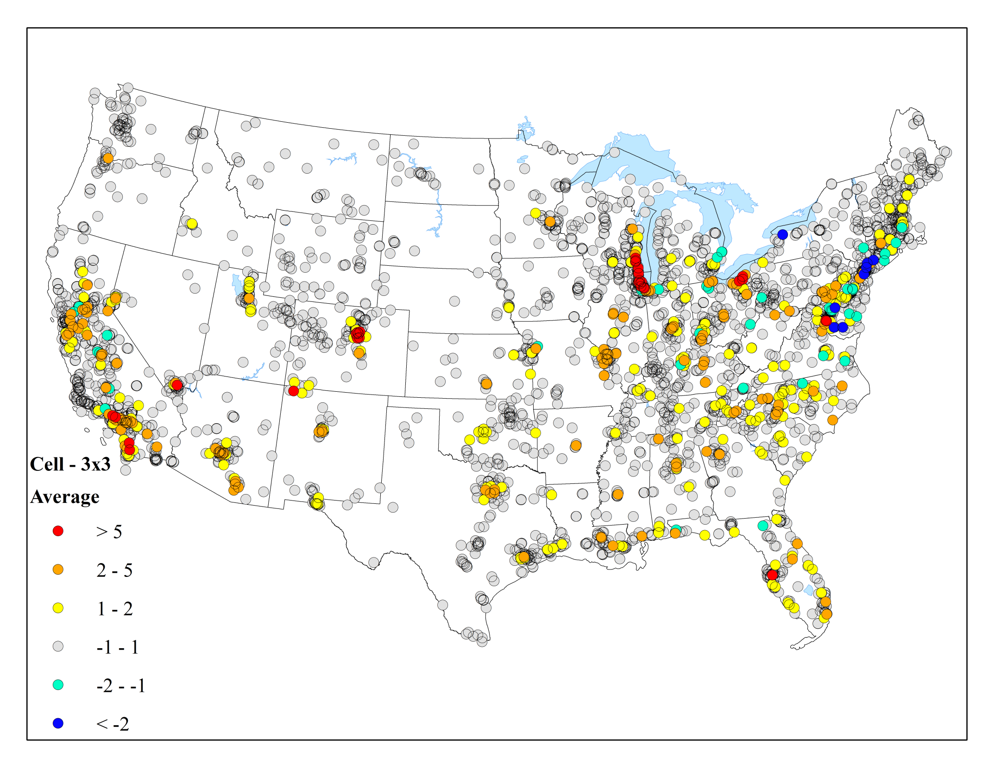
Δo₃ - CONUS - Average DV (2023)
8

Slide 9

Δo₃ - CONUS - MAXIMUM DV (2023)
9

Slide 10
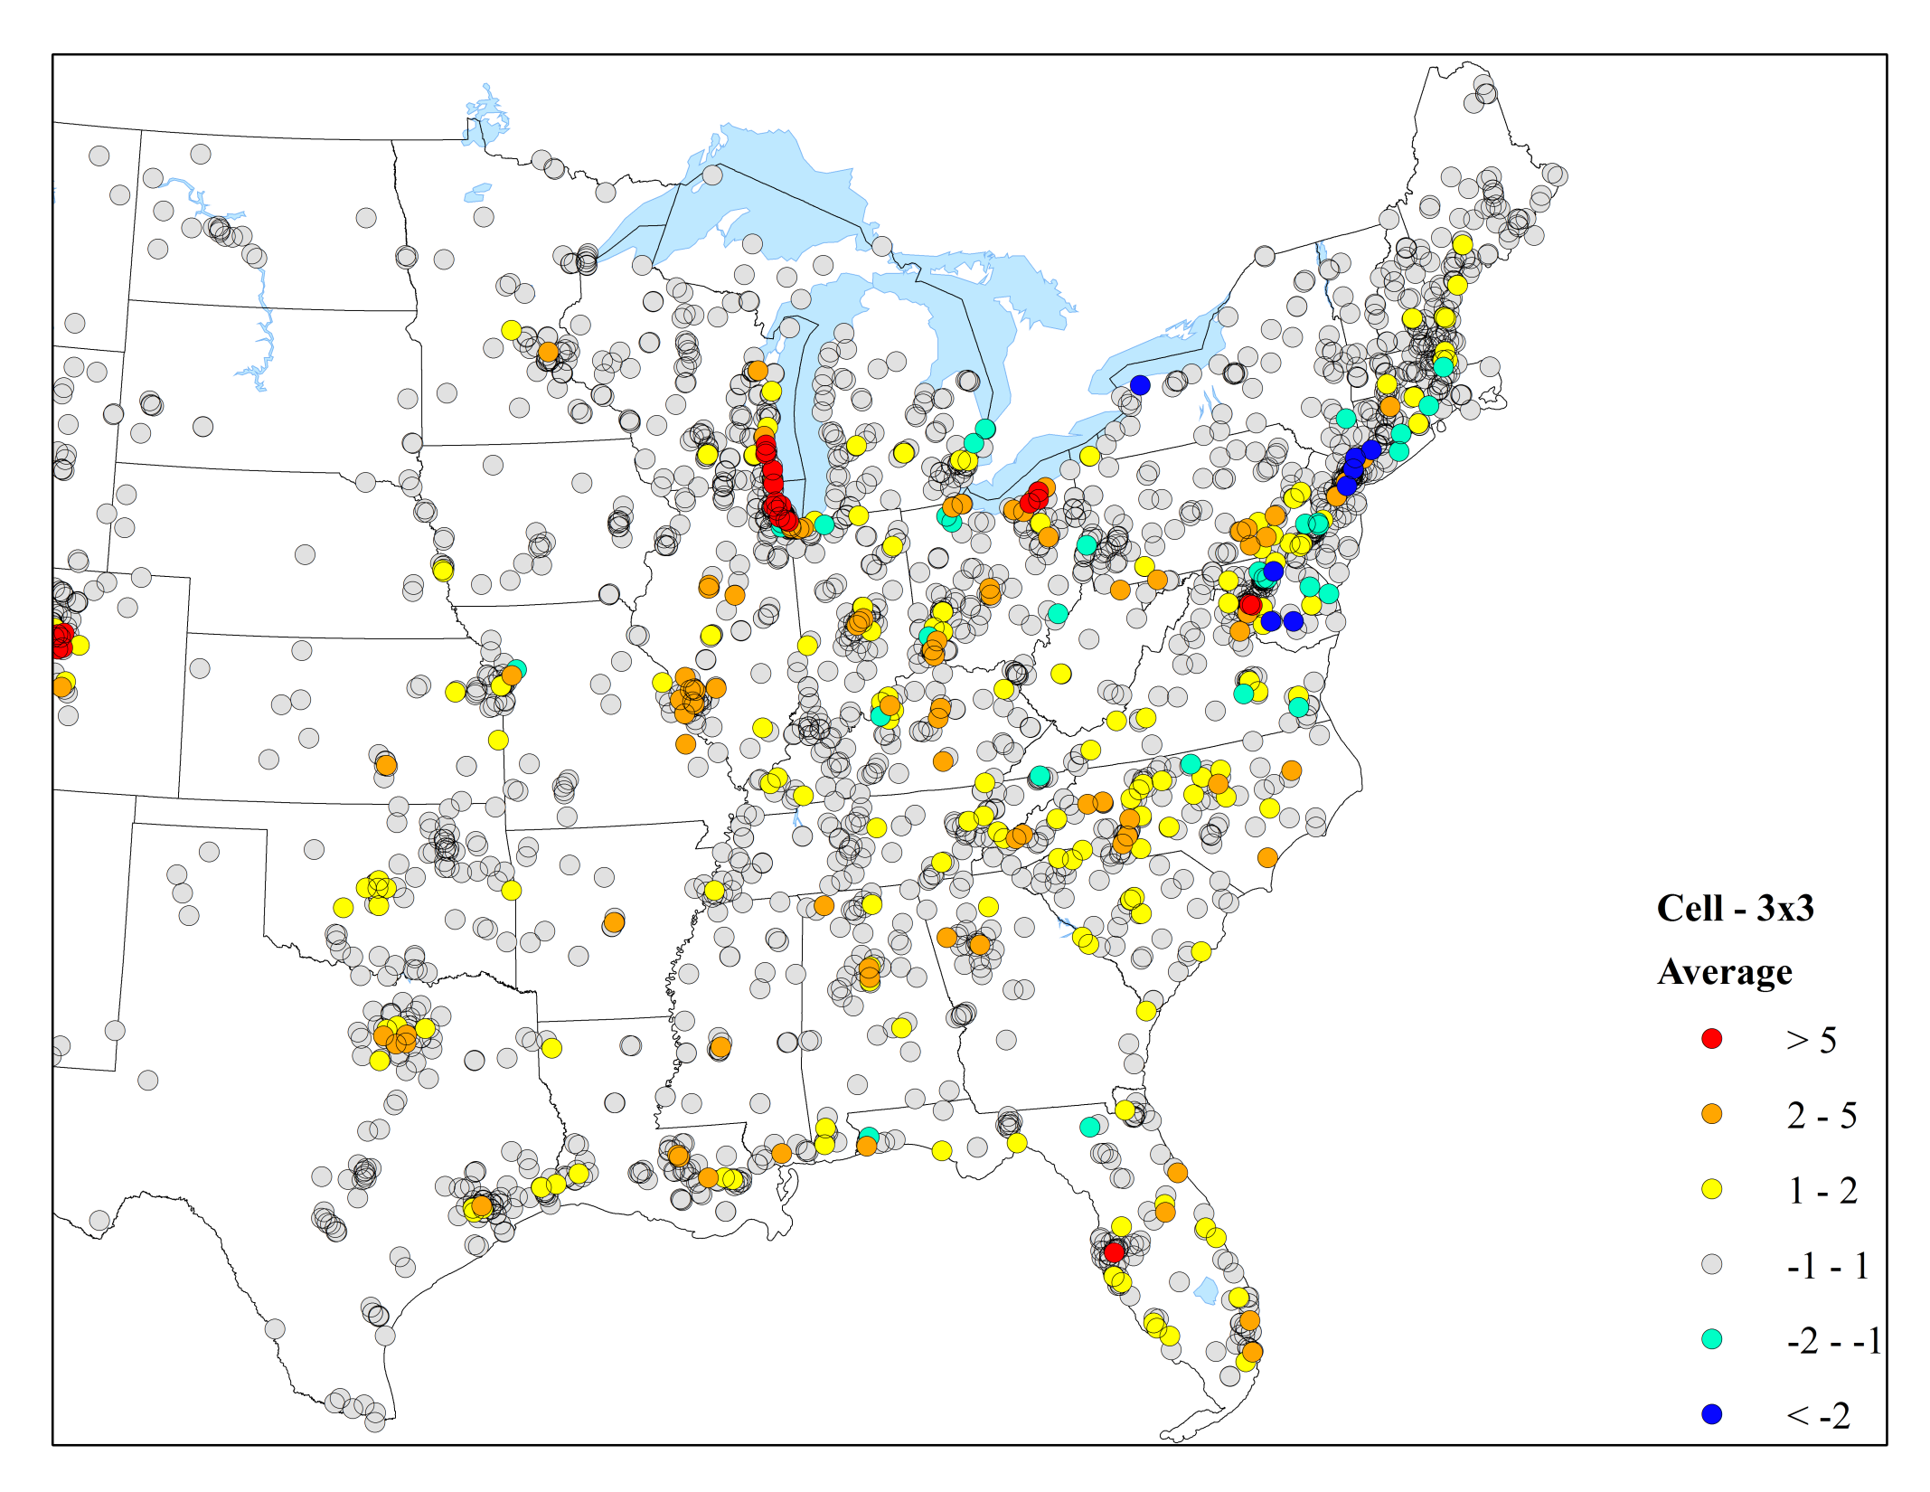
Δo₃ - Eastern U.S. - Average DV (2023)
10

Slide 11
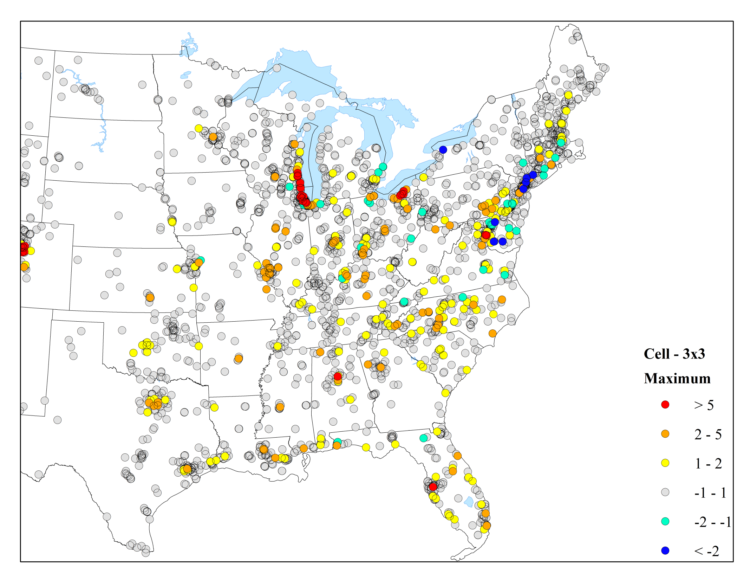
Δo₃ - Eastern U.S. - Maximum DV (2023)
11

Slide 12
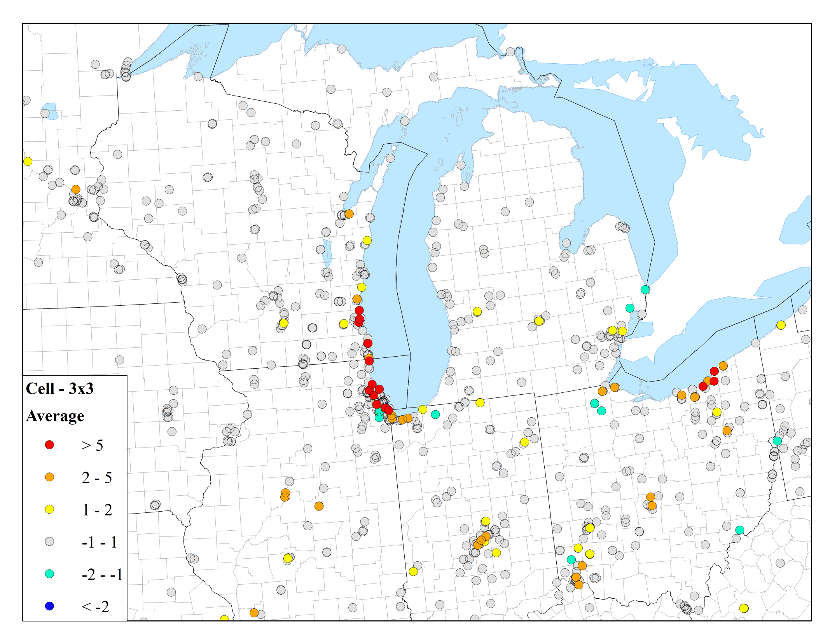
Δo₃ - Midwest - Average DV (2023)
12

Slide 13
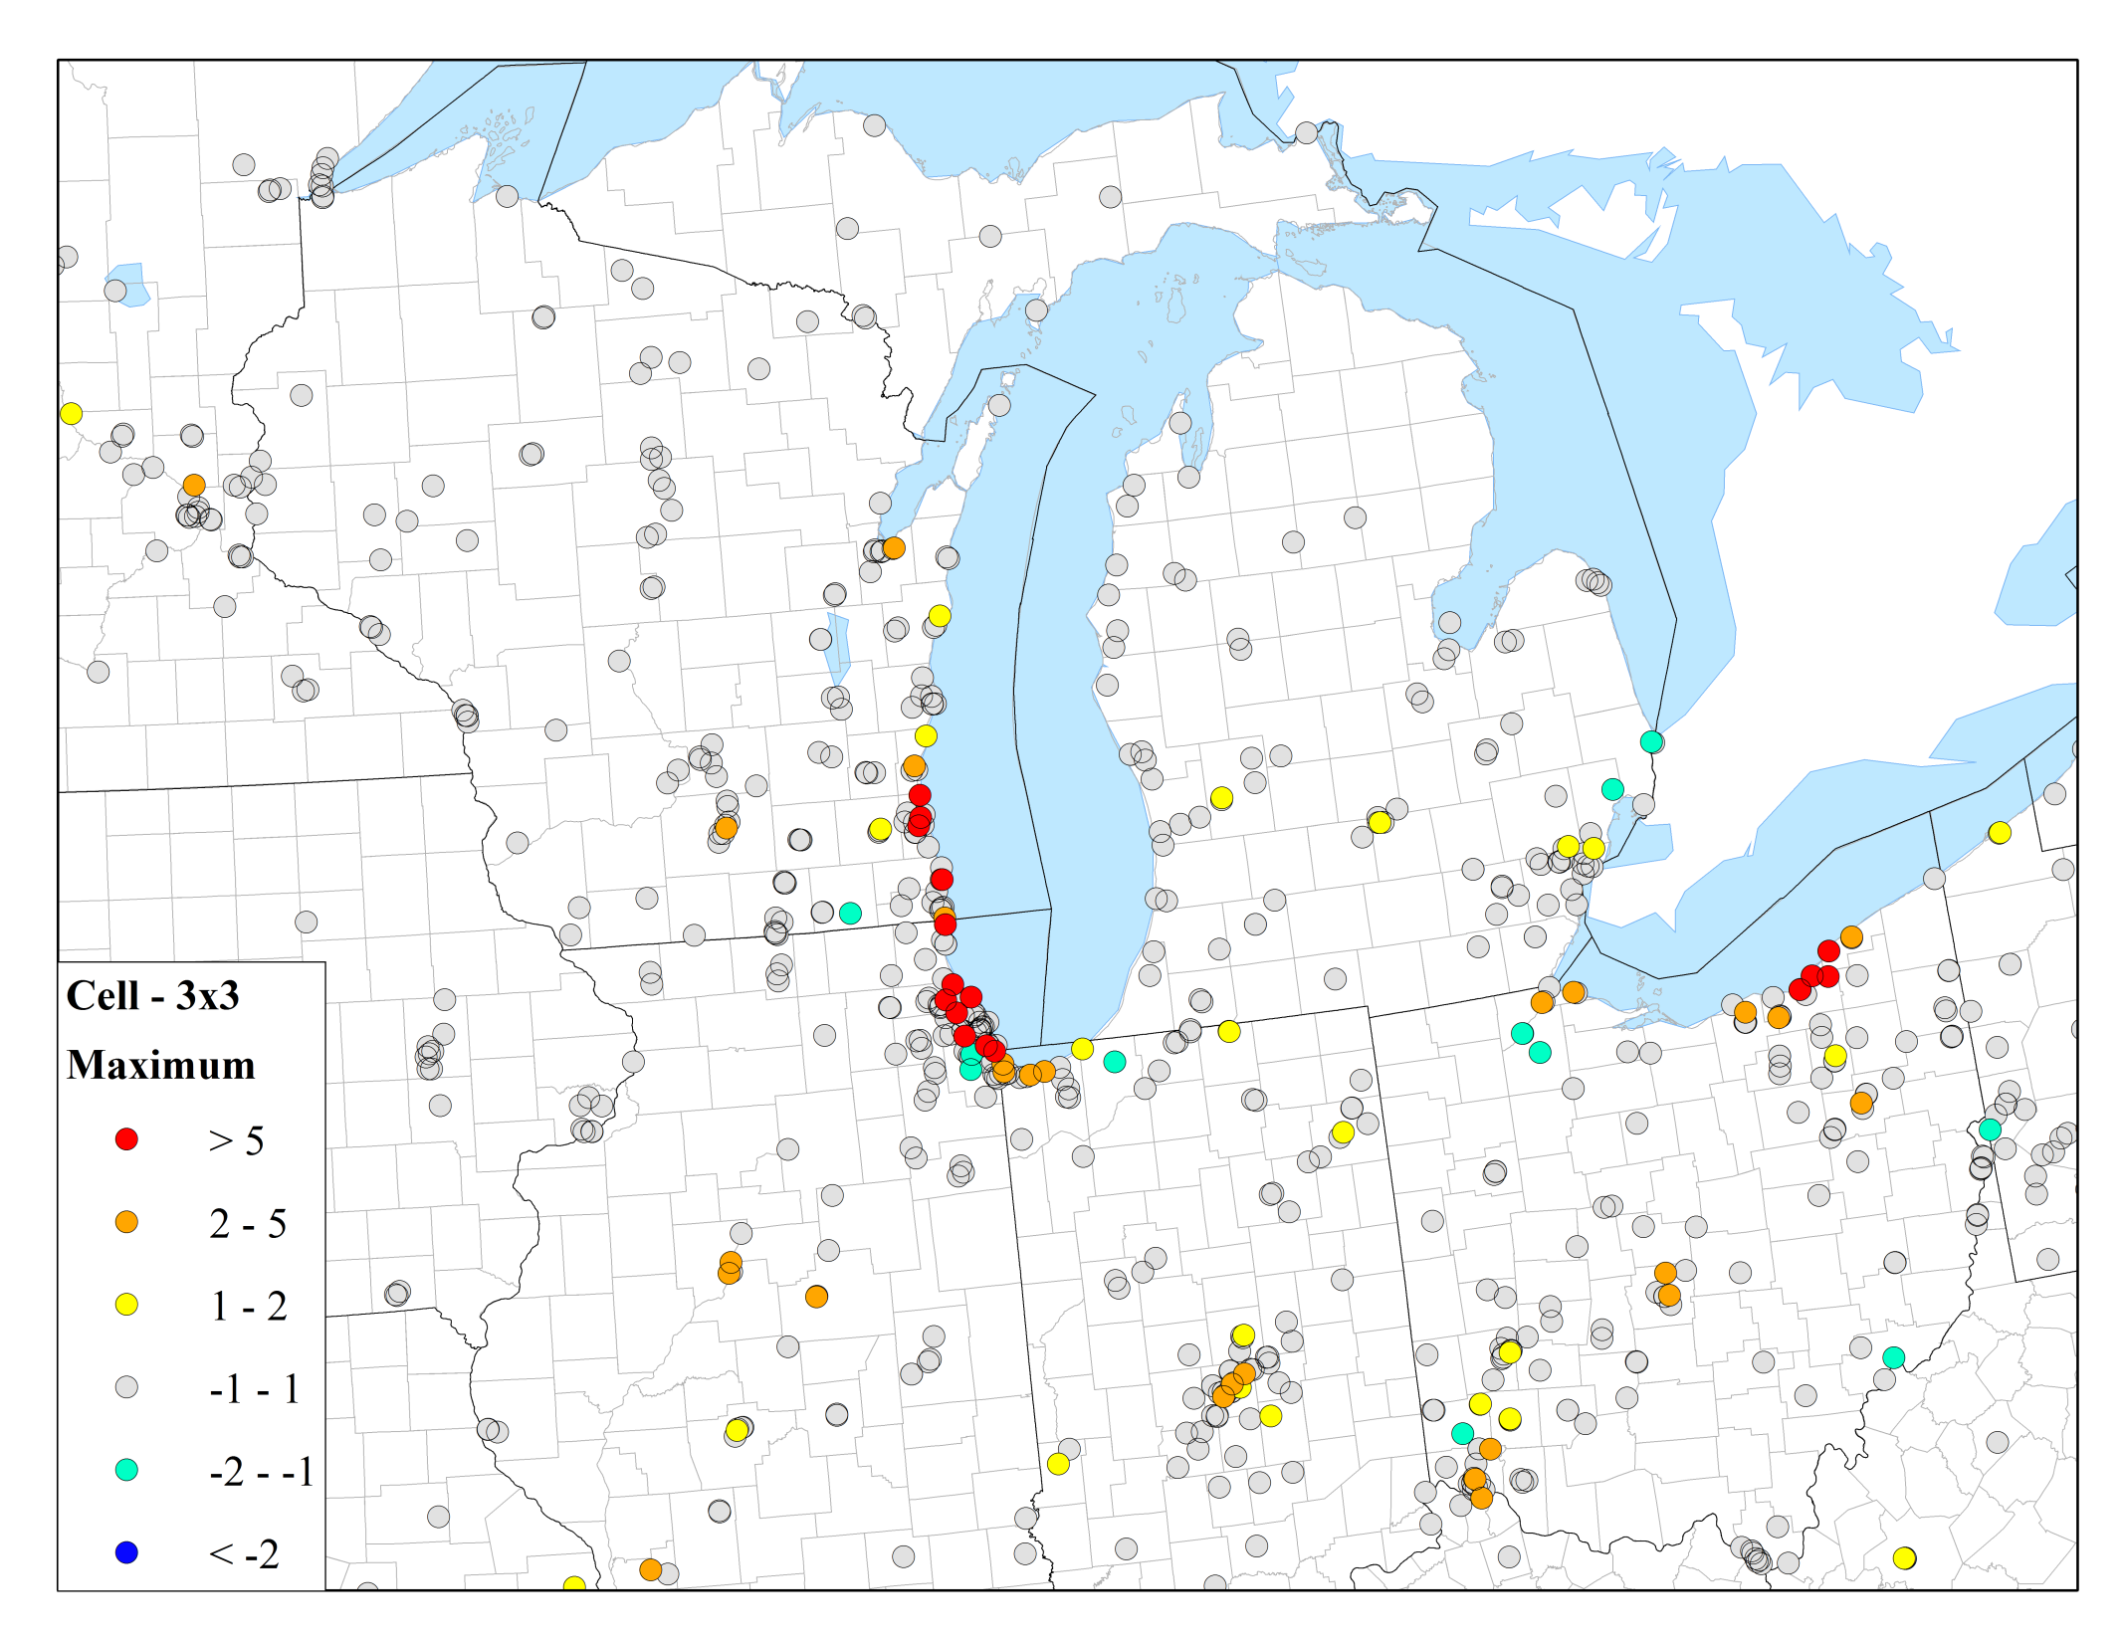
Δo₃ - Midwest – MAXIMUM DV (2023)
13

Slide 14
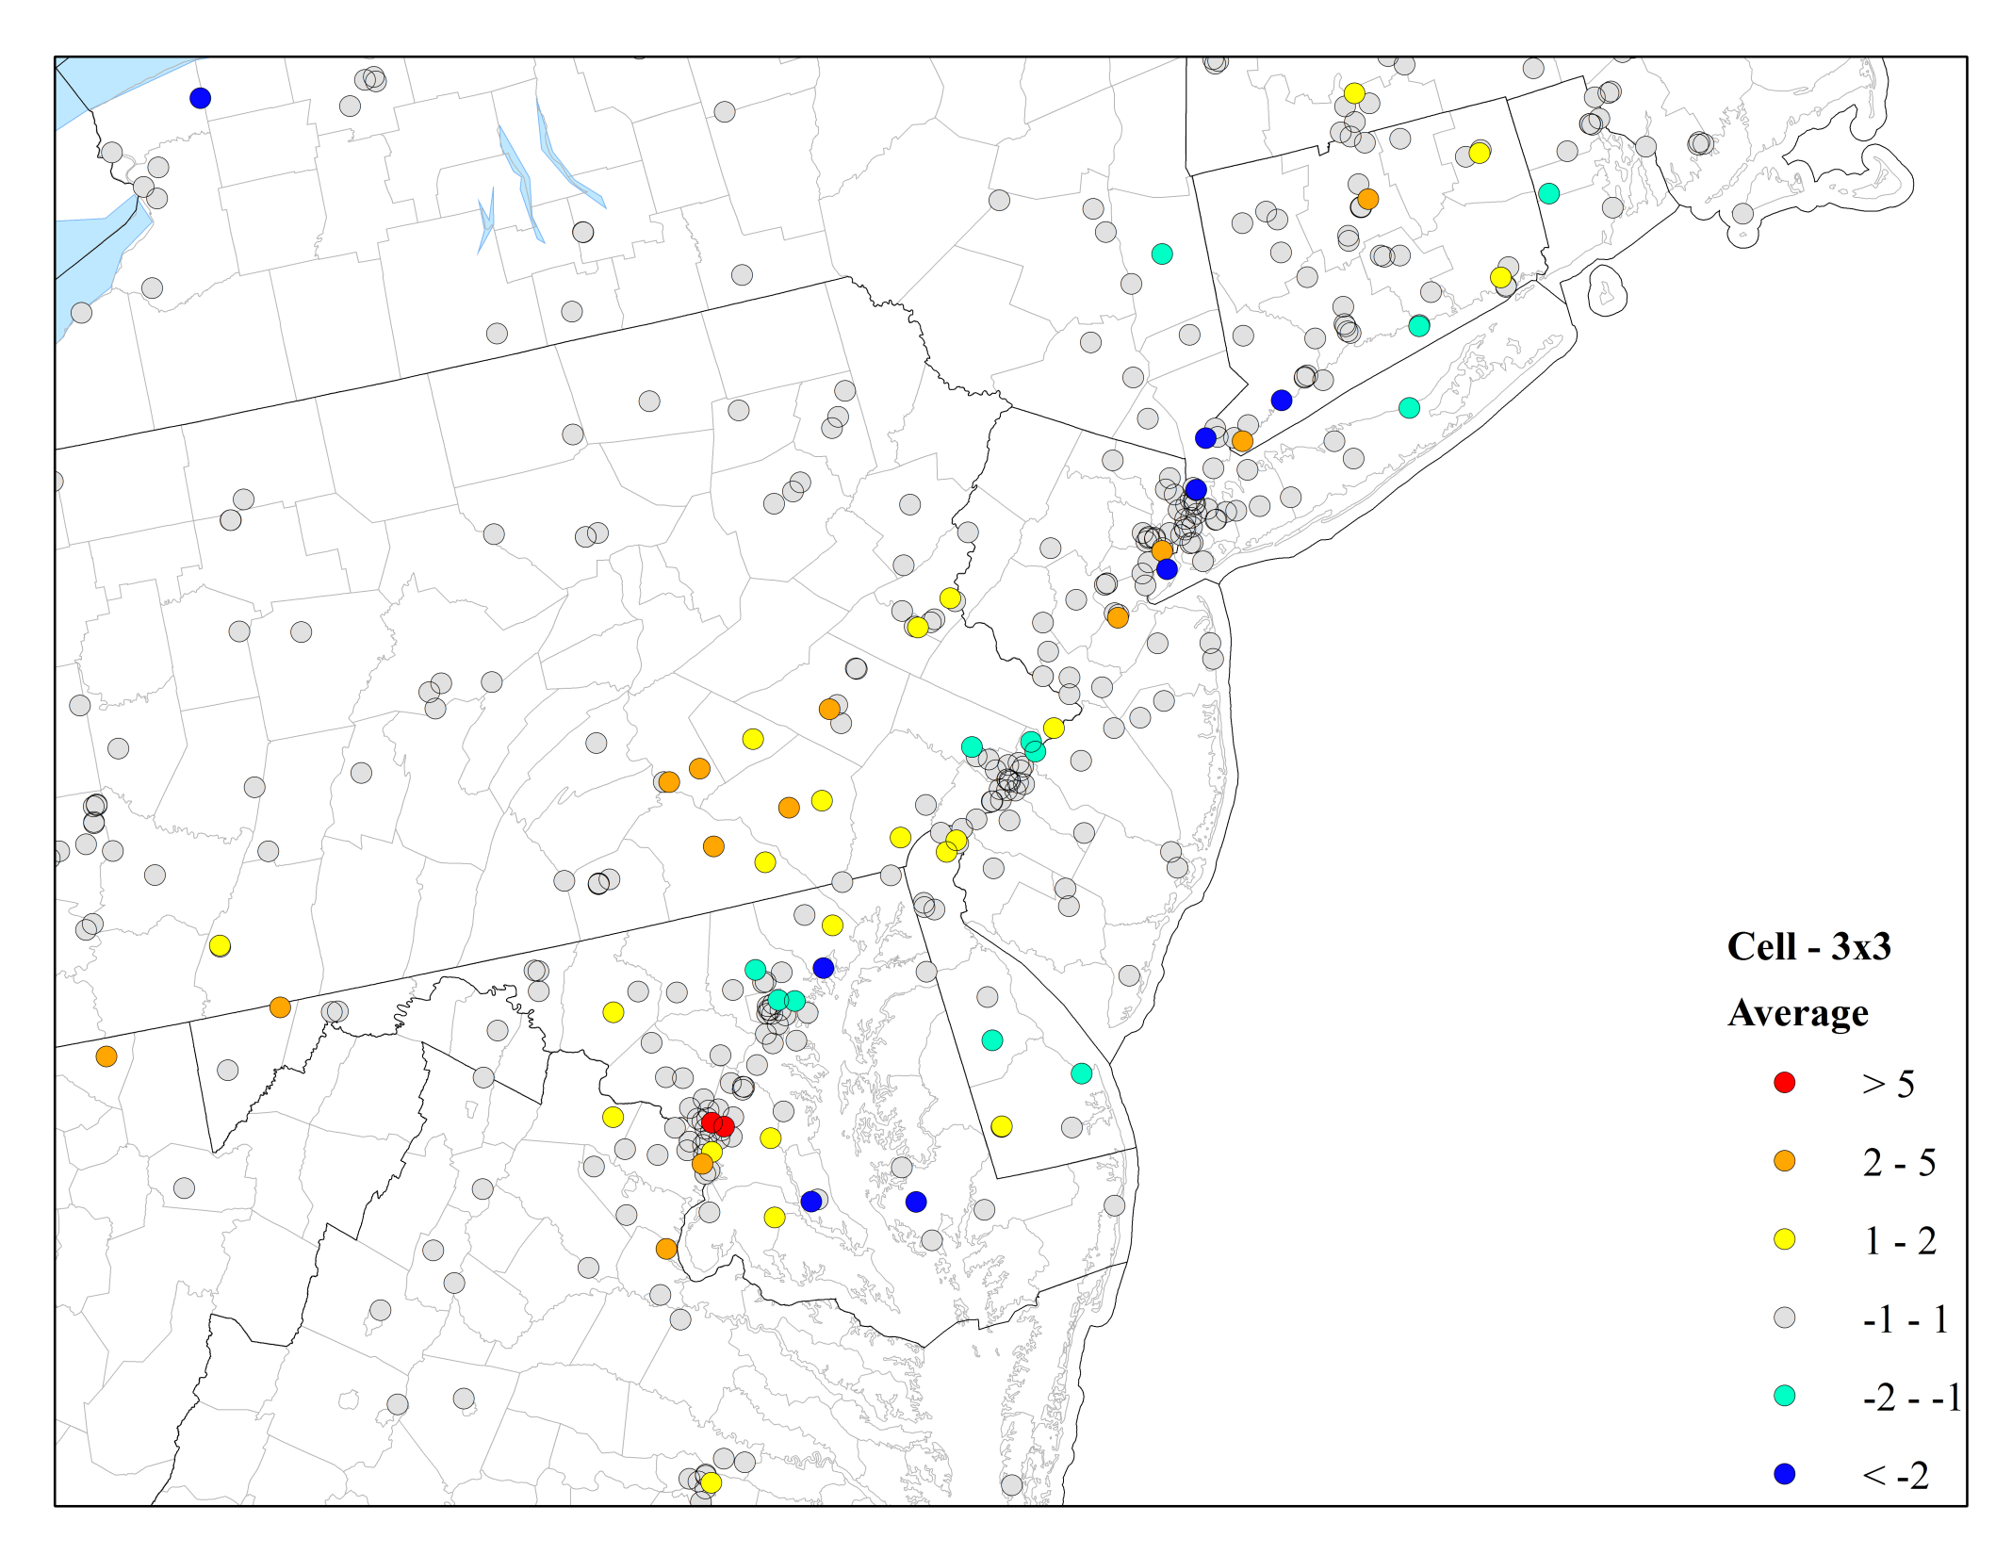
Δo₃ - Northeast - Average DV (2023)
14

Slide 15
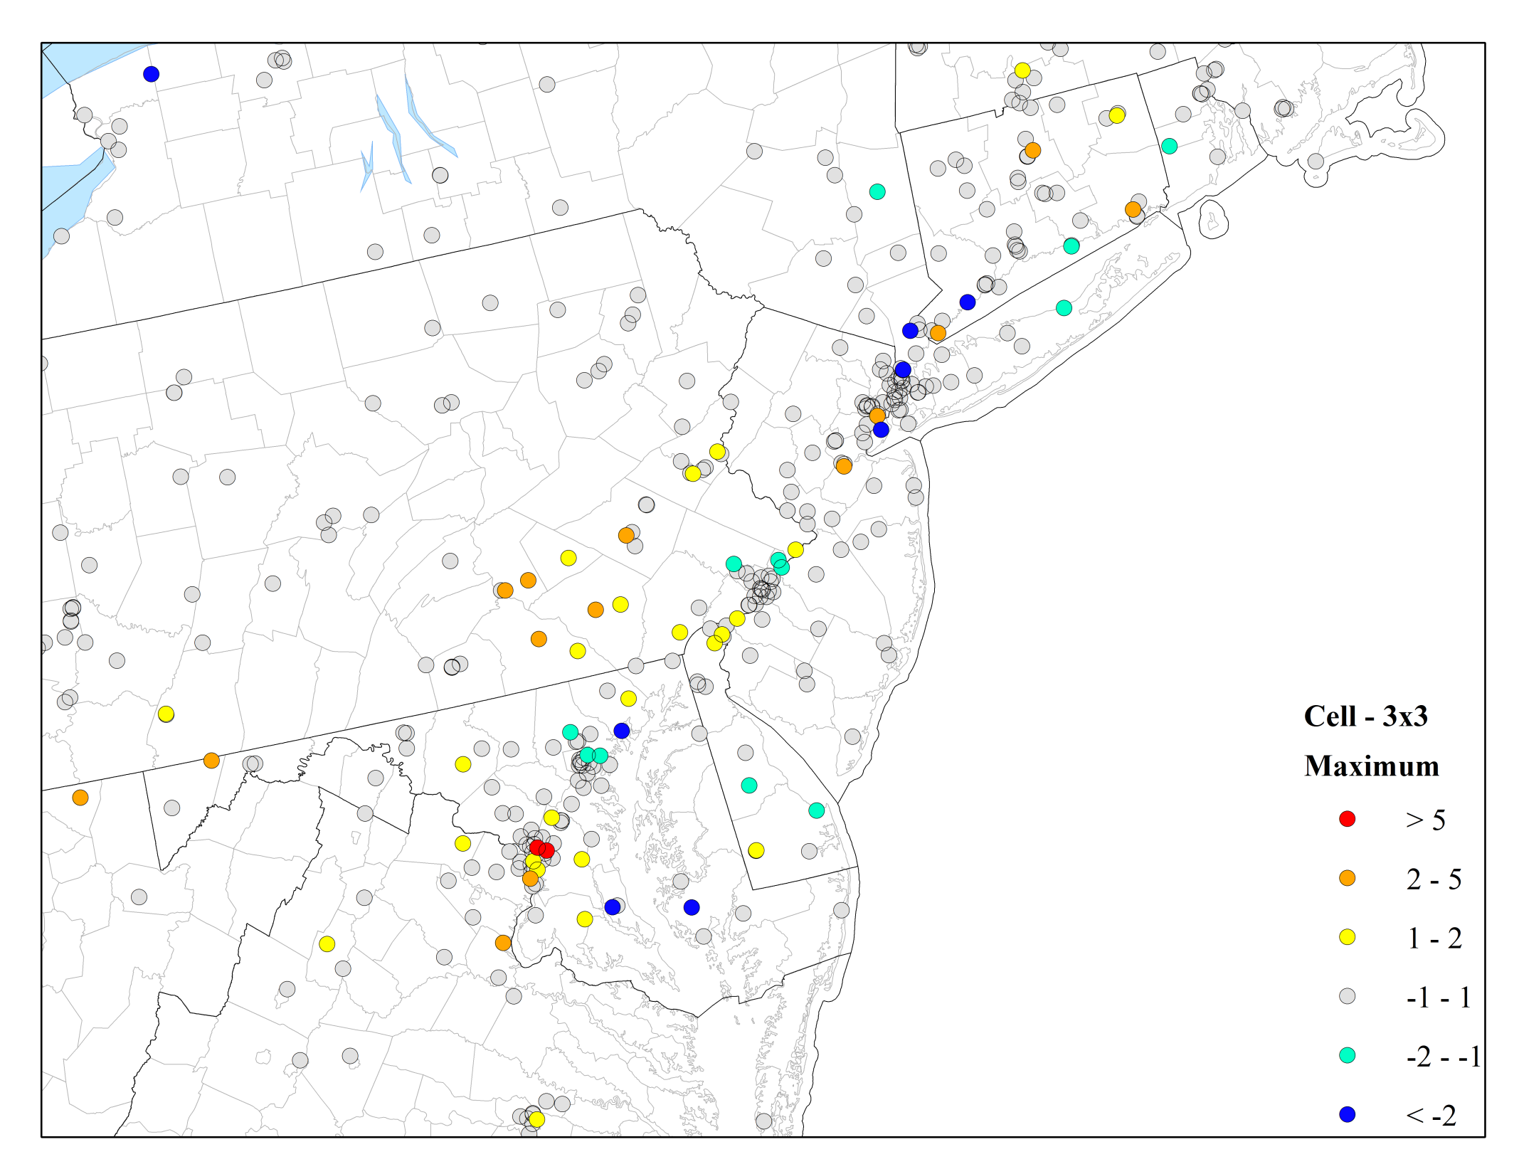
Δo₃ - Northeast - MAXIMUM DV (2023)
15

Slide 16
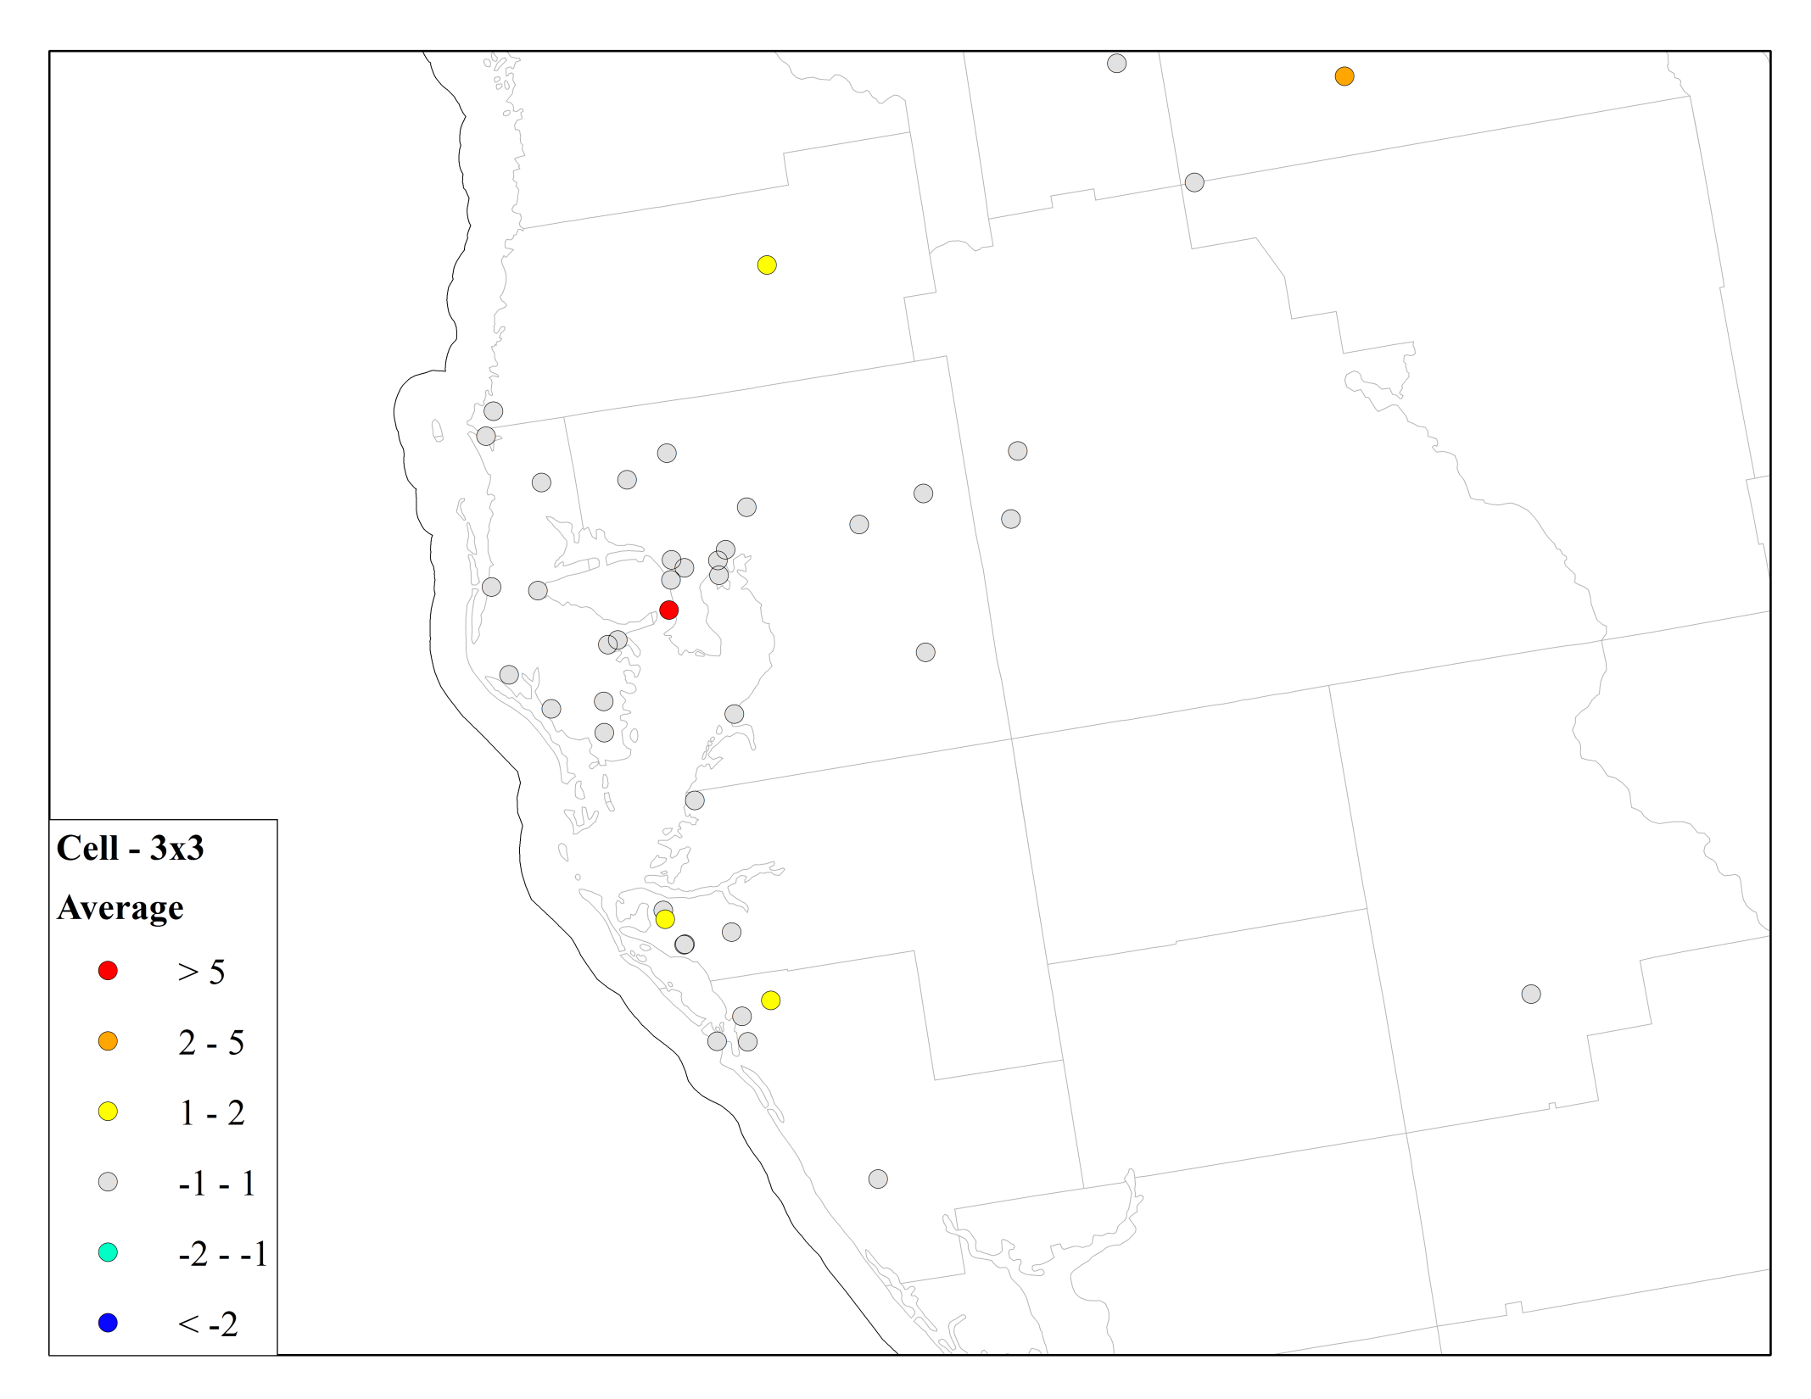
Δo₃ - TAMPA - Average DV (2023)
16

Slide 17

Δo₃ - TAMPA - MAXIMUM DV (2023)
17

Slide 18
70 PPb NAAQS
18

Slide 19
70 ppb NAAQS - Average DV (2023)
Nonattainment with 1x1
Attainment with 3x3
Attainment with 1x1
Nonattainment with 3x3
19

Slide 20
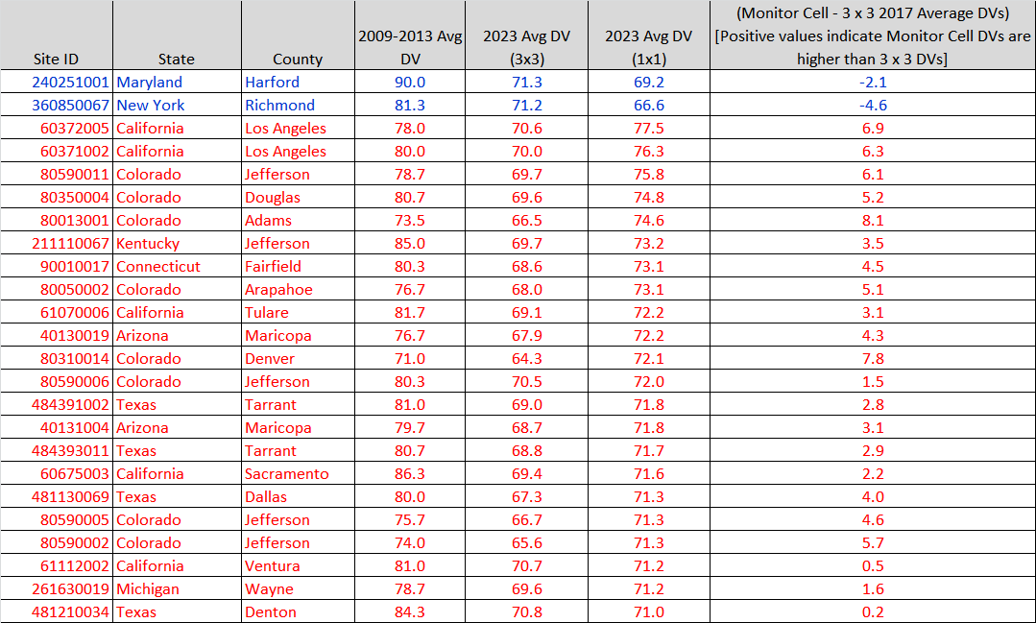
70 ppb NAAQS - Average DV (2023)
20

Slide 21
70 ppb NAAQS - MAXIMUM DV (2023)
Maintenance with 1x1
Attainment with 3x3
Attainment with 1x1
Maintenance with 3x3
21

Slide 22
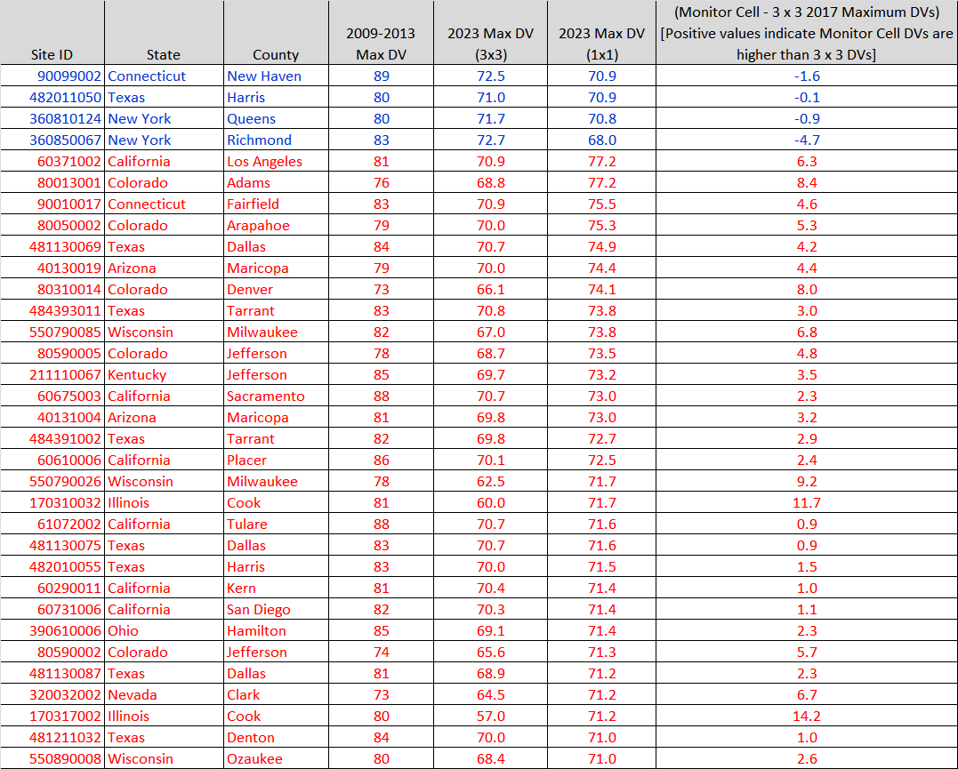
70 ppb NAAQS - MAXIMUM DV (2023)
22

Slide 23
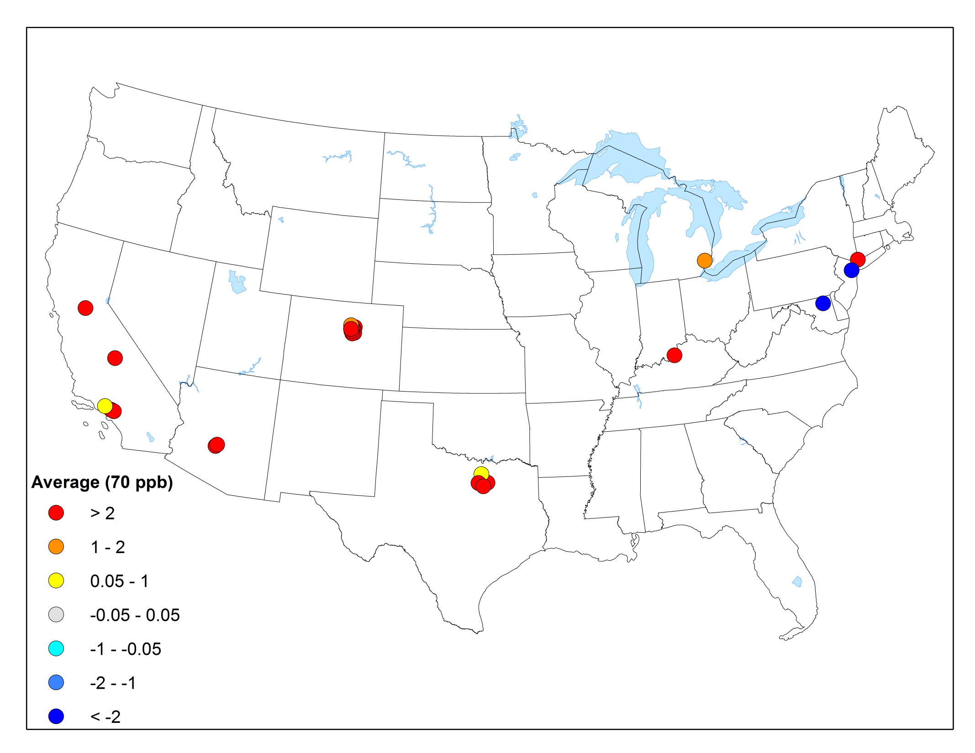
Δo₃ - CONUS - Average DV (2023)
Red: Attainment -> Nonattainment
Blue: Nonattainment -> Attainment
23

Slide 24
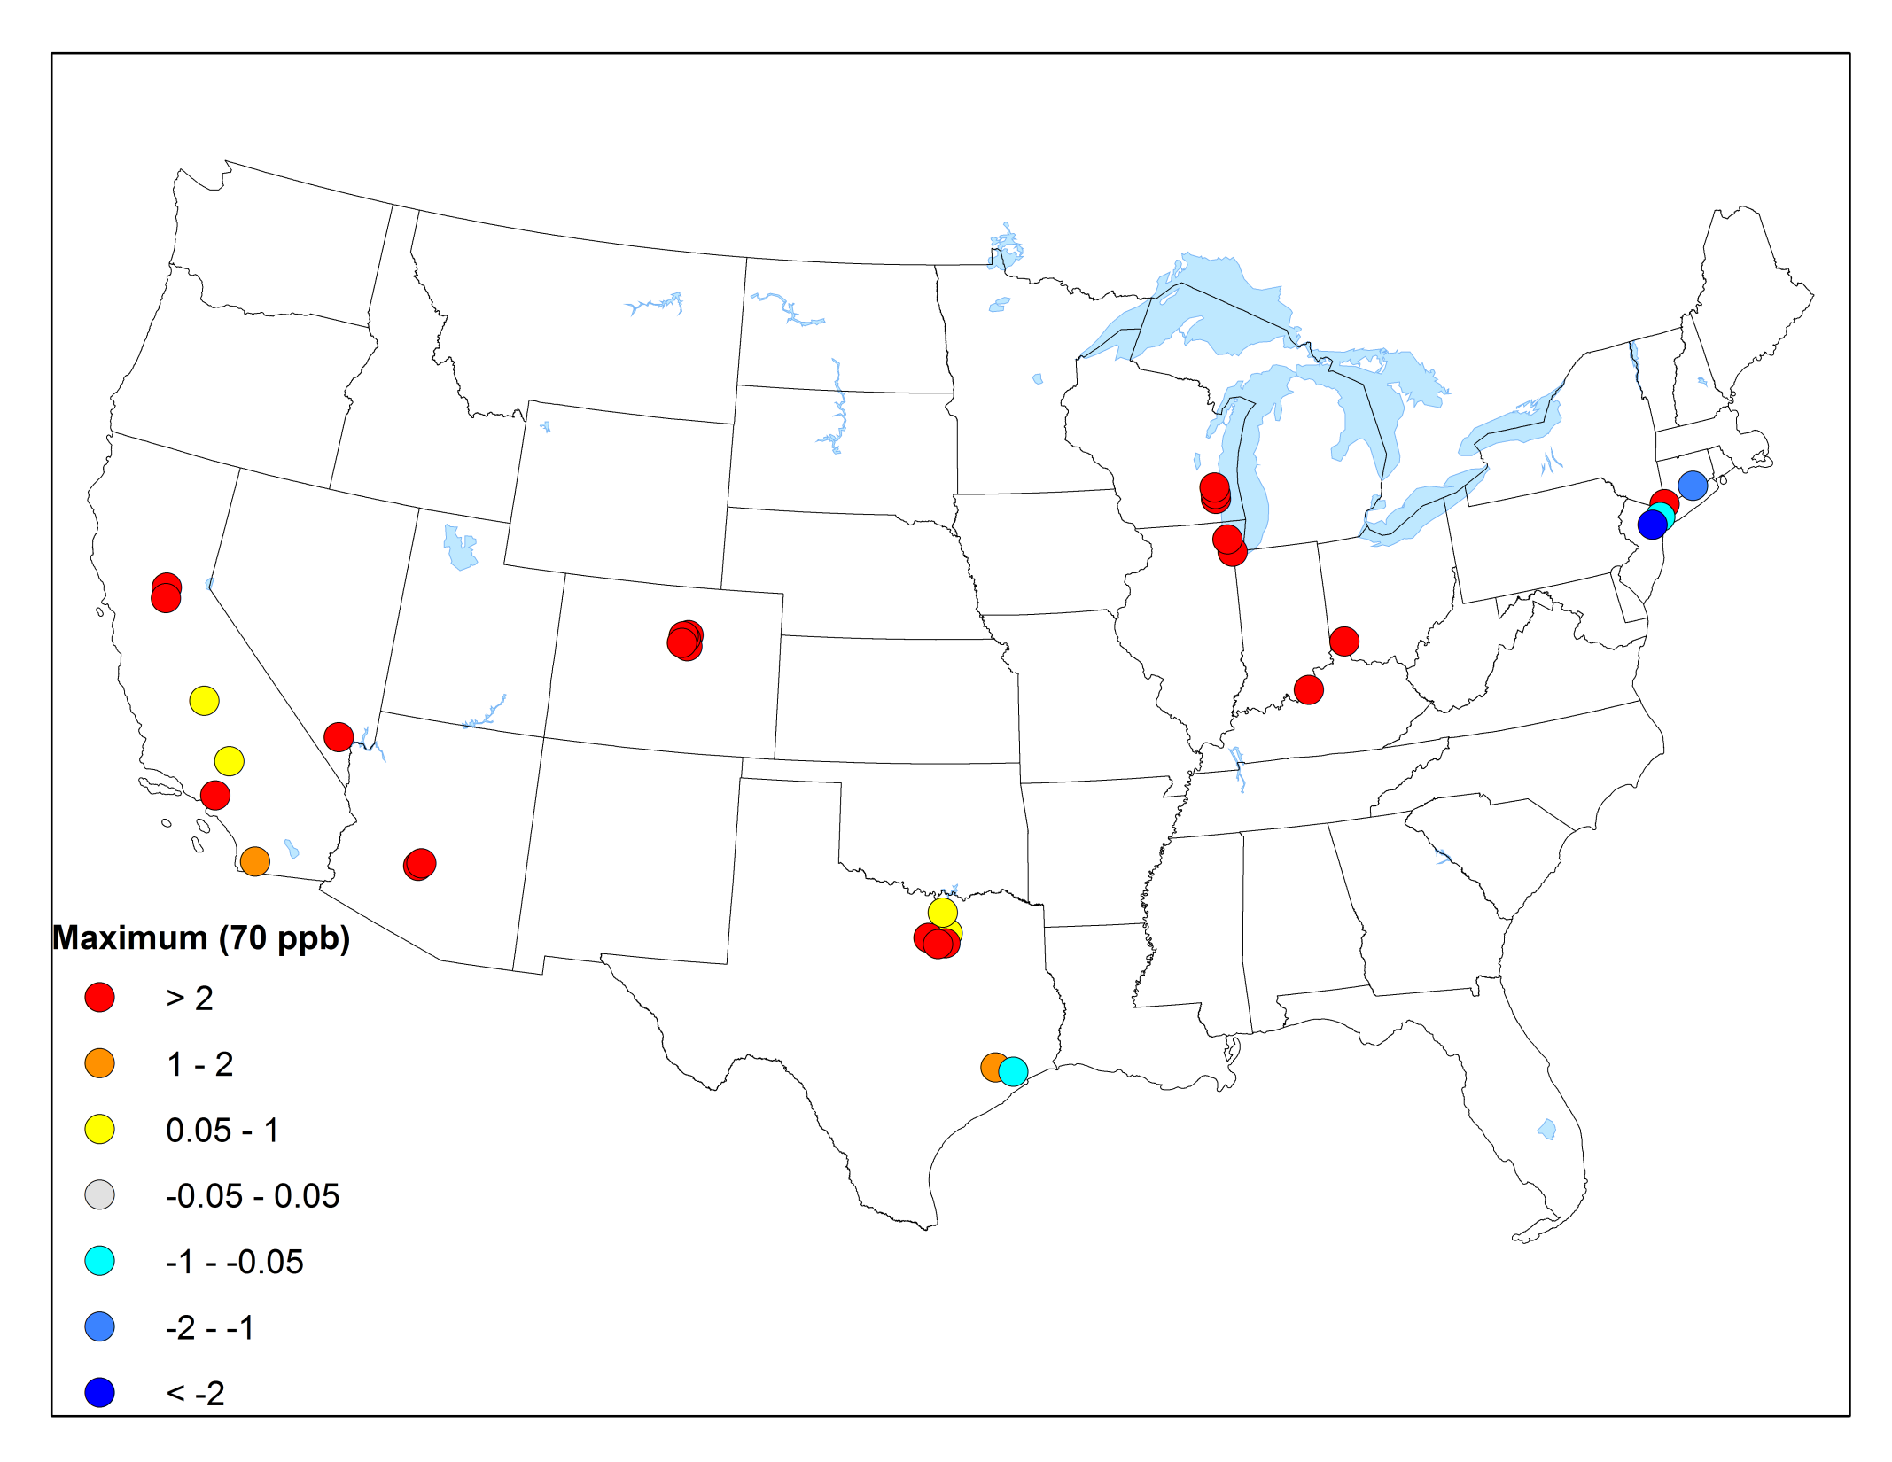
Δo₃ - CONUS - MAXIMUM DV (2023)
Red: Attainment -> Maintenance
Blue: Maintenance -> Attainment
24

Slide 25
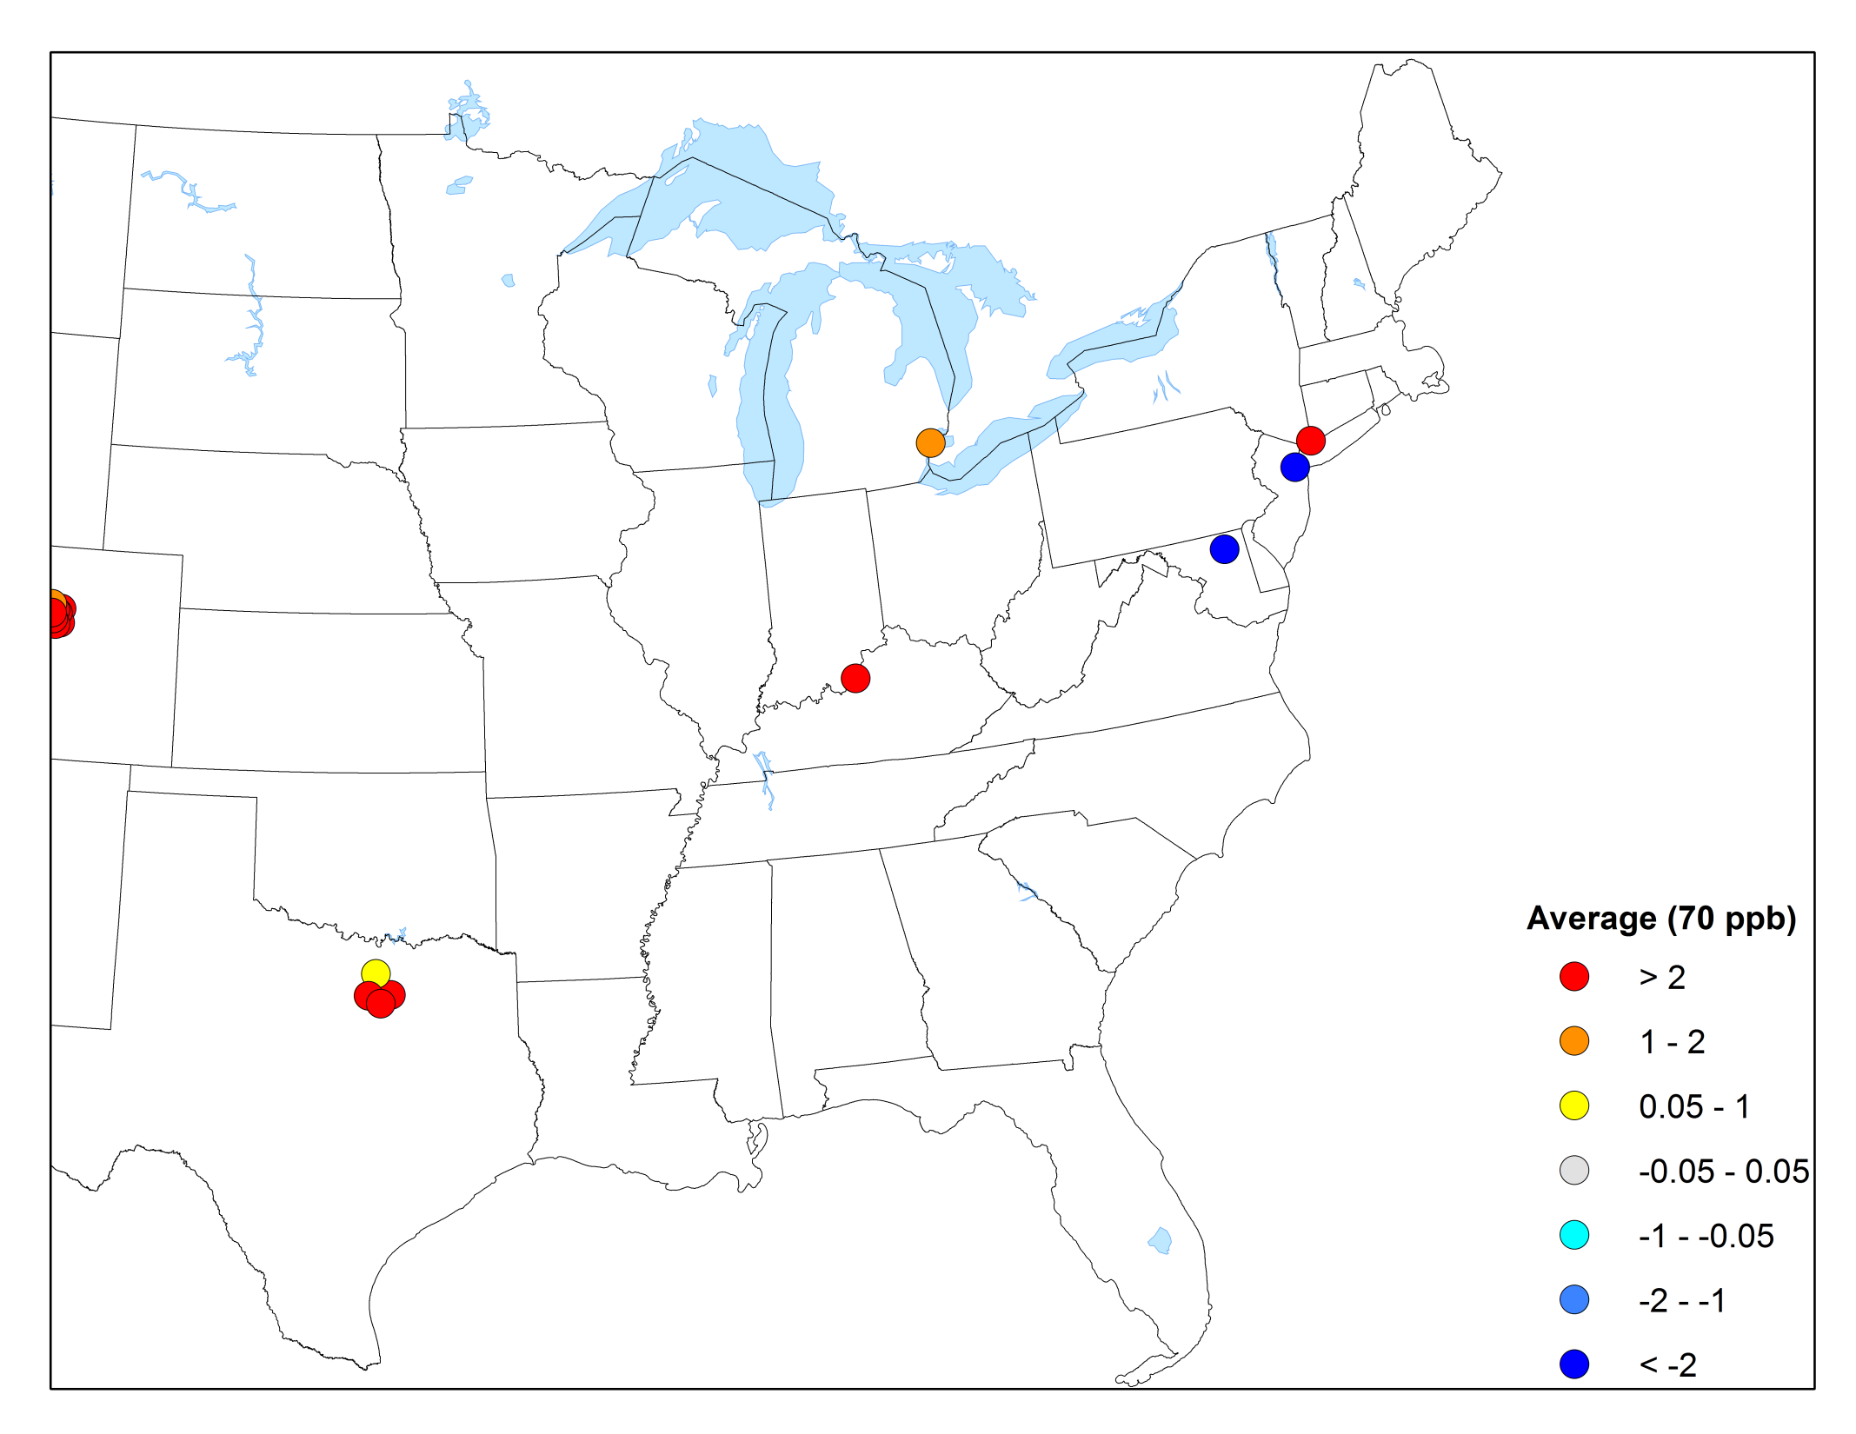
Δo₃ - EASTERN U.S. - Average DV (2023)
25

Slide 26
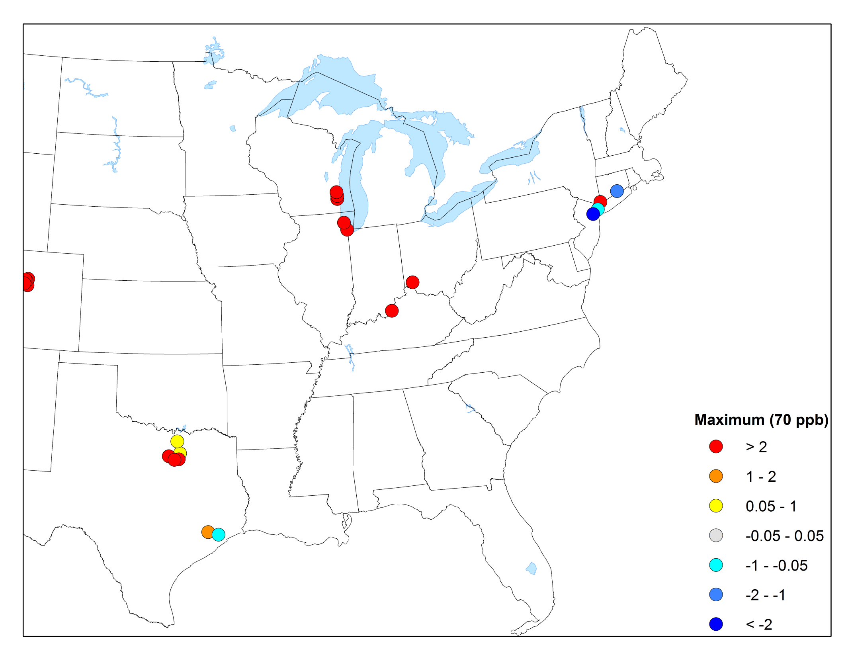
Δo₃ - EASTERN U.S. - MAXIMUM DV (2023)
26

Slide 27
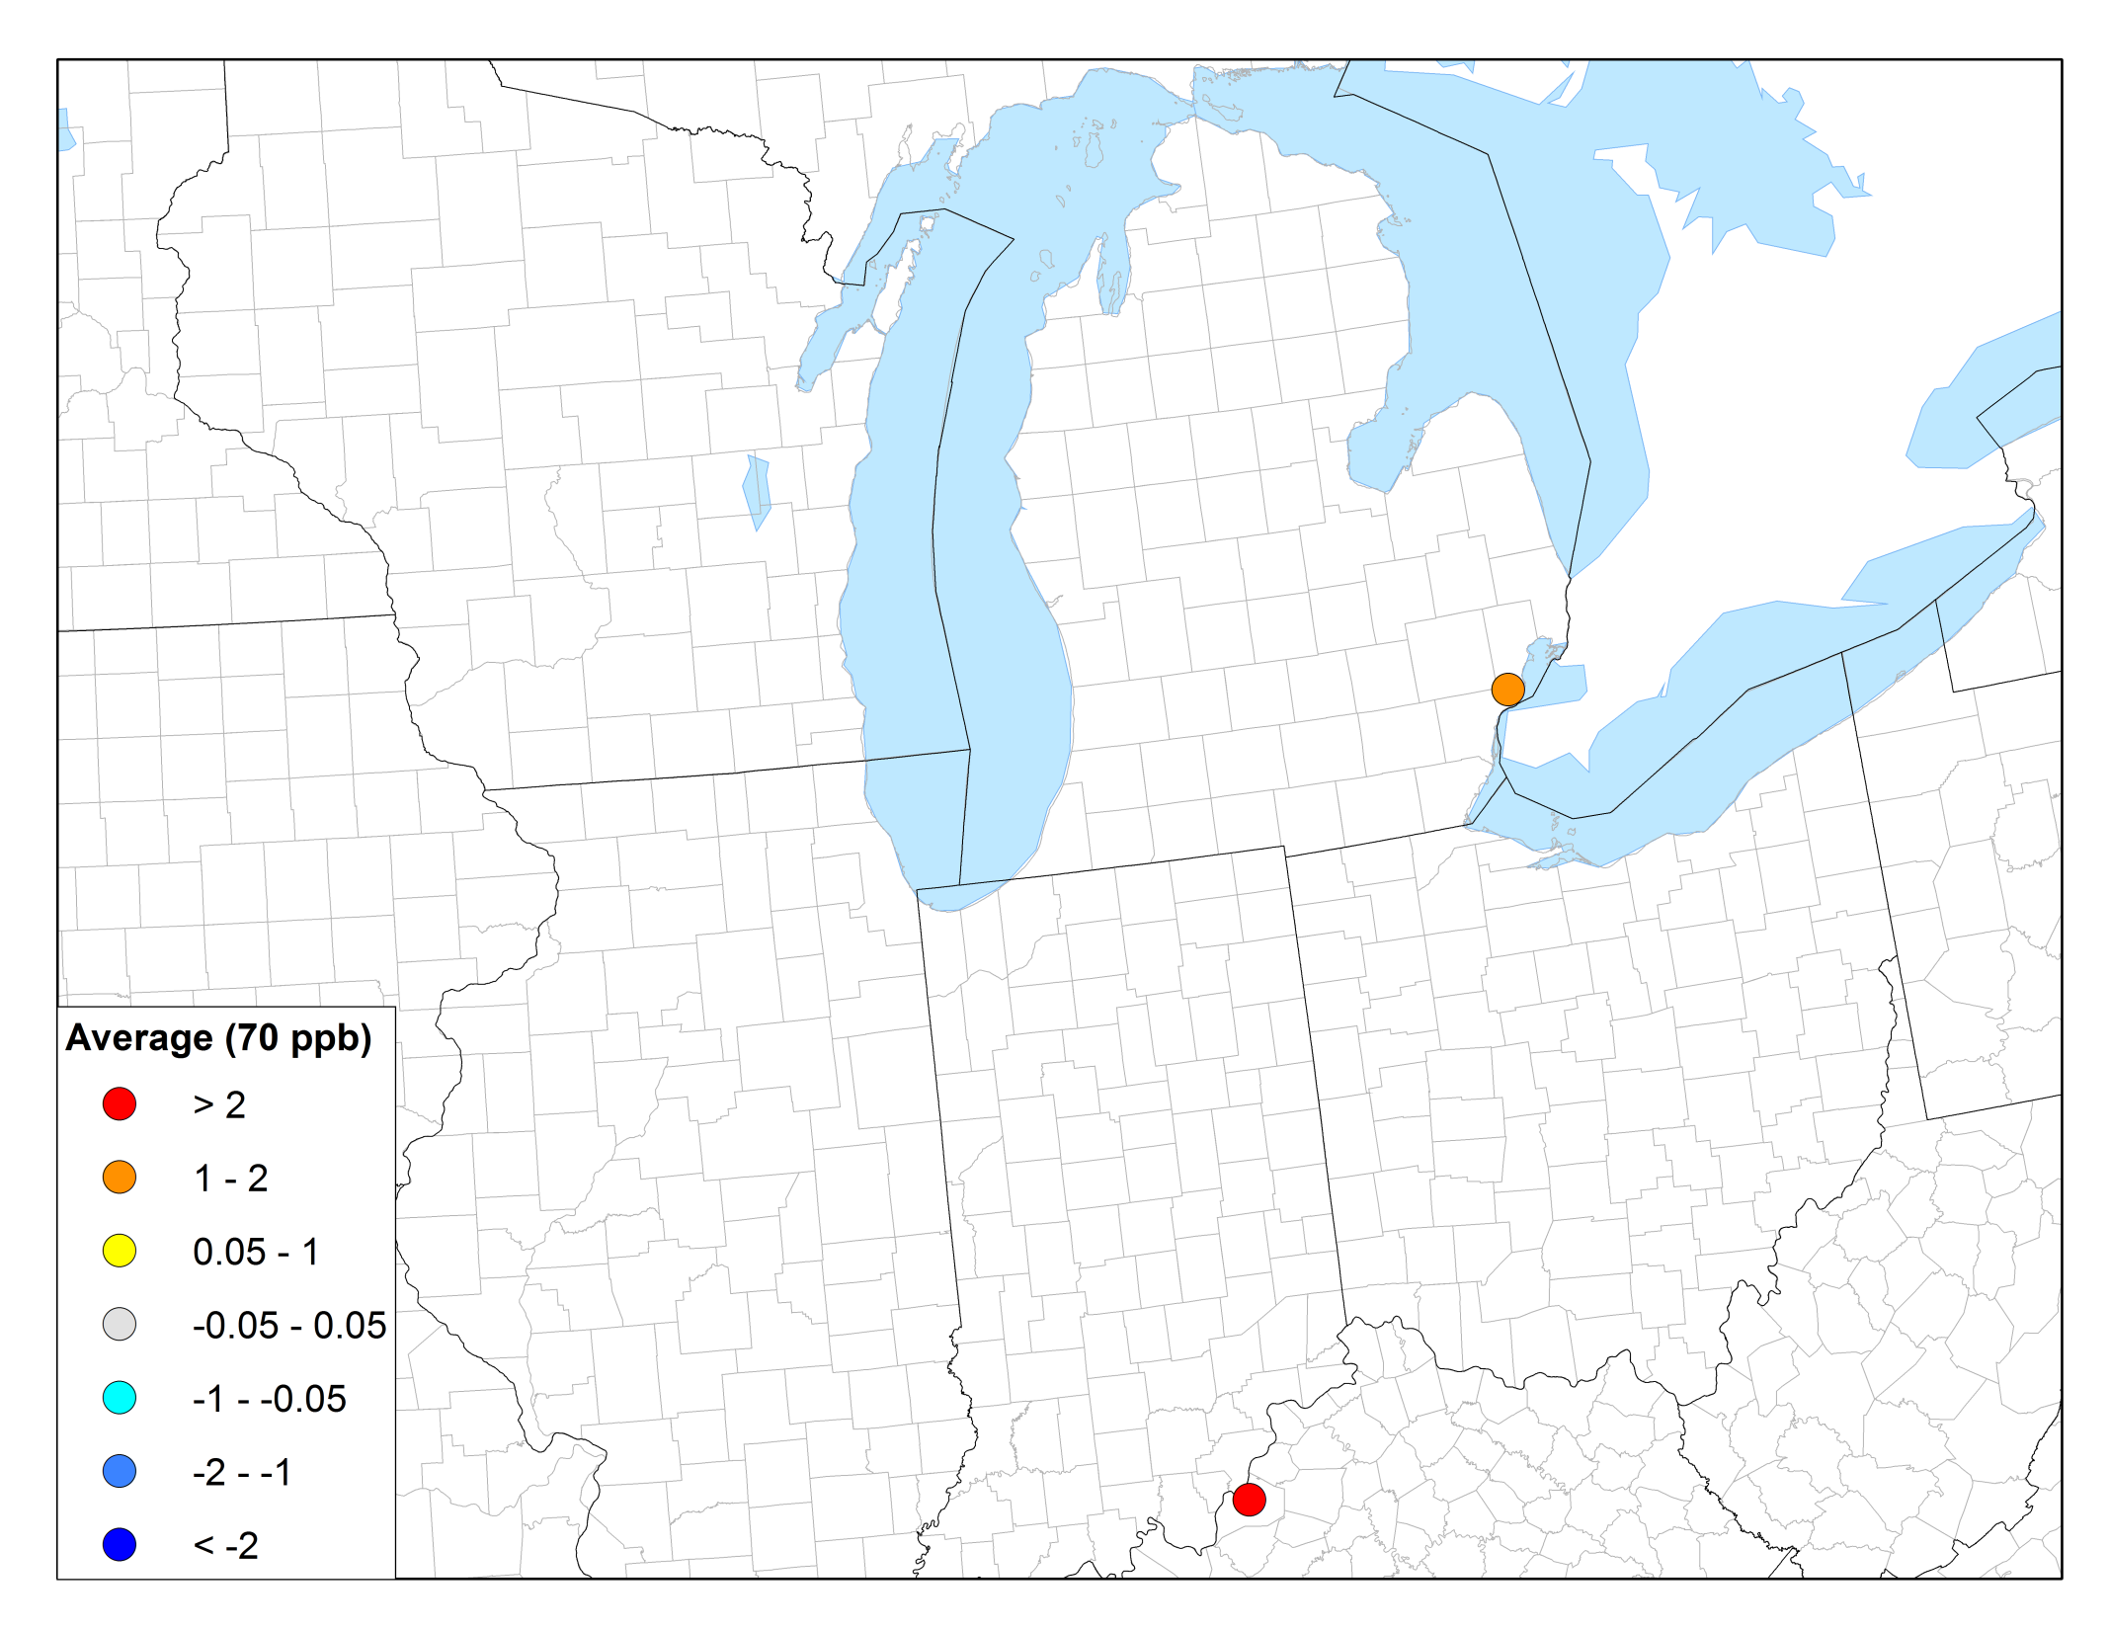
Δo₃ - MIDWEST - Average DV (2023)
27

Slide 28
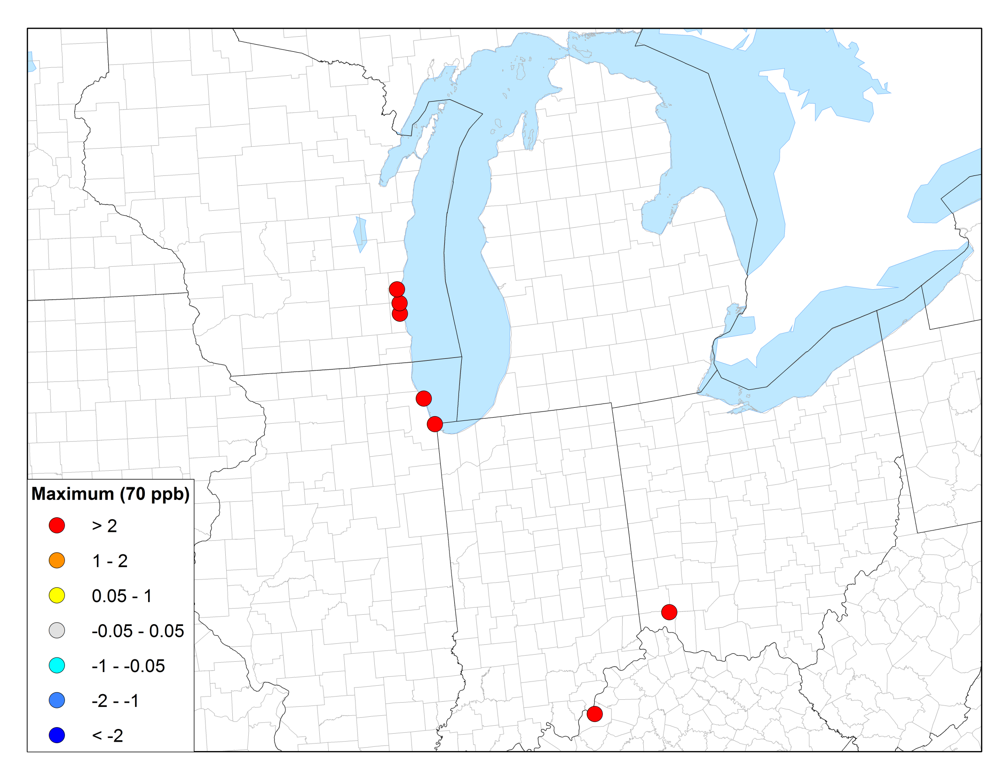
Δo₃ - MIDWEST - MAXIMUM DV (2023)
28

Slide 29
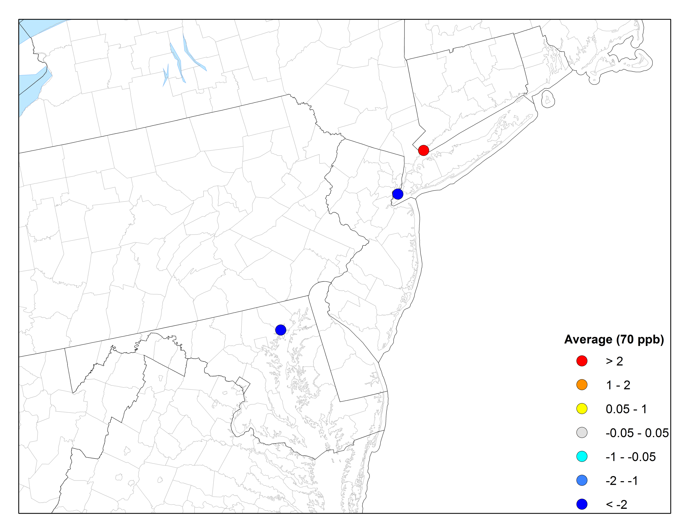
Δo₃ - NORTHEAST - Average DV (2023)
29

Slide 30
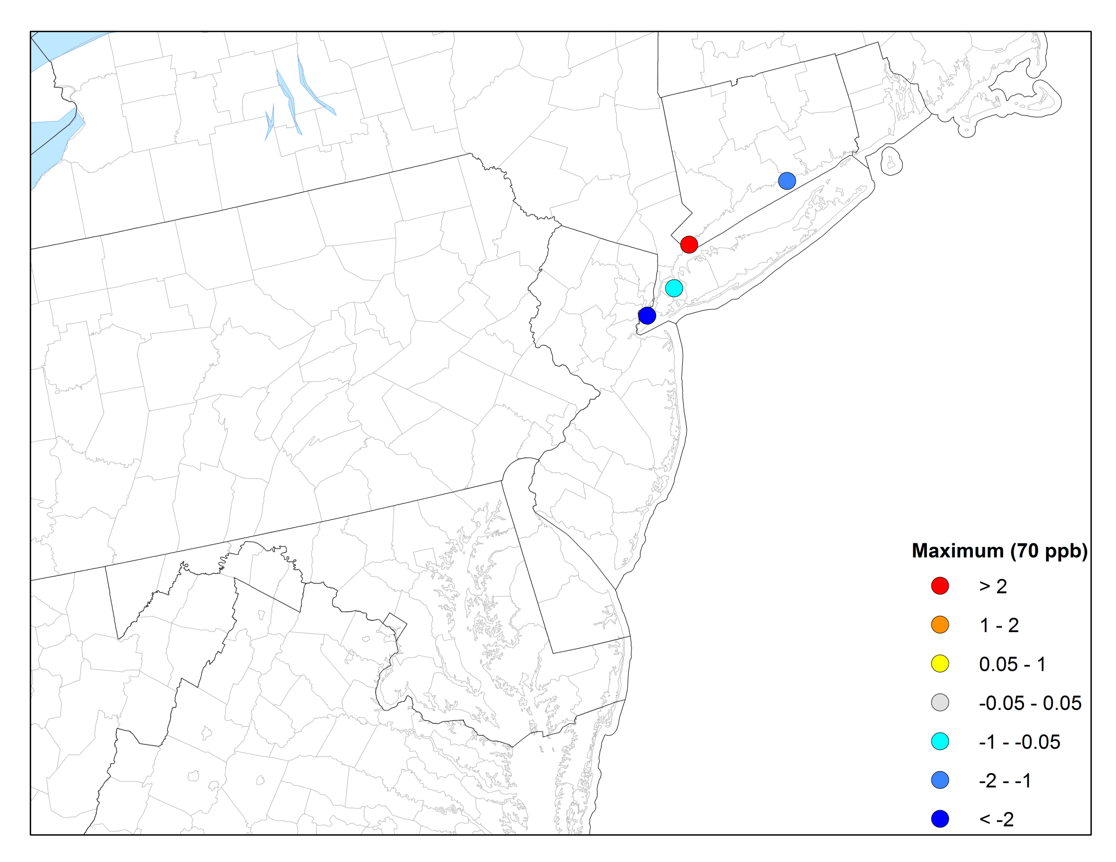
Δo₃ - NORTHEAST - MAXIMUM DV (2023)
30

Slide 31
SUMMARY
The choice of 3x3 vs. 1x1 grid cell can have an impact of up to 14 ppb on future design values.
        The largest impacts are typically at land-water interfaces.
In general, the future design values using the 1x1 grid cell are higher than using 3x3.
The choice of 3x3 vs. 1x1 can impact the list of monitors that are projected to be attainment or maintenance in the future.
31

Slide 32
Contact Information
Byeong-Uk Kim, Ph.D.
Georgia Dept. of Natural Resources
4244 International Parkway, Suite 120
Atlanta, GA 30354
Byeong.Kim@dnr.ga.gov
404-363-7085
Notes:
No major changes to VOC or NOX emissions between 2009 OTW BaseD and 2009 OTW BaseG4 (used in SIPs) inventories.

