Slide 1


Real world emissions of NOx and other pollutants in the Ft. McHenry tunnel
Andrey Khlystov and Dave Campbell
2215 Raggio Parkway, Reno, NV 89512 U.S.A.

Slide 2
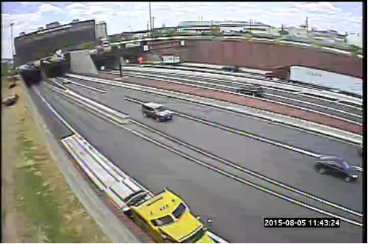
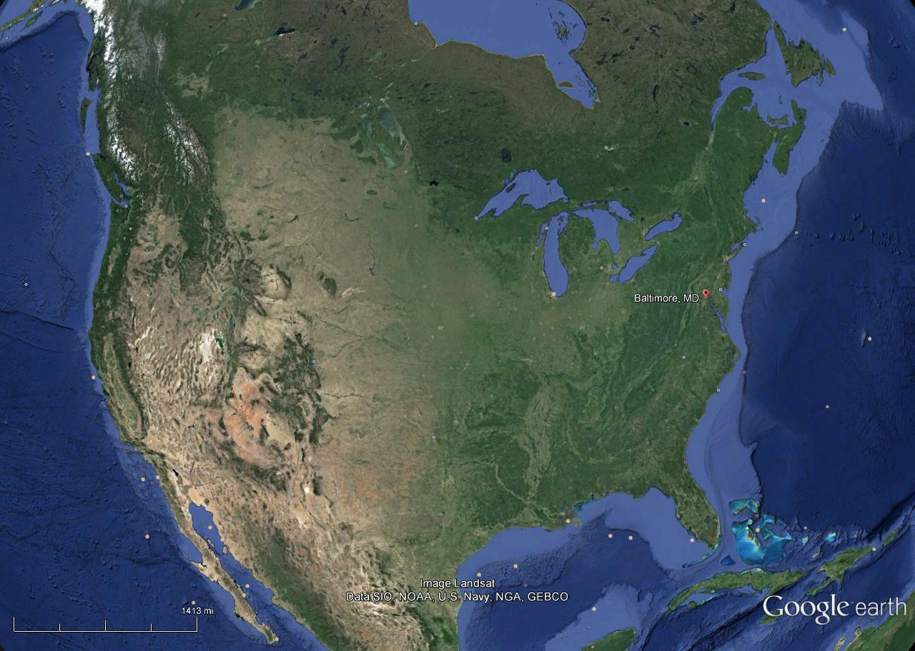
Study objectives
Analyze emissions in Ft.McHenry road tunnel (US I-95)
Establish source profiles
Determine fleet average emission factors (EFs)
Quantify evaporative emissions
Compare results with other tunnel studies
Evaluate performance of mobile source emission models

Slide 3
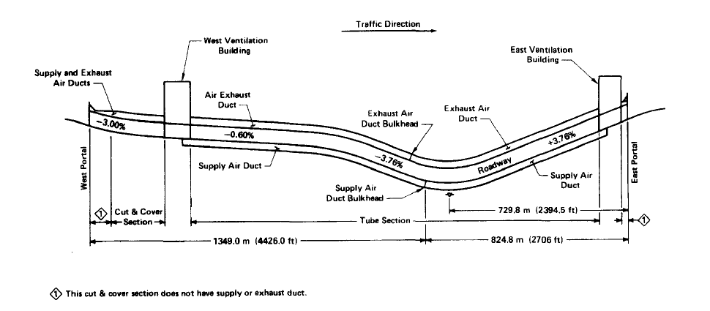
I-95 Fort McHenry Tunnel (FMT)
Four bores, two each direction, two lanes per bore
Light-duty (LD) vehicles are allowed in all bores
Heavy-duty (HD) directed into the right-hand bores
Speed limit is 55 mph
From Pierson et al., 1996

Slide 4
Sample collection and analysis
Season | Background (BG) | Bore 3 (LD) | Bore 4 (LD+HD)
Summer 2015 | 19 | 19 | 12
Winter 2015 | 16 | 14 | 16
Pollutant | Sampling method | Analysis method
CO, CO2, NO_{X} Ultra-fine particles | Continuous monitors
VOC (PAMS) | Canister | GC-MS/FID
Carbonyls | DNPH | HPLC-UV
PM_{2.5} for SVOC | TIGF/XAD | GC-MS
OC/EC | Quartz filter | TOR
Elements & ions | Teflon filter | XRF & IC

Slide 5
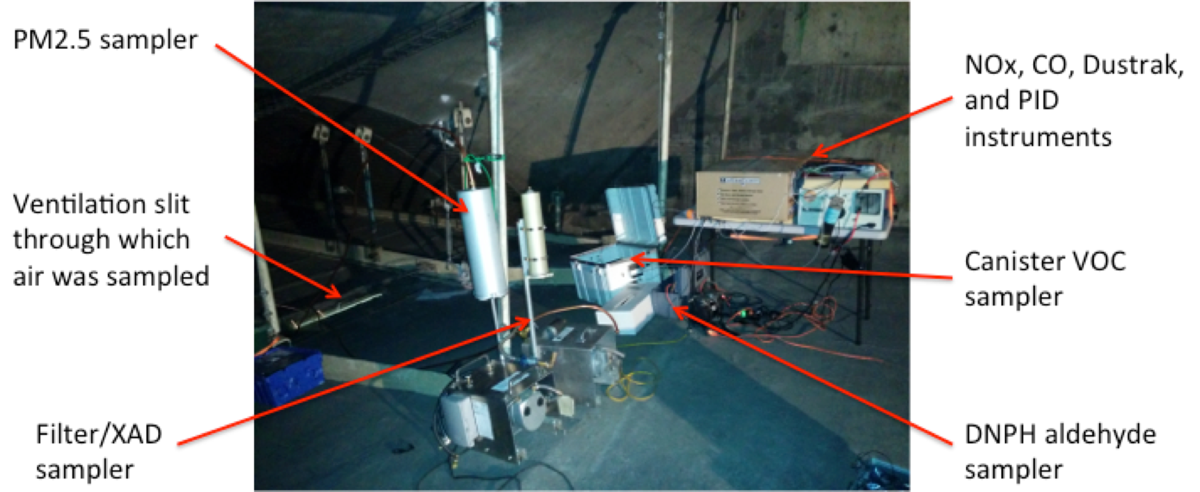

Slide 6
Miovision Scout traffic camera (FMT east portal)
 | Vehicle Category
Light Duty (LD) | Motorcycles
 | Cars
 | Light Goods Vehicles
Heavy Duty (HD) | Buses
 | Single Unit Trucks
 | Articulated Trucks

Slide 7
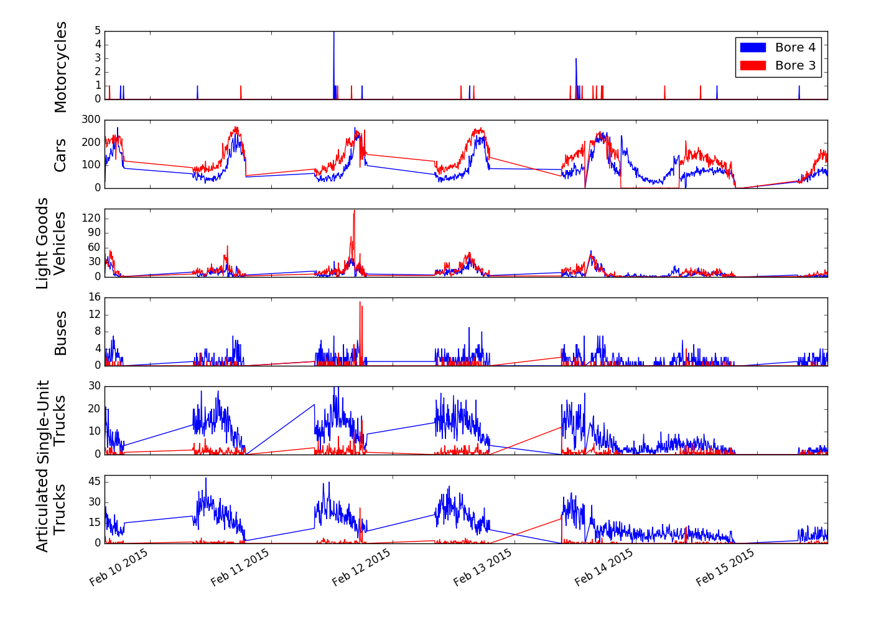
Traffic counts in winter

Slide 8
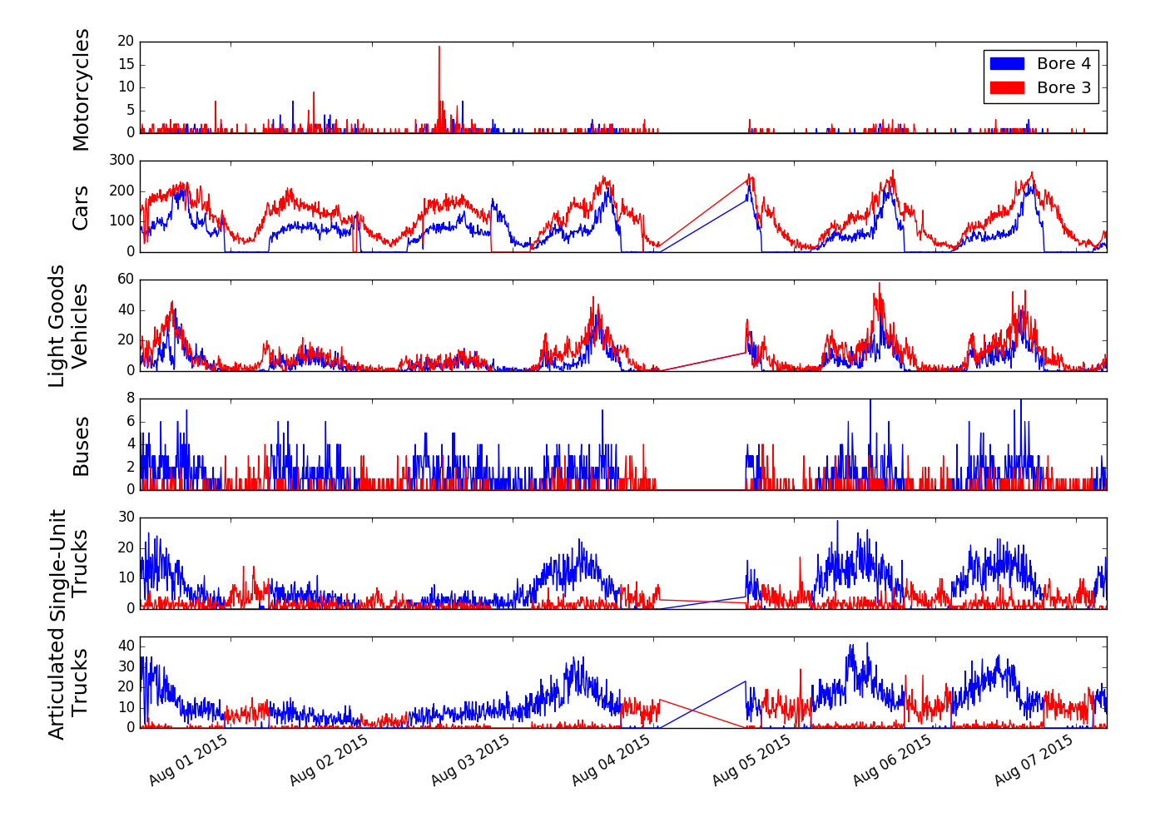
Traffic counts in summer

Slide 9
Derivation of emission factors

Slide 10
Comparison with previous FMT study
Year | EF_{C} (g/kg-C)
 | Heavy Duty |  |  | Light Duty
 | CO | NO_{x} | PM_{2.5} | CO | NO_{x} | PM_{2.5}
2015 Winter | 5.2 ± 2.4 | 34.0 ± 5.4 | 0.93 ± 1.0 | 10.0 ± 0.8 | 4.8 ± 1.7 | 0.26 ± 0.32
2015 Summer | 8.7 ± 3.0 | 20.6 ± 3.0 | 0.70 ± 0.12 | 9.7 ± 0.9 | 1.9 ± 0.5 | 0.03 ± 0.04
1992 Summer* | 7.7 ± 23.5 | 50.2 ± 7.2 | NA | 72.6 ± 6.6 | 14.7 ± 2.0 | NA

Slide 11
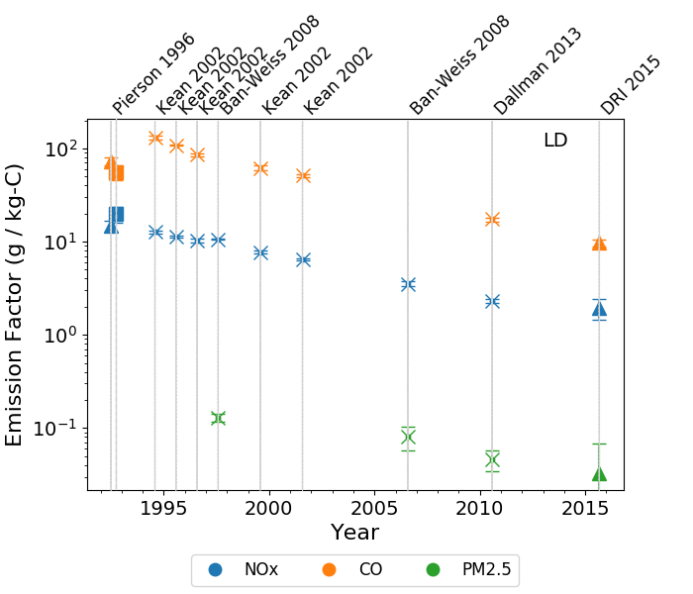
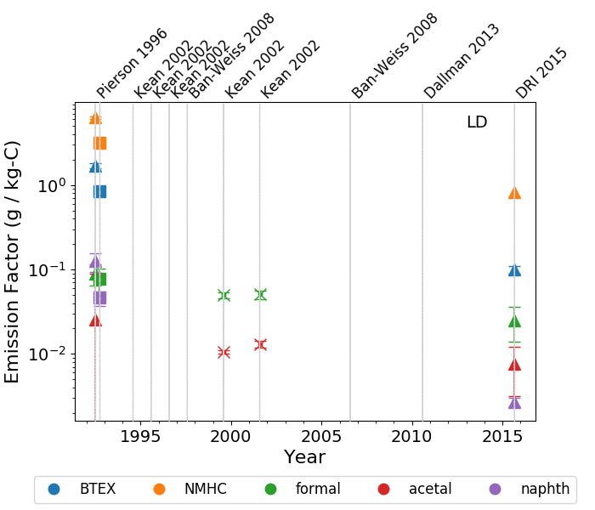
Comparison with previous studies (LD)

Slide 12
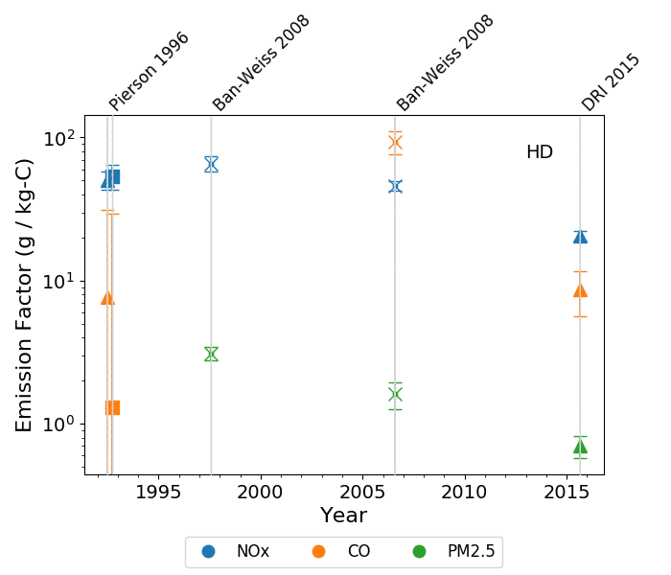
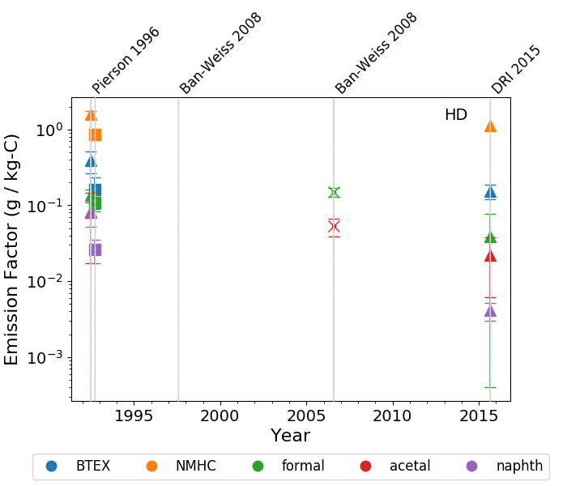
Comparison with previous studies (HD)

Slide 13
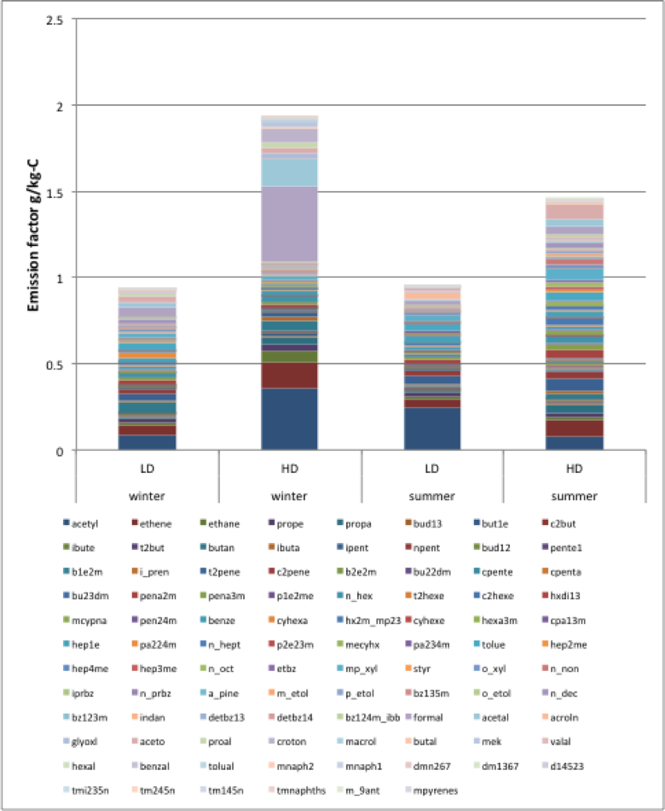
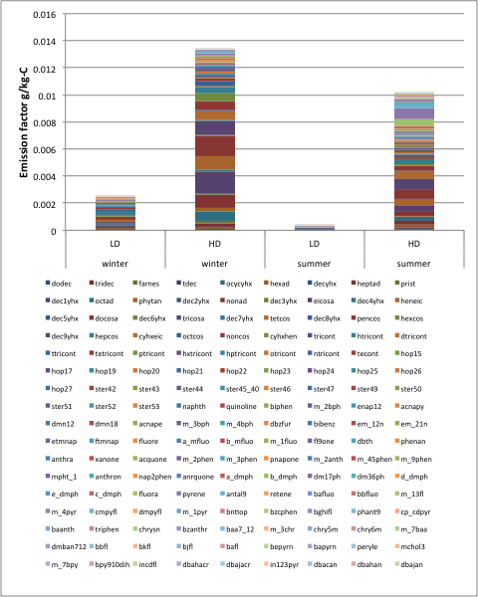
Speciated emission factors
Gases
Particles

Slide 14
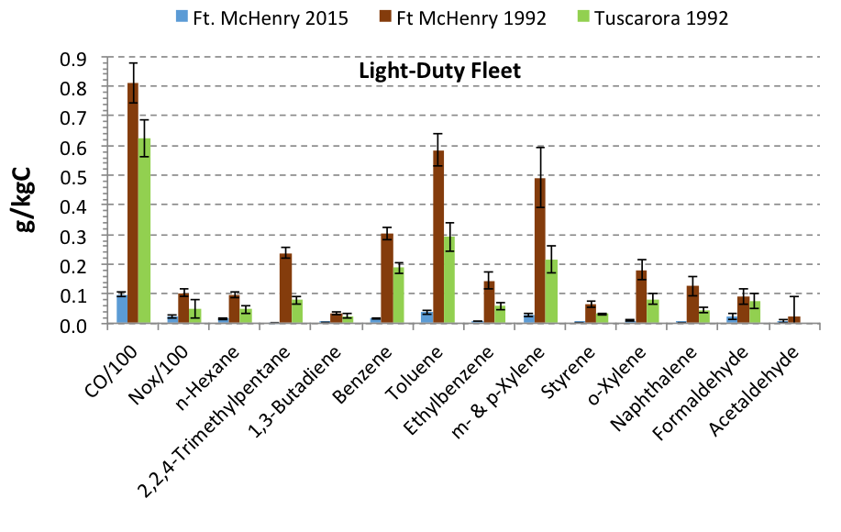
Mobile Source Air Toxics (MSAT)
A general reduction for most MSAT is observed relative to earlier studies.

Slide 15
MOtor Vehicle Emission Simulator (MOVES2014a)
EPA’s MOtor Vehicle Emission Simulator (MOVES) is a state-of-the-science emission modeling system that estimates emissions for mobile sources at the national, county, and project level for criteria air pollutants, greenhouse gases, and air toxics.
Approach for evaluation:
  MOVES was run in Project mode with ‘Zone and Link’ geographic bounds to allow us to specify actual driving and meteorological conditions (temperature and RH)
  Average driving profiles measured in the tunnel were used.
  MSAT emissions were estimated for three different fleet compositions – LD dominated (fraction LD >90%), high fraction of HD (HD fraction 30-40%), and mixed (10 - 15% HD), and compared to observations at the corresponding fleet compositions.

Slide 16
Driving profiles (speed and power)

Slide 17
Sensitivity of MOVES output to T and RH

Slide 18
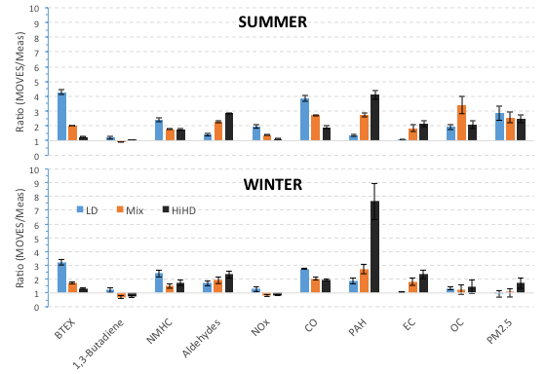
MOVES2014 vs. observations
MOVES generally overestimates emissions
“LD”: > 95% LD
“Mix”: 10 – 15% HD
“HiHD”: 30 – 45%HD

Slide 19
MOVES2014 vs. observations (PAHs)

Slide 20
Back to the measurements

Slide 21
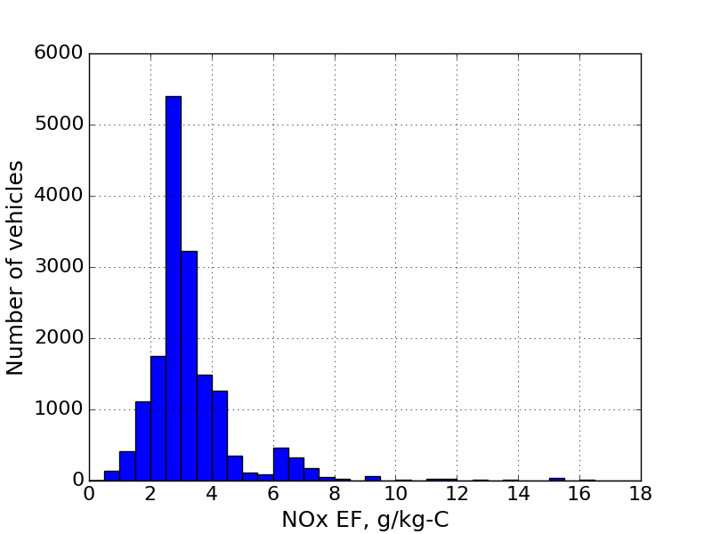
Light Duty NOx emission factors
(real-time data during LD-only periods)
Linear fit EF =1.9 ± 0.5 g/kg-C
EF =3.3 g/kg-C
EF =6.7 g/kg-C

Slide 22
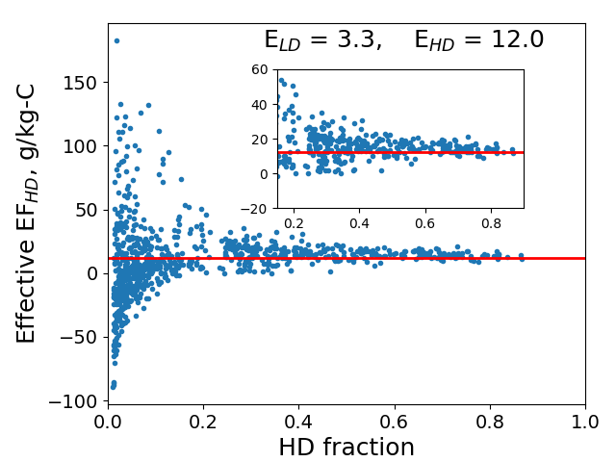
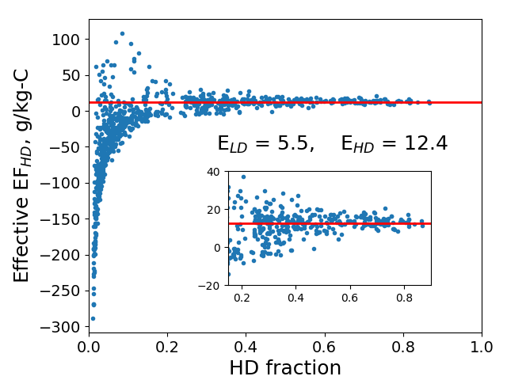
Bore 3, real-time data
EF_{HD,i} = [EF_{FA,i} – (1-f_{HD,i})×EF_{LD}] / f_{HD,i}
Scenario 1: EF_{LD} = 3.3 g/kg-C
Scenario 2: EF_{LD} = 5.5 g/kg-C

Slide 23
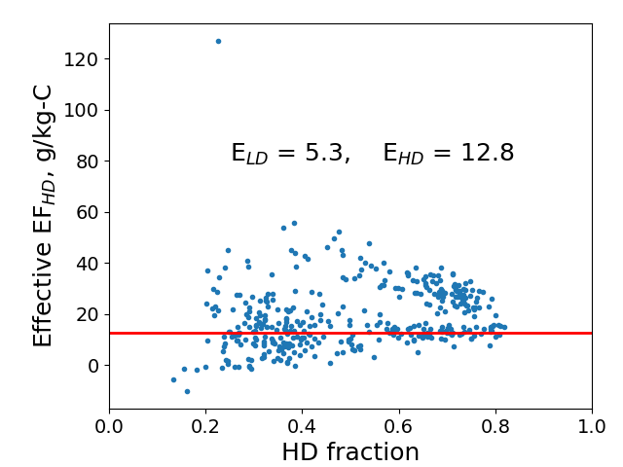
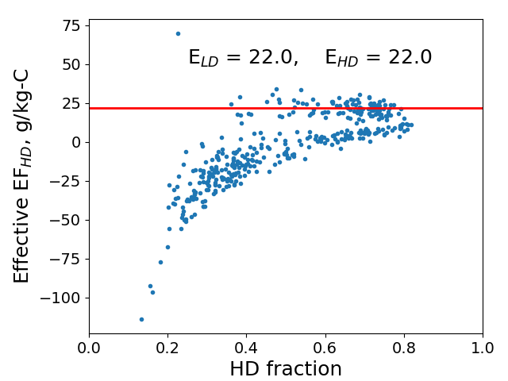
Bore 4, real-time data
EF_{HD,i} = [EF_{FA,i} – (1-f_{HD,i})×EF_{LD}] / f_{HD,i}
Scenario 1: EF_{LD} = 5.3 g/kg-C
Scenario 1: EF_{LD} = 22 g/kg-C

Slide 24
Summary
Fleet average EF_{c} were determined for criteria and non-criteria pollutants in winter and summer months at Ft. McHenry tunnel.
Compared to previous studies:
  Significant reductions in EFs for most pollutants.
  MSAT pollutants generally decreased.
MOVES2014a was compared to observations, generally overestimates pollutant emissions.
Assumptions underlying EF determination need to be carefully evaluated

Slide 25
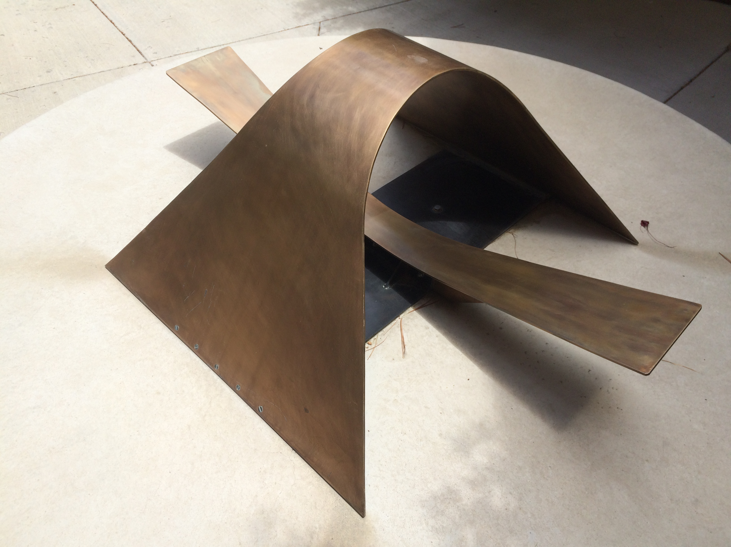
Acknowledgements
Health Effects Institute, grant 4947-RFPA14-1/15-1
Maryland Transportation Authority

