Slide 1
A Performance Evaluation of Lightning-NO Algorithms in CMAQ
Daiwen Kang¹, David Wong¹, Kristen Foley¹, George Pouliot¹, Wyat Appel¹, Shawn Roselle¹, and Pius Lee²
Computational Exposure Division, National Exposure Research Laboratory, U.S. Environmental Protection Agency, Research Triangle Park
Air Resources Laboratory (ARL), NOAA, College Park, MD
16th Annual CMAS Conference
Chapel Hill, North Carolina, USA
23-25 October, 2017

Slide 2
Lightning NO Production Schemes in CMAQ
An observation-based parameterization scheme (mNLDN):
  Use monthly mean NLDN (National Lightning Detection Network) data to constrain the lightning strikes over the domain
  Distribute the total lightning strikes to the local grid cells by relating NLDN strikes to grid-level Rain Convective (RC) values (CMAQ5.1 and earlier,)
A log-linear regression parameterization scheme (pNLDN) based on multiyear NLDN data and met model predicted convective rainfall using Kain-Fritsch (KF) convective scheme (CMAQ5.2).
A lightning NO scheme (hNLDN) directly based on hourly NLDN data (gridded lightning strikes) (CMAQ5.2).

Slide 3
Model configuration and simulations
Met Inputs: WFR 3.8 with lightning assimilation (Heath et al., 2016)
CTM: CMAQ5.2beta
Model Domain: 12 km contiguous US with 35 vertical layers
Emissions: 2011 NEI (National Emissions Inventory), NH₃ bidi, inline biogenic emissions
Simulation Period: April – September, 2011, with 10-day spin-up
Model cases: Base (No lighting NO production), mNLDN (monthly NLDN based scheme), pNLDN (linear (log-linear) regression based scheme), and hNLDN (hourly NLDN based scheme).
Observations: AQS (Air Quality System) and NADP (National Atmospheric Deposition Program) /NTN (National Trend Network)

Slide 4
Sum of Monthly and Daily Domain Column LTNG NO Produced by the CMAQ schemes
hNLDN
mNLDN
pNLDN
July, 2011
2011
hNLDN
mNLDN
pNLDN
Due to the fact that the RC field was unevenly overestimated by the met model, the monthly NLDN based algorithm produced more LTNG NO than the hourly NLDN based algorithm during summer, while the linear regression algorithm produced least LTNG NO for summer 2011.

Slide 5
Focal Points for this Presentation
Focus on July when the lightning events are most active.
Look at the model performance across entire domain as well as regions as shown on the map.
Identified two regions SE and RM: O₃ mixing ratios are mostly over predicted in SE, while mostly under predicted in RM.

Slide 6
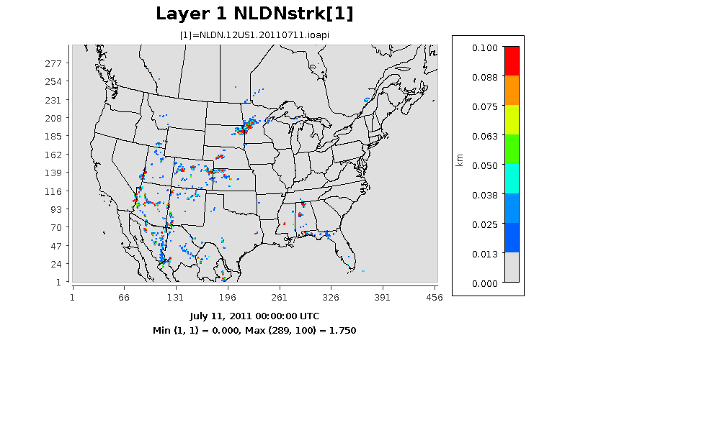
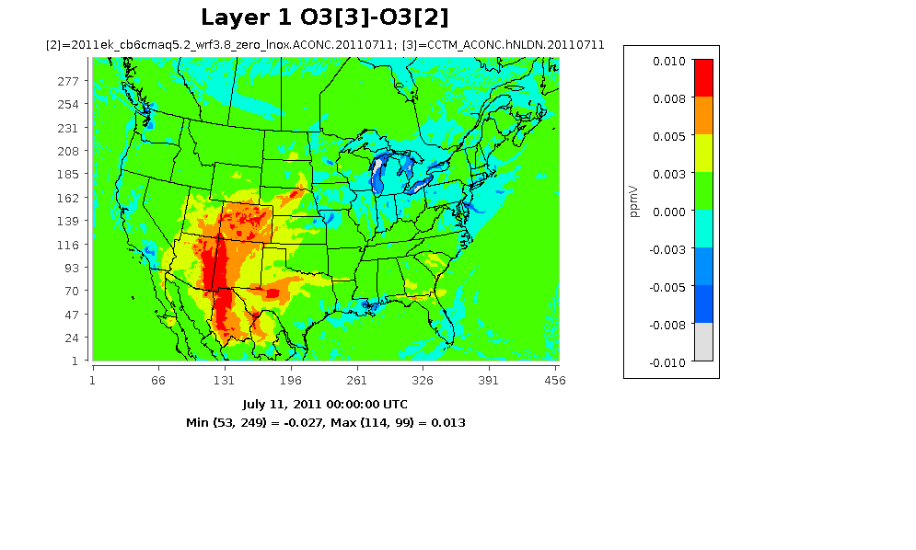
Animation of lightning strikes and surface O₃ difference
Hourly NLDN Strikes
Layer 1 O₃ (hNLDN – BASE)

Slide 7
Time series of Daily Maximum
8-hr (DM8HR) O₃
SE
Domain
RM
2011

Slide 8
Time Series of Daily Mean NO_{X}
SE (30)
Domain (341)
RM (68)
For surface NO_{X} mixing ratios, all the model cases are basically on top of each other; the numbers in the parentheses are the number of AQS sites

Slide 9
Diurnal Profiles of O₃ and NO_{X} (July, 2011)
O₃
Domain
SE
RM
Domain
SE
RM
NO_{X}

Slide 10
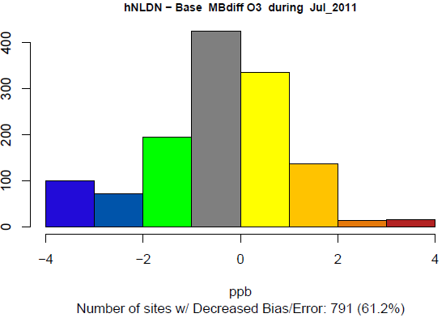
O₃ bias difference between hNLDN and Base
The bias differences show a strong regional pattern: bias increases mainly in southeast and decrease in the Rocky Mountains. Overall the MB decreases 61.2% of the AQS sites (shown in cool colors).

Slide 11
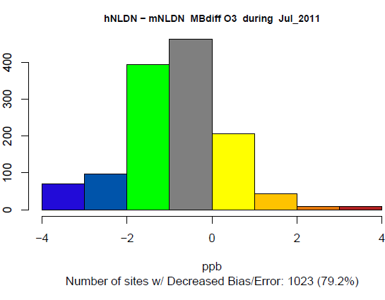
O₃ bias difference between hNLDN and mNLDN
Compare the hNLDN case with mNLDN case, the majority of the sites indicate bias decrease (79.2%).

Slide 12
O₃ bias difference between hNLDN and pNLDN, and pNLDN and mNLDN
hNLDN - pNLDN
pNLDN - mNLDN

Slide 13
Basic Statistics for DM8HR O₃ with Lightning Activities over Domain
13
12
11
10
7
6
5
4
3
2
.85
.80
.75
.70
RMSE (ppb)
Base
hNLDN
mNLDN
pNLDN
MB (ppb)
Base
hNLDN
mNLDN
pNLDN
R
Base
hNLDN
mNLDN
pNLDN
The stats are calculated by applying a filter which is the percentile of lightning strike distributions over the domain: 1. the percentiles (10 to 90) are calculated over the lightning strikes at all the sites within the domain for the month; 2. the stats are calculated only for those sites where the lightning strikes are equal or greater than the specific percentile: for instance, P60 is corresponding to all the sites where the lightning strikes >= 60% value of the lightning strike distribution.
All the statistics indicate that the model case hNLDN performed better than all other cases.

Slide 14
Basic Statistics for DM8HR O₃ with Lightning Activities over Southeast
13
12
11
10
9
8
7
6
5
4
3
.80
.75
.70
R
RMSE (ppb)
Base
hNLDN
mNLDN
pNLDN
MB (ppb)
Base
hNLDN
mNLDN
pNLDN
Base
hNLDN
mNLDN
pNLDN
In the Southeast, all the model cases with lightning NO performed worse than the Base case except that hNLDN shows better correlation when applying a lower lightning strike filter, but among all the cases with lightning NO, hNLDN always performs the best.

Slide 15
Basic Statistics for DM8HR O₃ with Lightning Activities over Rocky Mountains
10
9
8
7
-2
-3
-4
-5
-6
.75
.70
.65
.60
R
RMSE
Base
hNLDN
mNLDN
pNLDN
MB
Base
hNLDN
mNLDN
pNLDN
In the Rocky Mountains, all the model cases with lightning NO performed significantly better than the Base case.

Slide 16
NADP/NTN Summer Total Wet Deposition of NO₃
For summer total wet deposition of NO3, CMAQv5.2 performs much better than CMAQv5.02 (mNLDN lightning NO; the increase of R² from CMAQv5.0.2 to CAMAv5.2 is attributable to lightning assimilation)
The hNLDN and mNLDN algorithms have comparable performance, both are slightly better than the pNLDN algorithm.
All simulations with lightning NO perform better than that without
CMAQv5.02
BASE
pNLDN
mNLDN
hNLDN

Slide 17
NADP/NTN Summer Total Wet Deposition of NO₃
All the CMAQv5.0.2 simulations used the monthly-based NLDN (mNLDN).
Even though the bias is similar between CMAQv5.02 and CMAQv5.2 mNLDN case, the R² increased from 0.54 to 0.71 (previous slide).
Again, all the simulations with lightning NO performed better than the Base case.

Slide 18
Summary
The impact of lightning NO on surface O₃ mixing ratios varies with region and depends on the base model configuration, but at majority of the sites, the model performed better when the hourly-NLDN based algorithm is implemented than the base model.
The impact of lightning NO on surface NO_{X} mixing ratios is minor.
The hourly-NLDN based algorithm outperforms all other algorithms from all aspects for surface O₃, especially in regions where the base model is relatively better configured.
For deposition of NO₃, all model cases with lightning NO performed significantly better than the base case, while the hourly-NLDN and monthly-NLDN based algorithms performed equally well.

