Slide 1
Technical discussions on Emissions and Atmospheric Modeling (TEAM)
Gregory Frost – NOAA Earth System Research Laboratory
Barron Henderson, Rich Scheffe, Heather Simon – EPA Office of Air Quality Planning and Standards
Sherri Hunt, Terry Keating – EPA Office of Research and Development
Barry Lefer – NASA Earth Science Division

Slide 2
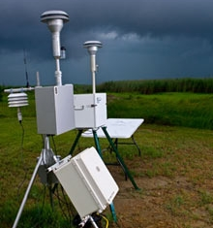
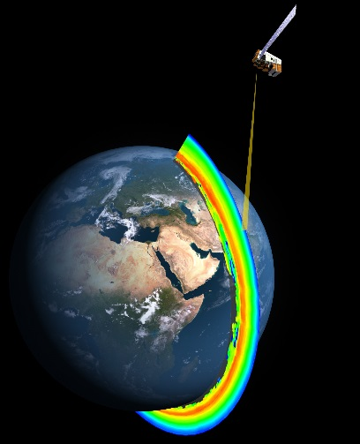
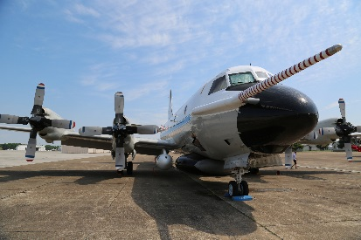
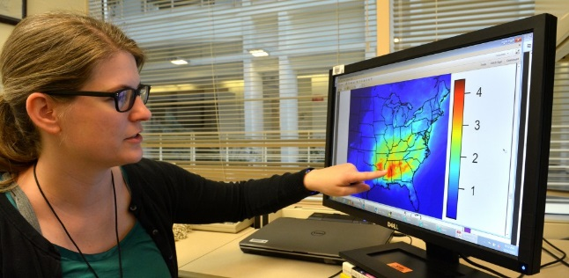
TEAM Motivation
EPA
Multiple federal agencies develop, collect and analyze complementary data relevant to atmospheric composition
Ambient ground measurements
Aircraft-based observations
Satellite-based retrievals
Weather models
Emission inventories
Air quality models
NASA
Ambient observations, atmospheric models, and emission inventories are fundamental tools for science and for federal and state actions
Field measurement campaigns and analysis of satellite observations highlight need to reconcile emission inventories with observed atmospheric concentrations
Each agency approaches reconciliation differently!
NOAA
EPA

Slide 3
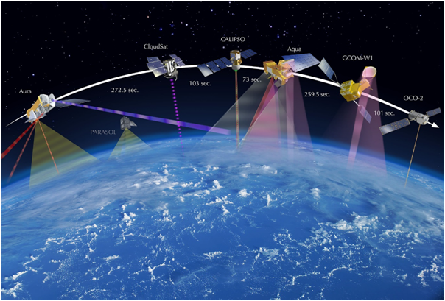
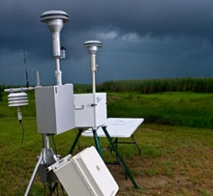
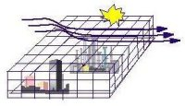
TEAM: Strengthening Inter-agency Collaboration and Knowledge by Sharing Data and Analytics
NASA
NOAA
EPA
Meteorology
Emissions

Slide 4
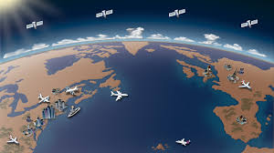
TEAM Purpose
Benefit state and federal environmental management
Better characterize present and future air quality
TEAM Objectives
Facilitate informal scientist-to-scientist interactions
Leverage resources through coordination, communication and collaboration
Improve scientific understanding of emissions and atmospheric processes
Close gaps limiting inventory development and atmospheric modeling
Increase understanding of uncertainties
Add value to existing efforts

Slide 5
TEAM Participants
Small steering committee composed of technical experts in atmospheric observations, modeling, and inventories
Currently includes EPA, NASA, and NOAA staff
Participants are active in atmospheric research, air quality modeling, emission inventory development, and environmental assessment
Participants will likely vary over time depending on the topic area
Technical staff at AQRS agencies with specific interests in emissions and atmospheric modeling are welcome to participate in TEAM

Slide 6
TEAM Design
Facilitate active and sustained communication through webinars and in-person meetings on emissions topics
Series of 3-4 webinars on a given topic will last several months
Webinar 1: Introduce topic, challenges, and concerns
Webinar 2: Discuss issues & connections
Webinar 3: Discuss issues & connections
Webinar 4: Agree on solutions & path forward
Complement webinars with face-to-face meetings of convenience
Interactions remain flexible, responding to needs of group
Inspire further expert-to-expert communications

Slide 7
TEAM Connections
TEAM fills a unique role not currently addressed by other interagency venues.
TEAM proposed topics and depth of inquiry are generally outside the scope of higher-level coordination efforts.
TEAM is an informal group interacting with more formal coordination vehicles:
Air Quality Research Subcommittee
NASA-EPA Memorandum of Agreement
NASA Health & Air Quality Applied Sciences Team
Multi-agency field missions
Related national/international collaborations

Slide 8
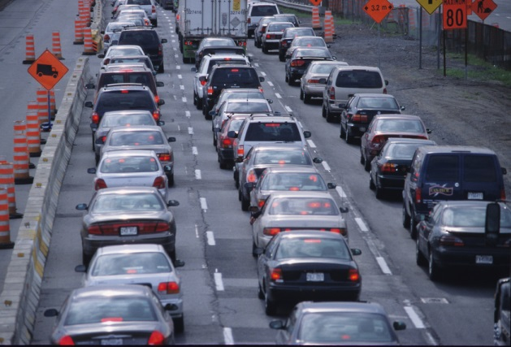
First TEAM Webinar Series: Reconciling NOx Emission Inventories with Ambient Observations
Carry out substantive discussions aimed at improving scientific understanding of NOx emissions
Build on work of EPA’s NOx Coordination Group
Webinars: April 17, May 15, August 8, and at least one more in next couple of months
Almost half of today’s platform presenters (Frost*, Henderson, McDonald, Sonntag) and 6/7 poster presenters are involved in TEAM webinars

Slide 9
Topics discussed in 1st TEAM Webinar Series: Reconciling NOx Emission Inventories with Ambient Observations
EPA process for developing the EPA emission platform
Development and evaluation of MOVES
EPA efforts to evaluate modeled NOy budgets with ambient observations
Using aircraft in-situ and remote-sensing data from research field missions to constrain NOx emissions
Using satellite data to constrain NOx emissions and extend inventories to near-real-time
Developing a US transportation inventory using a fuel-based approach combined with atmospheric EF observations
Impact of different NOx emissions approaches on modeled O₃

Slide 10
TEAM-related in-person meetings
EPA International Emissions Inventory Conference
This science session
Informal lunch discussion (yesterday)
Community Modeling and Analysis System Conference
October 23-25, 2017
Chapel Hill, North Carolina
Special Session: Improving the Characterization of the Ambient NOy Budget
https://www.cmascenter.org/conference.cfm
American Geophysical Union Fall Meeting
December 11-15, 2017
New Orleans
Session: Leveraging Inventories, Observations and Models to Improve the Scientific Basis of Emissions
https://fallmeeting.agu.org/2017/

Slide 11
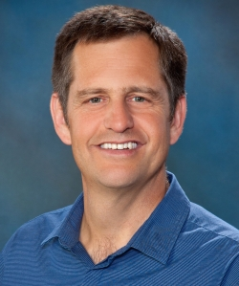
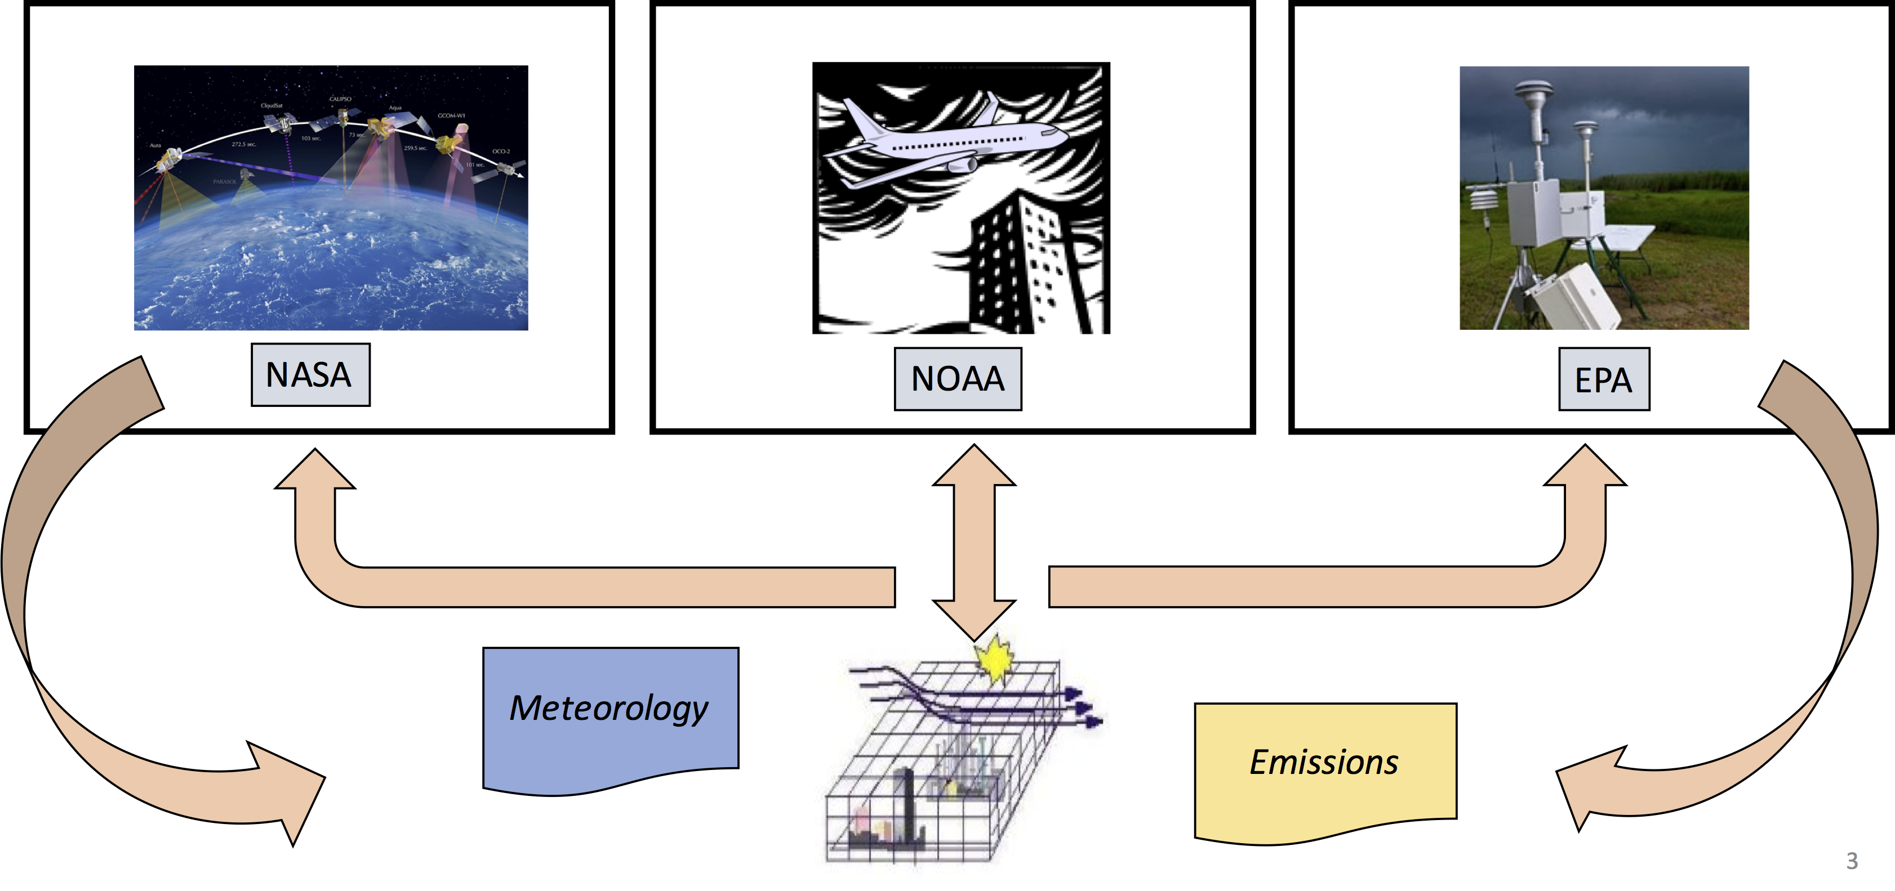
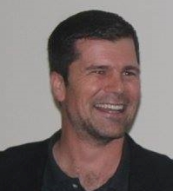
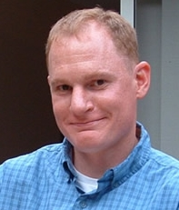
Questions?
Greg - NOAA
Barron - EPA
TEAM Points of Contact
Gregory Frost – NOAA, gregory.j.frost@noaa.gov
Barron Henderson – EPA, henderson.barron@epa.gov
Barry Lefer – NASA, barry.lefer@nasa.gov
Barry - NASA

