Slide 1
Assessing the impact of grid resolution on air quality model results and associated marginal benefit estimations
Melanie Fillingham, Burak Oztaner, Shunliu Zhao, Amir Hakami (Carleton University)
Wayne Boulton, Greg Conley, Martin Gauthier, Jeff Lundgren, Julia Veerman, Carol McClellan (RWDI)
Louise Aubin, Eric Tran, Kim McAdam (Regional Municipality of Peel Public Health Department)
Amanda Pappin (Health Canada); Matt Turner and Daven Henze (UC Boulder); Shannon Capps (Drexel); Peter Percell (Houston); Jaroslav Resler (ICS Prague); Jesse Bash, Kathleen Fahey, Sergey Napelenok, Rob Pinder (EPA); Ted Russell and Athanasios Nenes (Georgia Tech); Jaemeen Baek, Greg Carmichael, and Charlie Stanier (Iowa); Adrian Sandu (Virginia Tech); Tianfeng Chai (Maryland)

Slide 2
Outline
Background
Analysis 1: Alternating the resolution of CMAQ-adj inputs between coarse and fine
Analysis 2: Progressively Refined Resolution Runs
Future Work

Slide 3
Background

Slide 4
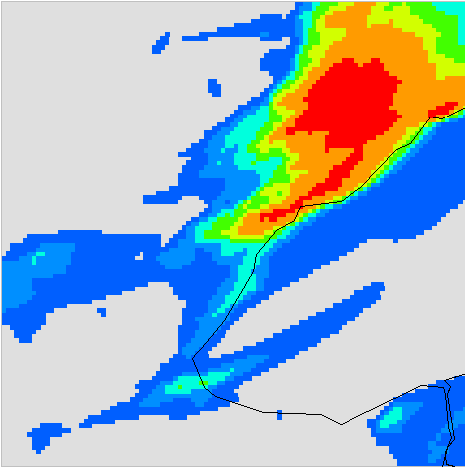
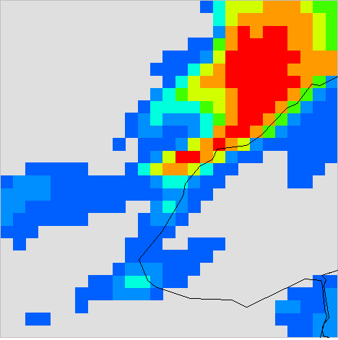
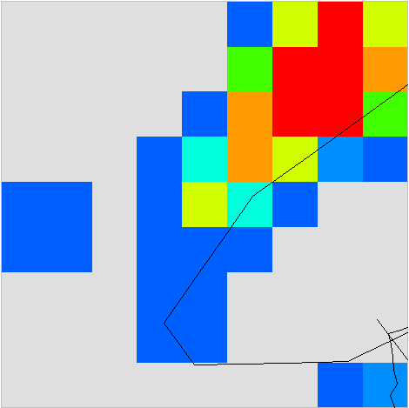
Coarse vs. Fine Resolution Modeling
Coarse resolution modeling →poor spatial representation
Dilution in concentrations due to averaging over the grid
Peaks are weakened (locations of highs or lows)
Bias in predicted concentrations → underestimation in urban areas, overestimation in rural
Figure shows a snapshot of NO₂ concentration results from 1 km, 4 km, 12 km, and 36 km resolutions on Feb 8th, 2012, at 7 pm

Slide 5
Sensitivity Modeling Of Air Quality Models
Shows change in model output with respect to a change in model input
chemistry, meteorology
Emissions
Input/Sources
Concentrations
Output/Receptor

Slide 6
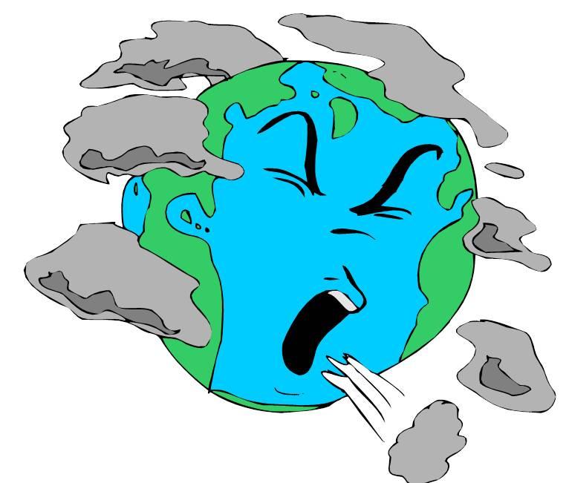
Health Impacts Pollution Exposure
Epidemiology: Air Quality Benefits Assessment Tool (AQBAT)
Changes in Air Pollution Concentrations (i.e. Ozone)
V_{SL}
Changes in Monetary Health Impacts
Changes in Exposure
Changes in Health Impacts

Slide 7
Sensitivity & Fine Grid Benefits
Can help determine contribution of specific emission sources on the defined receptor, helping to optimize pollution control strategies
$$\frac{∂ Health Benefits}{∂ Emission}$$
Outputs/Receptor
(Health Benefits)
Input/Sources
(Emissions)

Slide 8
Input Resolution Impacts
Meteorology
Concentration & Health Estimate Results
Inaccuracies due to averaging and dilutions
CMAQ-adj
Emissions
Inaccuracies due to averaging and dilutions
Population

Slide 9
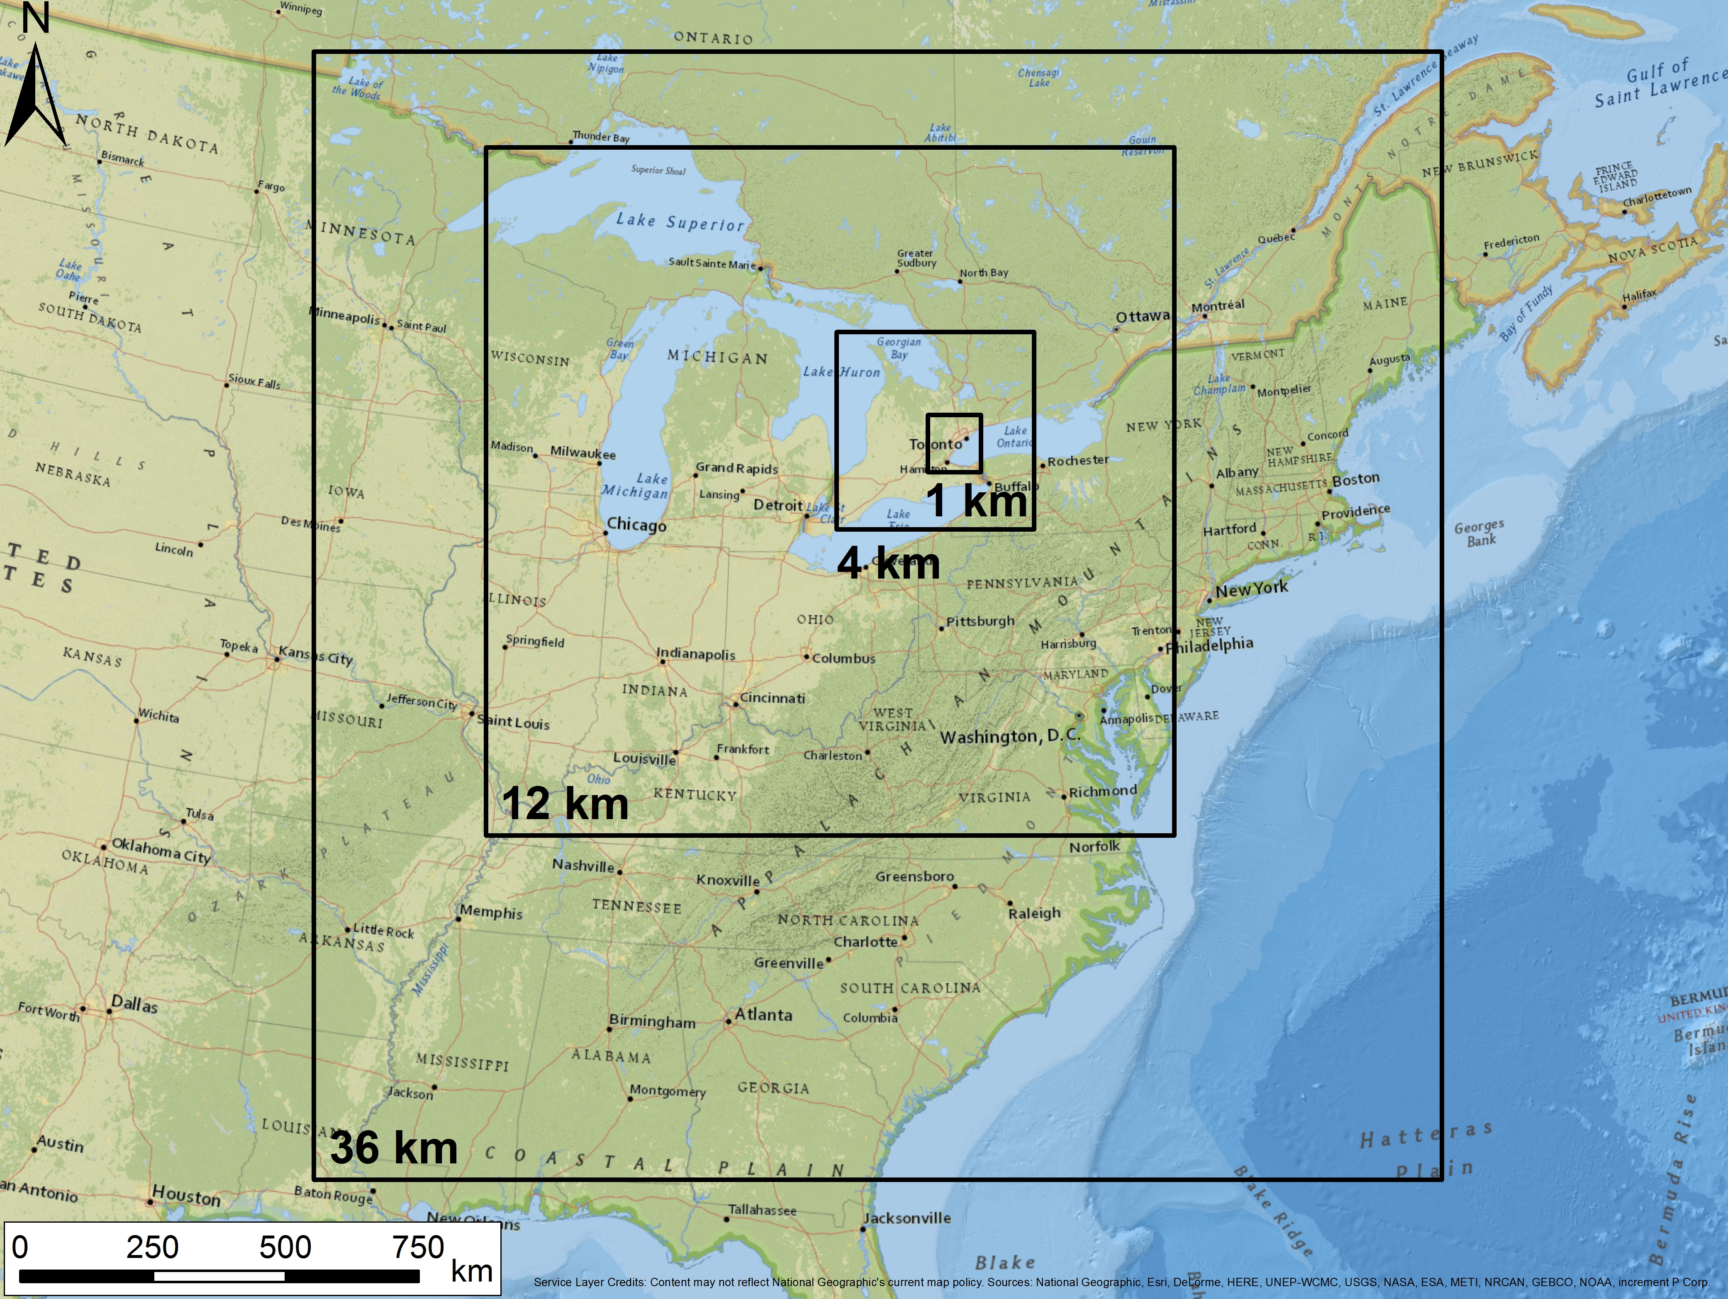
Methods
Model: Community-Multi-Scale Air Quality (CMAQv5.0-adj)
Resolution: Progressively refined (36, 12, 4 and 1 km)
Meteorological model: WRF run for each resolution / domain
Emission inputs: Fine resolution emission data developed for each domain, developed by RWDI
Period: First weeks of February and July, 2012
Sensitivity of: Monetized long-term Ozone and NO₂ Mortality Sensitivity to: NOx Emissions

Slide 10
Analysis 1: Alternating the resolution of CMAQ-adj inputs between coarse and fine

Slide 11
Objective
To analyze the extent of the impact resolution has on each CMAQ and CMAQ-adj input parameter (meteorology, emissions, population and the CTM itself) by running combinations of fine and coarse resolution inputs (i.e. 1 km CTM, Met, Pop, but 4 km Emis)

Slide 12
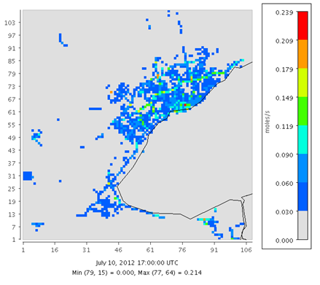
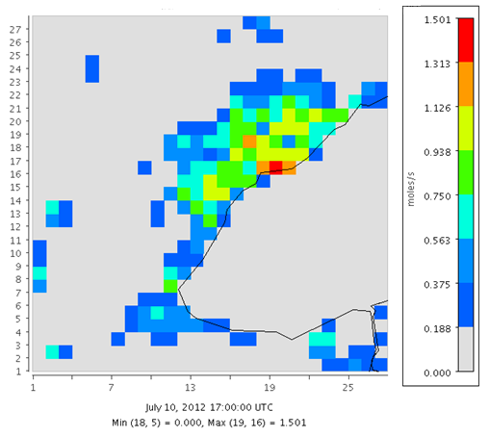
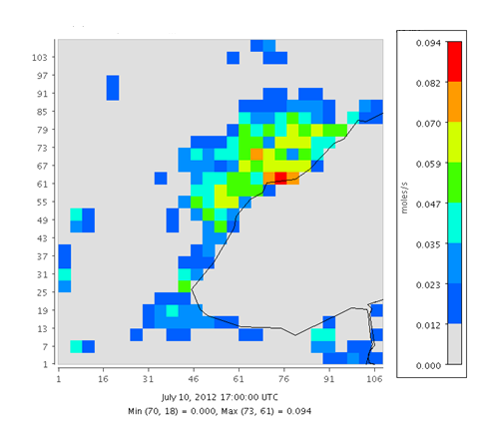
Methods: Re-gridding Fine → Coarse → Fine
Fine Gridded Input Data
Meteorology
Emissions
Population
Aggregate or Average
Re-gridded Coarse
Re-gridded Back Down to Fine to Use as Input
Example: 1 km emission data, re-gridded up to 4 km (aggregated) and back down to 1 km (dis-aggregated)

Slide 13
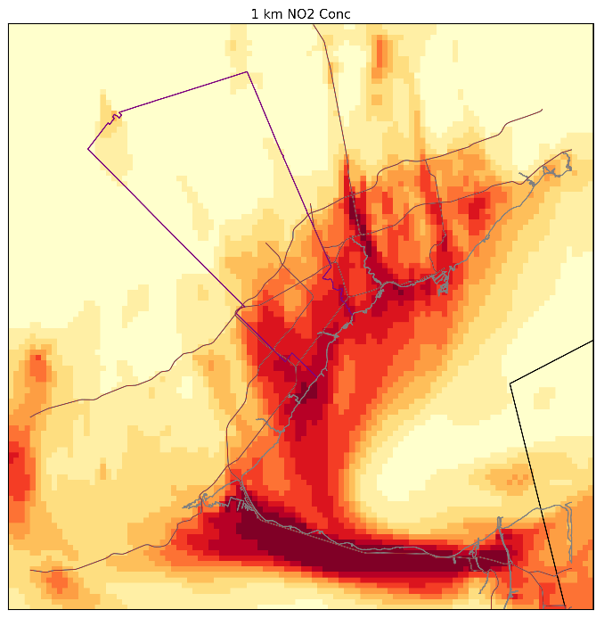
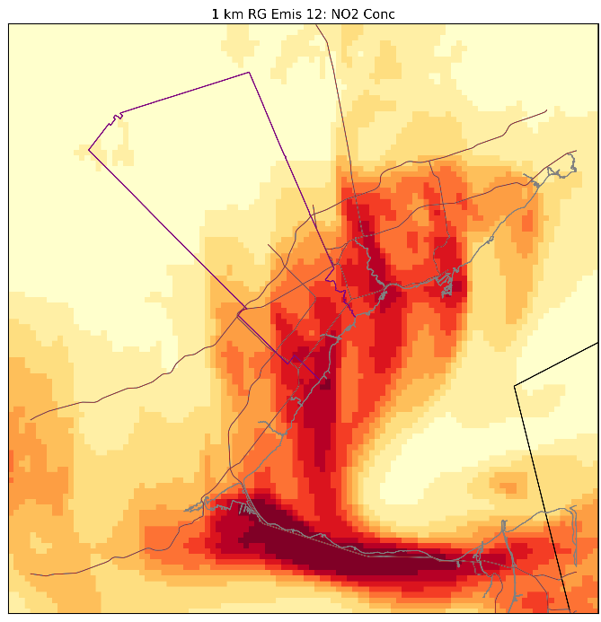
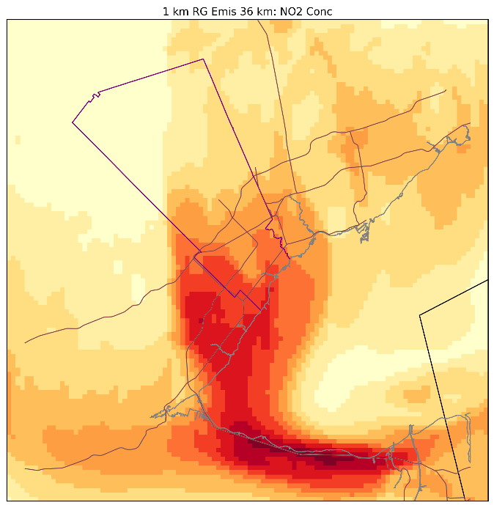
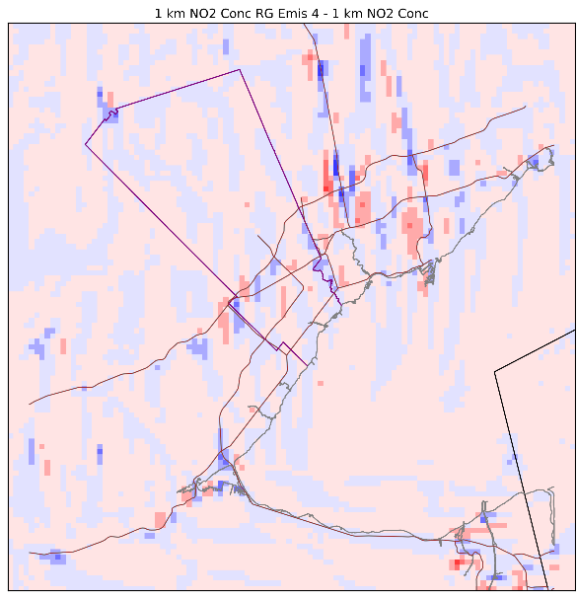
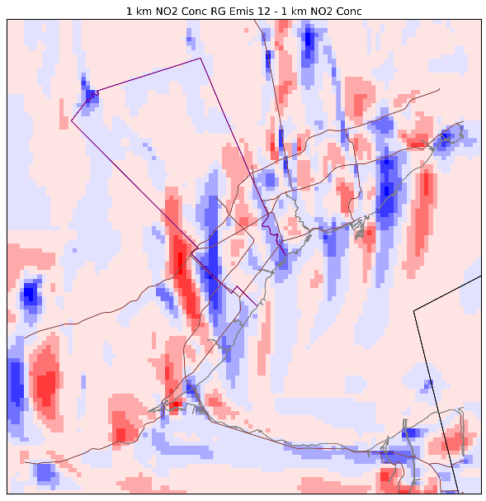
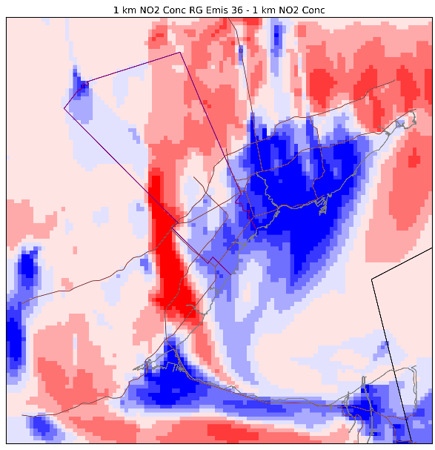
Results: Forward NO₂ Conc, 1 km Emissions Re-gridded Up
All fine 1 km
Emissions 4 km
Emissions 12 km
Emissions 36 km
Difference:
(Re-grid Results – All Fine)

Slide 14
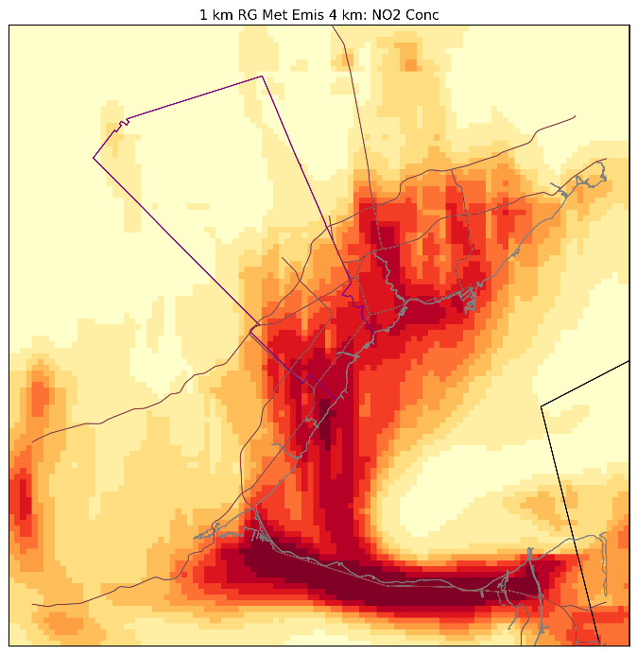
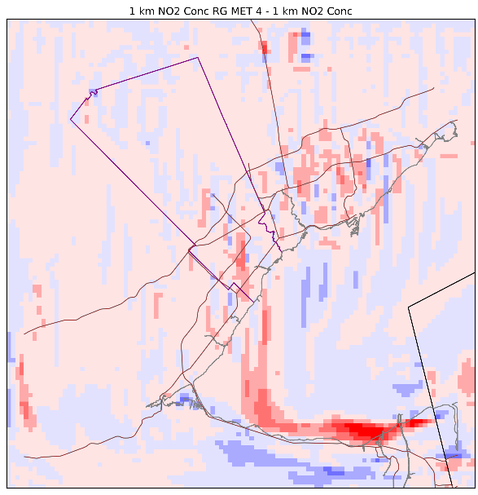
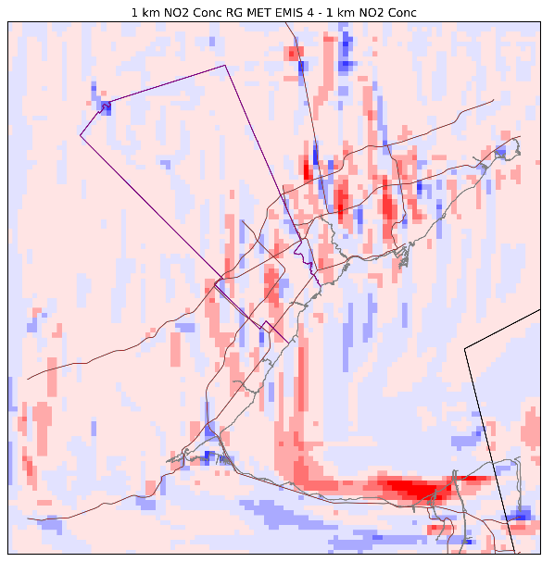
Results: Forward NO₂ Conc, 1 km Regridding Met & Emissions
All fine 1 km
Emissions 4 km
Meteorology 4 km
Emissions & Met 4 km
Difference:
(Re-grid Results – All Fine)

Slide 15
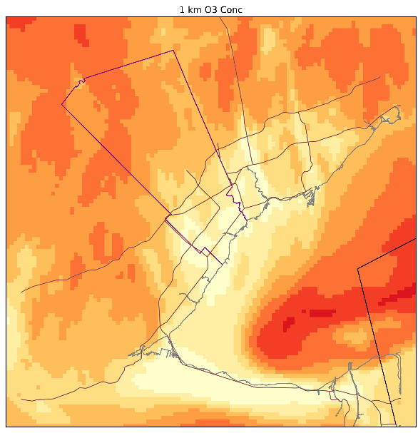
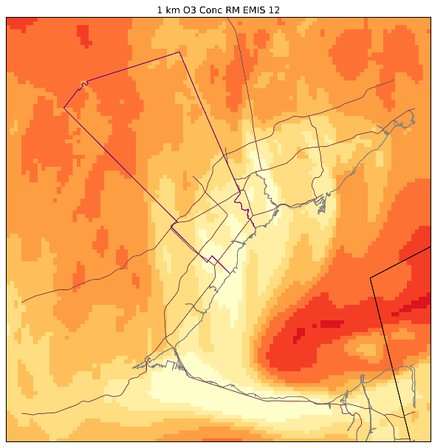
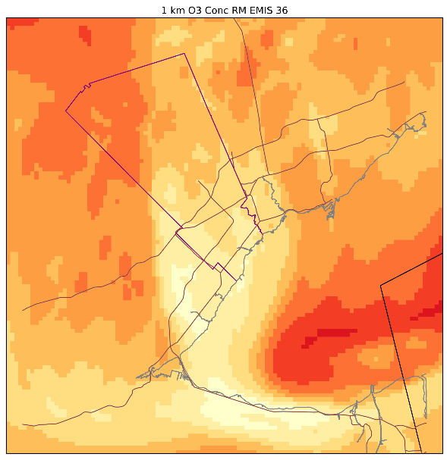
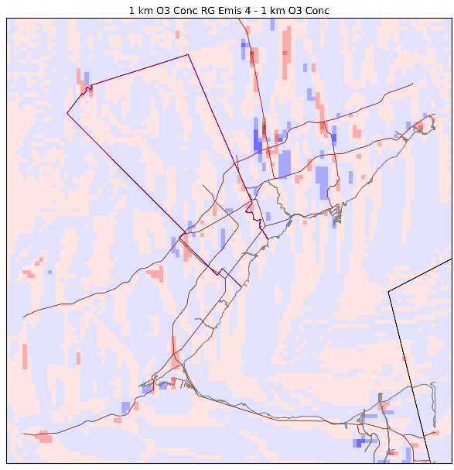
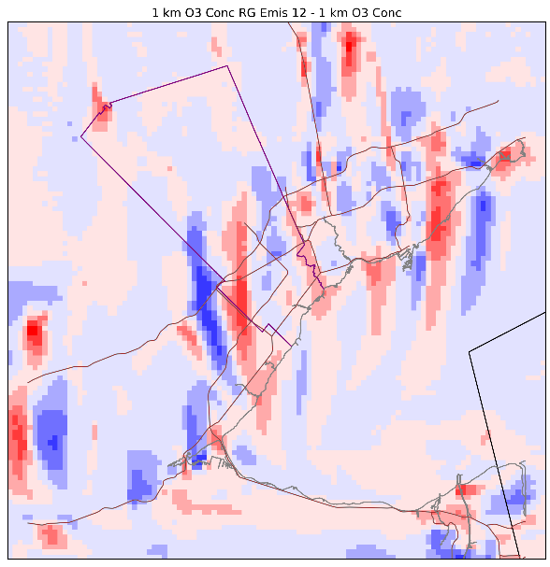
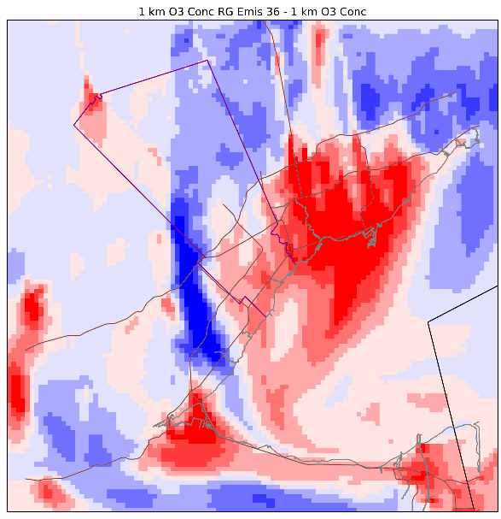
Results: Forward O₃ Conc, 1 km Emissions Re-gridded Up
All fine 1 km
Emissions 4 km
Emissions 12 km
Emissions 36 km
Difference:
(Re-grid Results – All Fine)

Slide 16
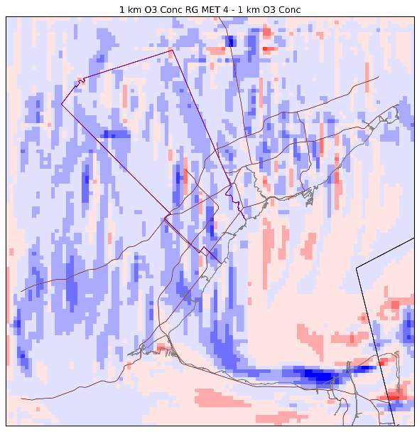
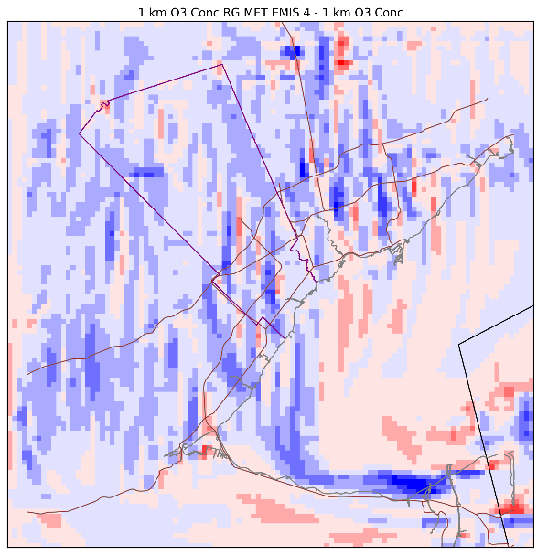
Results: Forward O₃ Conc, 1 km Regridding Met & Emissions
All fine 1 km
Emissions 4 km
Meteorology 4 km
Emissions & Met 4 km
Difference:
(Re-grid Results – All Fine)

Slide 17
Conclusions Analysis 1
The resolution of meteorology inputs influence CTM conc. results greater than emissions
As expected, the coarser the input, the greater the discrepancy in results
4 km emissions do not seem to have a significant impact on results
When 36 km emissions were used, NO₂ was underestimated in the downtown core, while O₃ was overestimated.
Higher resolution meteorological modelling, even in absence of higher resolution inventory, seems to be beneficial.

Slide 18
Analysis 2: Marginal Benefits over Progressively Refined Resolutions

Slide 19
Objective
To analyze the extent of the impact resolution has on marginal damage results.

Slide 20
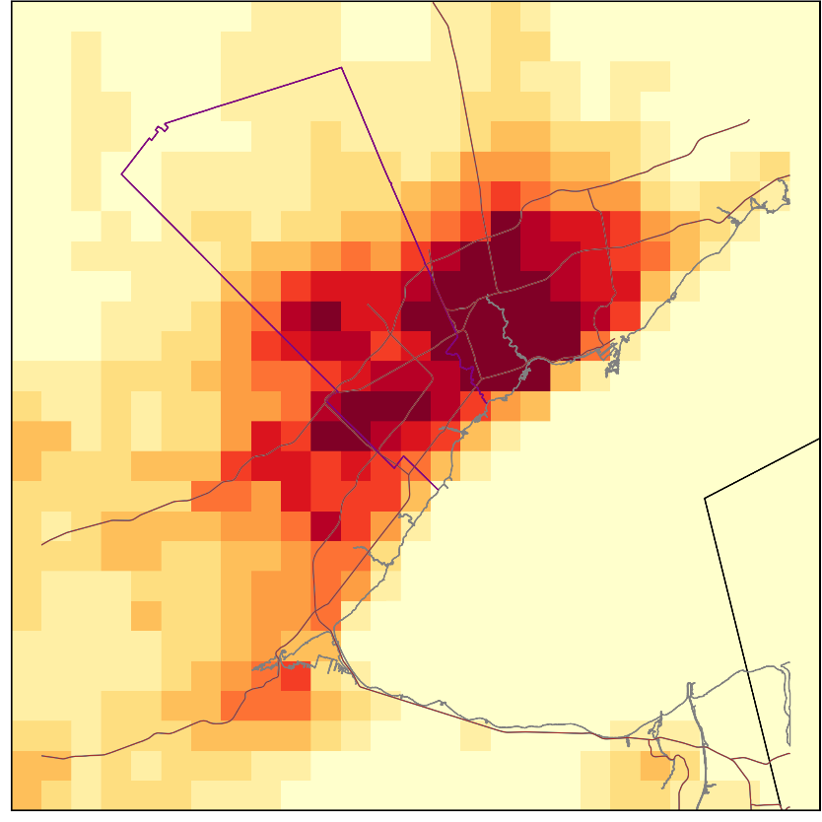
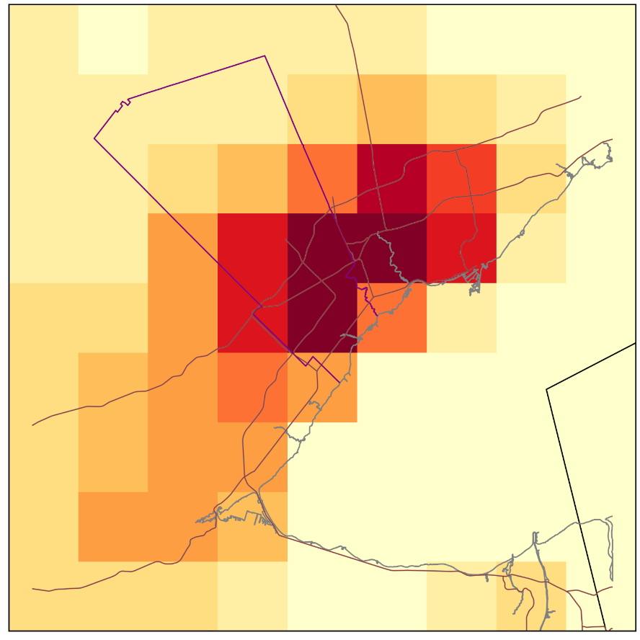
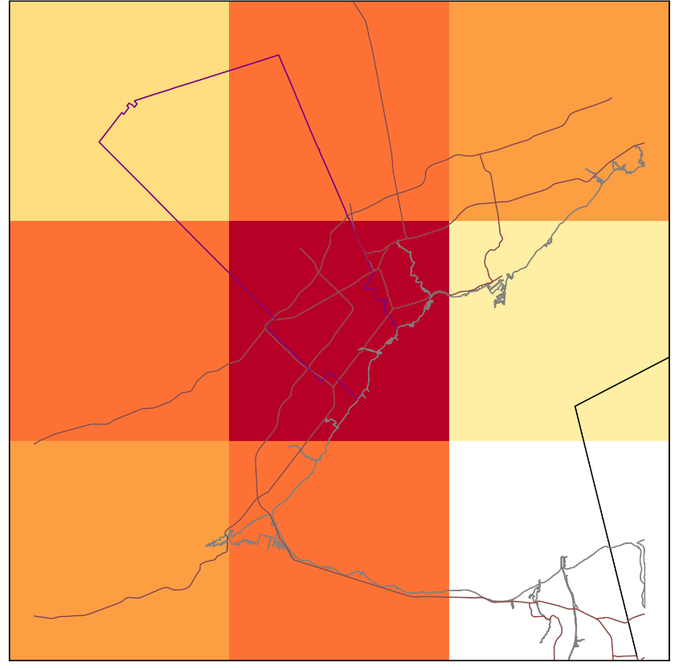
Comparison of Marginal Damage (NO₂ + O₃ Combined, Feb 2012)
4 km
12 km
36 km
Maximum: $266 600 / tonne NOx
Maximum: $218 000 / tonne NOx
Maximum: $189 000 / tonne NOx

Slide 21
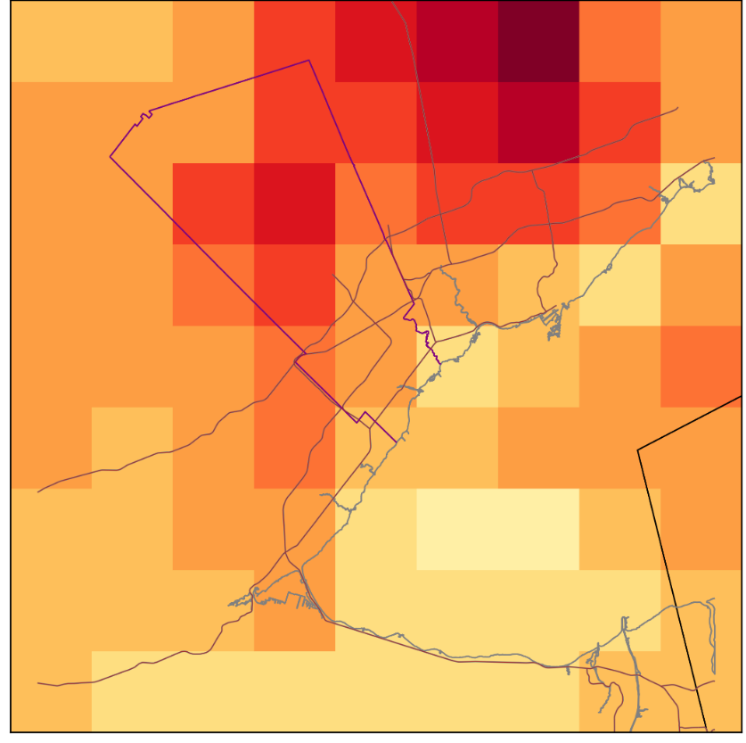
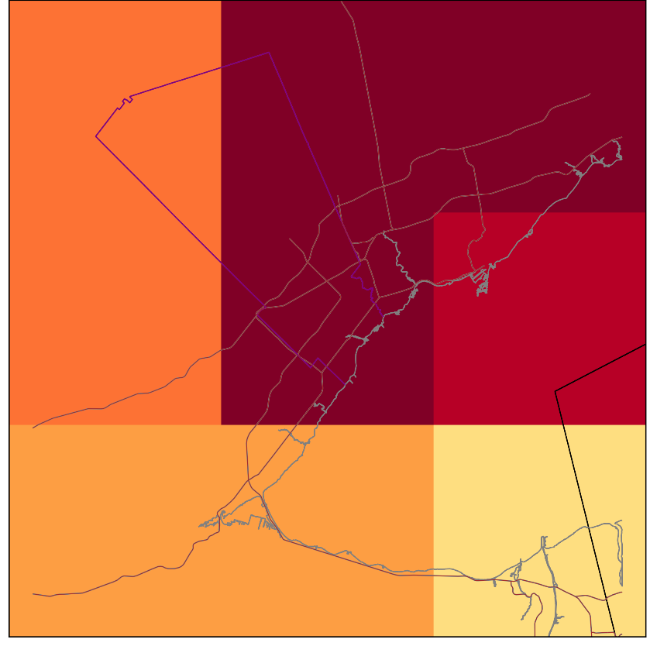
Comparison of Marginal Damage (NO₂ + O₃ Combined, July)
4 km
12 km
36 km
Maximum: $430 000 / tonne NOx
Minimum: -$73 000 / tonne NOx
Maximum: $432 000 / tonne NOx
Minimum: $0 / tonne NOx
Maximum: $580 000 / tonne NOx
Minimum: $0 / tonne NOx

Slide 22
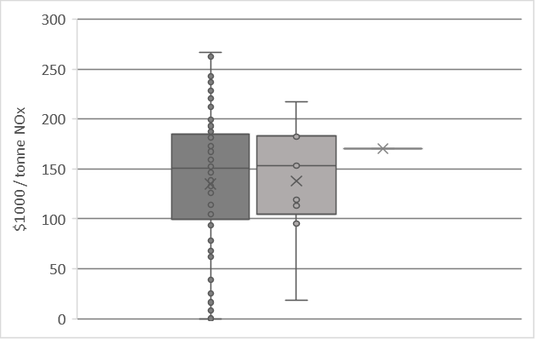
Comparison of Domain Results
4 km
12 km
36 km

Slide 23
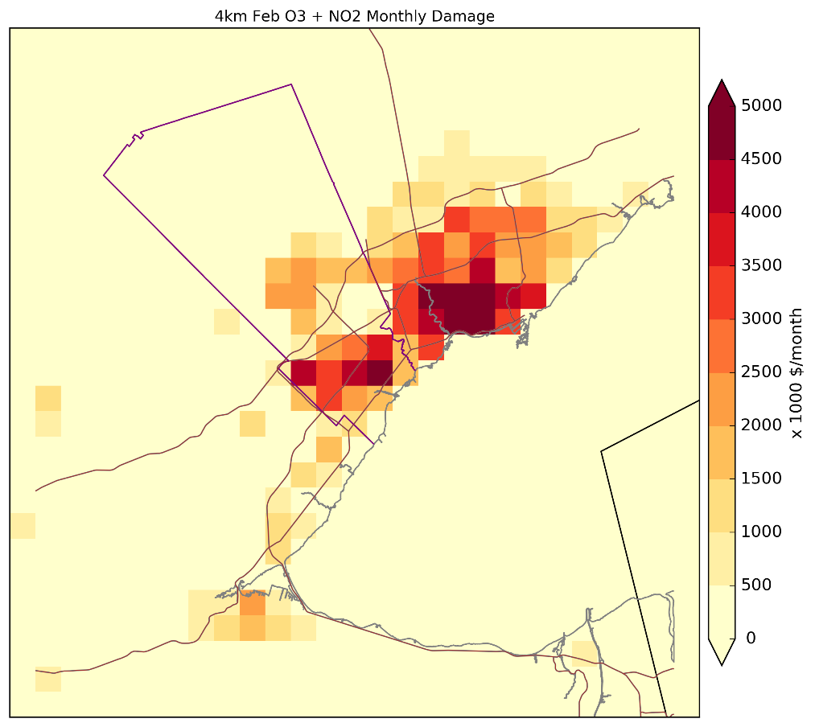
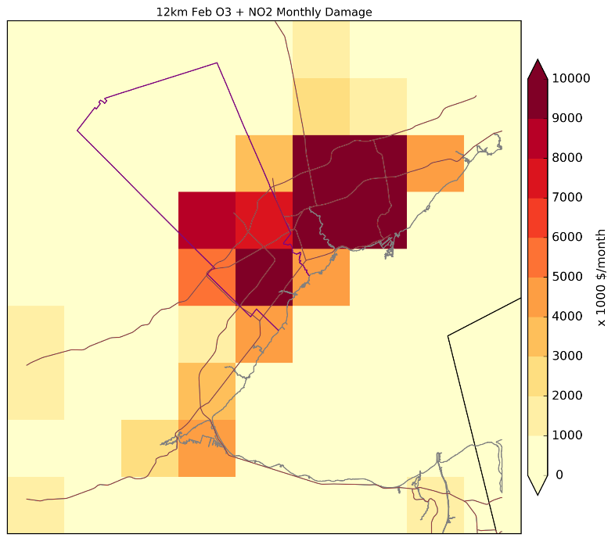
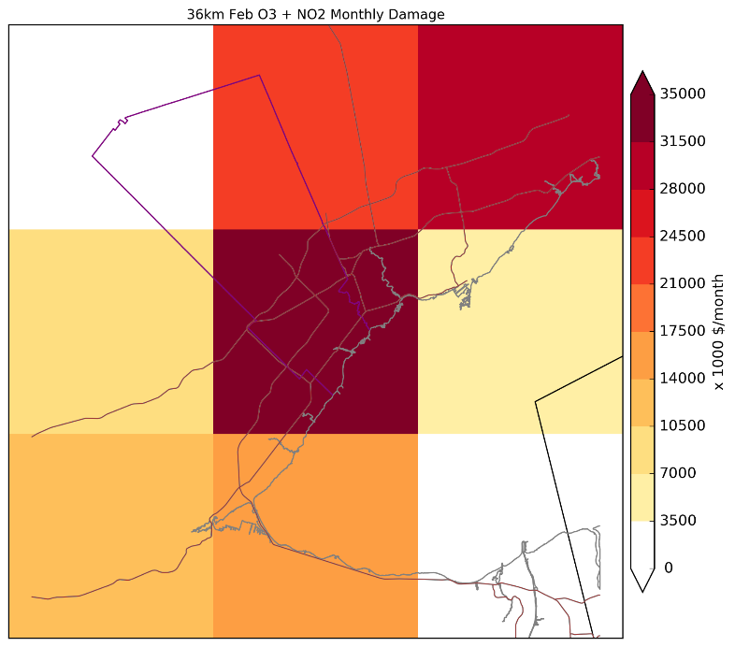
Total Monthly Damage Comparisons (Feb)
Domain sum of total monthly damage:
4 km: $2.36x10⁸
12 km: $1.75x10⁸
36 km: $1.77x10⁸

Slide 24
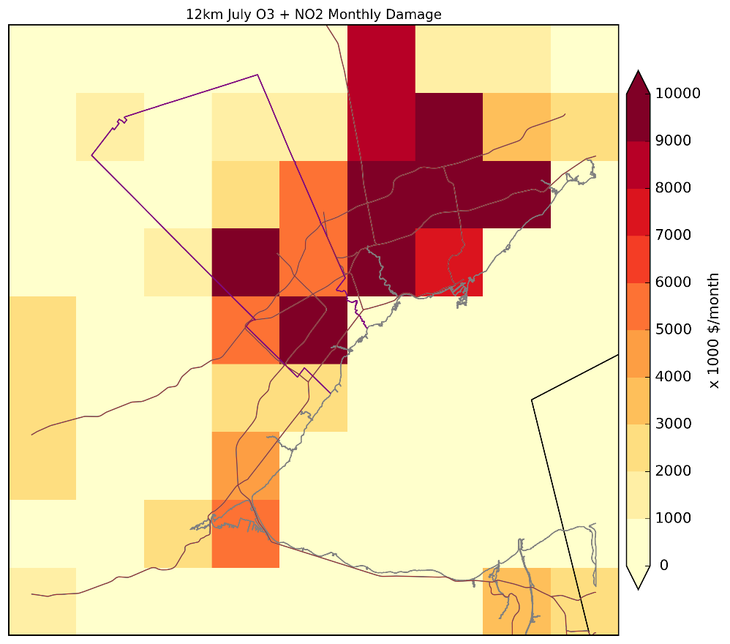
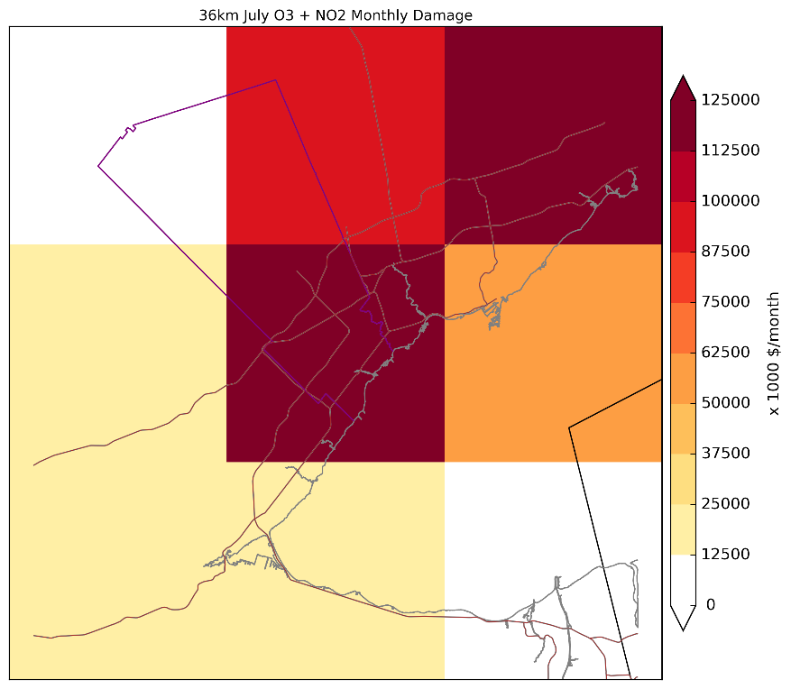
Total Monthly Damage Comparisons (July)
Domain sum of total monthly damage:
4 km: $1.7×10⁸
12 km: $2.0×10⁸
36 km:$5.4×10⁸

Slide 25
Conclusions Analysis 2
In most cases, high resolution results indicate maximums of higher marginal damages than coarse resolution
Fine grid sensitivity results better allow for specific source contributions to be determined
Fine resolution results demonstrate higher variance
Rural areas in close proximity to urban are over-predicted at coarse resolutions, while urban areas may be under-predicted
When damages from different resolutions are summed over the same domain, there is usually not a significant difference between results

Slide 26
Future Work
Adjoint sensitivity runs to determine marginal benefit for the alternative re-gridding scenarios
Similar analysis as presented but with 4 & 12 km combination inputs and 12 & 36 km combination inputs
Finalizing 1 km adjoint results
Including PM health effects

Slide 27
Acknowledgements
RWDI & the Region of Peel Municipality for providing the input data and inventories and their technical support.
Funding for this project was granted through NSERC and OGS

Slide 28
Thank you

