Slide 1
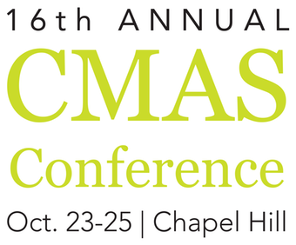
Estimating the Tipping Point (TP) of Urban NO_{X} Control in Two Major US Cities
Angele Genereux
Amanda Pappin
Amir Hakami
Main Driver:
Although nation-wide Nitrogen Oxides (NO+NO₂) & Ozone (O₃) levels have decreased over the last decade, there have been increased O₃ concentrations in urban/suburban areas ^{(Simon et al, 2015)}

Slide 2
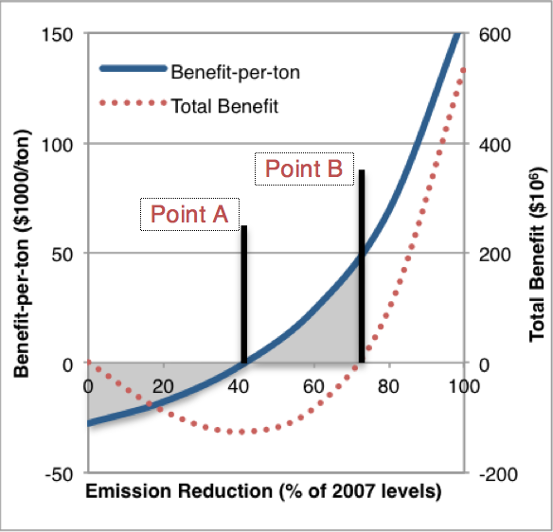
Methodology I
2
Study overview:
Anthropogenic emission abatement of NO_{X} in intervals of 10% (0% 80%)
Monetary valuation of the impact of emission control (“Benefit-per-ton” approach)
(Pappin and Hakami 2013; Fann, Fulcher and Hubbell 2009)
We aim to estimate 2 parameters for LA & NY:
Point A: Tipping Point (TP) -- Region shifts from NO_{X}-inhibited NO_{X}-limited
Point B: Break-Even Point (BEP) -- Cumulative benefits compensate accrued disbenefits
2 Cases (4 sets of results per location):
Local Emission Abatement (NY & LA only)
National Benefits ($)
Local Benefits ($)
National Emission Abatement (All locations)
National Benefits ($)
Local Benefits ($)

Slide 3
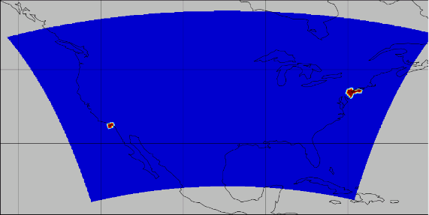
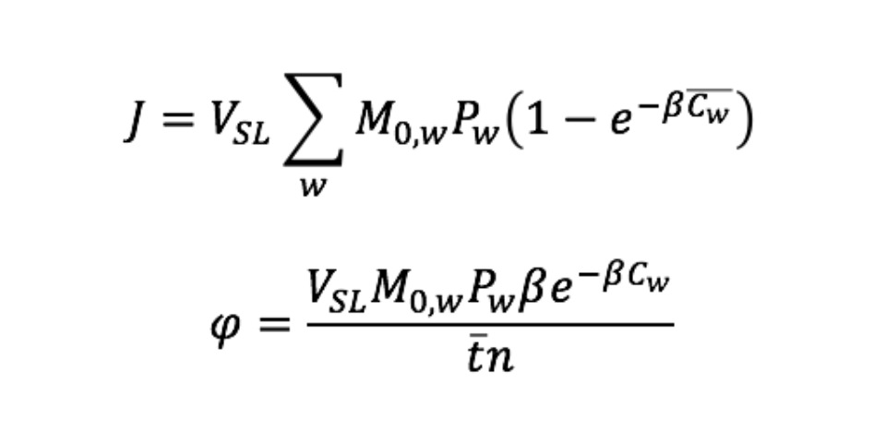
Methodology II
3
CMAQ:
CMAQ 4.5.1
CONUS 36 x 36 km resolution
1 vertical layer
July 1-31st, 2007 (scaled to the full ozone season)
Mask.nc added - generated using US population census data (U.S. Census Bureau 2016)
Marginal Damage:
Respiratory mortality based on chronic exposure to 1-hour O₃ (β=0.00392)
Single pollutant model
P_{w} = Population aged 30-90
M = Mortality risk
V_{SL}=Value of Statistical Life
W = location
C = Max 1-h [O₃]
(Jerrett et al. 2009; Pappin et al. 2016)
LA
NY
Cost Function & Forcing Equations:
(Pappin et al. 2016 )

Slide 4
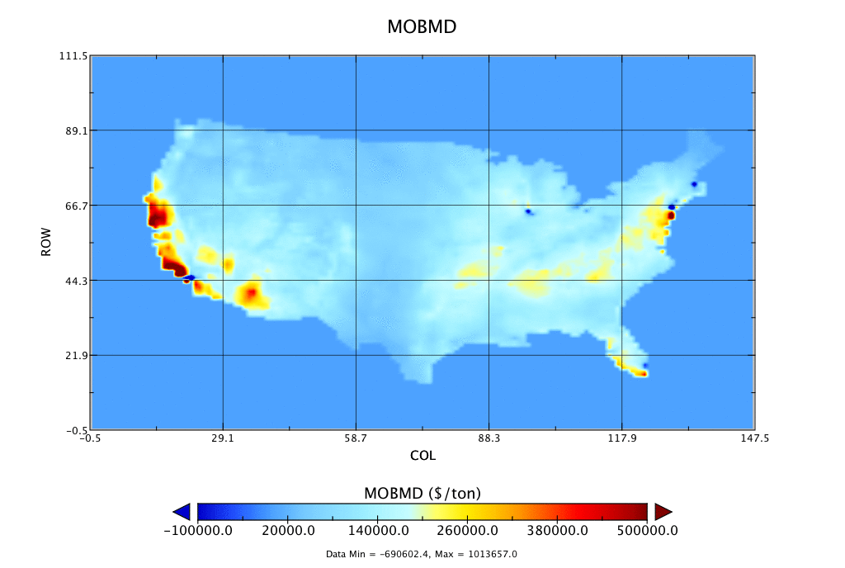
Methodology III
4
Case 1:
Case 2:
Summary of runs for each case:
. . .
Create a mask file to identify grid cells corresponding to NY & LA
Fwd
Adj-Nat
Adj-Loc
0%
Fwd
Adj-Nat
Adj-Loc
80%
Modify forward CMAQ to enable masking
Marginal Damage ($/ton)
Modify abatement percentage (%)
Run forward CMAQ
Repeat for each abatement interval
Adjoint – National CF
Adjoint – Local CF
Post-processing
Marginal Damage ($/ton)

Slide 5
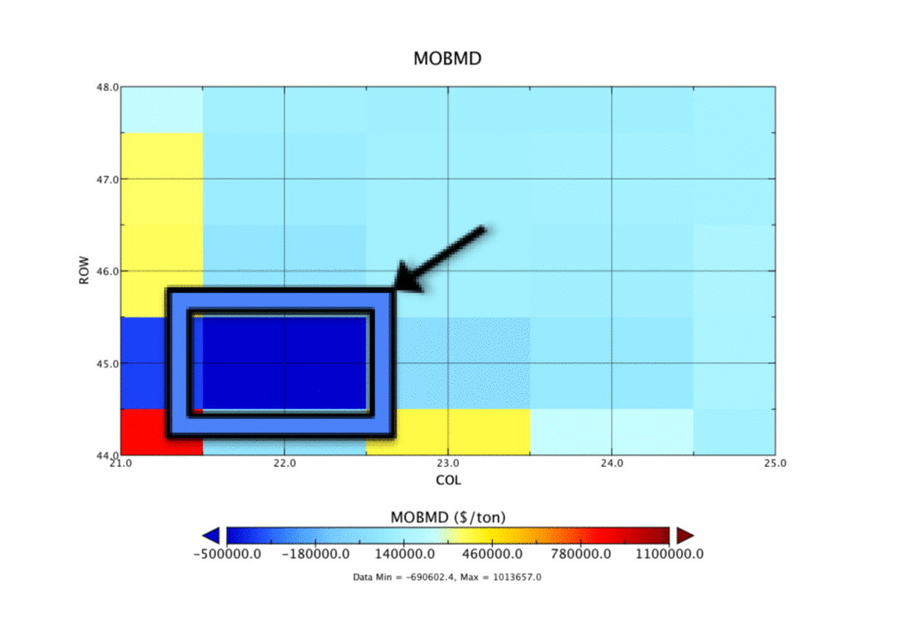
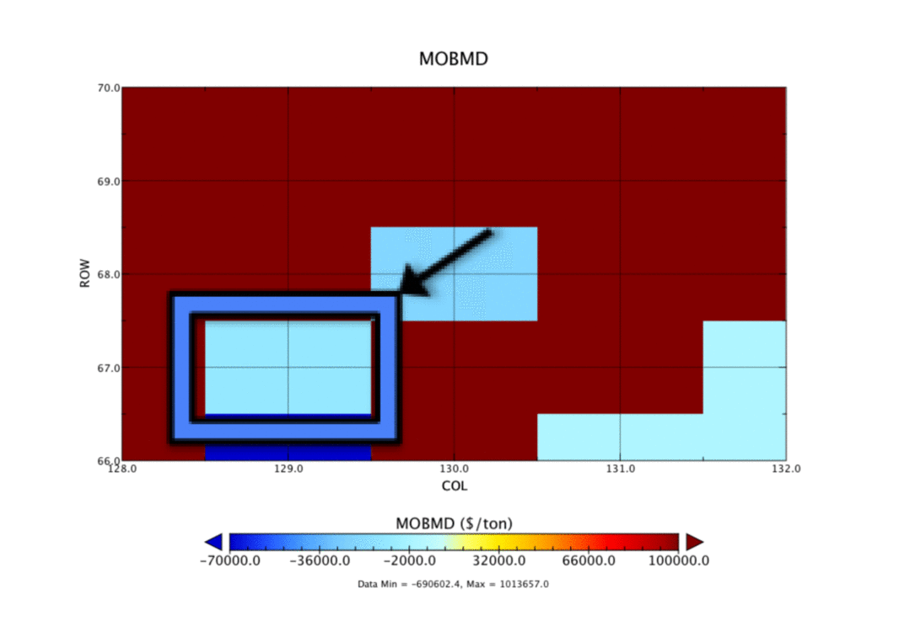
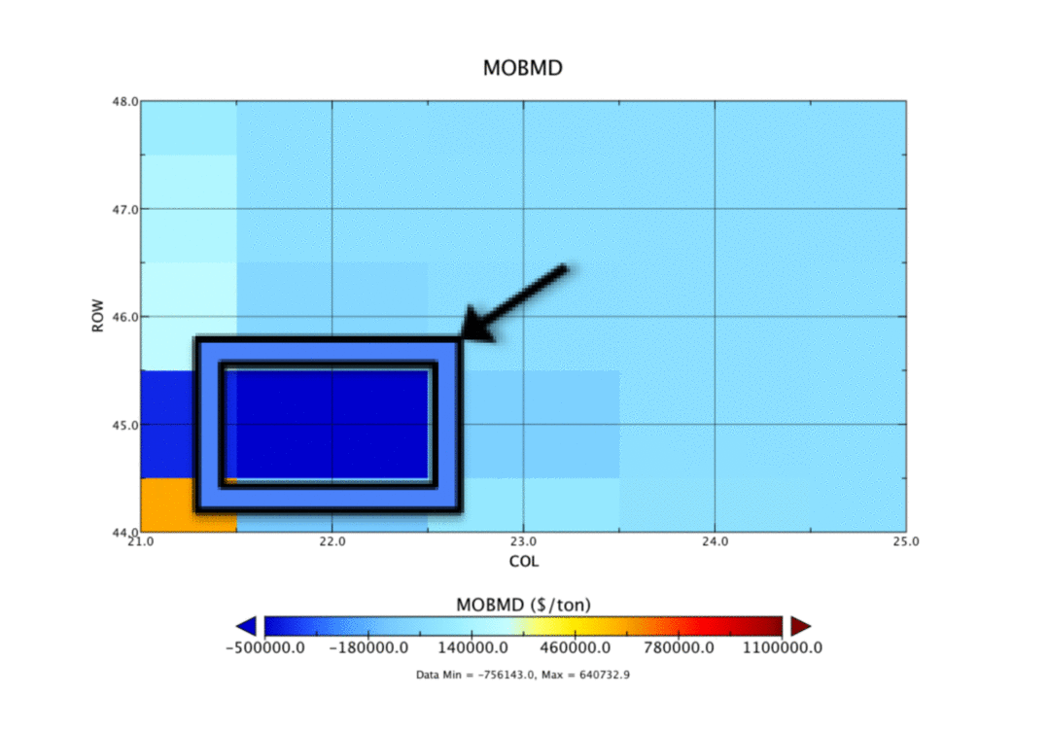
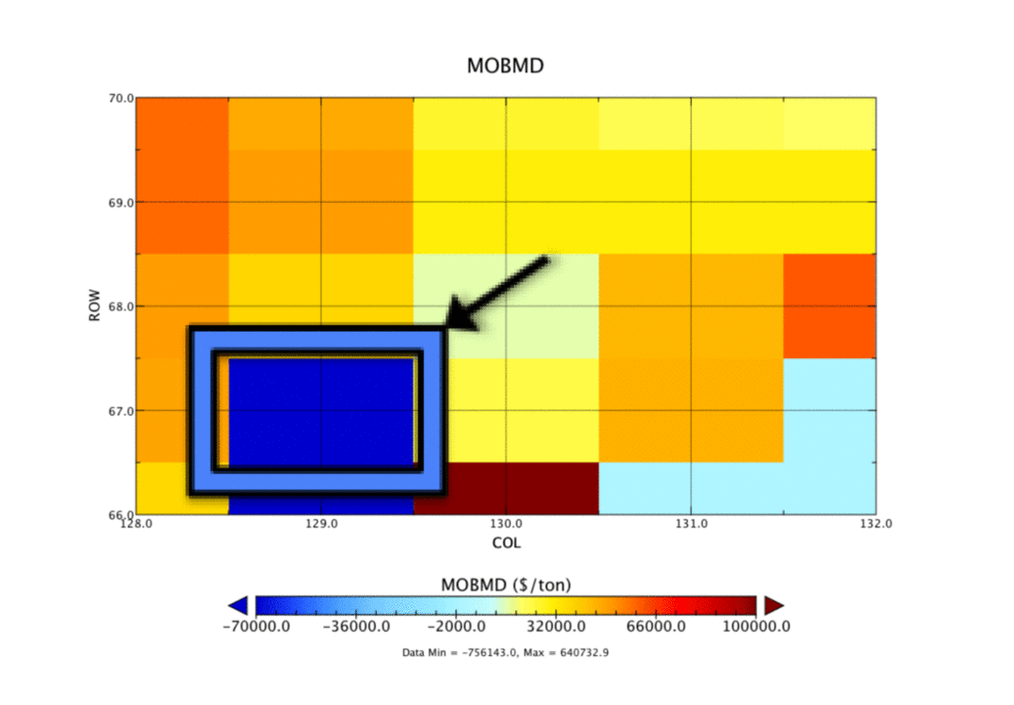
Results – Case I
5
LA
NY
National Benefits
National Benefits
National Benefits
National Benefits
National Benefits
Marginal Damage ($/ton)
Marginal Damage ($/ton)
Marginal Damage ($/ton)
Marginal Damage ($/ton)
Local Benefits
Local Benefits
Local Benefits
Local Benefits
Marginal Damage ($/ton)
Marginal Damage ($/ton)
Marginal Damage ($/ton)

Slide 6
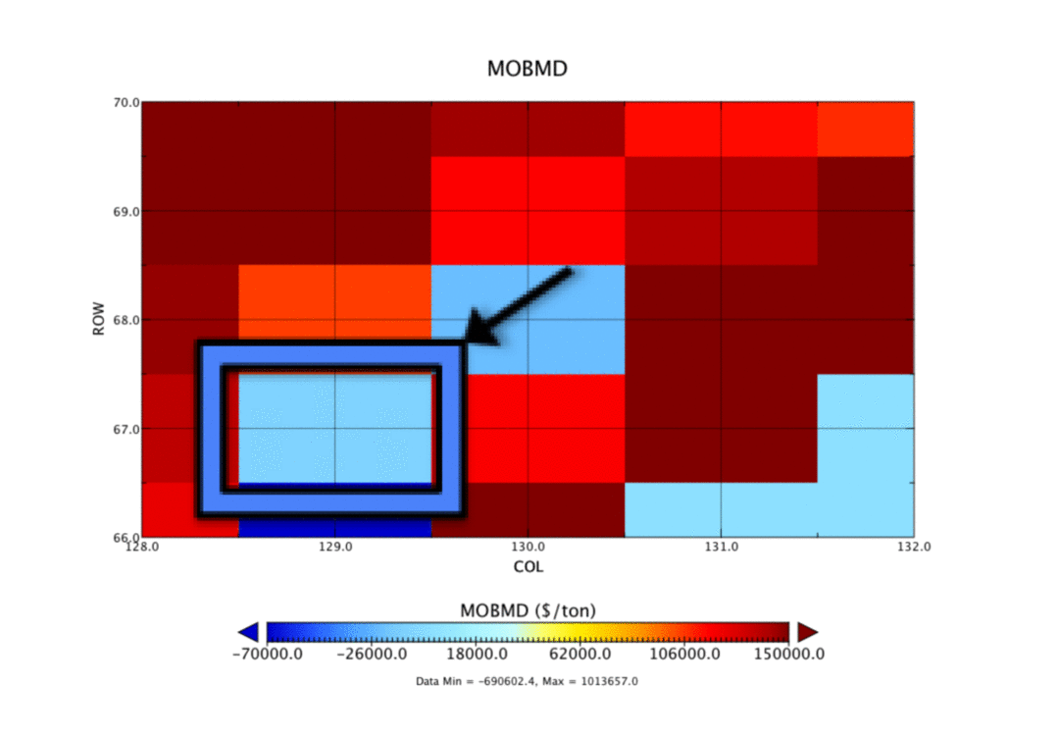
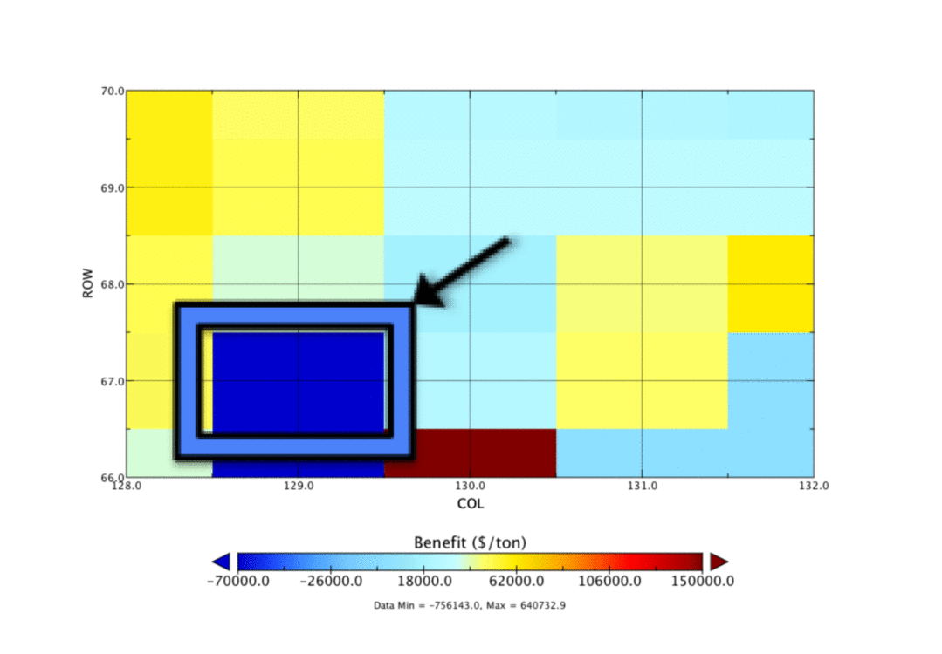
Results – Case II
6
LA
NY
National Benefits
National Benefits
National Benefits
National Benefits
National Benefits
Marginal Damage ($/ton)
Marginal Damage ($/ton)
Marginal Damage ($/ton)
Marginal Damage ($/ton)
Local Benefits
Local Benefits
Local Benefits
Local Benefits
Marginal Damage ($/ton)
Marginal Damage ($/ton)
Marginal Damage ($/ton)

Slide 7
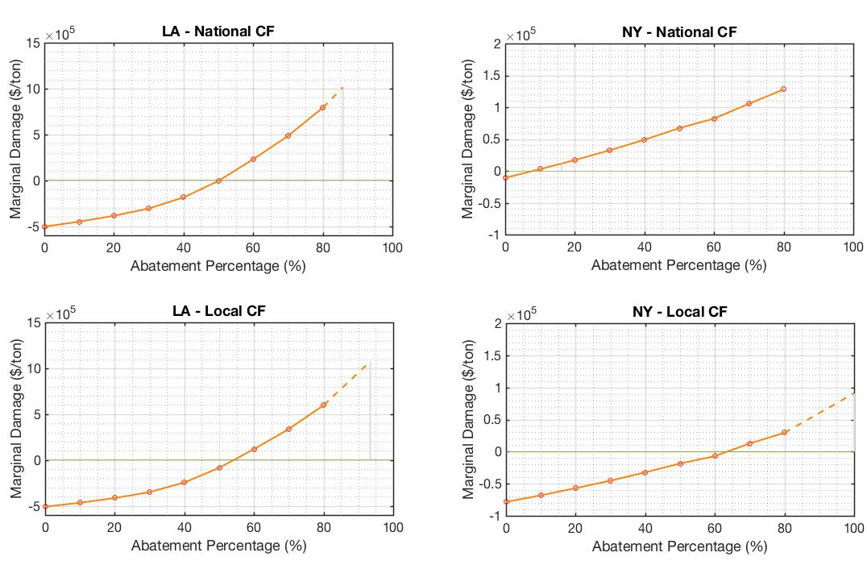
Results – Case I
7
Break-Even Point:
Cumulative Benefits
Cumulative Disbenefits
=
50
86
8
16
54
93
64
100

Slide 8
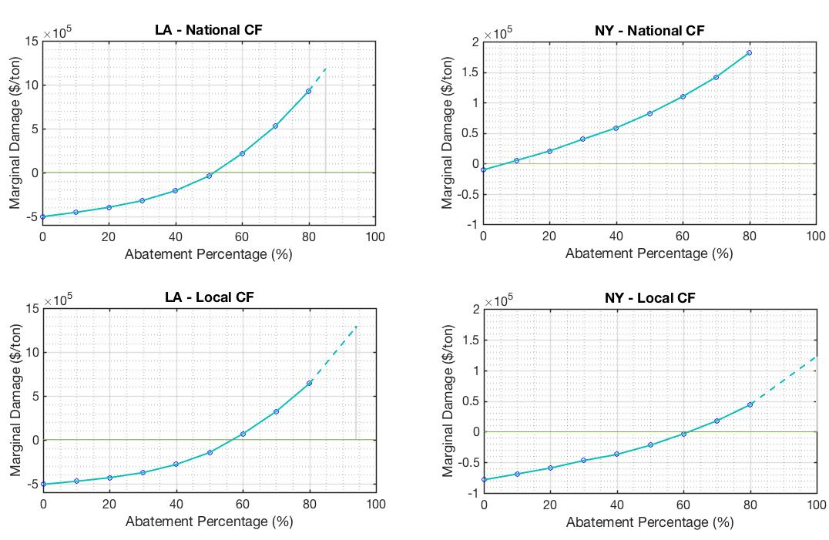
Results – Case II
8
52
85
7
14
57
94
62
100

Slide 9
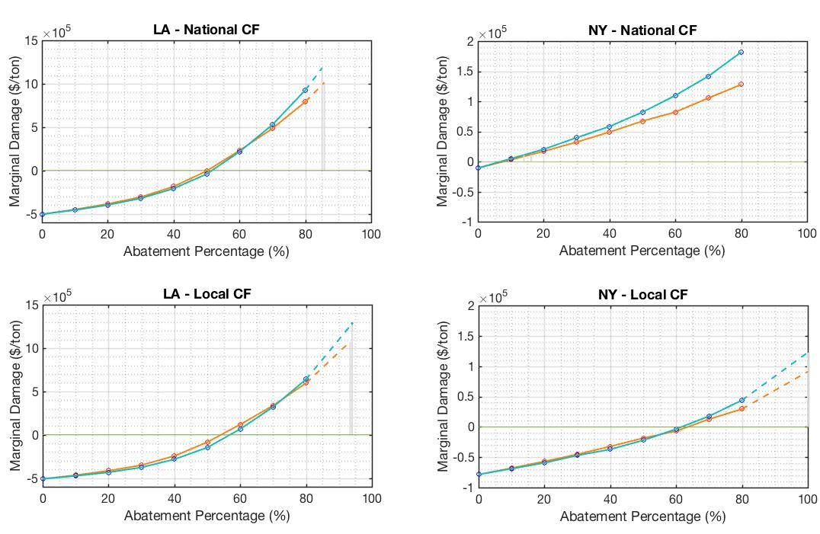
Results – Cases I & II
9
50 52
85 86
7 8
14 16
54 57
93 94
62 64
100 100

Slide 10
Summary & Conclusions
10
Take-Home Messages:
Our results validate the results of previous studies, showing that each additional ton of NO_{X} removed results in a larger benefit than the previous ton.
We identify the TP of NO_{X} control (where negative BPTs disappear and become positive) and show that this happens around:
National Benefits: 50% (LA) & 7% (NY) Local Benefits: 55% (LA) & 63% (NY)
Compounding benefits of both regional and national NO_{X} control compensate immediate dis-benefits in NY & LA along the abatement pathway.
We estimate the BEP (where benefits compensate dis-benefits) for LA and NY:
National Benefits: 85% (LA) & 15% (NY) Local Benefits: 93% (LA) & 100% (NY)
Nation-wide emission abatement results in larger benefits; however, local emission abatement still results in up to 70% of these benefits in NY and 85% in LA.

Slide 11
References & Acknowledgements
11
Simon, Heather, Adam Reff, Benjamin Wells, Jia Xing, and Neil Frank. "Ozone Trends Across the United States over a Period of Decreasing NOx and VOC Emissions." Environmental Science & Technology (American Chemical Society) 49, no. 1 (2015): 186-195.
Pappin, Amanda Joy, and Amir Hakami. "Source Attribution of Health Benefits from Air Pollution Abatement in Canada and the United States: An Adjoint Sensitivity Analysis." Environmental Health Perspectives (Environmental Health Perspectives) 121, no. 5 (2013): 572-579.
Fann, Neal, Charles M. Fulcher, and Bryan J. Hubbell. "The influence of location, source, and emission type in estimates of the human health benefits of reducing a ton of air pollution." Air Quality, Atmosphere, & Health (Springer) 2, no. 3 (2009): 169-176.
U.S. Census Bureau. "TIGER/Line Shapefile, 2016, 2010 nation, U.S., 2010 Census Urban Area National." DATA.GOV. October 17, 2016. https://catalog.data.gov/dataset/tiger-line-shapefile-2016-2010-nation-u-s-2010-census-urban-area-national (accessed November 1, 2016).
Jerrett, M., Burnett, R., Pope, C., Ito, K., Thurston, G., Krewski, D., et al. (2009). Long-Term Ozone Exposure and Mortality. The New England Journal of Medicine , 360, 1085-1095.
Pappin, A., Hakami, A., Blagden, P., Nasari, M., Szyszkowicz, M., & Burnett, R. (2016). Estimating the benefits of reducing NOx emissions in the presence of epidemiological and atmospheric nonlinearities. Environmental Research Letters , 11 (6), 1-10.
Special thanks to:
Dr. Amir Hakami – For his guidance throughout the project and through my Master’s degree.
Dr. Amanda Pappin – For her guidance and making this project possible.
Thanks for attending!

