Slide 1

Hybrid Plume/Grid Modeling for the Allegheny County PM_{2.5} SIPs
Chris Emery, Maria Zatko, Bart Brashers, Ralph Morris
Ramboll Environ
Jason Maranche, Tony Sadar
Allegheny County Health Department, Pittsburgh, PA
16th Annual CMAS Conference
October 23, 2017

Slide 2
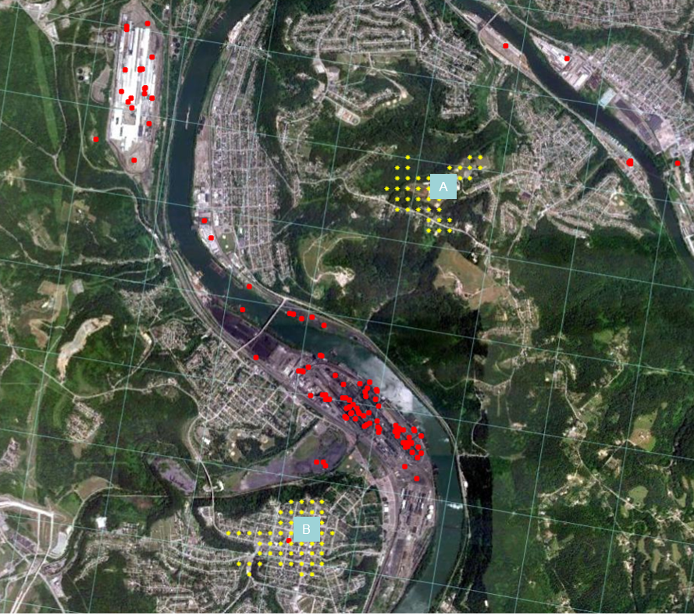
Background
Setting
Liberty-Clairton Nonattainment Area (LCNA) is within the Pittsburgh-Beaver Valley (PBVNA)
  Local industrial sources result in much higher PM_{2.5} than PBVNA
Modeling is challenging:
  Complex terrain river valley with many local industrial sources
  Violating Liberty monitor (A) is on a ridge ~140 m above the Monongahela River
  Contributions from local sources and regional transport
  Contributions from primary and secondary PM components
Calls for hybrid plume/grid modeling

Slide 3
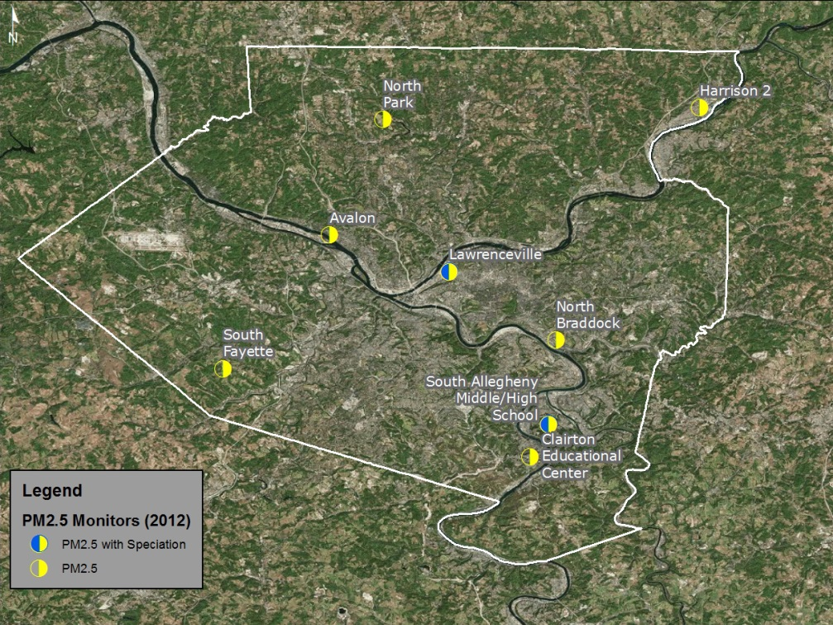
Background
PM_{2.5} Design Values in Allegheny County
Monitoring Site | Annual PM2.5 Design Values (µg/m3) |  | 24-Hour PM2.5 Design Values (µg/m3)
 | 2011-2013 | 2012-2014 | 2011-2013 | 2012-2014
Avalon | 11.4 | 10.6 | 25 | 22
Lawrenceville | 10.3 | 10.0 | 23 | 21
Liberty | 13.4 | 13.0 | 37 | 35
South Fayette | 9.6 | 9.0 | 24 | 20
North Park | 8.8 | 8.5 | 19 | 17
Harrison 2 | 10.6 | 10.0 | 25 | 22
North Braddock | 11.7 | 11.4 | 29 | 26
Clairton | 9.8 | 9.5 | 22 | 23
Liberty has exceeded annual (12 µg/m³) and 24-hour (35 µg/m³) standards
Notes:
Since Liberty exceeds PM2.5 standard, attention focused on this site during model performance evaluation

Slide 4
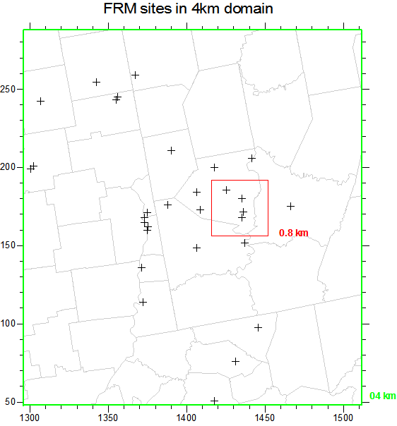
2012 Attainment Demonstration
24-hour PM_{2.5} Standard
Model 2007 base year, 2014 attainment year by 2 methods:
  AERMOD treats local-source primary PM, CAMx treats all other sources
  CAMx treats all sources including local-source primary PM using Plume-in-Grid (PiG)
Nested grids: 36/12/4 km resolution + 0.8 km grid over LCNA

Slide 5
2012 Attainment Demonstration
CAMx Treatment of Local Source PM impacts
CAMx PiG subgrid-scale plume module
  Treat near source chemistry and dispersion
  Sample puffs on 100 m receptor grid
  Release puff mass to grid when puff size is commensurate with grid size (0.8 km)
CAMx Particulate Source Apportionment Technology (PSAT)
  Track local source PM after mass is released from PiG puffs to CAMx grid
  CAMx grid output + PiG receptor grid output gives total PM concentrations
  Subtract PSAT from CAMx grid output eliminates local sources
    Add AERMOD output to CAMx non-local source results without double counting
    Also provides CAMx/PiG estimate of local source contributions

Slide 6
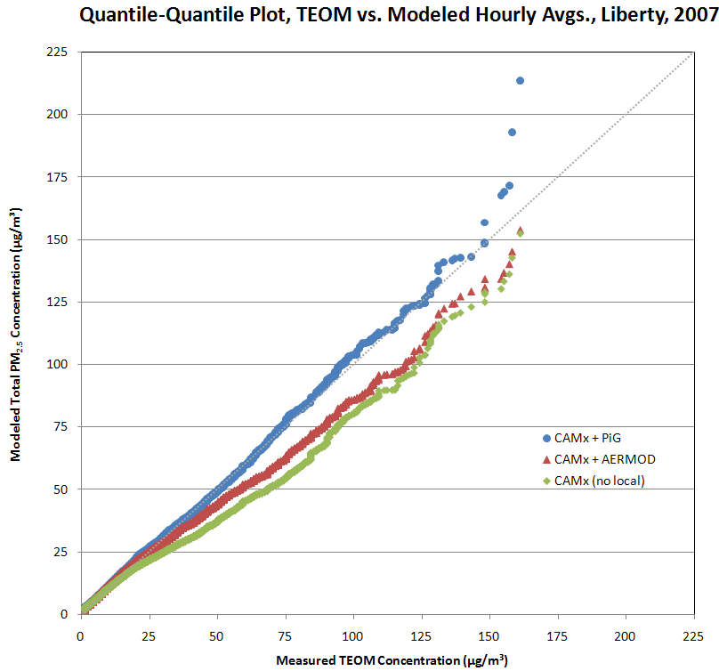
2012 Attainment Demonstration
24-hour PM_{2.5} Standard
CAMx/PiG vs. CAMx/AERMOD vs. CAMx without local sources
Compare to 24-hour PM_{2.5} at Liberty monitor:
2007 98th Percentile 24-Hour PM_{2.5}
  Observed = 54.7 µg/m³
  CAMx/PiG = 54.9 µg/m³ (+0.4%)
  CAMx/AERMOD = 48.9 µg/m³ (-10.6%)
CAMx/PiG performed best:
  A unified modeling approach
  Local vs. regional sources
  Primary vs. secondary PM
CAMx/PiG Performance | # Sites | Fractional Bias | Fractional Error
Performance Goal |  | ≤±30% | ≤50%
Performance Criteria |  | ≤±60% | ≤75%
12 km Domain | 536 | +10.5% | 38.5%
4 km Domain | 30 | +4.6% | 36.2%
0.8 km Domain | 4 | +4.1% | 37.8%

Slide 7
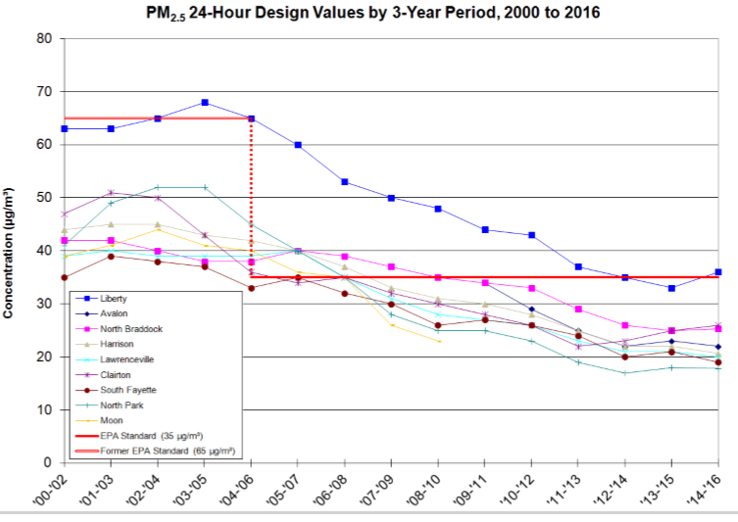
2012 Attainment Demonstration
24-hour PM_{2.5} Standard
2014 projected Annual and 24-hour PM_{2.5} at Liberty
  Using CAMx/PiG on 4 and 0.8 km grids
Modeling:
  LCNA would attain both standards by 2014
  24-hour PM_{2.5} = 34.0 µg/m³
Reality:
  2013-2015 Liberty 24-hour PM_{2.5} DV = 34 µg/m³
Standard | Observed 2005-09 | 2014 0.8 km | 2014 4 km
Annual | 18.4 | 11.5 | 10.8
24-Hr | 54.4 | 34.0 | 31.1

Slide 8
2017 Attainment Demonstration
Annual PM_{2.5} Standard
CAMx v.6.30: 2011 base year, 2021 attainment year
  1-way and 2-way nested domains: 36/12/4/1.33 km
  PiG, PSAT
  Boundary Conditions for 36 km CONUS grid from GEOS-Chem
Meteorological inputs from Weather Research Forecasting (WRF v3.7.1) Model
  Also ran a 444 m domain for potential AERMOD runs
Emission inputs from national, regional, and county emission inventories
  MARAMA α2, NEI 2011v2, ERTAC EGU, plus local point sources specified by ACHD

Slide 9
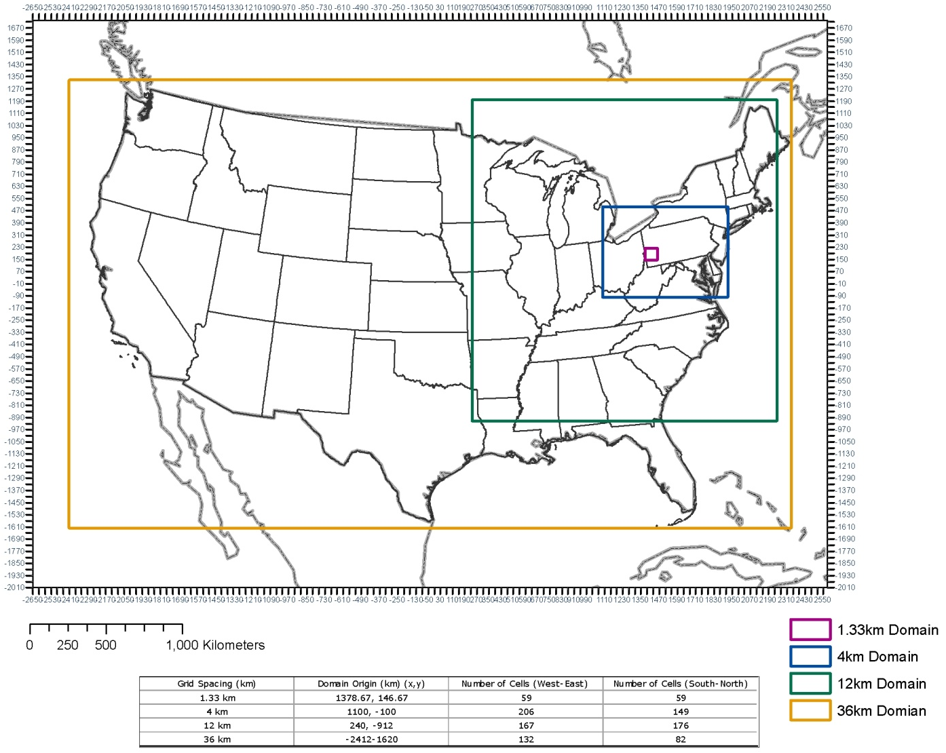
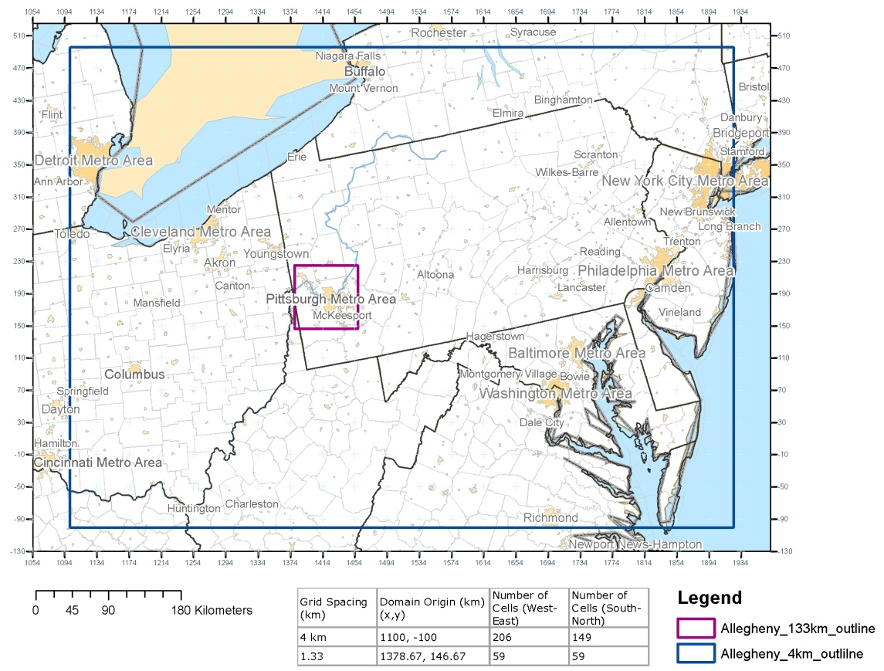
2017 Attainment Demonstration
Annual PM_{2.5} Standard
GEOS-Chem → (36 ↔ 12) → (4 ↔ 1.33)
Notes:
10 days of spin up for the 36/12 km run and 5 days for the 4/1.33 km run.

Slide 10
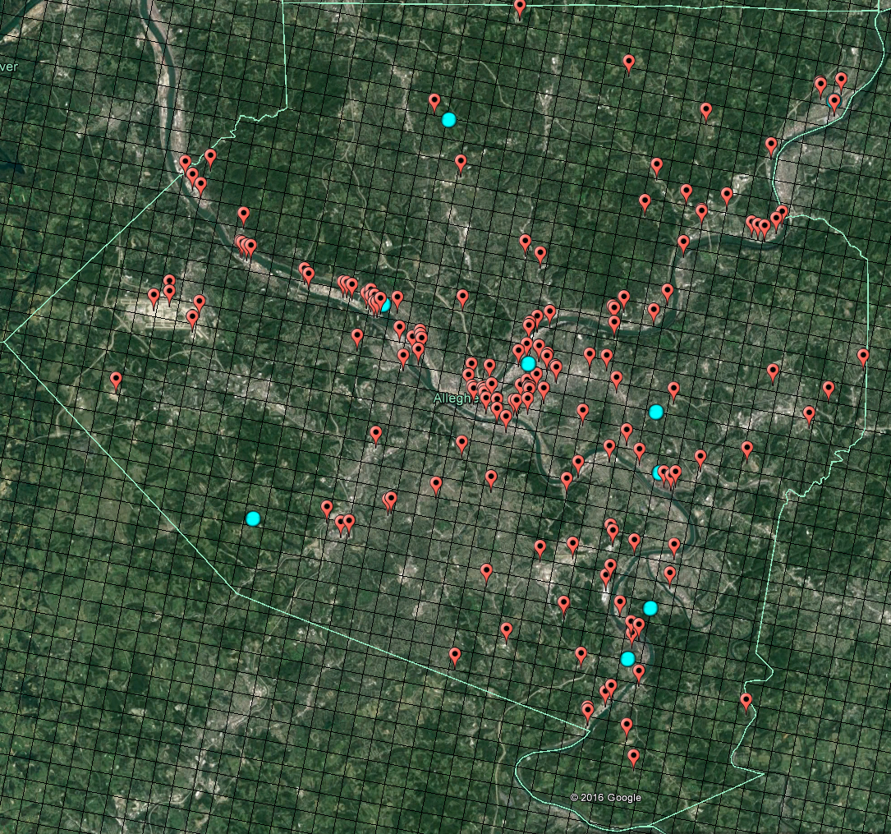
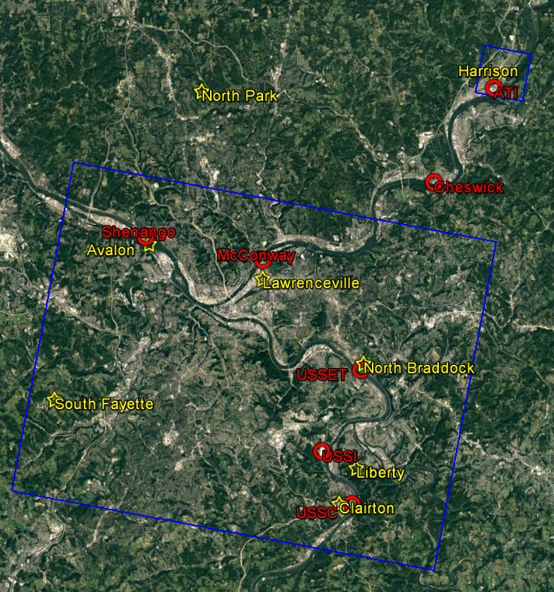
2017 Attainment Demonstration
Annual PM_{2.5} Standard
ACHD-provided point source emissions tracked in CAMx/PSAT to estimate contribution to total PM_{2.5}
7 largest emitters treated with PiG: “local major” (red)
Two 100 m receptor grids (blue)
Point sources (red), Monitors (blue)

Slide 11
2017 Attainment Demonstration
Annual PM_{2.5} Standard
PSAT in 4/1.33 km simulation
Source Groups:
1. All sources within Allegheny County
2. All sources in rest of 4 km PA domain
3. “Local major” source primary PM emissions (PiG sources)
4. “Local major” source gas precursor emissions (PiG sources)
5. “Local minor” source primary PM and precursor emissions
6. Boundary conditions
7. Initial conditions

Slide 12
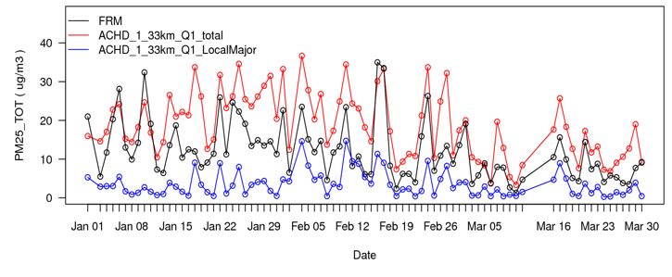
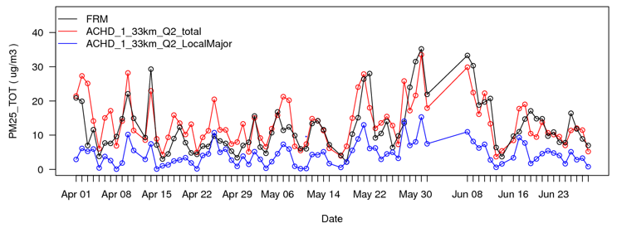
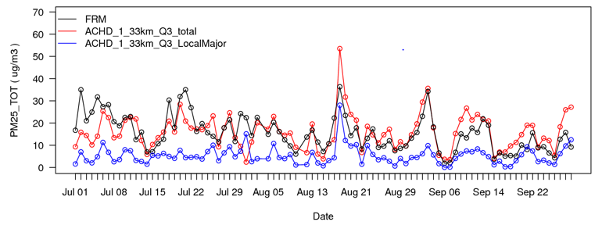
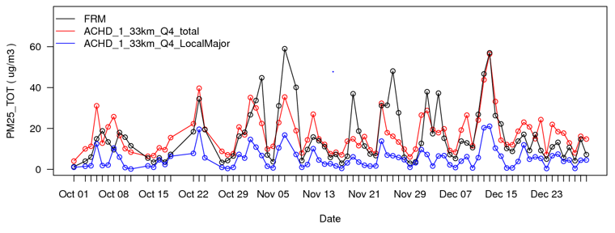
2017 Attainment Demonstration
Annual PM_{2.5} Standard
Jan-Mar
Apr-Jun
Jul-Sep
Oct-Dec
General agreement between modeled and observed PM_{2.5}
Small contribution of PM_{2.5} from local major sources
Better in spring through fall than in winter
Notes:
Note: OA = 1.4 * OC (appropriate for fresh OA emissions in urban Liberty-Clairton)

Slide 13
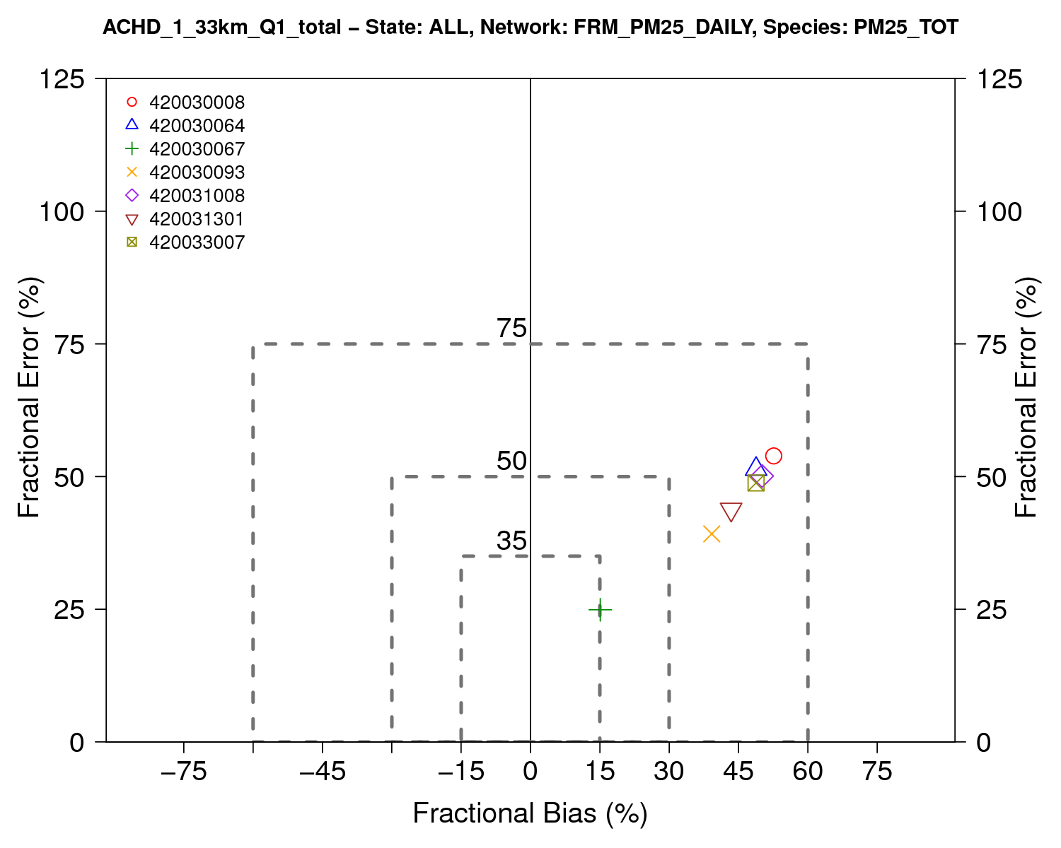
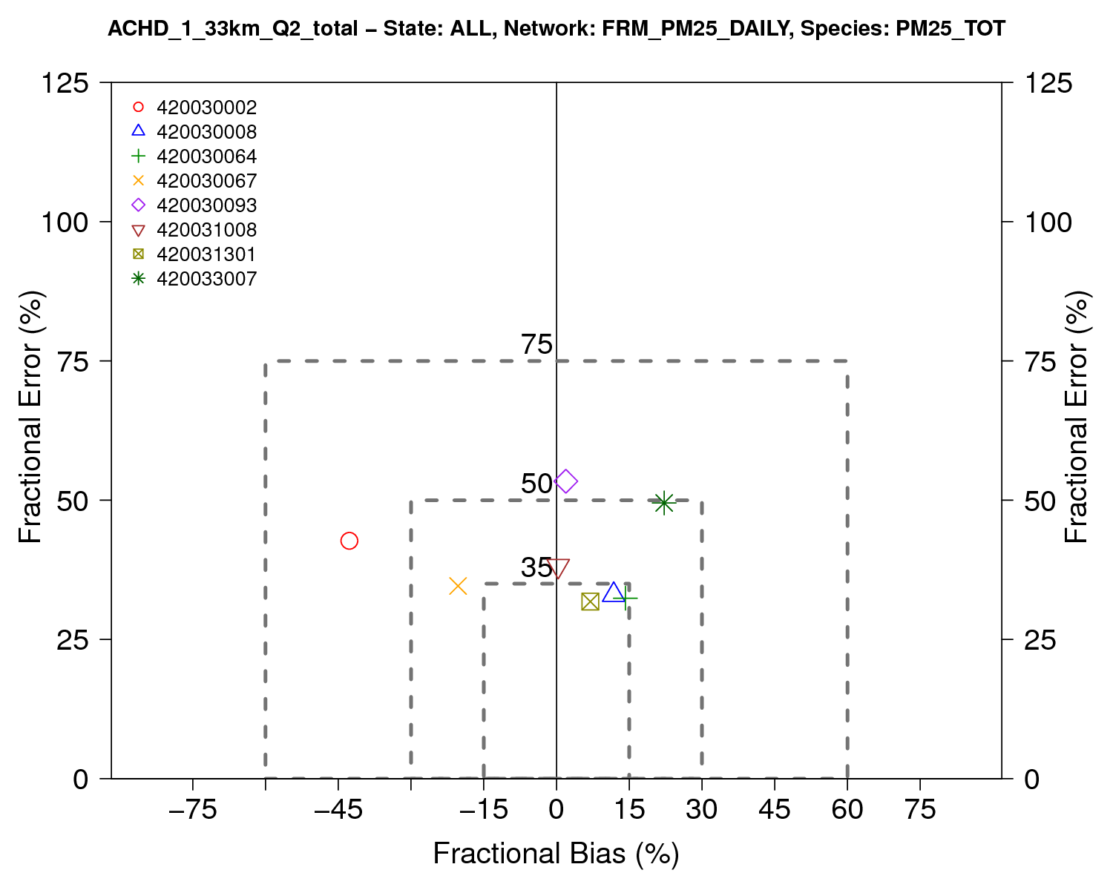
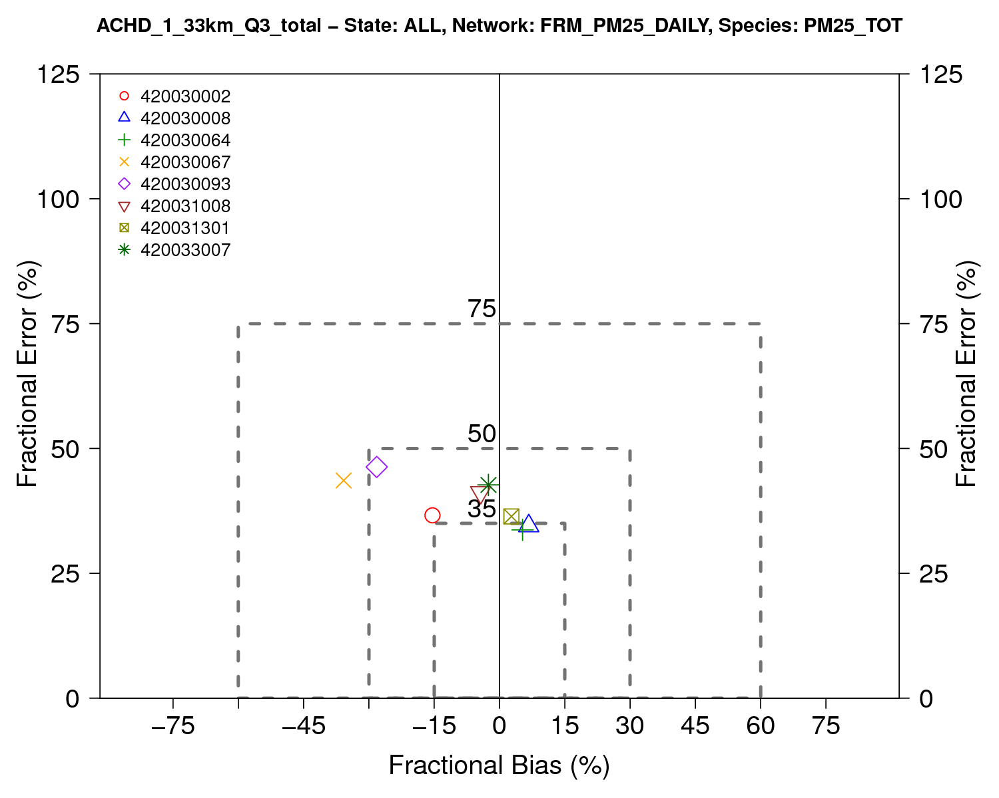
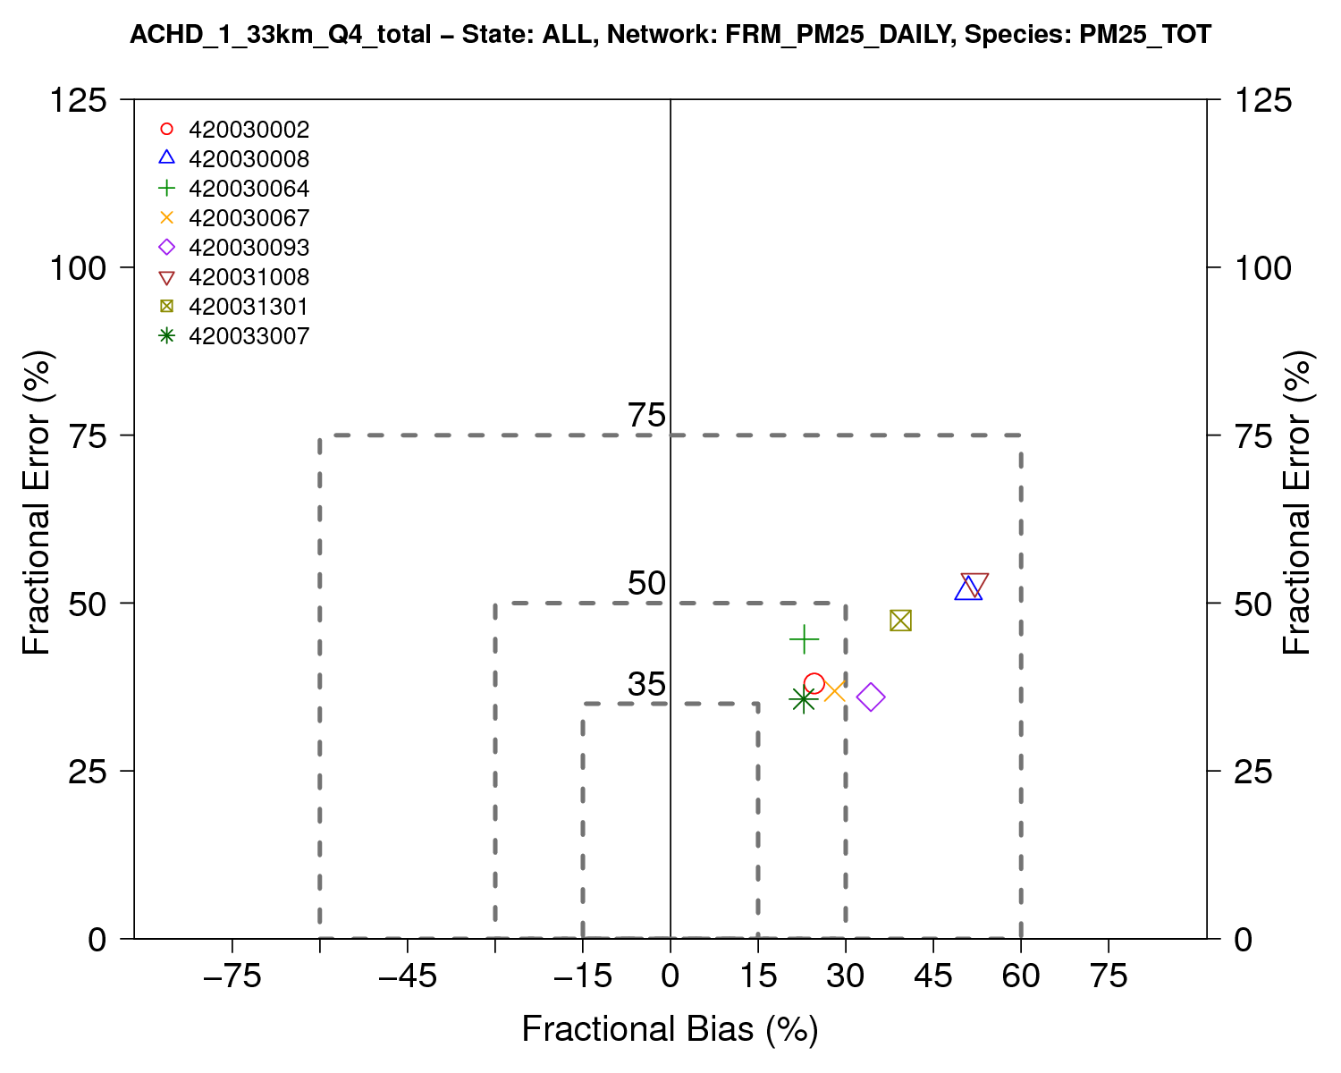
2017 Attainment Demonstration
Annual PM_{2.5} Standard
CAMx 24-hour PM_{2.5} (FRM) achieves FB/FE criteria (Boylan and Russell, 2006)
  Many site-quarters within FB/FE goals (especially summer) but high bias in fall & winter
FE is all <60% and usually <50%;
FB is all <60% and April-August <30%
Jan-Mar
Apr-Jun
Jul-Aug
Sep-Dec
Lawrenceville
Liberty
South Fayette
North Park
Harrison
North Braddock
Clairton
Lawrenceville
Liberty
South Fayette
North Park
Harrison
North Braddock
Clairton
Lawrenceville
Liberty
South Fayette
North Park
Harrison
North Braddock
Clairton
Lawrenceville
Liberty
South Fayette
North Park
Harrison
North Braddock
Clairton

Slide 14
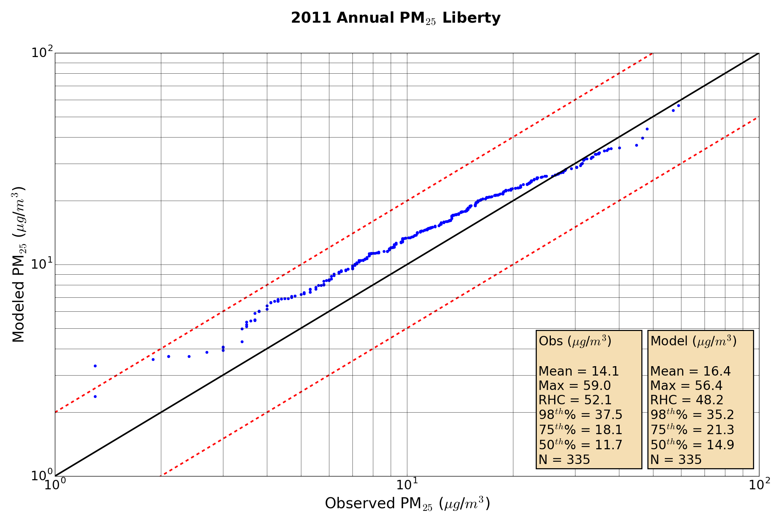
2017 Attainment Demonstration
Annual PM_{2.5} Standard
Excellent model-observation agreement at Liberty for highest 24-hour PM_{2.5}
Modeled annual average PM_{2.5} above observed
Modeled 98th percentile PM_{2.5} slightly below observed
Good agreement between modeled and observed PM2.5 across Allegheny County (not shown)

Slide 15
Conclusions
PM_{2.5} modeling in Allegheny County is challenging
  Regional component vs. Local Sources (both primary and secondary PM)
  Complex terrain, with sources in the river valley and monitors on the ridgelines
  Hybrid plume/grid modeling with source apportionment is an appropriate tool
CAMx model performance is acceptable
  CAMx + PiG treatment performs well
  Can support Allegheny County SIP demonstrations
Completing annual PM_{2.5} SIP modeling now:
  2014 base year speciated Model Performance Evaluation
  2021 attainment year, speciated attainment test

Slide 16
Thank You
Questions?
Notes:
Endslide

