Slide 1
Satellite Cloud Assimilation: The Impact of Improved Cloud Fields on 2013 Air Quality Simulations
Arastoo Pour Biazar¹, Maudood Khan¹, Andrew White¹, Richart T. McNider¹, YuLing Wu¹, Bright Dornblaser²
University of Alabama in Huntsville
Texas Commission on Environmental Quality (TCEQ)
Presented at:
16th Annual Community Modeling and Analysis System (CMAS) Conference
October 23-25, 2017
Friday Center, University of North Carolina, Chapel Hill, NC

Slide 2
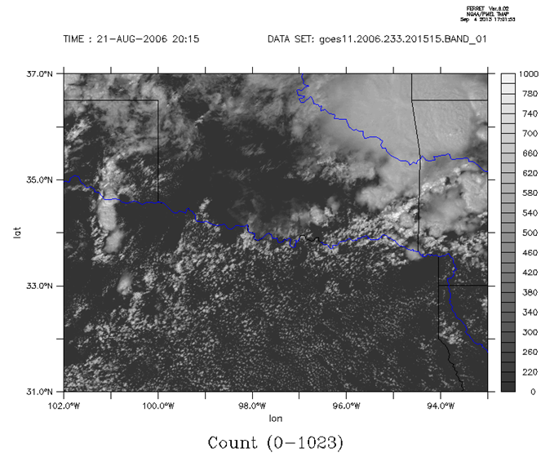
Background & Motivation
Model errors in location and timing of clouds are a major source of uncertainty in Air Quality Decision Models
IMPACT OF ERRORS IN CLOUD SIMULATION on AQ
Surface insolation & temperature, BL development
Regulating the photochemical reaction rates, biogenic VOC emissions
Vertical mixing/transport
Evolution and partitioning of particulate matter
Aqueous phase chemistry, wet removal, LNOx
Weather Forecasting/Climate
Air Quality Community
Precipitation, impact on climate
Evaluation: Statistical performance over large area and longer times
Correct location and timing of model clouds being less important as long as statistical evaluation is satisfactory
Both precipitating and non-precipitating clouds are important
Evaluation: Statistical as well as episodic (PAIRED IN SPACE AND TIME)
Correct location and timing of model clouds being important

Slide 3
Background & Motivation …
OBSERVED
ASSIM
From our previous work it was shown that adjusting photolysis rates based on goes observed clouds in the photochemical model significantly improves O3 simulations.
CNTRL
Under-prediction
Adapted from: Pour-Biazar et al., 2007
While the photolysis rate adjustment improved the performance of CMAQ for SIP activities, there was a fundamental disconnect between the model produced clouds and the attributes that were impacted by the assimilation.
There was a need for consistency and to correct clouds in the meteorological model. UAH attempted in accomplishing this objective by assimilating clouds in WRF model.
A technique was developed to assimilate satellite observed clouds in WRF. This technique was tested for a 2006 case study.
In the present study, the application of this technique to 2013 simulations (Discover-AQ field study) and its impact on air quality simulations will be presented.

Slide 4
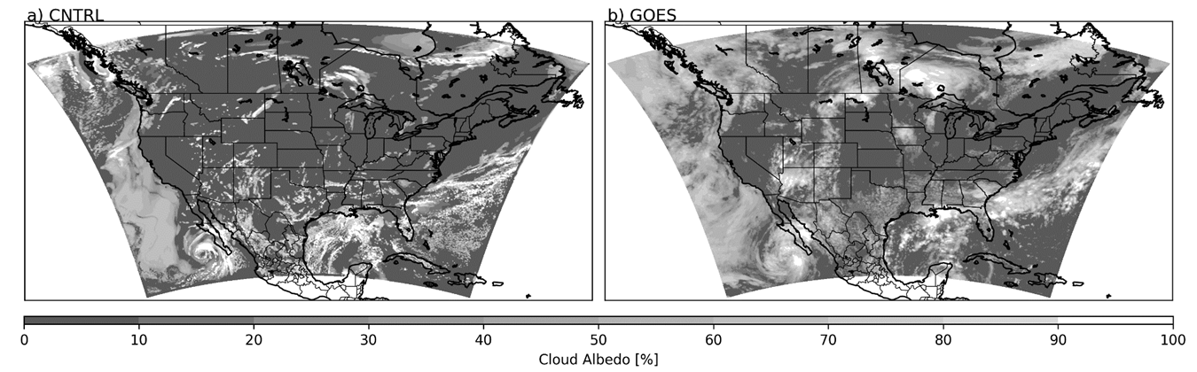
Cloud Correction in WRF: Fundamental Approach
Model Retrieved Cloud Albedo
Satellite Retrieved Cloud Albedo
W>0
W<0
Using 0.65 and 10.7 μm VIS surface, cloud features
Satellite image is compared with the model.
Areas of under-/over-prediction are identified.
A TARGET VERTICAL VELOCITY (Wmax) is estimated to generate/dissipate clouds.
A variational technique (similar to O’Brien, 1970) is applied to estimate the divergence needed to comply with Wmax.
Model horizontal winds are nudged to produce/sustain the target vertical motion.

Slide 5
Correcting Under-Prediction
Correcting Over-Prediction
ADJ_TOP
ADJ_TOP
Z_{ctop}
Z_{target}
Z_{Saturation}
∆Z
∆Z
Z_{parcel_mod}
Z_{parcel_mod}
Z_{base}
ADJ_BOT
ADJ_BOT
Lift a parcel to saturation using satellite info.
Estimate the location and thickness of the observed cloud from GOES derived cloud top temperature and cloud albedo.
Given the estimated cloud thickness, determine the minimum height a parcel at a given model location needs to be lifted to reach saturation.
Create subsidence within the model to evaporate cloud droplets.
Determine the model layer with the maximum amount of cloud liquid water (CLW) and how far it has to move to completely evaporate.
The displacement height is used to estimate vertical velocity.

Slide 6
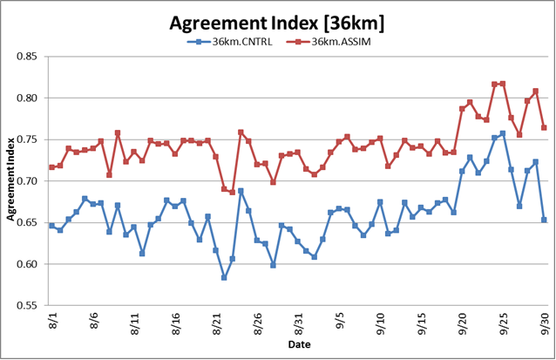
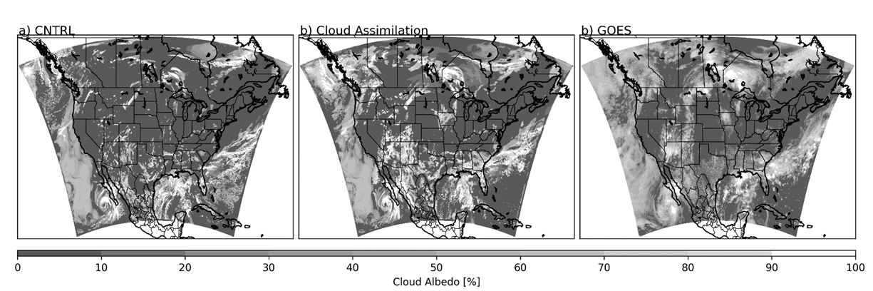
The Technique Was Applied for 2013 Air Quality Simulations
For 2013 simulations, similar improvements to 2006 were obtained:
  Increase in Agreement Index (10%).
  Reduction in wind speed and mixing ratio bias.
  Cold bias in temperature was increased. Perhaps due to new clouds generated by the assimilation being to opaque.
(Con. U.S.)
Assimilation
Control
The cloud assimilation increased the cloud agreement across the domain.

Slide 7
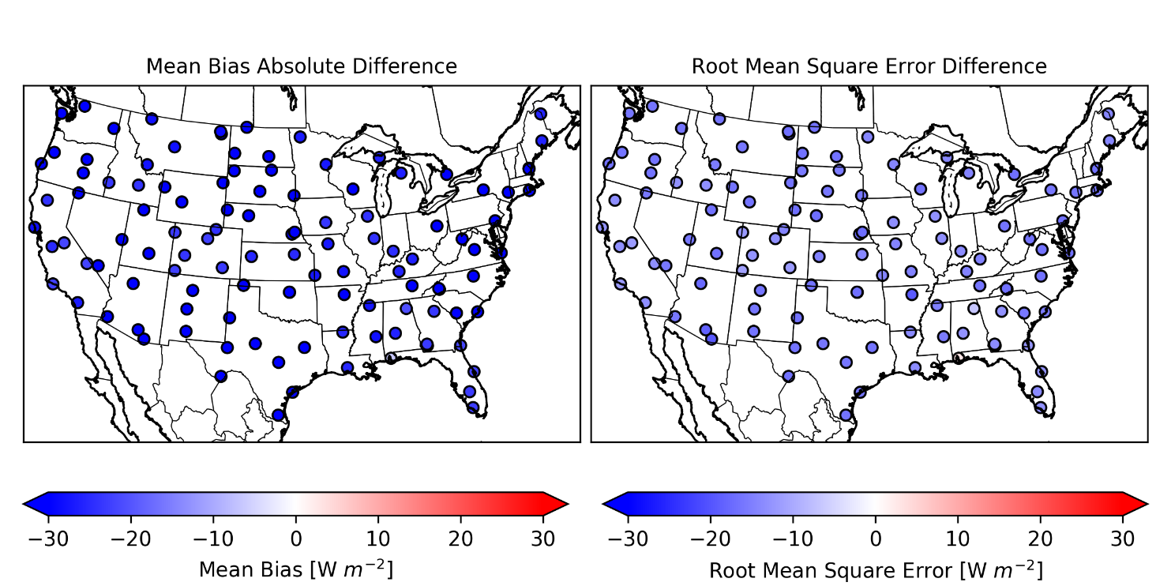
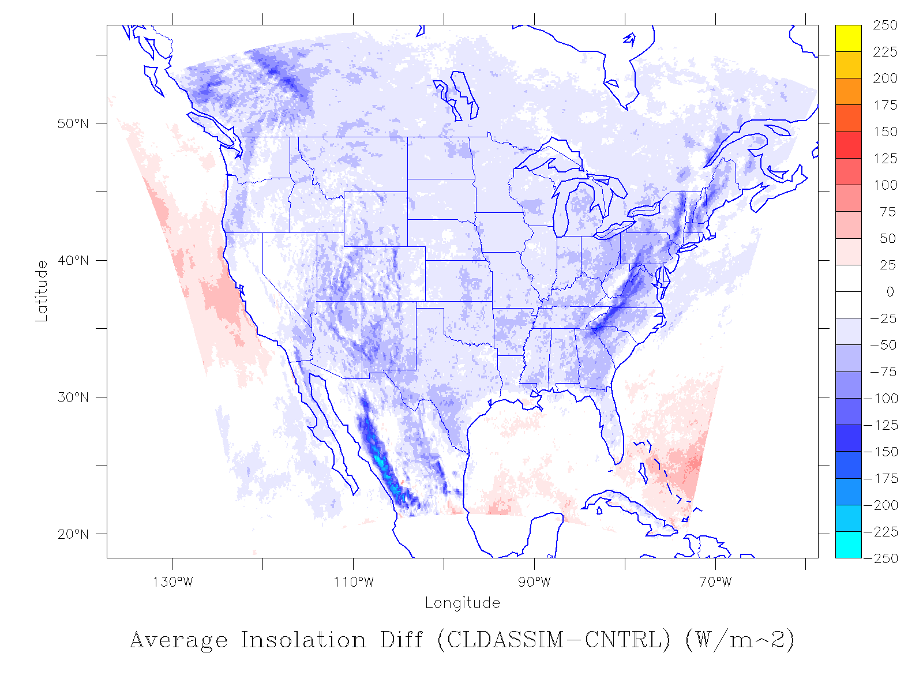
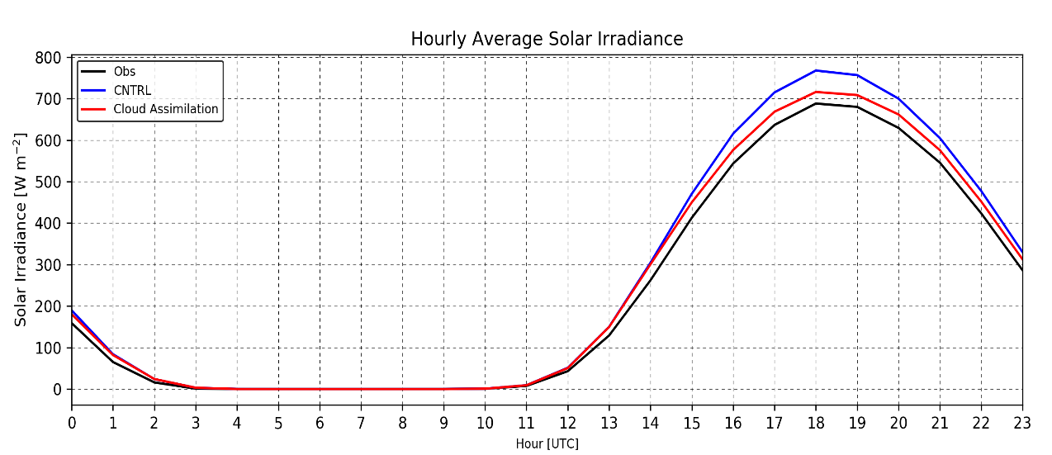
Impact on Surface Insolation August-September 2013
Comparison to USCRN pyranometer data shows a reduction in model bias and RMSE over the 14-23 UTC assimilation window.
Average bias and RMSE reduction of 28.5 W m⁻² and 15 W m⁻², respectively.
Insolation Difference: CLDSAT - CNTRL
Average For July-August-September, 2013

Slide 8
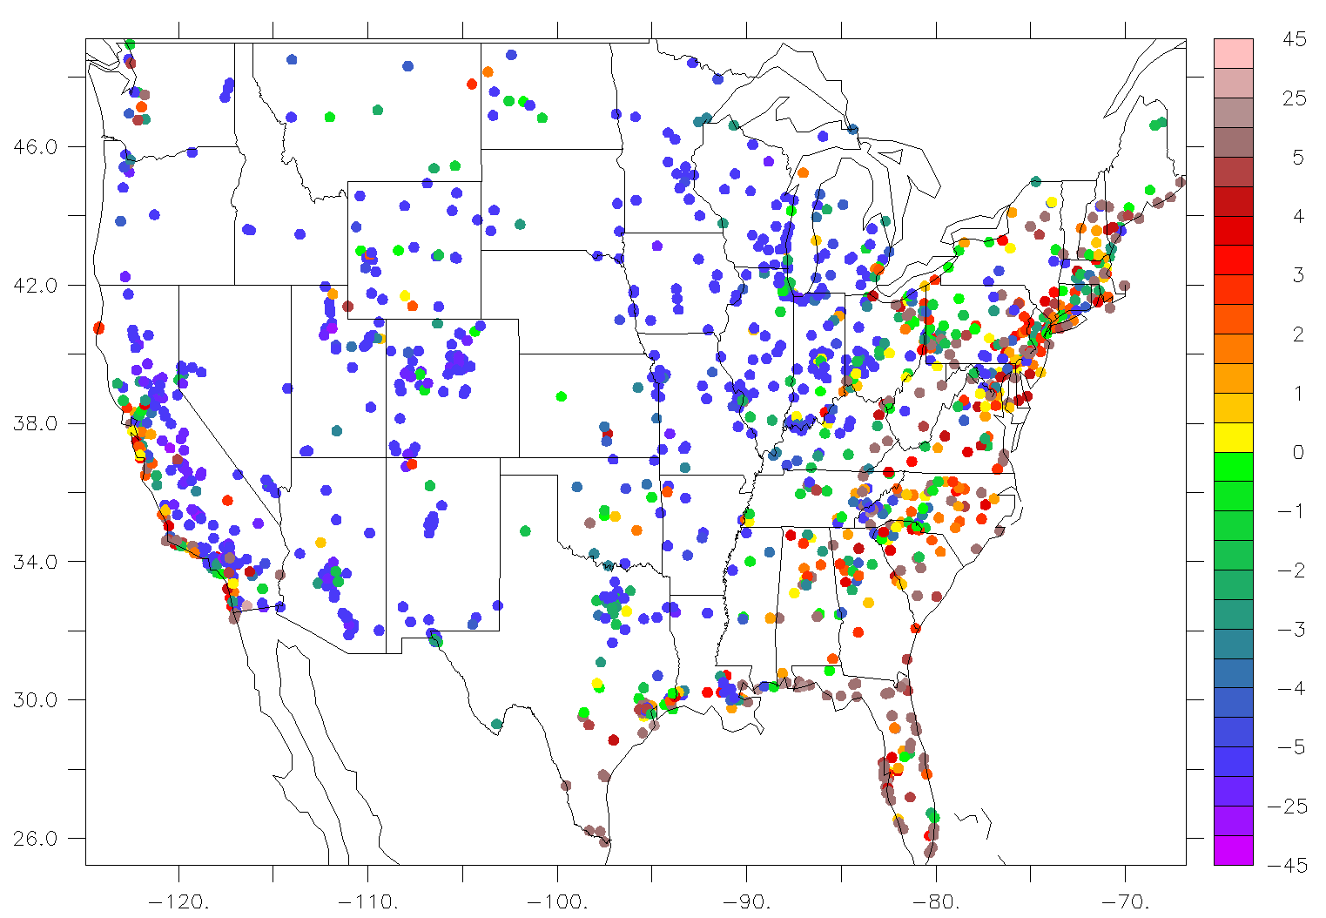
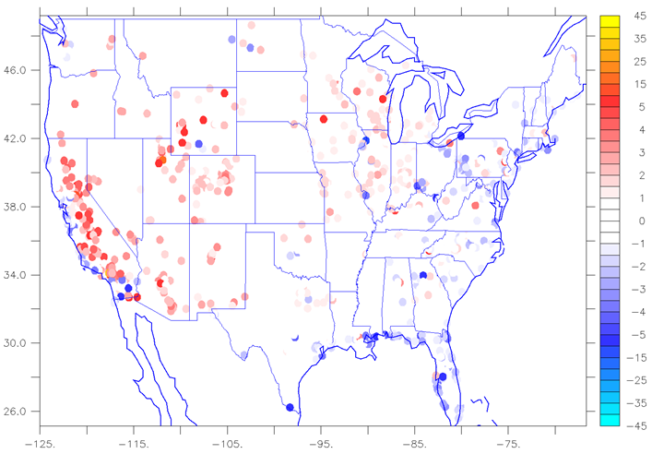
Impact on 2013 Photochemical Simulations
2013 WRF simulations was used in Community Multi-scale Air Quality (CMAQ) V5.1 to assess air quality impact of cloud assimilation
Emissions processed with SMOKE V3.6 Using 2011NEIv6.2, BEIS3 for biogenic emissions.
Model overpredicting over the eastern U.S. and over the coastal areas, underpredicting over central/western Continental U.S.
Average O3 BIAS at EPA Surface Monitors over July-Sept., 2013 Period
Increase/Decrease in Bias July-Sept., 2013 Period
Cloud Assimilation

Slide 9
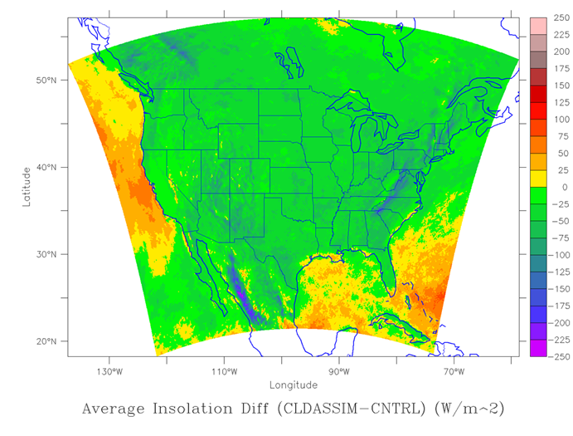
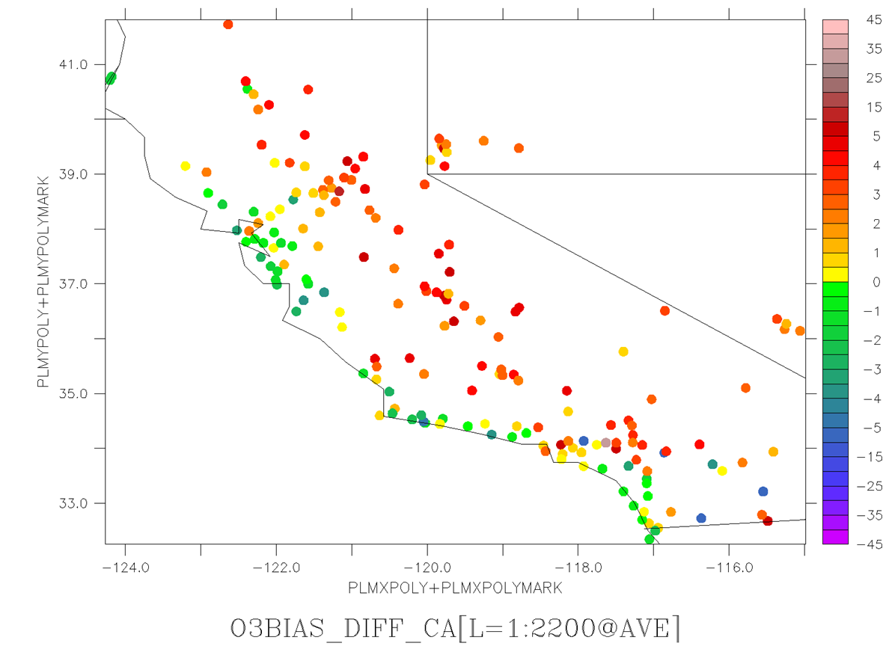
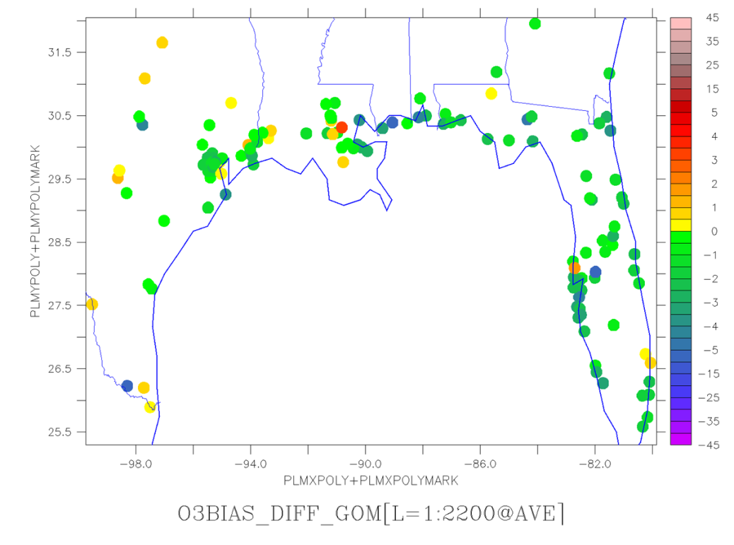
Impact on 2013 Photochemical Simulations
Surface Insolation Difference: CLDASSIM - CNTRL
Average for July-August-September, 2013
Coastal areas saw improvement in ozone concentration.
For the period of Jul-Sept. 2013, control WRF simulation produced more clouds over water and less over land.
Cloud assimilation removed clouds over water and produced more over land.
Increase/Decrease in O3 Bias
July-Sept., 2013
Increase/Decrease in O3 Bias
July-Sept., 2013

Slide 10
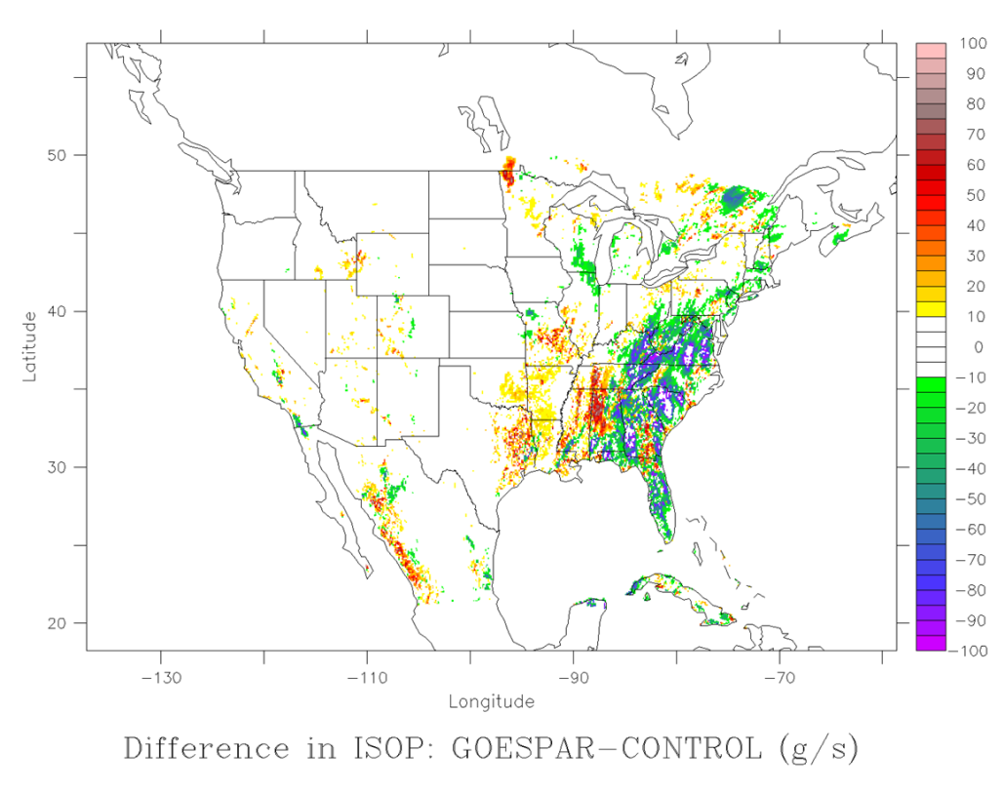
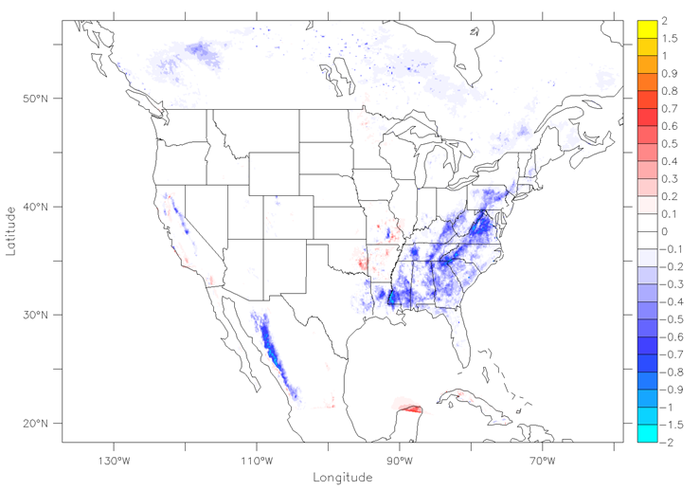
Impact on 2013 Photochemical Simulations
Control simulation under-predicting clouds over the eastern U.S. leading to over-prediction of isoprene emission.
Cloud Assimilation reduces isoprene concentration over eastern U.S. by about .5-1 ppb (averaged over Jul-Aug-Sept)
Isoprene emissions over S.E. was reduced substantially.
Difference in Isoprene Emissions (g/s) at 20 GMT on July 4, 2013
(CldAssim - Control)
Difference in Isoprene Concentration (ppb)
Averaged over July-August-September, 2013
(CldAssim - Control)
x

Slide 11
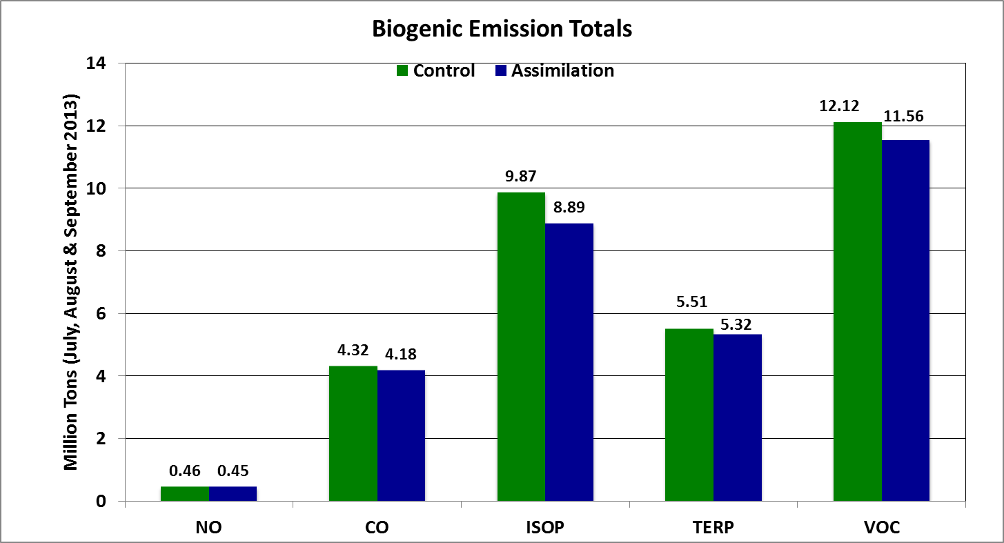
Impact of Cloud Assimilation on 2013 Photochemical Simulations
Average Isoprene emissions over VISTAS Region Was reduced by 10%

Slide 12
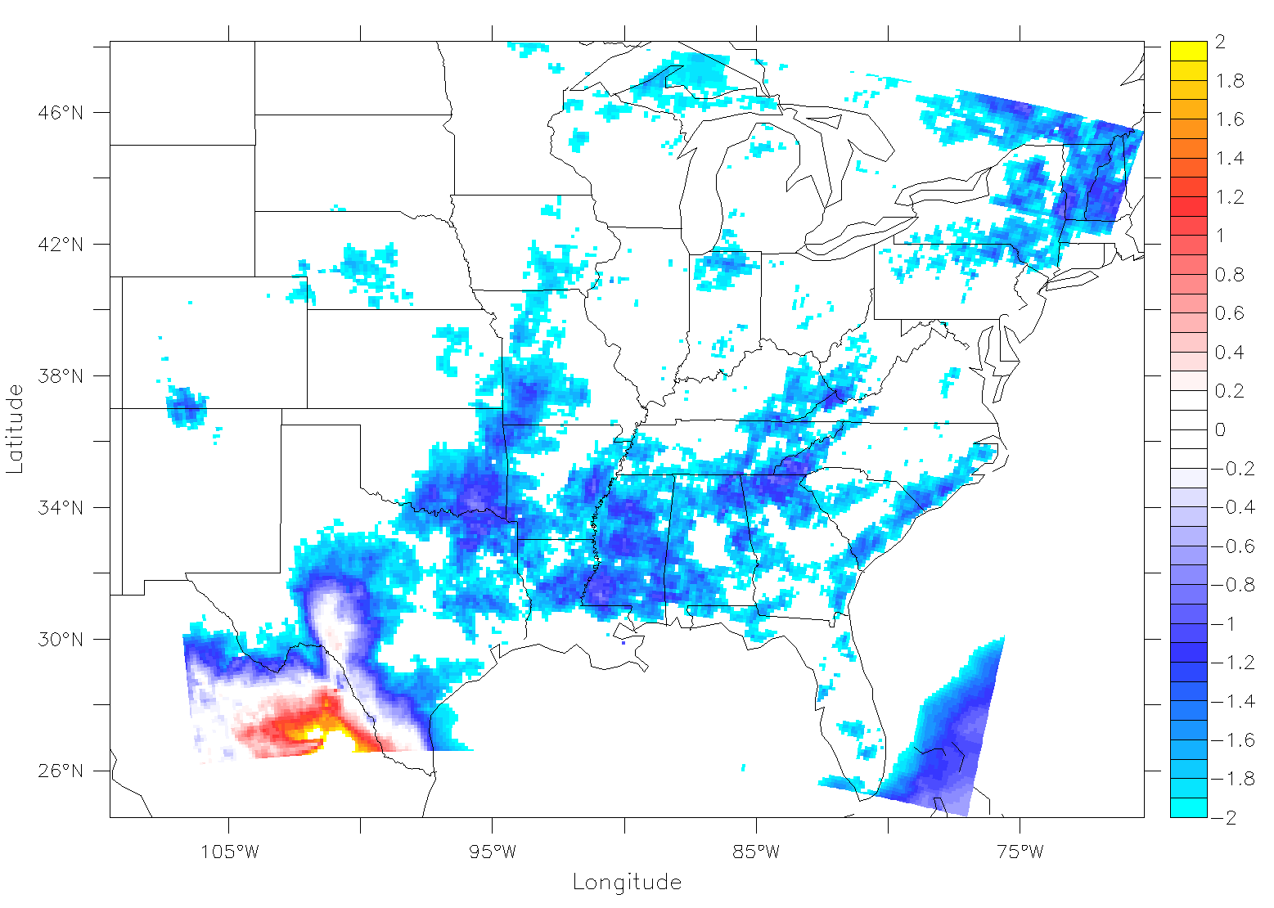
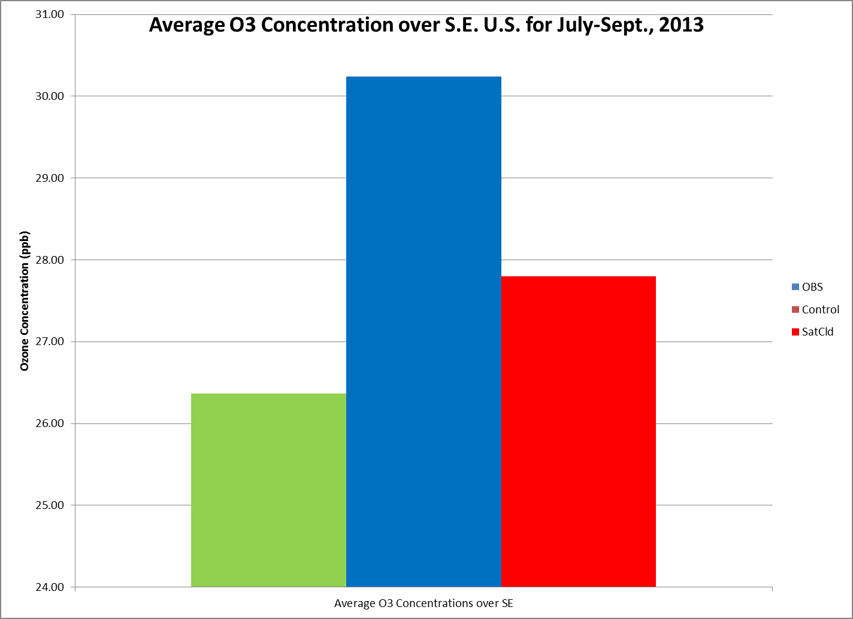
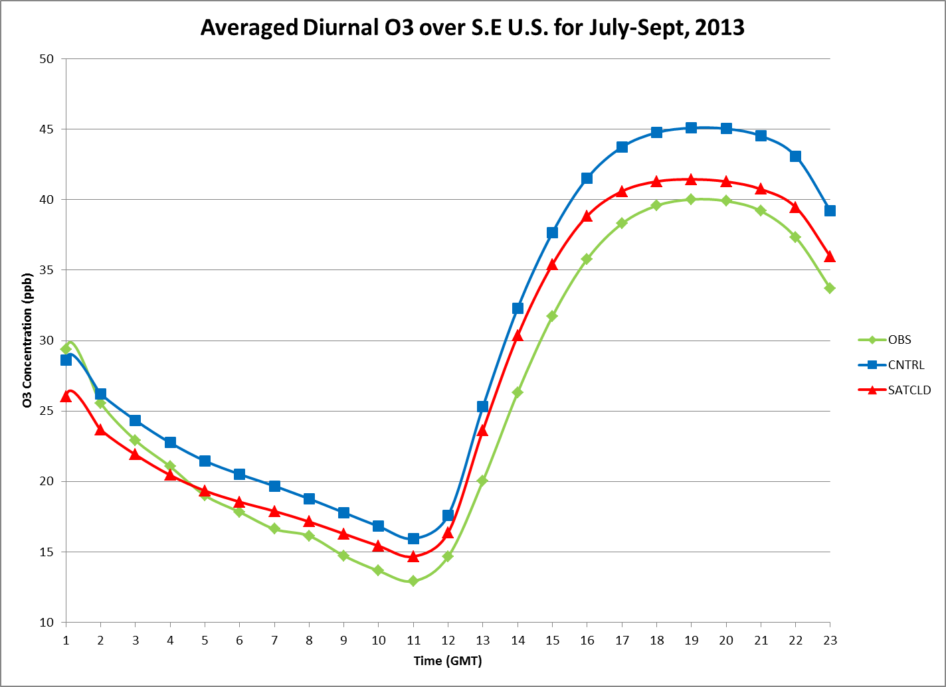
A Closer Look at the Results over S.E. U.S.
Average O3 difference between control and cloud assimilation simulations
(Aug-Sept, 2013): satcld-control
63% reduction in bias for ozone over the S.E.
Significant daytime improvement
CNTRL
SatCld
OBS

Slide 13
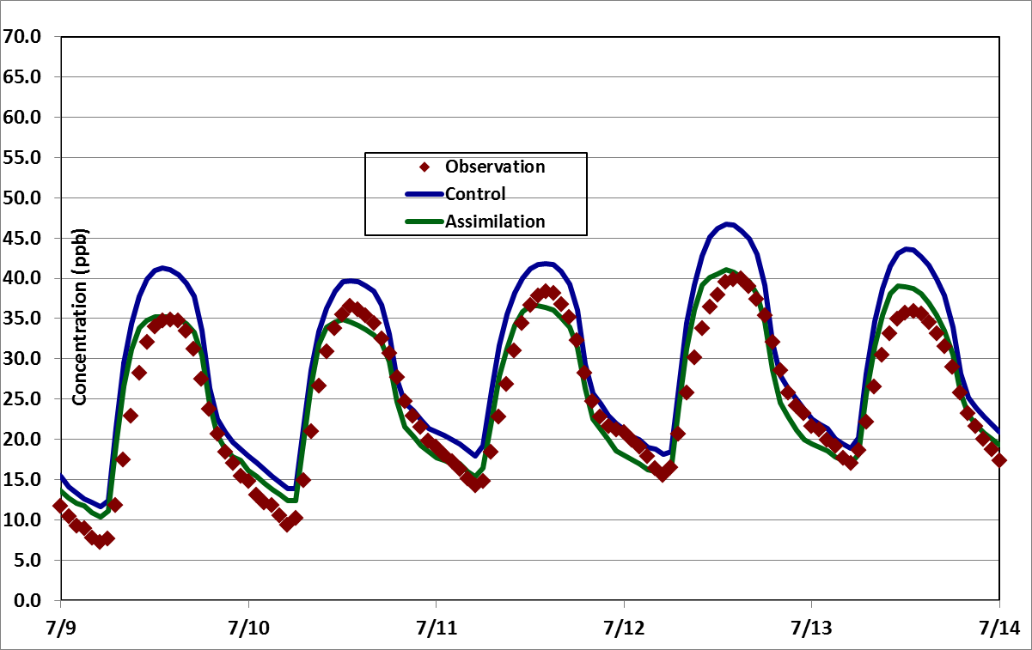
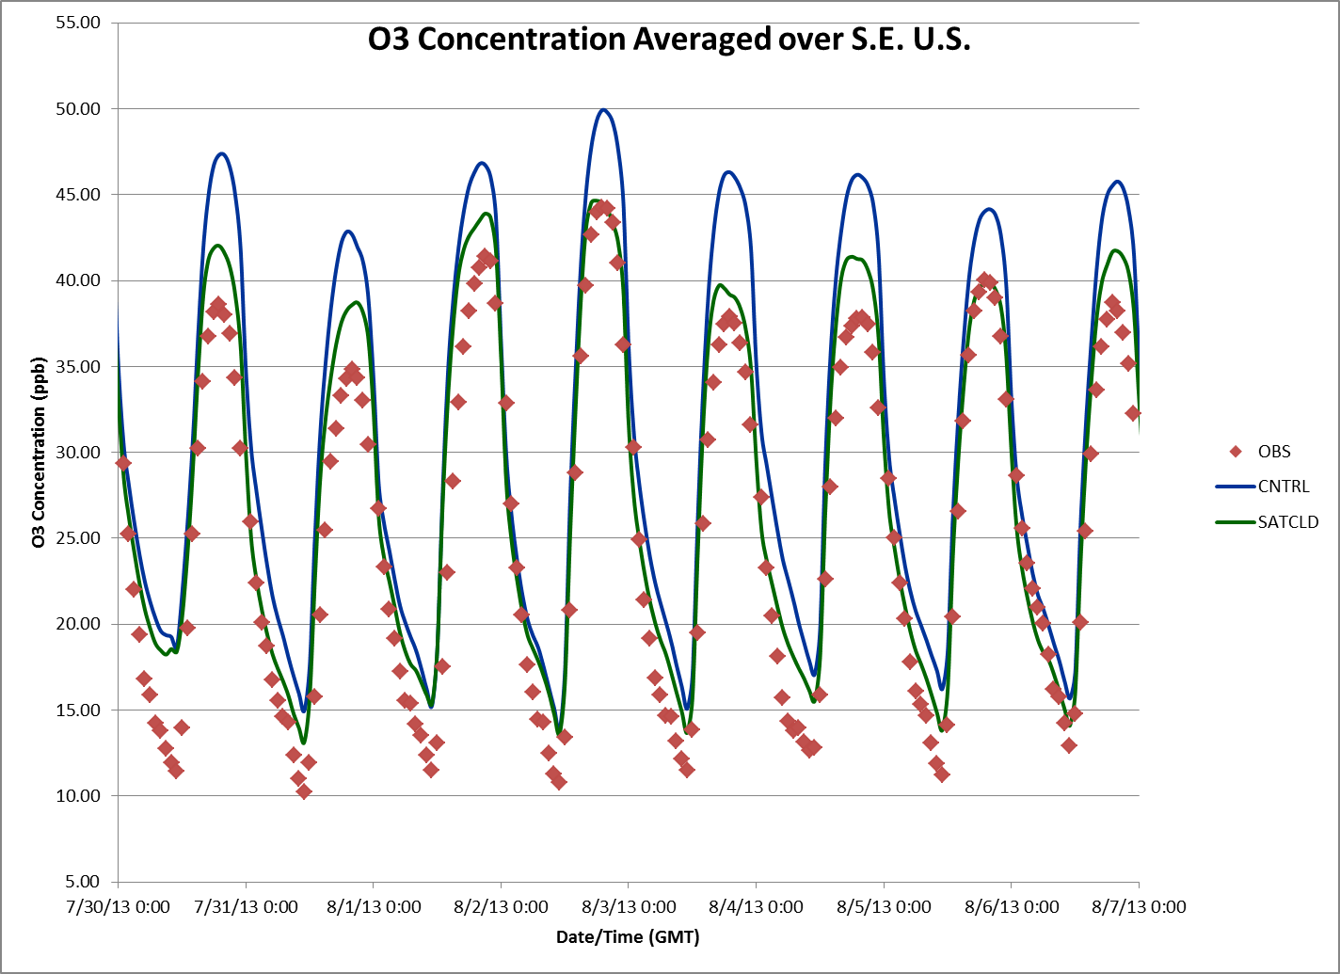
The Improvements Are More Pronounced Where the Error is Due to Clouds
Improvements are more pronounced on days with large regional cloud correction
TOP LEFT:
Performance for July 9 Through July 14 Over VISTAS Region.
BOTTOM RIGHT:
Performance for July 30 Through August 7 Over S.E. Region.

Slide 14
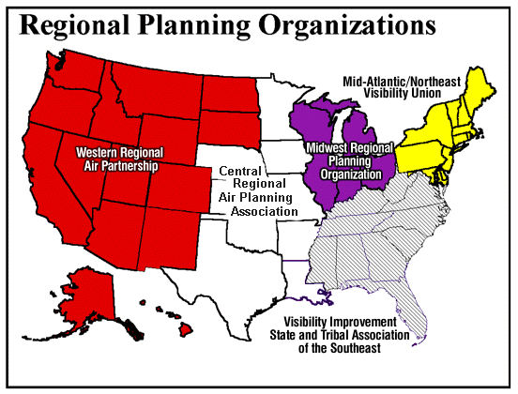
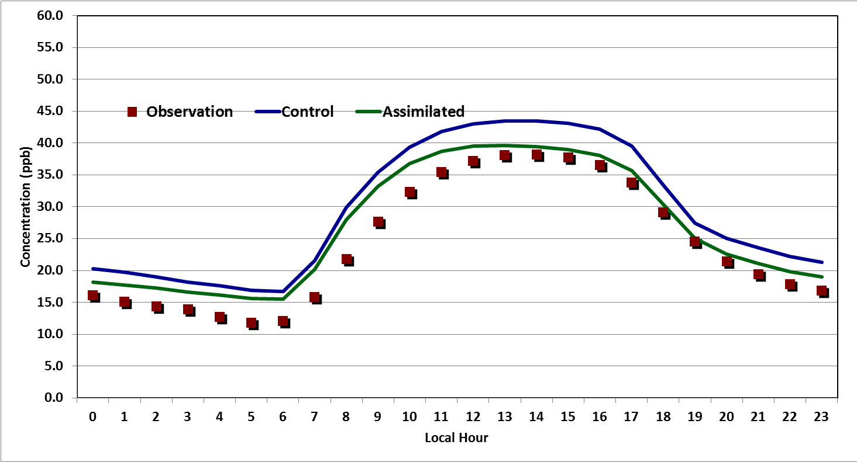
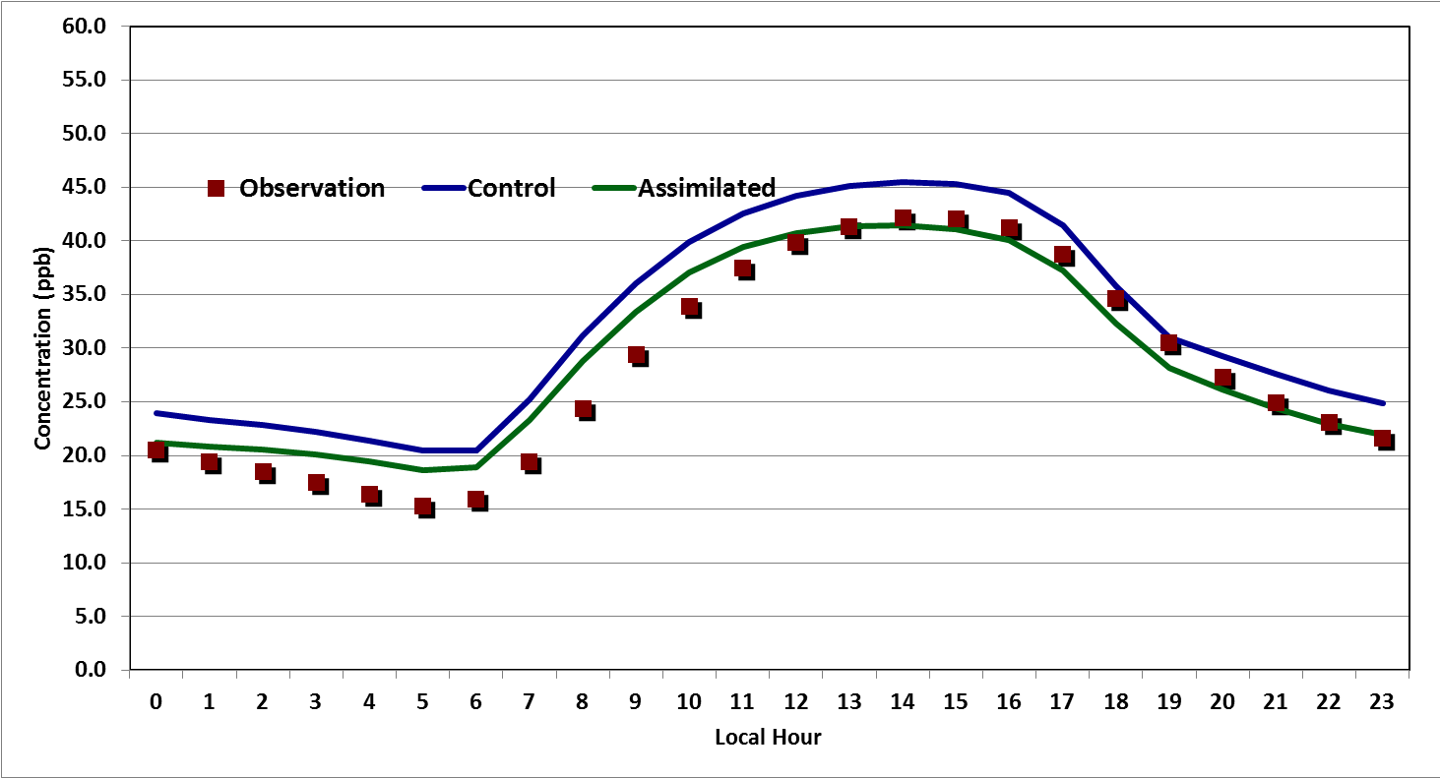
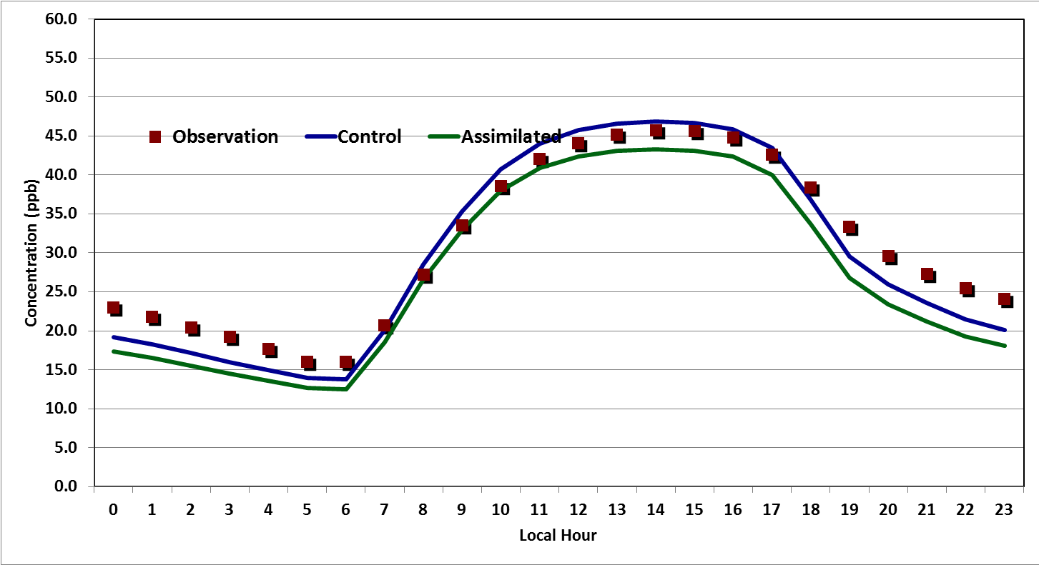
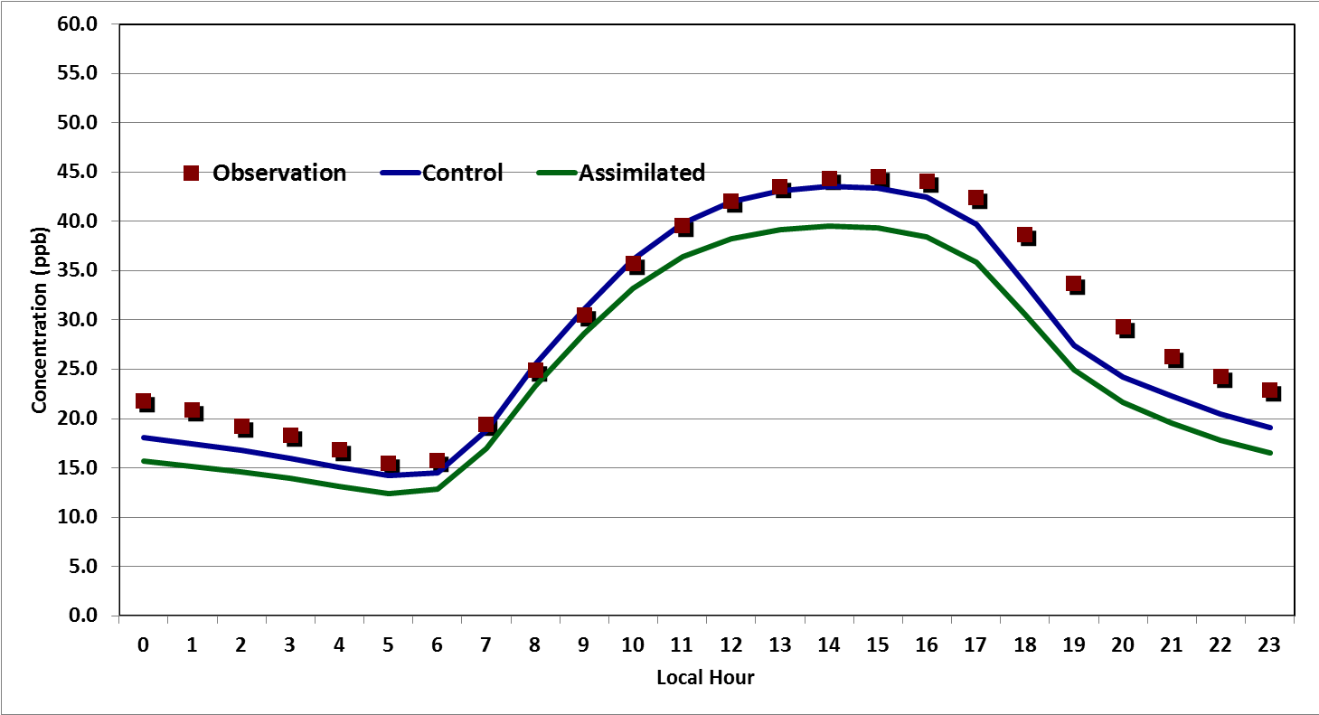
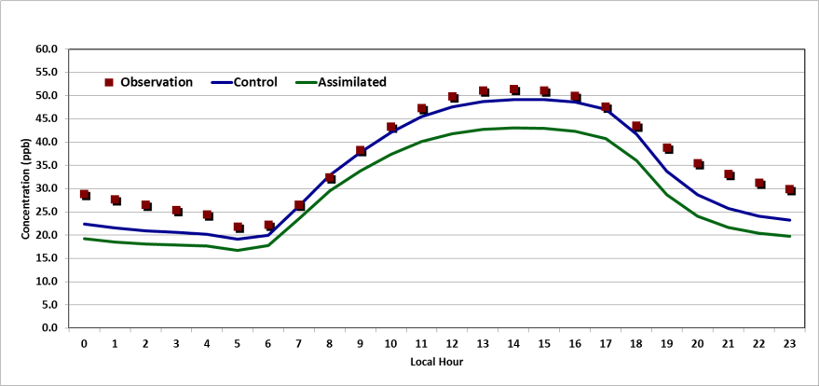
Averaged Diurnal Patterns Over Different Regions
VISTAS
MANEVU
CENRAP
WRAP
MWRPO

Slide 15
Recap and Concluding Remarks
A technique was developed to assimilate satellite observed clouds in WRF and was tested over summers of 2006 and 2013 with consistent results.
The impact of cloud assimilation on air quality simulations during 2013 NSASA Discover-AQ period was studied.
For the summer of 2013 (July-Sept), in general WRF model underestimated clouds over east/southeastern United States.
Due to cloud under-prediction, the control simulation over-estimated isoprene emissions. The simulation with cloud assimilation partially corrected this error and reduced isoprene emissions by 10%.
By slowing down the photochemistry and decreasing BVOC emissions, cloud correction also reduced O3 bias in the S.E. by over 60%.
The photochemical correction is episodic and is more pronounced where the dominant model error is due to errors in cloud placement and timing and in areas with large emission source.
Model clouds being too opaque remains an issue that needs to be resolved.

Slide 16
Acknowledgment
The findings presented here were accomplished under partial support from NASA Science Mission Directorate Applied Sciences Program and the Texas Commission on Environmental Quality (TCEQ).
Note the results in this study do not necessarily reflect policy or science positions by the funding agencies.

