Slide 1
Parameterization of MOVES Emissions Factors Lookup Tables for Air Quality Forecasting System
B.H. Baek, Alejandro Valencia, and Michelle Snyder
UNC at Chapel Hill, USA
SoonTae Kim and Changhan Bae
Ajou University, South Korea
Notes:
What is SMOKE simple way
Not a model like air quality models but a processor to convert monthly/annual county-level inventory pollutants to air quality modeling needs
History of SMOKE system and inventory data evolution … does not fit into a single pathway like area, mobile, point and biogenic
New way of thinking to process them and meets the need of air quality model with the continuous support from inventory group in OAQPS at EPA
Over the last 11 years, I have mada a few siginifcant updates…like SMOKE-MOVES integration tool in 2010. Now we are making another move forward movement to the future to meet the needs of global air quality modeling community.
2013 CARB also wants us to update the system to meet their CARB modeling system and developing the one integrated system without many sysytem

Slide 2
Current Status
SMOKE-MOVES Integration Tool Released on 2010
Latest SMOKE-MOVES2014a Integration Tool
Enhanced the meteorology dependency on mobile emissions for air quality modeling system
Technical Challenges:
Slow and Most Computationally Expensive!
Big size of ASCII-format MOVES Emissions Factors Lookup Tables (MOVES EF LUTs)
Limited numbers of Reference County MOVES EF LUTs
Limited to ambient temperature, not yet to RH

Slide 3
SMOKE-MOVES Integration Tool
RatePerDistance [grams/miles]
Exhaust and most evaporative emissions that happen on real road types
Sorted By SCC (=vehicle/road/process/fuel), 16 Speed Bins and Ambient Temperature Bins
RatePerVehicle [grams/vehicle/hour]
Exhaust and most evaporative emissions that occur off-network
Sorted By SCC, Hour of day and Ambient Temperature Bins
RatePerProfile [grams/vehicle/hour]
Vapor venting evaporative emissions that occur off-network
Sorted By SCC, Hour of day and Min/Max Temperatures
RatePerHour [grams/hour]
APU operation and extended idling processes
Sorted By SCC, Ambient Temperature
Notes:
Before we get into SMOKE-MOVES2014 integration tool, I would like to quickly explain what is SMOKE-MOVES integration tool first for your better understanding of this presentation.
As you already know, previous MOVES2010 can develop emissions in two different methods. First one is “Inventory Mode” which allows you to develop annual/monthly county total emissions inventory. And the other method is called “Emissions Rate” mode which allows you to develop on-road and off-network emission rates outputs from three different modes.
RPD which represents exhaust and most evaporative on-read emissions from real road types. Because these are EF in unit of g/mile, we need to apply hourly VMT activity inventory to compute hourly emissions from onroad sources.
RPV which represents
RPP
As some of you already know SMOKE is emission processor that creates hourly spatially gridded emissions input files for air quality models like CMAQ and CAMx. To develop these kind of hourly gridded chemically speciated emissions files for air quality model, we have developed the SMOKE-MOVES tool.
This tool will allow users to apply real time hourly on-road and off-network emissions using hourly meteorological input data, these emissions rates from MOVES and mobile activity inventories (VMT and VPOP)

Slide 4
Current SMOKE-MOVES Integration Runs
Around 350 Reference Counties for Continental U.S. Modeling Domains
Two Fuel Months per Each Reference County
Size of MOVES Lookup Tables:
RPD: 85-150MB, RPV: 45-95MB, PRP: 15-50MB, PRH: Less than 1MB
Processing Optimization: Processing 7 consecutive days at a time.
Faster processing but requires more RAM memory
Processing 1 days at at time, much slower processing time
Tagging or source grouping options: much more memory and slower processing time
More Grid Cells and more reference counties = more memory and slower processing time
Sectors | Computing Time | RAM Memory Usages
RPD | 4 hours | 10-20 GB
RPV | 1.5 hours | 5-10 GB
RPP | 30 minutes | < 1 GB
RPH | 5 minutes | 2 GB

Slide 5
Solutions
Current Solutions:
Computational Optimization of the SMOKE-MOVES Integration tool
Reduce the size and numbers of MOVES EF lookup tables:
Aggregated Processes (Less than 15 processes)
Aggregated Vehicle and Road Types
Reduced optimized temperature increments
Limited numbers of reference counties.
Proposed Solutions:
Parameterization of Current ASCII-format MOVES EF Lookup Tables into Polynomial Algorithms using Best-Fitted Curve Algorithms (BFCA)
Store the algorithms in NetCDF format to eliminate I/O bottlenecks
Coupling with SMOKE and AQ models including forecasting AQ

Slide 6
RatePerDistance (RPD)
Reference County:
Baltimore County, MD (24005)
Vehicle Types:
Passenger Vehicle
Transit Buses
Processes:
All Exhaust, Evaporative, Brake and Tire [81]
Refueling [62]
Pollutants: TOG, NOx, PM2.5

Slide 7
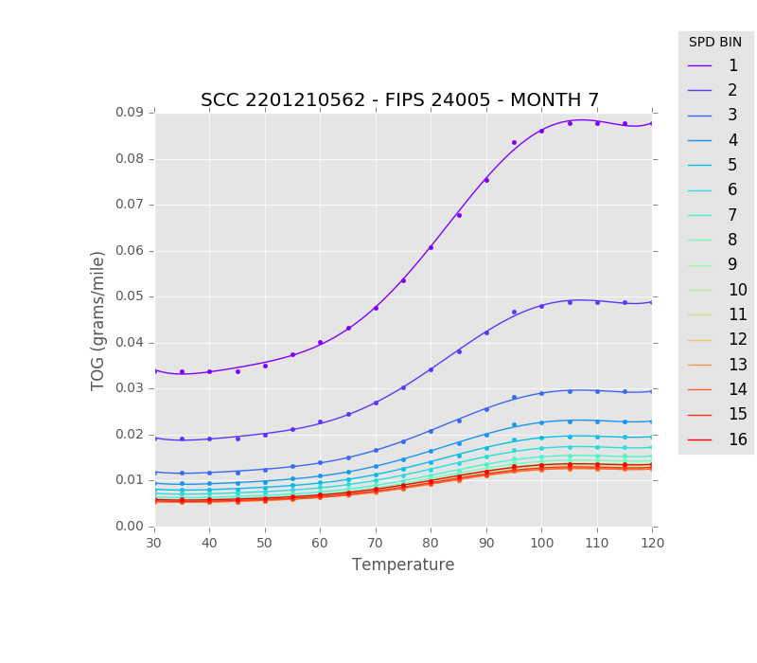
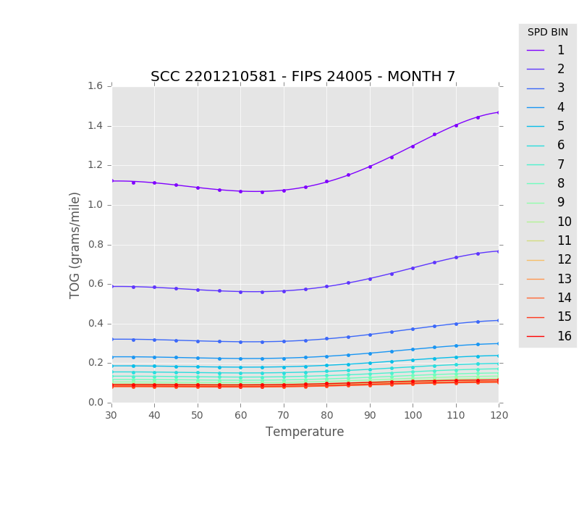
TOG: Gasoline-Passenger Car: Urban Unrestricted Access Refueling [62] and All Exhaust, Evaporative, Brake and Tire [81]

Slide 8
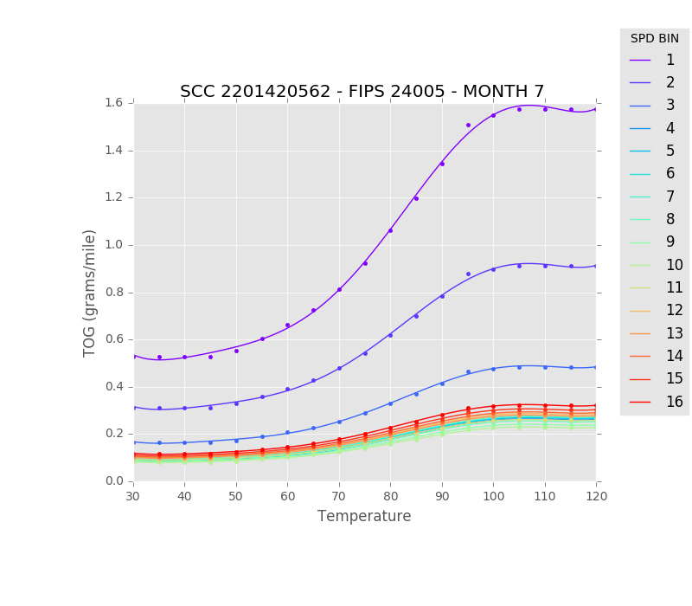
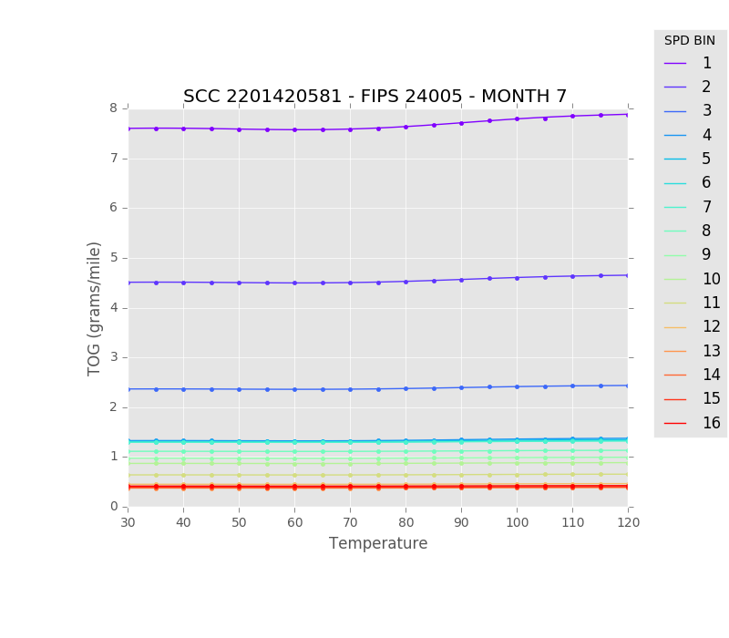
TOG: Gasoline-Transit Buses : Urban Unrestricted Access Refueling [62] and All Exhaust, Evaporative, Brake and Tire [81]

Slide 9
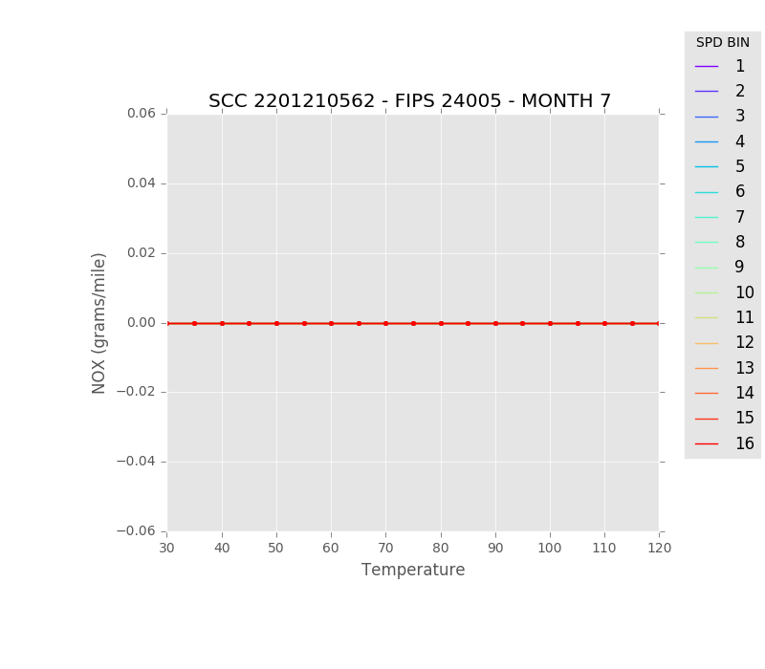
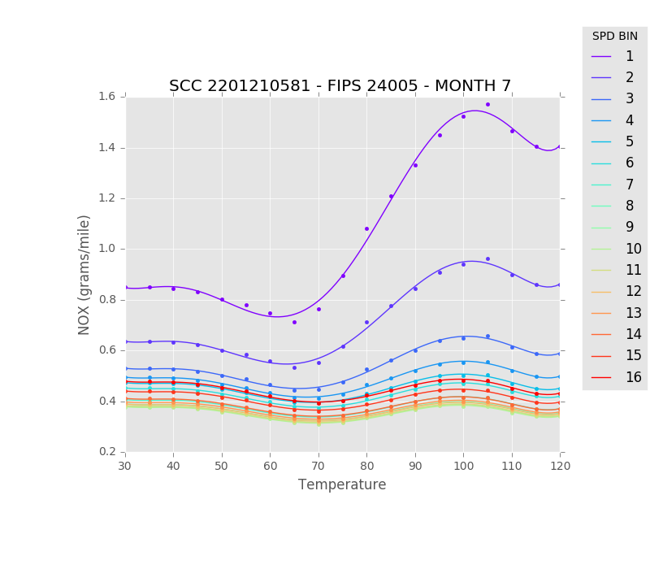
NOx: Gasoline-Passenger Car: Urban Unrestricted Access Refueling [62] and All Exhaust, Evaporative, Brake and Tire [81]

Slide 10
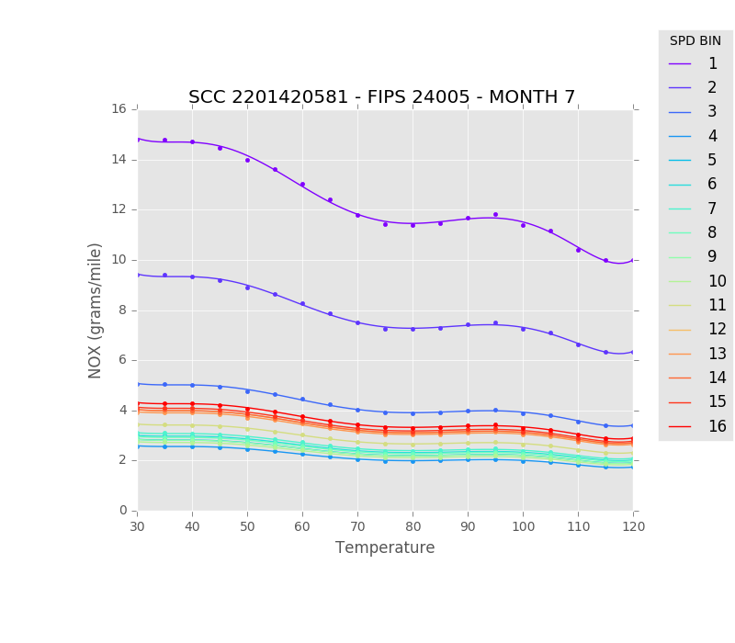
NOx: Gasoline-Transit Buses : Urban Unrestricted Access Refueling [62] and All Exhaust, Evaporative, Brake and Tire [81]

Slide 11
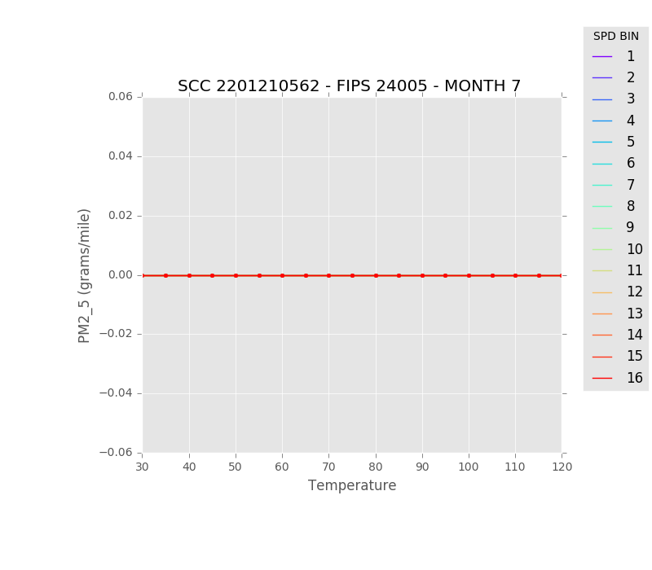
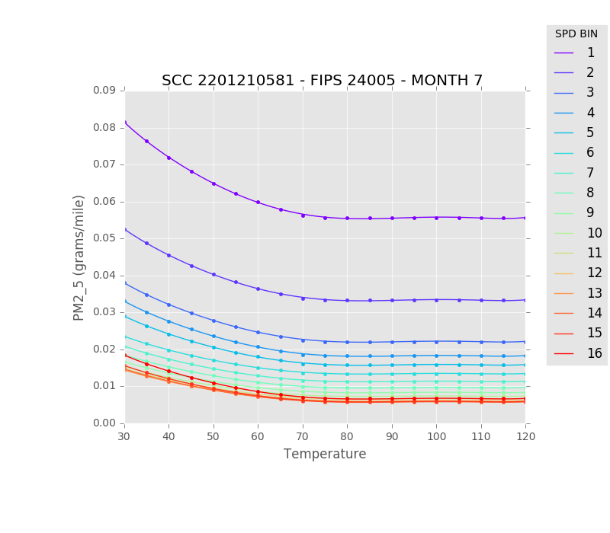
PM2.5: Gasoline-Passenger Car: Urban Unrestricted Access Refueling [62] and All Exhaust, Evaporative, Brake and Tire [81]

Slide 12
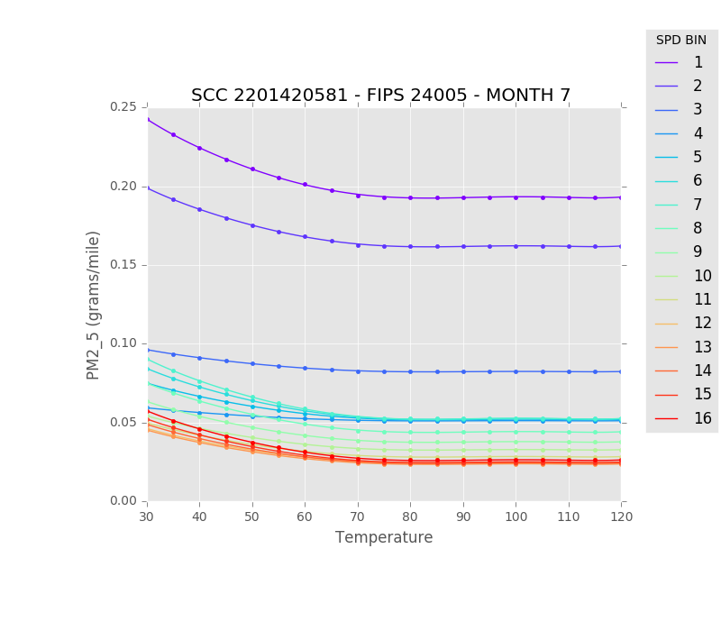
PM2.5: Gasoline-Transit Buses : Urban Unrestricted Access Refueling [62] and All Exhaust, Evaporative, Brake and Tire [81]

Slide 13
Rate Per Vehicle (RPV)

Slide 14
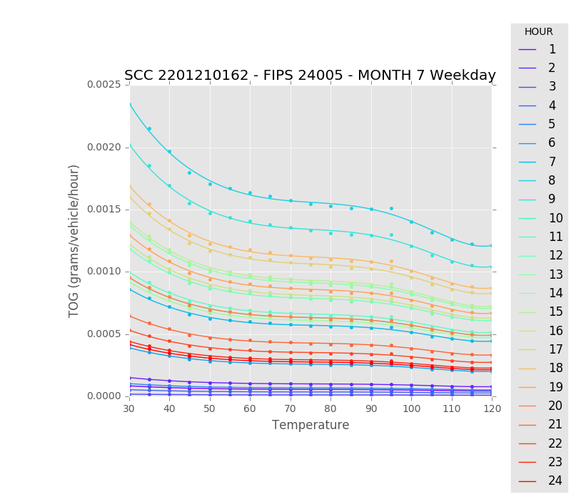
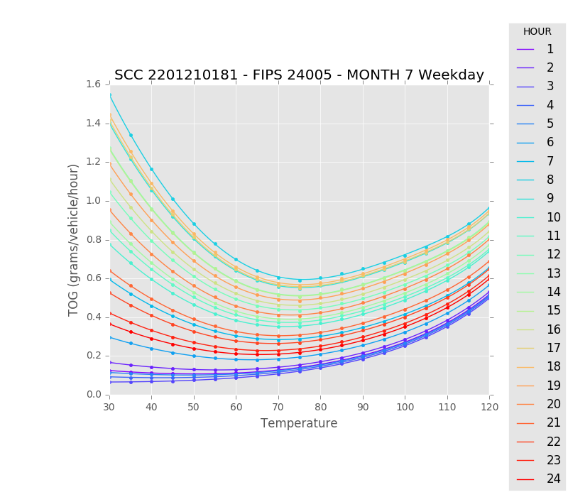
TOG: Gasoline-Passenger Car : Off-network Refueling [62] and All Exhaust, Evaporative, Brake and Tire [81]

Slide 15
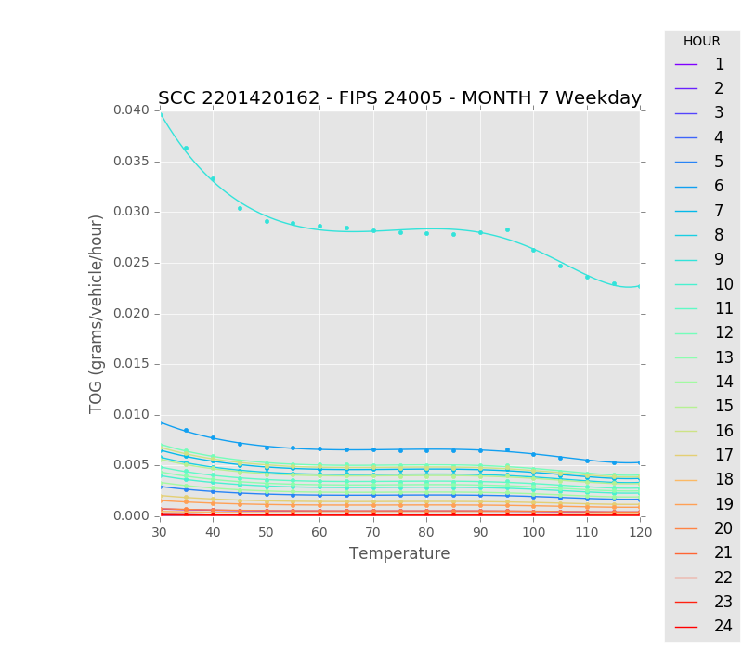
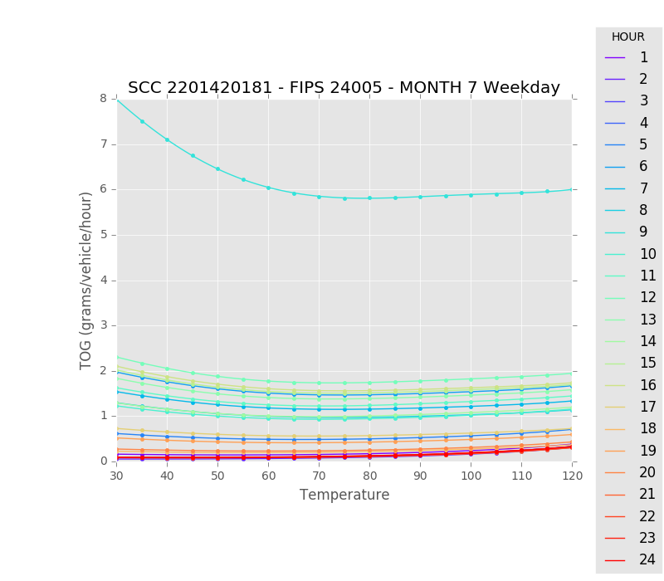
TOG: Gasoline-Transit Buses : Off-network Refueling [62] and All Exhaust, Evaporative, Brake and Tire [81]

Slide 16
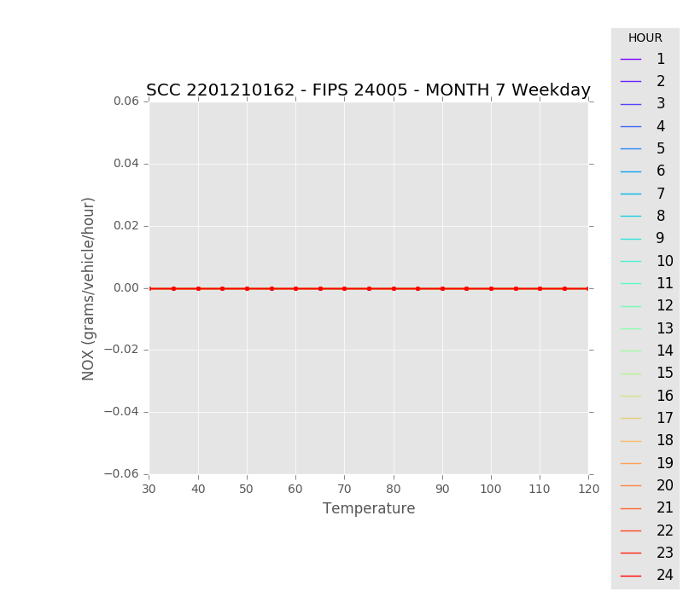
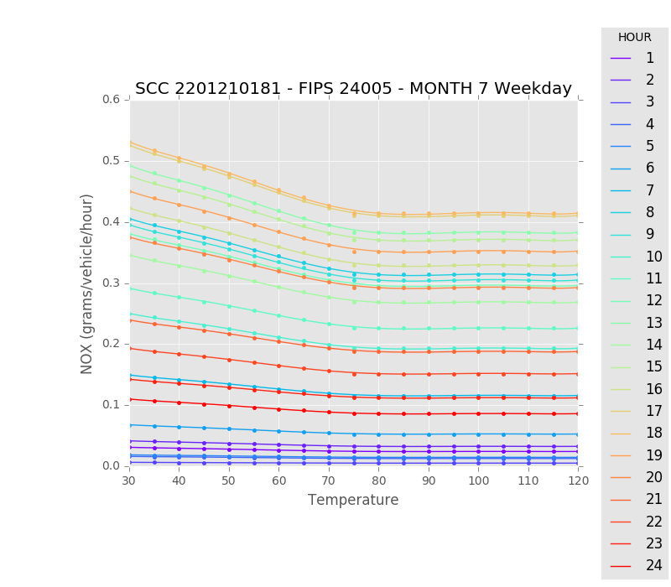
NOx: Gasoline-Passenger Car : Off-network Refueling [62] and All Exhaust, Evaporative, Brake and Tire [81]

Slide 17
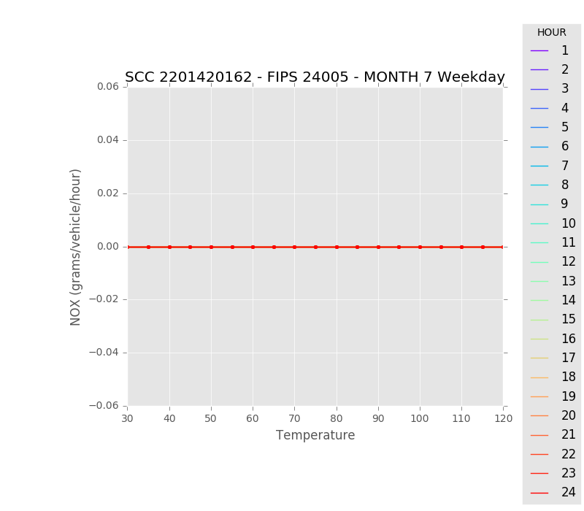
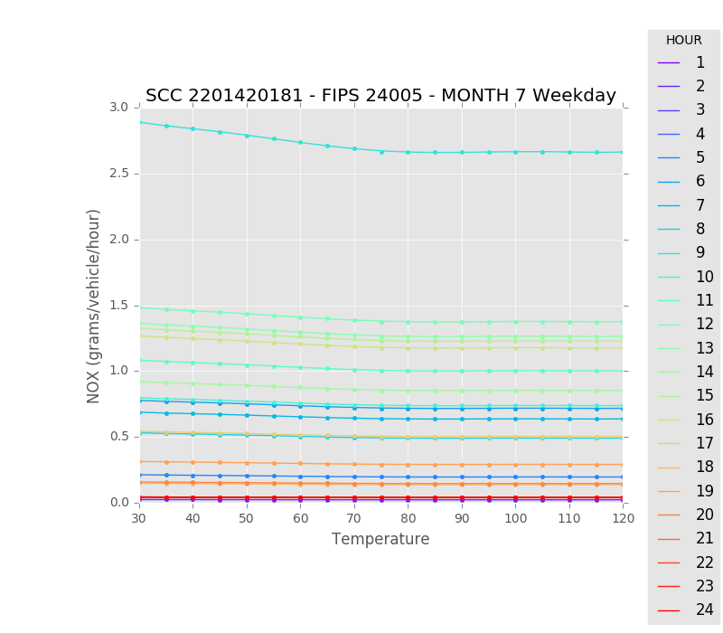
NOx: Gasoline-Transit Buses : Off-network Refueling [62] and All Exhaust, Evaporative, Brake and Tire [81]

Slide 18
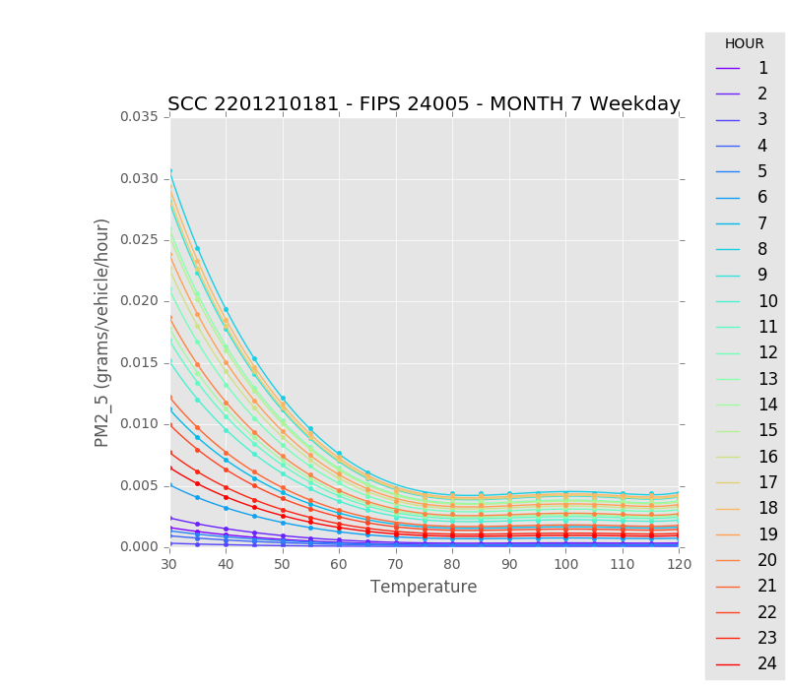
PM2.5: Gasoline-Passenger Car : Off-network Refueling [62] and All Exhaust, Evaporative, Brake and Tire [81]

Slide 19
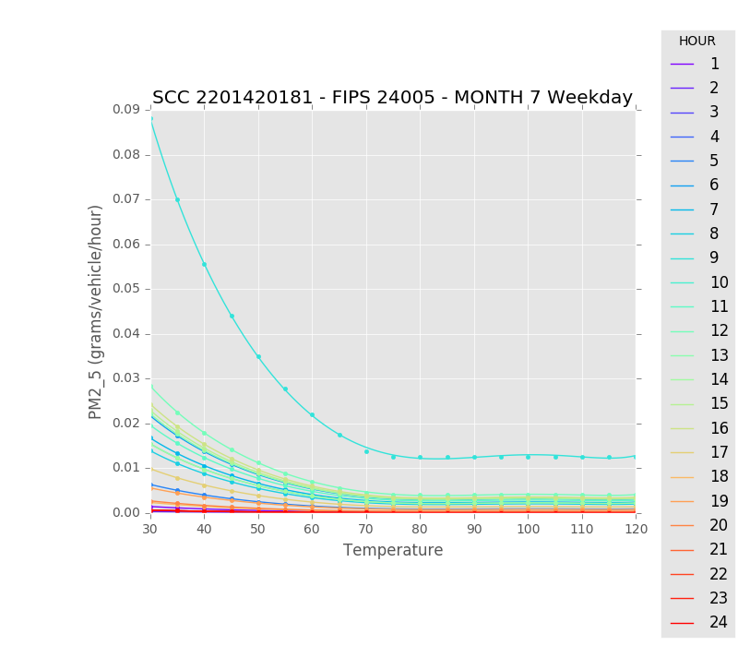
PM2.5: Gasoline-Transit Buses : Off-network Refueling [62] and All Exhaust, Evaporative, Brake and Tire [81]

Slide 20
Rate Per Hour (RPH)

Slide 21
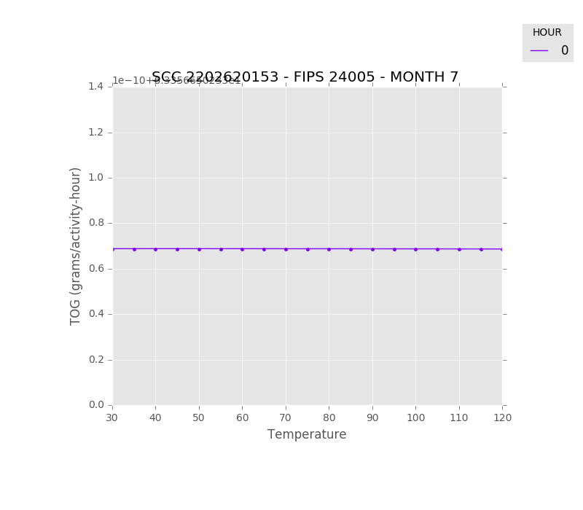
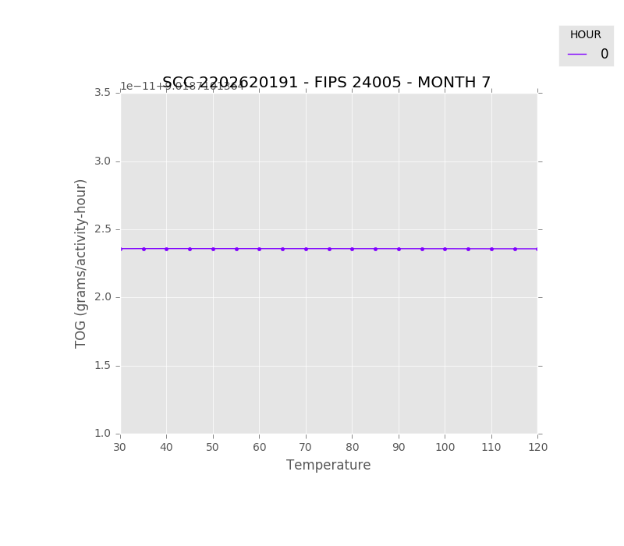
TOG: Diesel Long-haul Truck : Off-network Extended Idle Exhaust [53] and Auxiliary Power Exhaust [91]

Slide 22
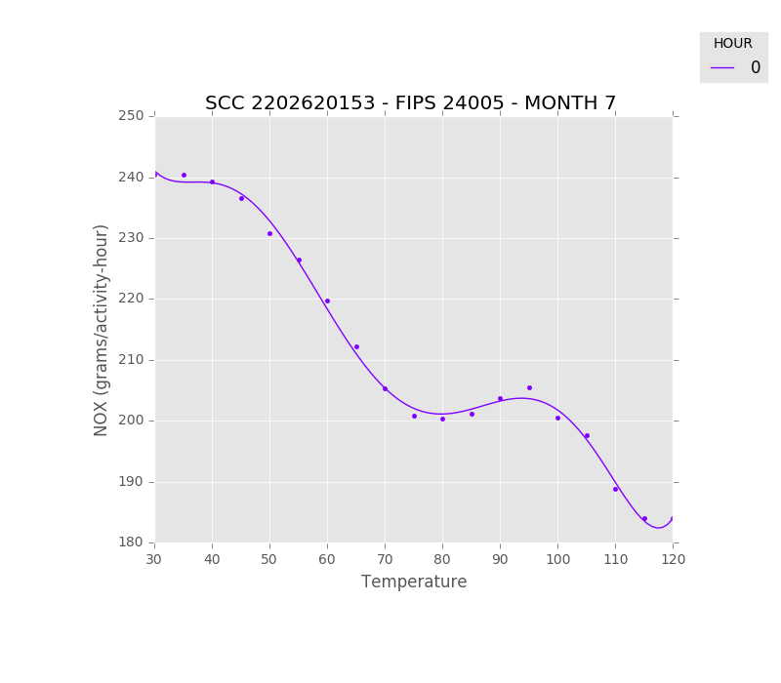
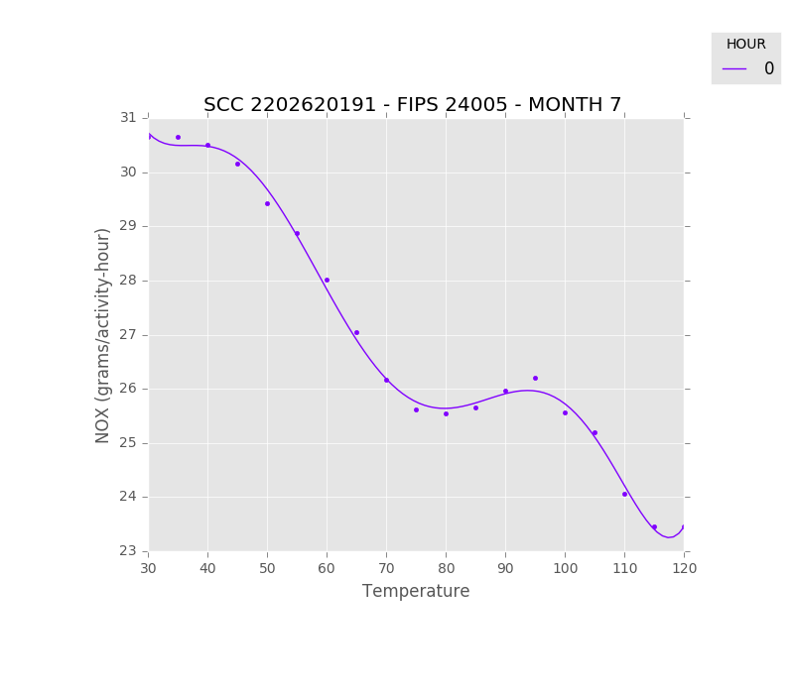
NOx: Diesel Long-haul Truck : Off-network Extended Idle Exhaust [53] and Auxiliary Power Exhaust [91]

Slide 23
Rate Per Profile (RPP)

Slide 24
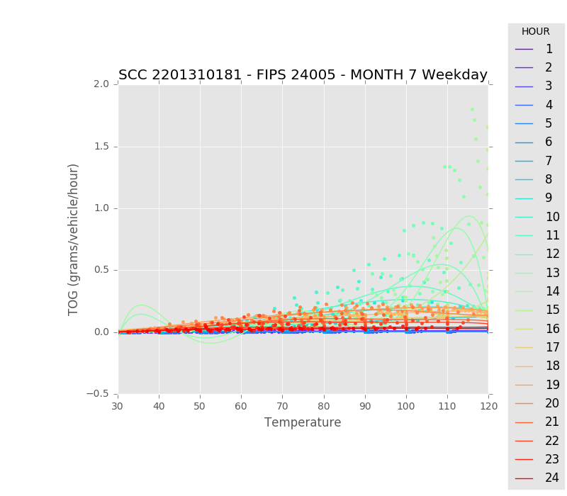
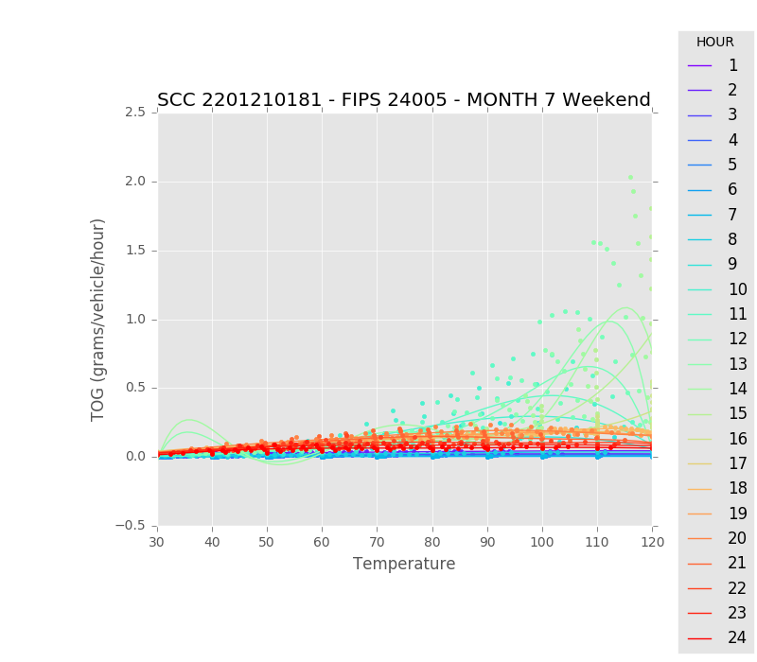
TOG: Gasoline-Passenger Cars : Off-network All Exhaust, Evaporative, Brake and Tire [81] : Weekday vs. Weekend

Slide 25
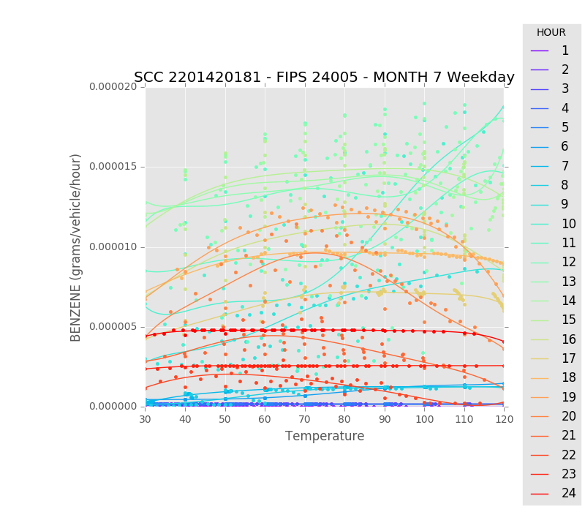
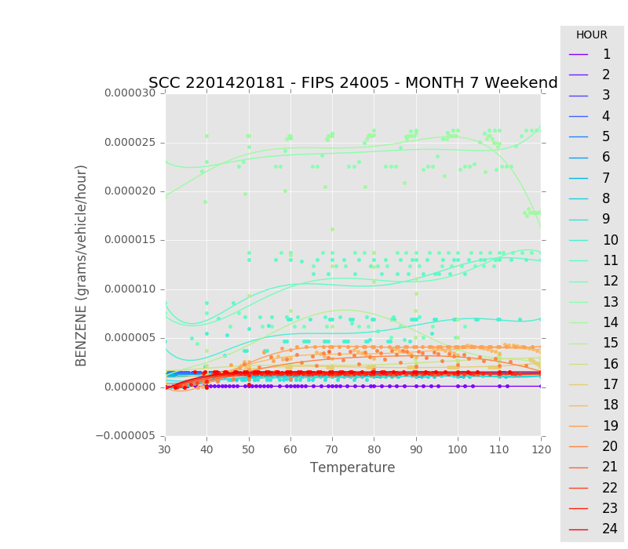
TOG: Gasoline-Transit Buses: Off-network All Exhaust, Evaporative, Brake and Tire [81] : Weekday vs. Weekend

Slide 26
File Size Comparison
The main factors of NetCDF-format MOVES BCFA Lookup Table Size:
Temperature Bins
Number of Pollutants
Number of Vehicle/Road/Processes (=SCC)
Order of algorithms and Intercept values
Do not expect significant changes in the size of NetCDF BFCA Lookup Tables
Sectors | ASCII (MB) | CSV* (MB) | NetCDF* (MB)
RPD | 85-150 (87*) | 33 | 20
RPV | 45-100 (55*) | 25 | 15
RPP | 15-50 (17*) | 2.2 | 1.4
RPH | <1MB (.65*) | 0.7 | 2.7
* Size estimate is based on Baltimore reference county

Slide 27
Future Applications
Integrated into the current SMOKE Modeling System
Reducing the computational time/memory usages
Enhancing the quality of mobile emissions with more no of reference counties
Validating the BCFA-based onroad mobile emissions results
“Inline” MOVES-CMAQ Development, similar to integrated biogenic emissions models (BEIS and MEGAN)
A fully coupled with various air quality modeling systems:
Estimating emissions using WRF/MCIP gridded meteorology that reflects the feedbacks of gases and aerosol for air quality models.
Finer mobile emission estimate time step (~15min or less)
WRF-CMAQ-MOVES, Other air quality and climate models

Slide 28
Acknowledgement
Korea National Institute of Environment and Research (NIER)
U.S. EPA
Office of Air Quality Planning and Standards (OAQPS)

Slide 30
Motivations
Introduce the meteorology dependency to Korea National Institute of Environmental Research (NIER) Air Quality Forecasting Modeling System (NAQFMS)
Targeted emissions sources:
Agricultural NH₃ Emissions
Residential Heating Emissions
Onroad Mobile Emissions
2016: Development of the meteorology-dependent Temporal Profiles based on source-related measurements and meteorological datasets.
Developed the polynomial algorithms for onroad mobile emissions
2017: Developing meteorology-sensitive gridded mobile emissions based on the polynomial algorithms using forecasted gridded ambient temperature.

