Slide 1
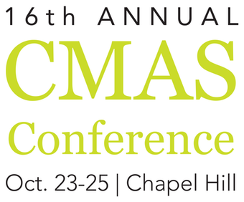
Predicting Future-Year Ozone Concentrations: Integrated Observational-Modeling Approach for Probabilistic Evaluation of the Efficacy of Emission Control strategies
Marina Astitha¹, Huiying Luo¹, Christian Hogrefe², Rohit Mathur², S.T. Rao^{1,3}
¹Department of Civil & Environmental Engineering, University of Connecticut, Storrs-Mansfield, CT, USA
² U.S. Environmental Protection Agency, Research Triangle Park, NC, USA
³North Carolina State University
Email: marina.astitha@uconn.edu
Webpage: www.airmg.uconn.edu
Notes:
`` AS’
\

Slide 2
Background
U.S. EPA recommends the use of regional-scale photochemical models for designing emission control strategies
Despite continual improvement, model predictions still don’t always faithfully
reproduce corresponding observations
Model-predicted ozone time series are often:
- biased (average observed values are not reproduced)
- Exhibit less variability than the corresponding observations
Nonetheless, models are needed to answer “what if” questions.
What can we learn from the analysis of 30⁺ years of observed ozone time series?

Slide 3
Data and Methods
Data
Time series of the daily maximum 8-hour ozone concentrations
Observations: Quality-assured ozone having at least 80% data coverage at each AQS monitoring location from 1981 to 2014 (34 years of historical ozone data)
Method of Analysis
Scale Separation: Spectral decomposition of the daily max 8-hr ozone time series into the shorter-term (i.e., Synoptic Forcing – attributable to weather-induced variations) and longer-term (i.e., Baseline Forcing – attributable to seasonality, emissions policy, and trend) components [O3 = BL + SY] using the KZ (5,5) filter (Rao et al., 1997 BAMS)

Slide 4
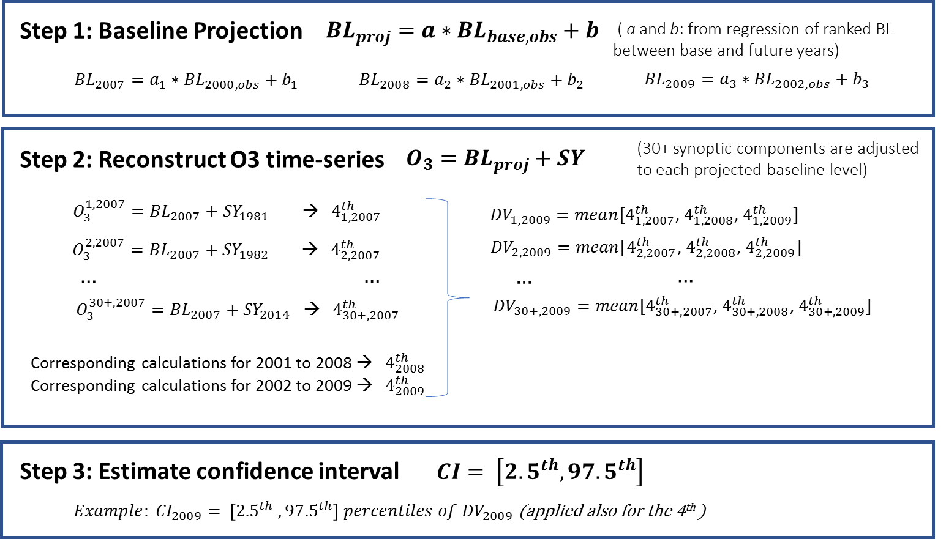
Baseline Projection Example of a 7-yr projection

Slide 5
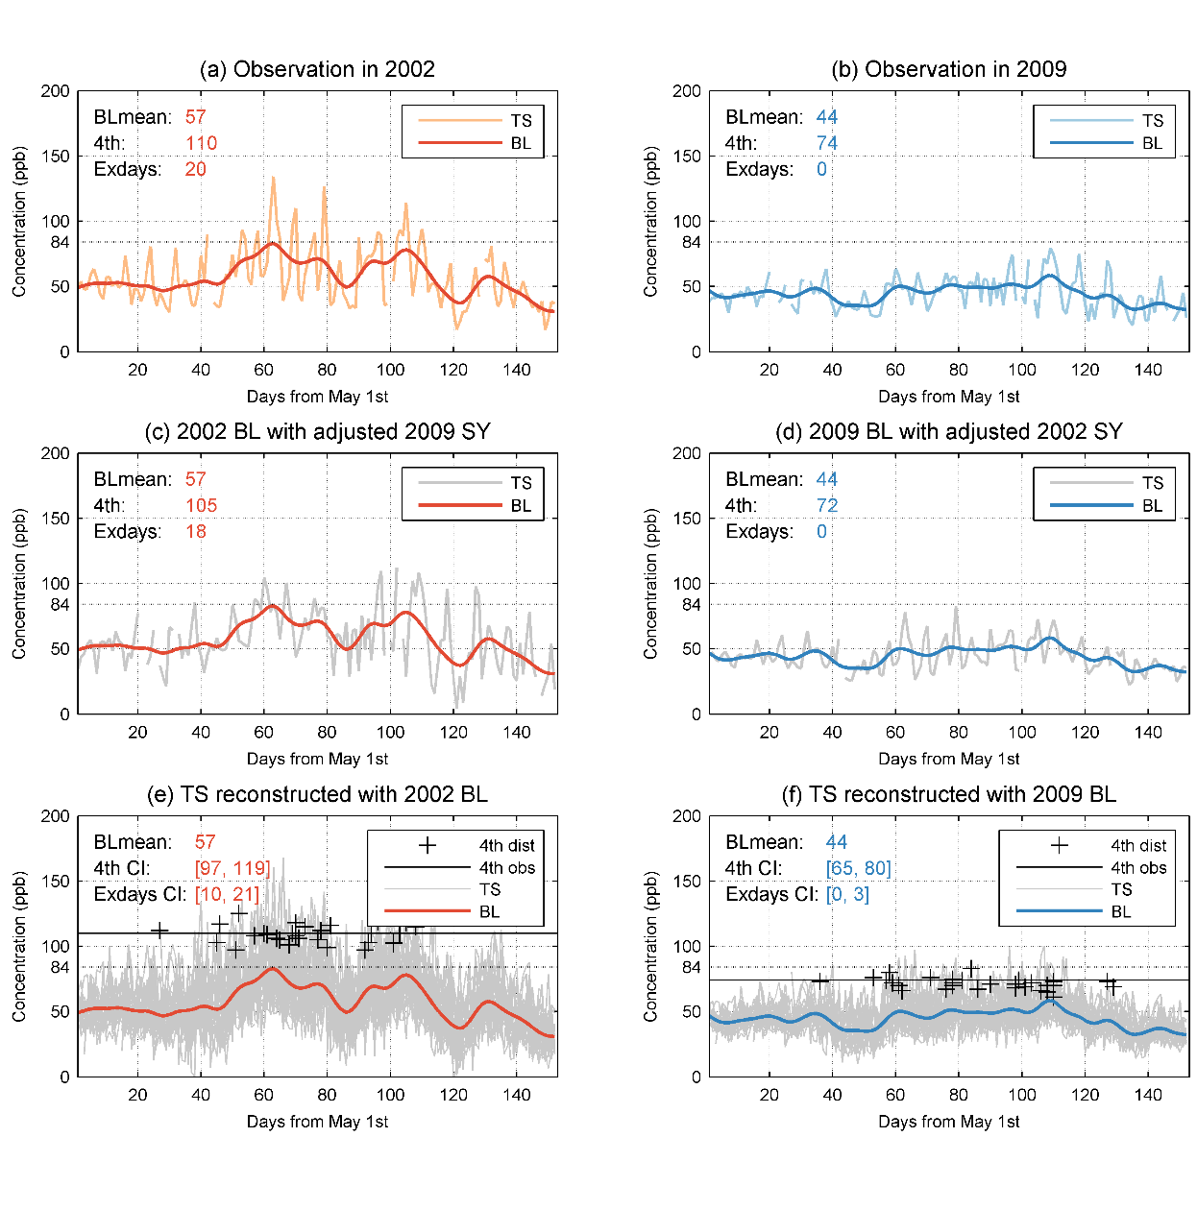
Baseline embedded in time series of observed daily maximum 8-hr ozone concentrations at Madison, CT in 2002 vs. 2009
Obs 4th: 110 ppb
CI for 4th: 97-119
Obs 4th: 74 ppb
CI for 4th: 65-80

Slide 6
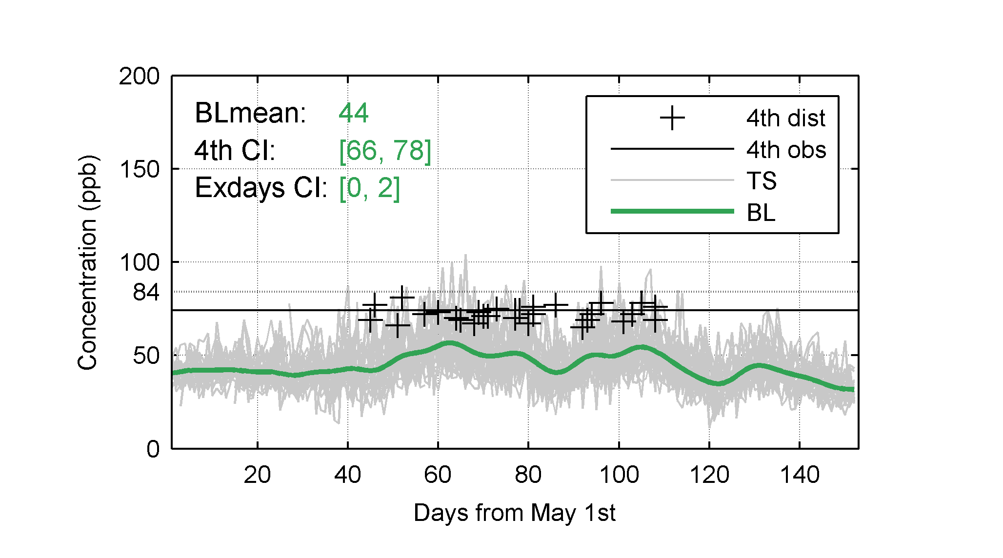
Ozone reconstruction-2009
Reconstructed ozone using the projected BL in 2009 (base year=2002) and superimposing 30 years of SY forcings
Range for the 4th highest:66-78 ppb
Actual 4th= 74 ppb

Slide 7
Ozone Dynamics
Ozone can be thought of as baseline of pollution that is formed by the emitting sources and modulated by the prevailing meteorology (i.e., synoptic-scale forcing)
It is the combination of the baseline level and associated synoptic forcing that controls the extreme ozone concentrations
When the baseline level is reduced due to emission reductions, the strength of the synoptic forcing acting on that baseline level is also reduced.

Slide 8
The use of regional-scale photochemical models (e.g., CMAQ) to design the emission control policy to meet the AQ standard is termed
“attainment demonstration”
♦ An attainment demonstration consists of:
base case (current conditions)
+
prediction (of future conditions)
♦ Future conditions derive from a model experiment: future (reduced) emissions
+
past meteorology

Slide 9
Estimating the Confidence Interval (CI) for Design Value (DV)

Slide 10
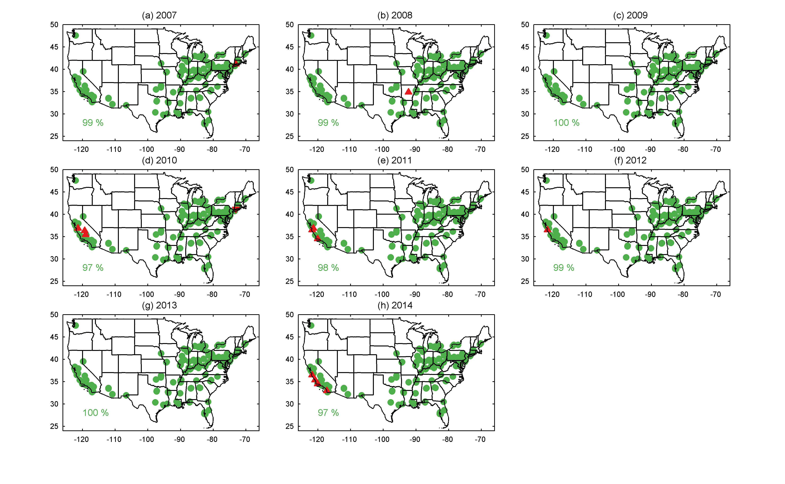
Maps indicating whether the observed DV falls within the confidence intervals calculated using the 5-yr Baseline projection methodology

Slide 11
Example Regulatory Scenario: Emission Controls Help Decrease the 2008 - 2010 Baseline Levels by 5% and 15% in 2018 - 2020
Step 1: Baseline Projected to 2018 - 2020 reflecting the above hypothetical control cases
$Ratio= {BL}_{2018}/{BL}_{2008 }=$(1-0.05) (i.e., BL₂₀₁₈ = 5% decrease from BL₂₀₀₈)
$Ratio= {BL}_{2019}/{BL}_{2009 }=$(1-0.05) (i.e., BL₂₀₁₉ = 5% decrease from BL₂₀₀₉)
$Ratio= {BL}_{2020}/{BL}_{2010 }=$(1-0.05) (i.e., BL₂₀₂₀ = 5% decrease from BL₂₀₁₀)
Step 2: Construct ozone time series and determine the CI for the 4th highest and DV
Reconstruction of 2020 ozone time-series:
O₃(2020)_1 = BLobs(2010) *Ratio + SYadj(1981)
O₃(2020)_2 = BLobs(2010 *Ratio + SYadj(1982)
…
O₃(2020)_30+=BLobs(2010) *Ratio + SYadj(2014)
Corresponding calculations for 2008 → 2018
Corresponding calculations for 2009 → 2019
A. 4th highest 2020 O₃
D. Design Value (DV)
4th (2020),1
4th (2020),2
…
4th (2020),30+
DV(2020),1 = MEAN4th(2020,2019,2018)
DV(2020),2 = MEAN4th(2020,2019,2018)
…
DV(2020),30+ = MEAN4th(2020,2019,2018)
B. 4th highest 2018 O₃
C. 4th highest 2019 O₃
Step 3: Confidence Interval (CI) is estimated by taking the values at the 2.5th and 97.5th percentiles of the distribution [Apply exact theory of extreme values to verify the CI]
Notes:
For the DV calculation, we assume that the baselines in 2008, and 2009 are reduced by the same amount (5% and 15%) from that of the 2010. Then, we take the reduced 2008, 2009 and 2010 baselines and superimpose on them 30+ years of SY to derive 30 DVs. The distribution of 30 DVs is used calculating the CI for the projected baseline in 2020.

Slide 12
Example Regulatory Scenario: Emission Controls Help Decrease the 2008 - 2010 Baseline Levels by 5% and 15% in 2018 - 2020
5% BL reduction
15% BL reduction
Notes:
Compare CI from EVT and 30+ SY for the DV in 2010

Slide 13
Probability of DV exceeding the 2015 NAAQS ozone standard in 2020
5% baseline reduction
15% baseline reduction

Slide 14
Summary
A methodology is proposed to develop confidence intervals for the O₃ design value
There is a strong relationship between the baseline level (long-term forcing) and the number of exceedances in both observations and model simulations
Accurate prediction of changes in the baseline ozone coupled with observed historical synoptic forcing provide robust estimates of the impact of emission controls
Estimation of the probability of exceeding the ozone threshold for each emission reduction scenario
Modeling results analyzed and presented in this probabilistic manner would enable more explicit consideration of the ever-present uncertainty in projected changes in air quality needed to comply with the ozone standard in the future.

Slide 15
References
Rao et al., EM Magazine, 1996, pp: 18-31.
Rao et al., Bull. Amer. Meteor. Soc., 1997, pp: 2153-2166.
Hogrefe et al., Bull. Amer. Meteor. Soc., 2000, pp: 2085-2106.
Hogrefe et al., J. Air & Waste Manage. Assoc., 2001, pp: 1060-1072
Rao et al., EM Magazine, 2011, pp: 42-48.
Porter et al., Atm. Environ., 2015, pp: 178-188.
Astitha et al., Atm. Environ., 2017, pp: 102-116.

Slide 16
Acknowledgements
Two of the authors (MA and HL) gratefully acknowledge the support of the Electric Power Research Institute (EPRI) for this research under Contract #00-10005071, 2015-2017.
Although this work has been reviewed and approved for publication by the U.S. Environmental Protection Agency, it does not reflect Agency’s views and policies.

