Slide 1
Estimating the Sources of Black Carbon Deposition to the Himalayan Glaciers in Current and Future Climates through Dynamical Downscaling
M. J. Alvarado¹ (malvarad@aer.com), E. Winijkul^{1,*}, R. Adams-Selin¹, E. Hunt¹, C. Brodowski¹, C. R. Lonsdale¹, D. T. Shindell², G. Faluvegi³, G. Kleiman⁴, and T. M. Mosier⁴
¹AER ²Duke ³Columbia ⁴World Bank *Now at Asian Institute of Technology
CMAS Conference October 25, 2017

Slide 2
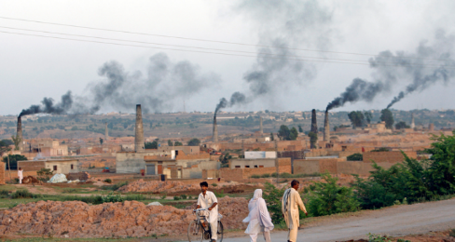
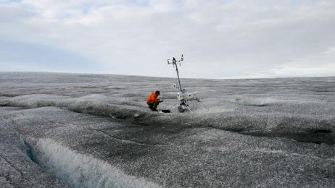
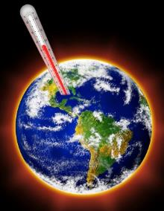
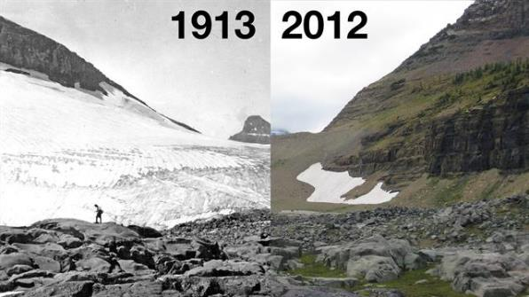
Overall goal: What are the impacts of GHGs and aerosols on Himalayan glaciers?
Temperature increases from GHG
emissions
Black carbon deposition
(Wikimedia Commons)
(PBS)
(livescience.com)
?
(National Geographic)

Slide 3
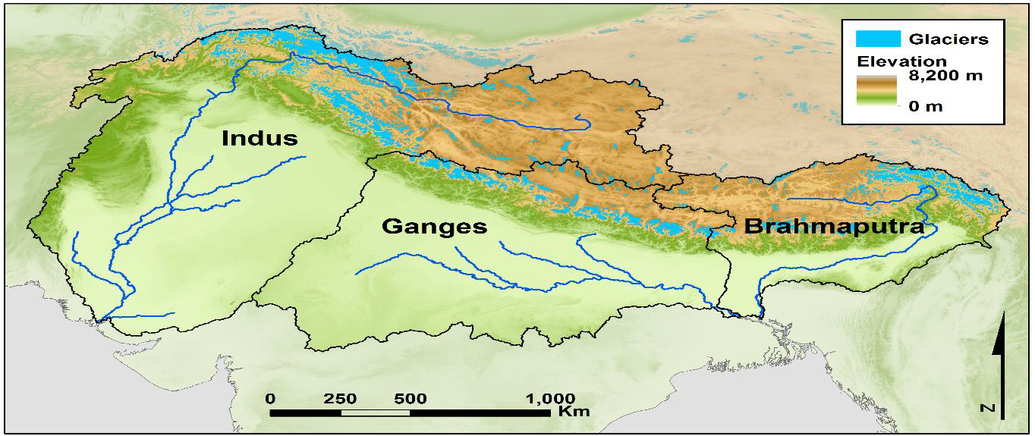
Our role: From global to local
Activity 1: Aerosol-Monsoon Interaction
Activity 2: Sector Impacts
End Goal: Cryosphere and Hydrology Impacts
Himalayan, Karakorum, and Hindu Kush (HKHK) Mountains
Key Activity 2 Outputs:
Impact of BC and dust on temperature, precipitation, and albedo in HKHK
Sensitivity of results to different source sectors and emission scenarios

Slide 4
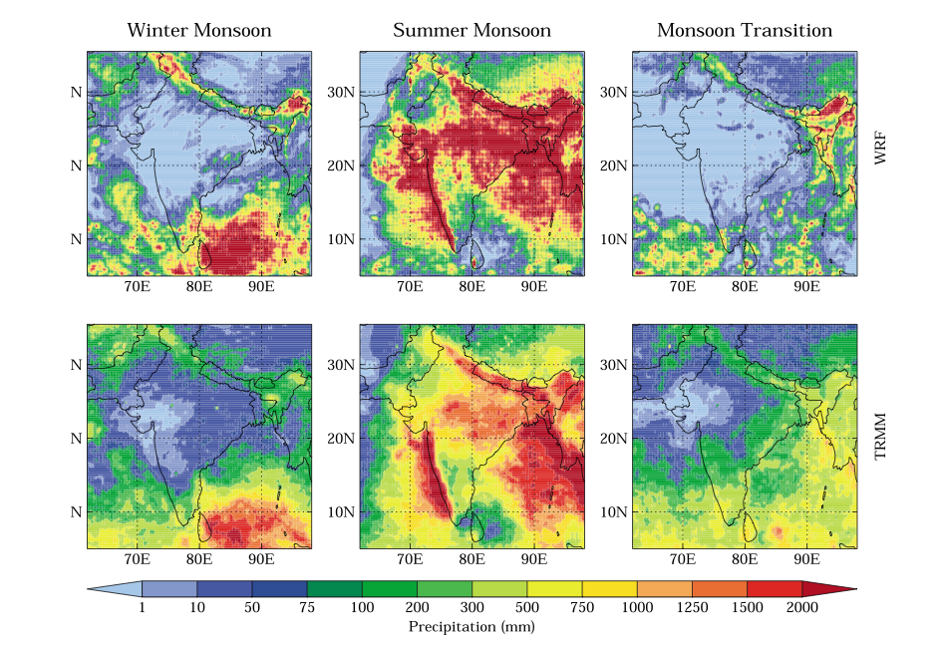
Previous work on modeling BC in HKHK
Kumar et al. (2015a,b)
WRF-Chem able to simulate BC surface and upper air concentrations over South Asia.
Precipitation generally overestimated.
Used tagged tracers to look at impacts of different regions/sectors.
Did not look at deposition of BC.
Kopacz et al. (2011)
Sources outside of South Asia contribute significantly to BC deposition to Himalayas
BC deposition to glaciers creates global annual mean forcing of +0.32W m⁻² .
Used lower-resolution (2º lat. by 2.5º long.) global model
Did not break down impacts by source type

Slide 5
Experimental setup
WRF-Chem with GOCART
GOCART similar to the study of Kopacz et al. (2011).
Includes interactions with radiation, but not with clouds.
12 km horizontal grid resolution
Similar to resolution used in Kumar et al. (2015).
One “current” year (2013) and three “future” (2040-2050) years
El Nino, La Nina, and Moderate
For each year, four 1-month simulations (14 days spin-up, 14 days analysis) were performed.
Two emission scenarios
No Further Control (NFC)
Mitigation (MIT)

Slide 6
WRF-Chem configuration
Process | Selection
Cloud microphysics | Morison Double Moment
Radiation | AER’s RRTMG
Surface layer | MM5 similarity scheme
Land surface model | Noah land surface
Planetary boundary layer | Yonsei university scheme
Cumulus Param. | Grell-3-D
Aerosols | GOCART
Dry Deposition | Wesley
Wet Deposition | Neu and Prather
Fire Emissions | FINN
Dust Emissions | In-Line AFWA scheme
Generally follows Kumar et al. (2015)
Tagged tracers for BC aerosols added for 5 sectors and 6 locations.
Sectors: Industry (including brick kilns), Solid Fuel, Diesel Fuel, Open Burning, and Biomass Burning
Locations: India, China, Nepal, Pakistan, Bangladesh, and Myanmar

Slide 7
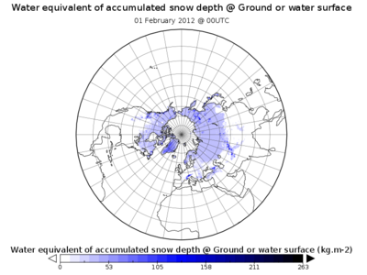
Boundary and initial conditions
2013 Conditions
NCEP Final Global Data Assimilation Analysis
NCAR MOZART-4/GEOS5
2040-2050 Conditions
GISS-E2-R model (Schmidt et al., 2014)
Physics option 3: includes aerosol-cloud interactions
RCP 4.5
RCP 4.5 minus South Asian aerosols
Used the method of Trail et al. (2013) for linking to WRF
Issues with RH > 120% at tropopause
Issues with matching soil levels

Slide 8
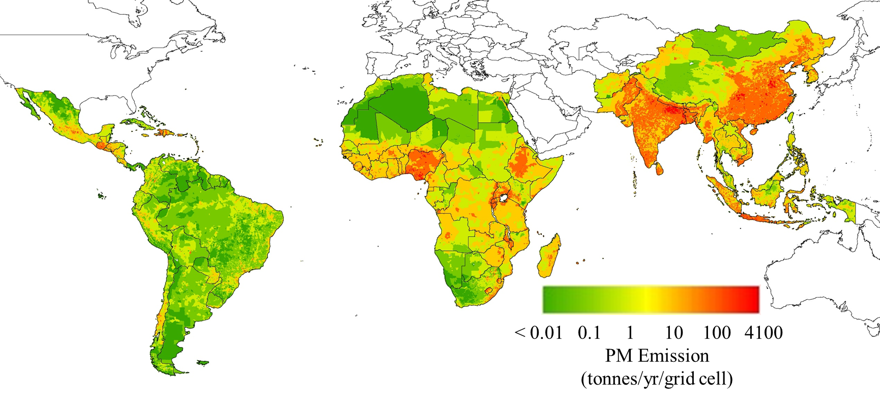
Anthropogenic emission inventories
ECLIPSE dataset (Stohl et al., 2015)
State level in India and China, country level elsewhere
Includes brick kilns, oil and gas flares, high emitter engines, and wick lamps
Winijkul et al. (2016) used to improve spatial distribution of cook stove emissions
Final inventory scaled to match totals from RCP 4.5 scenarios
Winijkul et al. (2016) Cookstove Emissions

Slide 9
2013 BC deposition & seasonal cycle
BC surface concentrations peak in January (dry season) and are at a minimum in July (wet season), as expected.
But seasonal peak in deposition to HKHK varies
January and April for southern regions
July to October for northern regions
Range of values and distribution consistent with lower resolution study of Kopacz et al. (2011).
Total BC Deposition (μg/m²)
Notes:
BC concentrations and depositions peak in January during the winter monsoon (dry season) and are at a minimum in July during the summer monsoon (wet season), as expected.
Biomass burning generally a minor contributor to total deposition.

Slide 10
Sources outside South Asia are important
Anthropogenic sources dominate over India.
BC from sources outside S. Asia are consistently important in the HKHK regions.
Long-range transport of BC in the free troposphere?
Consistent with Kopacz et al. (2011).
Fractional contribution of the anthro. sources in S. Asia to HKHK deposition have a strong seasonal cycle.
62% in January
45% in April
13% in July
54% in October
Biomass burning was responsible for <4% of the BC deposition to the HKHK region.
Fraction of Total BC Deposition
Notes:
BC concentrations and depositions peak in January during the winter monsoon (dry season) and are at a minimum in July during the summer monsoon (wet season), as expected.
Biomass burning generally a minor contributor to total deposition.

Slide 11
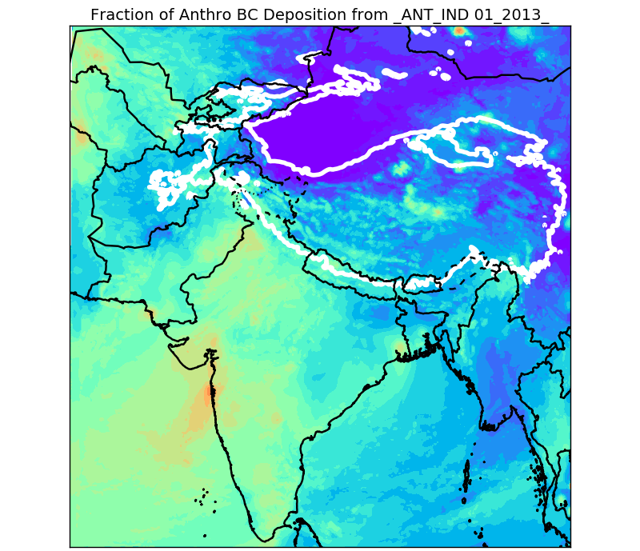
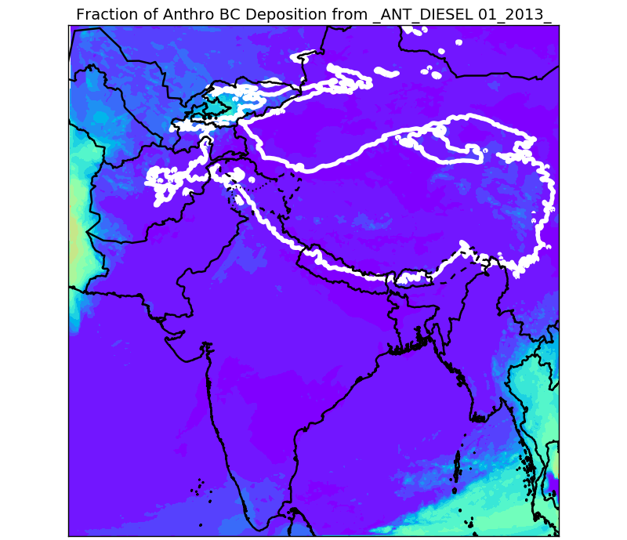
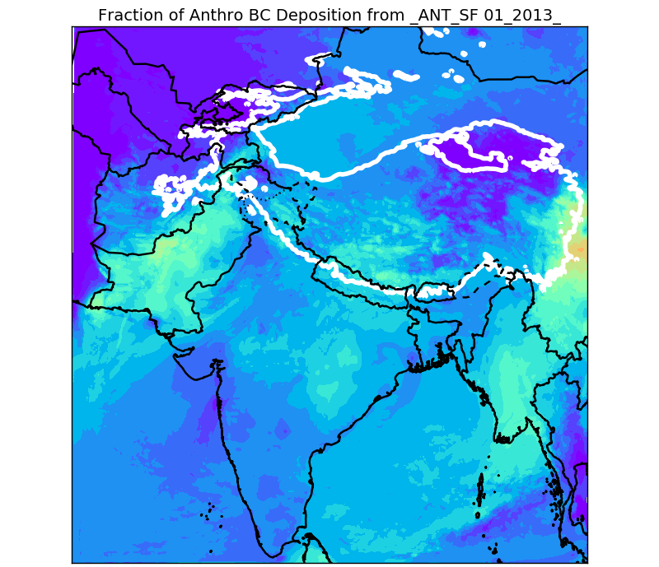
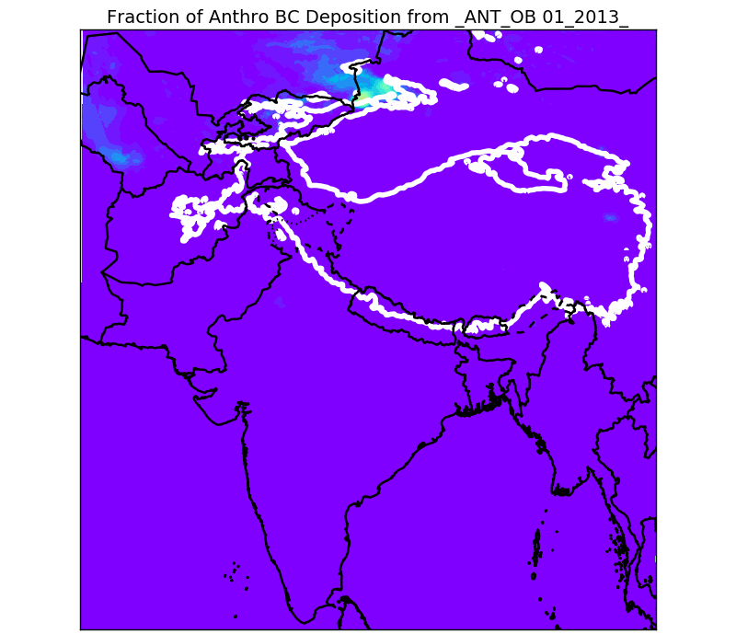
Brick kilns and (residential) solid fuel burning important components of in-domain emissions.
Industry
Diesel
The in-domain anthropogenic contribution to HKHK deposition is 45-66% from industry (mainly brick kilns) and residential solid fuel burning.
Diesel fuel is 7-18%
Open burning is <3%.
Solid Fuel
Open Burning
Fraction of Jan. Anthropogenic BC Deposition

Slide 12
China, India, and Nepal have significant impacts on deposition, but less than 50% of total BC
Fraction of Jan. Total BC Deposition

Slide 13
Mitigation scenario reduces deposition, but reductions outside South Asia are equally important
Total BC Deposition (μg/m²)
NFC scenario for 2050 reduces BC deposition to HKHK by 31% relative to 2013.
MIT scenario for 2050 reduces BC deposition to HKHK by 53% relative to 2013.

Slide 14
Diesel fuel relative contribution decreases dramatically under mitigation scenario
Fraction of Anthropogenic BC Deposition

Slide 15
ENSO variations have no consistent impacts on BC deposition
Total BC Deposition (μg/m²)

Slide 16
Fine-scale variations in BC mixing ratio in fresh snow
Snowfall (mm/hr)
BC mixing ratio (ppbm)

Slide 17
Summary
Sources outside South Asia currently account for 35-87% of total BC deposition to the HKHK region.
The in-domain anthropogenic contribution is 45-66% from industry/brick kilns and residential solid fuel burning.
MIT scenario reduces BC deposition to HKHK by 53% relative to 2013.
Contribution from S. Asian anthro. sources reduced to 11-34%.
Contribution of diesel fuel is dramatically reduced, while the (relative) contribution from industry/brick kilns increases.
ENSO changes are less dramatic and do not seem to follow consistent patterns with ENSO.
Next Steps: Our partners perform the hydrology modelling to see the impact of BC deposition changes on glacier melting and water resources in South Asia.

Slide 18
BACKUP SLIDES

Slide 19
2013 evaluation: Temperature
Compared WRF-simulated 2 m temperature with surface temperature retrieved by the Atmospheric InfraRed Sounder (AIRS) aboard NASA Aqua Satellite
Interpolated results to the 1ºx1º grid of the AIRS Level 3 product
Used both day and night data in evaluation (01:30 and 13:30 LST)

Slide 20
2013 evaluation: Precipitation
Compared WRF-simulated monthly precip. with that retrieved by the NASA Tropical Rainfall Measuring Mission (TRMM)
Interpolated results to the 0.5ºx0.5º grid of the TRMM Level 3 product
Comparison consistent with previous WRF-Chem studies

Slide 21
2013 evaluation: Surface BC
Notes:
Largest discrepancies are the model underestimates at Dibrugarh, Port-Blair, and Lhasa.
Better than Kumar et al. (2015) at Dehli and Langtang.

Slide 22
Spatial distribution of res. combustion emissions (Winijkul et al., 2016)
Developed based on stove types, population, and resources in 5 land types
High emissions in areas that have both high population and forest access
East China, part of India, main island of Indonesia, parts of Africa
Lower emissions are mostly electrified with a lower population and no forests

Slide 23
Sources outside of South Asia have a larger relative contribution under the MIT scenario

