Slide 1
AQcast: A Scalable, Automated System for Photochemical Modeling on the Cloud
M. J. Alvarado (malvarad@aer.com), E. H. Fahy, E. J. Fanny, E. S. Bettencourt, C. R. Lonsdale,
C. M. Brodowski, B. Brown-Steiner,
and J. Henderson
Atmospheric and Environmental Research (AER)
CMAS Conference
October 24, 2017
Notes:
I’m happy to be able to show you some of the work we are doing to simplify and scale up our air quality modeling by adopting a cloud computing approach.

Slide 2
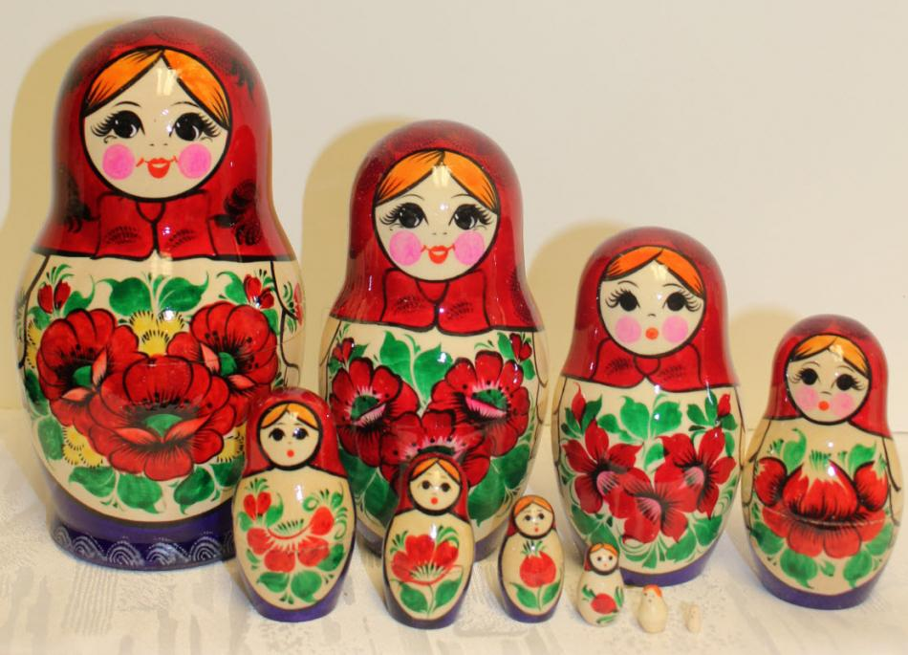
Issues Facing New Air Quality Modelers
Steep learning curve
  Many different codes required even for simple jobs.
  Hard for any one person to learn all of the steps.
Time-consuming setup
  Multi-step installations with many dependencies.
  Compiler and OS-dependent bugs.
  Scientists spend time debugging instead of doing scientific analysis.
Difficult to do large projects
  Complicated workflow with many chances for bottlenecks.
  Limited amount of CPUs and RAM on in-house machines.
CMAQ
WRF
SMOKE
MOVES
MCIP
FEST-C
MEGAN
BCON
IOAPI
NetCDF

Slide 3
Inspiration #1: AER nCast for WRF
Software to automate the set up, running, and post-processing of WRF.
Specify area of interest, resolution, and physics options in a single XML file.
nCast automatically collects needed input data (e.g., NARR) using wget.
nCast has been provided to government and private customers for operational forecasts and research.
nCast Forecasts for Greek Olympics

Slide 4
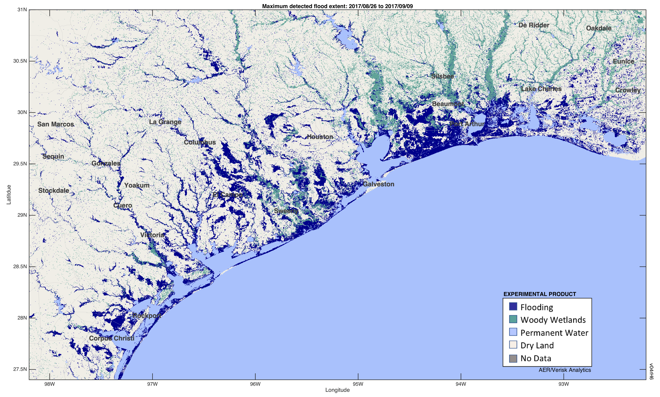
Inspiration #2: AER FloodScan
90-m maximum detected flood extent
From daily AMSR2 observations, 26 Aug – 9 Sept 2017
Houston
Galveston

Slide 5
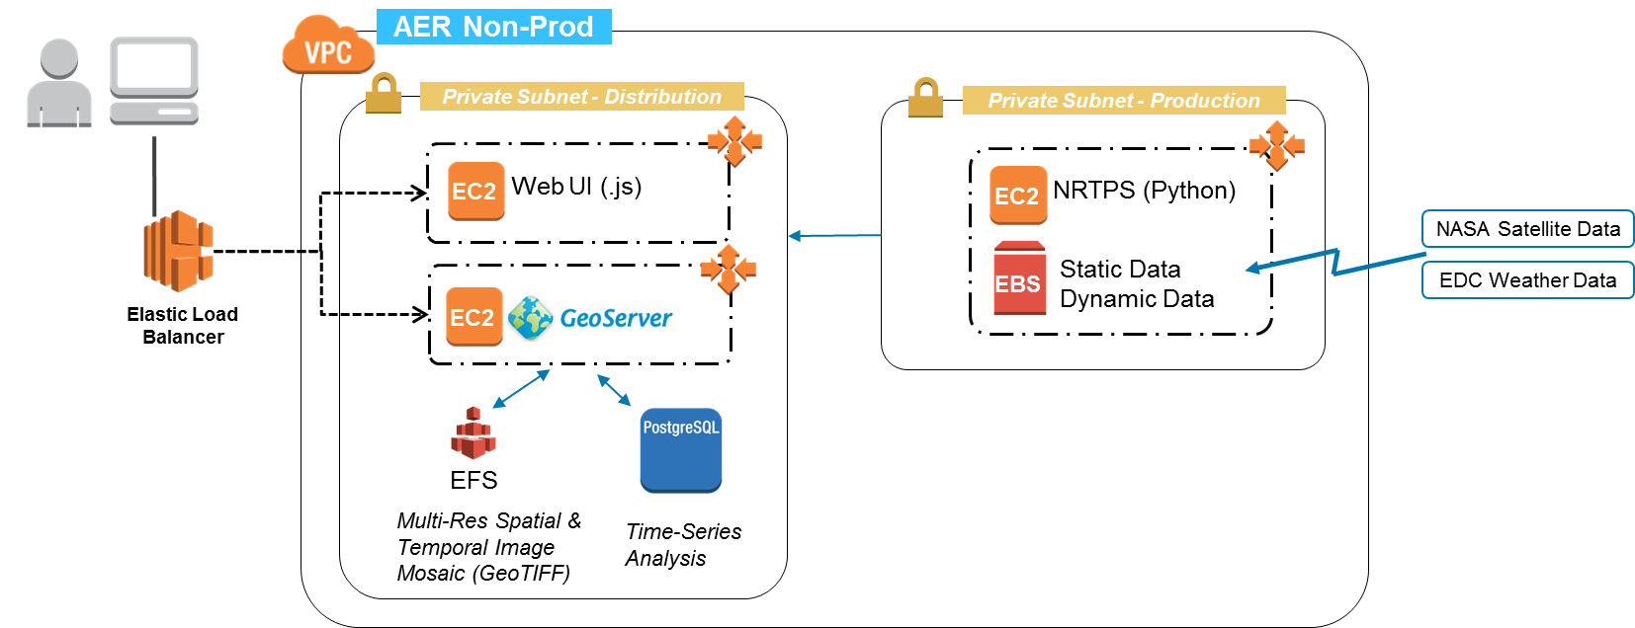
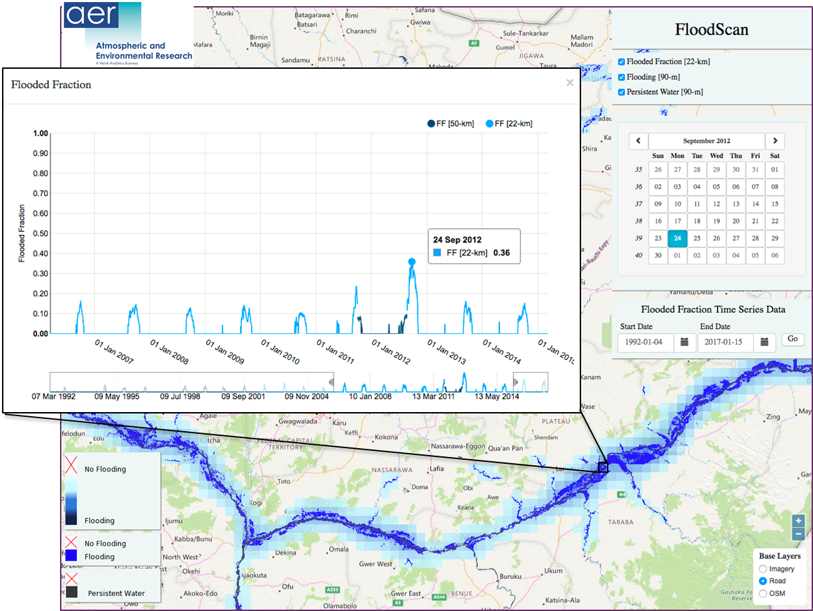
NRT FloodScan for African Union
Notes:
Web UI developed using Node.js, Angular.js, and GeoServer is open source technology (www.geoserver.org)

Slide 6



“Simple” Cloud Computing on AWS
Start with an existing “machine image” and add your needed libraries and other dependencies.
Do setup once, then easily clone duplicates of your new machine.
  Can add and remove instances as cluster nodes for big jobs.
Master EC2
Instance
(CPU/RAM)
EBS
Storage
Node 1
Node 2
SSH
Users

Slide 7
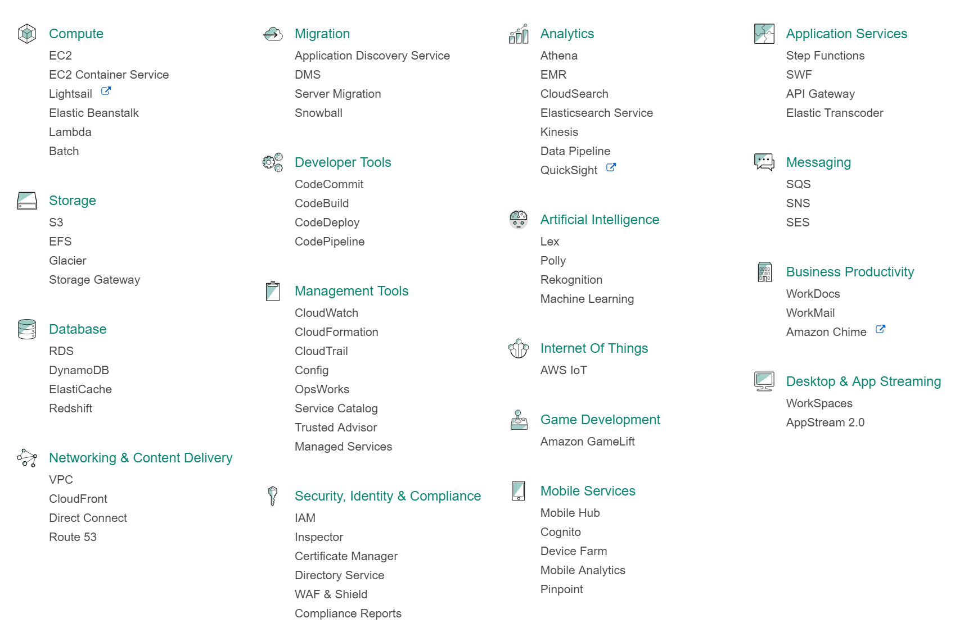



So you’ve been told to move to the cloud. Just log on to the AWS Management Console and unlock power beyond your wildest dreams!
OK Let’s see, I’ll just log on to the console and …
Me

Slide 8

What Support do Scientists Need to Use Cloud Computing?
Scientists shouldn’t have to learn the details of the Amazon cloud.
Cloud infrastructure tasks are better handled by software and IT experts.
But the software folks must work with the scientists to understand the model requirements.
AER software engineers and IT specialists regularly work with our atmospheric, ocean, and climate scientists and are able to provide the needed support.
Science!!!
AER Scientists & Outside Users
AER
Software Engineers

Slide 9
Saving Your Machine Setup as Code
Version Control
Infrastructure
Cloud settings stored using Terraform
Runtime Environment
Linux container built in Docker
CMAQ
Built using Makefile
Common infrastructure eliminates OS and compiler-dependent bugs!

Slide 10
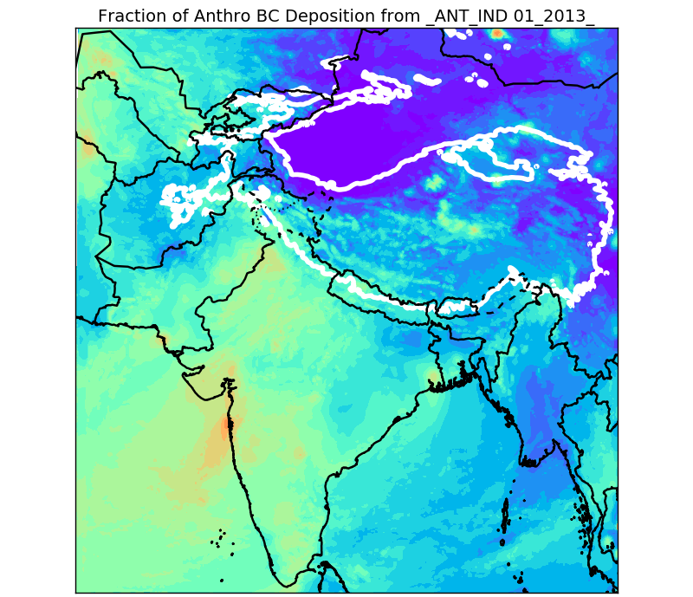
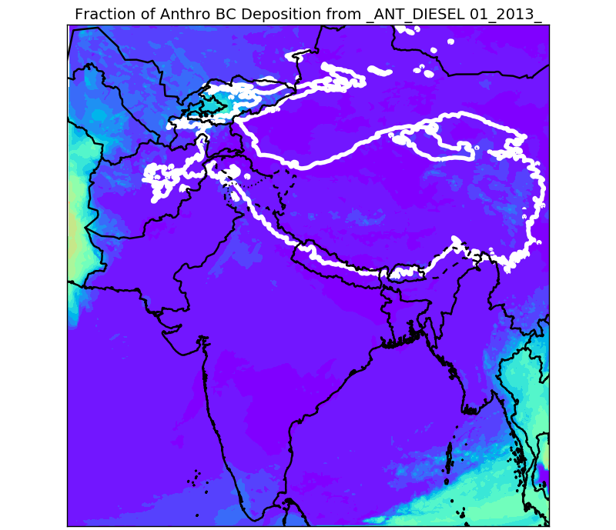
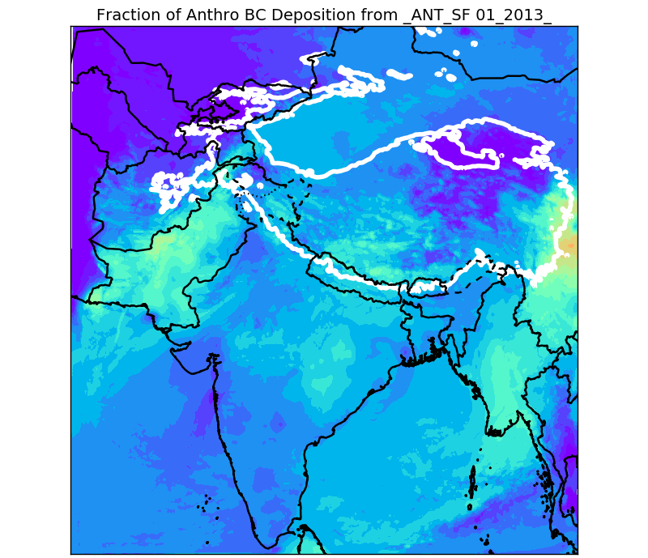
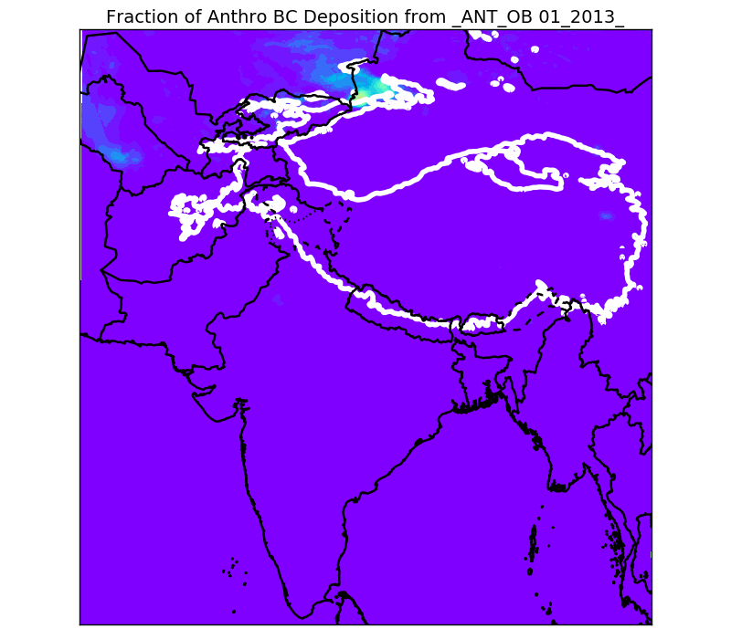
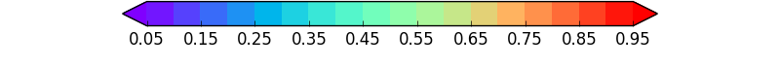
Challenge #1: Data Storage
Industry
Diesel
This WRF-Chem project needed ~0.7 TB for each of 24 model months.
  EBS: $100/TB/mo.
  S3: $22.50/TB/mo.
  Glacier: $4/TB/mo.
Our solution:
  Limit EBS storage (in this case, enough for 4 parallel runs at a time).
  Move input and output files from EBS to S3 as quickly as possible.
  Store inputs and outputs on Glacier at end of project.
Solid Fuel
Open Burning
Fraction of Anthropogenic BC Deposition

Slide 11
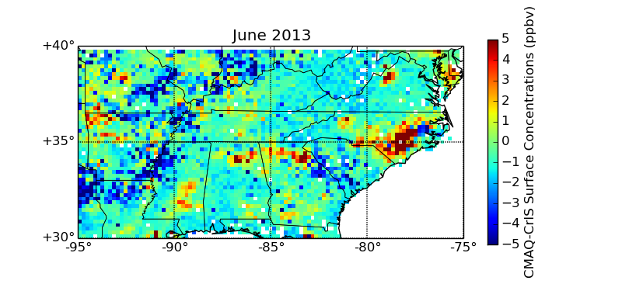
Challenge #2: Data Retrieval
AWS uploads are free, but downloads cost $90/TB.
Our solution: Do post-processing and analysis on the cloud.
  Use VERDI on cloud.
  Use THREDDS to make data accessible via netCDF viewers like Panoply or the web.
  Use Python or R to avoid license charges.

Slide 12
AQcast Phase I System for Continental US
Met Inputs
Global CTMs
Emission Inventory
Reanalysis Data
Real-Time
Forecasts
NCAR MOZART
Forecasts
NEI
nCast WRF
Other Inputs
EPA Emission Modeling Platform
ICON/BCON
OMI O₃
Spatial Surrogate Tools
WRF
MCIP
NormBEIS
SMOKE
FEST-C
Lightning
CTM
CMAQ
Scalable System
Automated System
Unified System
Air Quality Analyses
Sensitivity Studies
Air Quality Forecasts

Slide 13
Example: Improving NH₃ Emissions with Satellites
CMAQ w/BiDi and NEI 2011
North Carolina
Northern AL and GA
CrIS NH₃ retrievals (Shephard and Cady-Pereira, AMT, 2015).
Finite-difference, iterative mass balance (Lamsal et al., GRL, 2011).
Requires two model runs per iteration – baseline and perturbed.
Calculate emission scaling factors and apply to next iteration.
Ideally needs two identical large clusters running in parallel, taking advantage of cloud computing scalability.

Slide 14
Example: Improving NH₃ Emissions with Satellites
CMAQ w/BiDi and NEI 2011
After 1 Iteration: Feedlot Changes Only
CrIS NH₃ retrievals (Shephard and Cady-Pereira, AMT, 2015).
Finite-difference, iterative mass balance (Lamsal et al., GRL, 2011).
Requires two model runs per iteration – baseline and perturbed.
Calculate emission scaling factors and apply to next iteration.
Ideally needs two identical large clusters running in parallel, taking advantage of cloud computing scalability.

Slide 15
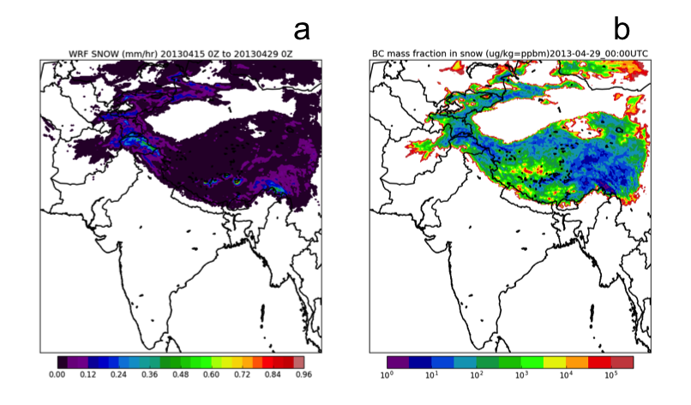
Phase II: International and Streamlined
Add CAMx and WRF-Chem as options.
  Easier inter-comparisons and ensembles.
  Chemistry-meteorology interaction studies.
Expand emissions component to cover the globe using new SMOKE tools for EDGAR.
Create simple web interface for running jobs.
Example of WRF-Chem run on the cloud. 24 total runs were performed (2 emission scenarios, three phases of ENSO, and four months per year). (a) Average snowfall (mm/hr). (b) Mass ratio of BC deposition to snowfall (μg BC/kg snow). Required six month schedule would not have been possible without cloud resources!
Stay for Wed. 4:30 PM talk for more on this project.

Slide 16

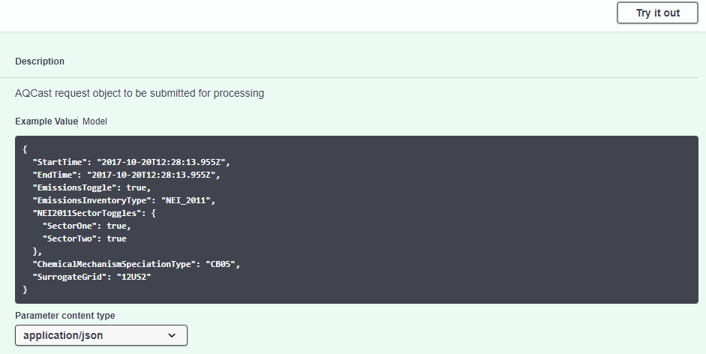
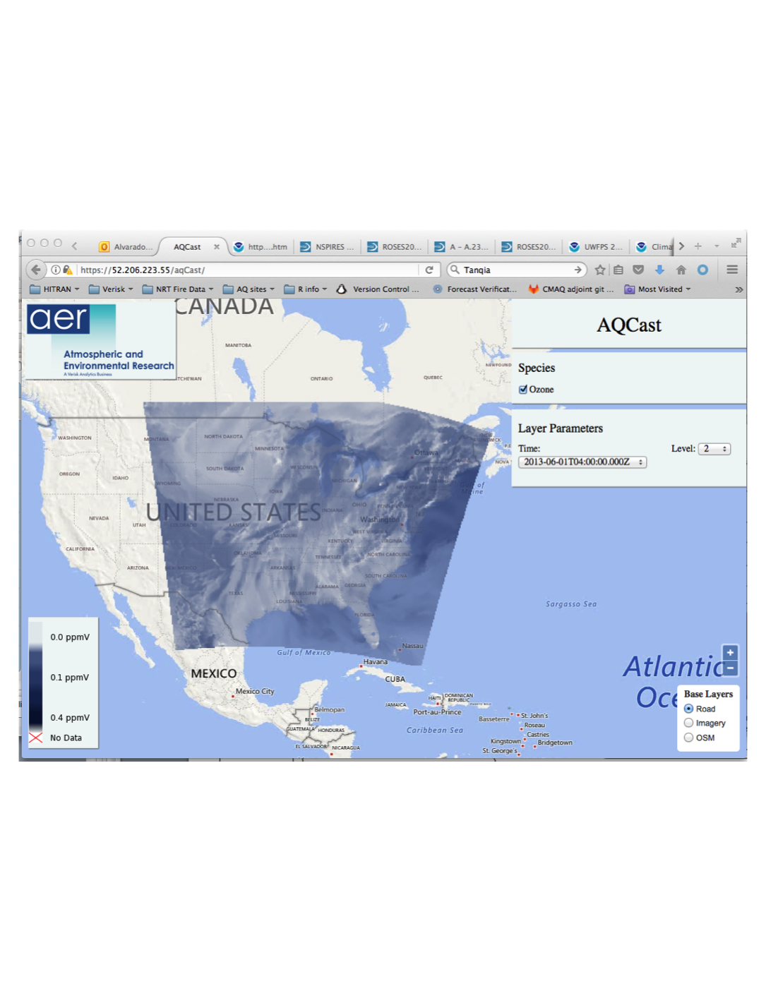










Design of AQcast Web Interface
Users
Private Subnet
API Gateway
Batch
Submit Request
Compute Environment
ECS
Step Functions
Lambda
Job Queue
EC2
Retrieve results
Job 1
Job 2
Job 3
Job …
EC2
Define workflow
Submit Batch Jobs
submit-batch-job
affirm-job-completion
*
*
EC2
*
Bootstrap Init Data
*
Archive Results
*
* Compute
Containers
S3 Bucket
EFS Volume

Slide 17
Community Access to AQcast
The cloud-based architecture of AQcast Phase II will make it easy for us to offer the system to users outside of AER.
Users would submit a job description file over the web.
AQcast would automatically run the job.
AER’s job would be to handle software installation, model and inventory updates, IT, and QA/QC.
Outside user would be responsible for the Amazon cloud and maintenance charges for their jobs.
Future work could allow users to make modifications to CMAQ code or emission platform that we would pull into AQcast from a Git repository.

Slide 18
Summary
Cloud computing allows you to quickly run an arbitrarily large number of AQ model simulations.
Saving the infrastructure as software allows you to create identical machines and easily maintain them.
We used these principles to create a scalable, automated system for air quality modeling: AQcast.
  Reduces the time and labor to go from idea to analysis.
  Reduces learning curve for new users.
Looking for partners to test complementary “early access” version of AQcast for many different applications!

Slide 19
Questions? Email malvarad@aer.com
Thank You!

Slide 20
BACKUP slides

Slide 21
Emission Component
EPA 2011 NEI Emission Modeling Platform (SMOKE)
Running of platform scripts debugged, simplified, and automated.
Can be run for a given subset of days.
Spatial surrogate generation tool included, but needs further work.
Non-point source CO, June 3, 2013

Slide 22
CTM Component
CMAQ (v5.1 now, v5.2 by end of year)
Initial and boundary conditions from NCAR MOZART4 forecasts
  GEOS-Chem converters also available, but you need to provide the GEOS-Chem output.
Preprocessors automatically make needed inputs for:
  In-line Dust Emissions
  In-Line Biogenic Emissions
  In-Line Lightning NO_{x}
  Bi-Directional NH₃
No Bi-Di NH₃
Bi-Di NH₃
Bi-Di NH₃ & adjusted feed lots
CMAQ NH₃ (ppbv)
TES (Satellite) NH₃ (ppbv)
From Lonsdale et al., ACP, 2017.

Slide 23
EC2 Instances
Instance | CPUs | RAM (GB) | Price (per hr)
c4.large | 2 | 3.75 | $0.10
c4.xlarge | 4 | 7.5 | $0.20
c4.2xlarge | 8 | 15 | $0.40
c4.4xlarge | 16 | 30 | $0.80
c4.8xlarge | 36 | 60 | $1.59

Slide 24
Choosing instances
The cloud gives you a lot of CPUs, but that may not be your problem.
  AQ modeling is highly memory-limited (lots of segmentation faults on small instances).
  Now you can use new memory- or storage-optimized instances if you are memory or I/O limited.

Slide 25
AWS Data Storage
RDS $$$$
Managed relational database
You pay for underlying EC2 and EBS resources + I/O
EFS $$$$
NFS 4.1, mounts to EC2, etc.
EBS $$$
Analogous to a local hard drive that can be mounted to EC2
S3 $$
Glacier $
Postgres, MySQL, Oracle, MariaDB, Microsoft SQL Server
Expands and contracts from 0 to 8 exabytes (!)
Connect to many machines at once
Can only be mounted to one EC2 instance at a time
Must preallocate storage space
Object store, cannot be mounted and used like a regular block store.
Like S3 but even cheaper
Used for cold storage of files that do not need to be regularly accessed.
$ not drawn to scale

Slide 26
Linux Containers
Linux containers (usually Docker containers) are like having lightweight sandboxes that can run within an operating system.
Define/build Docker Image using Dockerfile.
Share Docker images through a registry such as ECR or Docker Hub.
Shared images will work on anyone’s machine; no installation instructions or dependency management to worry about.

Slide 27
What if you have HPC jobs too big for any one EC2 instance?
AWS Batch is currently limited to running jobs that fit on a single EC2 instance; if you need more than that, you can use:
  cfnCluster
  StarCluster
  Cycle Computing

Slide 28
QA/QC and Analysis
Data can be moved off the cloud for analysis, but Amazon charges a fee (~$90 per TB).
QA/QC and analysis scripts can be run on small, one-processor instances on the cloud.
Using open-source tools (Python, R) avoids license issues.
Can also set up a server (e.g., THREDDS) to make data accessible via netCDF viewers like Panoply or via the web (see right).

Slide 29
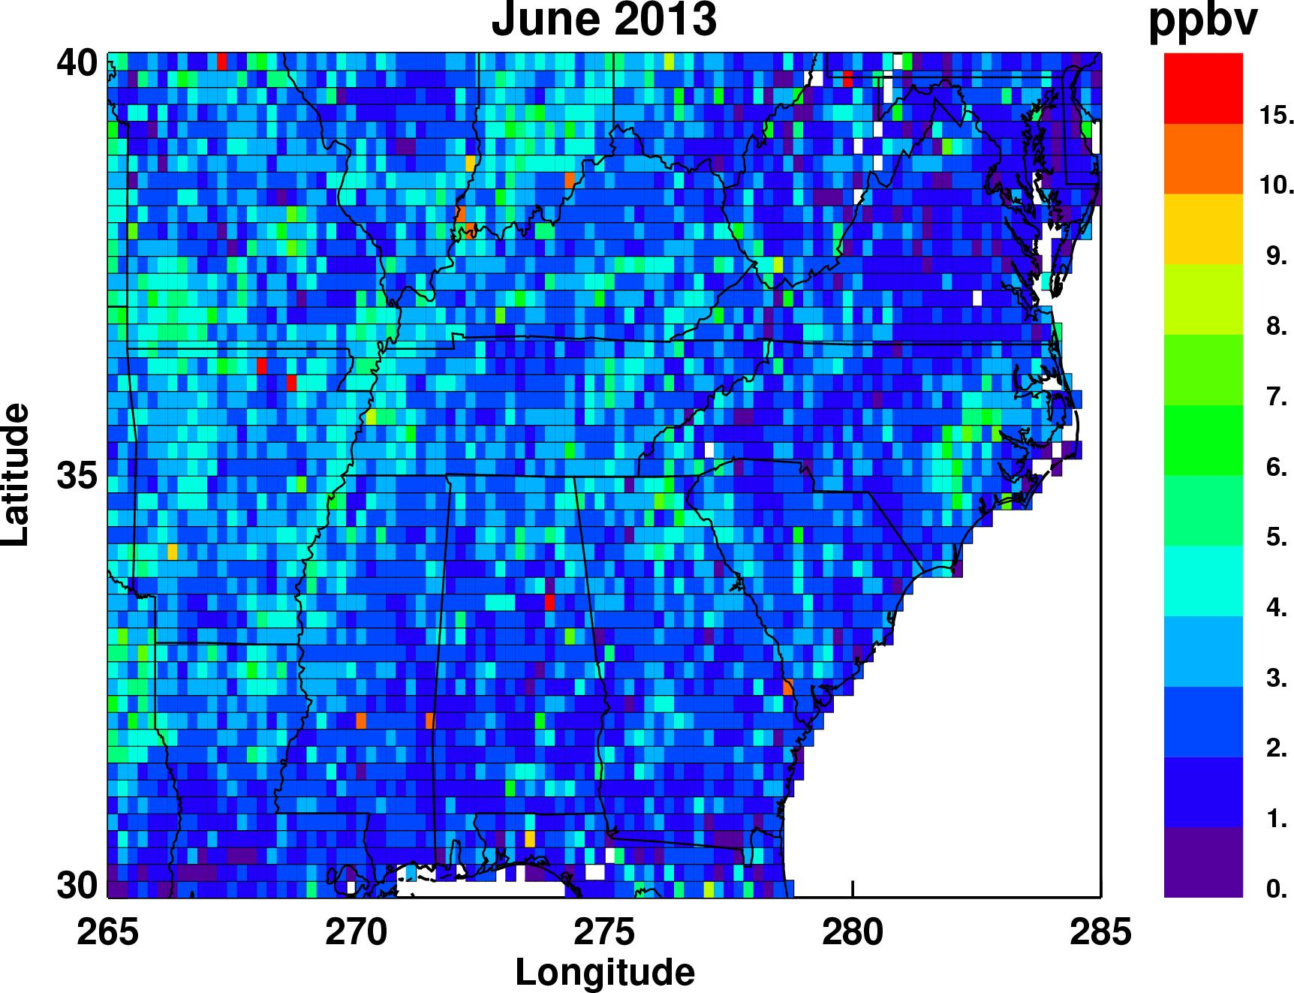
Evaluating NH₃ Emissions Using Satellites
CrIS Monthly Average NH₃ retrievals by Karen Cady-Pereira

Slide 30
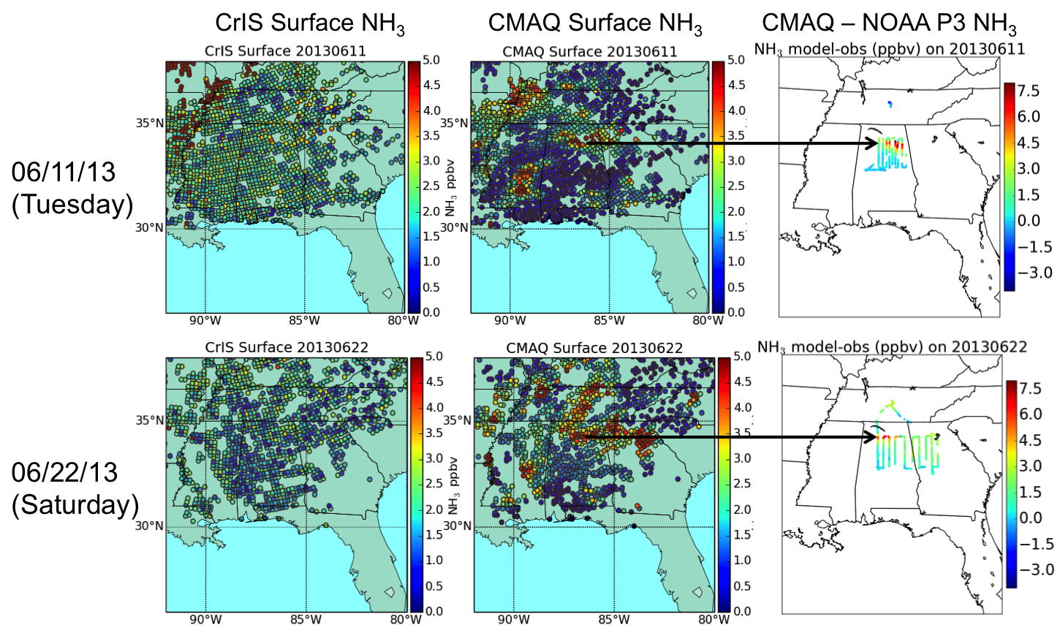
Evaluating NH₃ Emissions Using Satellites

Slide 31
Example: Improving NH₃ Emissions with Satellites
A Priori NH₃ Emissions (moles/s)
Optimized NH₃ Emissions (moles/s)
CrIS NH₃ retrievals (Shephard and Cady-Pereira, AMT, 2015).
Finite-difference, iterative mass balance (Lamsal et al., GRL, 2011).
Requires two model runs per iteration – baseline and perturbed.
Calculate emission scaling factors and apply to next iteration.
Ideally needs two identical large clusters running in parallel, taking advantage of cloud computing scalability.

Slide 32
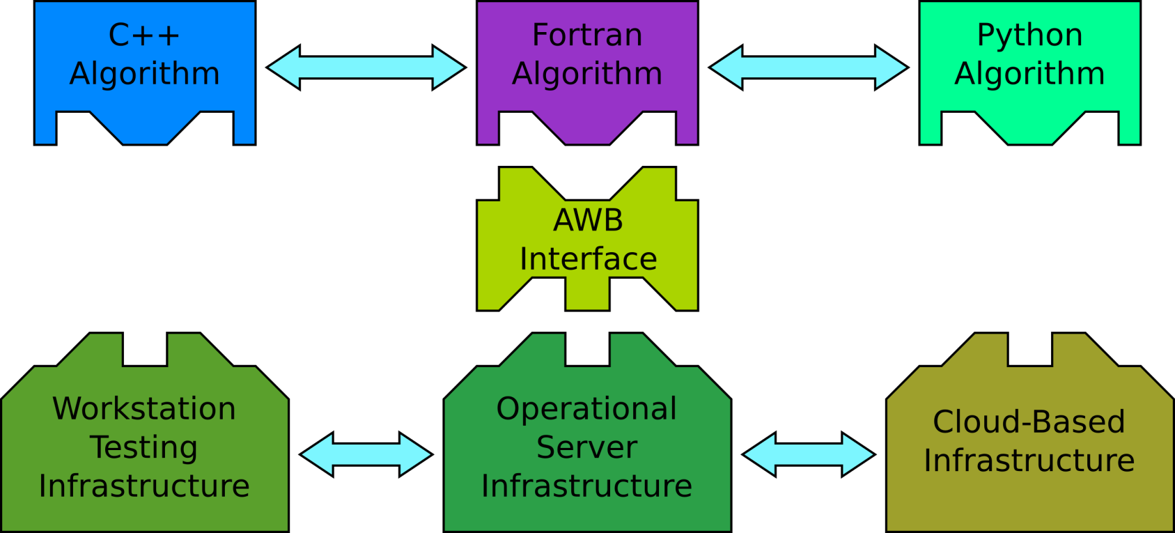
Future: Modular Algorithm Interfaces
“Algorithm WorkBench” designed at AER for satellite data processing
Standardized interface allows algorithms and infrastructure to be swapped without code changes
Algorithms in different languages run in the same environment
Users can change/add algorithms using standard interfaces

Slide 33

Phase I Implementation on Amazon Cloud
Private Subnet
In Phase I, starting and stopping machines and the transfer of files between storage volumes is done by the user.
Phase II will use Amazon Batch to do these housekeeping tasks.
Chemical
Transport
Model
Weather
Emissions
Emissions
Emissions
Emissions
t2.micro –
m4.8xlarge
Emissions
t2.micro –
m4.8xlarge
Emissions
Emissions
t2.micro –
m4.8xlarge
Emissions
Emissions
Emissions
t2.large
t2.large
t2.large
Emissions
Emissions
Emissions
t2.large
t2.large
t2.large
t2.large
t2.large
t2.large
t2.large
t2.large
t2.large
User RDS
PostgreSQL
S3 Bucket
(Long-term storage)
EFS Volume
(Short-term storage)

Slide 34
AQcast Advantages
Scalable System
  Run arbitrary number of model runs.
  OS, libraries, compiler settings saved using Terraform/Docker.
  Only pay for what we actually use.
Automated System
  WRF, emissions platform, and CMAQ, plus all their pre-processors, run automatically.
Unified System
  All components run using common inputs.
  Removes chances for inconsistencies.
  Easier to train new users.

