Slide 1
Impacts of Land Use Changes From Urban Development on Future Air Quality in Kansas City
15th CMAS Conference
10/26/2016
Yuqiang Zhang, Jesse Bash, Shawn Roselle, Alice Gilliland, Christian Hogrefe, George Pouliot, Angie Shatas, Robyn DeYoung, and Jamie Piziali

Slide 2
Science Question
Does urban greening (trees, green roofs, and reduced impervious surfaces) have an impact on air quality and meteorology?
Motivation
Drive a novel application of the CMAQ modeling system
Provide tools and data for decision-makers regarding green infrastructure impacts on air-quality
Methods
Application of the coupled WRF-CMAQ modeling system for 12 km CONUS, 4 km KC and 1 km KC domains

Slide 3
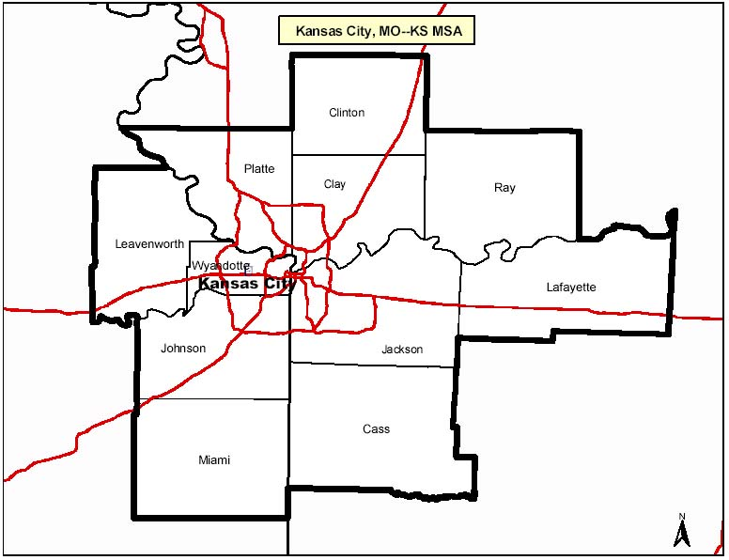
Kansas City, MO-KS Air Quality Modeling
- Metropolitan planning organization:
Mid America Regional Council (MARC)
- MARC provided land use data for 2012 (BASE simulations) and projections for 2040 (FUTURE simulations)
- Interested in ozone, so the focus of this modeling study a 3-month (June, July, and August)

Slide 4
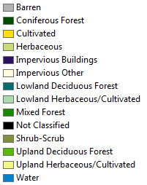
MARC Base Land Use
Based on 2012 satellite Imagery (2.5 m)
14 Land Cover Classes
Impervious Surface Land Cover included

Slide 5
MARC Future Land Use
Considered “business as usual” (BAU) projection of future urban development in the KC area
GIS layer with 36 categories
Most categories were for developed areas
No GIS layer for impervious surface

Slide 6
NLCD 2011 Land Use
Typically used in CMAQ air-quality simulations
Anderson Land Cover Classification system
20 Classes
4 Developed
Based on 30m LandSat satellite imagery
Including the data of impervious surface and tree canopy coverage
http://www.mrlc.gov/nlcd2011.php

Slide 7
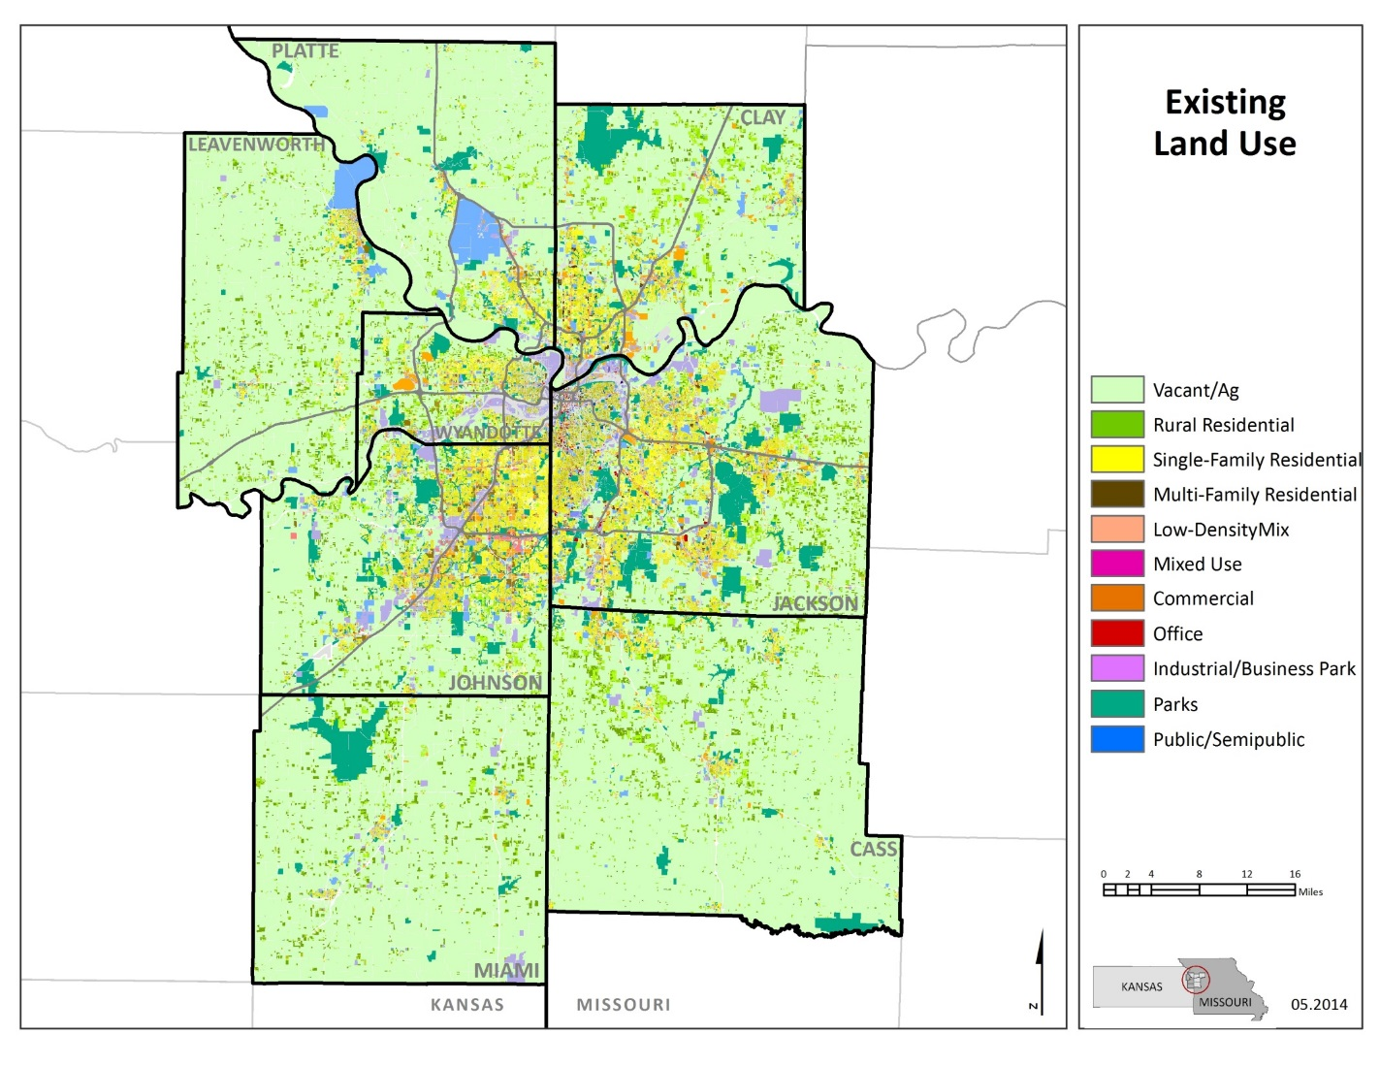
Mapping 2012 MARC land use to NLCD categories
MARC’s Base Year use (2012) | NLCD Land Use
Barren Not Classified | Barren Land
Coniferous Forest | Evergreen Forest
Cultivated | Cultivated Crops
Impervious Buildings Impervious Other | % 0-19 Impervious in grid cell = Developed, Open Space
Impervious Buildings Impervious Other | % 20-49 Impervious in grid cell = Developed, Low Intensity
Impervious Buildings Impervious Other | % 50-79 Impervious in grid cell = Developed, Medium Intensity
Impervious Buildings Impervious Other | % 80-100 Impervious in grid cell = Developed, High Intensity
Lowland Deciduous Forest Upland Deciduous Forest | Deciduous Forest
Lowland Herbaceous/Cultivated Upland Herbaceous/Cultivated | Pasture/Hay
Herbaceous | Grassland/Herbaceous
Mixed Forest | Mixed Forest
Shrub-Scrub | Shrub/Scrub
Water | Open Water

Slide 8
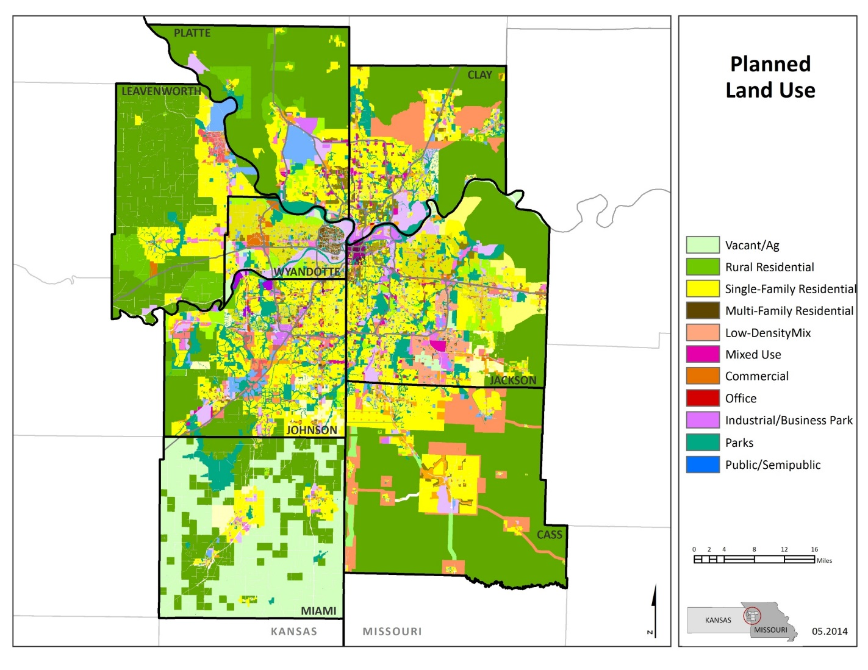
Mapping 2040 MARC land use to NLCD categories
MARC 2040 Economic Forecast | Mapped NLCD Land Use
Parks Open Space Public/Semipublic Rural Corridor Residential SF Rural, Large Lot, Rural Policy Residential SF Low and Very Low | Developed, Open Space (Assumes % 0-19 Impervious Surface)
Residential SF Medium; Urban Fringe Residential MF Low Low Mix; Mixed Use Low Office Low; Commercial Low; Indust./Bus. Park Low | Developed, Low Intensity (Assumes % 20-49 Impervious Surface)
Residential SF High Residential MF Low-Med Office Medium | Developed, Medium Intensity (Assumes % 50-79 Impervious Surface)
Residential MF Medium; High and Very High Condo High Mix Mixed Use High; Mixed Use Very High; Mixed Use Urban Office and Commercial High Industrial/Bus. Park High and Very High Industrial Center and Employment Center | Developed, High Intensity (Assumes % 80-100 Impervious Surface)
Vacant/Agriculture | Pasture/Hay

Slide 9
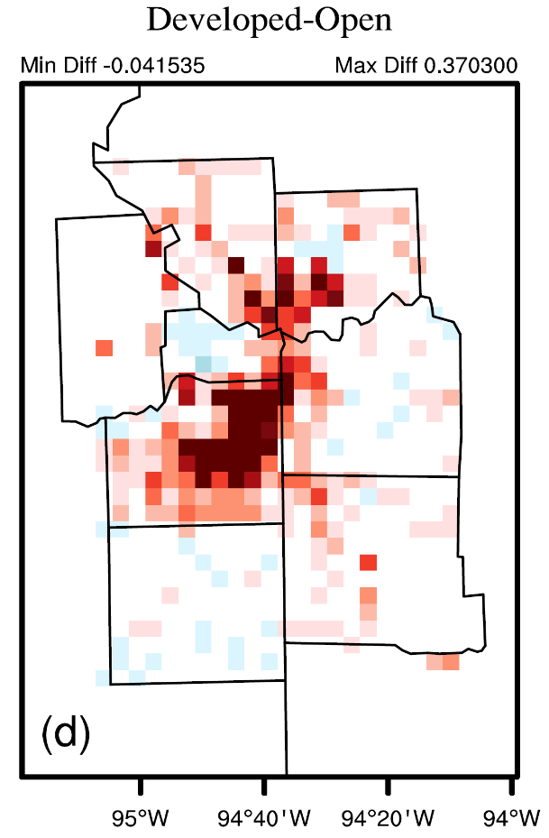
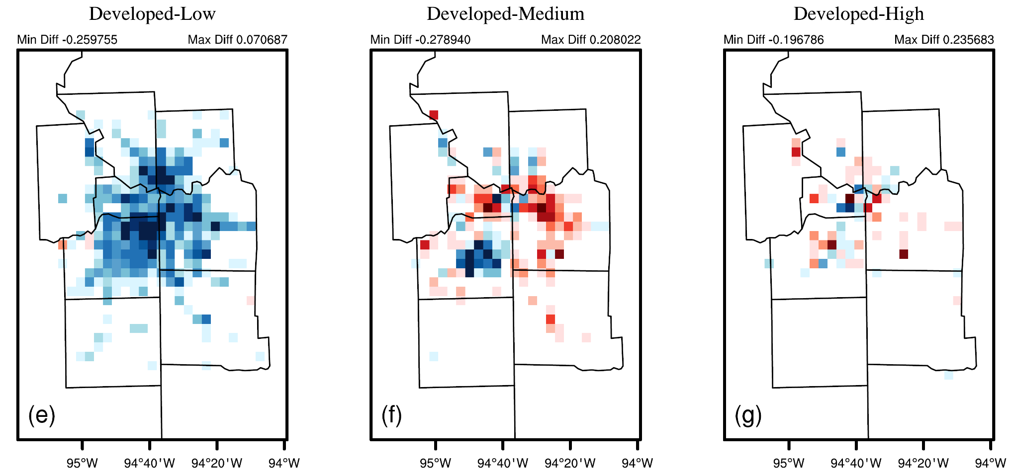
Land use changes (2040-2012)
- MARC provided land use data for 2012 (BASE simulations) and projections for 2040 (FUTURE simulations)
There is a shift from developed-low to developed open
There is also a move to developed medium

Slide 10
Land Use Change in WRF-CMAQ Model
CMAQ
WRF
Change in
PBL Height
Temperature
Humidity
Change in
Reaction Rates
Deposition
Mixing
Change in Surface Energy Balance
Land Use Change
Notes:
The change in surface land cover, such as vegetation and impervious surface will introduce changes in surface heat and water vapor fluxes in the WRF model and the deposition of pollutants on surfaces in CMAQ;

Slide 11
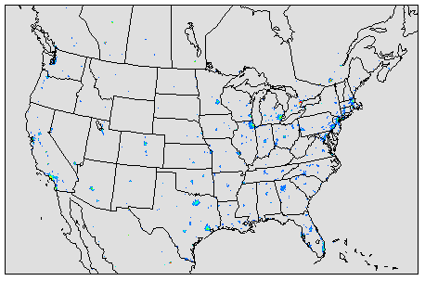
Model Configuration
WRF 3.7 – CMAQ 5.1
simulations were run for June, July and August 2011 (3 month period summertime)
Domains: 12 km CONUS and199x199 4km and 198x198 1 km that is centered over Kansas City
Land use
MARC supplied 2012 BASE and 2040 FUTURE land use
WRF, CMAQ, and BEIS land use and impervious surfaces updated for changes
1 km
4 km
12 km
Notes:
By keeping all other emission sources constant, could the analysis isolated the effects of land use on biogenic emission deposition and better understand the key meteorological processes that influence air quality when land use and land cover changes over time.

Slide 12
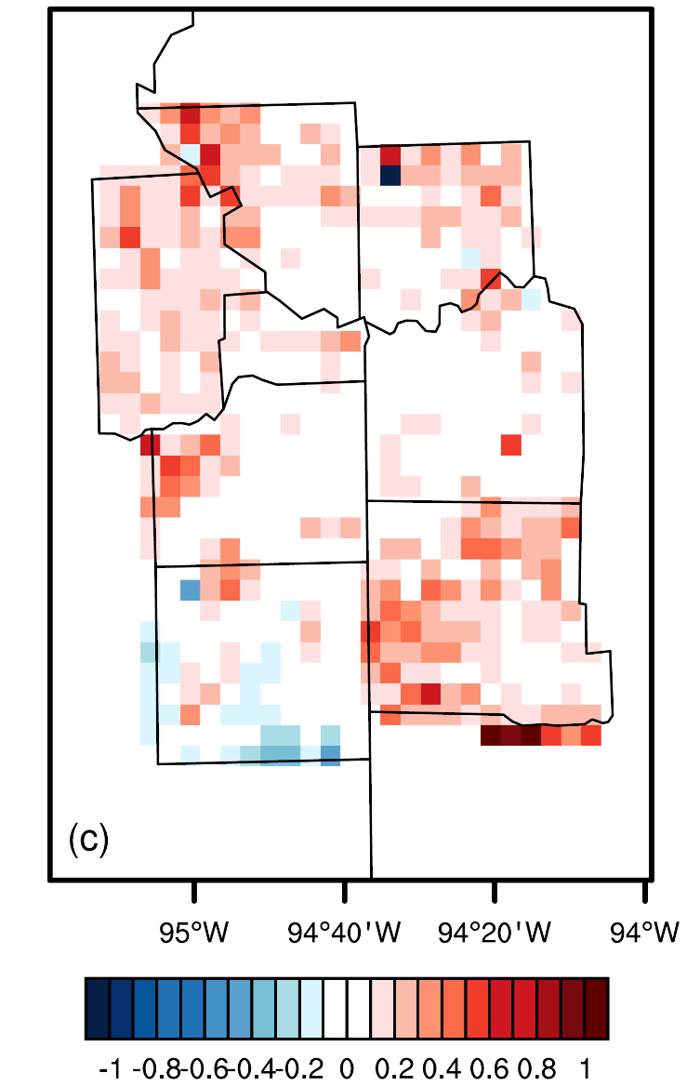
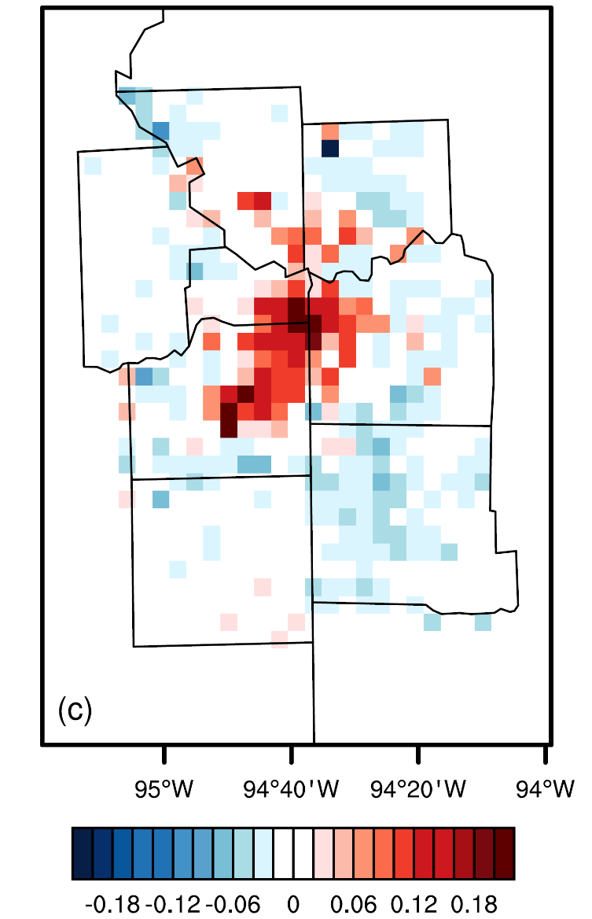
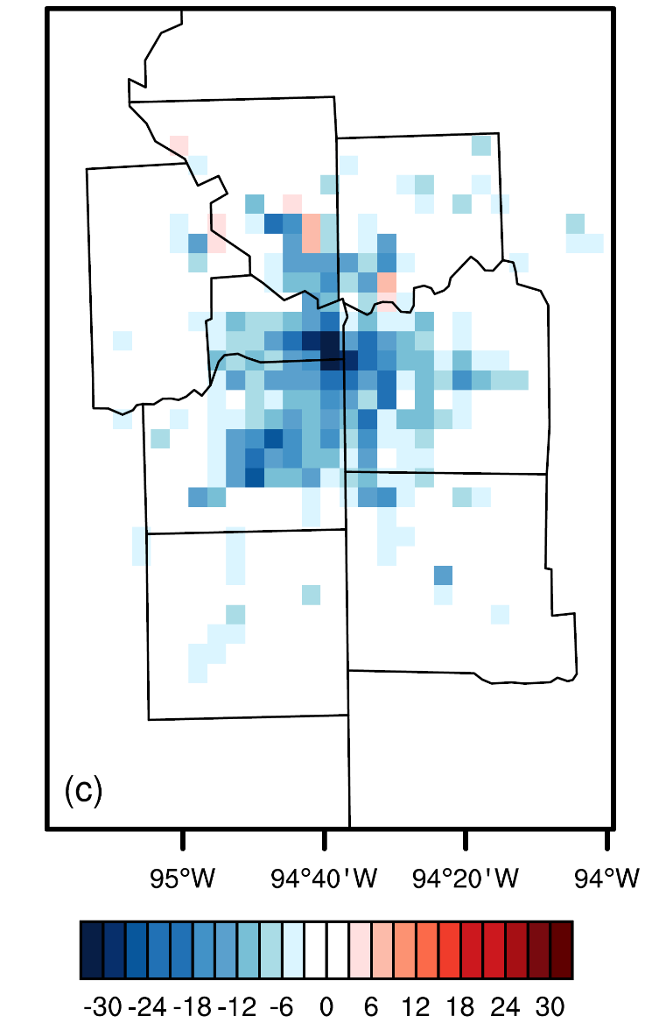
Preliminary results
LAI (Leaf Area Index) Vegetation Fraction Impervious
LAI and Vegetation increases over the downtown of KC, and Impervious decreases throughout KC
Notes:
The leaf area index (LAI, Fig.4-11) increases over the KC metro area,
The vegetation fraction increases over the downtown areas (Fig. 4-12), and decreases over the surrounding, as a result of new development.
The impervious surface fraction decreases in the 8 counties, especially over the downtown areas from approximately 70% to 40%,
Impervious surfaces are able to store more heat than natural surfaces and vegetation, and convert the solar radiation into the sensible heat.

Slide 13
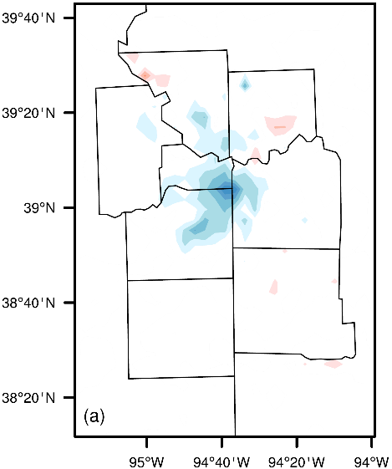
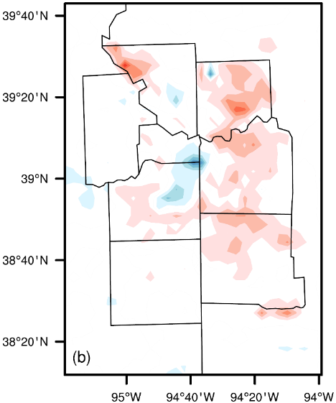
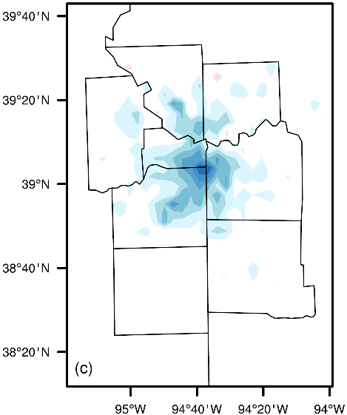
Land Use Change Impacts on 2 Meter Temperature (T2)
24-hr average day time (10am-6pm) nighttime
T2 decreases over the domain, especially during the night
Notes:
Trees and more vegetations could more easisly storate the energy into latent heat, and then decrease the sensible heat;
This effect is especially important at night when evapotranspiration rates are greatest.

Slide 14
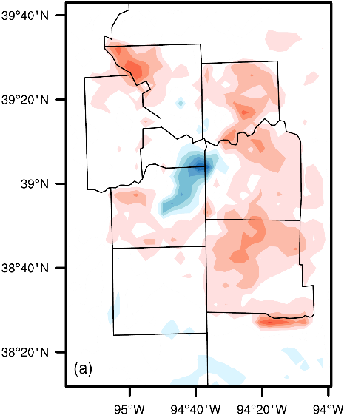
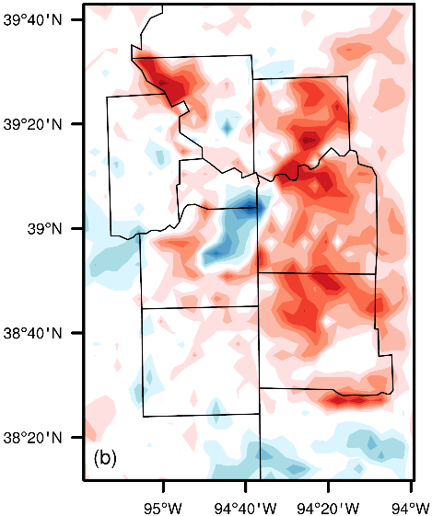
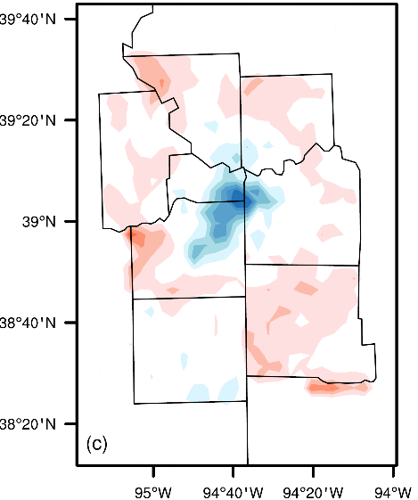
Land Use Change Impacts on Planetary Boundary Layer (PBL) Height
24-hr average day time (10am-6pm) nighttime
PBL changes are consistent with T2 changes

Slide 15
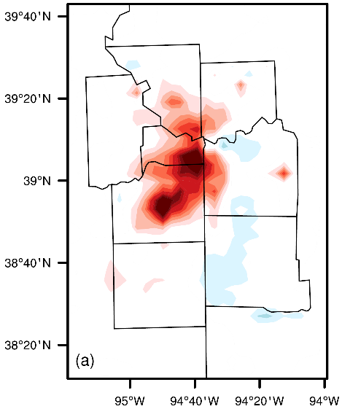
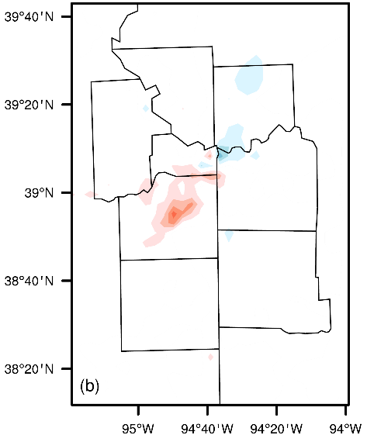
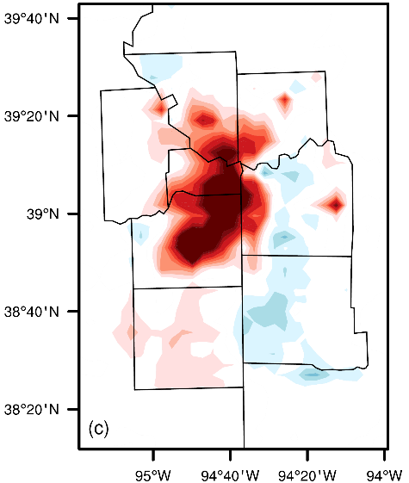
Land Use Change Impacts on JJA NO_{x} (ppbv)
24-hr average day time (10am-6pm) nighttime
NO_{x} increasing over most of the domain, due to PBL changes

Slide 16
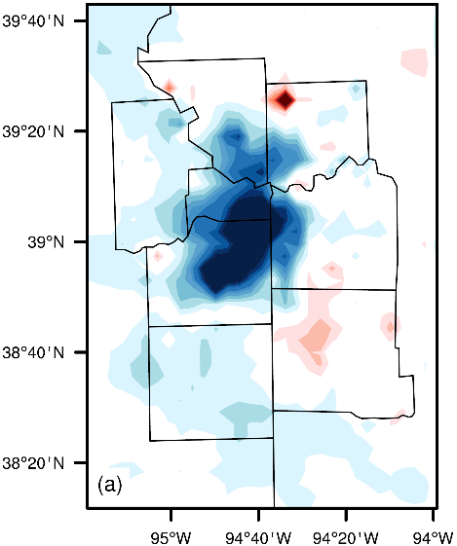
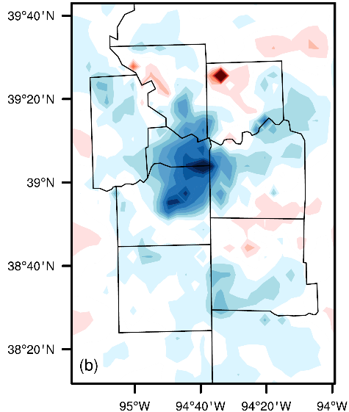
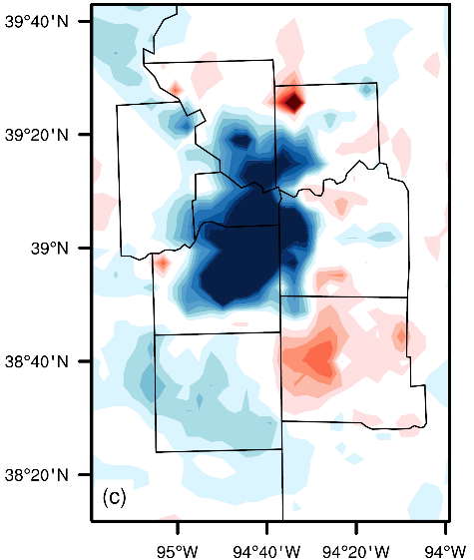
Land Use Change Impacts on JJA O₃ (ppbv)
24-hr average day time (10am-6pm) nighttime
O₃ decreases over most of the domain, especially over the downtown areas
could be caused by NO_{x} titration and dry deposition increase

Slide 17
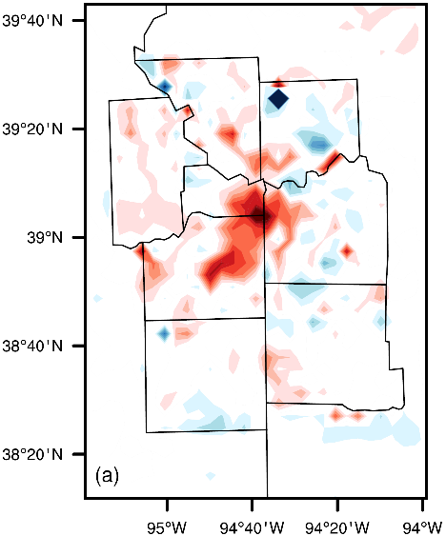
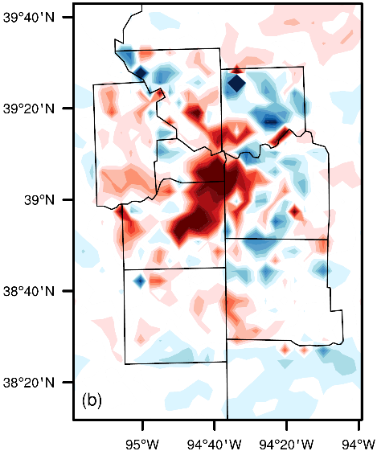
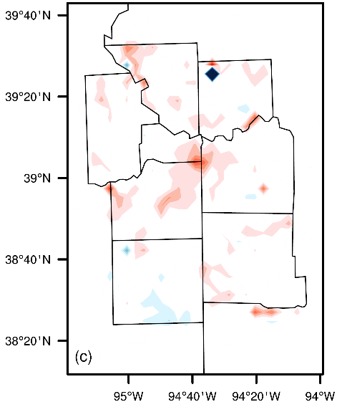
Land Use Change Impacts on JJA O₃ Dry Deposition (kg/ha)
24-hr average day time (10am-6pm) nighttime
O₃ dry deposition increases over most of the domain, especially over the downtown areas

Slide 18
Land Use Change Impacts on JJA PM_{2.5} (µg/m³)
24-hr average day time (10am-6pm) nighttime
PM_{2.5} increases over Kansas, and slightly decreases in Missouri

Slide 19
Changes in PM_{2.5} Components (µg/m³)
PM_{2.5} increases are mainly caused by the increase of the primary PM—OC, EC, Unspeciated and Soil
48% of the total PM_{2.5} emissions is from the dust in Johnson county, KS

Slide 20
Conclusions
Vegetation and impervious changes lead to changes in meteorology and associated air quality
T2 and PBL decrease due to the transfer of sensible heat flux to latent heat flux from the increase in vegetation
Changes in land use from urban development in KC could reduce O₃ concentrations due to the combined effect of increasing NO_{x} titration and O₃ dry deposition
We also see disbenefit in PM_{2.5}, especially in primary PM_{2.5}, due to the decrease of the PBL height

Slide 21
Further steps
Compare the results between 4km and 1km
Develop a green infrastructure (GI) only scenario with MARC to isolate the GI effect on the simulated changes of meteorology and air quality

Slide 22
Thanks!
Disclaimer. Although this work was reviewed by EPA and approved for publication, it may not necessarily reflect official agency policy.
Acknowledgements. Yuqiang Zhang held ORISE Postdoctoral fellowship at U.S. EPA.

Slide 23
Extra slides

Slide 24
Sector emissions in Johnson, KS from 2011 NEI
Unpaved road dust: 796 tons/yr
Construction dust: 733 tons/yr
Pave road dust: 406 tons/yr
Dust composite 48% of total PM_{2.5} emissions in Johnson

Slide 25
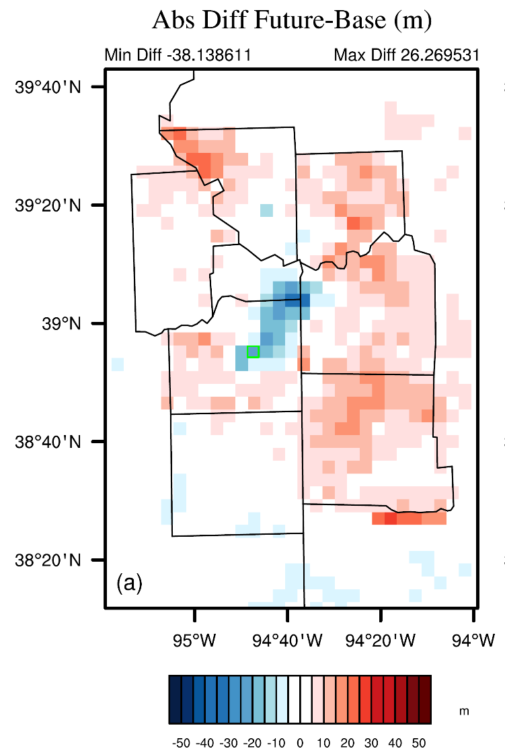
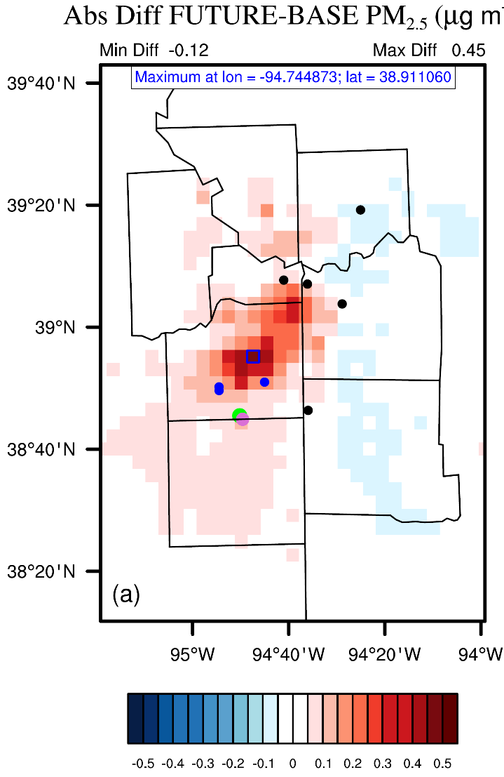
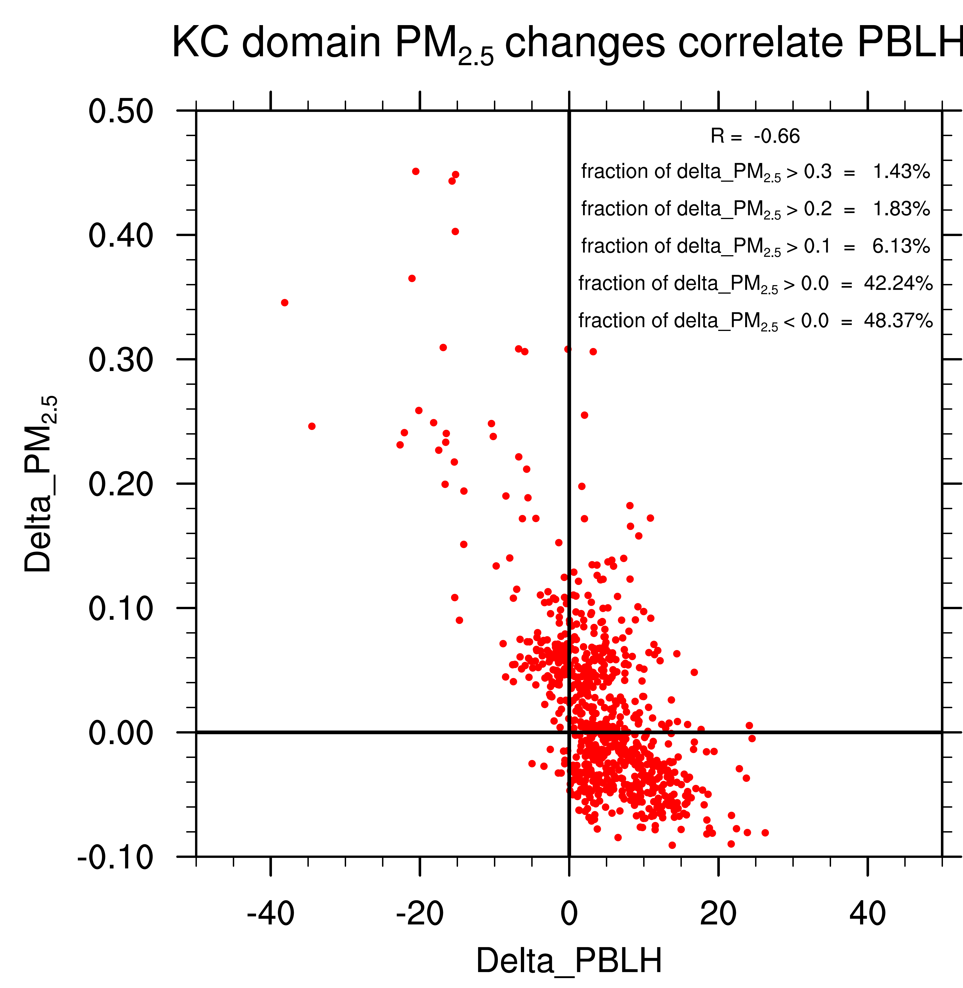
PBLH with PM_{2.5} changes
3% of total areas (747 grid cells in KC) greater than 0.2 µg/m³.

Slide 26
Mobile + Dust in Johnson, KS from 2011 NEI
Mobile: 624 tons/yr
Dust: 1968 tons/yr
(Mobile + Dust) composites of 64% of total PM_{2.5} emission in Johnson county.

