Slide 1
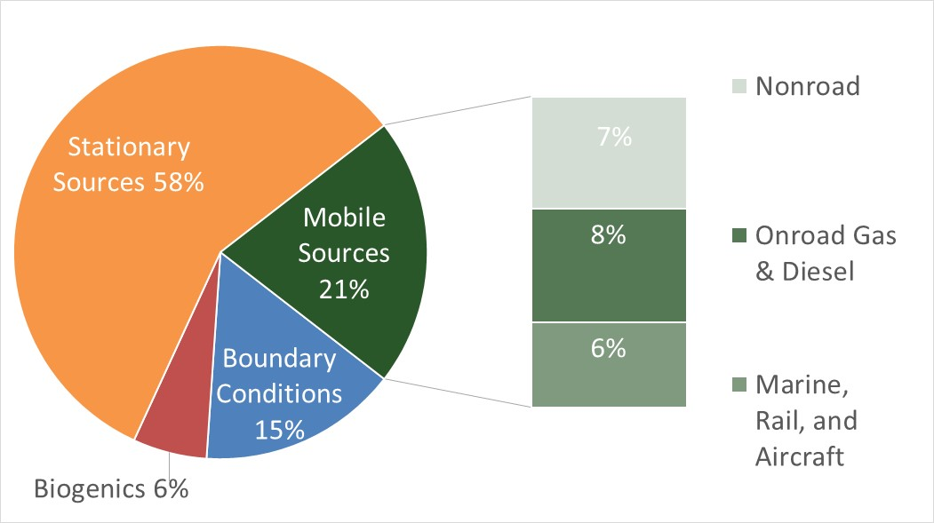
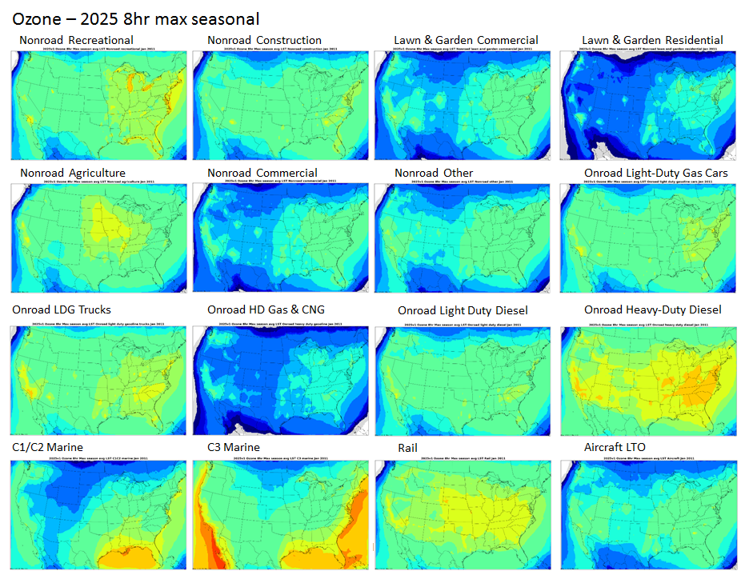
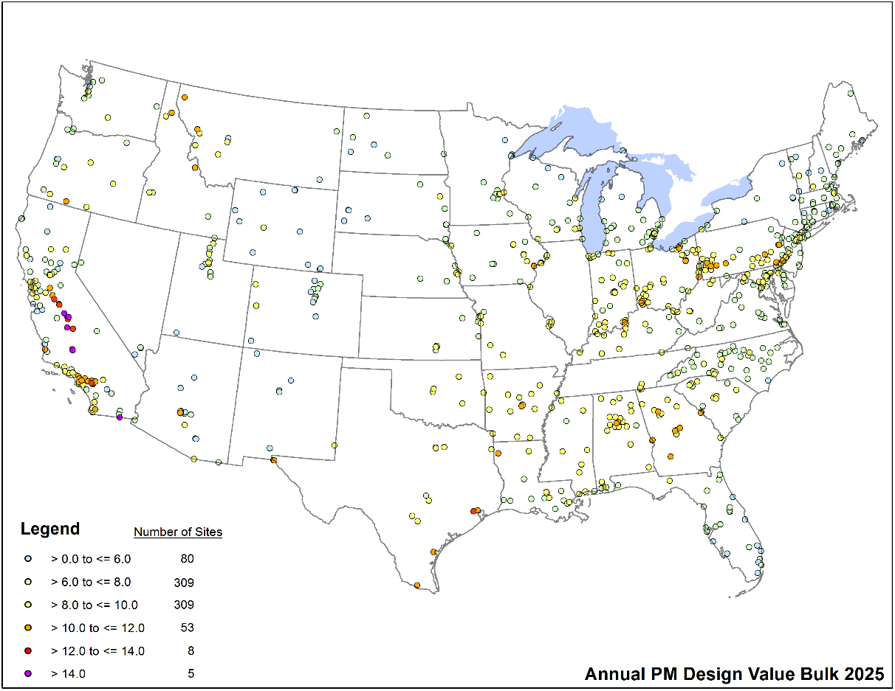
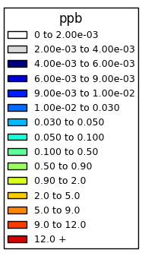
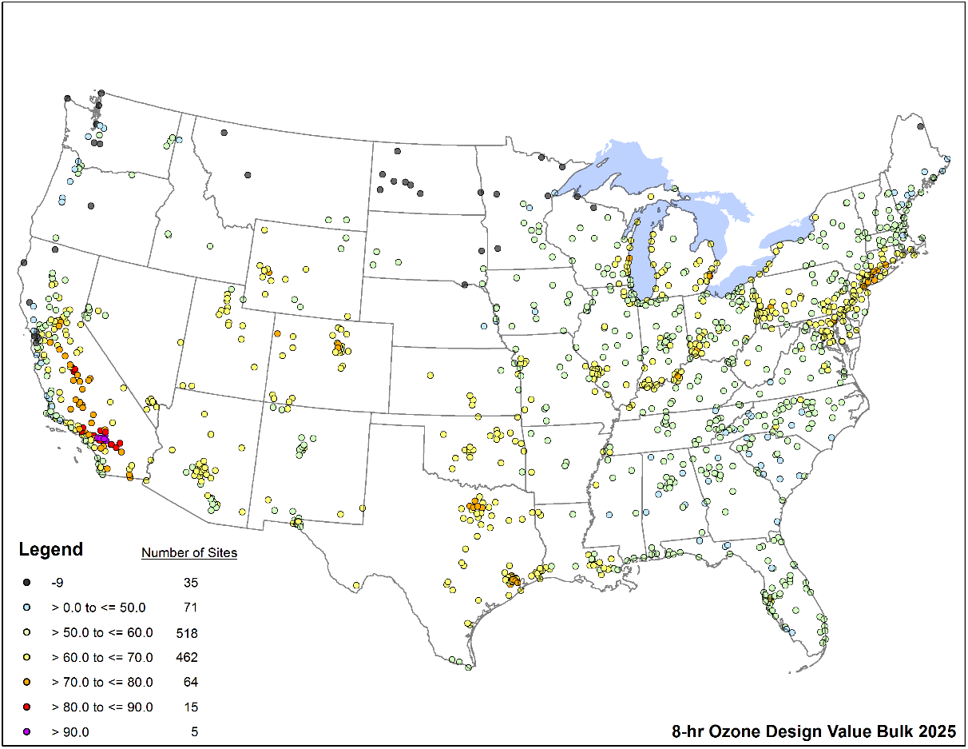
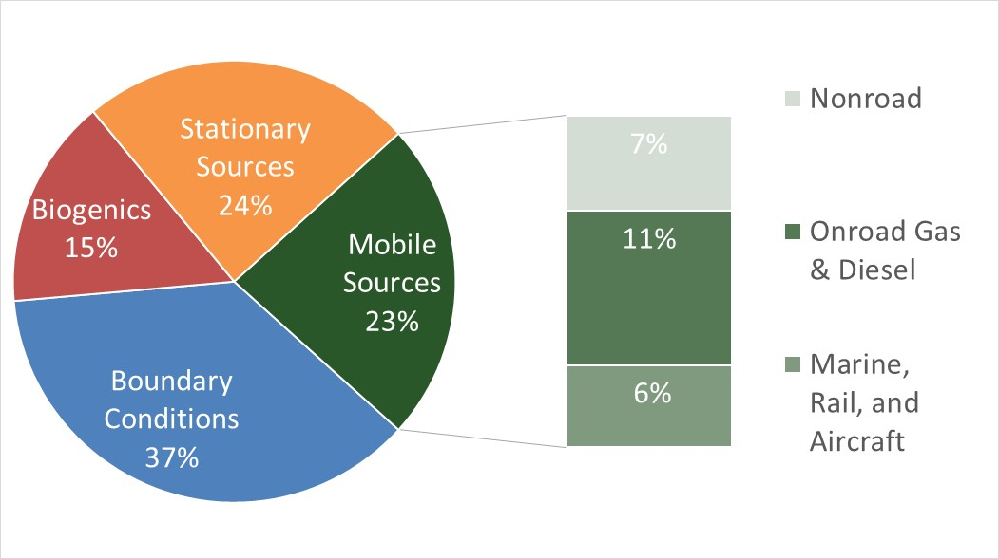
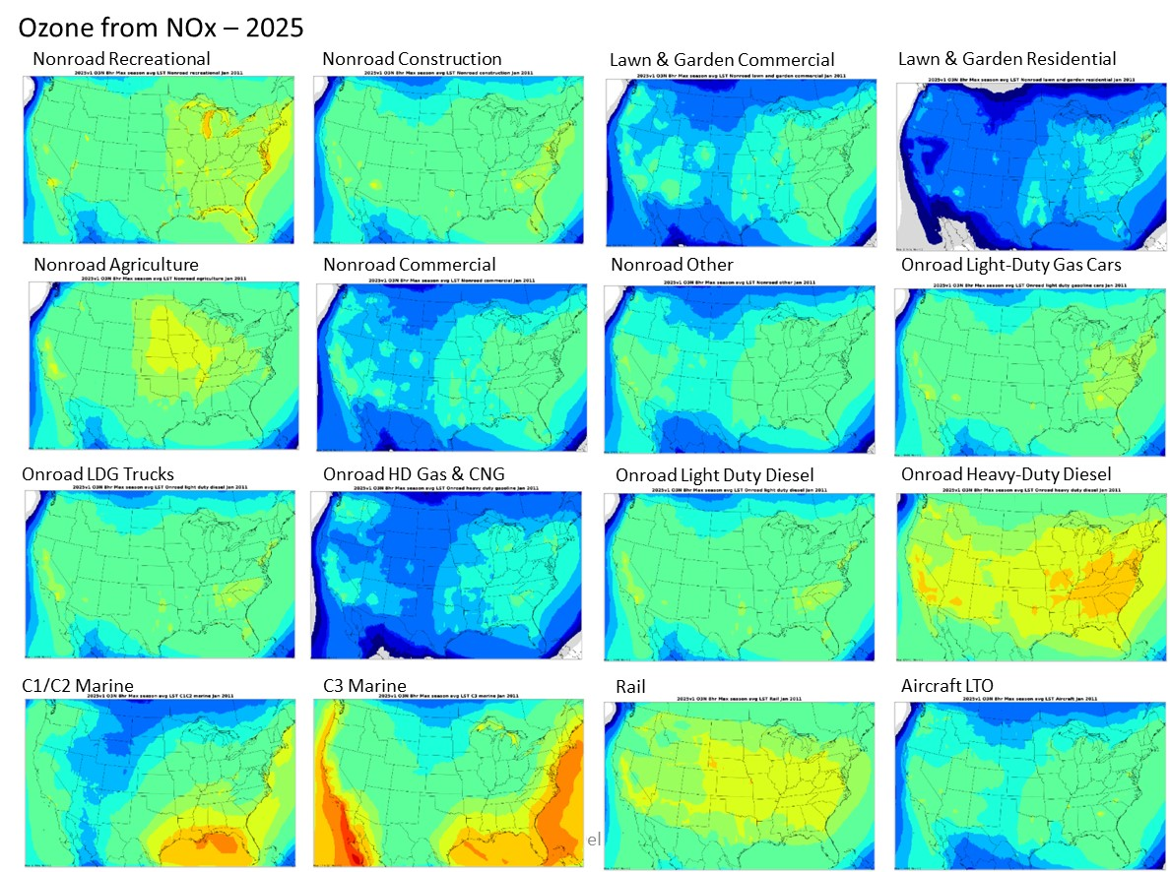
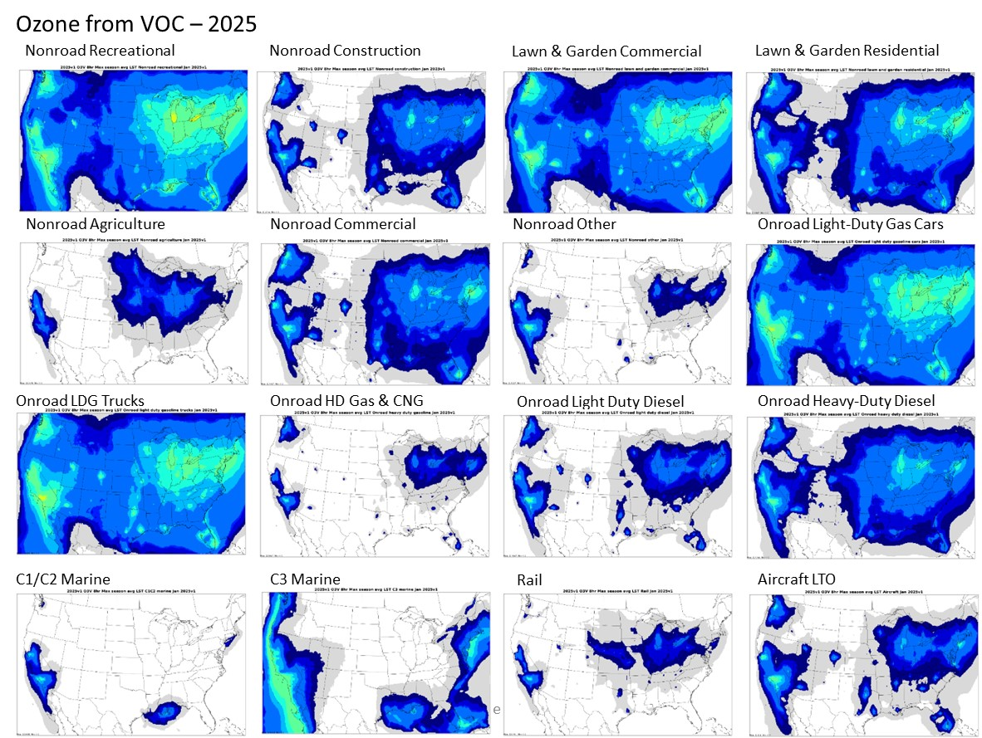
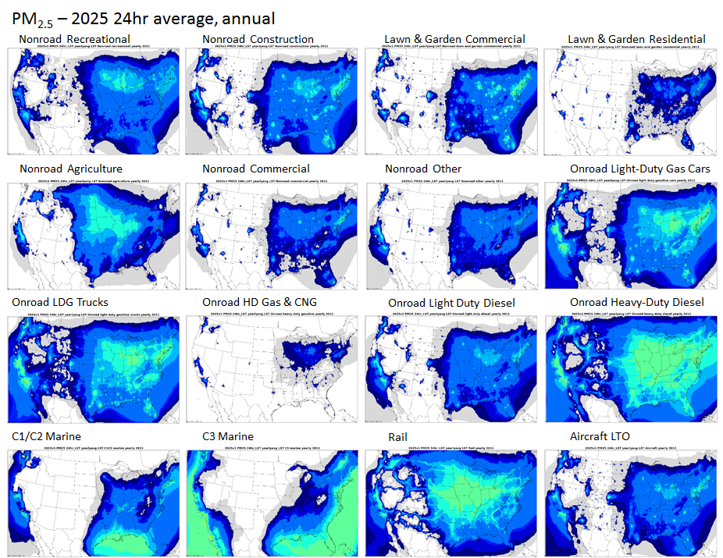
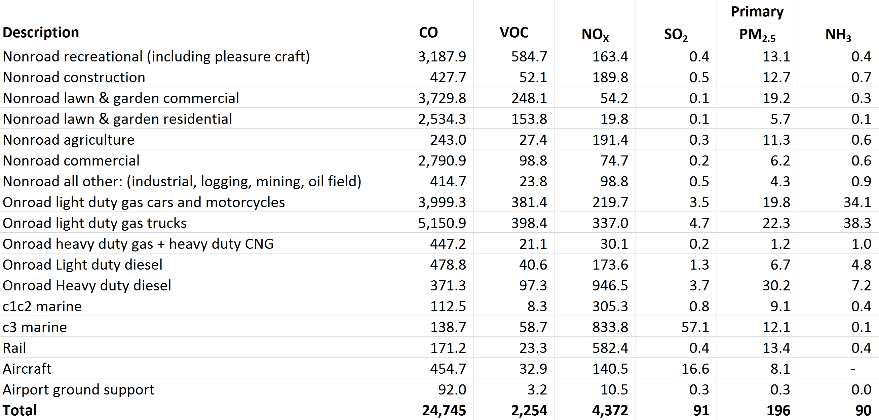
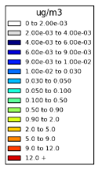
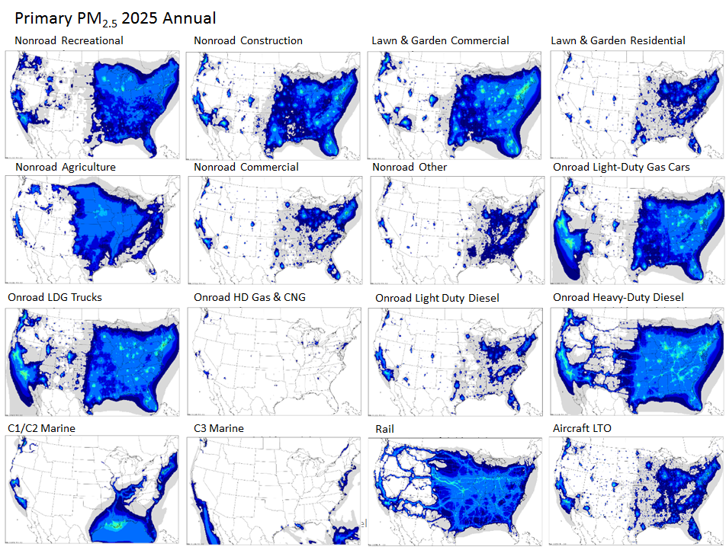
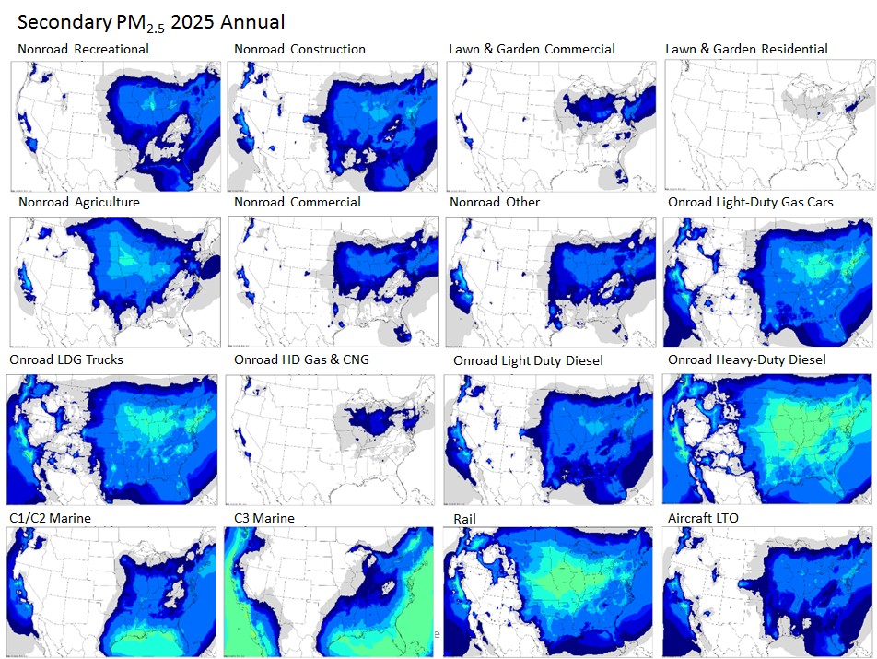
Mobile Source Contributions to Ambient PM_{2.5} and Ozone in 2025
Margaret Zawacki, Kirk Baker, Sharon Phillips, Ken Davidson
U.S. EPA – Office of Transportation and Air Quality/Office of Air Quality Planning and Standards
Introduction
Figure 1. 2025 Annual PM_{2.5} Design Values
Figure 3. Average Contribution of Mobile Sources to 2025 Annual PM_{2.5} Design Values
Figure 8. Mobile Source Contributions to Ozone in 2025
Understanding the impact of different mobile source sectors on ambient concentrations of ozone and PM_{2.5} is important for policy makers. The relative impact of direct particulate matter (PM) emissions, and emissions of NO_{X}, SO_{X}, and ammonia, on ambient concentrations of PM_{2.5} can be difficult to estimate without photochemical modeling. Photochemical air quality models are used by EPA in analyzing potential regulations because they can simulate the physical and chemical processes that affect air pollutants as they disperse and react in the atmosphere. Source apportionment analysis provides a computationally efficient way to compare many different emissions sources, such as mobile source sectors, and to estimate the contribution of emissions in each sector to ambient concentrations of ozone and PM_{2.5}. This analysis allows the mobile source contribution to ambient PM_{2.5} concentrations to be broken out into primary PM_{2.5} (composed of elemental carbon, organic carbon, and other primary PM) and secondary PM_{2.5} (composed of nitrate ions, sulfate ions, and ammonium ions).
Legend for
Figures 8 -10
Methodology
Figure 2. 2025 8-hour Ozone Design Values
Figure 4. Average Contribution of Mobile Sources to 2025 8-hour Ozone Design Values
Figure 10. Mobile Source Contributions to Ozone from VOC in 2025
CAM_{X} v6.20 was used to complete a source apportionment analysis for 2025
  Twelve km grid cells were used across the contiguous U.S
  2011 v6.2 platform
    Meteorology: WRF v3.4
    Initial and Boundary Conditions: GEOS-Chem version 8-03-02
    2025 Emissions
      SMOKE v3.6.5
      MOVES2014
      BEIS 3.6.1
Contributions to ambient PM and ozone assessed from 17 mobile source sectors
CAMx source apportionment approach for ozone (OSAT) includes contributions from:
  NO_{X} (nitrogen oxides) to ozone
  VOC (volatile organic compounds) to ozone
CAM_{X} source apportionment approach for PM (PSAT) includes contributions from:
  NOx to PM_{2.5} nitrate ion, SO₂ to PM_{2.5} sulfate ion, NH₃ to PM_{2.5} ammonium ion
  primary elemental carbon, primary organic carbon, other primary PM_{2.5}
Figure 9. Mobile Source Contributions to Ozone from NO_{X} in 2025
Results
The results provide information about mobile source sectors’ contributions to ambient PM_{2.5} and ozone concentrations. These results are especially interesting because they parse mobile source emissions into many discrete sectors so that the impact from different types of mobile sources can be studied.
This analysis also allows the mobile source contribution to ambient ozone concentrations to be broken out into ozone from NO_{X} emissions and ozone from VOC emissions. Figures 8, 9, and 10 compare the contribution from NO_{X} and VOC to projected ozone concentrations in 2025 for 16 different mobile source sectors by location. For most of the mobile source sectors, emissions of NO_{X} contribute to higher concentrations of ozone than emissions of VOC.
Background
Figure 5. Mobile Source Contributions to Total PM_{2.5} in 2025
Table 1. Mobile Source Sectors with 2025 Emissions (thousand tons/yr)
Legend for
Figures 5 -7
Discussion
Even with the mobile source regulations and voluntary programs already in place, mobile sources will contribute significantly to ambient levels of PM_{2.5} and ozone well into the future. The results from the source apportionment runs allow us to visualize the impact of emissions from specific mobile source sectors on these ambient levels.
These results can be used to evaluate the need for further emissions reductions from mobile source sectors in order to improve AQ and impact public health.
These results can also inform decisions about prioritizing data collection activities to focus such action on the sources with the largest impact on ambient air pollution.
Figure 6. Mobile Source Contributions to Primary PM_{2.5} in 2025
Figure 7. Mobile Source Contributions to Secondary PM_{2.5} in 2025
Limitations
Source apportionment modeling relies, of course, on the validity of the photochemical model approach and its inputs (see methods section for details on inputs to CAMx and the OSAT and PSAT algorithms). In particular, inventories for nonroad sectors, including rail and marine, are less certain than inventories for onroad sectors. OTAQ is working to update several facets of the nonroad inventory but results will not be complete for several years. Also, this version of CAM_{X} does not include all processes contributing to secondary organic aerosol (e.g. POA volatility, SOA from unspeciated VOC).
Data from 2011 Version 6.2 Platform (https://www.epa.gov/air-emissions-modeling/2011-version-62-platform)
Projected design values for annual PM_{2.5} and ozone are shown in Figures 1 and 2. These design values represent total projected ambient concentrations and allow for the relative importance of the mobile source contribution to be assessed. The dots represent locations where design values are calculated.
Figures 3 and 4 present the relative importance for the different sources contributing to the projected ozone and PM_{2.5} design values. “Stationary sources” include emissions from point and nonpoint sources, fires, and emissions from Canada and Mexico that occur within the CAM_{X} modeling domain. “Boundary conditions” include emissions from outside the 12 km CAM_{X} domain, these are supplied by the hemispheric model GEOS-CHEM. “Biogenic emissions” include emissions from plants, fugitive dust emissions, and ammonia emissions from agriculture.
References
Figures 5, 6, and 7 compare the total, primary, and secondary contribution to projected PM_{2.5} concentrations in 2025 for 16 different mobile source sectors by location. For many of the mobile source sectors, the contribution to the secondary portion of ambient PM_{2.5} is as large, or larger, than their contribution to primary PM_{2.5}.
Environ International Corporation, 2015. CAMX User’s Guide Version 6.2. www.camx.com/files/camxusersguide_v6-20.pdf
U.S. EPA, 2015. Technical Support Document (TSD) Preparation of Emissions Inventories for the Version 6.2, 2011 Emissions Modeling Platform. https://www.epa.gov/sites/production/files/2015-10/documents/2011v6_2_2017_2025_emismod_tsd_aug2015.pdf

