Slide 1
Assessment of Air Quality Impacts from the 2013 Rim Fire
Matthew Woody¹, Kirk Baker¹, Benjamin Murphy¹, Jose Jimenez², Pedro Campuzano-Jost², Emma Yates³, Laura Iraci³
¹U.S. EPA
²University of Colorado at Boulder
3 NASA Ames Research Center

Slide 2
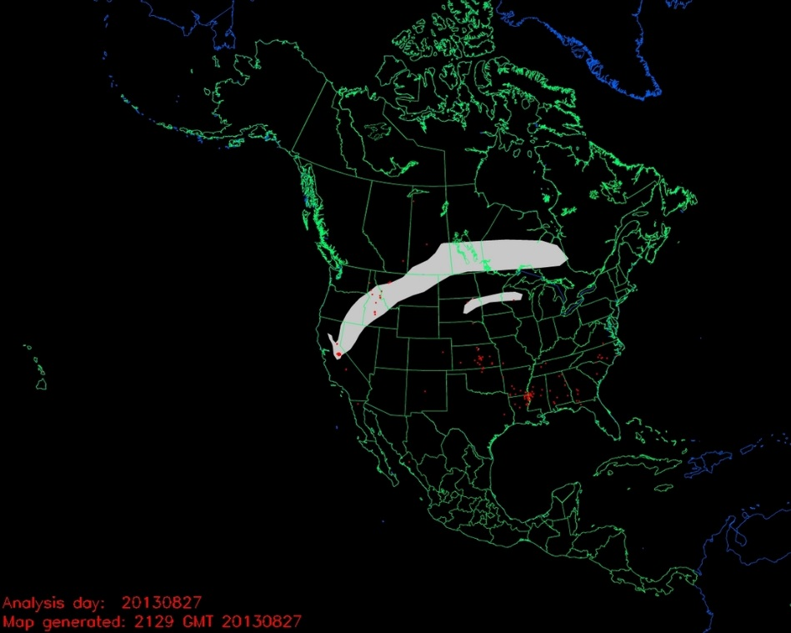
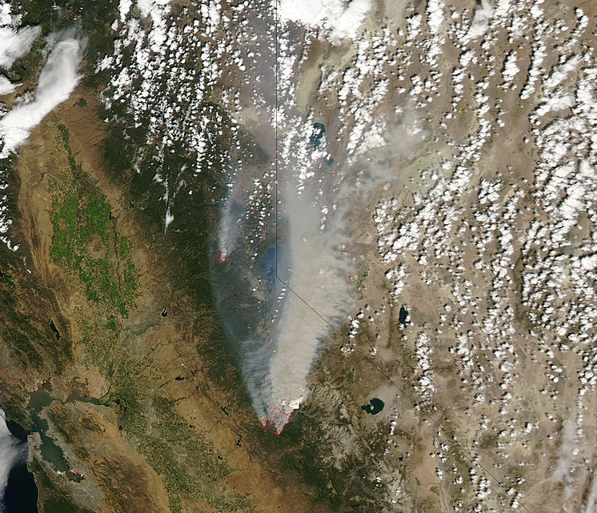
2013 Rim Fire
Started 8/17/13 from a campfire in Stanislaus National Forest
3rd largest wildfire in CA history
Fully contained on 10/24/13
Burned 257,314 acres
Cost $127 million to extinguish

Slide 3
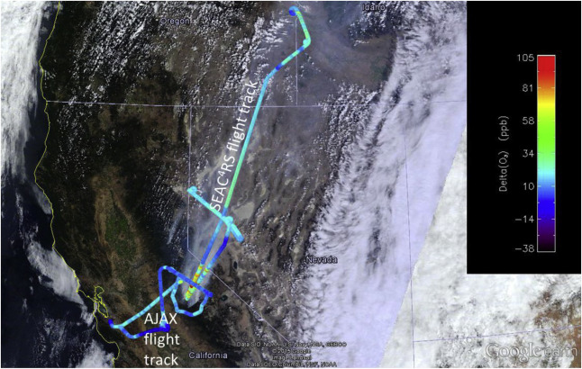
Instrumented Field Campaigns and Modeling Approach
Instrumented Field Campaigns
  SEAC4RS
    NASA DC-8
    8/26 and 8/27
    Trace Gases and Aerosols
  AJAX
    NASA Ames Alpha Jet
    8/29
    GHG (CO₂, CH₄, O₃)
  Fire impacts estimated by subtracting background concentration from observed concentration
Modeling Approach
  August – September 2013
    4k and 12k Simulations
  CMAQ v5.2
    Separate semi-volatile (SV) and non-volatile (NV) POA CMAQ simulations
    pcSOA (potential combustion SOA, which includes SOA from IVOCs) excluded for wildfires
  Fire emissions estimated using SMARTFIRE v2 and BlueSky framework
Yates et al., AE, 2016

Slide 4
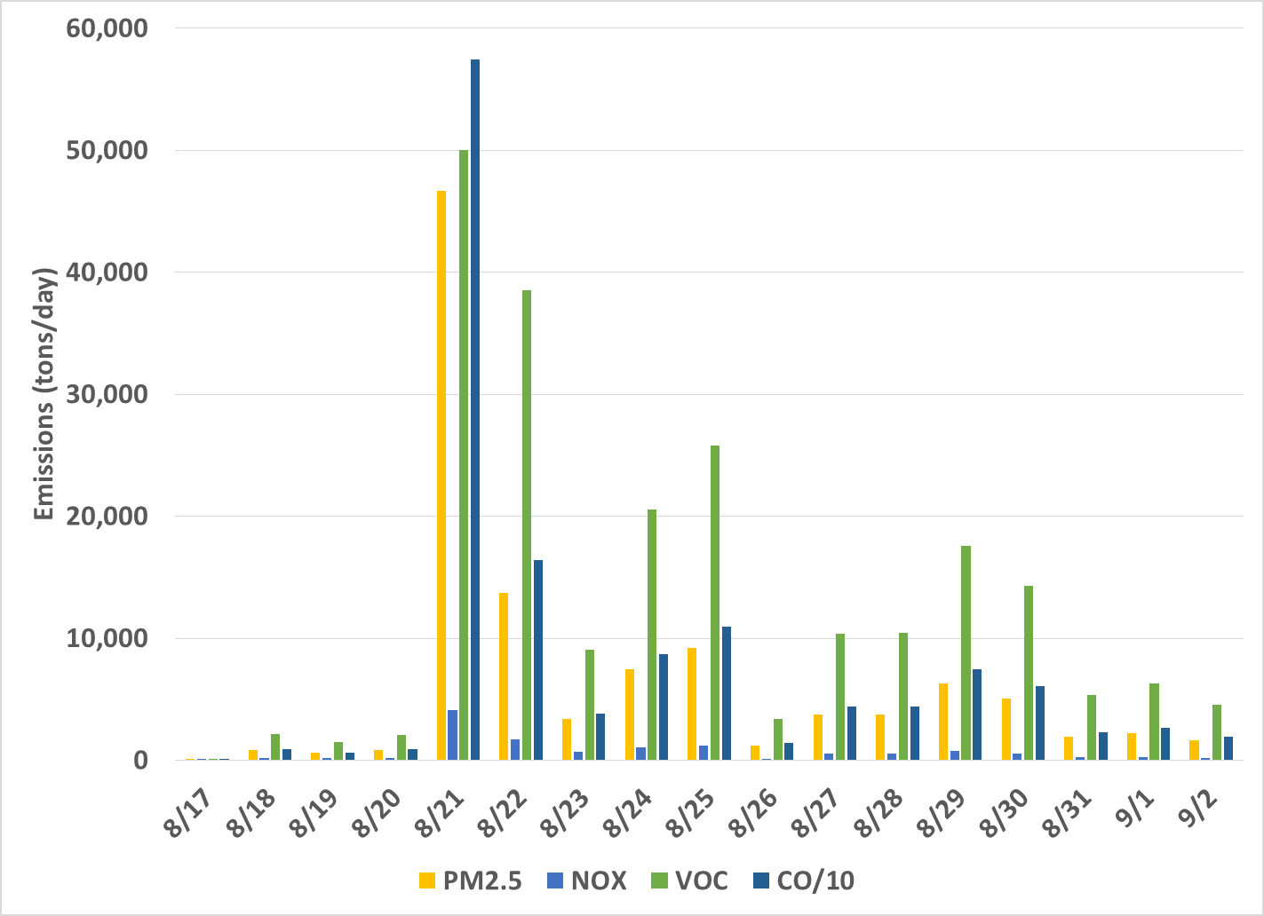
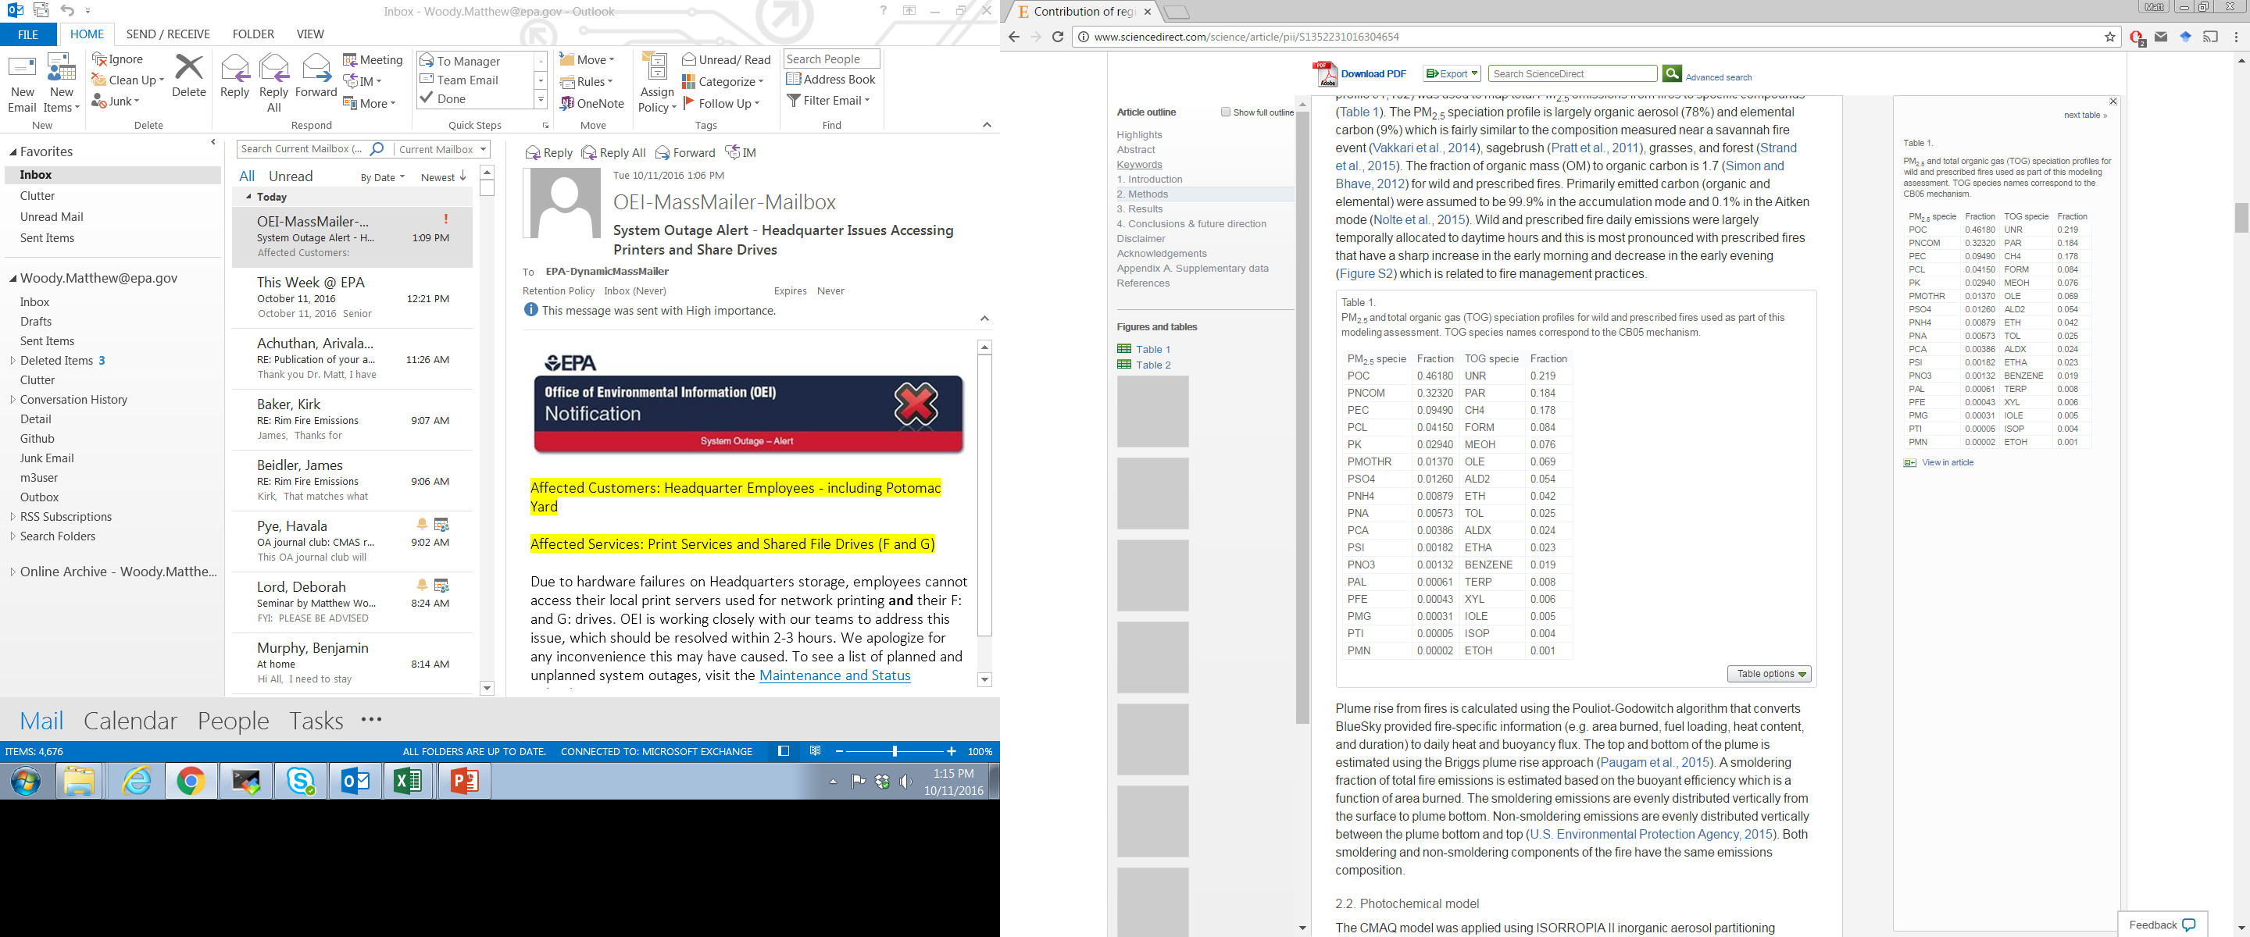
Rim Fire Emissions
PM_{2.5} and TOG Speciation
78% of PM_{2.5} is POA
Baker et al., 2016

Slide 5
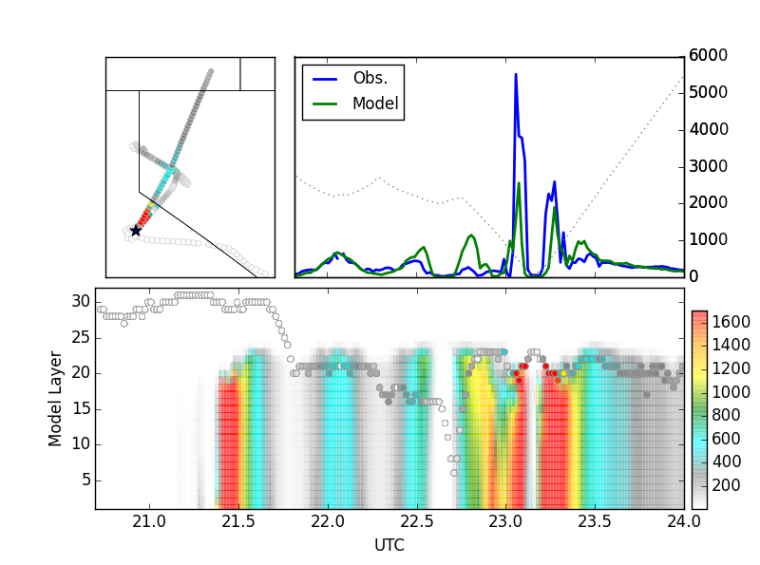
SEAC4RS observed vs. modeled CO
Transect
Transect
Transect

Slide 6
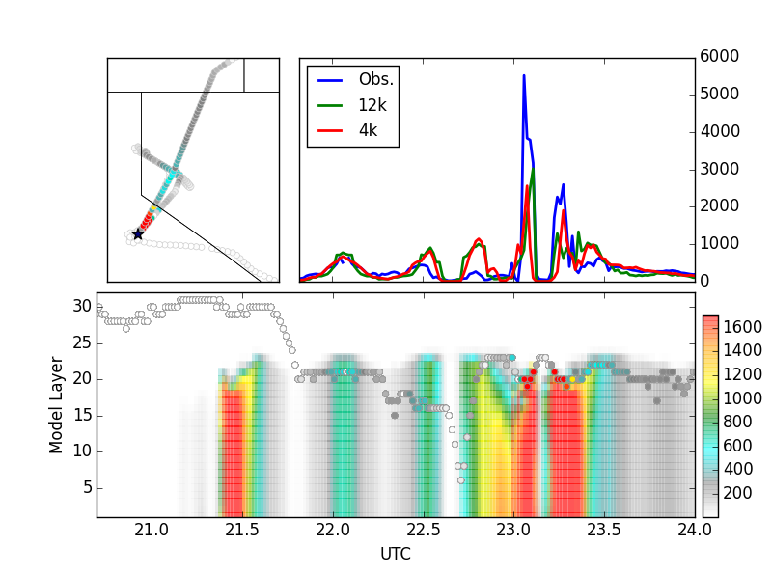
SEAC4RS observed vs. modeled CO (12k and 4k)

Slide 7
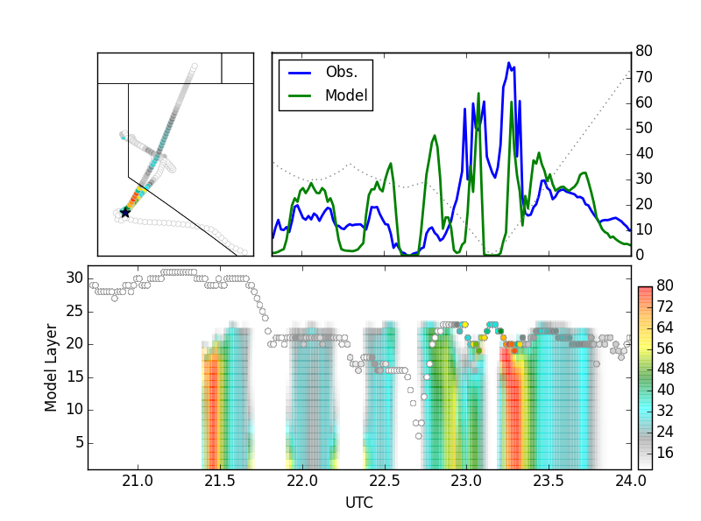
SEAC4RS observed vs. modeled O₃
Obs within model mixing height

Slide 8
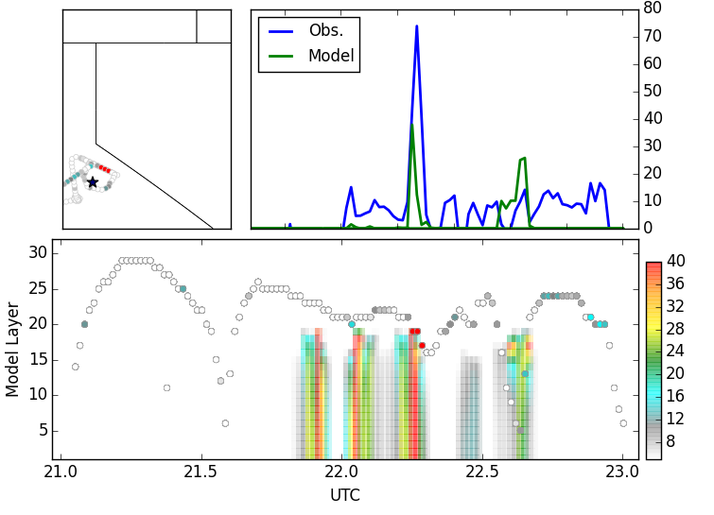
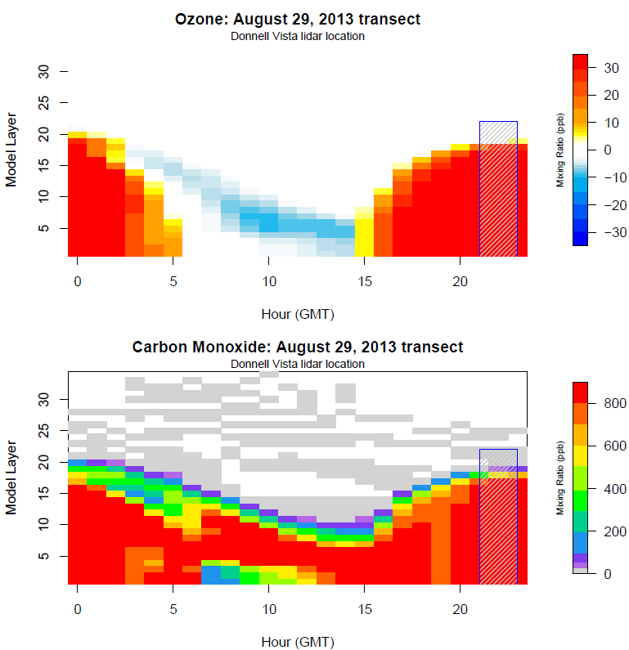
AJAX observed vs. modeled O₃
Modeled Impacts at Donnel Vista
Model mixing height too low
Obs above model mixing height

Slide 9
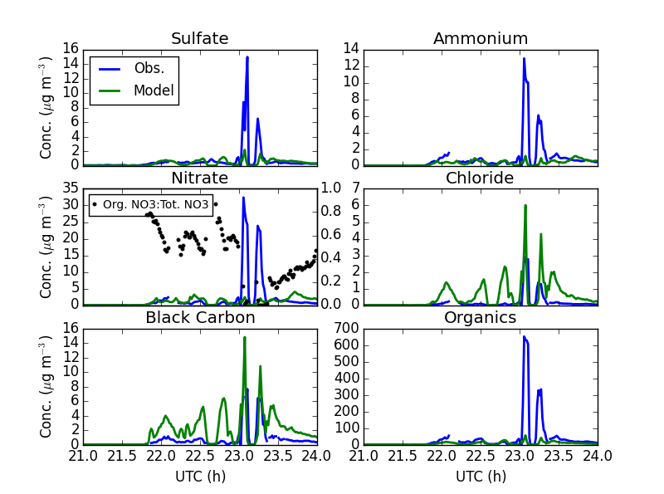
SEAC4RS observed vs. modeled PM₁
CMAQ PM_{2.5} Speciation
Baker et al., 2016

Slide 10
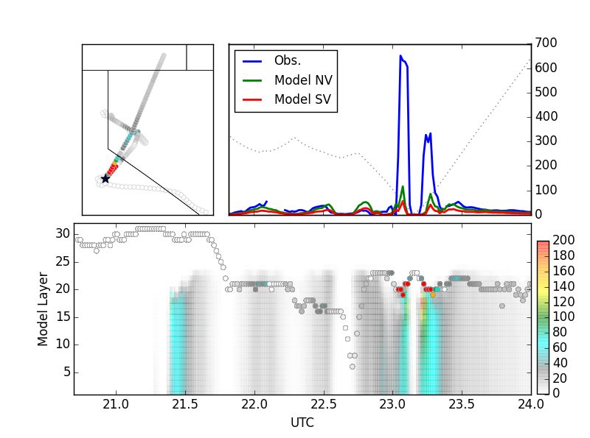
SEAC4RS observed vs. modeled OA

Slide 11
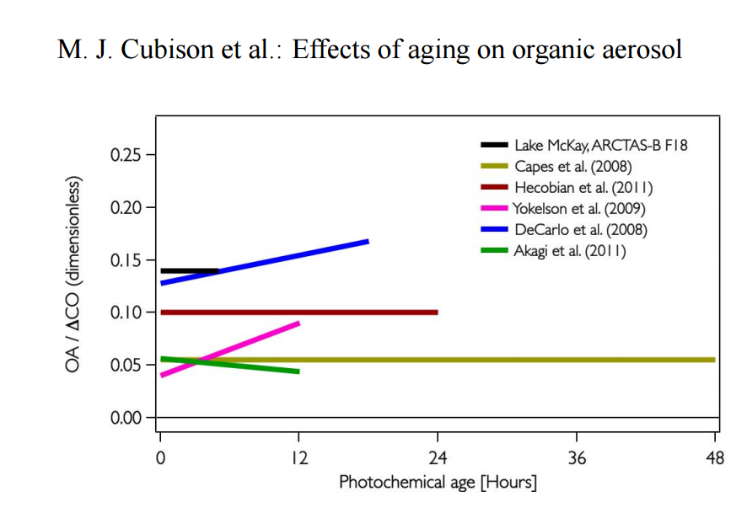
Do fires produce SOA?
Yes
Decarlo et al., 2008, ACP
Yokelson et al., 2009, ACP
Varkkari et al., 2014, GRL
Konovalov et al., 2015, ACP
No
Cubison et al., 2011, ACP
Jolleys et al., 2012, ES&T
Forrister et al., 2015,GRL
Liu et al., 2016, JGR
Yu et al., 2016, JGR

Slide 12
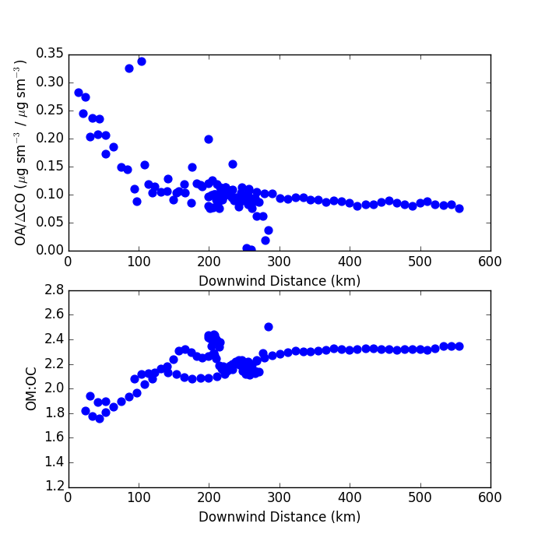
Rim Fire OA
If the Rim Fire made SOA
OA/ΔCO suggests no significant SOA formation
OM:OC suggests ageing of OA

Slide 13
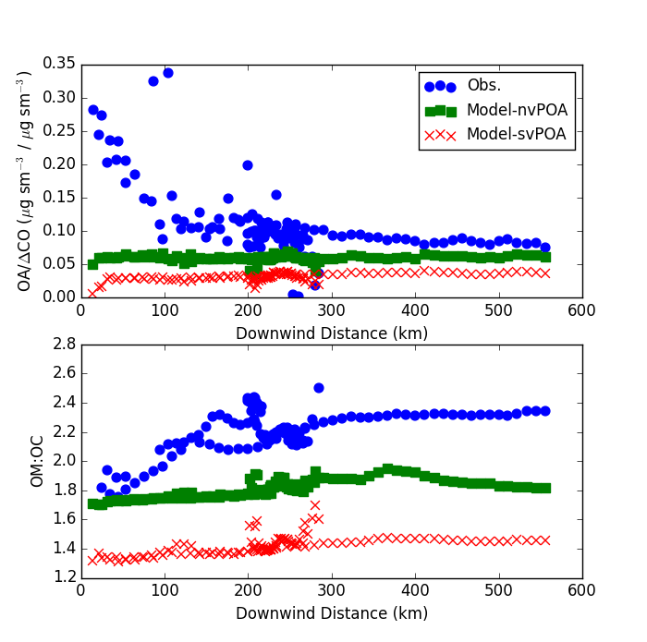
OA vs. Downwind Distance

Slide 14
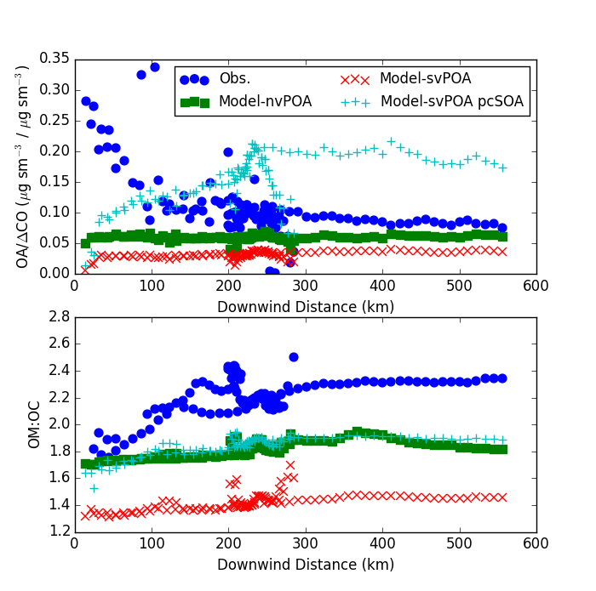
OA vs. Downwind Distance
Modeled SOA from IVOCs doesn’t match obs
…but improves svPOA OM:OC

Slide 15
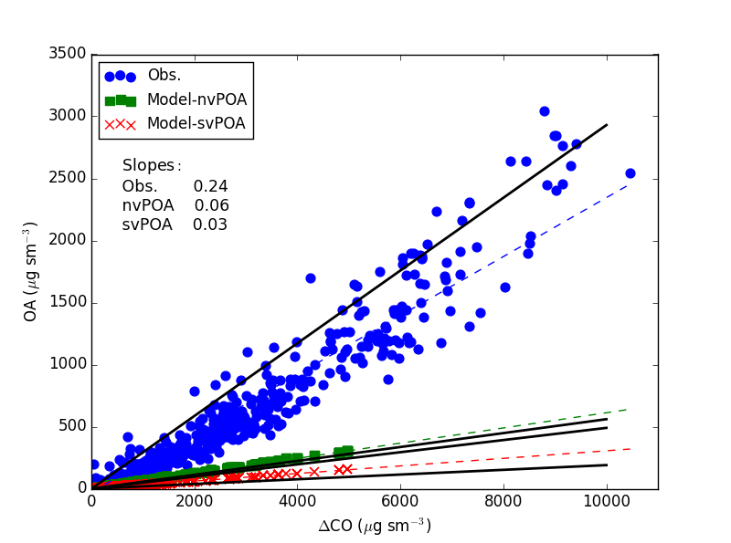
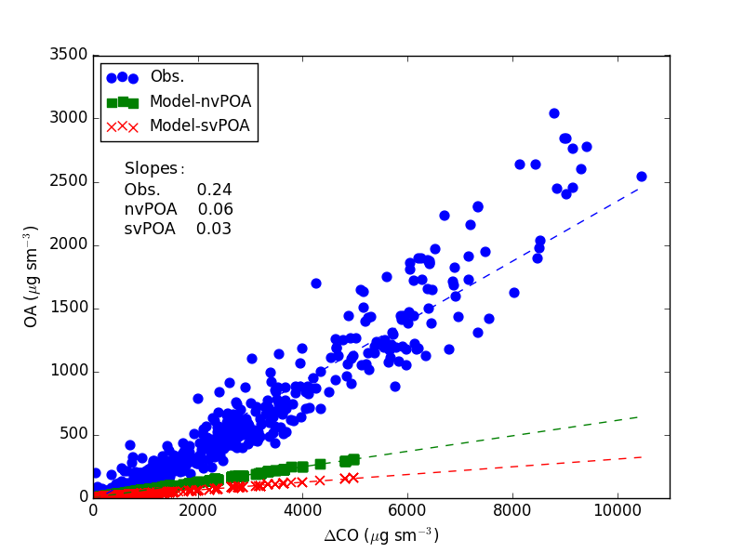
OA vs. ΔCO
0.25
Emission Factors
CMAQ Rim Fire PM_{2.5}:CO EF
0.08 – 0.10
4-8x low
FLAME II Measured PM_{2.5}:CO EF
0.04 – 0.38
0.06
0.05
Jolleys et al., JGR, 2014
Black lines (obs) adapted from Jolleys et al., ES&T, 2012
0.02

Slide 16
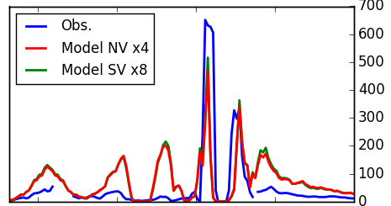
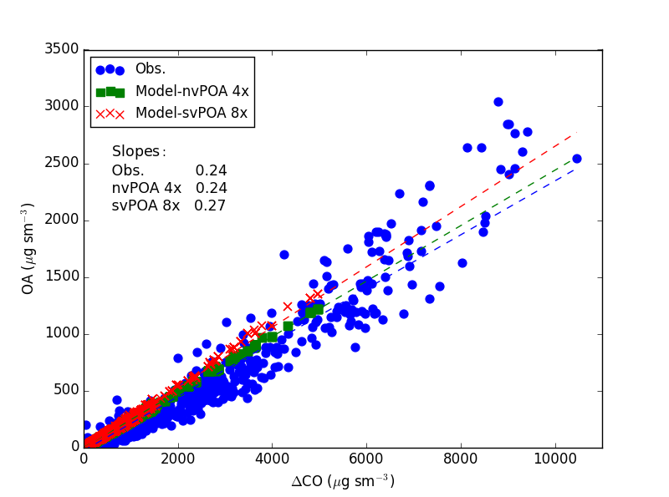
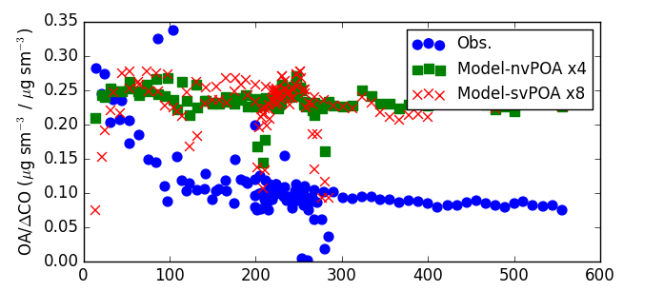
Observed vs. modeled OA (4x and 8x Emissions)
Better represents peaks
…but overestimates downwind impacts
…and ‘short circuits’ svPOA

Slide 17
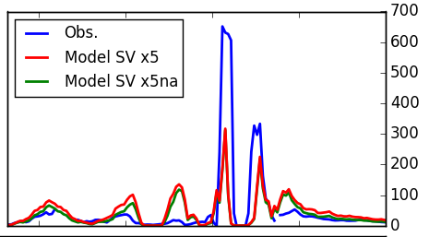
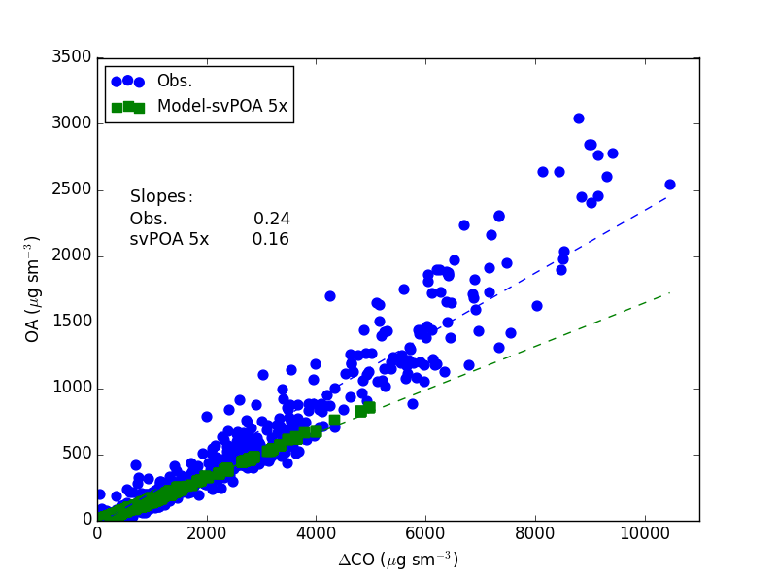
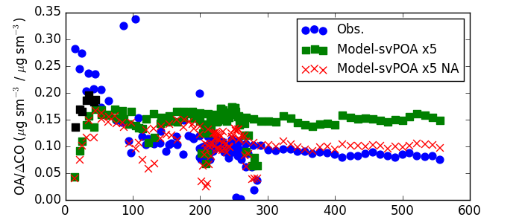
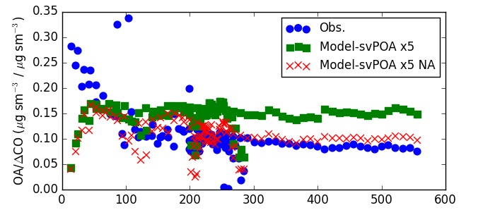
Maybe 5x OA Emissions (svPOA)?
OA more closely matches CO performance
Plume rise?
Fire Location?
IVOCs?
Without aging, model trend matches obs

Slide 18
Conclusions
CO and O₃ are generally well represented on 8/26
  O₃ not well represented on 8/29 likely due to model mixing height being too low
OA impacts near the source significantly underpredicted (4-8x)
With reasonable adjustments (increased emissions and remove anthropogenic aging scheme), modeled svPOA can capture trends in observed OA (and OA/ΔCO vs. downwind distance)
Modeled OM:OC and influence of anthropogenic aging scheme suggests need for biomass burning specific model OA species and treatment, including aging, in CMAQ

Slide 19
Questions?

