Slide 1
Photo credit: Radha Muthiah
SPATIAL DISTRIBUTION OF PM EMISSION FROM RESIDENTIAL COMBUSTION IN LATIN AMERICA, AFRICA, AND ASIA
Ekbordin Winijkul*, Tami C Bond**, Laura Fierce***
* Atmospheric and Environmental Research (AER)
** University of Illinois at Urbana-Champaign
*** Brookhaven National Laboratory

Slide 2
Residential Emission & Key Problems
Residential Sector
  Account for 44% of global energy consumption (all fuels) in 2010 [IEA, 2012]
  Significant combustion source of PM, BC, OC, CO, CO2, and HC on a global scale [Bond et al., 2004; EDGAR, 2014]
Current emission inventories of residential sector
  Based on simple calculation
    Fuel consumption x Emission Factors of Stoves
  Not consider end-use: cooking, heating
  Spatial distribution of emission based on population and urban/rural at most, not consider availability of fuels in the area.
  Future projection: assume 100% replacement of fuels which is hardly possible

Slide 3
Study Objectives
Estimate Potential Reduction in Residential Emission
  Provide spatial distribution of residential fuel, population, and end-use that aids in spatially distributed residential emission.
  Provide estimation of more realistic emission reductions from different policy options.
Study area: 128 countries in Asia, Africa, and Latin America (92% of global biomass consumption in residential sector)

Slide 4
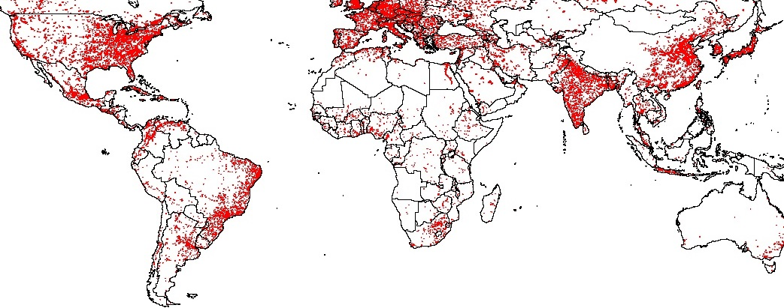
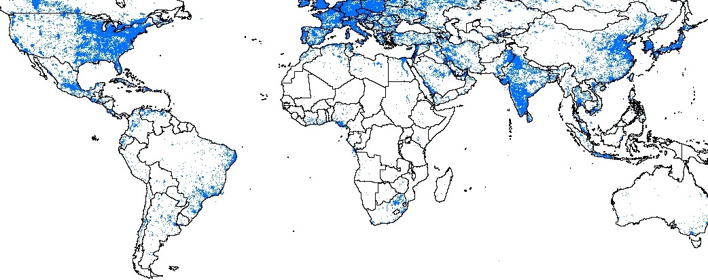
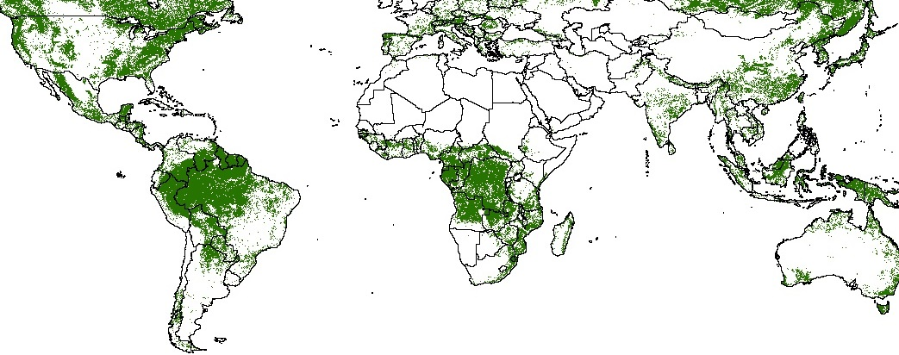
Global
GIS
Maps
Urban Land Types
Source: CIESIN [2004]
Night Light Map – Electrified Land Types
All maps with
cells 2.5 arc-min
on each side
(5 km at equator)
Source: NOAA-NGDC [2014]
Forest Access Land Types
Source: EC [2003]

Slide 5
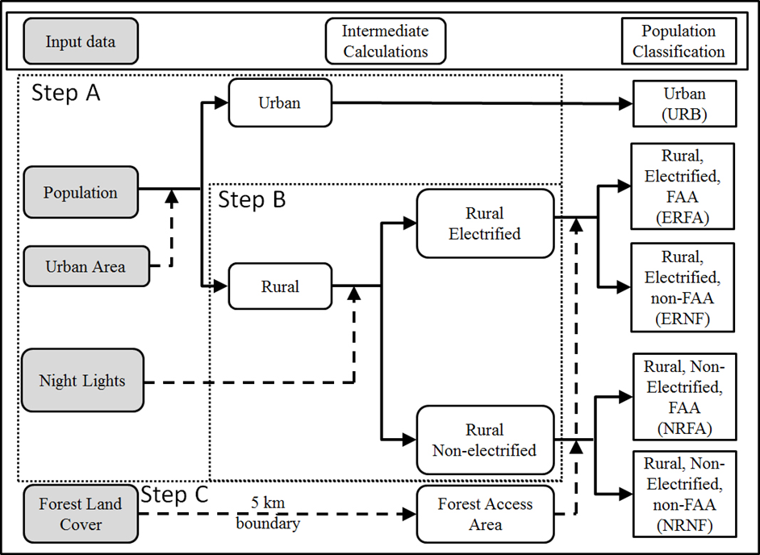
Spatial Distribution of Population & Resource
Matching population with resources availability in 5 land types
Step A & B:
Access to electricity:
  Urban
  Electrified rural
  Non-electrified rural
Step C:
Access to fuelwood
  Forest Access Area (FAA)
  Non-FAA
Major Assumptions:
Free fuels
  Fuelwood in FAA
  All agricultural waste and dung

Slide 6
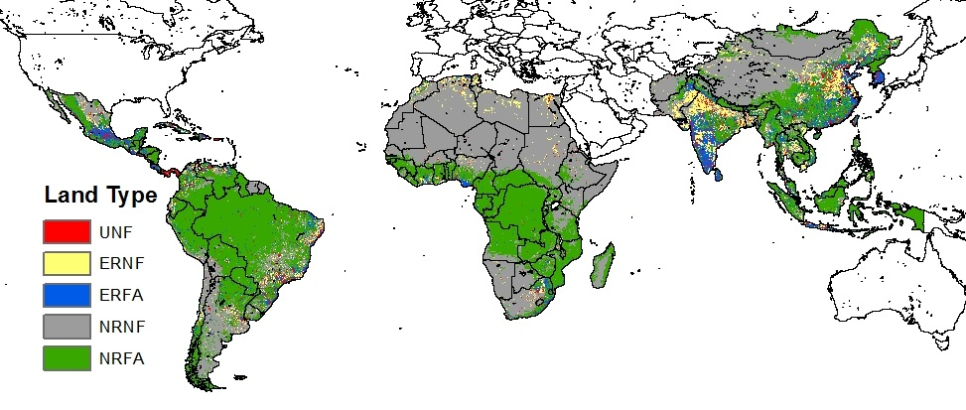
Spatial Distribution of Land Types
UNF = Urban with non-forest access, ERNF = Electrified Rural with Non-Forest Access, ERFA = Electrified Rural with Forest Access, NRNF = Non-electrified Rural with Non-Forest Access, NRFA = Non-electrified Rural with Forest Access
Large portions of the world are classified as non-electrified (grey and green)
Large clusters of electrified land types in East Asia, South Asia, and Latin America
The green land types are areas where wood is available but electricity is not, and wood is likely to become the main fuel
Gray areas indicate energy poverty: lack both electricity and readily available wood

Slide 7
Distribution of National Fuel Consumption (1)
Energy Consumption from IEA [2012]
  National level
  Fuel Types
  Consumption
Estimated Per-capita Energy Consumption in 4 end-uses
  Cooking: literature review
  Lighting: literature review
  Heating: linear relationship between energy consumption and heating degree days
  Others

Slide 8
Distribution of National Fuel Consumption (2)
Spatial Distribution of fuel use
Previous inventories
  Select only clean fuels to distribute in urban area
This inventory
  Step 1: Distribute fuelwood to forest access area
  Step 2: Distribute others & remaining fuelwood
  by efficiencies
        Urban
        Electrified rural
        Non-electrified rural

Slide 9

Emission Calculation
Emission Calculation
  Assume all stoves are traditional stoves (baseline)
j = end-uses
k = fuels
Em is emission in grams
P is the population
fj,k is the fraction of population for whom fuel k supplies end-use j
UEj is the per-capita useful energy in MJ required for end-use j
ƞj,k is the thermal efficiency of the device used
LHVk is the lower heating value of fuel k in MJ (kg fuel)-1
EFj,k are measured in grams of pollutant per kilogram of fuel burned
The term in brackets gives the mass of fuel k used by one person for end-use j

Slide 10
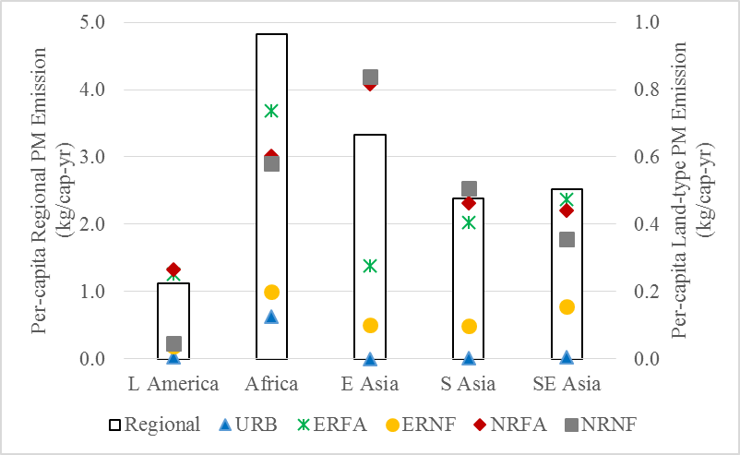
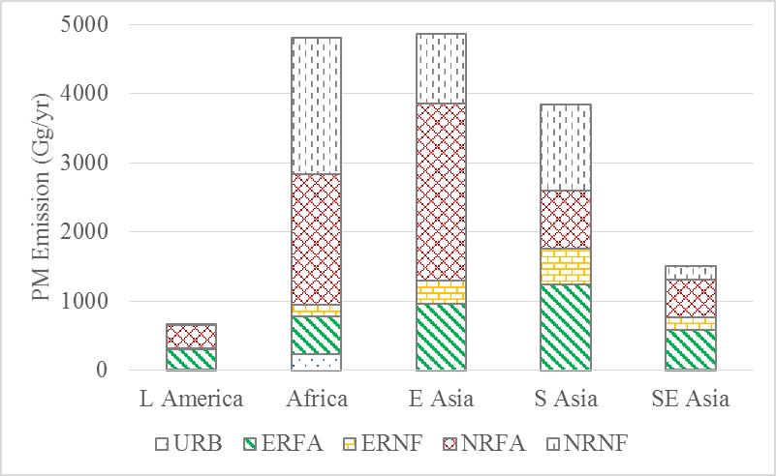
Emission Characteristics in Five Land Types
Per capita PM Emission in 5 land types
PM Emission in 5 land types
TOTAL
Per-capita emission depends on fuel use
  Africa -> highest solid biomass use -> highest per-capita emission
  East Asia -> high coal -> high per-capita emission
  Latin America -> high LPG -> low per-capita emission
  Urban and electrified rural with non-FAA -> using high efficiency fuels -> lower per-capita emission
  Two non-electrified rural land types -> using lowest quality fuels in each country -> highest emission per-capita

Slide 11
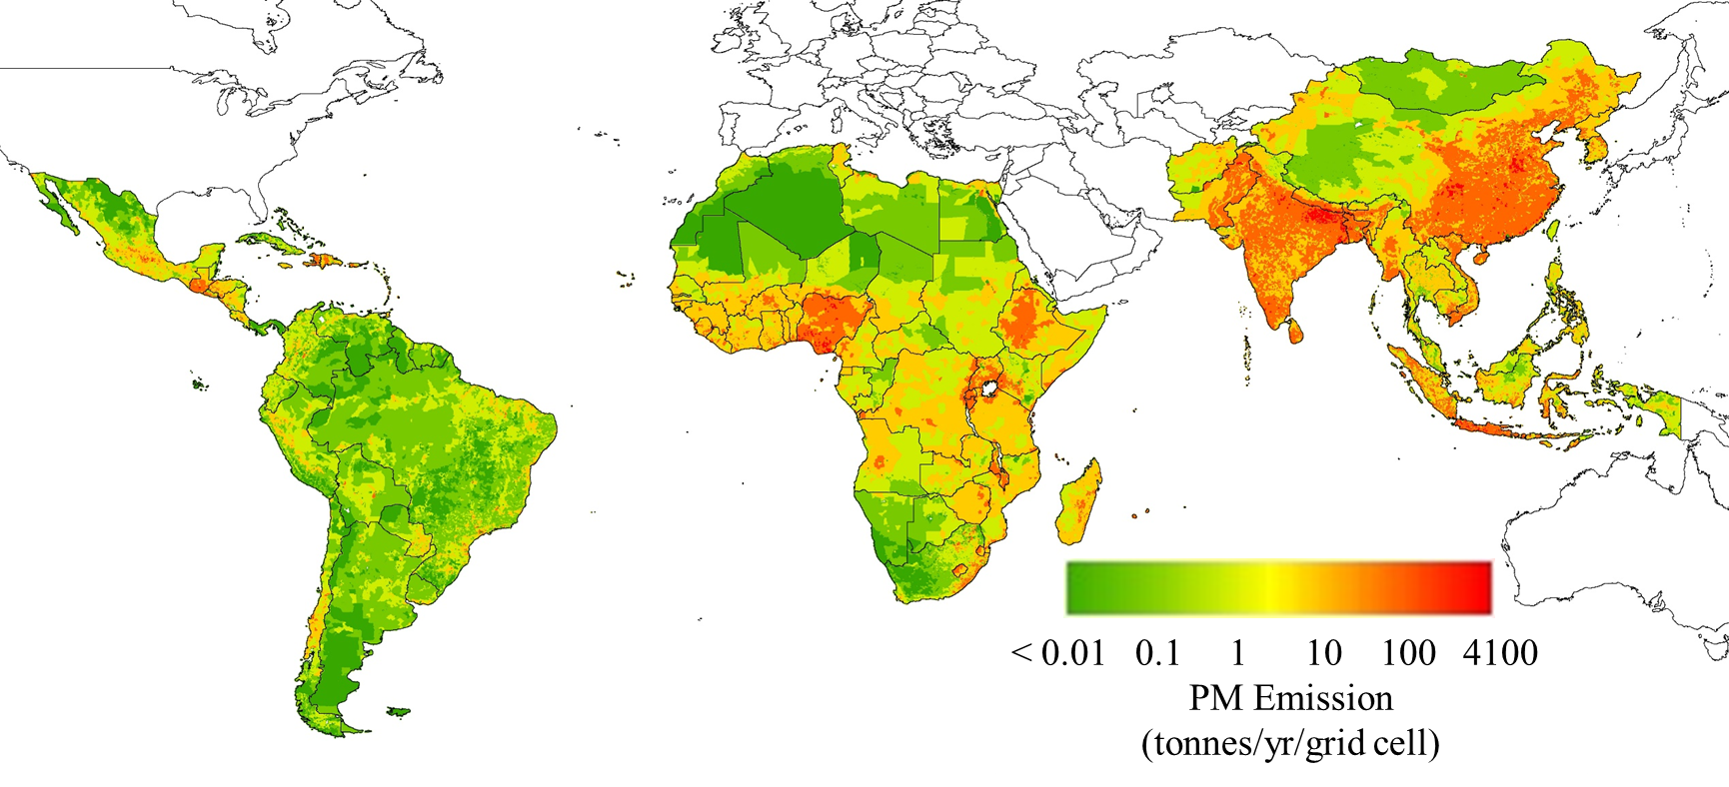
Spatial Distribution of Emission
Developed based on stove types and spatial distribution of population and resources in 5 land types
High emission in areas that have both high population and forest access
  The east coast of China, part of India, main island of Indonesia, and some areas in Africa
Lower emission are mostly electrified with non-FAA with lower population.

Slide 12
Emission Reduction Scenarios (1)
Scenario 1: Cleanest Current Stove Scenario
  Same spatial distribution of fuels as baseline
  Use cleanest stoves in each land types instead of traditional stoves
    Commercially available & broad acceptability demonstrated
Example of stove improvement (Note: the choice differs by fuel and land type)
E = 16%, PM = 8g/kg
E = 40%, PM = 0.5g/kg
E = 30%, PM = 4g/kg
Three-stone fire
(Traditional stove: baseline scenario)
Philips Fan Stove
(Improved stove with fan: electrified land types)
Rocket Stove
(Improved stove: non-electrified land types)

Slide 13

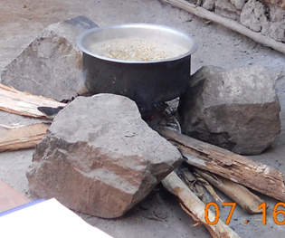
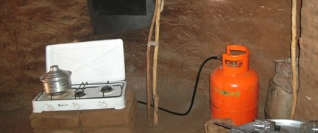
Emission Reduction Scenarios (2)
Scenario 2: Fuel Switching Scenario
  Users adopt the cleanest possible fuels
    Switching to electricity in electrified areas and LPG in non-electrified areas
    No switching for free fuels (fuelwood in FAA & agricultural waste and dung)
  Use traditional stoves for new fuels
Example of fuel switching
(Note: the choice differs by fuel and land type)
Three-stone fire
(Traditional stove: baseline scenario)
E = 75%, PM = 0g/kg
Electric stove
(electrified land types)
E = 16%, PM = 8g/kg
E = 55%, PM = 0.4g/kg
LPG stove (non-electrified land types)

Slide 14
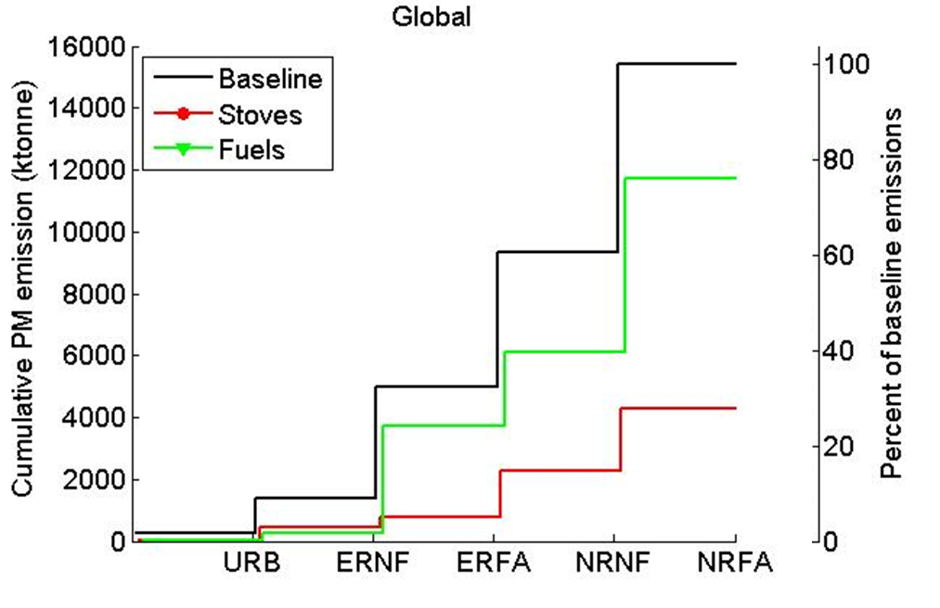
Global Emission Reduction Scenarios
Current cleanest stove and Fuel Switching scenarios
Land Types
URB = Urban
ERNF = Electrified Rural with Non-Forest Access
ERFA = Electrified Rural with Forest Access
NRNF = Non-electrified Rural with Non-Forest Access
NRFA = Non-electrified Rural with Forest Access
Scenario 1: Cleaner stove (red line) -- higher reduction in forest access land
  Especially in the electrified land types where improved stoves with fan can be used
  Overall PM reduction of 72%
Scenario 2: Fuel switching (green line) -- higher reduction in non-forest access land
  Users do not have access to free fuels and assumed to be more willing to switch to cleaner fuels
  Users are not adopting cleaner fuels if they have forest access
  Overall PM reduction of 25%

Slide 15
Conclusion & Availability
Developed method to distribute national-level fuel consumption among 5 land types and 4 major end-uses for Asia, Africa, and Latin America
Estimated emission reduction from 2 mitigation scenarios
  Scenario 1: Cleaner Stove provides higher reduction & highest reduction in electrified forest access area
  Scenario 2: Cleaner Fuel has negligible reduction in forest access area due to assumption of free fuels
Current Inventory: Gridded emission of 5km x 5km is available for Asia, Africa, and Latin America
  PM, BC, OC, NOx, CO, CO2, CH4, NMHC
  Base year 2010

Slide 16
Acknowledgements
Bond research group, University of Illinois at Urbana-Champaign
Clean Air Task Force
USEPA

Slide 17

Questions
Photo credit: http://bluesource.com/Efficient-Cook-Stoves
Thank you for your attention
ewinijkul@aer.com

