Slide 1

Equatorward redistribution of emissions dominates the 1980 to 2010 tropospheric ozone change
Yuqiang Zhang^{1,2}, Owen R, Cooper^{3,4}, Audrey Gaudel^{3,4}, Anne M. Thompson⁵, Philippe Nedelec⁶, Shin-Ya Ogino⁷, J. Jason West¹
¹ Environmental Sciences and Engineering, University of North Carolina at Chapel Hill
² now at US Environmental Protection Agency
³ Cooperative Institute for Research in Environmental Sciences, University of Colorado
⁴ Chemical Sciences Division, NOAA Earth System Research Laboratory
⁵ NASA Goddard Space Flight Center
⁶ CNRS Universite Paul Sabatier Toulouse
⁷ Japan Agency for Marine-Earth Science and Technology
Title
Carolina First Steering Committee
October 9, 2010
Paper in press with Nature Geoscience

Slide 2
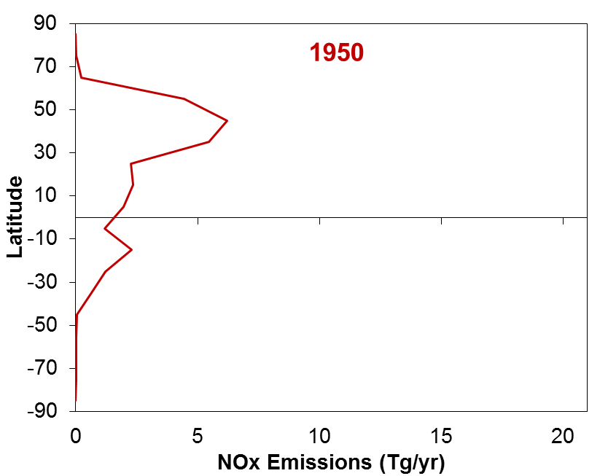
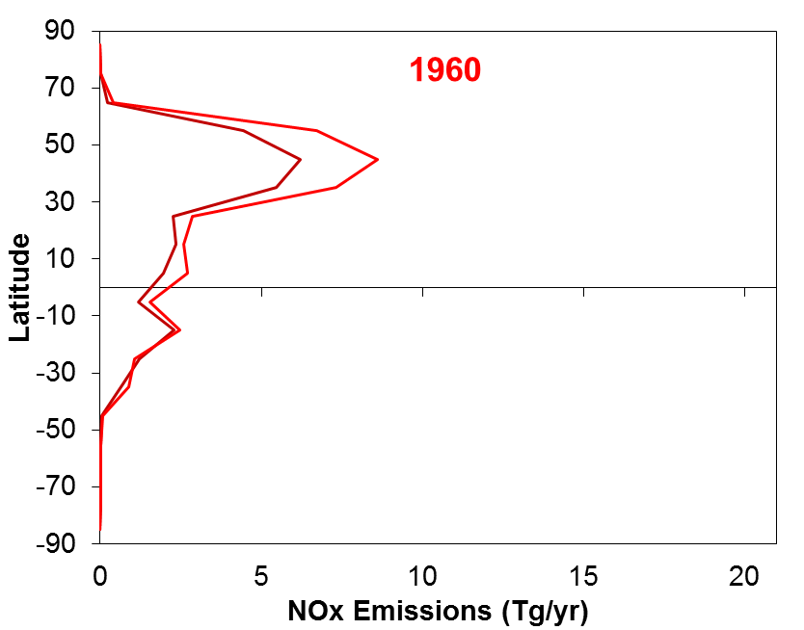
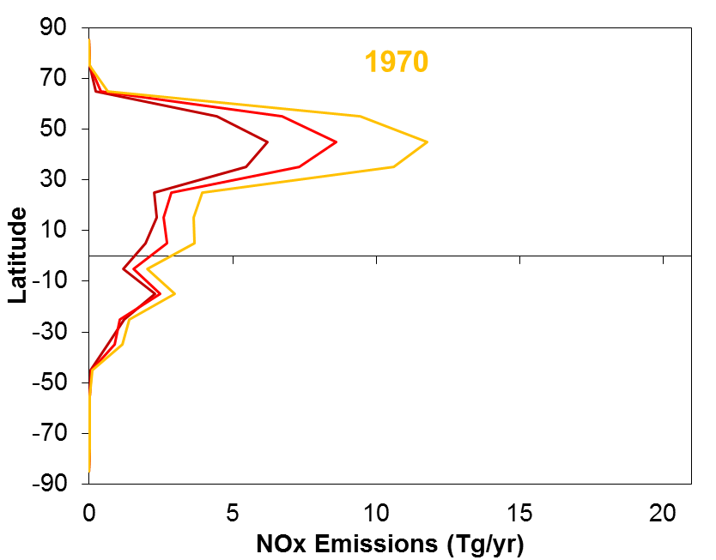
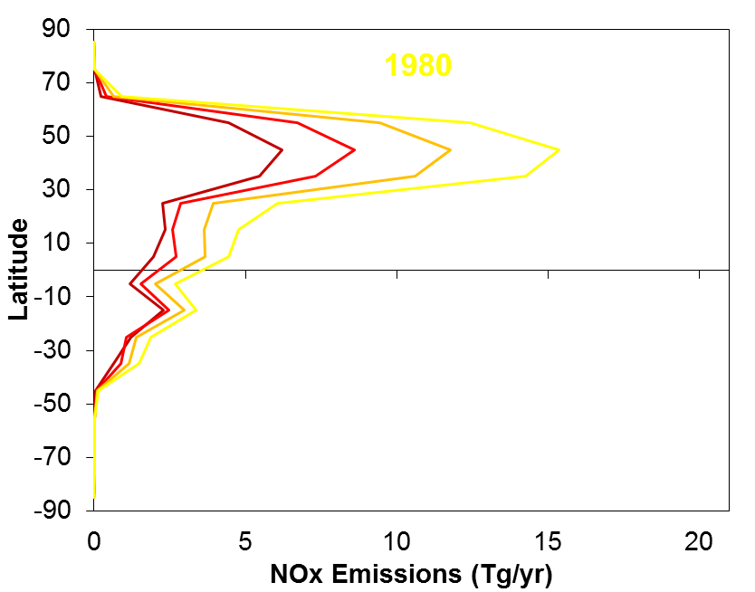
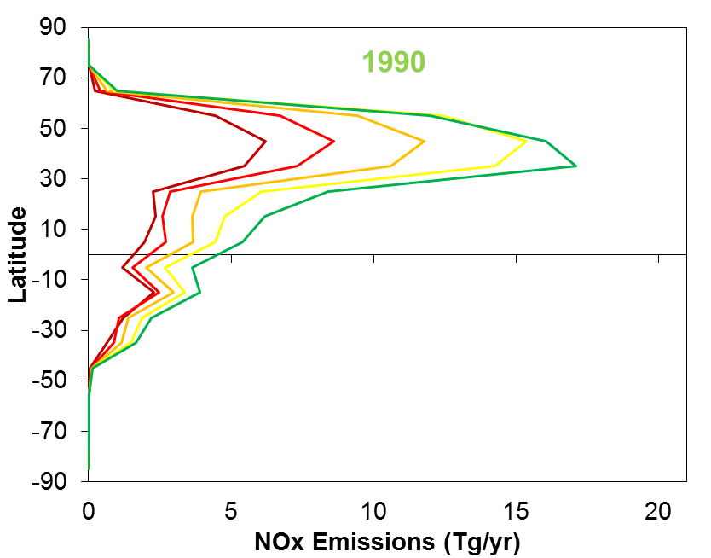
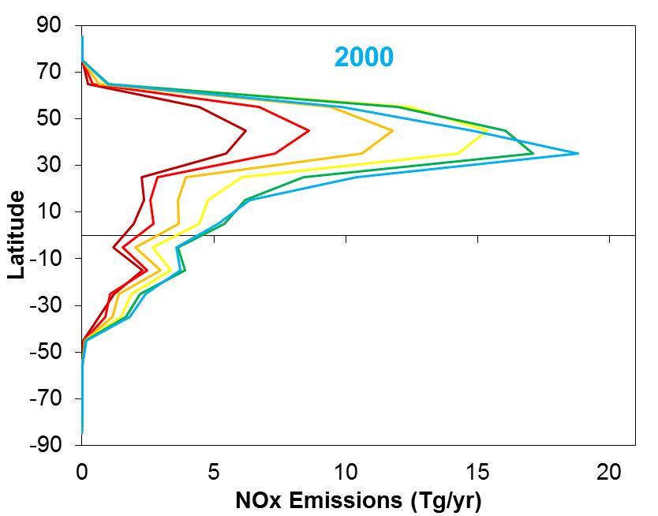
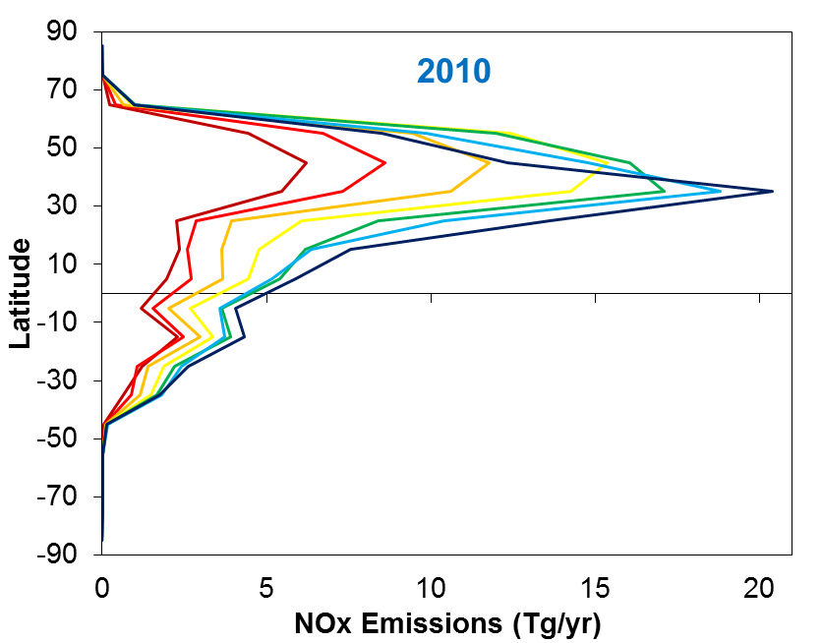
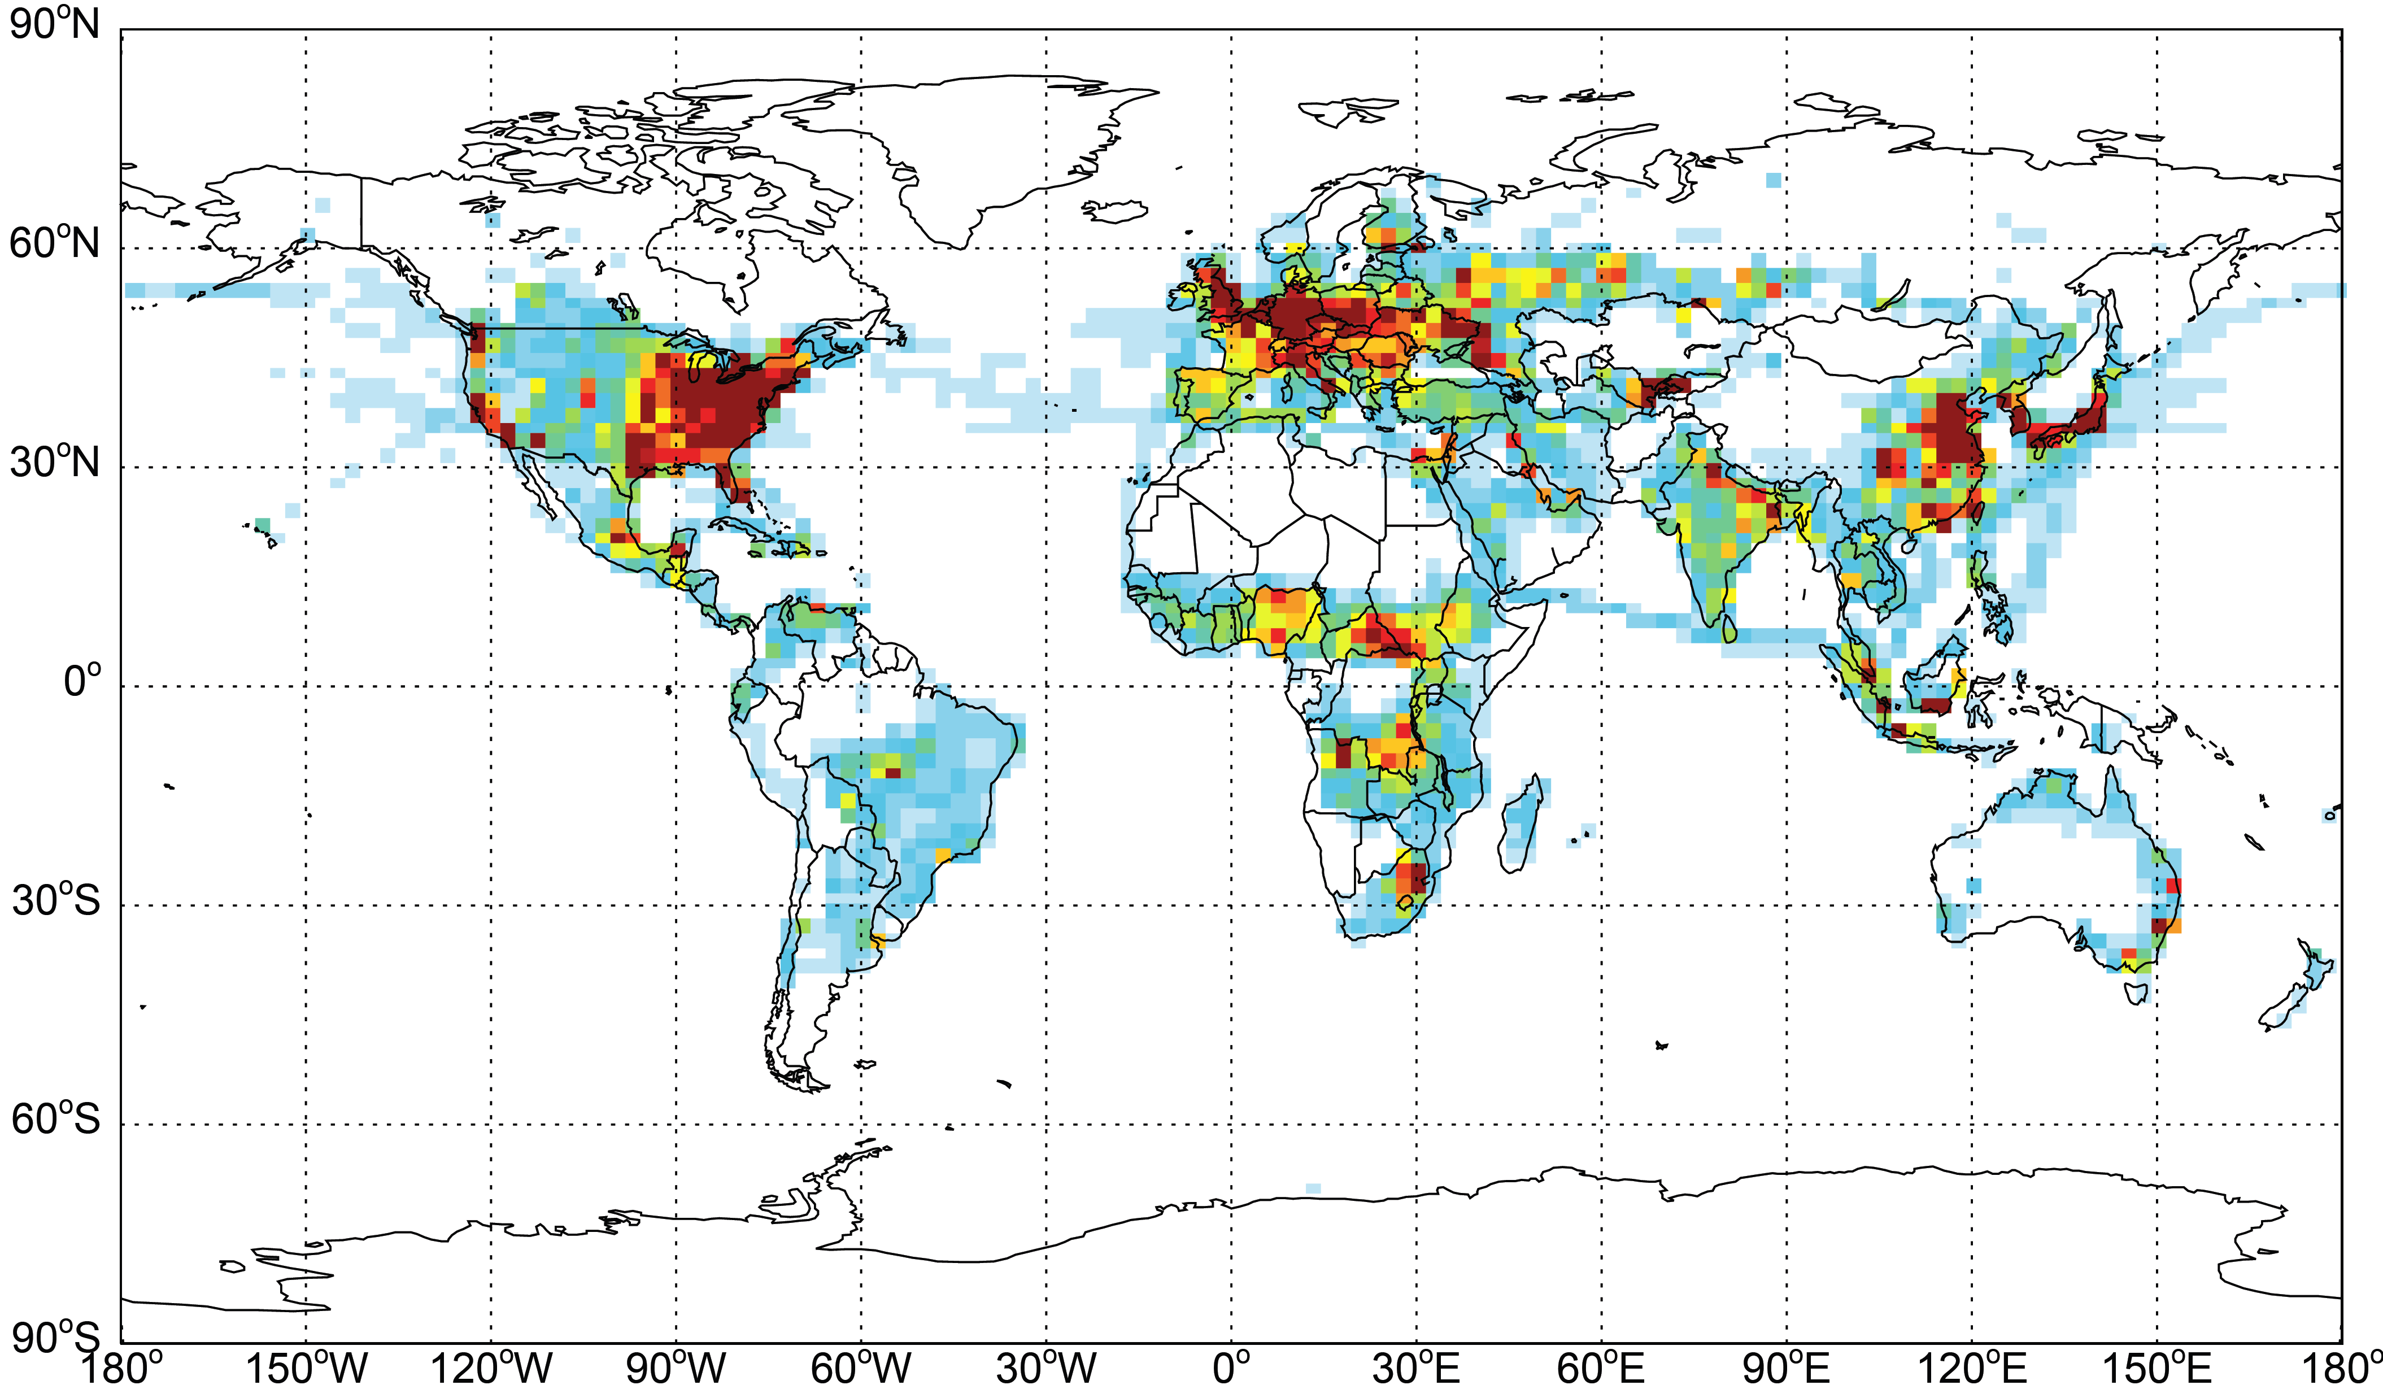
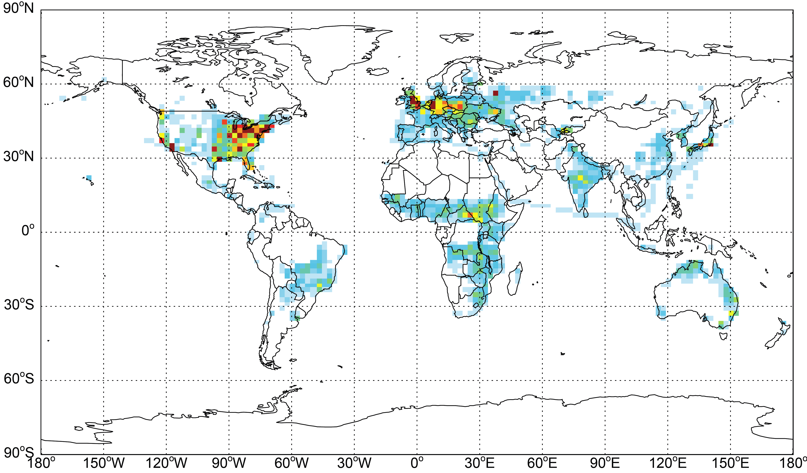
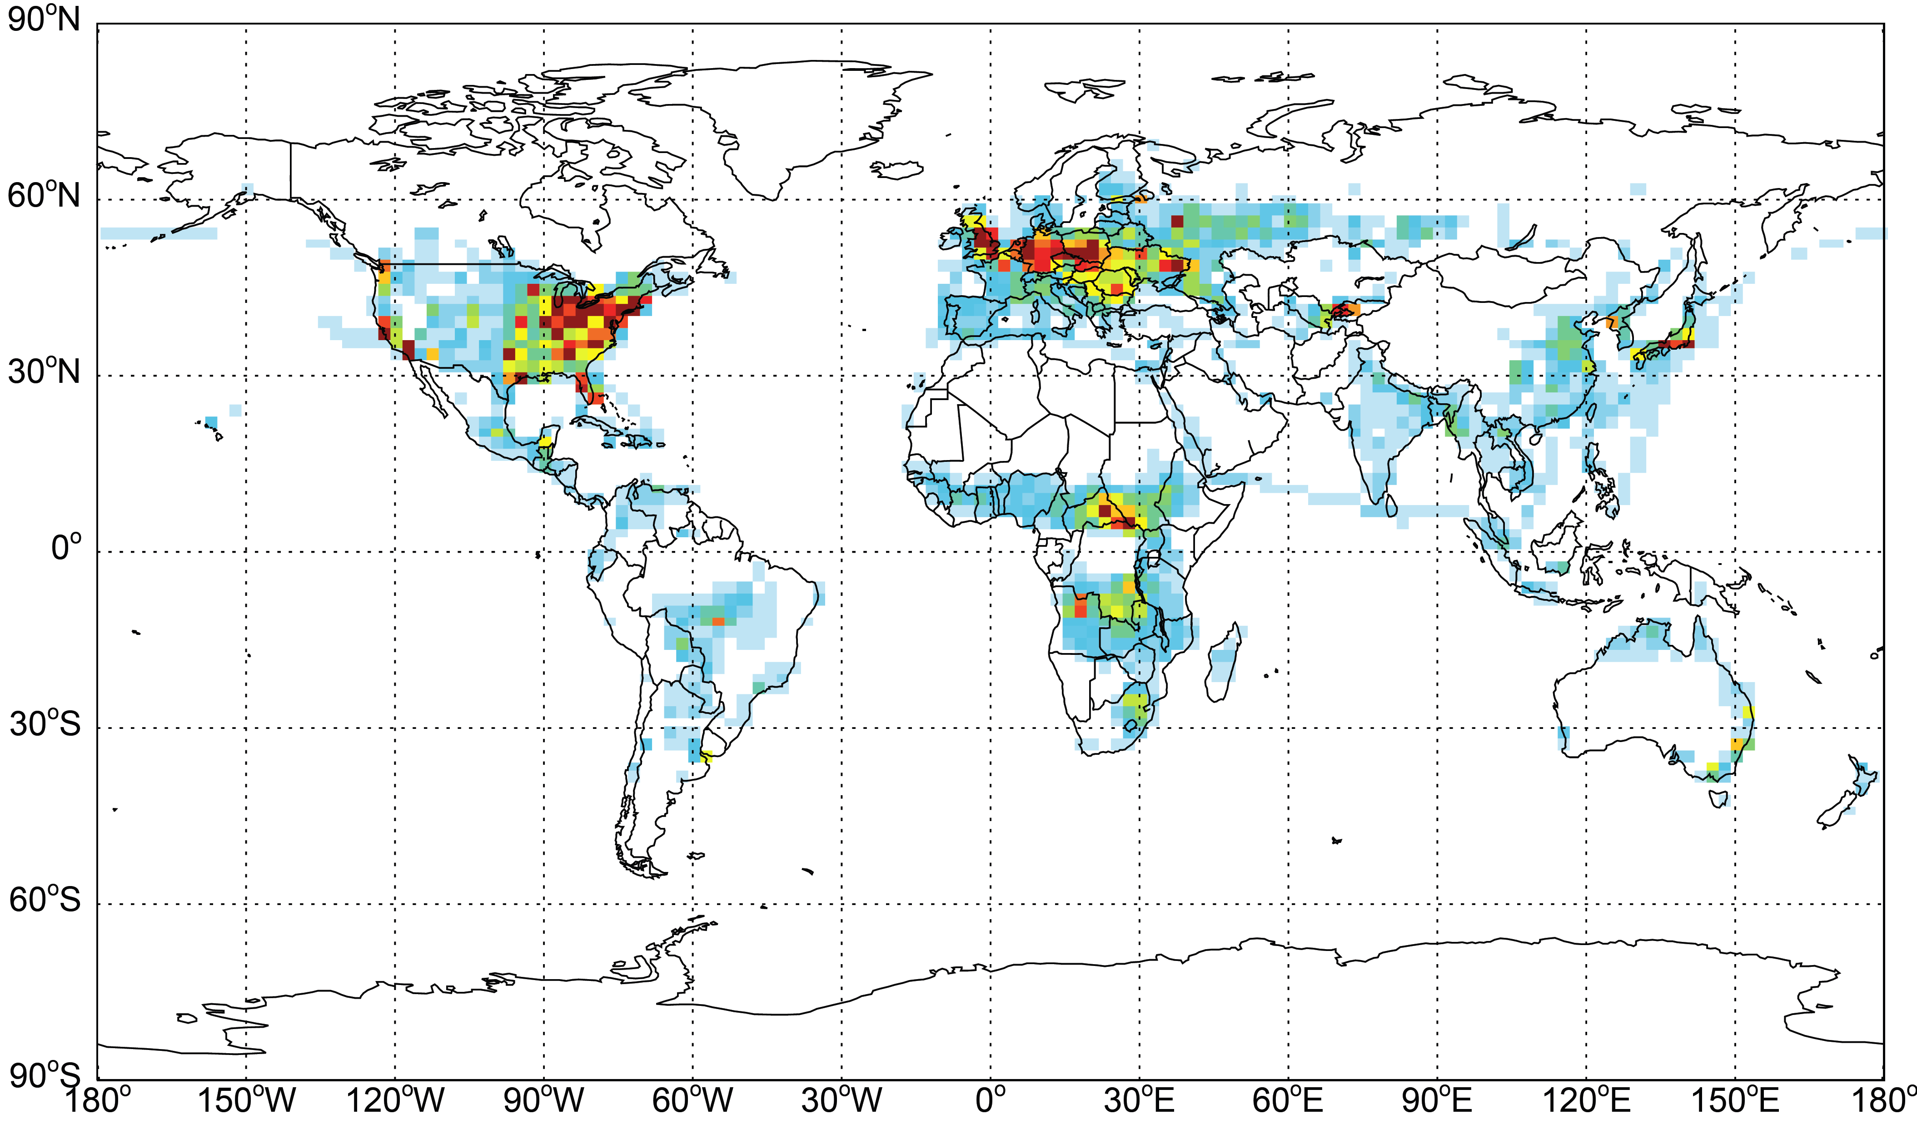
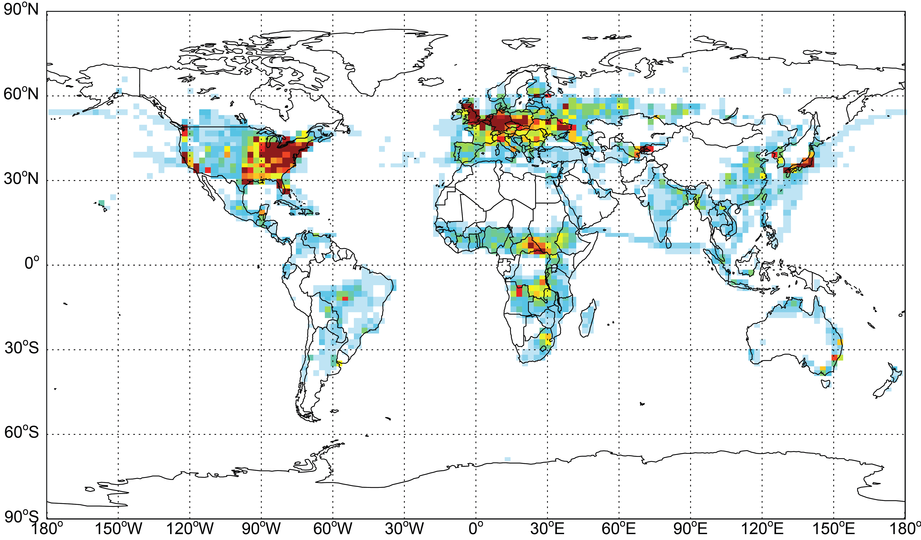
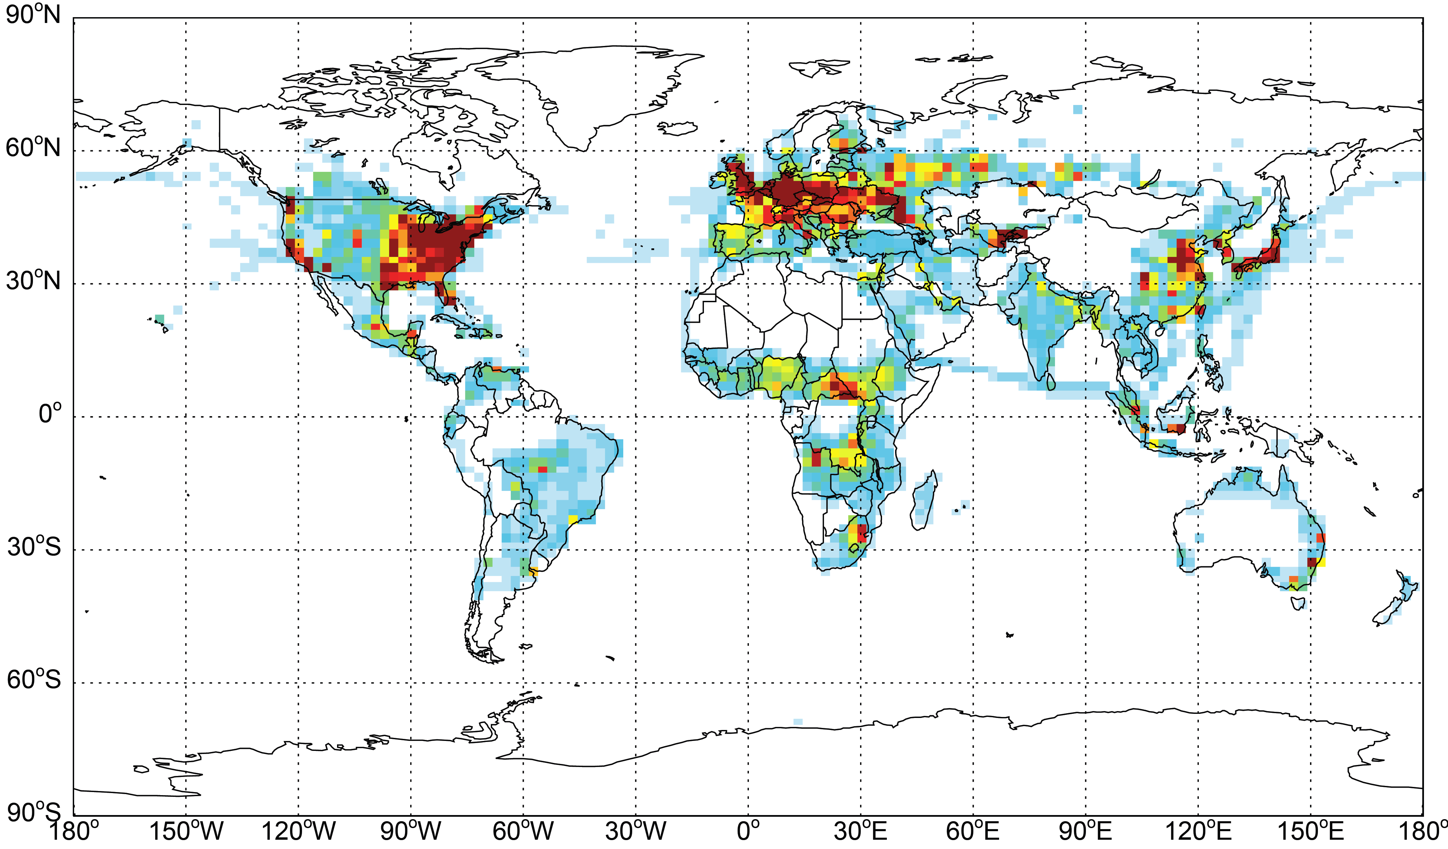
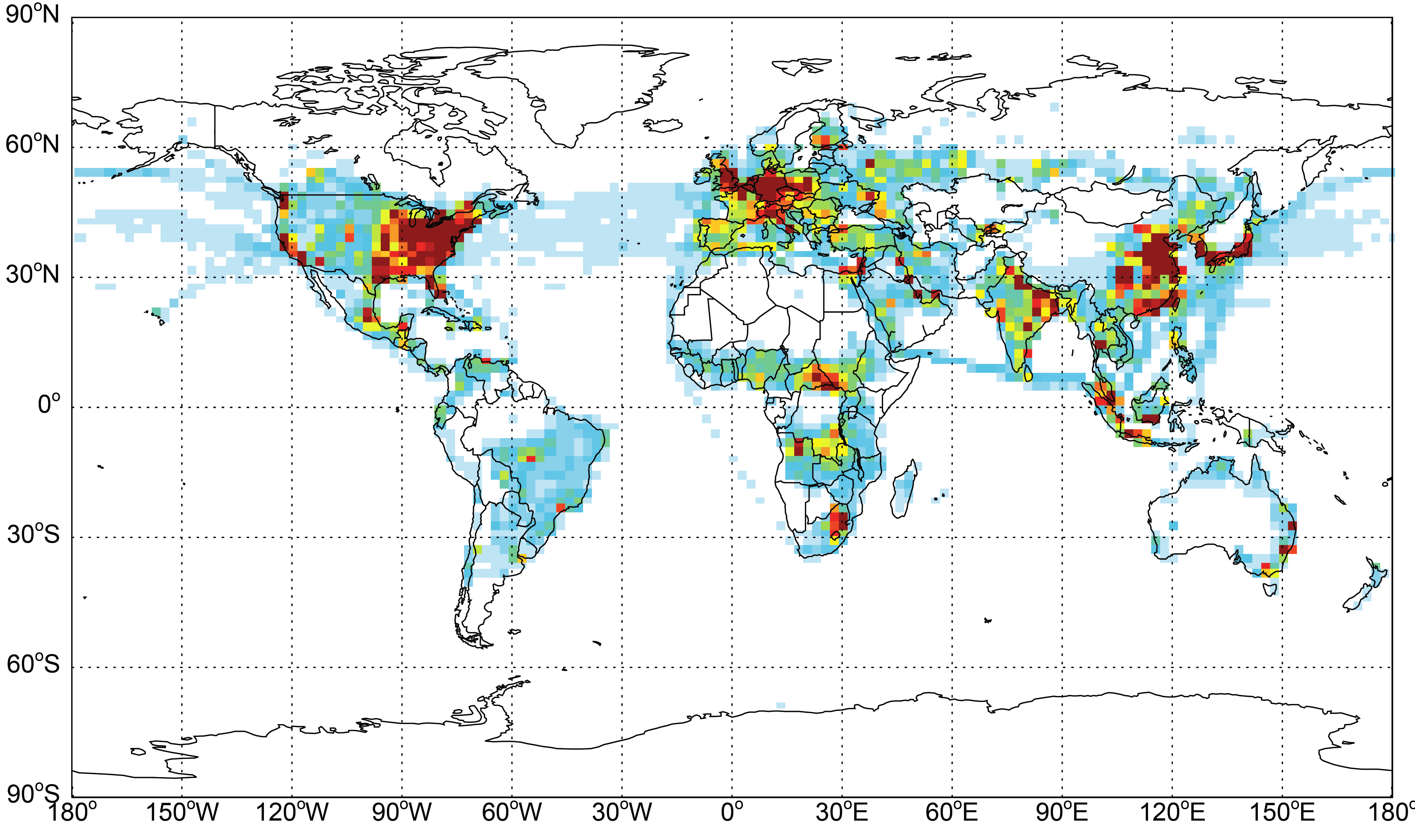
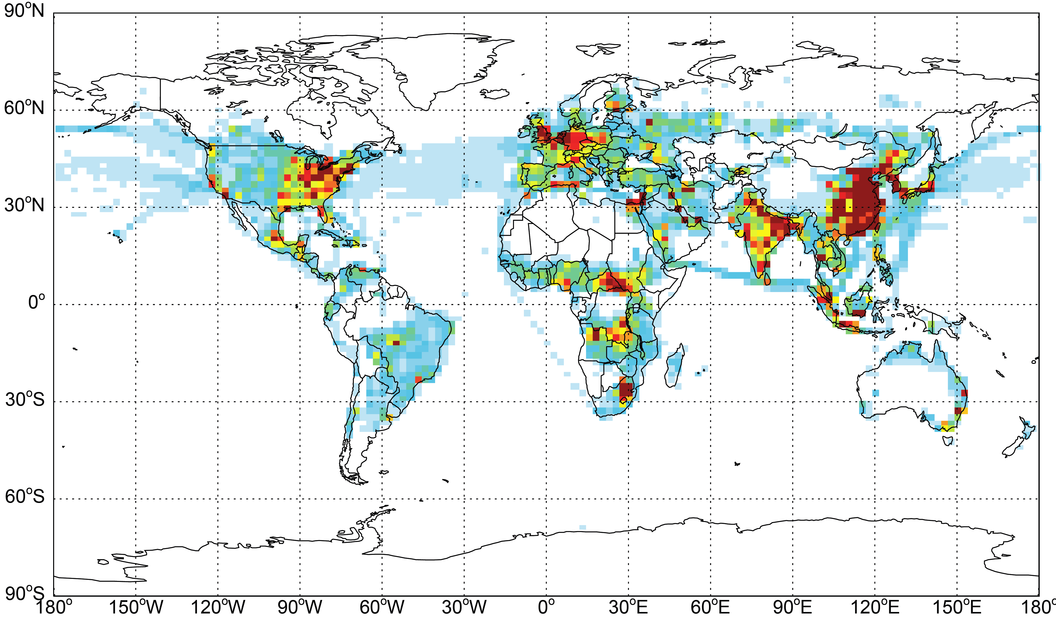
Global ozone precursors shifting southwards
1950
1970
1960
1980
1990
2000
2010
Anthropogenic NOx emissions (including biomass burning) from ACCMIP and RCP8.5.
Notes:
Ozone precursors are increasing globally from 1980 to 2010.
CO & NMVOCs increases at south of 30˚N, but decreases north of this latitude from 1980 to 2010.
NO_{x} increase south of 40˚N, but decreases north.
The peak emission regions shifts southwards.

Slide 3
Global tropospheric O₃ burden much more sensitive to emissions from the tropics and SH
Sensitivity of global trop. O₃ burden to changes in NO_{x} emissions, based on simulations of 10% NO_{x} reductions from 9 world regions (West et al., 2009).

Slide 4
Global Anthropogenic Emission Changes, 1980-2010
 | Global | Tropics (23°S-23°N)
NO_{x} | +21% | +49%
CO | +6% | +22%
NMVOCs | +6% | +16%
Global CH₄ mixing ratio +15%
Anthropogenic emissions (including biomass burning) from ACCMIP and RCP8.5.

Slide 5
Objectives
Separate the changes in the global tropospheric ozone burden (B_{O3}) from 1980 to 2010 into contributions from changes in:
  the spatial distribution of anthropogenic short-lived pollutant emissions,
  the global magnitude of these emissions, and
  the global CH₄ mixing ratio.

Slide 6
Methods
Global CTM: CAM-chem (Lamarque, 2012)
Anthropogenic and biomass burning emissions are from ACCMIP for 1980 and RCP8.5 for 2010 (Lamarque, 2010; Riahi, 2011).
Biogenic emissions are calculated on-line using MEGAN-v2.1 (Guenther, 2012)
Global meteorology is from NASA GEOS-5 for 2008-2012.
Simulations carried out for this study
 | Emission total in year | Spatial pattern in year | CH₄ concentration
S_2010 | 2010 | 2010 | 1798 ppb
S_1980 | 1980 | 1980 | 1567 ppb
S_Distribution | 2010 | 1980 | 1798 ppb
S_Magnitude | 1980 | 2010 | 1798 ppb
S_CH₄ | 2010 | 2010 | 1567 ppb
Notes:
All the models are run for consecutive five years and we use four years average for the data analysis. We apply the same meteorology for all the simulations, neglecting the effects of climate change or variability.
Explain the three sensitivity scenarios.

Slide 7
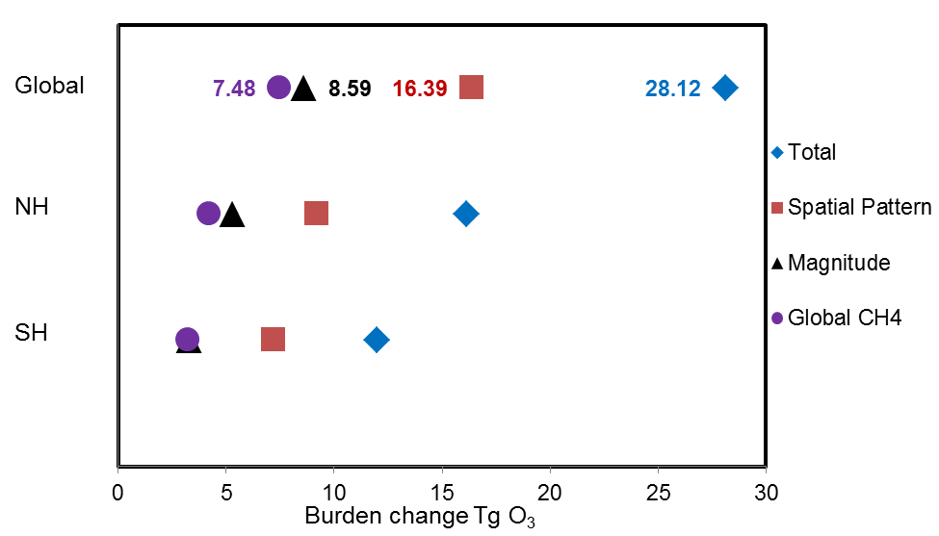
Tropospheric O₃ burden change, 1980 to 2010
Methane
Distribution
Total
Magnitude
The change in the emission spatial distribution contributes slightly more to the total B_{O3} change than the emission magnitude and methane changes combined.
Notes:
1. Global B_{O3} have increased by 28.12 Tg from 1980 to 2010, with NH accounting for 57%.
2. slightly greater than the combined influence of the change in emission magnitude (8.59 Tg) and the global CH₄ change (7.48 Tg)

Slide 8
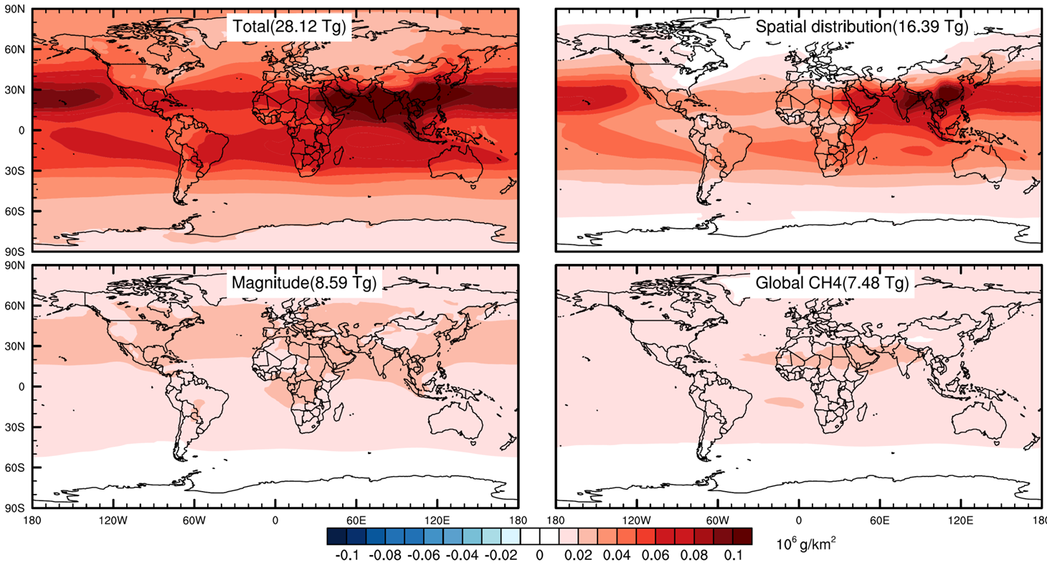
Tropospheric O₃ burden change, 1980 to 2010
Greatest B_{O3} increases are over South and Southeast Asia.

Slide 9
Tropospheric O₃ burden change, 1980 to 2010
Total
Spatial distribution
Magnitude
Methane
The change in spatial distribution of emissions best explains the magnitude and pattern of the overall change.

Slide 10
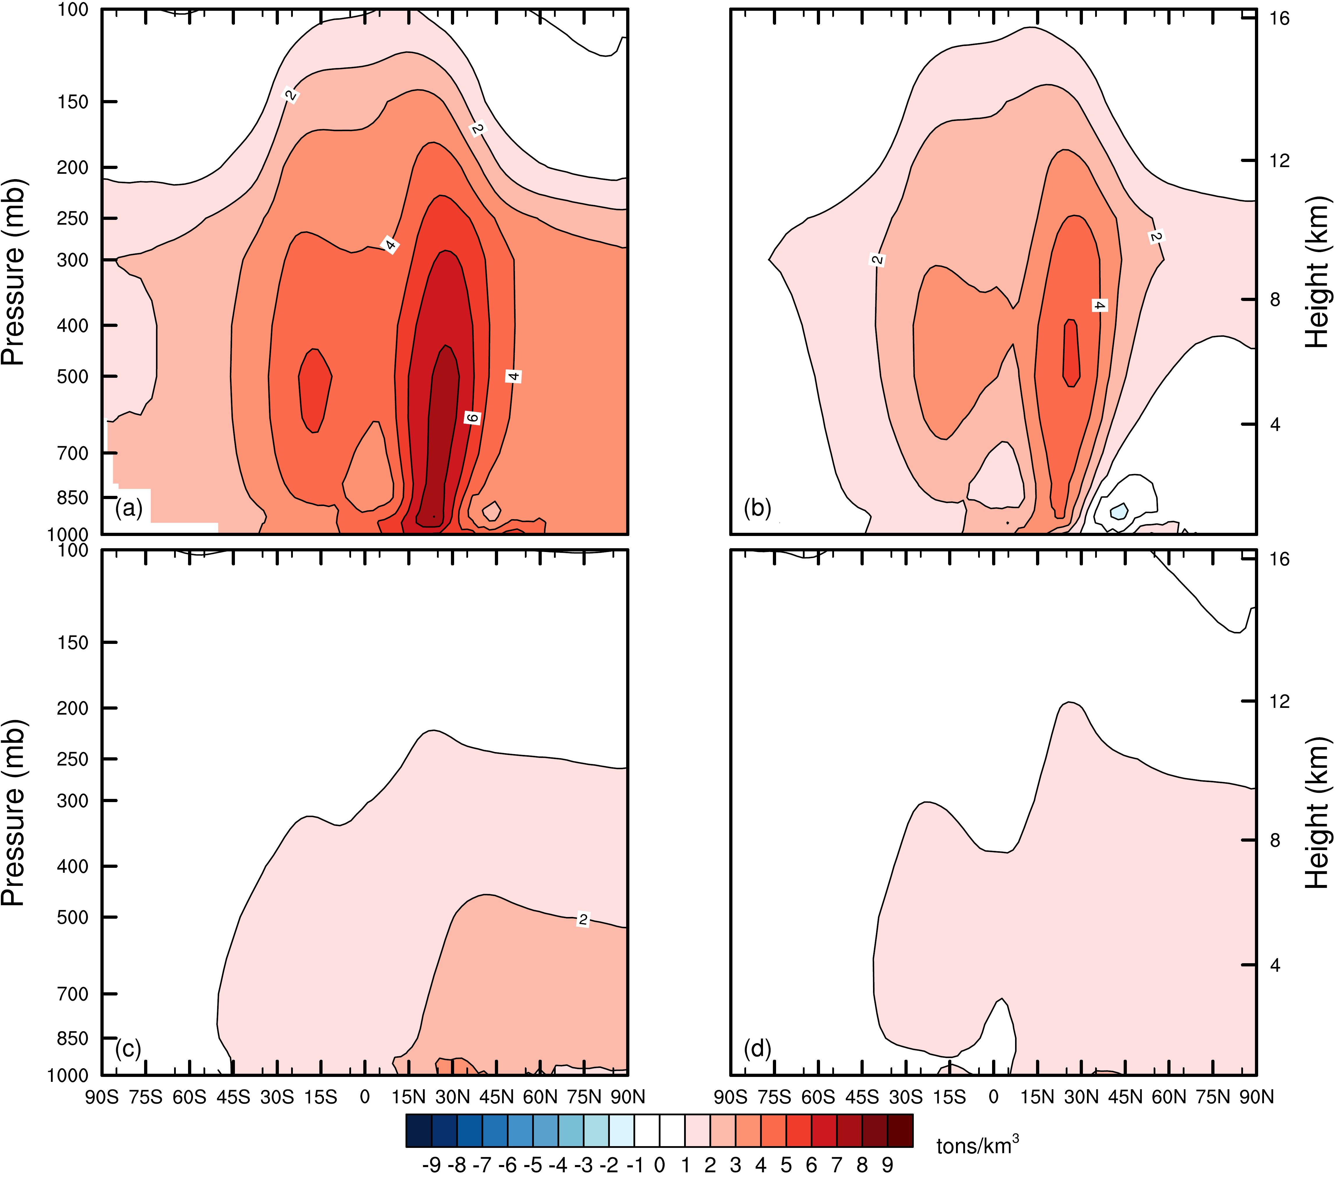
Zonal distributions of tropospheric O₃ changes
Total
Spatial
distribution
Magnitude
Global CH₄
Latitude Latitude
O₃ increases most over 0°N-35°N from the surface to the upper troposphere, and over 30°S-0°S
The spatial distribution change best explains the overall change.

Slide 11
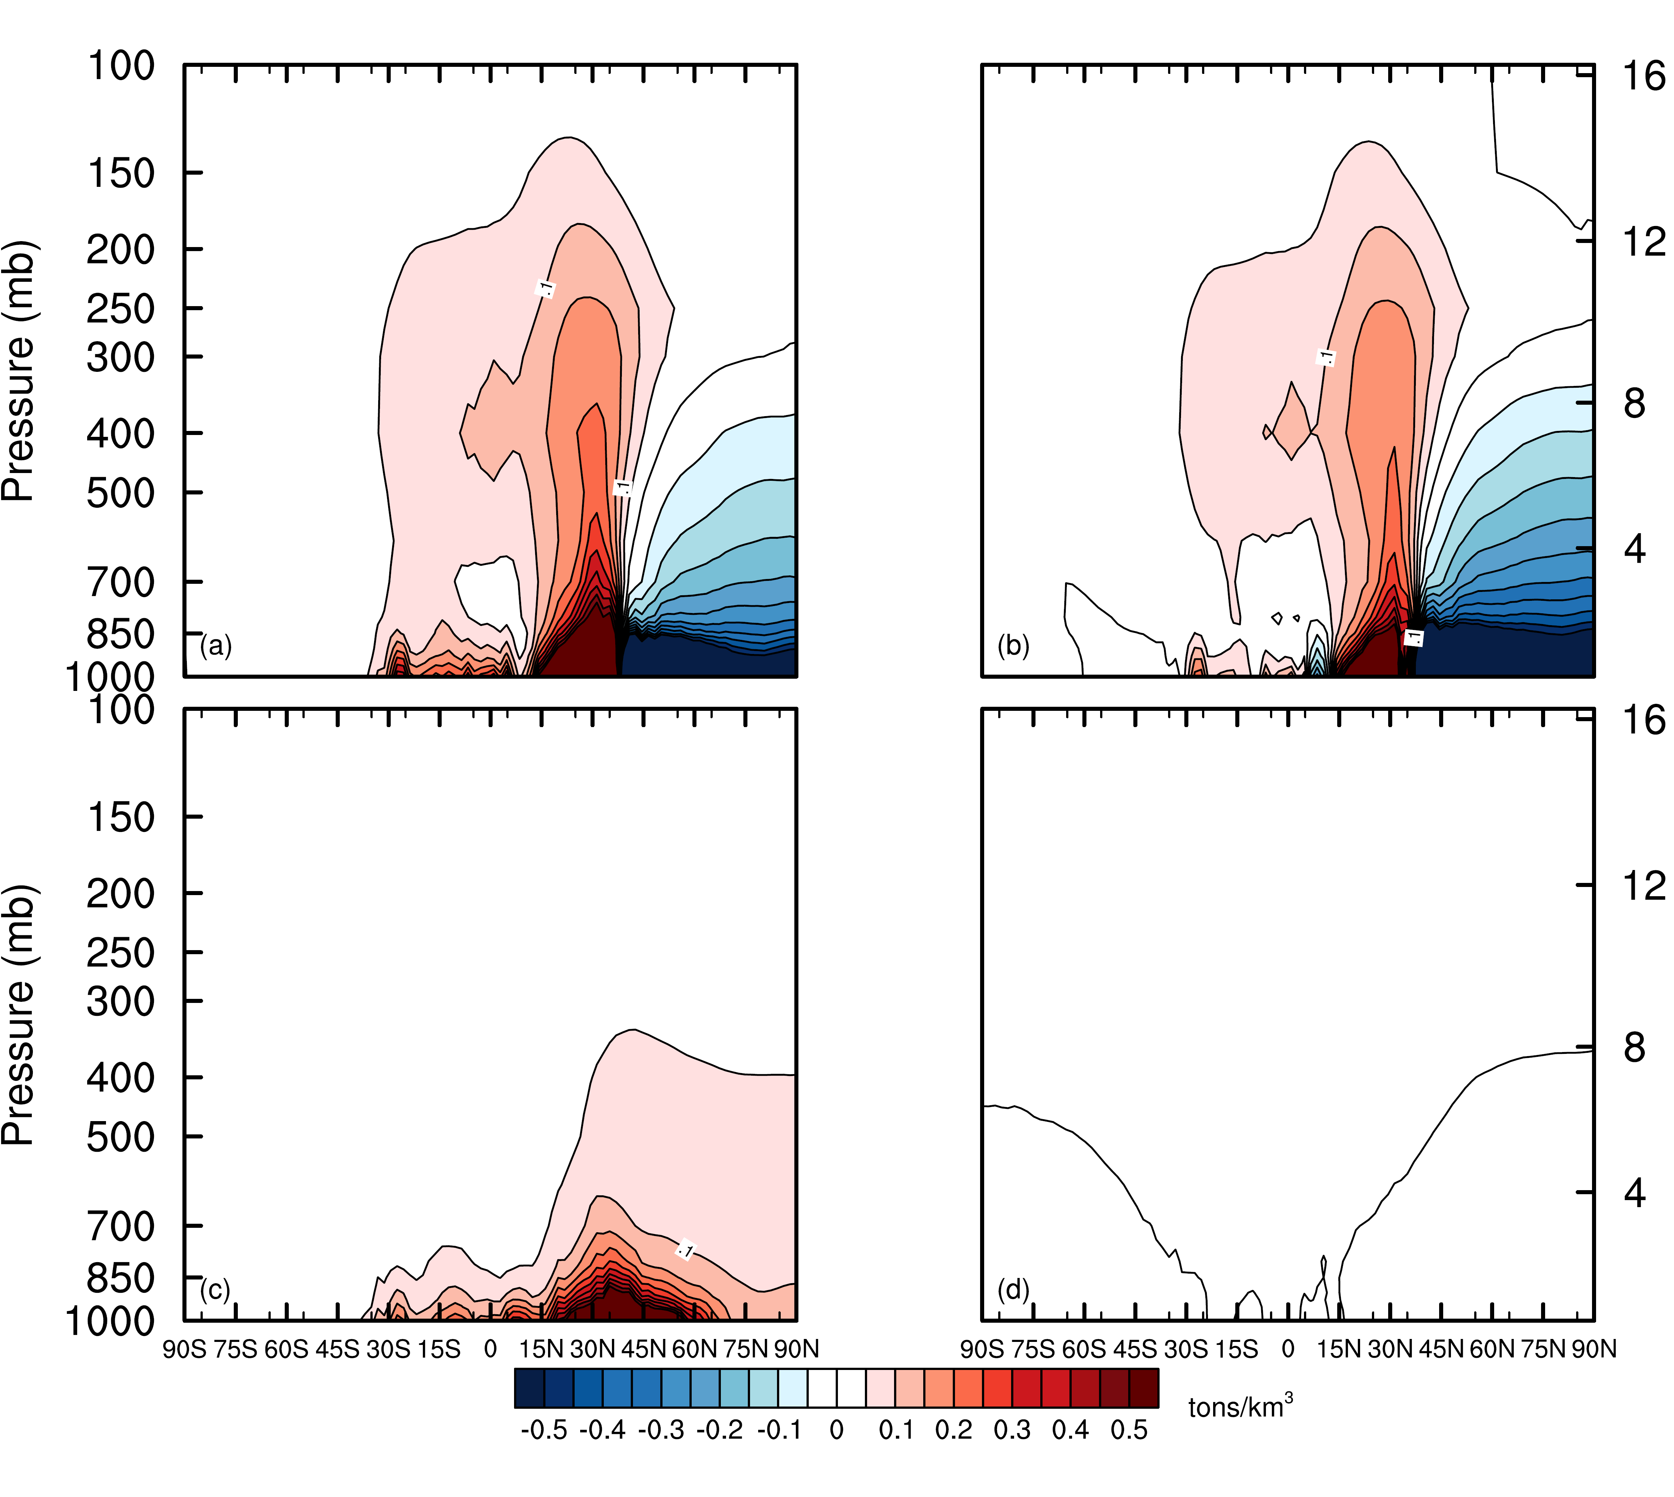
Zonal distributions of tropospheric NO_{y} changes
Total
Spatial
distribution
Magnitude
Global CH₄
Latitude Latitude
Emission increases <35ºN are transported efficiently upward, due to strong Hadley cell convection.
Emission decreases >35ºN stay at higher latitudes and lower elevation.

Slide 12
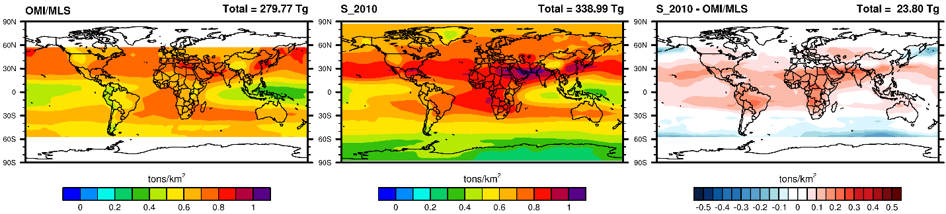
OMI/MLS
Modeled 2010
Model - OMI/MLS

Slide 13
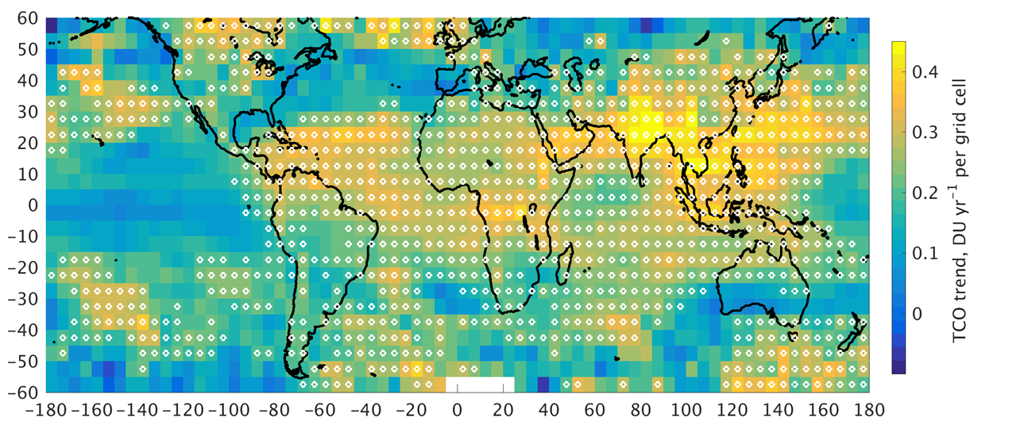
11-year OMI/MLS satellite O₃ column trends (2004-2015), white circles show statistically significant positive trends.
Modeled O₃ burden change (1980 to 2010)

Slide 14
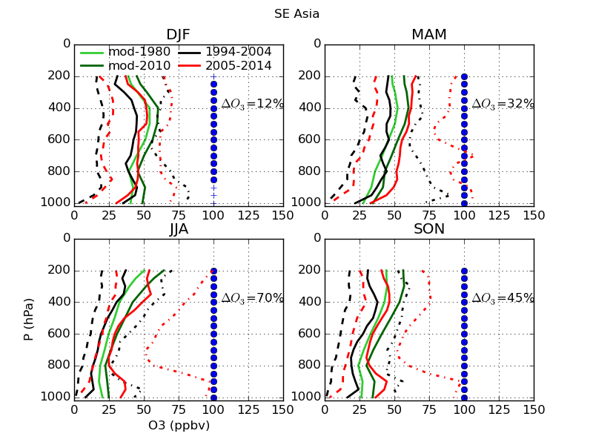
SE Asia ozone profiles
First observed significant O₃ increase over SE Asia.
IAGOS commercial aircraft O₃ profiles to/from several airports (incl. Hong Kong, Bangkok, Hanoi, Ho Chi Minh City, Guangzhou), SHADOZ ozonesondes over Hanoi.

Slide 15
Change in NO_{x} emissions (1980-2010)
Change in O₃ burden due to regional emission changes
Sensitivity of O₃ burden to NO_{x} emissions (West et al. 2009)

Slide 16
Conclusions
Changes in the spatial distribution of global anthropogenic emissions dominate the 1980-2010 tropospheric O₃ burden change, slightly larger than the combined effect of the global emission magnitude and global CH₄ change.
O₃ production is much more sensitive to emissions from tropical and subtropical regions due to strong photochemical rates, NO_{x}-sensitivity, and strong convection, despite a shorter O₃ lifetime.
Emissions increases from South and Southeast Asia may be particularly important for the global B_{O3} increase.
The future ozone burden will be determined mainly by emissions from the tropics and subtropics.
A continued equatorward shift may cause B_{O3} to increase, even if global emissions decrease.
Y. Zhang et al., Nature Geoscience, in press

Slide 17

Thank you
Thanks for help, data, and analysis tools from: Jerry Ziemke, Louisa Emmons, Simone Tilmes, Jim Schwab, and Paul Young.
Funding Sources:
EPA STAR Grant #834285
NIEHS Grant #1 R21 ES022600-01
834285
UNC Climate Health and Air Quality Lab
www.unc.edu/~jjwest
Notes:
17

Slide 18
Model evaluation
The model reproduces the O₃ trend from 1980 to 2010 at six long-term remote sites well.
The model also performs well for O₃ seasonal, spatial, and vertical distribution in 2010.
Notes:
1. We compare the O3 trend from 1980 to 2010 at six long-term remotes sites between model outputs and observations, and found that the model reproduces the trend well.
2. By comparing model output with multi-year ozonesonde data, satellite data, aircraft campaigns, and ground-based observation data, though with a tendency to overestimate surface O₃

Slide 19
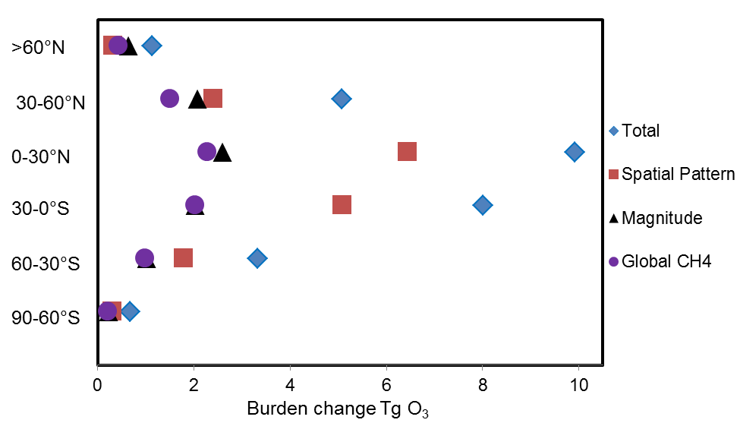
ΔB_{O3} at different latitudinal bands
∆B_{O3} from 1980 to 2010 are greatest over the tropical regions, from 30ºS to 30ºN (17.93 Tg).
For different latitudinal bands, the effect of the change in emission spatial distribution changes is always larger than that from emission magnitude and global CH₄, except for north of 60ºN.
Notes:
Then we take a look at the global O3 burden changes at different latitudinal bands.

Slide 20
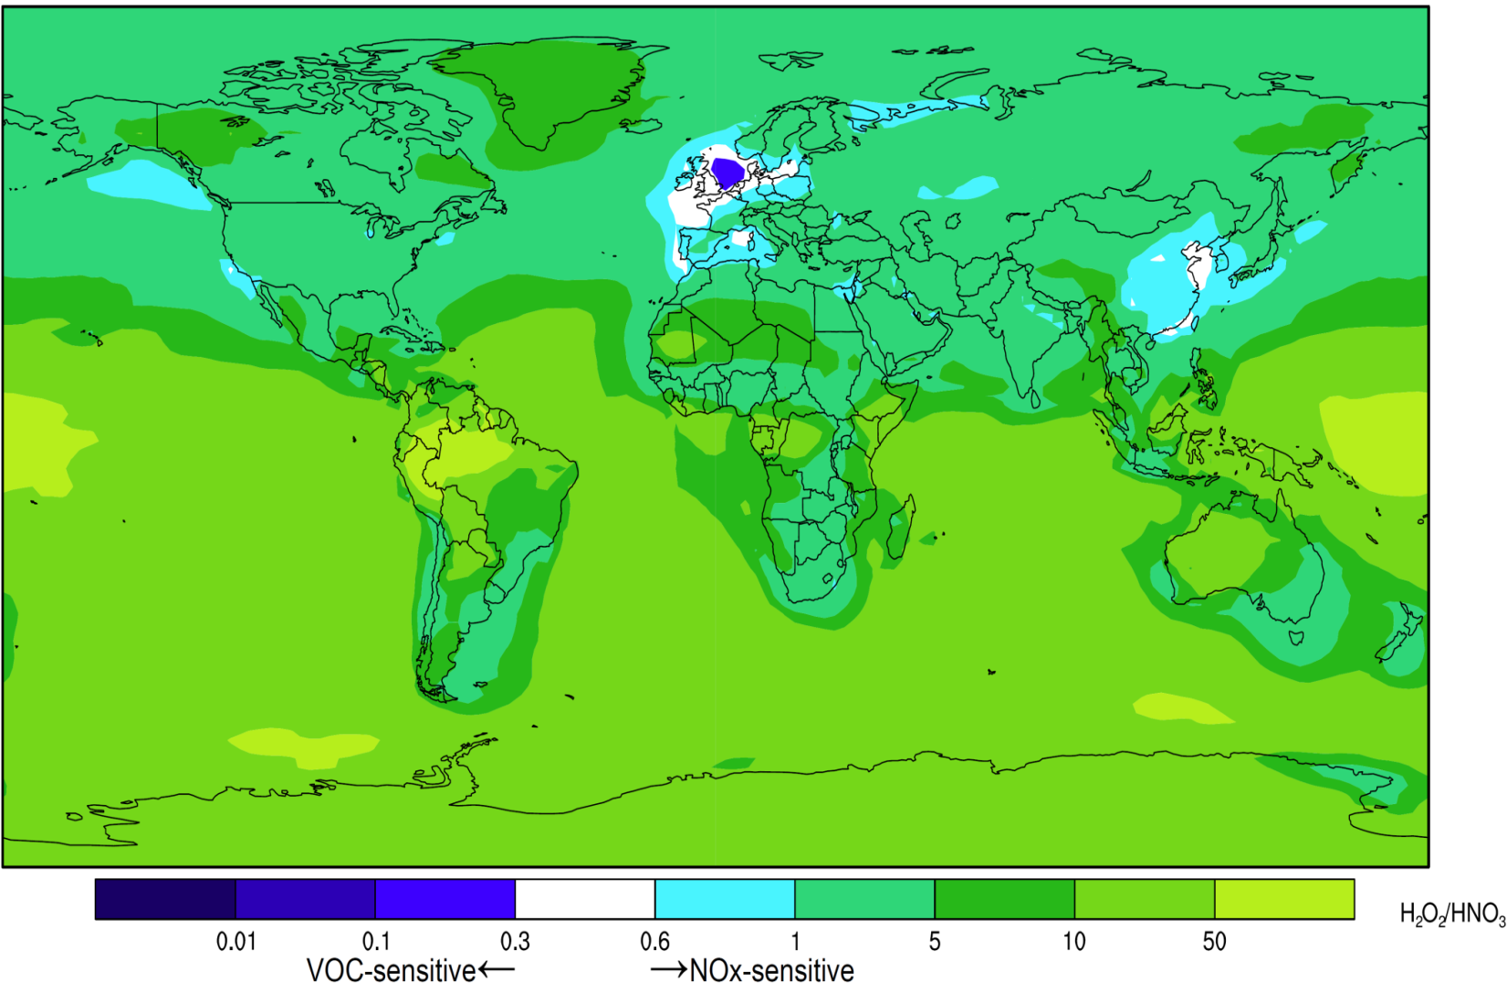
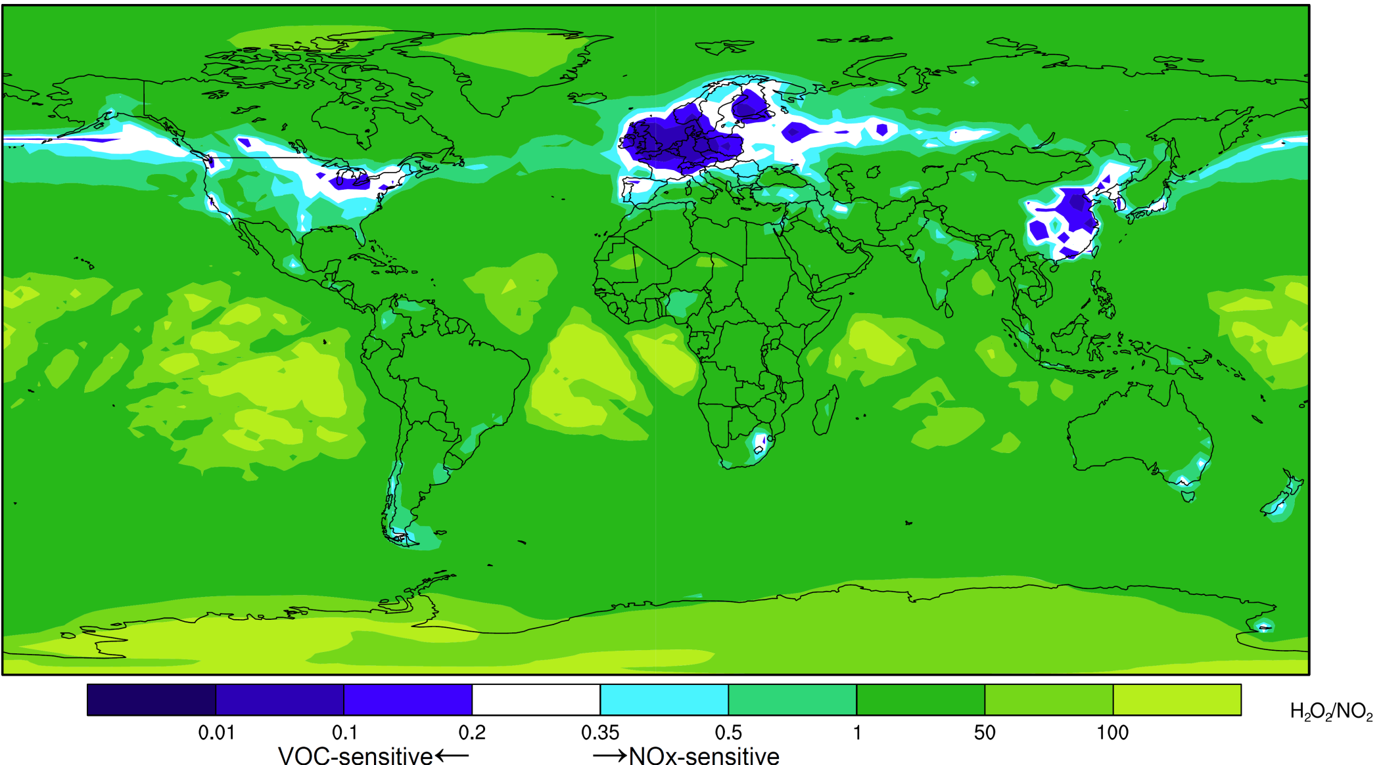
O₃-NO_{x}-VOCs sensitivity
Annual average surface ratios
H₂O₂/HNO₃ ratio
H₂O₂/NO₂ ratio
VOC-sensitive← → NO_{x}-sensitive VOC-sensitive← →NO_{x}-sensitive
Strong NO_{x}-sensitivity is prevalent over tropical regions, especially in the middle and upper troposphere (not shown here), and emission trends show greater increases of NO_{x} than of VOCs.

Slide 21
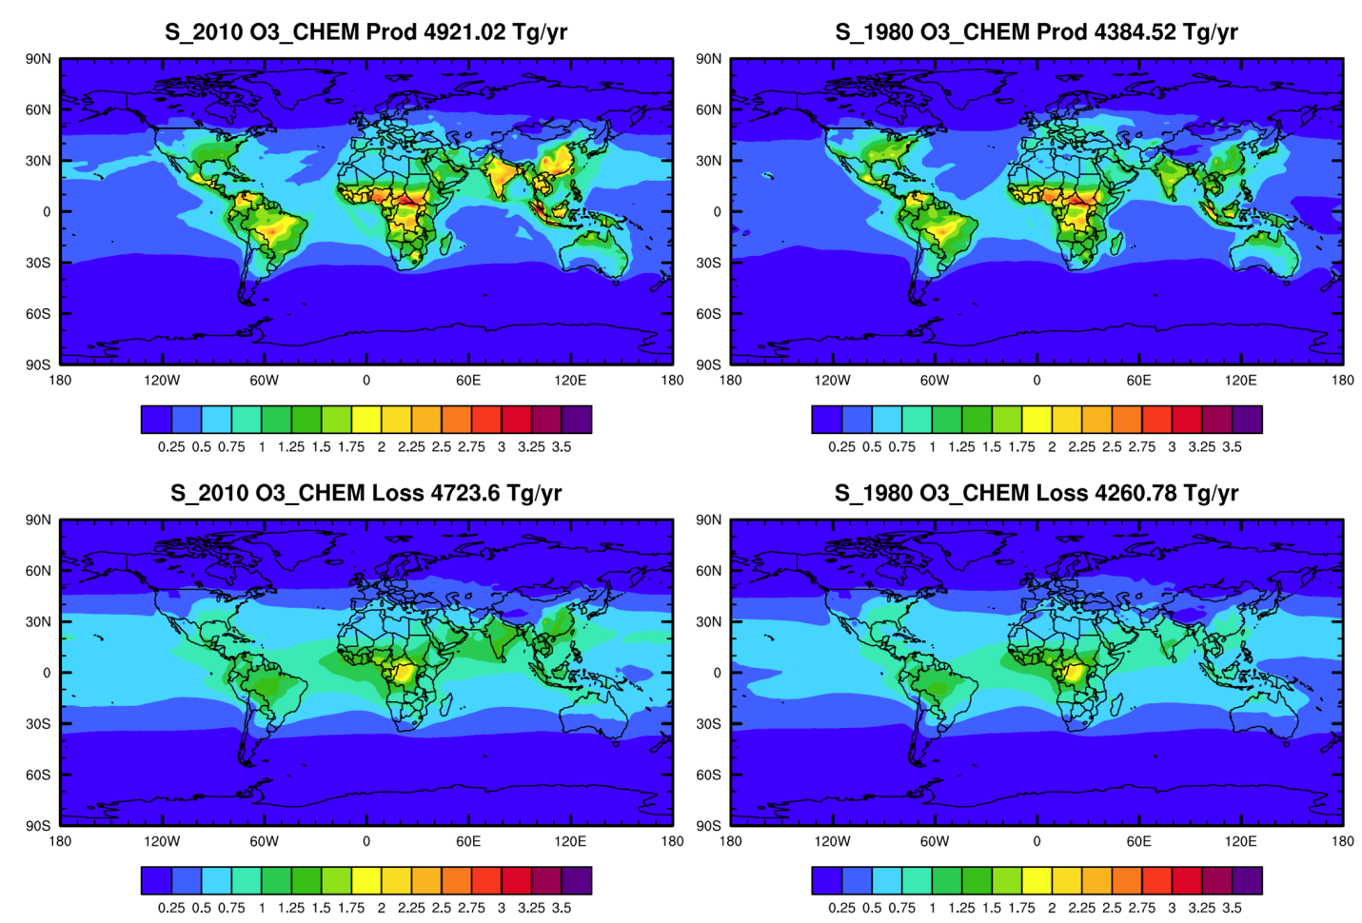
Global O₃ chemical production and loss rate
Tropical regions have fast chemical reaction rates due to strong sunlight and high temperature.

Slide 22
IAGOS commercial aircraft O₃ profiles to/from several airports (incl. Hong Kong, Bangkok, Hanoi, Ho Chi Minh City, Guangzhou), SHADOZ ozonesondes over Hanoi.
First observed significant O₃ increase over SE Asia.

Slide 23
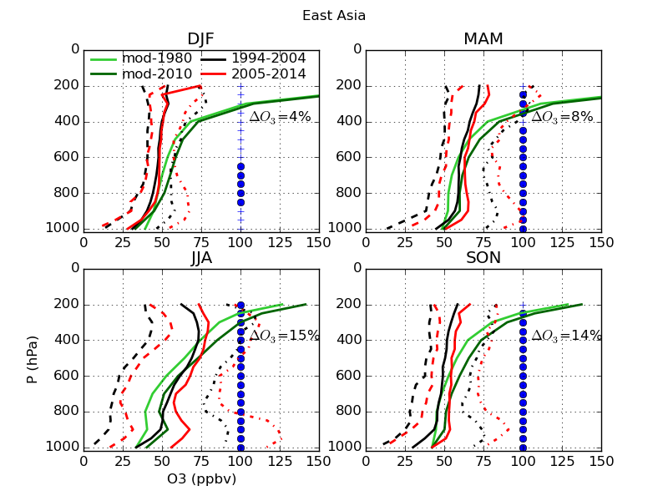
IAGOS commercial aircraft O₃ profiles over northeastern China to/from several airports.
Extends observations of positive trend by Ding et al. (2008).

Slide 24
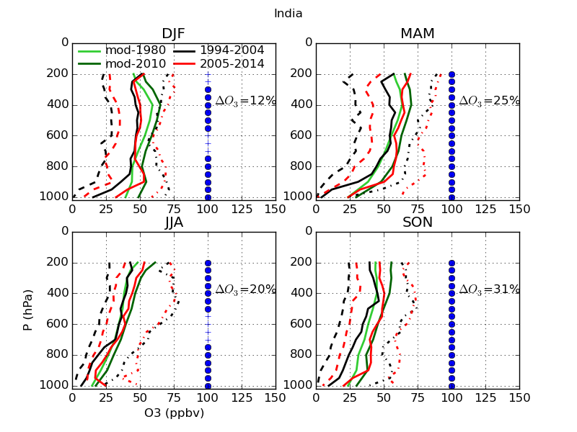
IAGOS commercial aircraft O₃ profiles over southern India to/from several airports.

