Slide 1
Using Dynamical Downscaling to Project Changes
in Air Quality
Tanya L. Spero
U.S. EPA Office of Research and Development, Research Triangle Park, NC
Panel Discussion:
Alternative Future Realities – Considerations for Modeling
Presented to:
15th Annual CMAS Conference
Chapel Hill, NC
26 October 2016

Slide 2
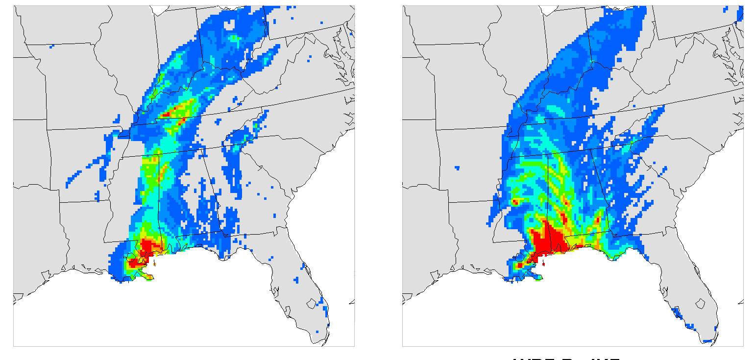
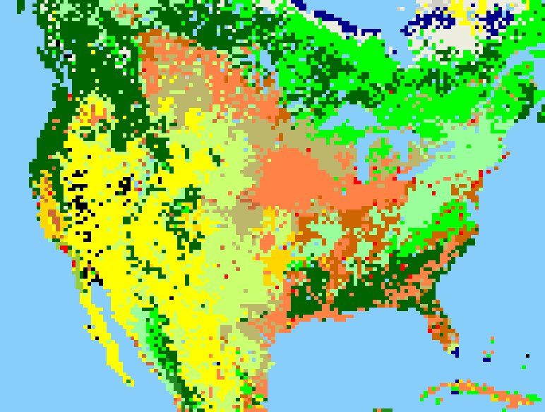
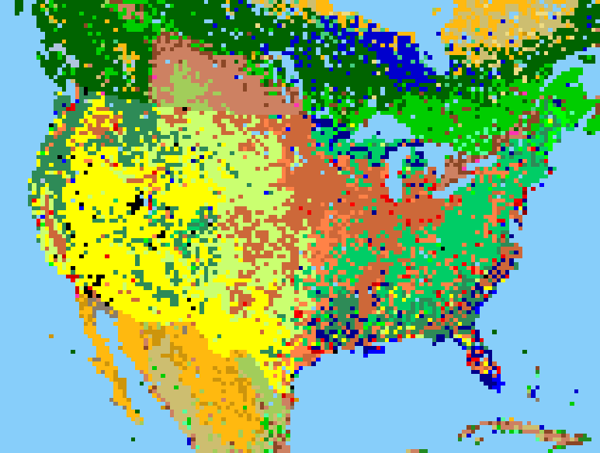
Regional Climate Modeling is not a “Solved Problem”.
Constraint toward Large Scale
Improving Physics
Bowden et al.,
Clim. Dyn.,
2013
Bullock et al.,
Mon. Wea. Rev.,
2015
Obs
Model
Obs
Model
Bowden et al., J. Climate, 2012; Otte et al., J. Climate, 2012; Bullock et al., JAMC, 2014; Spero et al., JGR-A, 2014
Alapaty et al., GRL, 2012; Herwehe et al., JGR-A, 2014
Handling Inland Water Bodies
Expanding Options for RCM
USGS
NLCD
Mallard et al., JGR-A, 2014; Mallard et al., GMD, 2015; Spero et al., J. Climate, 2016
See CMAS 2016 Presentations by M. Mallard and S. Taylor. Also Bowden et al., Adv. in Met., 2016.
New Configuration | Proven Science | Coarser Resolution

Slide 3
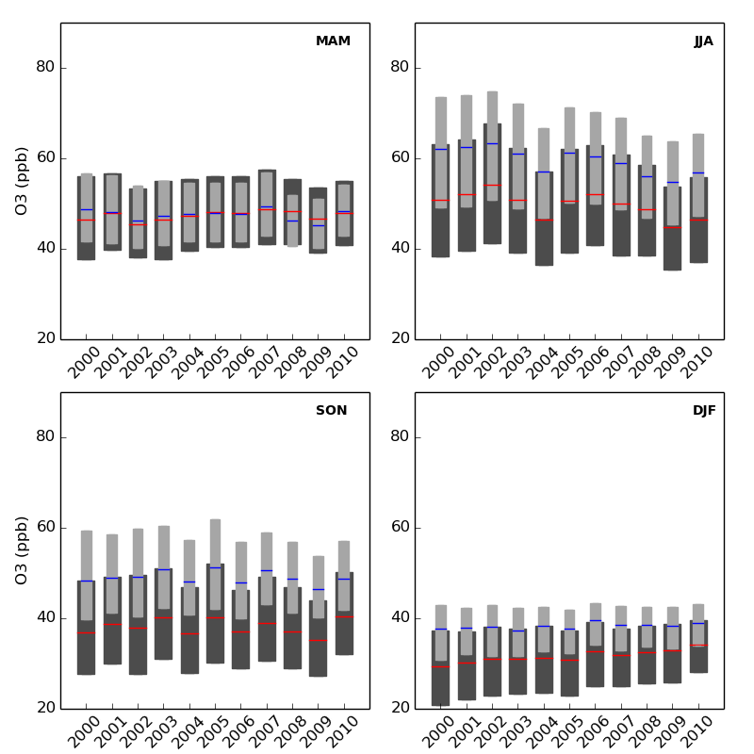
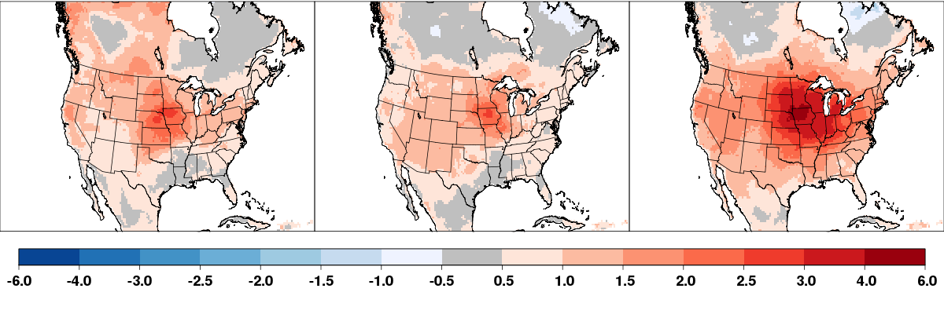
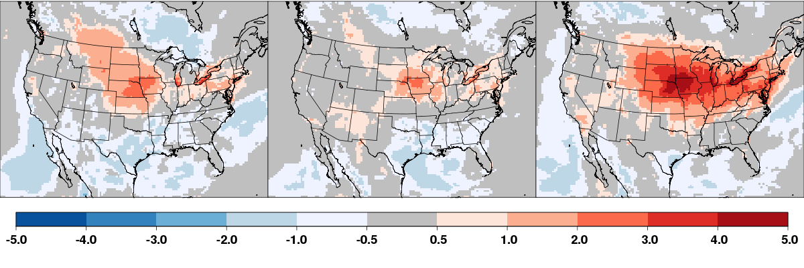
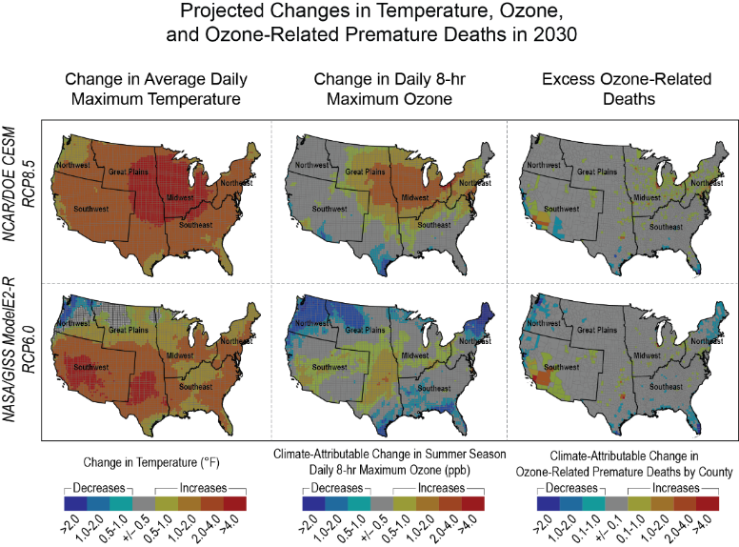

Using Regional Climate for Air Quality/Health Projections
Seltzer et al.,
Atmos. Environ.,
2016
Nolte et al., In preparation
Additional AQ/Health Papers:
Wilson et al.,
JESEE.,
2016
Dionisio et al., submitted.
Fann et al.,
USGCRP,
2016
Fann et al.,
JAWMA
2015

Slide 4

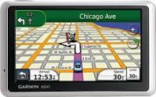
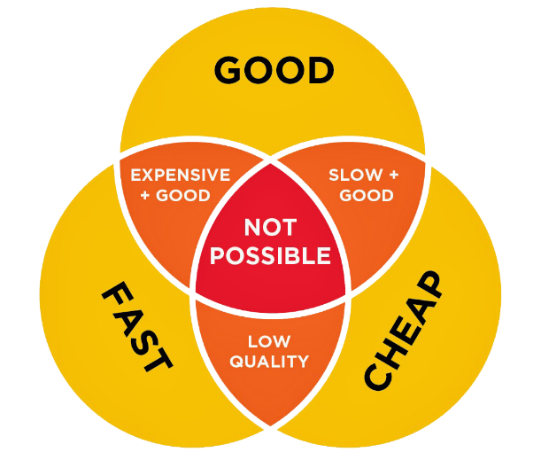



Alternative Future Realities – Considerations for Modeling
Food for Thought (with overused clichés)
Frame the Problem
Chart Your Course
2
1
4
3
5
Know Your Limits
Do Your Homework
6
Think Outside the Box
(the grid box and your tool box)
Tell Me Something
I Don’t Already Know

