Slide 1
Innovations in projecting emissions for air quality modeling
Dan Loughlin, Ph.D.
U.S. EPA Office of Research and Development
Research Triangle Park, NC
Panel presentation
15th Annual CMAS Conference, UNC-Chapel Hill, Chapel Hill, N.C.
Oct. 24th-26th, 2016

Slide 2
Modeling application
Typical application
Assess costs and benefits in a future year by comparing:
Base Case – All “on the books” rules included
Control Case – Base Case plus illustrative control strategy for new rule
Models
Control cost estimate
Benefits estimate
IPM
EGU emissions
Controlled inventory
Temporally-, spatially-allocated, gridded inventory
Gridded air quality
MOVES
Highway emissions
CoST
SMOKE
CMAQ
BenMap
Offroad emissions
Base Case air quality
NONROAD
Gridded air quality
Other emissions
Other models,
tools, data sources
Illustrative control strategy
SMAT
Attainment assessment

Slide 3
Emission projection challenges
Considerations when modeling multiple decades years into future:
Evolution of energy system
Population, economics, technology change, climate, policy
Spatial distribution of emissions
Land use change
Temporal distribution of emissions
Changing use of technologies and fuels
Uncertainty in all of the factors listed above

Slide 4
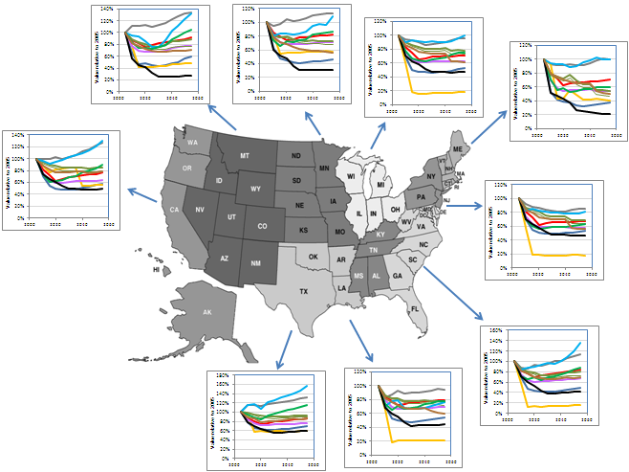
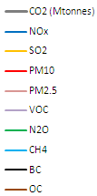
Emission projection methods
Loughlin, D.H., Benjey, W.G., and C. Nolte, C. (2011). ESP v2.0: Methodology for exploring emission impacts
Of future scenarios in the United States. Geoscientific Model Development, 4, 287-297.
Energy system models can be used to develop emission projections
Future-year growth and
control factors for SMOKE
Mountain
West North Central
East North Central
Sector | NO_{x} | SO₂ | PM₁₀
Electric | 0.56 | 0.19 | 0.88
Industrial | 1.69 | 0.93 | 1.05
Commercial | 1.25 | 0.79 | 1.19
Residential | 0.89 | 0.39 | 0.91
Light duty | 0.12 | 0.21 | 0.41
Heavy duty | 0.21 | 0.06 | 0.19
Aircraft | 1.29 | 0.97 | 0.67
Marine | 0.81 | 0.05 | 0.86
Nonroad | 0.35 | 0.05 | 0.33
Railroads | 0.48 | 0.02 | 0.21
New England
Pacific
2005 2030 2055
2005 2030 2055
2005 2030 2055
2005 2030 2055
Middle Atlantic
2005 2030 2055
CO₂
NO_{x}
SO₂
PM₁₀
PM_{2.5}
VOC
N₂O
CH₄
BC
OC
2005 2030 2055
South Atlantic
2005 2030 2055
2005 2030 2055
2005 2030 2055
West South Central
East South Central
Illustrative results

Slide 5
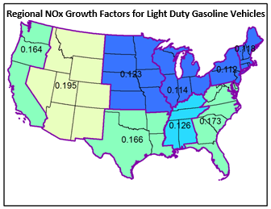
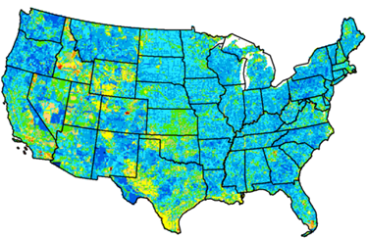
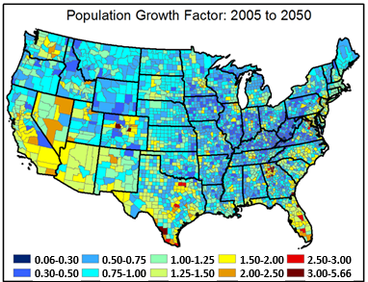
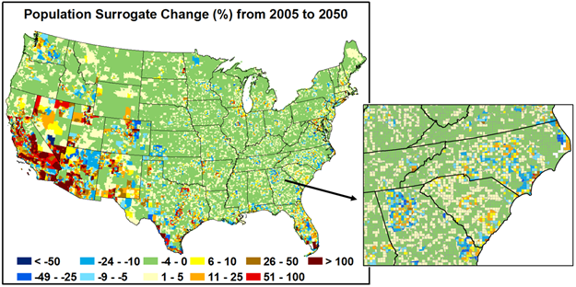
Spatial emission distribution
Ran, L., Loughlin, D.H., Yang, D., Adelman, Z., Baek, B.H., Nolte, C., and W.G. Benjey (2015). ESP2.0: Revised
Methodology for exploring emission impacts of future scenarios in the United States – Addressing spatial
Allocation. Geoscientific Model Development, 8, 1775-1787.
Land use models can be used to spatially allocate future emissions
Regional emission growth factors
Future-year, spatially re-distributed inventory
Energy
model
County-level population changes
Land use
model
Spatial surrogate changes
Illustrative results

Slide 6
Temporal emission distribution
Observations:
Coal shifts from relatively constant output to higher use in summer and reduced use in other seasons.
Gas use expands in all time slices, but night-time use in fall, winter and spring increases dramatically.
Historic temporal profiles would not capture these potentially important shifts.
Illustrative results

Slide 7
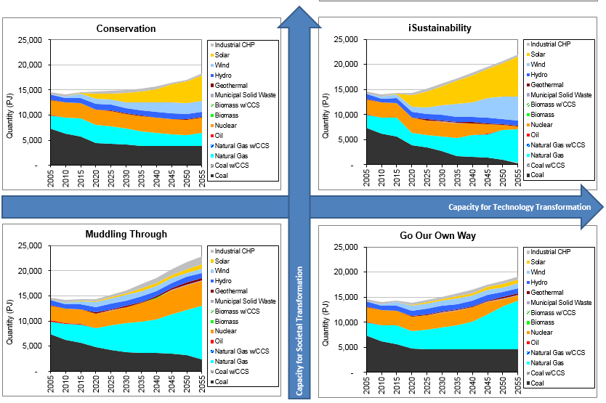
Addressing future uncertainty via scenarios
Scenario development techniques can be used to generate very different visions of the future. How can these alternatives be used effectively (and efficiently) in supporting air quality management?
Electricity production projections for alternative scenarios of the future
Solar
Wind
Societal transformation
Technology transformation
Nuclear
Gas
Coal
Illustrative results

Slide 8
Future directions?
What other aspects of emissions modeling could be addressed to improve emission projections?

Slide 9
Acronyms
BenMAP – Benefits Mapping model
CCS – carbon capture and sequestration
CHP – Combined heat and power
CMAQ – Community Model for Air Quality
CMAS – Community Model and Analysis System
CoST – Control Strategy Tool
CT – Combustion turbine
IGCC – Integrated gasification combined-cycle
IPM – Integrated Planning Model
MARKAL – MARKet ALlocation energy system optimization model
MOVES – Mobile Vehicle Emissions Simulator
NONROAD – Nonroad mobile source emissions model
NO_{x} – nitrogen oxides
ORD – Office of Research and Development
PM₁₀ – Particulate matter of diameter 10 microns or less
RIA – Regulatory Impact Analysis
SMAT – Speciated Modeled Attainment Test
SMOKE – Sparse Matrix Operator Kernel Emission processor
SO₂ – Sulfur dioxide

Slide 10
Forward
Objectives of this presentation
Serve as a discussion starter on the topic of how emission projection methods could be improved
Intended audience
Emissions and air quality modelers at the CMAS Conference
Disclaimers
The views expressed in this presentation are those of the author and do not necessarily represent the views or policies of the U.S. Environmental Protection Agency.
All results are provided for illustrative purposes only.

Slide 11
Emission projection challenges
Consideration of climate change and greenhouse gas emissions mitigation introduces the need for multi-decadal modeling
Questions to be addressed may include:
How do we project emissions several decades into the future, accounting for expectations regarding population, economic growth, climate change, land use change, behavior and policy?
How can we account for uncertainty in these factors?
How do we predict and then take into account spatial and temporal changes in emission profiles?
How do we identify important cross-sector and/or cross-media interactions?
How can we meet multi-pollutant objectives efficiently and robustly?

