Slide 1
Some Thoughts
Alternative Future Realities – Considerations for Modeling
CMAS Community Forum
October 26, 2016

Slide 2
Pick on 2 Posed Questions
Which input parameters can be feasibly and reliably projected given current understanding and technical resources?
Given that multiple future year scenarios are possible, should we consider alternatives to deterministic models for projecting medium to long-range air quality?
Academia: should be good fodder for a good many dissertations

Slide 3
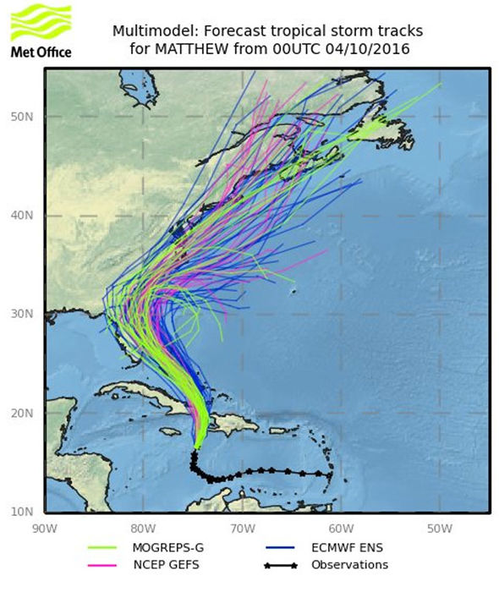
What’s really At the Crux of the Issue?
Bridge temporal scales between traditional regulatory (5-10 yr) and climate projections (≥ 50 yr)
  Regulatory/policy:
    Single model/period, project only emissions
    Formulaic, codified, rigid → “the answer”
  Operational weather forecasting and G/RCMs
    Multiple scenarios/models/configurations, address uncertainties/variability
    Probabilistic/statistical, diverse → complicated
Spatial scales: global → regional → local
  Increasing difficulty, larger variations in model response
A messy problem

Slide 4

So where should long-term AQ modeling Head?
Address compounding vs. compensating uncertainty
Move toward a probabilistic approach → envelope of likely outcomes
ENSEMBLES!
My, your wearing a wonderful ensemble today, Mrs. Cleaver

Slide 5
Ensembles are appropriate, but…
Deser et al. (2014): a lot going on in just ~50 year forecasts
  Projecting North American Climate over the Next 50 Years: Uncertainty due to Internal Variability. J. Climate, 27, 2271-2295, DOI: 10.1175/JCLI-D-13-00451.1
  40-member CCSM3 ensemble, single forcing (SRES A1B GHG), multiple atmospheric IC’s from different days in Dec 1999/Jan 2000
  Total signal = “Free” + “Forced”, where:
    Forced = external climate change inputs
    Free/unforced = internal variability from IC sensitivity, irreducible/ unpredictable “noise” (per Lorenz, 1963).
  NA Surface Air Temperature: Free ≈ Forced
  NA Precipitation: Free > Forced
  “Even [observed] ‘white noise’ exhibits multi-decadal variability”

Slide 6
Other Issues
Global chemical models
  Desertification (dust trends)
  “Purposed” deforestation (biogenic & agricultural trends)
  Mega cities (anthropogenic trends)
  Energy production (traditional vs. renewables, where/when?)
  Polar areas – new emissive areas?
  Coupling to GCMs: chemical vs. meteorological variability/uncertainty
NA regional land cover
  “Natural” deforestation (wildfires, infestations) – long term scarring
  Urban growth, other significant land cover transitions
  Impacts to surface energy budgets, wind stress, emissions, deposition
  Possible feedbacks to global scale variability

