Slide 1





NO_{X} emissions, isoprene oxidation pathways, and implications for surface ozone in the Southeast United States
Katherine (Katie) Travis
CMAS 2016: 10/26/16
Co-authors: D. J. Jacob, J. A. Fisher, P. S. Kim, E. A. Marais, L. Zhu, K. Yu, C. C. Miller, R. M. Yantosca, M. P. Sulprizio, A. M. Thompson, P. O. Wennberg, J. D. Crounse, J. M. St. Clair, R. C. Cohen, J. L. Laughner, J. E. Dibb, S. R. Hall, K. Ullmann, G. M. Wolfe, I. B. Pollack, J. Peischl, J. A. Neuman, and X. Zhou
This work was supported by the NASA Earth Science Division and by STAR Fellowship Assistance Agreement no. 91761601-0 awarded by the US Environmental Protection Agency (EPA). It has not been formally reviewed by EPA. The views expressed in this presentation are solely those of the authors.
Notes:
Good afternoon. Today I am going to talk about ‘Nox emissions, isoprene oxidations pathways, and implications for surface ozone in the Southeast US. I would like to thank my advisor Daniel Jacob, and the Jacob group working on this project at Harvard, as well as the PI’s from the SEAC4RS field campaign whose data I will discuss in this work. I would also like to thank my funding from both the NASA Earth Science Division and the EPA Star Fellowship program.

Slide 2
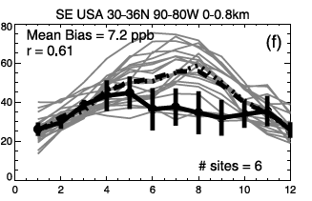
The Southeast US Is One of the Most Difficult Regions to Model for Surface Ozone
2001
Monthly Mean Surface O₃
CASTNET Observations
Multi-model Mean
Fiore et al, 2009
Blame has included isoprene chemistry, isoprene emissions, dry deposition etc.
Notes:
Mainly CAMX and CMAQ, 134-150 sites
21 global
and hemispheric chemical transport models - HTAP

Slide 3
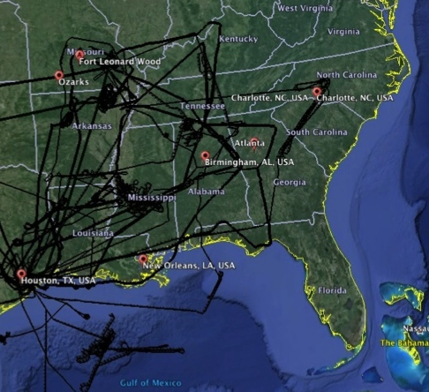

SEAC⁴RS (Aug-Sep 2013) Provided an Unprecedented Dataset to Investigate Air Quality in the Southeast US
Data Used for this Study Include:
  Thomas Ryerson, NOAA: NO_{y}, NO, NO₂, O₃
  Ron Cohen, Berkeley: NO₂
  Paul Wennberg, Caltech: isoprene oxidation products
  Jack Dibb, UNH: HNO₃
  Sam Hall, NCAR: J-values
SEAC⁴RS Flight Tracks from DC8 Aircraft

Slide 4
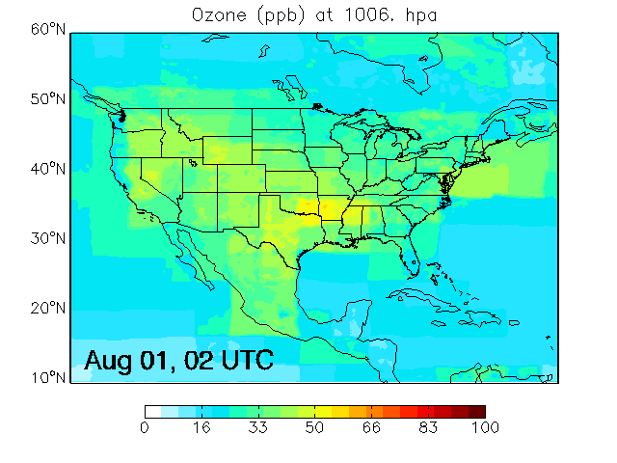
GEOS-Chem Incorporates State-of-the-Science Understanding of O₃-NO_{x}-VOC Chemistry
0.25ºx0.3125º resolution over North America.
Emissions:
  Biogenic from MEGAN (Guenther et al., 2012).
    See Zhu et al, 2016 (ACPD)
  Soil NO_{x} from Hudman et al (2012).
  Lightning NO_{x} according to Murray et al. (2012).
  Anthropogenic emissions from EPA’s NEI 2011v1.
Chemistry:
  Chemistry from Mao et al. (2013).
    With bromine chemistry (Parrella et al., 2012).
  Improved treatment of low- and high- NO_{x} pathways to incorporate recent lab studies.
Physical processes:
  Faster deposition of isoprene oxidation products (Nguyen et al, 2015).
1
Notes:
To study O3 in the southeast, I am using the GEOS-Chem chemical transport model. O3 in surface air from this model is show for the campaign on the right. We use assimilated meteorology from NASA, with 47 vertical layers, 0.25 degree horizontal resolution, and 88 advected tracers. We take biogenic emissions from the MEGAN inventory. Lightning Nox is constrained by observations of lightning flashes from the Lightning Imaging Sensor (LIS) and the Optical Transient Detector (OTD) satellite instruments.
Bromine sources include sea-salt aerosol, photolysis, and oxidation of short-lived bromocarbons. Decreases global mean tropospheric OH by 4%. Improves our ability to simulate 19th century O3 and seasonality. Decreases tropospheric O3 bruden by 6%,
The lightnign Nox emitted in the model for a given grid cell is distributed vertically between the surface and convective cloud top height following standard profiles for marine, tropical, midlatitude storms etc. 1-7% below 2km.
Note SENEX and SEAC4RS
Emissions:
Biogenic from MEGANv2.1 (Guenther et al, 2010)
Hourly anthropogenic emissions from EPA’s NEI08 for 2010
Daily fire emissions from the Quick Fire Emissions Database (QFED) (Darmenov et al, 2013)
Chemistry
Initial chemistry from Mao et al, 2013
Improved treatment of isoprene RO₂ isomerization (Crounse et al, 2011; Stavrakou et al, 2010; Peeters et al, 2014)
Reduced NO₂ recycling from isoprene nitrates (Lee et al, 2014)
Reduced yields of MVK/MACR (Liu et al, 2013)
Added gas-phase source of HONO (Li et al, 2014)
Physical processes:
Fast deposition of isoprene oxidation products
Aqueous uptake of soluble isoprene oxidation products
Fast photolysis of carbonyl nitrates (Muller et al, 2014)
Daily fire emissions from the Quick Fire Emissions Database (QFED) (Darmenov et al, 2013)
Aircraft. Aircraft emissions are from the AEIC inventory [Stettler et al., 2011] (new development).
Ships. Global shipping emissions are from ICOADS, as implemented in GEOS–Chem by Lee et al. [2011]. Shipping emissions of NOx are processed by the PARANOX module of Vinken et al. [2012] to account for ozone and HNO3 production in the plume.
Open Fires. Emissions from open fires for individual years are from the GFED2 inventory with 3-hourly, 8-day, or monthly resolution [van der Werf et al., 2009] or from the GFED3 inventory with 3-hourly, daily, or monthly resolution [Giglio et al., 2010; van der Werf et al., 2010; Mu et al. 2011].
Lightning. Lightning NOx emissions are computed with the algorithm of Price and Rind [1992] as a function of cloud top height, and are scaled globally as described by Murray et al. [2012] to match OTD/LIS climatological observations of lightning flashes. Biogenic VOCs. Biogenic VOC emissions in GEOS–Chem are from the MEGAN v2.1 inventory of Guenther et al. [2012] as implemented by Barkley et al. [2011].
Soils. Biogenic soil NOx emissions are from Hudman et al. [2012] (new development).
Reduced yields of MVK/MACR (Liu et al, 2013)
Added gas-phase source of HONO (Li et al, 2014)
Biogenic from MEGANv2.1 (Guenther et al, 2010)
Anthropogenic from NEI08 for 2010 from EPA with annual scale factors
Daily fire emissions from QFED Chemistry
Base chemistry from Mao et al, 2013
Improved treatment of isoprene RO₂ isomerization (Crounse et al, 2011, Stavrakou et al, 2010, Peeters et al, 2014)
Reduce NO₂ recycling from isoprene nitrates by 50% (Lee et al, 2014)
Reduce yields of MVK/MACR (Liu et al, 2013)
Physical processes:
Fast deposition of isoprene oxidation products
Aqueous uptake of IEPOX to form SOA (Pye et al, 2013)
Fast photolysis of carbonyl nitrates (Muller et al, 2014)

Slide 5
NO_{x} and Ozone are Overestimated in the Original GEOS-Chem Simulation
PBL is 60% too high for NO_{x} and 12ppb too high for ozone.
SEAC⁴RS PI
Jack Dibb: HNO_{3,} Thomas Ryerson: O₃, NO, NO₂
NEI11v1 (Gg N)
Notes:
Two fundamentally different methods have been compared: chemiluminescence (NO-O3 chemical reaction and emission of radiation from the nitrogen dioxide product) and laser-induced fluorescence (absorption of radiation by nitric oxide and then reradiation at different wavelengths by the excited nitric oxide).

Slide 6
Reducing NEI11v1 by 50% Improves Agreement with SEAC⁴RS NO_{y} and O₃
NEI11v1
SEAC⁴RS PI
Jack Dibb: HNO₃
Thomas Ryerson: O₃, NO, NO₂
Many studies find that NEI mobile NO_{x} is overestimated –
  Castellanos et al, 2011; Fujita et al, 2012; Yu et al, 2012; Brioude et al, 2013; Anderson et al, 2014.
We scale NEI11v1 by 50% by reducing industry and mobile NO_{x} by 60%.
Notes:
The uncertainty in this scaling factor due to the presence of soil NO_{x} is 30-60%.
If I didn’t scale industry, I would need a 50-90%
We reduce the overall NOx budget by 41%.
Two fundamentally different methods have been compared: chemiluminescence (NO-O3 chemical reaction and emission of radiation from the nitrogen dioxide product) and laser-induced fluorescence (absorption of radiation by nitric oxide and then reradiation at different wavelengths by the excited nitric oxide).
The model's treatment of emissions from aging vehicles is one likely contributor; the NEI overestimate of NOx emissions could indicate that engines produce less NOx and catalytic converters degrade more slowly than assumed by MOVES2010. MOVES2010 likely fails to capture dependence of NOx emissions on vehicle age accurately. Similarly, Bishop et al. (2012) shows that 1% of the vehicle fleet could emit as much as 15% of total NOx emissions, indicating that misrepresen- tation of the attributes of these outliers in emissions inventories could have significant effects on the estimated emissions. Incorrect emissions apportionment to the diesel portions of the on- and off- road fleets would lead to significant errors in the ratio of CO to NOx emissions. Incorrect emission factors are also another possible source of error. Lindhjem et al. (2012) found that the use of MOVES2010 emissions factors increased NOx emissions by 50% in comparison to those found in the previous EPA model, MOBILE6.

Slide 7
Spatial Variability Shows No Significant Biases
NO_{x} and O₃ Concentrations Below 1.5 km
NO_{x}, ppb
O₃, ppb
Observed NO_{x}
Observed O₃
r=0.71
Model NO_{x}
Model O₃
SEAC⁴RS PI
Thomas Ryerson: O₃, NO, NO₂
Mean model bias for ozone is +2 ppb, 9% for NO_{x}
Notes:
The highest observed ozone (>75 ppb) was found in air influenced by agricultural burning along the Mississippi River and by outflow from Houston over Louisiana. GEOS-Chem does not capture the extreme values and this probably reflects a dilution effect (Yu et al., 2016).
MS, AL, GA
Get citation on Ag fires

Slide 8

Simulation with Scaled NO_{x} Successfully Captures Isoprene Oxidation Pathways From SEAC⁴RS
‘High NOx pathway’
NO
ISOPN
Isom.
SEAC⁴RS PI
Paul Wennberg:
ISOPN, ISOPOOH, HPALD
ISOPRENE + OH →
RO₂
HPALD
HO₂
ISOPOOH
See Fisher et al, 2016 (ACP) for more on ISOPN
Notes:
Say that the yield of isoprene nitrates matters.
Mao et al, 2013 - this is attributed to a lower and reversible yield of isoprene nitrates, increasing the ozone production efficiency per unit of nitrogen oxides (NOx ≡NO+NO2).
The bias for HPALD is within the uncertainty of the kinetics and measurement. Our HPALD source is based on the ISOPO2 isomerization rate constant from Crounse et al. (2011).
A theoretical calculation by Peeters et al. (2014) suggests a rate constant that is 1.8× higher, which would reduce the model bias for HPALD and ISOPOOH and increase boundary layer OH by 8%.
GEOS-Chem overestimates ISOPOOH by 74% below 1.5 km. Recent work by St. Clair et al. (2015) found that the reaction rate of ISOPOOH + OH to form IEPOX is approximately 10% faster than the rate given by Paulot et al. (2009b), which would further reduce the model overestimate. It is likely that after these changes the GEOS-Chem overestimate of 15 ISOPOOH would be within measurement uncertainty. For both ISOPOOH and HPALD, GEOS-Chem captures much of the
spatial variability (r = 0.8 and 0.7, respectively).
5% from other minor pawthw
We successfully capture the fate of ISOPO₂ that leads to O₃.
We underestimate HPALD by a factor of 2.
Isomerization rate is uncertain by 50% (Crounse et al, 2011)
OH reaction rate is uncertain by +/- 35% (Wolfe et al, 2012)
ISOPOOH is overestimated – formation rate is uncertain by +/- 16%.
ays

Slide 9
Reductions in NO_{x} Have a Smaller Impact Due to Spatial Segregation of Emissions
More details in:
Yu, K. et al, ACP (2016)
Notes:
High NOx pathway would just be 62% with original Nox, 13% change in high NOx pathway

Slide 10



We Add New Constraints on NO_{x} Using Measurements of Deposition
Very
soluble
NO₂ + OH + M→ HNO₃
“ What Goes Up Must Come Down”
NO_{x} = NO + NO₂
H⁺ ,NO₃⁻
Dry deposition of HNO₃
Wet deposition of NO₃⁻
Measured during Southern Oxidant and Aerosol Study June-July 2013
Measured by the National Atmospheric Deposition Program

Slide 11
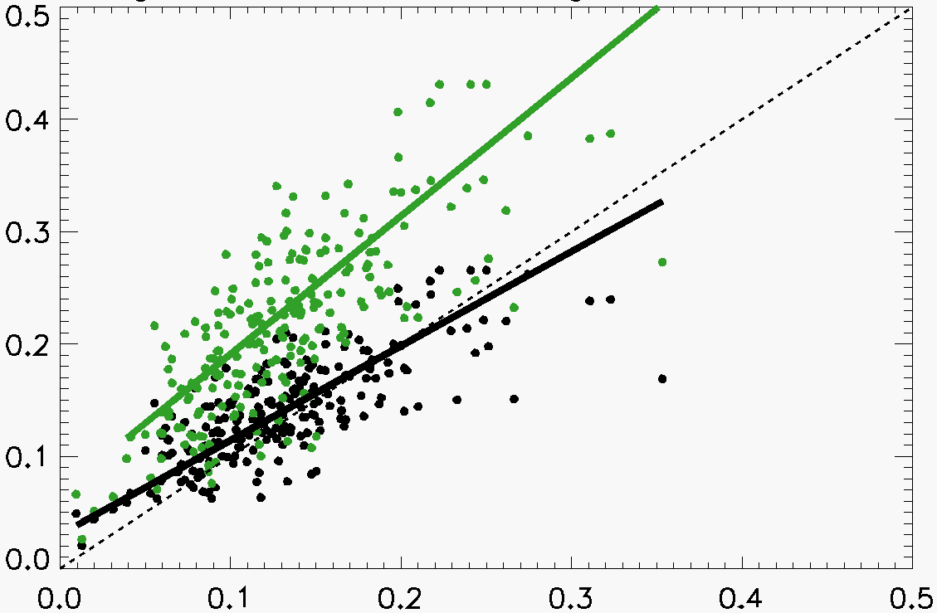
Wet Deposition Supports National Scaling of NEI11
US Nitrate Wet Deposition
August-September 2013
Model (kg N ha⁻¹ month⁻¹)
Nitrate
((kg N ha⁻¹ month⁻¹)
Reduced NO_{x} (Bias = 7%)
Original NO_{x} (Bias = 63%)
0.0 0.1 0.2 0.3 0.4
Southeast US: Bias = 8%, r=0.71
CONUS: Bias =7%, r= 0.76
Observations (kg N ha⁻¹ month⁻¹)
Notes:
*Midwest: 66% reduced to 7%, *Southeast: 71% reduced to 8%
The National Atmospheric Deposition Program has measured acids, nutrients since 1978.
250 sites, with monthly data in mg NO₃⁻/L.

Slide 12
Ozone Production Efficiency (OPE) Provides Constraint on Efficiency of Ozone Formation
Southeast US
Without scaling, OPE = 14.7 which means ozone would be produced less efficiently than observed.
Notes:
NOz = NOy – NOx

Slide 13
How well can we constrain US NO_{x} emissions with OMI NO₂?
Aug-Sep 2013 data with GEOS-Chem shape factors
OMI NO₂
(BEHR)
OMI NO₂
(NASA v2.1)
Low bias in GEOS-Chem is due to upper troposphere, not surface emissions
GEOS-Chem
with reduced
NO_{x} emissions
With original NEI emissions, Bias = +26-31%
-18% vs. BEHR
-11% vs. NASA

Slide 14
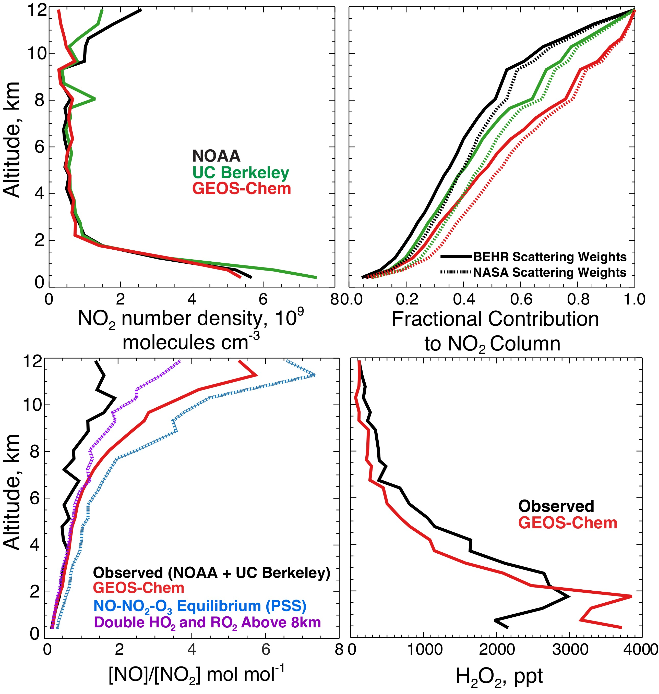
Free/upper troposphere makes major contribution to OMI NO₂ tropospheric column in summer
Mean SEAC⁴RS NO₂ profiles
Mean NO/NO₂ ratio
GEOS-Chem low bias in upper troposphere is caused by NO/NO₂ chemistry; insufficient convection of HO_{x} precursors HCHO and CH₃OOH?
Current OMI retrievals may have large AMF errors
25-40%
of column
[NO]/[NO2] ≈ k7/(k5[O3])
65-80%
of column
SEAC⁴RS PI
Thomas Ryerson: NO₂
Ron Cohen: NO₂
Notes:
Current retrievals of satellite NO₂ data do not properly account for this elevated pool of upper tropospheric NO₂, so that the reported tropospheric NO₂ columns are biased high.
K7 = NO2 photolysis
K5 = NO + O3
The upper troposphere above 8 km contributes 32–49% in the aircraft observations and 23% in GEOS-Chem.

Slide 15
Discrepancy Remains Between Surface & Upper PBL O₃
Median Ozonesonde
40ppb
Altitude, km
48ppb
O₃, ppb
PI. Anne Thompson
O₃
Remaining uncertainties are potential O₃ sinks and boundary layer mixing.
Notes:
Median ozone for CASTNET

Slide 16
Conclusions
NEI11v1 for NO_{x} is biased high across the US by as much as a factor of 2.
Emissions from industrial and mobile sources must be 30-60% lower than NEI values.
Evidence for this comes from (1) SEAC⁴RS observations of NO_{x} and its oxidation products, (2) NADP network observations of nitrate wet deposition fluxes.
The OPE in the boundary layer is well reproduced.
There may be large errors in satellite NO₂ columns due to the presence of upper tropospheric NO₂. Observations show departure from photochemical steady-state.
MDA8 surface ozone is still biased against the CASTNET observations by approximately 8ppb.
ktravis@fas.harvard.edu
Travis, K. R., Jacob, D. J. et al. Why do models overestimate surface ozone in the Southeast United States?, ACP, 2016 (in press).
Notes:
Emissions include scaling

Slide 17
Additional Papers from SEAC⁴RS
Organic nitrates: Fisher, J. A. et al.: Organic nitrate chemistry and its implications for nitrogen budgets in an isoprene- and monoterpene-rich atmosphere: constraints from aircraft (SEAC⁴RS) and ground-based (SOAS) observations in the Southeast US, Atmos. Chem. Phys., 16, 5969–5991, doi:10.5194/acp-16-5969-2016, 2016.
Formaldehyde: Zhu, L. et al.: Observing atmospheric formaldehyde (HCHO) from space: validation and intercomparison of six retrievals from four satellites (OMI, GOME2A, GOME2B, OMPS) with SEAC⁴RS aircraft observations over the Southeast US, Atmos. Chem. Phys. Discuss., doi:10.5194/acp-2016-162, in review, 2016.
Aerosols: Kim, P. S., Jacob, D. J. et al.: Sources, seasonality, and trends of southeast US aerosol: an integrated analysis of surface, aircraft, and satellite observations with the GEOS-Chem chemical transport model, Atmos. Chem. Phys., 15, 10411–10433, doi:10.5194/acp-15-10411-2015, 2015.
SOA: Marais, E. A. et al.: Aqueous-phase mechanism for secondary organic aerosol formation from isoprene: application to the southeast United States and co-benefit of SO₂ emission controls, Atmos. Chem. Phys., 16, 1603–1618, doi:10.5194/acp-16-1603- 2016, 2016.
Model Resolution: Yu, K. et al.: Sensitivity to grid resolution in the ability of a chemical transport model to simulate observed oxidant chemistry under high-isoprene conditions, Atmos. Chem. Phys., 16, 4369–4378, doi:10.5194/acp-16-4369- 2016, 2016

