Slide 1
Comparing Extreme Events Simulated by WRF Using USGS and NLCD Land Use Data Sets
Stephany Taylor^{1,2}, Tanya Spero¹ and Megan Mallard¹
¹US EPA National Exposure Research Laboratory, Research Triangle Park, NC
²North Carolina Agricultural and Technical State University, Greensboro, NC
15th Annual CMAS Conference
October 26, 2016

Slide 2
Motivation
Extreme weather events have catastrophic impacts on society.
Climate change can alter frequency and intensity of extreme events.
Need to simulate extreme events with confidence.
Currently using USGS land use for regional climate modeling.
Want to update to NLCD land use
Better representation in US, especially at higher resolution
Better alignment with configuration used at EPA for AQ modeling
Using NOAH LSM in WRF
NLCD not tested with NOAH
Is there an impact on simulating extreme events in WRF by changing from USGS to NLCD?

Slide 3
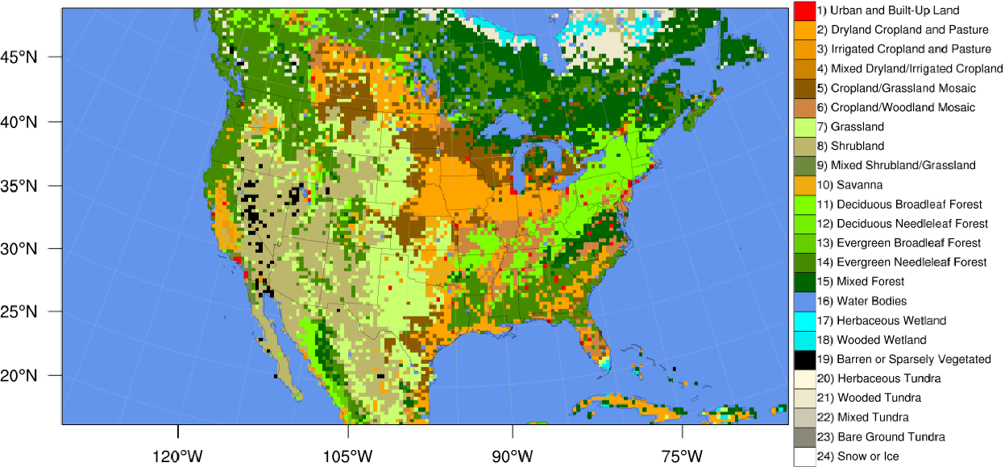
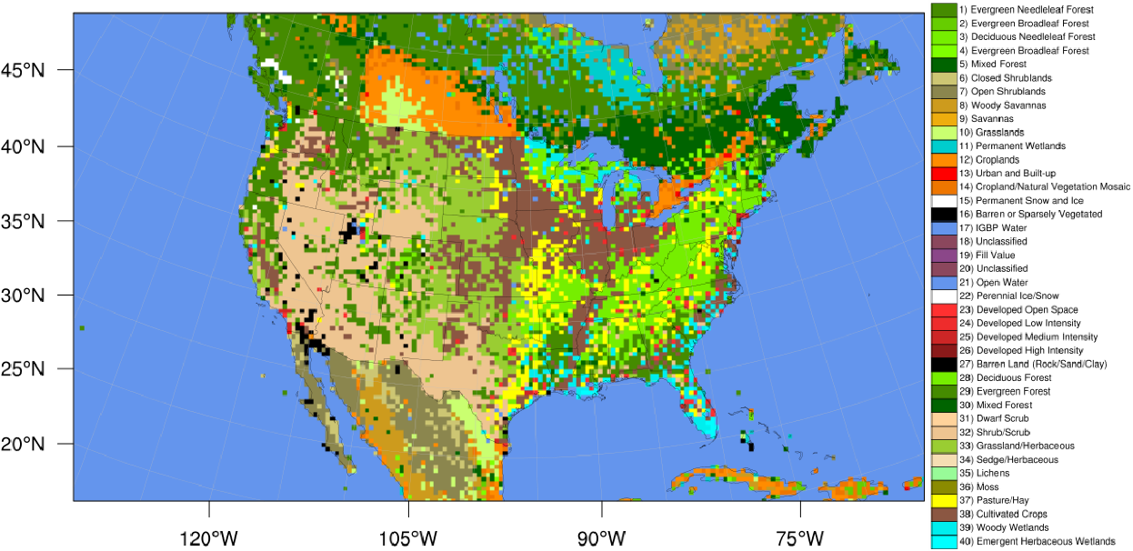
Methodology
WRFV3.8 with downscaling physics/nudging options (Spero et al. 2016)
Two continuous runs: Oct 1987 – Dec 1990 (analyzed 1988-1990)
USGS 24-category land use
NLCD/MODIS 40-category land use
108-36-km North American domain, focus on 36-km CONUS
Comparisons to:
North American Regional Reanalysis (NARR), 32-km
Climate Prediction Center (CPC) precipitation reanalysis, 0.25-deg
USGS
NLCD

Slide 4
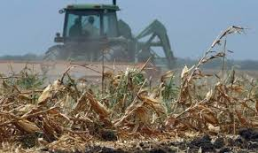
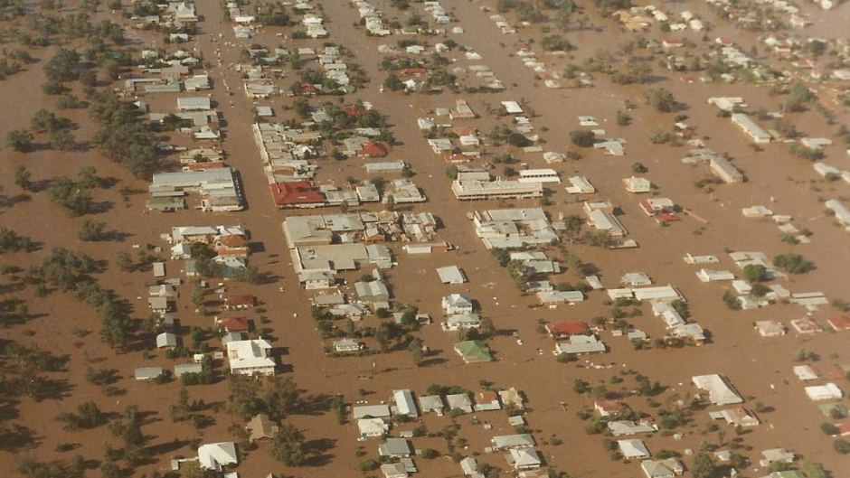
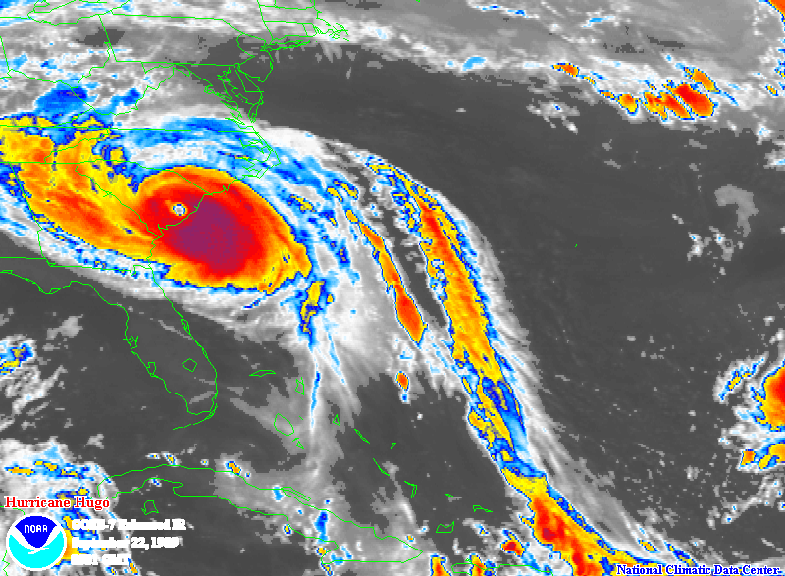
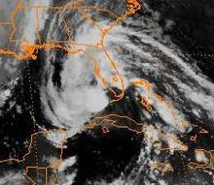
NC Severe Storm Outbreak May 1-6, 1989 $1B damages
Midwest Drought/Heat Wave 1988 >5,000 Deaths $40B damages
Texas/Arkansas Flooding May 11-19, 1990 >$1B damages 13 Deaths
Hurricane Hugo Sept. 21-22, 1989 >100 Deaths >$7B damages
Deep Freeze Dec. 21-26, 1989 ~$5B agricultural/crop damages
Tropical Storm Marco
Oct. 10-13, 1990 $57M damages 7 deaths

Slide 5
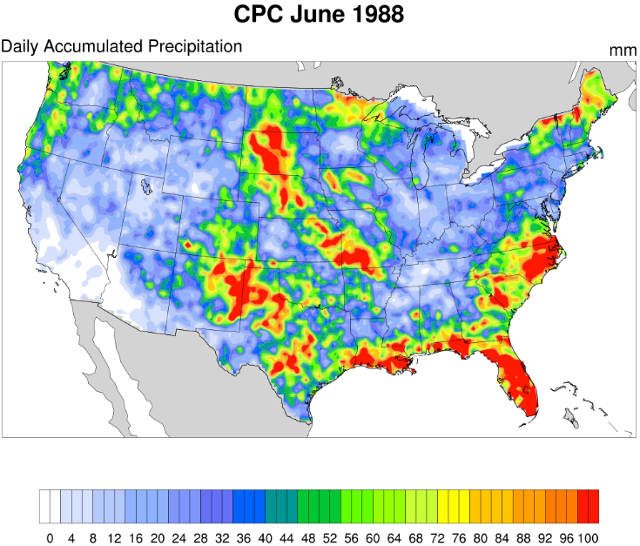
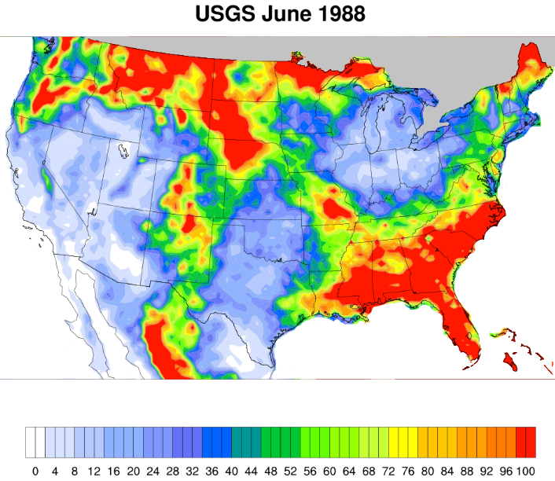
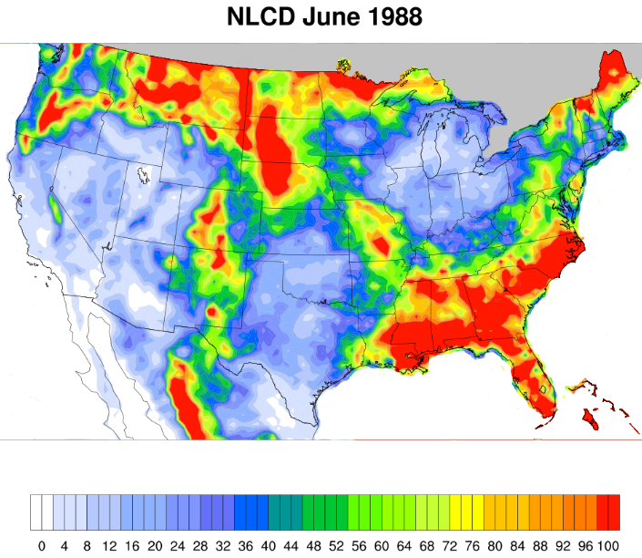
Accumulated Precipitation (mm) Comparisons for Drought Case June 1988
Both LU data runs:
Have similar precip. patterns.
Over predict precip. over SE and northern US border.
Under estimate rainfall across NM and central TX.
USGS over saturates southern MO and KY.
NLCD over estimate precip. over northern MO.
NLCD matches better to CPC data over northern NY.

Slide 6
Average Soil Temperature and Moisture in the Top Layer for July and August 1988 Drought Case
Notes:
Both LU simulations:
Over estimate temperatures/soil dryness over NV/UT.
Under predicts temperatures and over predicts soil moisture across the NE.
NLCD drier than USGS across NE, lower MS River Valley and GA coastline.
USGS drier than NLCD near central TX.

Slide 7
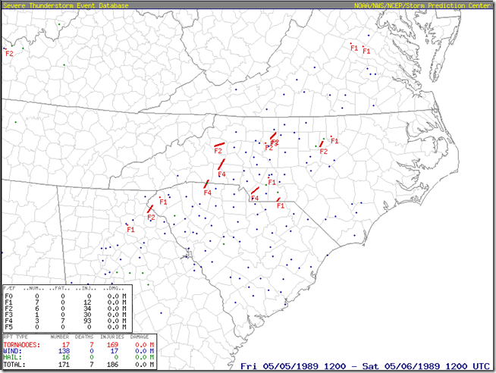
Severe Storms May 1-6, 1989
GOES 7 Infrared Satellite Image

Slide 8
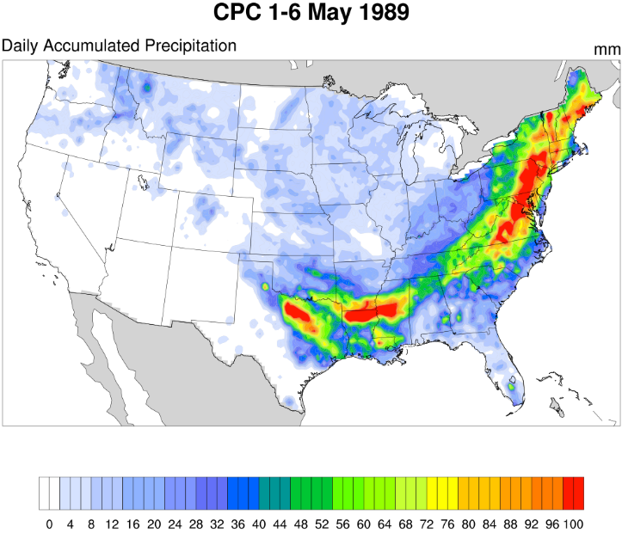
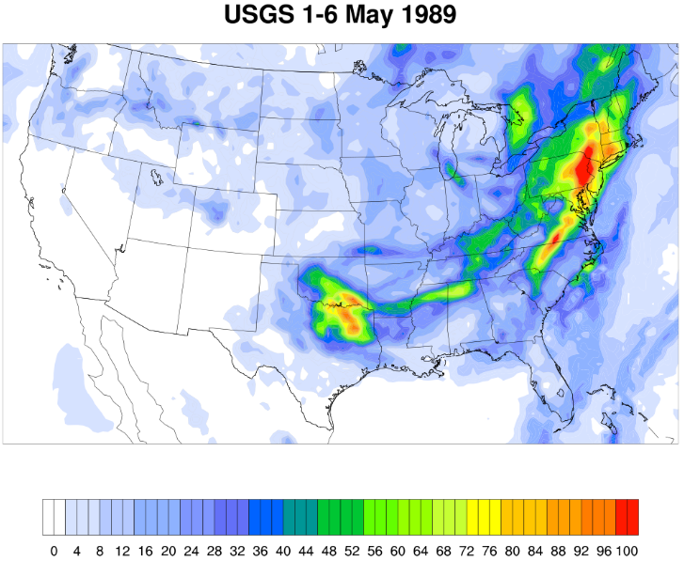
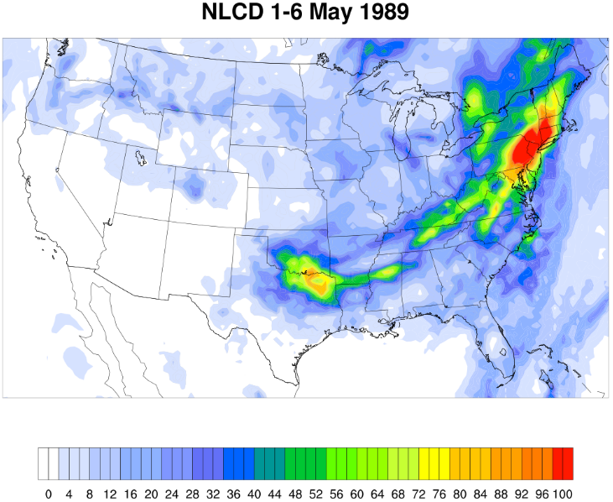
Severe Storms May 1-6, 1989 Accumulated Precipitation (mm)
Both LU simulations:
Under estimates precip.
USGS has a wider precip. pattern over TX/OK and the Carolinas.
NLCD matches CPC better over New England.
GOES 7 Infrared Satellite Image.

Slide 9
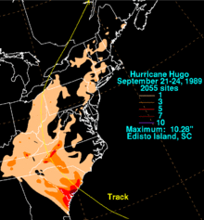
Hurricane Hugo Sept. 21-22, 1989
GOES 7 Infrared Satellite Image

Slide 10
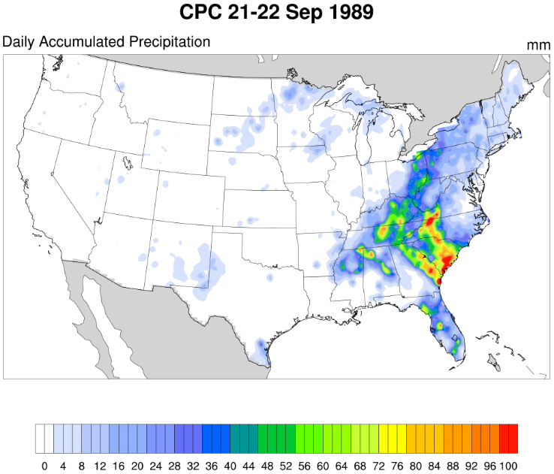
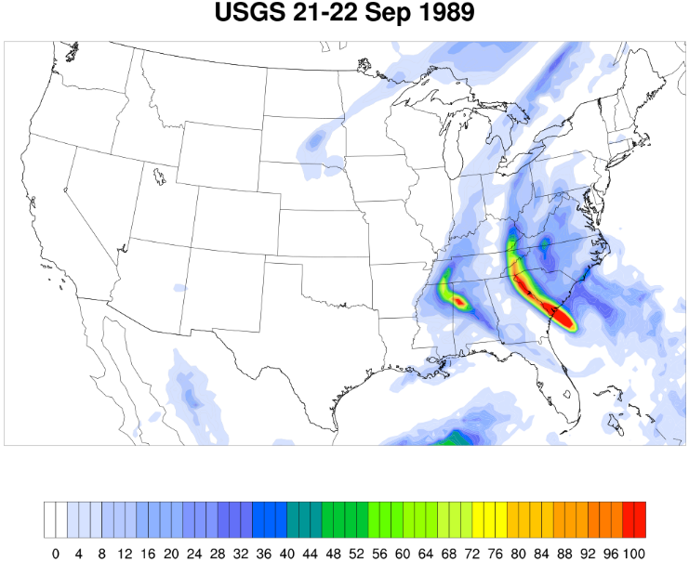
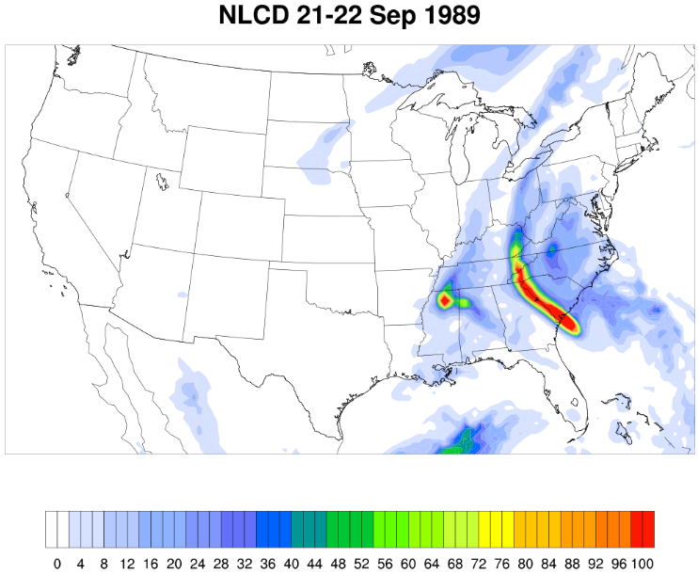
Hurricane Hugo Sept. 21-22, 1989 Accumulated Precipitation
Both LU categories have precip. discontinuity over the Appalachian Mountains.

Slide 11
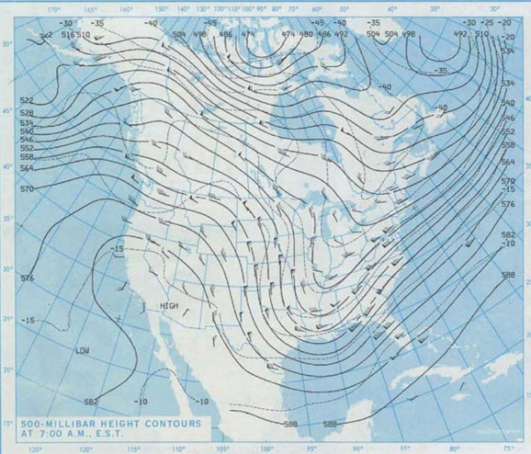
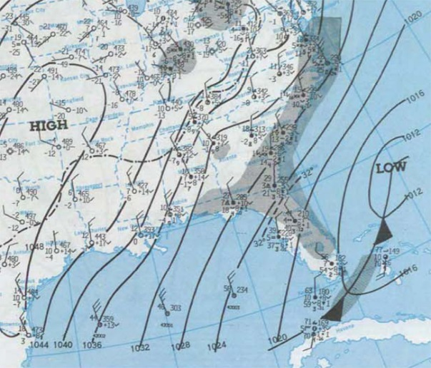
Deep Freeze Dec. 21-26, 1989

Slide 12
Deep Freeze Dec. 21-26, 1989 2-meter Temperature (K)
Both LU simulations have similar temperature patterns.
USGS matches NARR better over southern TX.
NLCD matches NARR better over NC.

Slide 13
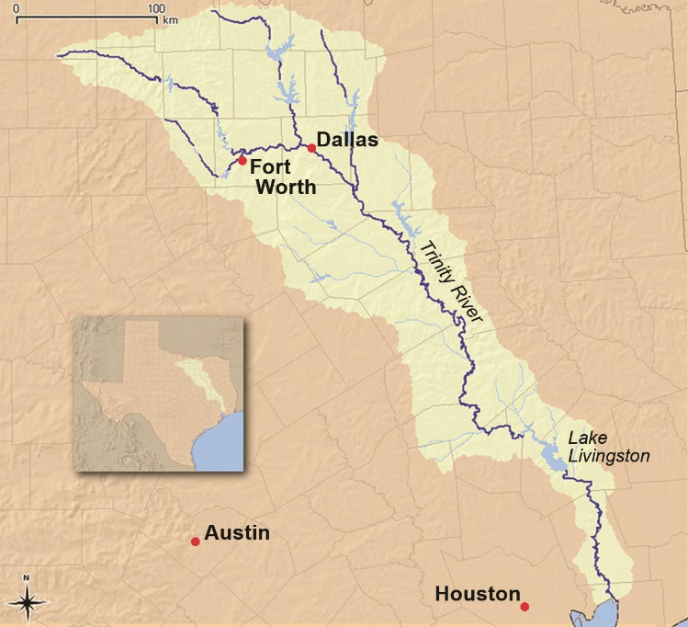
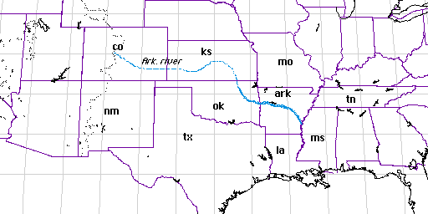
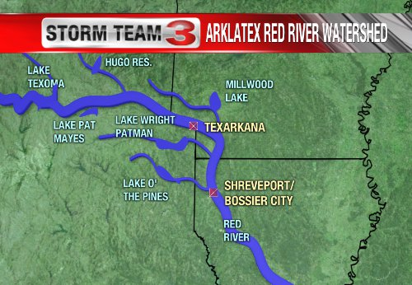
Flooding Event May 11-19, 1990
Flooding of the Trinity, Red and Arkansas rivers resulted in 13 casualties and $1.0 billion in damages.

Slide 14
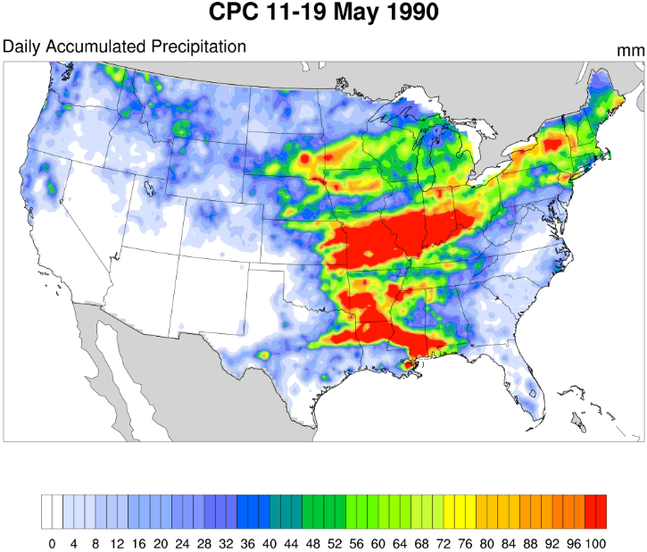
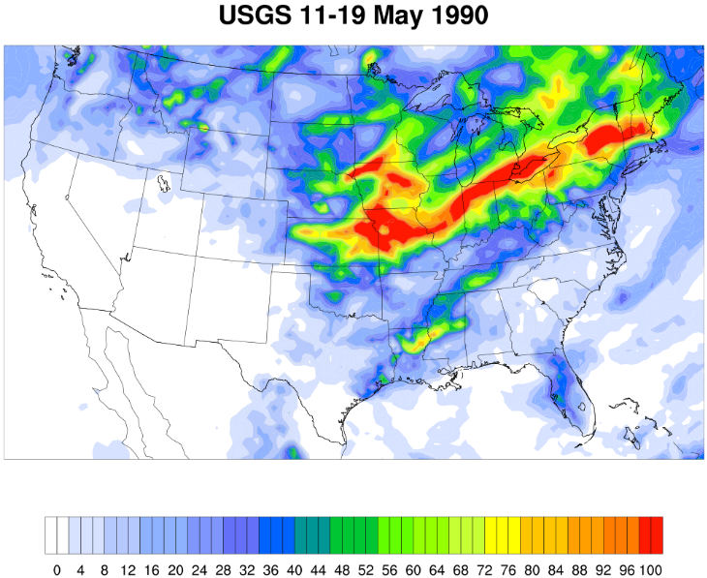
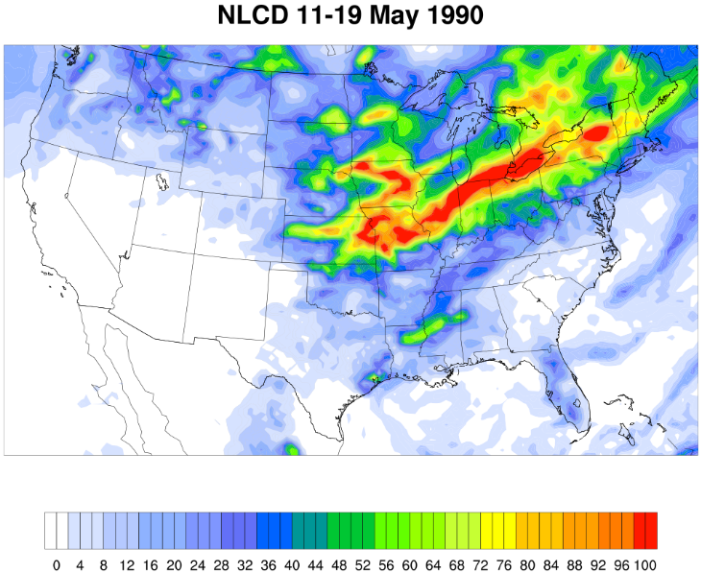
Flooding May 11-19, 1990 Accumulated Precipitation (mm)
Both LU runs substantially misrepresent precip. coverage for this flooding event.
USGS has more precip. coverage over the SE.
NLCD matches CPC better across the NE.

Slide 15
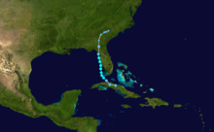
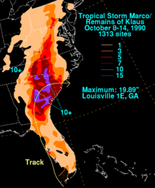
Tropical Storm Marco Oct. 10-13, 1990
Tropical Storm Marco Track
GOES 7 Visible Satellite Image

Slide 16
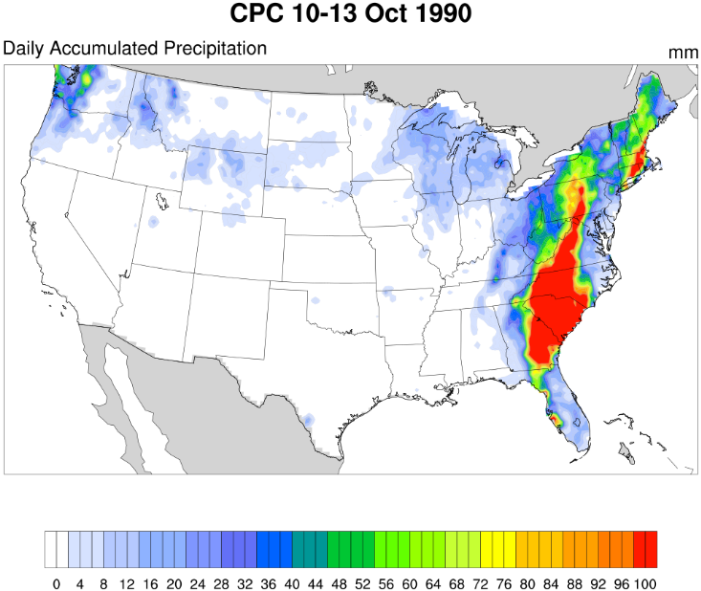
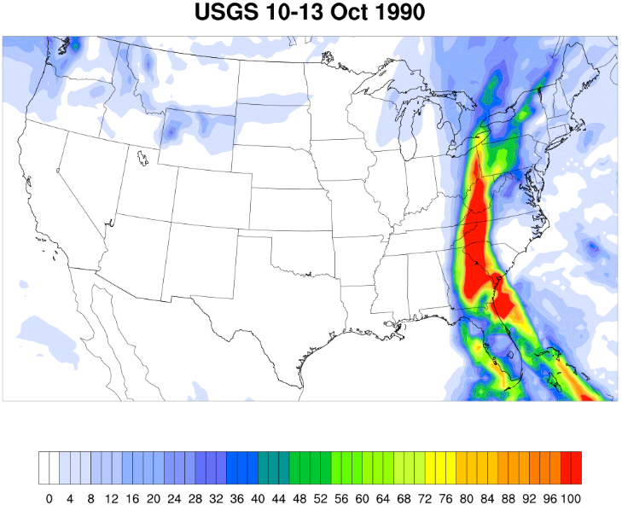
Tropical Storm Marco Oct. 10-13, 1990 Accumulated Precipitation (mm)
USGS correctly estimates precip. over west coastal FL.
NLCD has better precip. coverage over eastern NC.

Slide 17
Summary
NLCD soil moisture tends to be drier than USGS over eastern U.S. across all case studies.
Similar precipitation patterns for all events, regardless of LU.
Usually USGS has “wider” precip. than NLCD.
USGS often better for high precip. events in SE.
NLCD tends to be better for precip. in NE.
Warmer temperatures in NLCD than USGS, especially in the SE.
Disclaimer: The views expressed in this presentation are those of the authors and do not necessarily represent the views or policies of the U.S. Environmental Protection Agency.

Slide 18
Supplemental material
WRF Parameterizations used:
Noah Land Surface Model
WRF single moment 6-class microphysics scheme
Rapid radiative transfer model for global models for short and longwave radiation scheme
MM5 Monin-Obukhov similarity surface scheme
Yonsei University planetary boundary layer scheme
Kain-Fritsch cumulus scheme
Run Time: Oct. 1987-Dec. 1990
REFERENCE:
Spero, T., Chris Nolte, J. Bowden, M. Mallard, AND J. Herwehe. The Impact of Incongruous Lake Temperatures on Regional Climate Extremes Downscaled from the CMIP5 Archive Using the WRF Model. Journal of Climate. American Meteorological Society, Boston, MA, 29(2):839-853, (2016).

