Slide 1

Aerosol Assimilation Based on NCEPs GSI Compared to Optimal Interpolation Method
Youhua Tang^{1,2}, Mariusz Pagowski^{4,5}, Tianfeng Chai^{1,2}, Li Pan^{1,2}, Pius Lee¹, Barry Baker^{1,2}, Rajesh Kuma⁶, Luca Delle Moncache⁶, Daniel Tong^{1,2,3}, and Hyun-Cheol Kim¹²
1. NOAA Air Resources Laboratory, College Park, MD.
2. Cooperative Institute for Climate and Satellites, University of Maryland at College Park, MD.
3. Center for Spatial Information Science and Systems, George Mason University, Fairfax, VA.
4. NOAA Earth System Research Laboratory, Boulder, CO.
5. Cooperative Institute for Research in the atmosphere, Colorado State University at Fort Collins, CO.
6. National Center for Atmospheric Research, Boulder, CO.

Slide 2
Background of this work
Existing National Air Quality Forecasting Capability (NAQFC) expanded to support PM2.5 prediction. However PM2.5 is not a single aerosol species but the combination of aerosols with diameter < 2.5 um and its source/sink are very uncertain.
NCEP has the existing data assimilation tool Gridpoint Statistical Interpolation (GSI) to assimilate observation to adjust models’ initial condition. Pagowski et al (Geosci. Model Dev. 2014) expanded the 3D-Var method to assimilate surface PM2.5 and MODIS AOD (only for WRF-CHEM with GOCART aerosols).
In this study we apply this GSI assimilation tool to CMAQ aerosols using surface PM and MODIS AOD and make the test runs in 4-cycle per day. This result is compared to a simpler optimal interpolation (OI) method (Tang et al 2015)

Slide 3
GSI 3D-var Cost Function
$J=\frac{1}{2}\left(xa−xb\right)T$B⁻¹$\left(xa−xb\right)+\frac{1}{2}\left(Hxa−Oo\right)T\text{O}\text{−}1\left(Hxa−Oo\right)+Jc$
Where x_{a} and x_{b} are the analyzed and background (a prior modeled) concentrations or AOD data, B and O are the background and observation error covariance matrices, H is the observational operator, O_{o} is the observations and J_{c} is the constraint terms.
Optimal Interpolation method (Tang et al 2015)
Where Xª and X^{b} are the analyzed and background ( a prior modeled) concentrations or AOD data, B and O are the background and observation error covariance matrices, H is the observational operator and H^{T} is its matrix transpose operator, and Y is the observation vector

Slide 4

Aerosol Assimilation Diagram
CMAQ v5.1 a prior aerosols from previous run
AIRNow/AQS Surface PM2.5
GSI/OI Assimilation
Satellite AOD (Terra/Aqua MODIS currently)
OI uses CMAQ’s reconstruction method to estimate AOD while GSI has its own method for AOD via CRTM
Adjusted Aerosol Concentrations
MODIS AOD Observation
(Terra and Aqua)
Prediction Cycle
00Z
06Z
12Z
18Z
AQS/AIRNow PM2.5

Slide 5
CMAQ mean aerosol sizes for each mode: DGATKN, DGACC, DGCOR
ASO4I ANO3I ANH4I ACLI ASO4J ANO3J ANH4J ASO4K ANO3K ANH4K
Sulfate Aerosol
AECI AECJ
Black Carbon Aerosol
APOCI APNCOMI APOCJ AOTHRJ AXYL1J AXYL2J AXYL3J ATOL1J ATOL2J ATOL3J ABNZ1J ABNZ2J ABNZ3J AISO1J AISO2J AISO3J ATRP1J ATRP2J ASQTJ AALK1J AALK2J AORGCJ AOLGBJ AOLGAJ APAH1J APAH2J APAH3J APNCOMJ
CRTM calculation of aerosol optical properties for each CMAQ aerosol species
Organic Carbon Aerosol
AFEJ AALJ ASIJ ACAJ AMGJ AKJ AMNJ ACORS ASOIL
Dust Aerosol
Ambient relative humidity
ANAJACLJ ACLK ASEACAT
Sea Salt Aerosol
GOCART Aerosol Optical Properties used in GSI/CRTM
CMAQv5.1 Aerosol Species

Slide 6
The model relative uncertainties used in the OI assimilation are varied in location and time

Slide 7
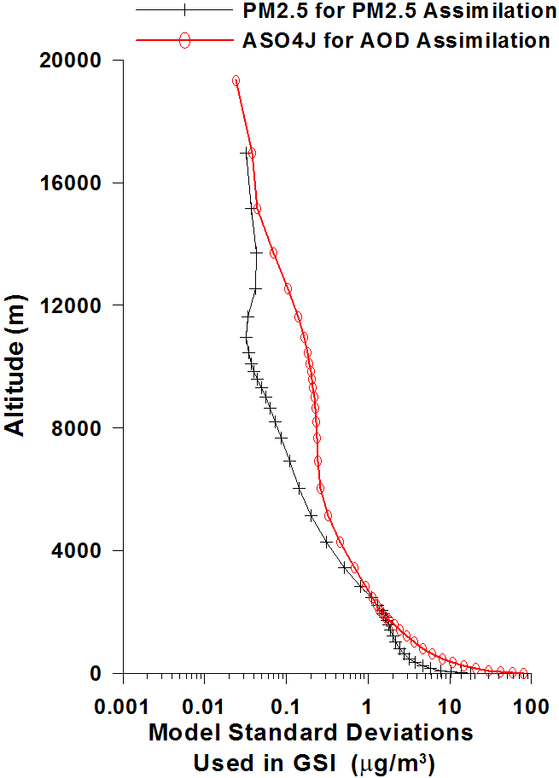
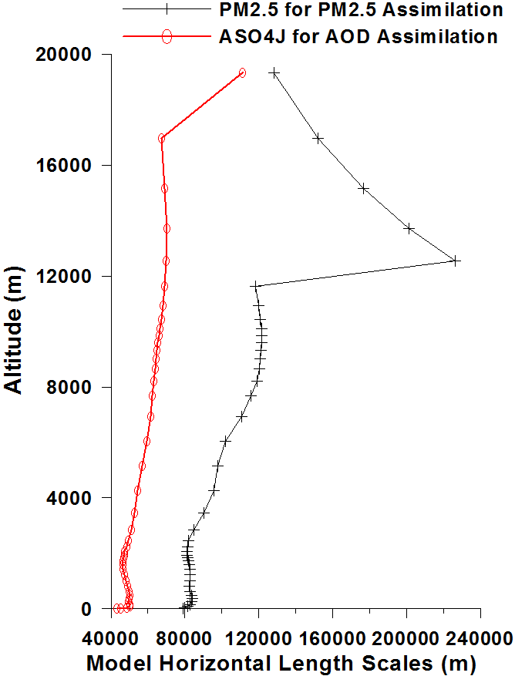
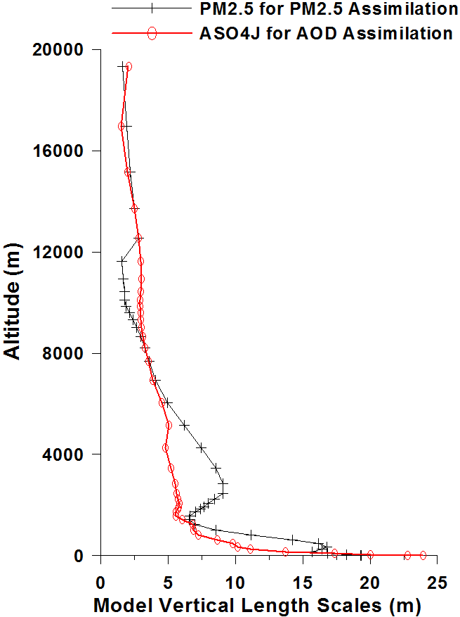
Model Standard Deviation and Length Scales used in GSI assimilation

Slide 8
Base CMAQ Model Configuration
Meteorology: WRF-ARW 3.4 driven by the NCEP FNL (Final Global Analysis) 1°×1° analysis field and was re-initialized every 24 hours
Air Quality Model: CMAQ 5.1 in 12km horizontal resolution and 42 vertical layers up to 50hPa
National Emission Inventory (base year 2011);
HMS-BlueSky wildfire emission;
RAQMS chemical lateral boundary condition
Study period: July 2011

Slide 9
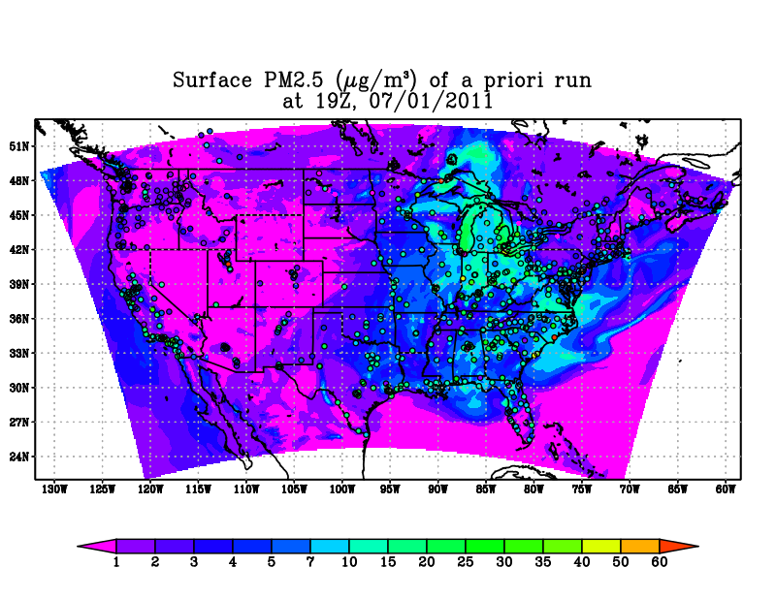
The base case generally under-predicted PM2.5, especially over Western CONUS

Slide 11
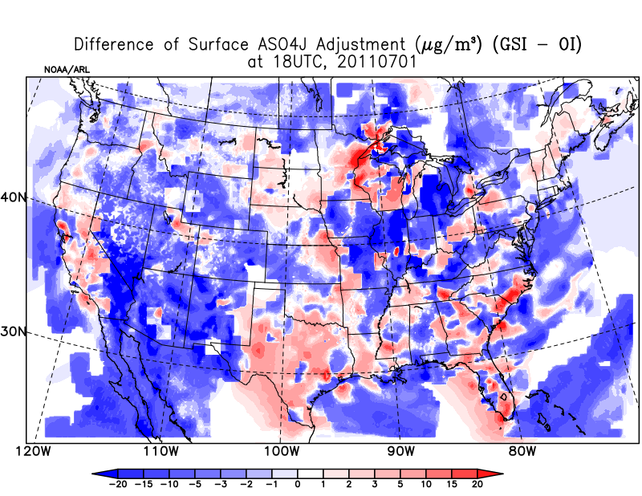
Overall difference of GSI versus OI methods

Slide 12
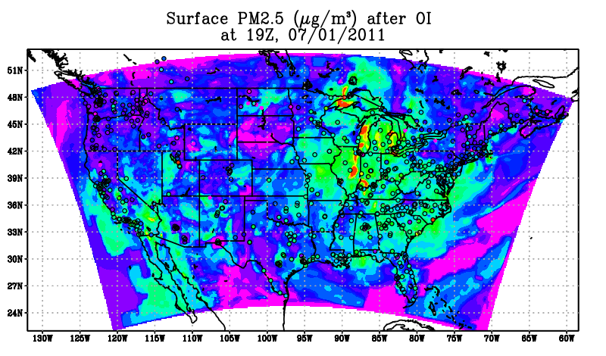
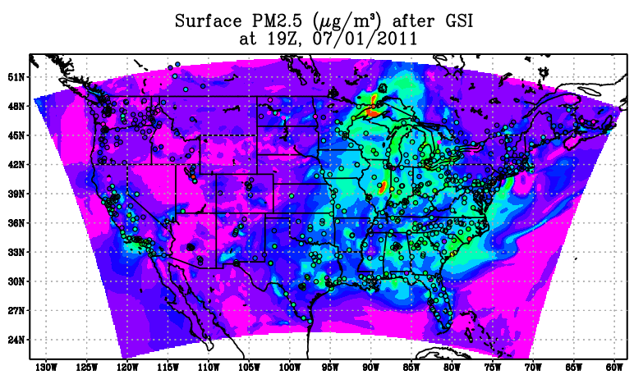
OI adjustment is stronger, especially for its AOD adjustment. GSI yields more moderate adjustment based on our current figuration.

Slide 13
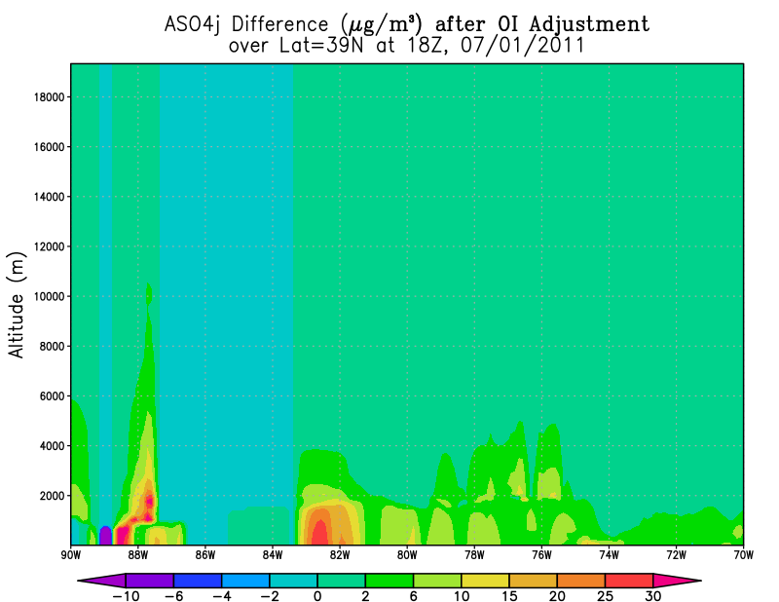
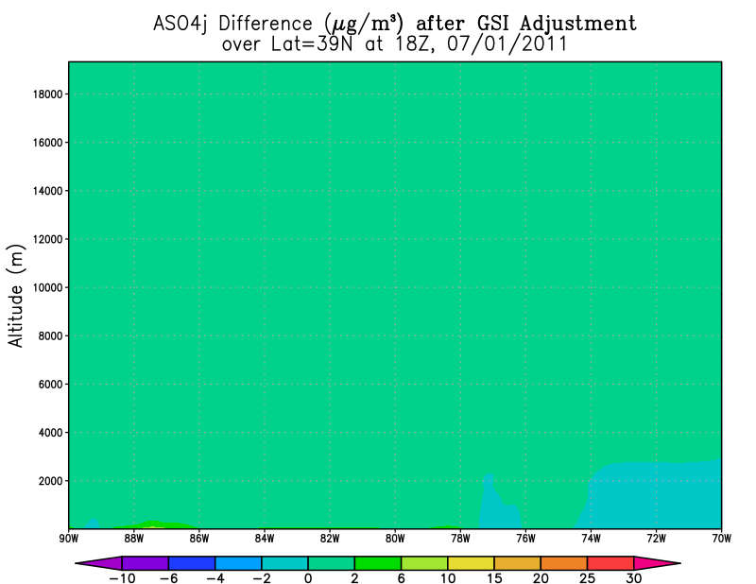
Cross-section Comparison
OI adjustment is also stronger vertically, and yield sharper gradient near the PBL top.

Slide 14
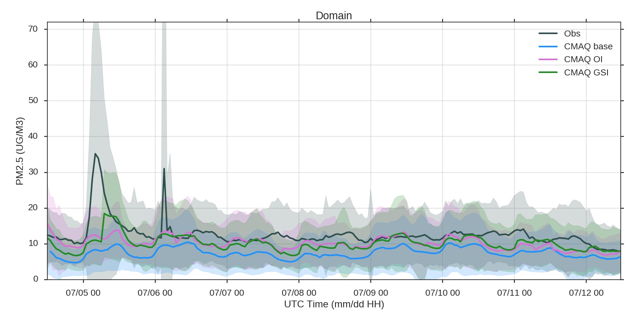
Continuous CMAQ runs with GSI and OI adjustments for CONUS domain
CMAQ Base: MB=-4.39 µg/m³ R=0.34
CMAQ OI: MB=-1.92 µg/m³ R=0.38
CMAQ GSI: MB=-2.04 µg/m³ R=0.48

Slide 15
Summary
We tested the two assimilation method: optimal interpolation and GSI to adjust CMAQ’s initial conditions for July 2011 over the continental USA using AIRNow/AQS surface data ( every 6 hours) and MODIS AOD (once per day). Both of them yield better results than the base case without adjustments. In our current setting, the OI adjustment is stronger and changes the aerosol field more aggressively. GSI yields smoother adjustment with much higher correlation coefficient.
CRTM’s AOD calculation through GOCART aerosol table is quite different from CMAQ’s own reconstructive method. We need investigate further in order to get the best AOD assimilation.
The effect-lasting time of adjusted initial condition depends on many factors, such as the strength of local emission and of local wind.

