Slide 1


Assessment of current and future impacts of air pollution on human health
Urszula Parra Maza, Peter Suppan

Slide 2
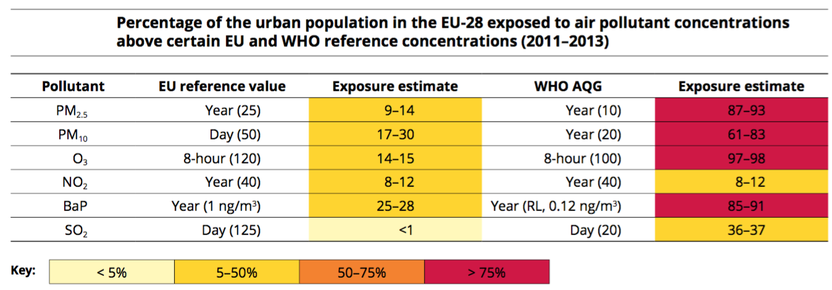

Background
Air pollution is the environmental factor with the greatest impact on health in Europe (EEA 2015)
Introduction of emission control strategies may reduce future health risks of air pollution
Regional and local studies are needed to assess possible impacts under alternative scenarios

Slide 3
Introduction
Study goals
  High resolution regional chemistry simulations to estimate future changes in air quality over Southern Germany
  Assessment of different emission scenarios on air quality
  Effects of changing emissions and air quality on human health
  Estimation of the potential benefits of pollution reduction programs based on future scenarios
  Performance of long term assessment studies

Slide 4
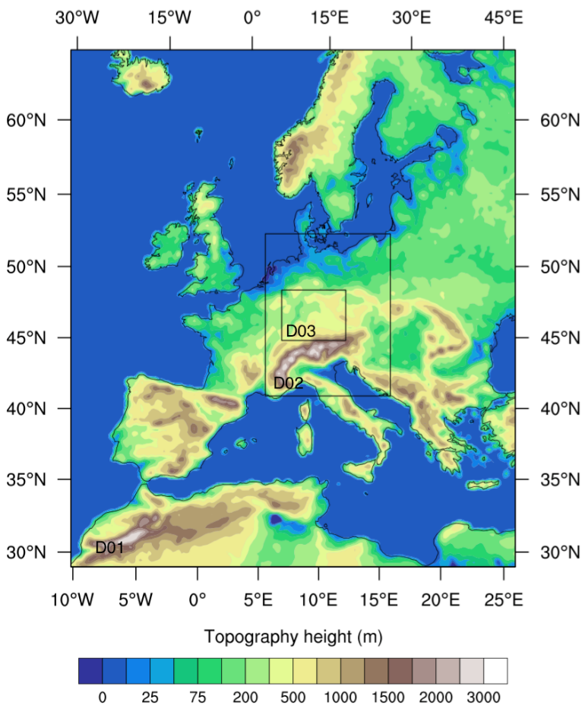
Air Quality Modelling Approach
Model: WRF-Chem 3.6.1
Nesting strategy:
  D1: Δx = 18 km, 270 x 240 cells
  D2: Δx = 6 km, 175 x 226 cells
  D3: Δx = 2 km, 268 x 221 cells
Input Data Sources
Meteorological BCs ECMWF
Chemical BCs MOZART
Anthropogenic Emissions TNO-MACC / IER
Biogenic Emissions on-line MEGAN

Slide 5
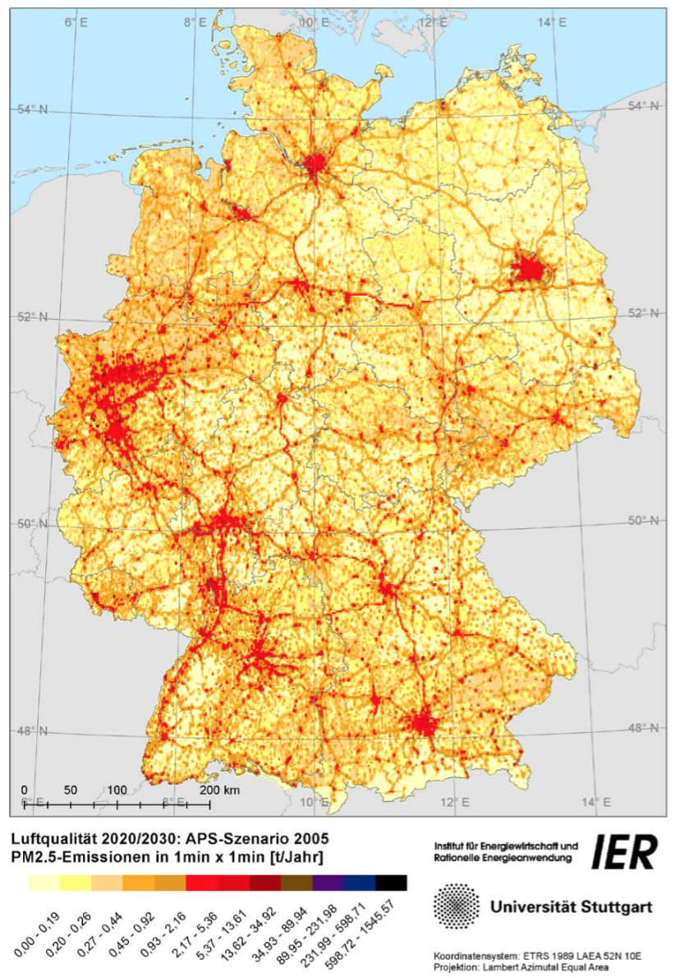
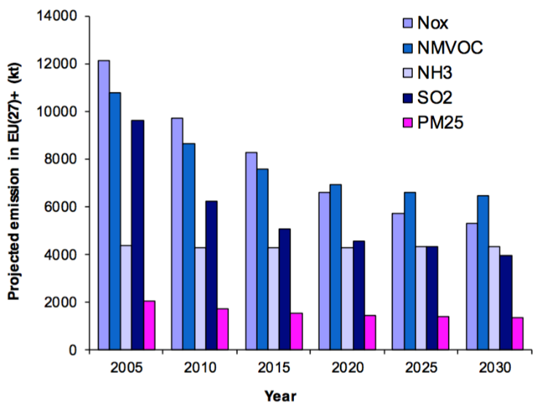
Emission projections
Future emissions for the EU27+
Future emissions projection for Germany
The Current Policy Scenario (APS) reflects energy and climate measures
The Energy Turnaround Scenario (EWS) - Energiewende - assumes additional climate protection measures
Emission inventory 2 km x 2 km
Scenarios and simulation names:
Current Policy Scenario (APS09) for 2009
Current Policy Scenario (APS30) for 2030
Energy Turnaround Scenario (EWS30) for 2030
TNO emission inventory (1/8° x1/16°)
Projections produced by GAINS model

Slide 6
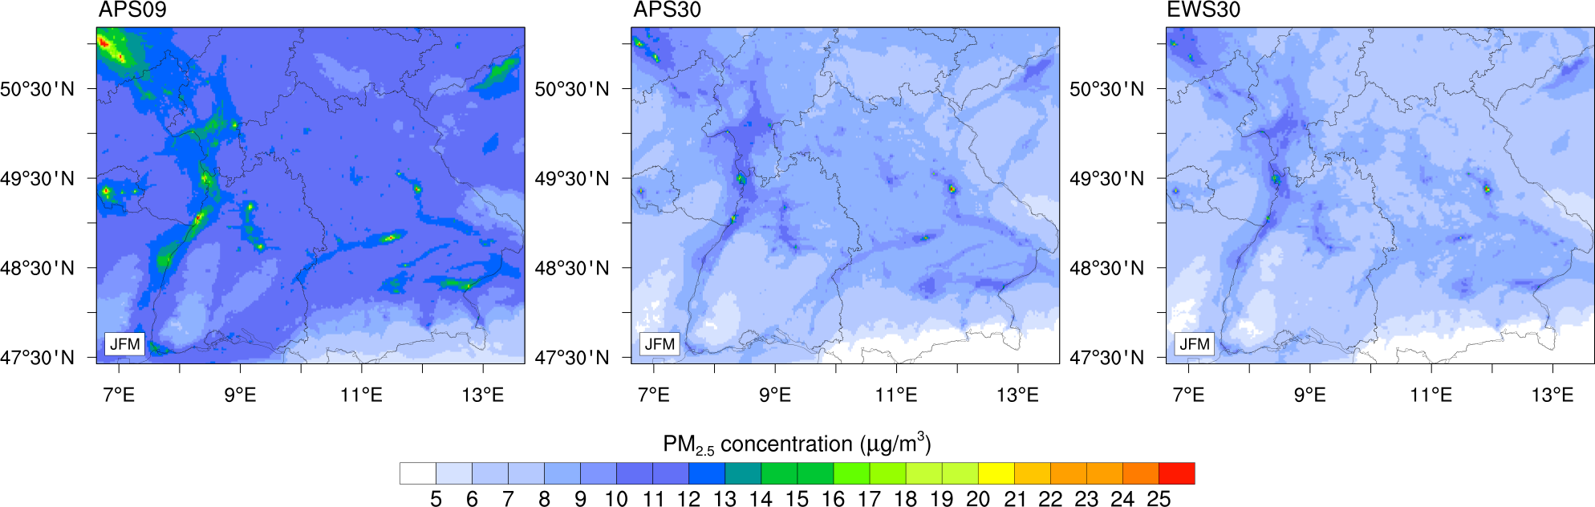
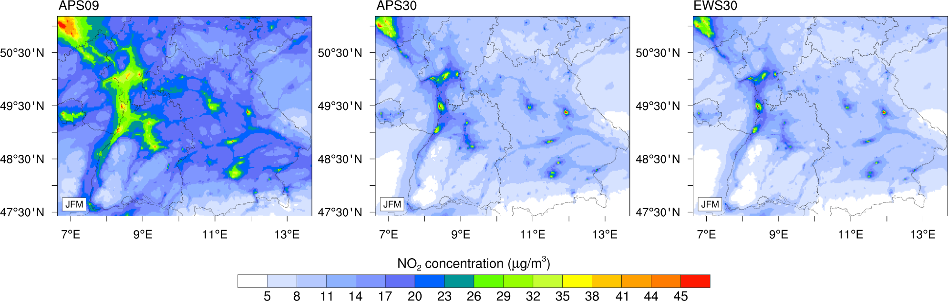
Model predicted concentrations under alternative scenarios
Meteorology is based on 2009 !!

Slide 7
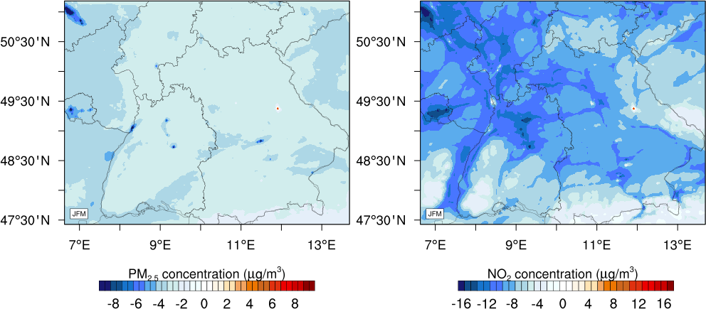
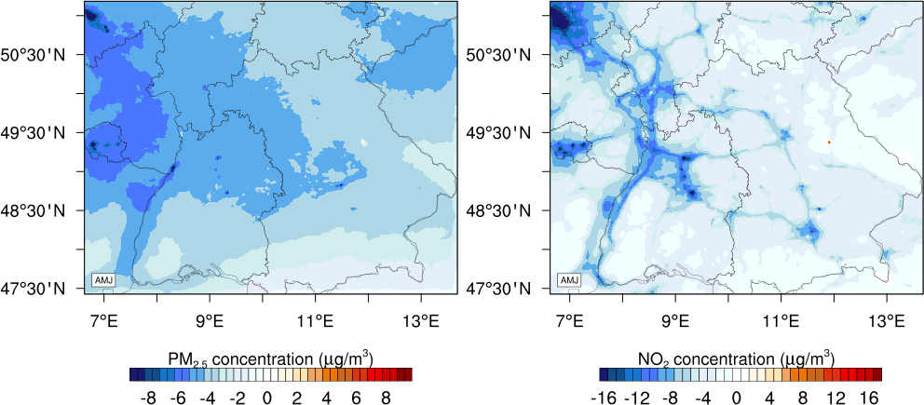
Projected changes in concentrations from 2009 to 2030
Differences in Jan-Mar
APS09-EWS30
Differences in Apr-Jun
(no climate effects considered)

Slide 8
Mortality burden (attributable deaths)
Inputs
      Modelled pollutant concentration(s)
      Concentration-response function UR per u
      Where UR = Unit Risk; u = unit
      Age-specific population and mortality data
      Annual, population-weighted concentration: x
Calculations
      Attributable deaths
        Relative Risk RR(x) = UR(u)^{x/u}
        Population Attributable Fraction (of deaths): PAF = (1 – RR) / RR
        Attributable deaths AD = PAF * total deaths

Slide 9
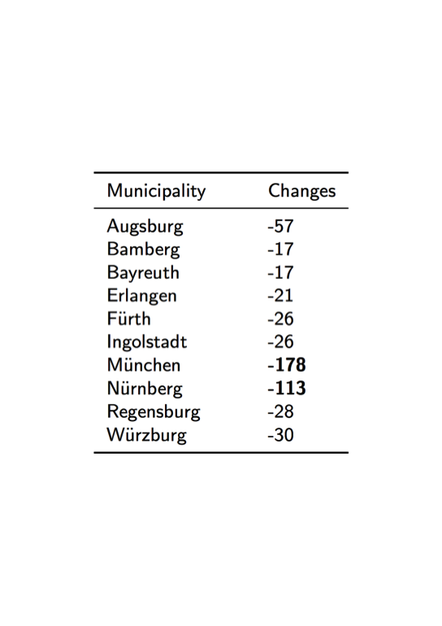
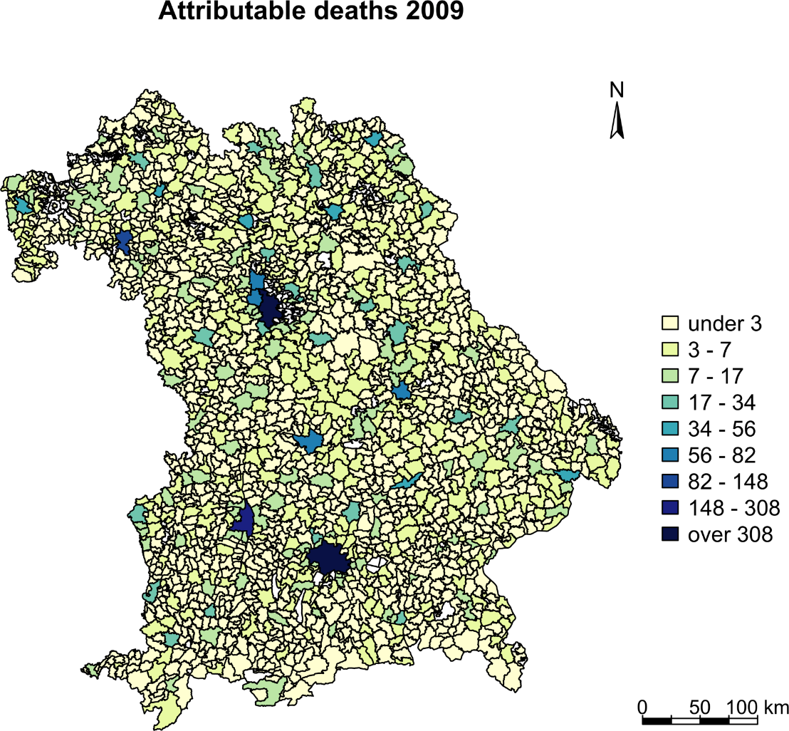
Number of deaths attributable to PM2.5
Future changes in deaths due to PM_{2.5}: EWS30 scenario

Slide 10
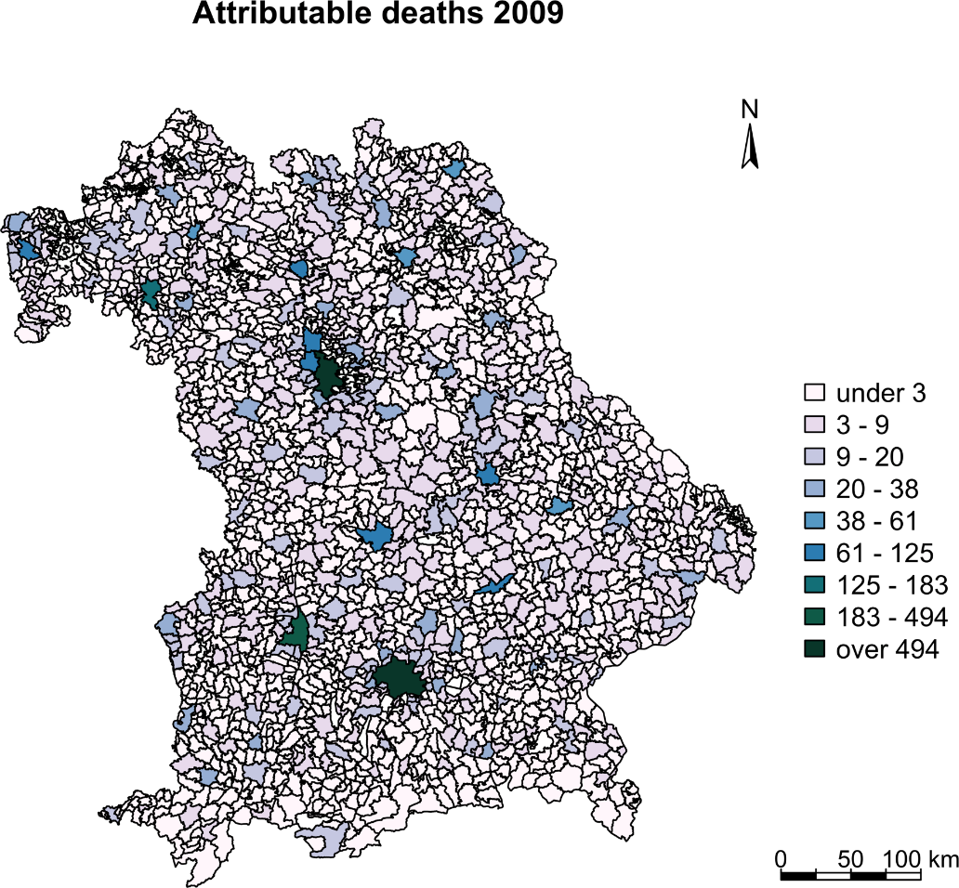
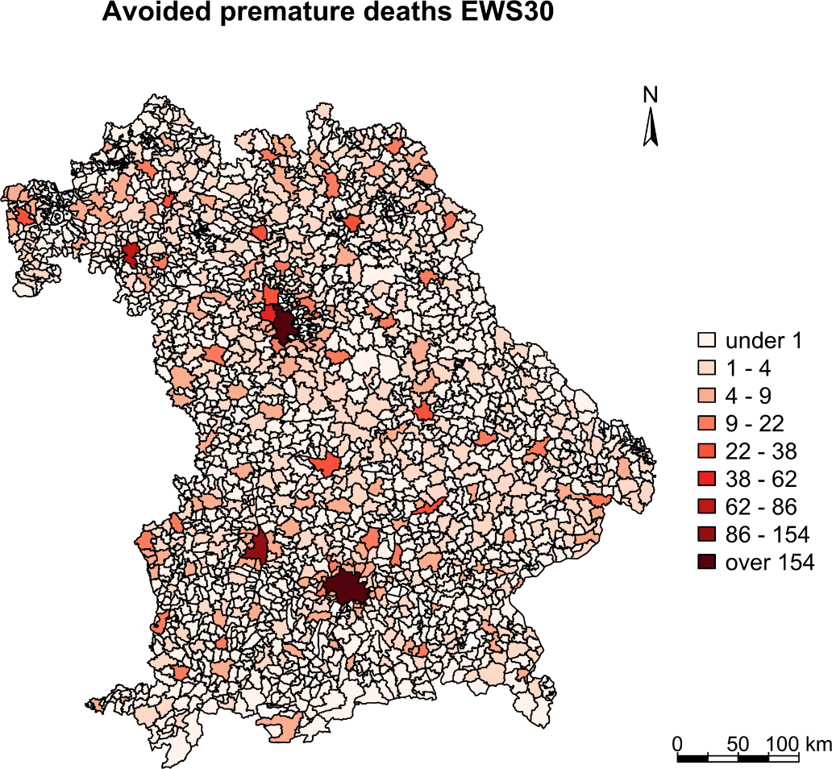
Number of deaths attributable to NO₂

Slide 11
Conclusion and Outlook
Regional air quality simulations have been conducted to estimate the effects of changing emissions on AQ
The simulations predicted significant decreases in PM_{2.5} and NO₂
Reductions in premature deaths were found under EWS30 scenario
Next steps?
  Estimation of the changes in the PM_{2.5} and NO₂ public health burden for APS30
  Assessment of health impacts of ozone
  Climate Change effects

Slide 12
Thank you very much
for your attention !
Acknowledgements
GRACE Graduate School for Climate and Environment
MICMoR Helmholtz Research School on Mechanisms and Interactions of Climate Change in Mountain Regions
TNO Netherlands Organisation for Applied Scientific Research for the Emission-Inventory

