Slide 1
Examining Changes to Extreme Temperatures and Precipitation Across the U.S. Through 2100
Tanya L. Spero¹, Megan S. Mallard¹, Stephany M. Taylor^{1,2},
and Christopher G. Nolte¹
¹U.S. EPA Office of Research and Development, Research Triangle Park, NC
²ORISE
Presented to:
15th Annual CMAS Conference
Chapel Hill, NC
26 October 2016

Slide 2
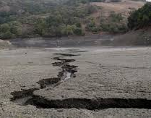
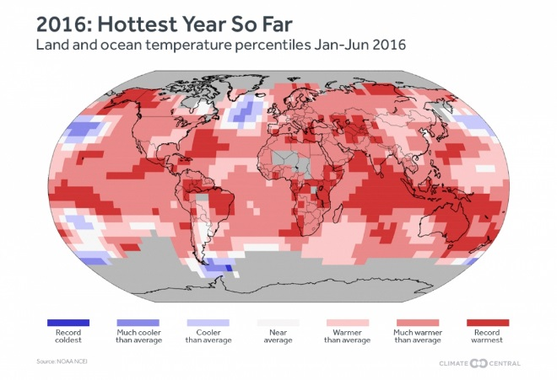
Responding to a Changing Climate
EPA needs better tools to:
  understand how climate change can affect air pollutants regulated by NAAQS
  prepare for future extreme weather events at regional and local levels
  EPA/ORD modeling techniques improve simulated regional climate:
    Atmospheric circulation
    Summertime precipitation
    Effects of lakes
    Extreme events
  Small ensemble of regional climate and air quality data dynamically downscaled from global models that contributed to the IPCC Fifth Assessment Report.
  Future regional climate used with CMAQ to examine projected changes to human health and ecosystems.
Parched river bed in
California. (LA Times)
Figure courtesy NOAA and Climate Central

Slide 3
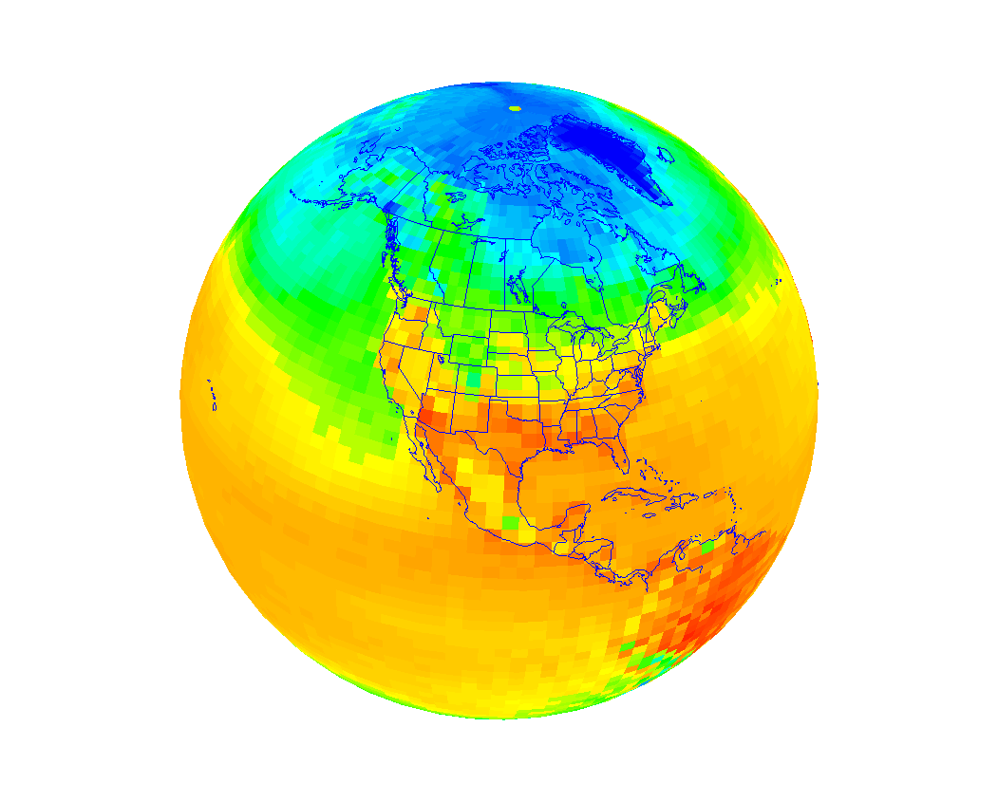
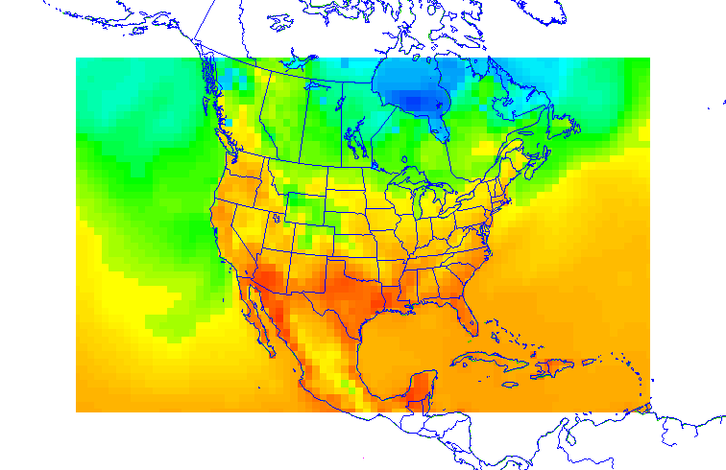
Developing Downscaling Methodology
for Environmental Applications
Global climate model creates coarse gridded future climate with world-wide coverage.
Use historical data sets to develop downscaling methodology
Apply downscaling methodology to future climate simulations
Examine air quality-climate change interactions, as well as impacts on
human exposure, energy demands, ecosystems, etc.
GCM
RCM
Regional climate model generates gridded higher-resolution climate predictions over focal area.

Slide 4
Downscaling Configuration
Global climate: NCAR/DOE Community Earth System Model (CESM)
  Approximately 1° × 1° resolution
  6-h atmospheric data
  Monthly surface data
  Data from CMIP5 (most current public archive)
Regional climate: Weather Research and Forecasting (WRF) Model
  36-km North American domain, 34 layers, hourly output
  Continuous simulations (no reinitialization)
  Downscaling options (e.g., Spero et al., J. Climate, 2016)
    Spectral nudging, YSU PBL, NOAH LSM, USGS LU
Study periods
  “Historical” period: 1995 – 2005
  Future periods: 2025 – 2100 following RCP4.5 and RCP8.5

Slide 5
Representative Concentration Pathways
RCPs are radiative forcing in W m⁻² at 2100 relative to pre-industrial levels.
They include socio-economic and emissions drivers from existing literature.
RCPs were used in CMIP5 global models for the IPCC 5th Assessment Report.
van Vuuren et al., Climatic Change, 2011

Slide 6
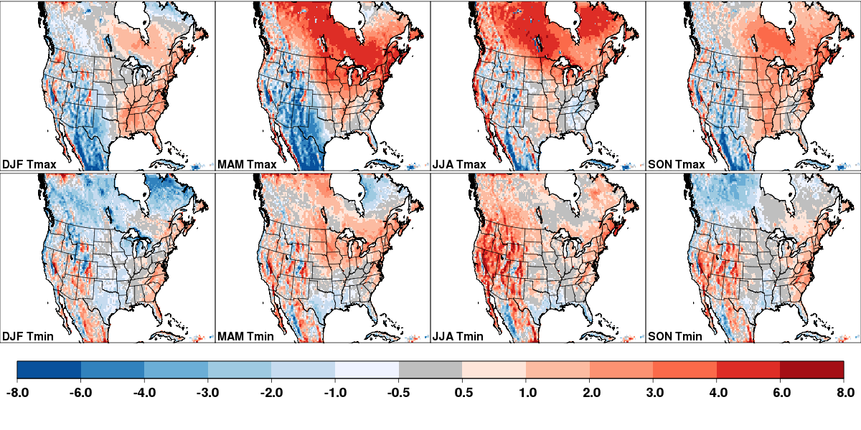
2-m Temperature Bias
CESM-WRF (1995–2005) vs. NARR Reanalysis
**GCM “historical” data do not correspond directly to observed conditions.**
DJF
MAM
JJA
SON
T_{max}
DJF
MAM
JJA
SON
T_{min}
CESM (downscaled by WRF) is biased for the “historical” period.
Biases are not systematic in T_{max} and T_{min} either spatially or by season.
Biases are less pronounced in US than in Canada Mexico.

Slide 7
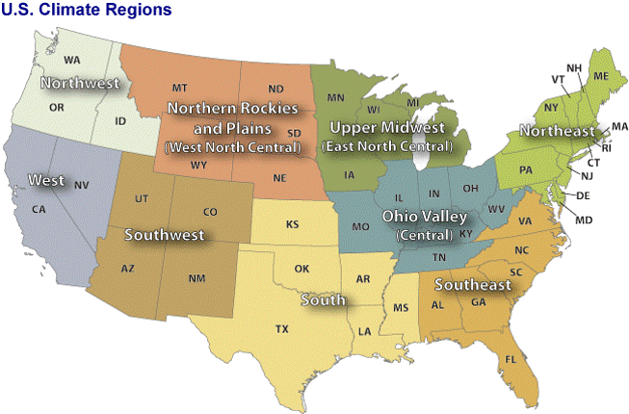
Regional Analysis
using NCEI U.S. Climate Regions
www.ncdc.noaa.gov

Slide 8
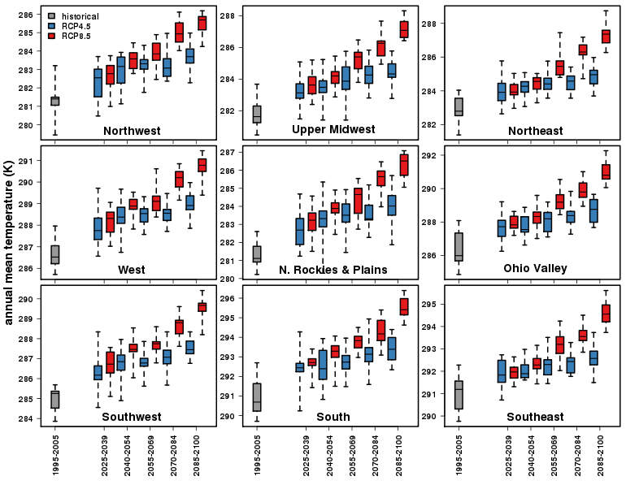
Annual Mean Temperature

Slide 9
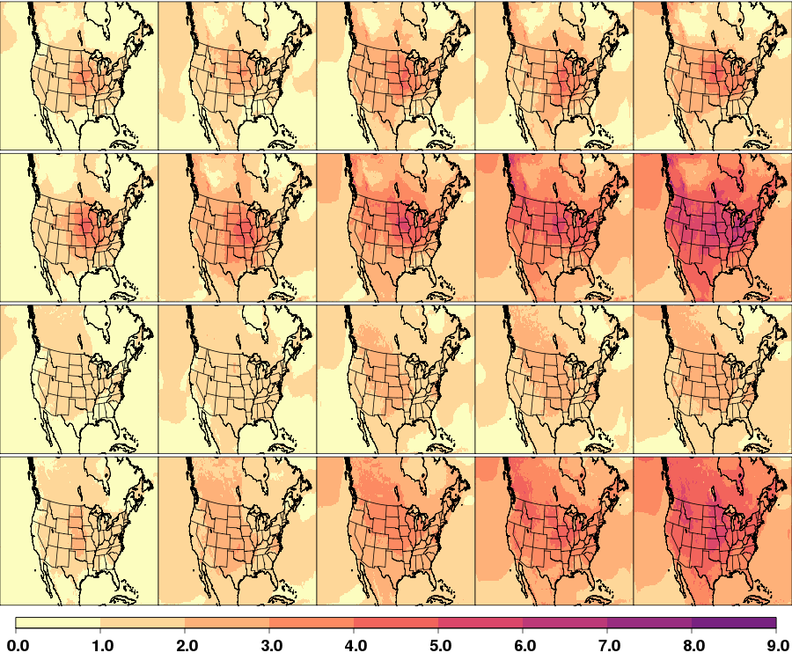
Changes in T_{max} & T_{min} (K): Summer (JJA)
2035
2050
2065
2080
2095
RCP4.5
Maximum
Temperature
RCP8.5
RCP4.5
Minimum
Temperature
RCP8.5

Slide 10
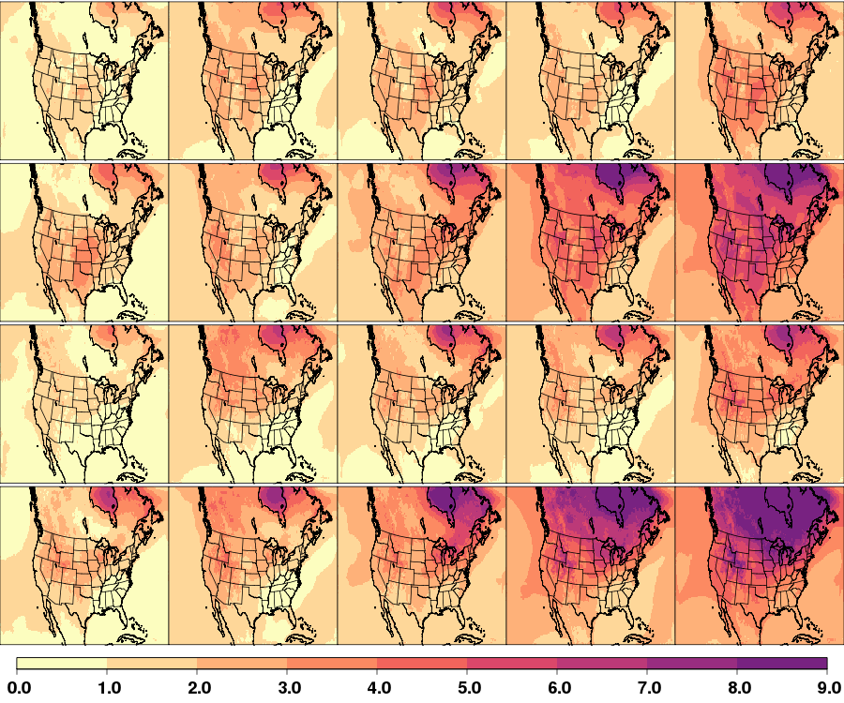
Changes in T_{max} & T_{min} (K): Winter (DJF)
2035
2050
2065
2080
2095
RCP4.5
Maximum
Temperature
RCP8.5
RCP4.5
Minimum
Temperature
RCP8.5

Slide 11
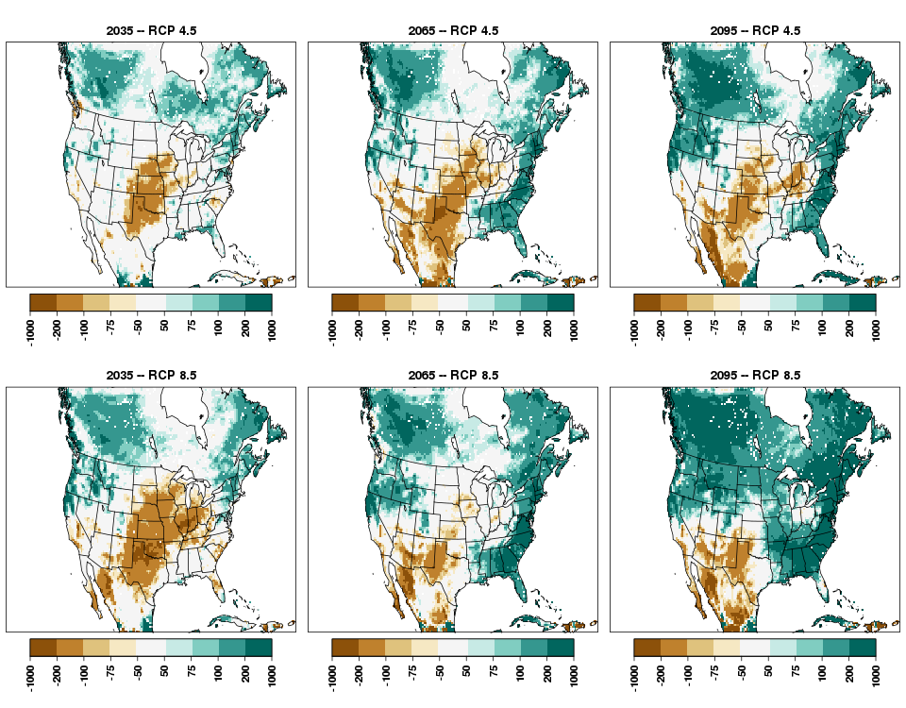
Change in Annual Precip (mm)
RCP
4.5
2035
2065
2095
RCP
8.5
2035
2065
2095

Slide 12
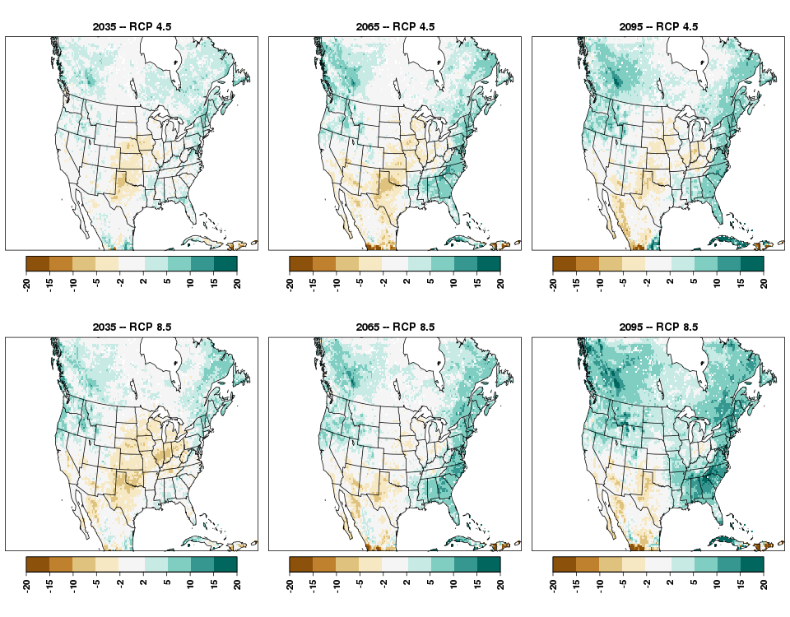
Change in Days with Precip > 0.5 in
RCP
4.5
2035
2065
2095
RCP
8.5
2035
2065
2095

Slide 13
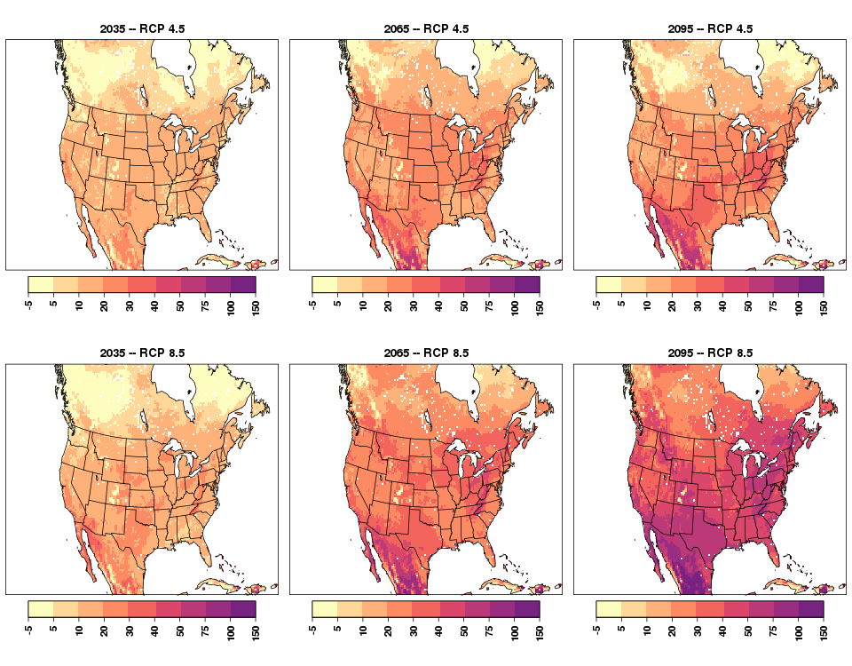
Change in Summer Days (T_{max} > 25°C)
RCP
4.5
2035
2065
2095
RCP
8.5
2035
2065
2095

Slide 14
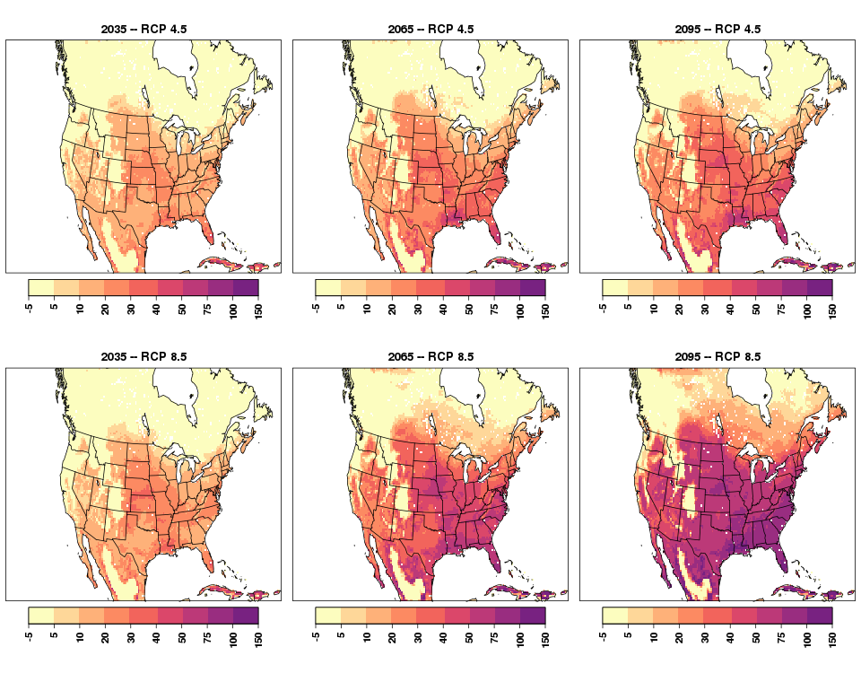
Change in Tropical Nights (T_{min} > 20°C)
RCP
4.5
2035
2065
2095
RCP
8.5
2035
2065
2095

Slide 15
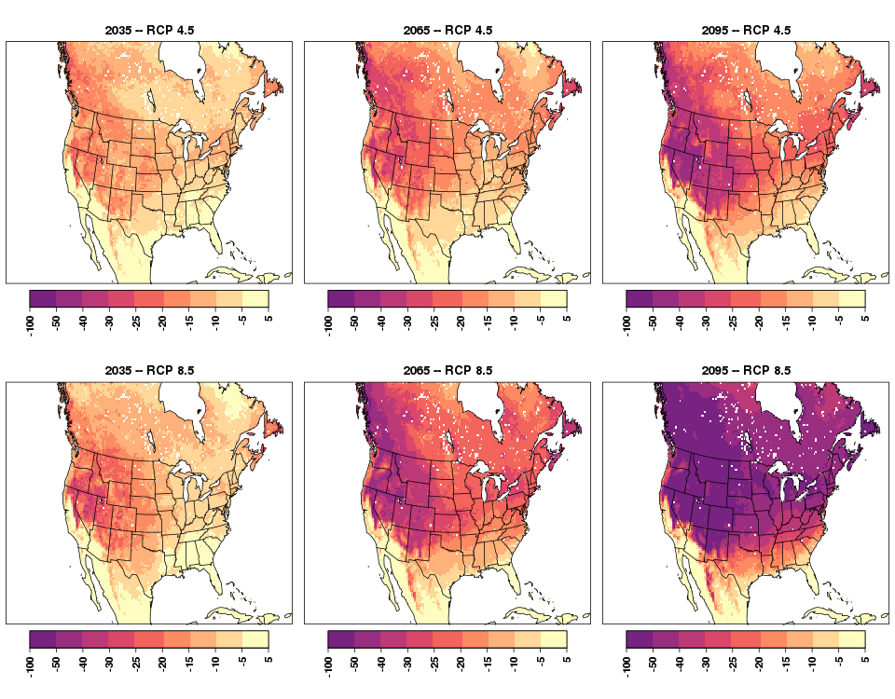
Change in Frost Days (T_{min} < 0°C)
RCP
4.5
2035
2065
2095
RCP
8.5
2035
2065
2095

Slide 16
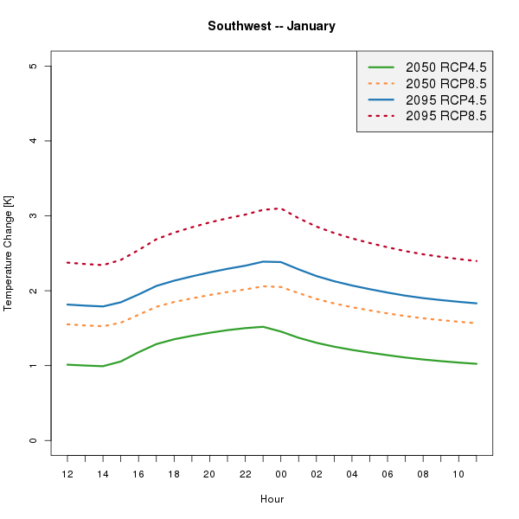
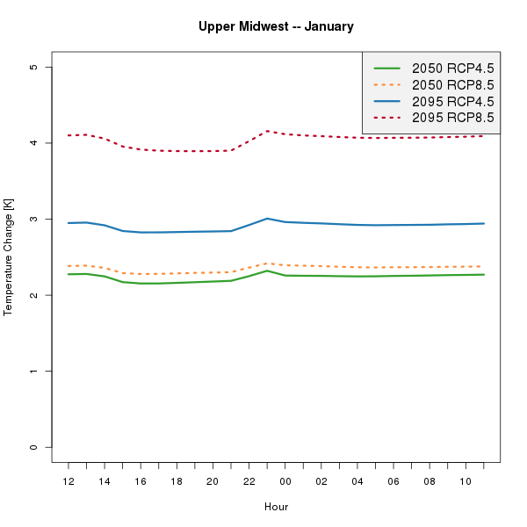
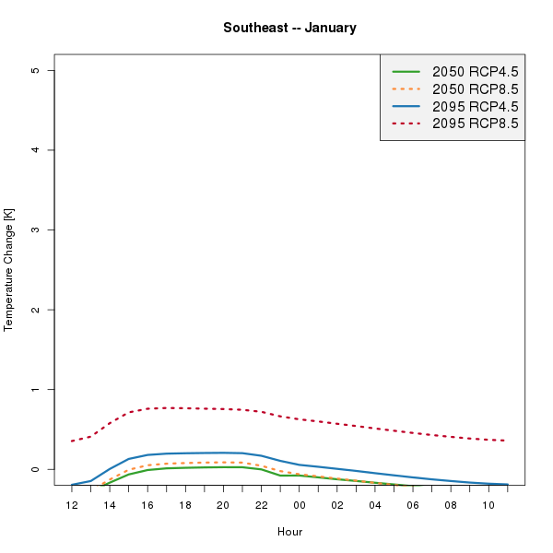
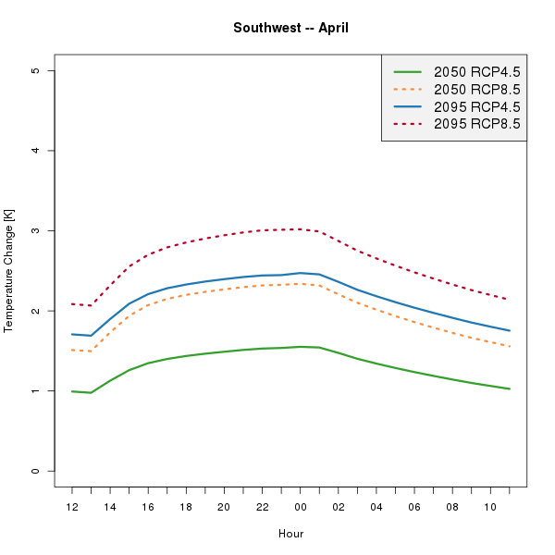
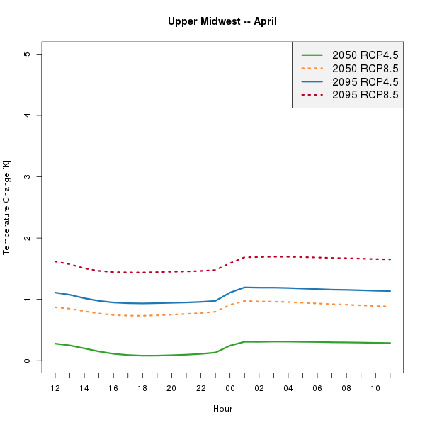
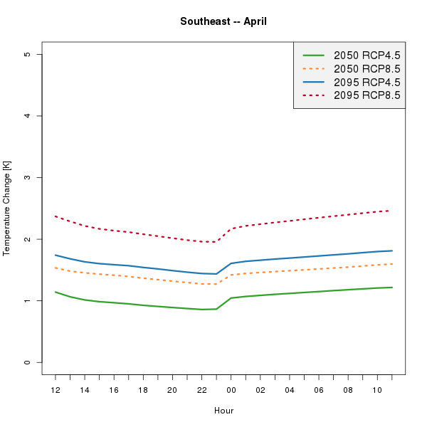
Jan and Apr: Regional Changes in
Diurnal 2-m Temperature (K)
Southwest
Upper Midwest
Southeast
5
5
5
4
4
4
3
3
3
January
2
2
2
1
1
1
0
0
0
5
5
5
4
4
4
3
3
3
April
2
2
2
1
1
1
0
0
0

Slide 17
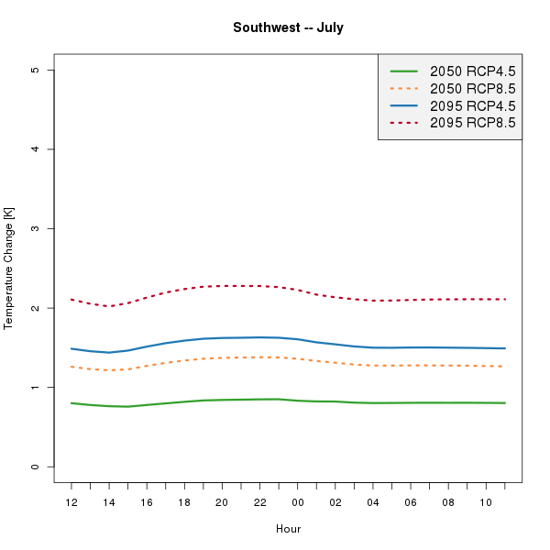
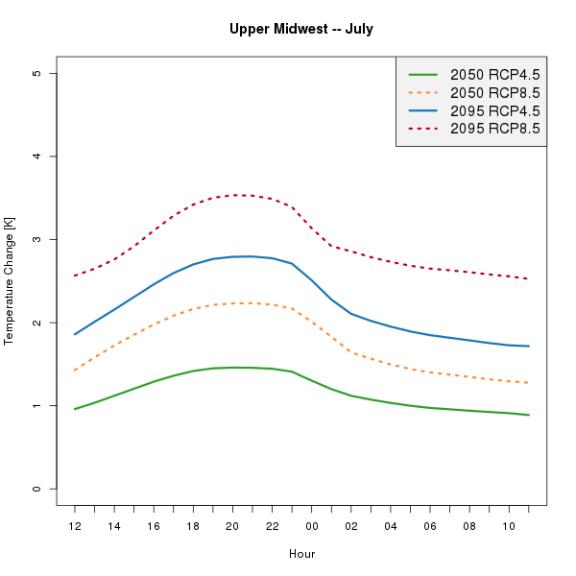
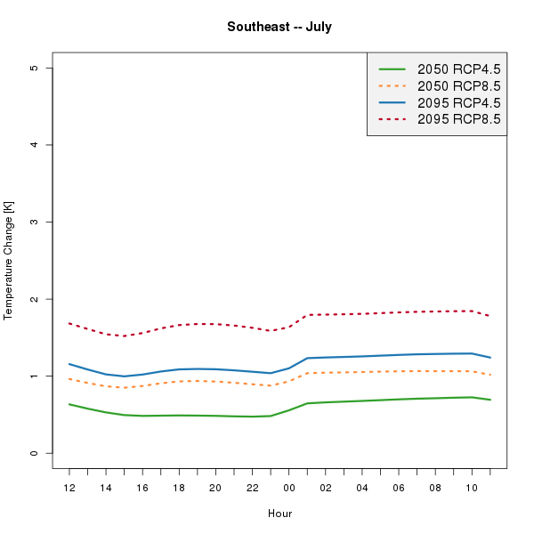
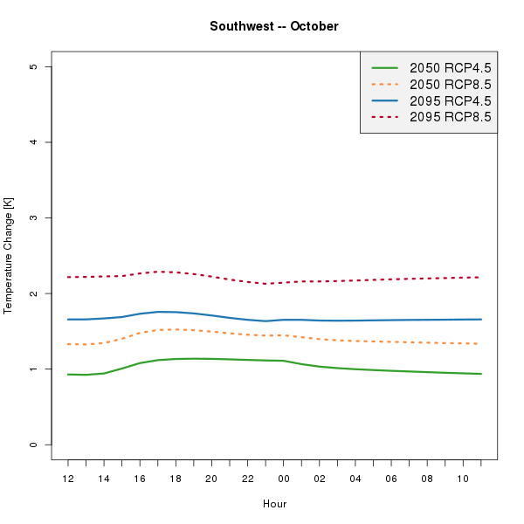
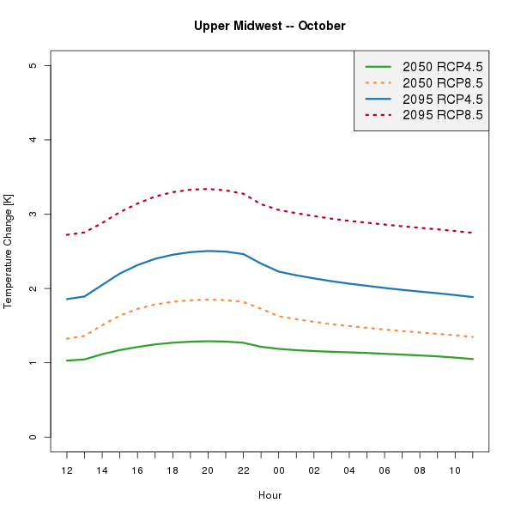
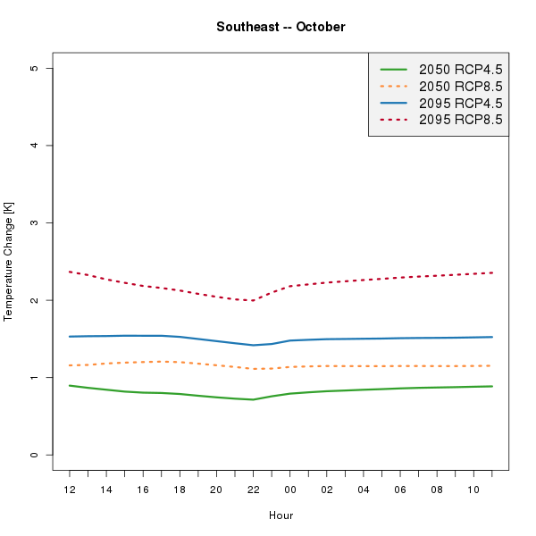
Jul and Oct: Regional Changes in
Diurnal 2-m Temperature (K)
Southwest
Upper Midwest
Southeast
5
5
5
4
4
4
3
3
3
July
2
2
2
1
1
1
0
0
0
5
5
5
4
4
4
3
3
3
October
2
2
2
1
1
1
0
0
0

Slide 18
As Climate is Changing, Extremes are Becoming More Pronounced.
Temperature in downscaled CESM (using WRF) follows theory for RCPs.
  More intense changes in extremes with RCP8.5 compared with RCP4.5.
Changes in temperature and precipitation threshold values are locally accentuated.
  Gradients in terrain and near coastlines for temperature and precipitation.
Changes are non-uniform spatially, seasonally, and diurnally.
  Value of using high-resolution downscaled data.
Downscaled future climate and air quality from CMAQ used in EPA’s CIRA2.0 and 4th National Climate Assessment.

