Slide 1
Investigating Causes of CMAQ Under-Predictions of Sea Salt Aerosol in the San Francisco Bay Area
Su-Tzai Soong, Cuong Tran, David Fairley, Yiqin Jia, Saffet Tanrikulu
Bay Area Air Quality Management District - San Francisco, CA
Christopher Emery, Andrew Wentland, Bonyoung Koo
Ramboll Environ - Novato, CA

Slide 2
Motivation
Conducting a health impacts study of PM2.5 in the Bay Area
Simulating PM2.5 year-round to prepare input to BenMAP
  Under-predicting PM2.5 during summer, especially in May
  Primarily due to under-prediction of sea salt
Sea salt contributes 8% to annual PM2.5 in the Bay Area
On some days, it contributes up to 50%

Slide 3
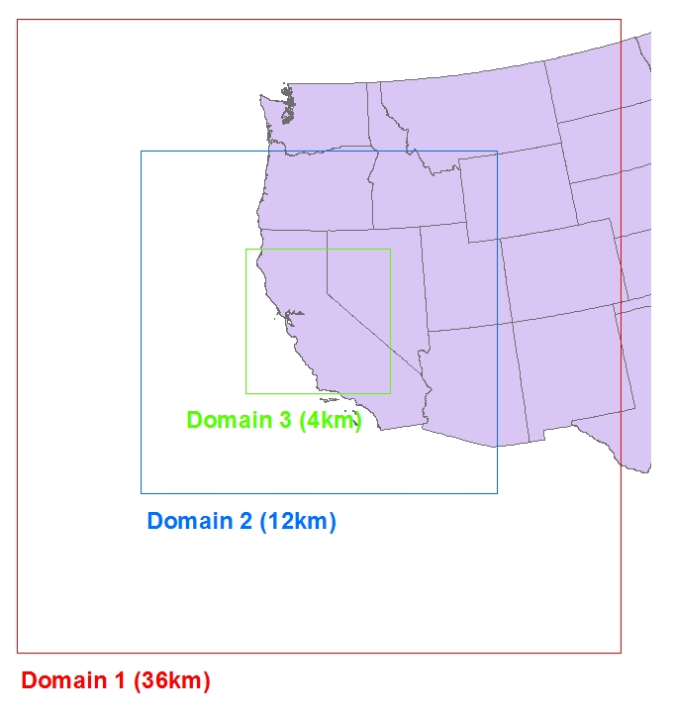
Modeling Approach
WRF
  36-12-4 km nested domains
CMAQv5.0.2 (original sea salt algorithm)
    Majority of simulations
    4 km, no nesting
  MOZART boundary conditions
CMAQv5.0.2 and CMAQv5.1 (revised sea salt algorithm)
Comparison of model results with observations

Slide 4
Observed and Simulated PM2.5
San Francisco Bay Area Mean

Slide 5
Daily Differences Between Measured and Simulated Sea Salt
Boxplots across All CA Stations

Slide 6
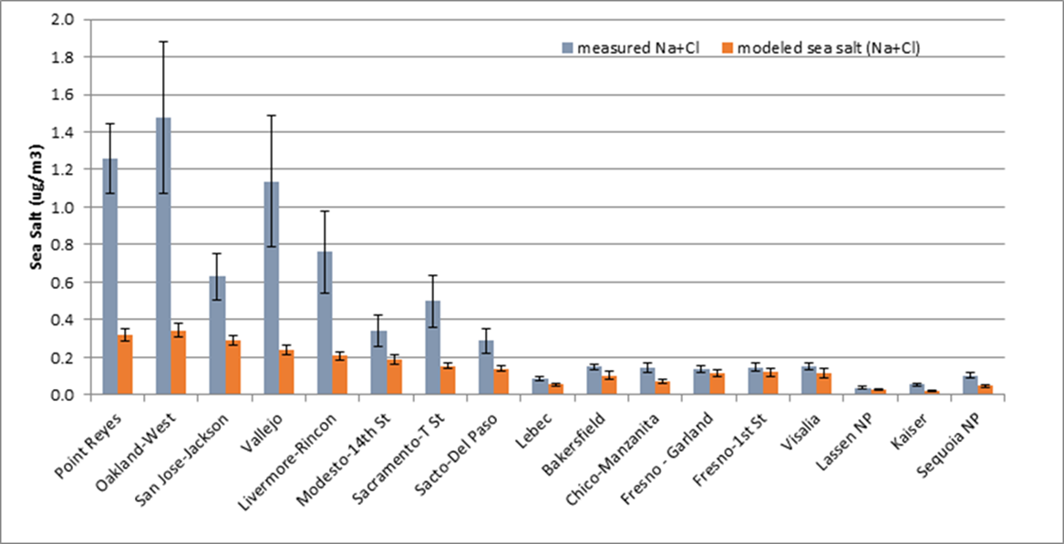
Observed and Simulated Sea Salt
Annual Mean at Selected Stations

Slide 7
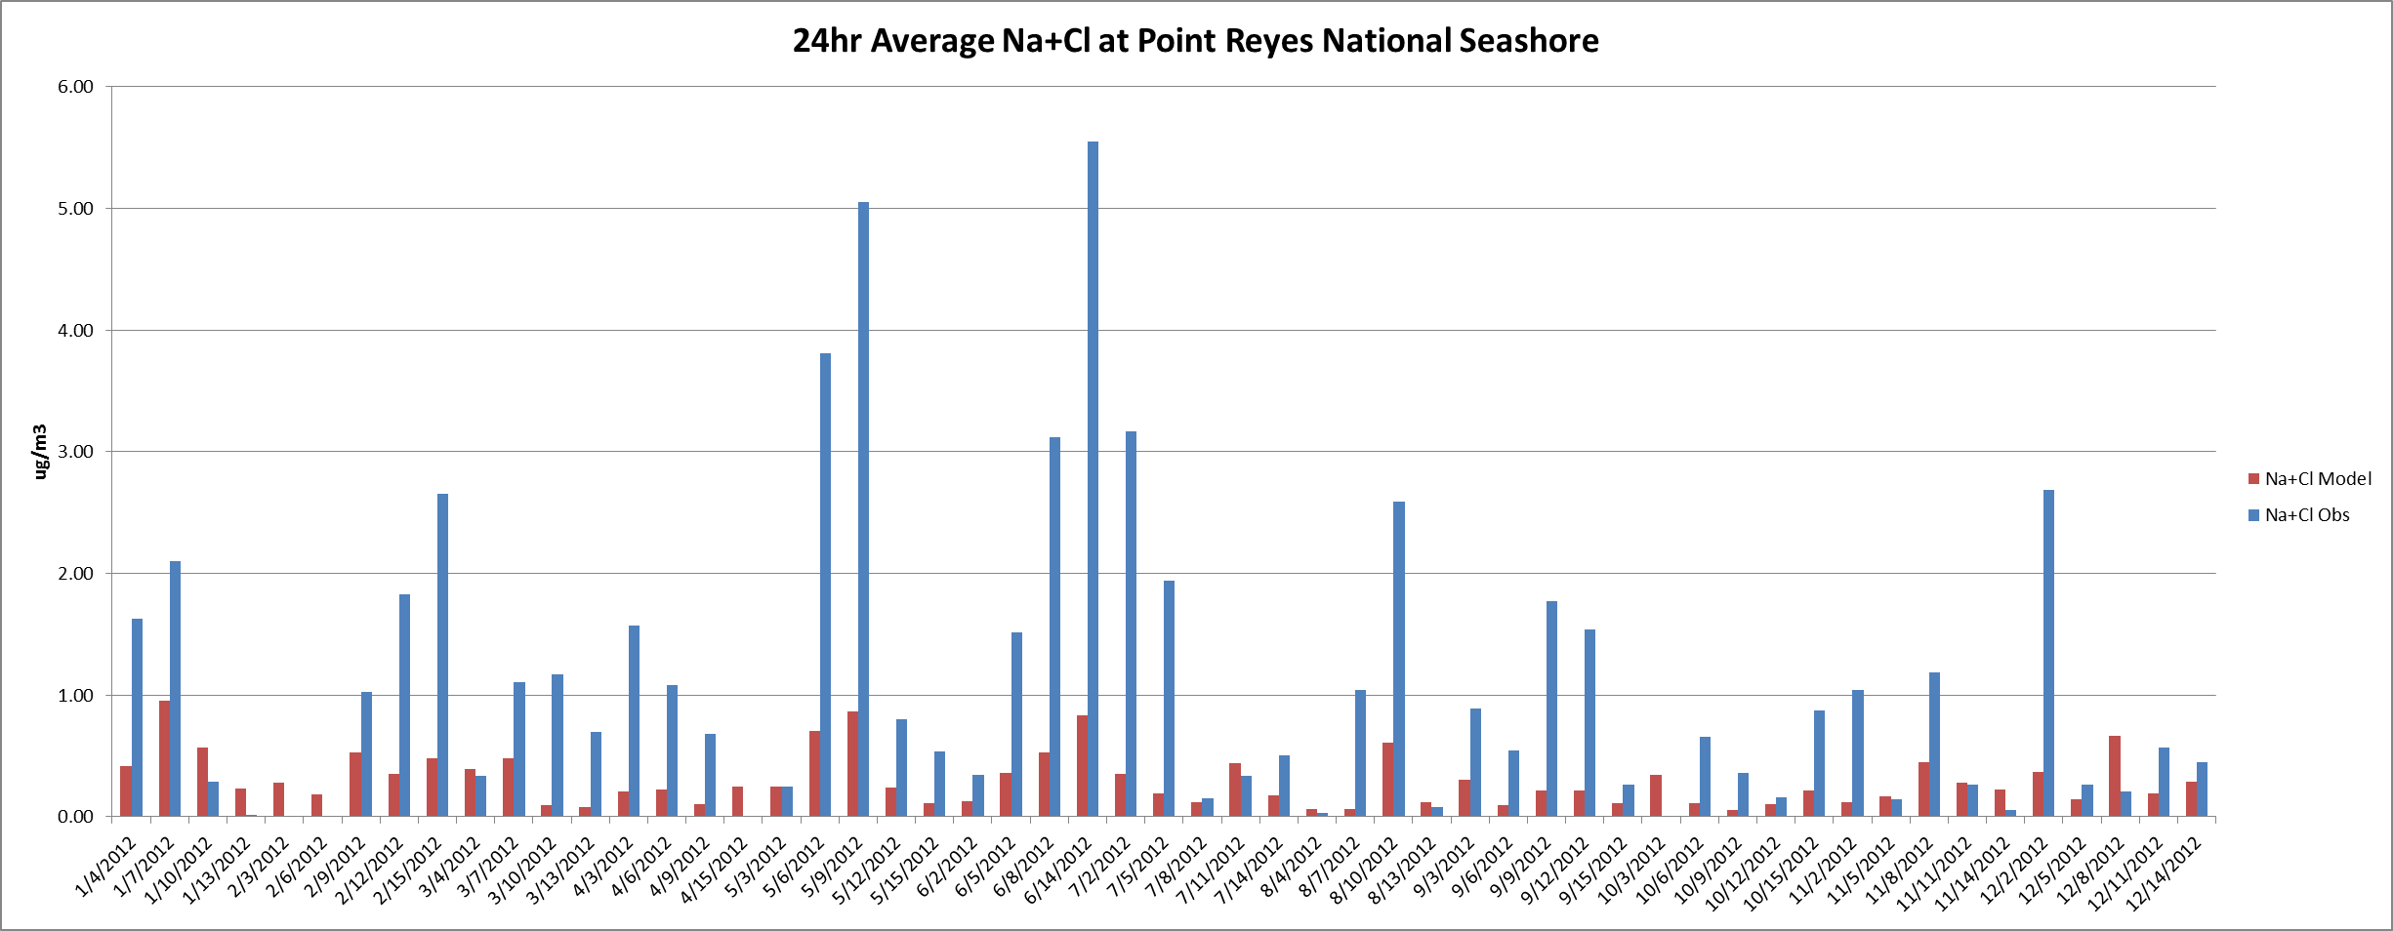
Daily Average Sea Salt
Point Reyes

Slide 8
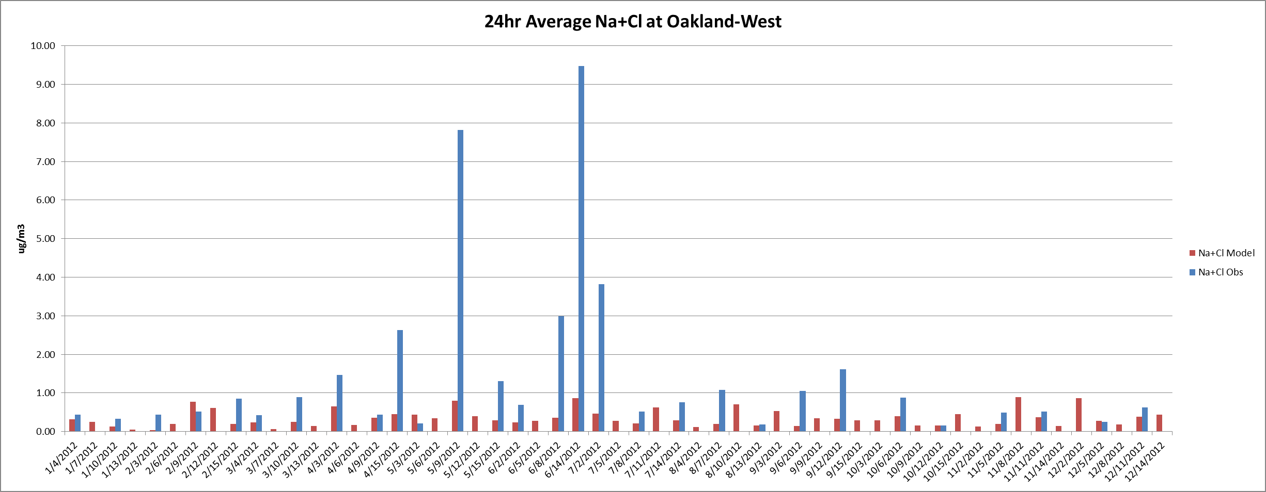
Daily Average Sea Salt
West Oakland

Slide 9
Factors Investigated
Relationship between wind and sea salt
Effect of modeling domain size on sea salt distribution
Sea spray emission algorithm in CMAQ
Potential lateral boundary problem for PM species

Slide 10
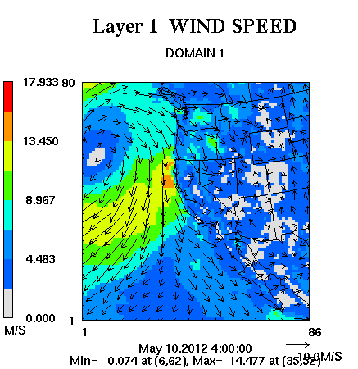
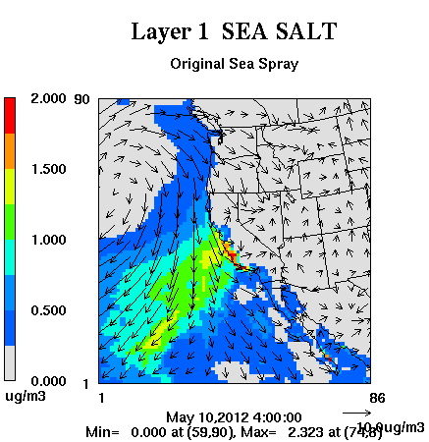
Simulated Wind and Sea Salt (36 KM Domain)
4 UTC May 10, 2012

Slide 11
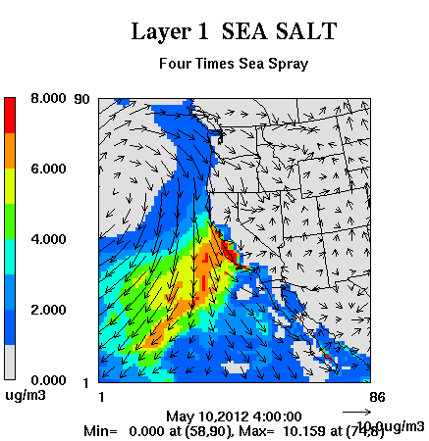
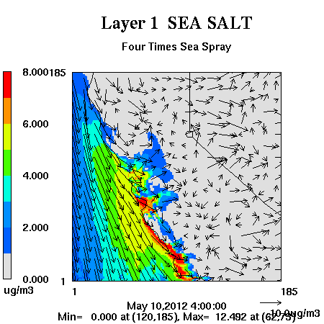
Simulated Sea Salt (36 KM and 4 KM Domains)
4 Times Sea Spray

Slide 12
Simulated Sea Salt with 4 Times Sea Spray
Average of West Oakland, Vallejo and Livermore

Slide 13
Summary and Conclusion
Contribution of sea salt to ambient PM is significant in the Bay Area
Both versions of CMAQ are underestimating PM from sea salt:
  CMAQv5.0.2 by factors of 2-10
  CMAQv5.1 by factors of 2-5
Increasing sea spray emissions by a factor of 4 significantly improves modeled sea salt concentrations
We have encountered a lateral boundary problem for PM species in CMAQv5.1 using s07-ae6.
Need help from CMAQ developers to minimize both errors

Slide 14
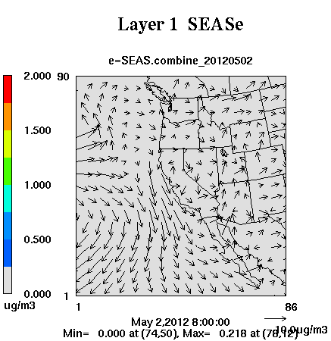
Hourly Sea Salt Animation (Domain 1)

Slide 15
Possible CMAQv5.1 Lateral Boundary Problem
CMAQv5.0.2 S99-ae5 MOZART BC
CMAQv5.1 s07-ae6 MOZART BC

Slide 16
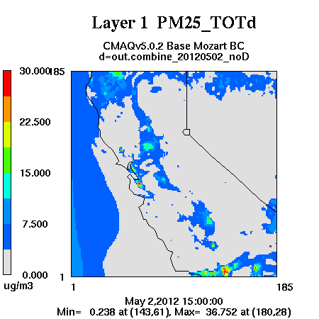
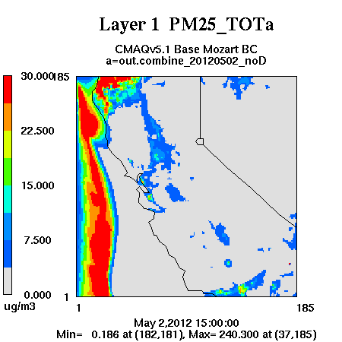
PM2.5
CMAQv5.0.2 vs CMAQv5.1

Slide 17
Clean Boundary Condition Experiments
CMAQv5.0.2 S99-ae5 Reducing MOZART BC to 1% of the original values
CMAQv5.1 s07-ae6 Reducing MOZART BC to 1% of the original values

Slide 18
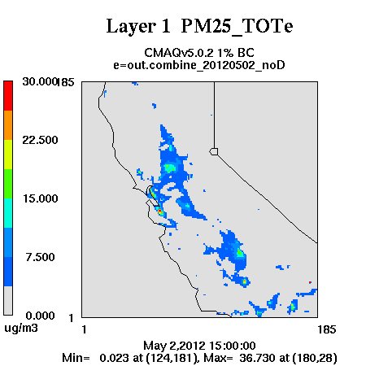
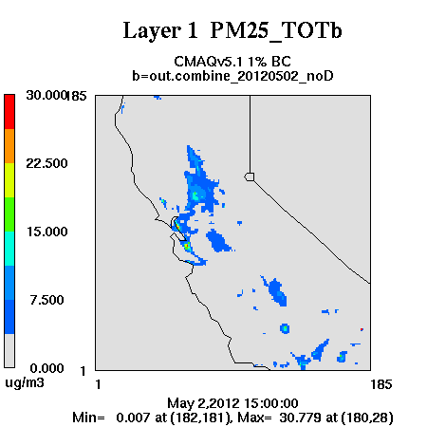
Experiments with 1% BC

Slide 19
Fixed Boundary Condition Experiments
CMAQv5.0.2 S99-ae5 Reducing MOZART BC to 1% of the original values
Set ANAJ = 2.3 ACLJ = 3.55 A25J = 1 NO2 = .002 O3 = .01
CMAQv5.1 s07-ae6 Reducing MOZART BC to 1% of the originalvalues
Set ANAJ = 2.3 ACLJ = 3.55 AOTHRJ = 1 NO2 = .002 O3 = .01

Slide 20
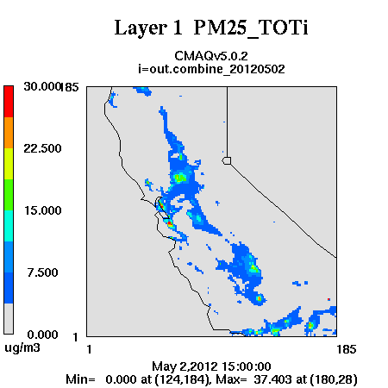
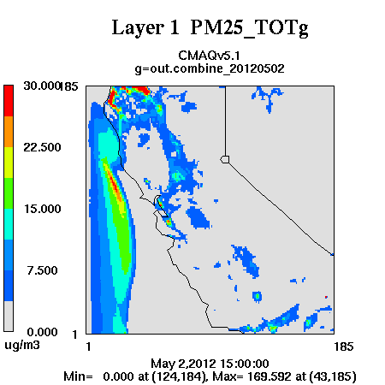
Experiments with 1% BC and
ANAJ = 2.3 ACLJ = 3.55 OTR = 1 NO = .002 O3 = .01

Slide 21
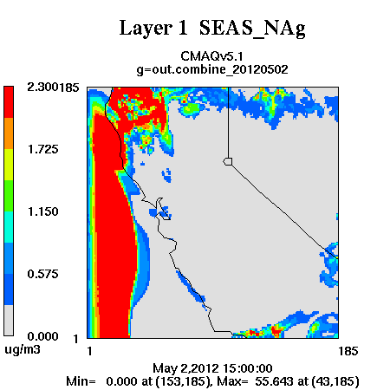
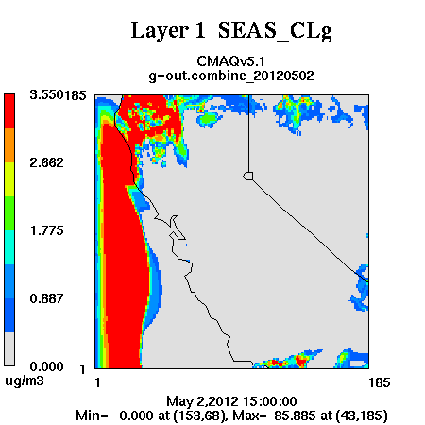
ANAJ and ACLJ Have Identical Patterns

Slide 22
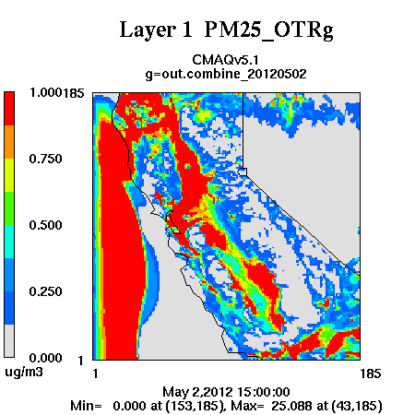
OTR has Identical Pattern Too

Slide 23
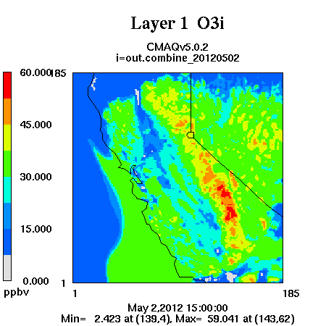
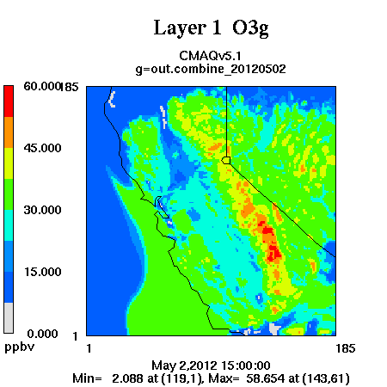
There is no problem in O3

