Slide 1
Ongoing EPA efforts to evaluate modeled NOy budgets
Heather Simon¹, Darrell Sonntag², Megan Beardsley², Kristen Foley³, Chris Owen¹, Claudia Toro⁴, Norm Possiel¹, Alison Eyth¹, Pat Dolwick¹
¹ US EPA, Office of Air Quality Planning and Standards, RTP, NC
² US EPA, Office of Transportation and Air Quality, Ann Arbor, MI
³ US EPA, National Exposure Research Laboratory, RTP, NC
⁴ ORISE Research Participant, Hosted by the US EPA, Office of Transportation and Air Quality, Ann Arbor MI

Slide 2
Air Quality/Emission Inventory Evaluation Studies in the Literature
Reference | Location Evaluated | Year Evaluated | Conclusion
Brioude et al (2011); Kim et al (2011) | Texas | 2006 using 2005 NEI | Urban Houston: good NOx performance Houston Ship Channel: NOx too high
Marr et al (2013) | Norfolk, VA | 2008 | Near-road measurements agreed well with onroad NOx emissions
Anderson et al (2014) | Baltimore | 2011 using projected 2005 NEI | NOx emissions are overestimated by 51-70% in Maryland
Kota et al (2014) | Houston | 2006 | NOx overpredicted in areas dominated by mobile sources
Kemball-Cook et al (2015) | Texas | 2006 | Two satellite retrievals lead to different conclusions on whether emissions were too high or too low
McDonald and McKeen (2016) | Southeast US | 2013 using 2011 NEI | Mobile source NOx emissions in the NEI 2011 are high by ~50% compared to a fuel-based inventory
Souri et al (2016) | Houston | 2011 | Area NOx 44% high, mobile NOx 30% high, point source NOx 60% high, soil NO 52% low, rural area NOx 37% low
Travis et al (2016) | Southeast US and CONUS | 2013 using 2011 NEI | NOx emissions are too high by 50% in the Southeast US
In recent years, there have been several published studies evaluating modeled or emitted NOx/NOy in the US.
These studies use different methodologies and cover different portions of the US.
Many, but not all, recent comparisons of measured ambient concentrations to modeled or inventory values show a high bias in NOx or NOy
To improve model agreement, some researchers have proposed reducing mobile-source NOx by 30% to 70%
While individual papers have uncertainties and limitations, together they suggest there may be problems with ambient NOy estimates produced by current modeling systems
Notes:
Many studies enabled by recent field campaigns, TEXAQS II, DISCOVER-AQ, SENEX/SOAS

Slide 3
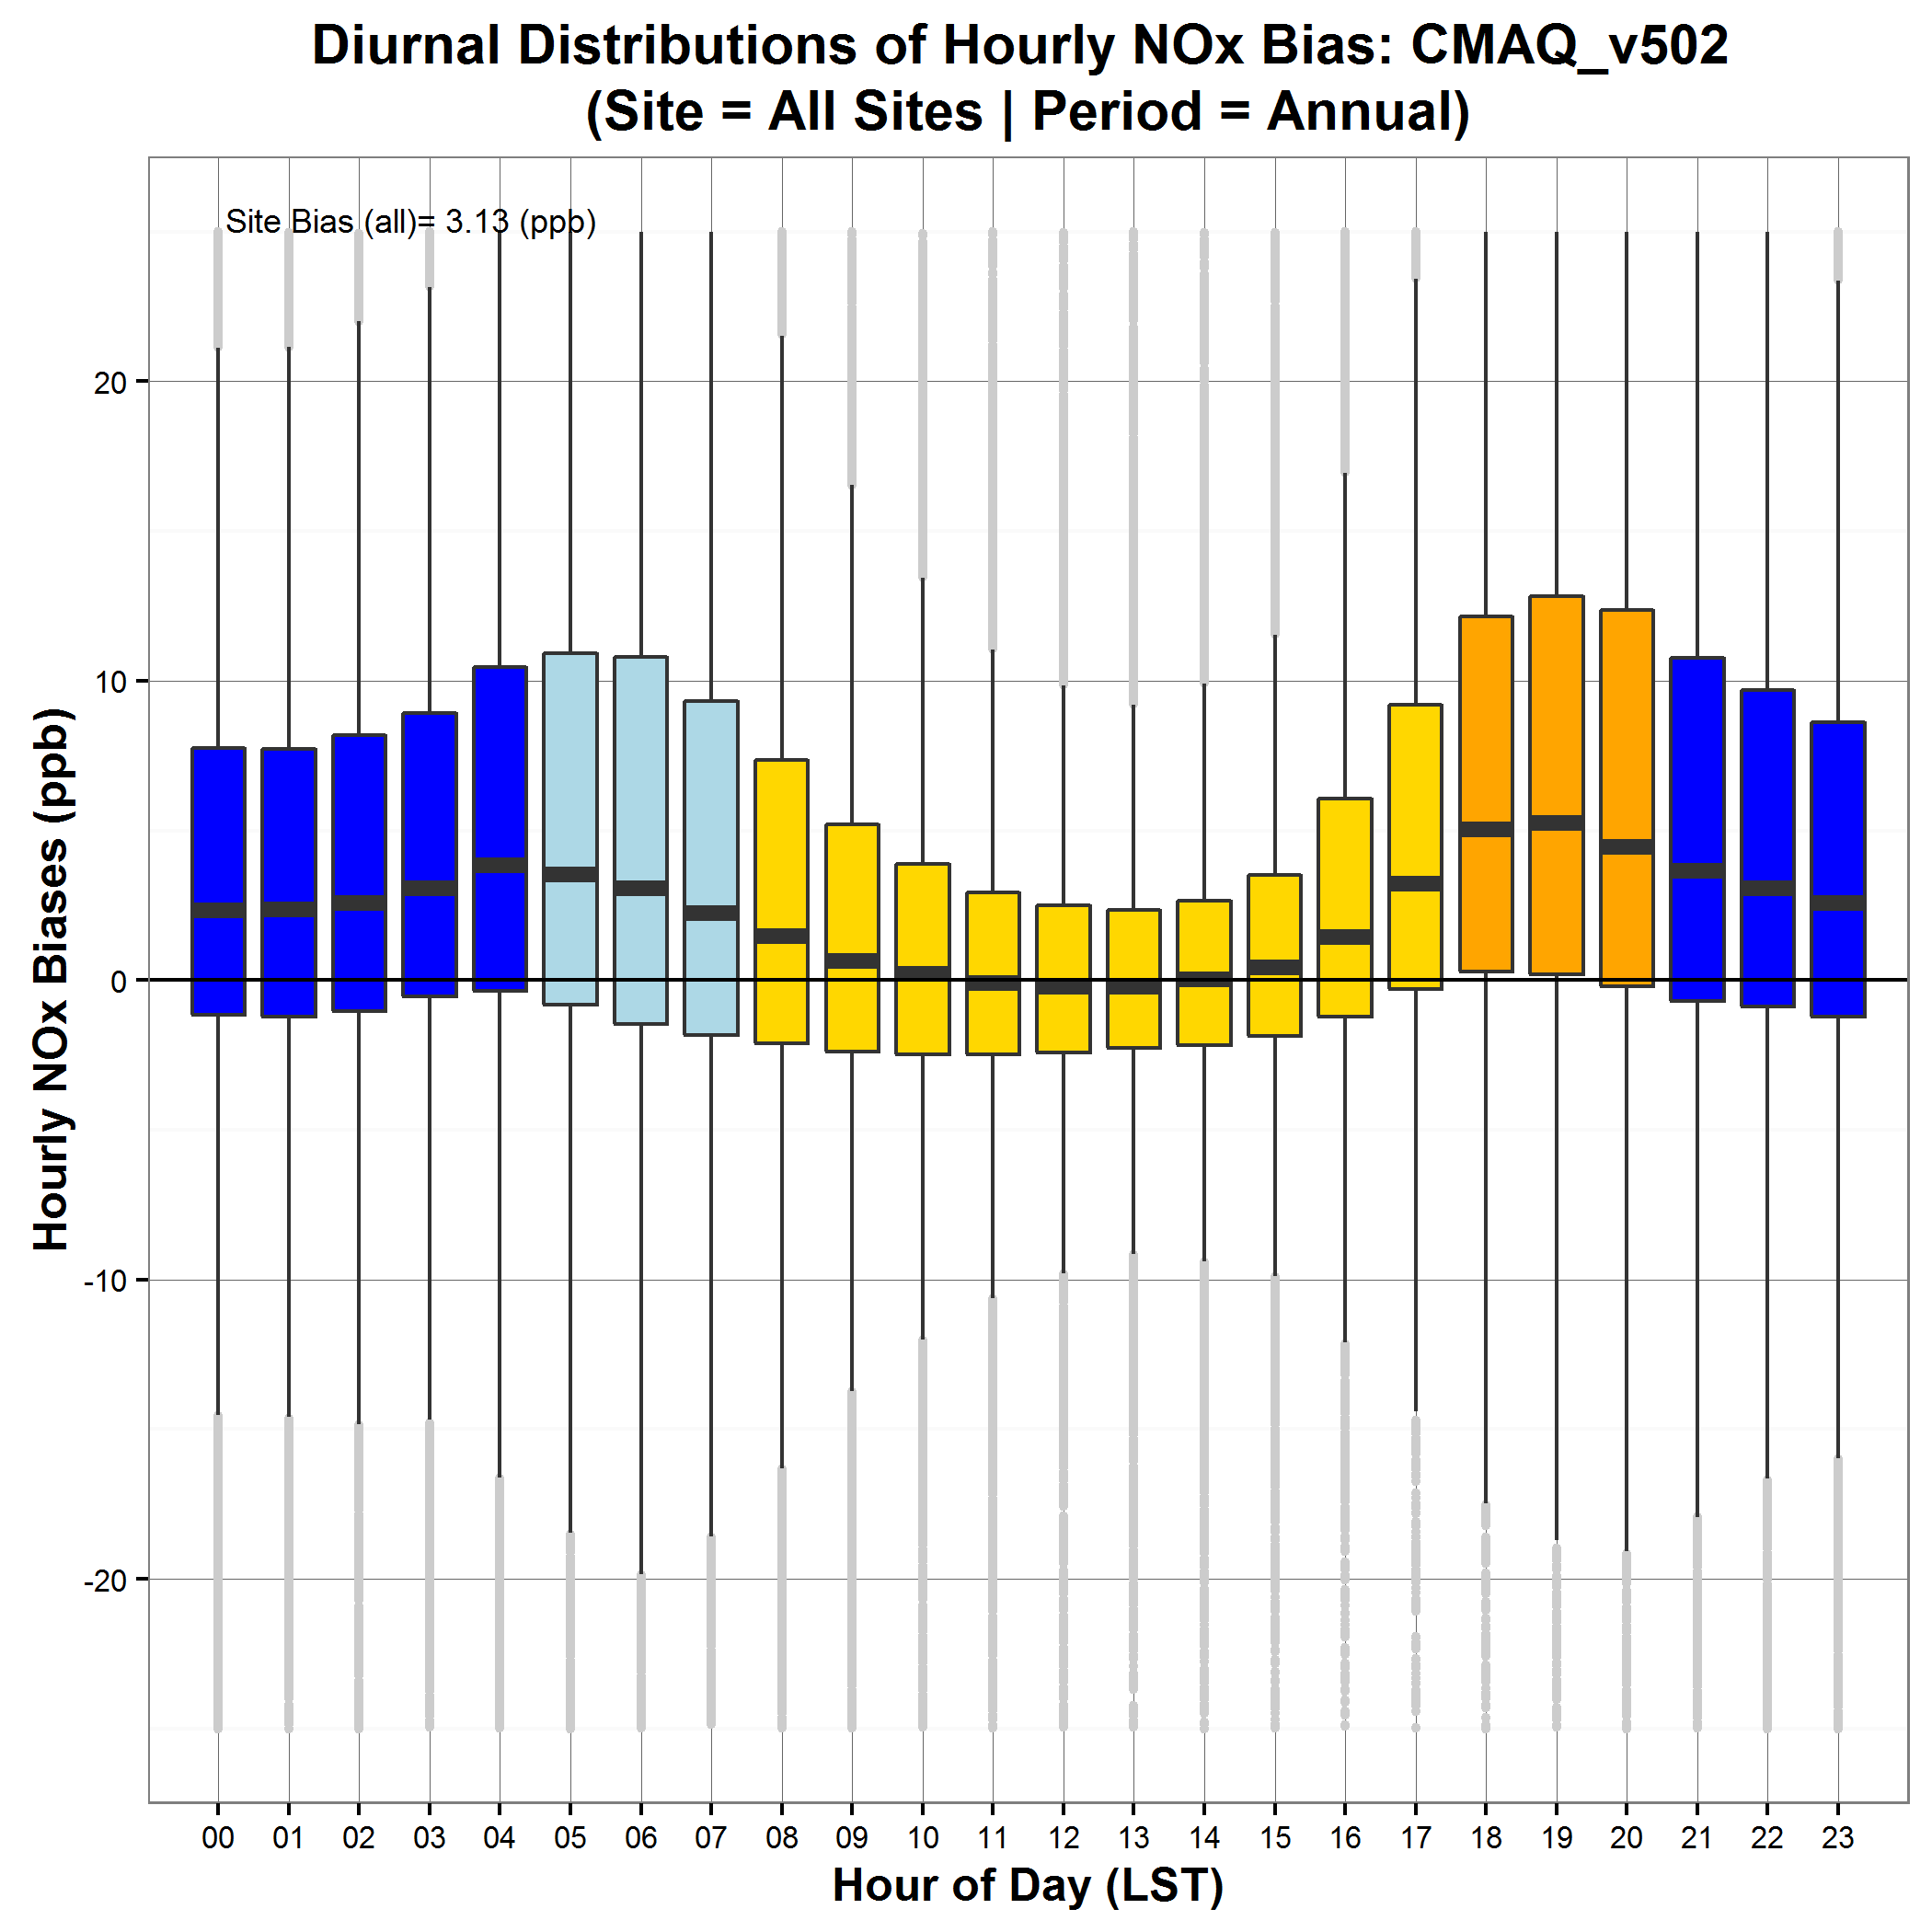
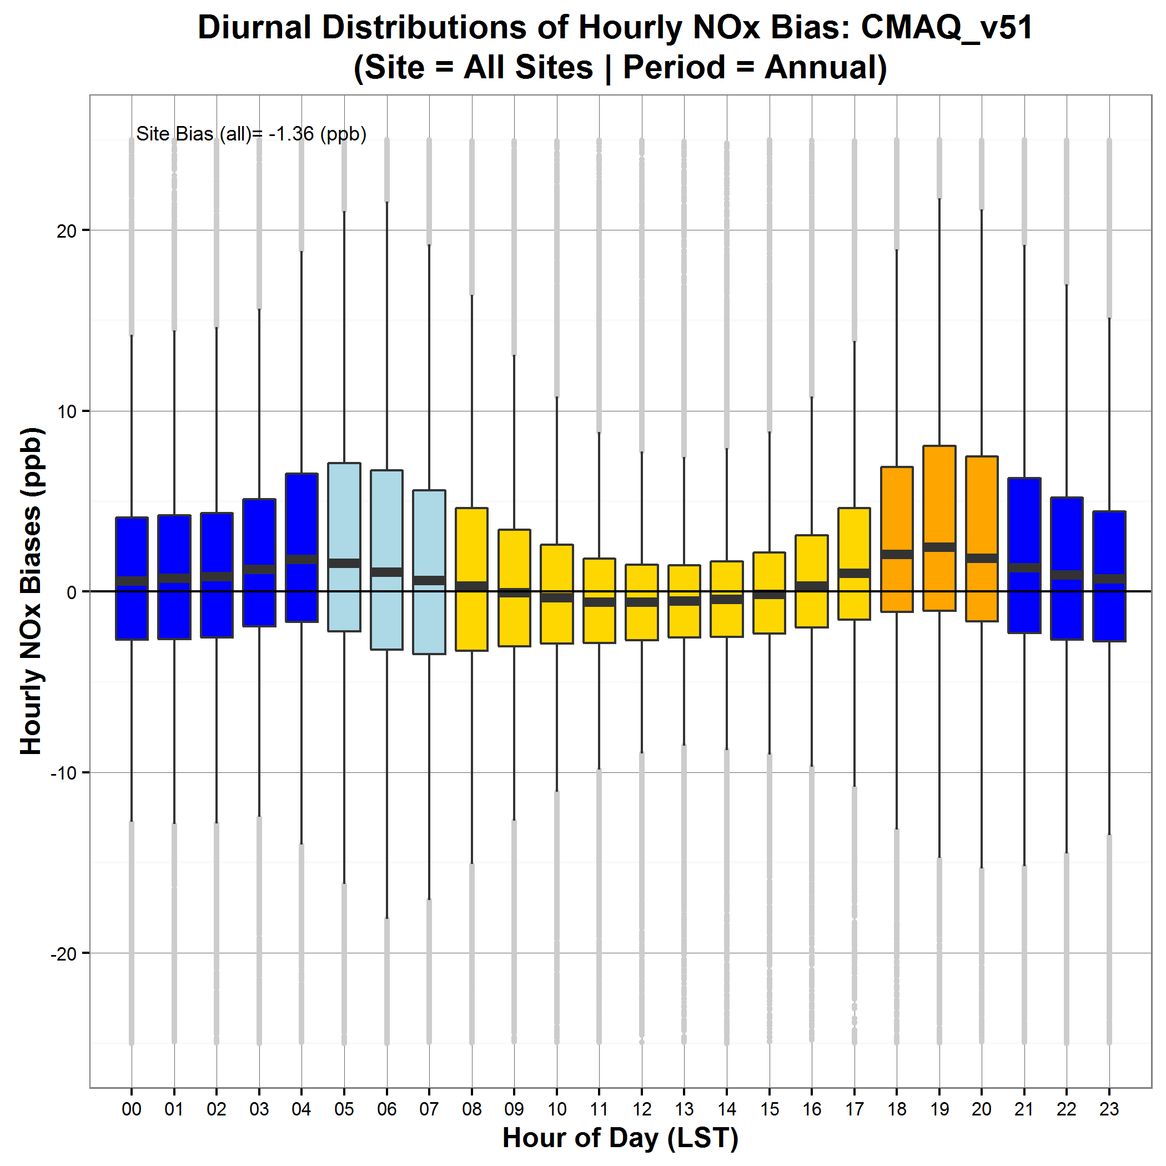
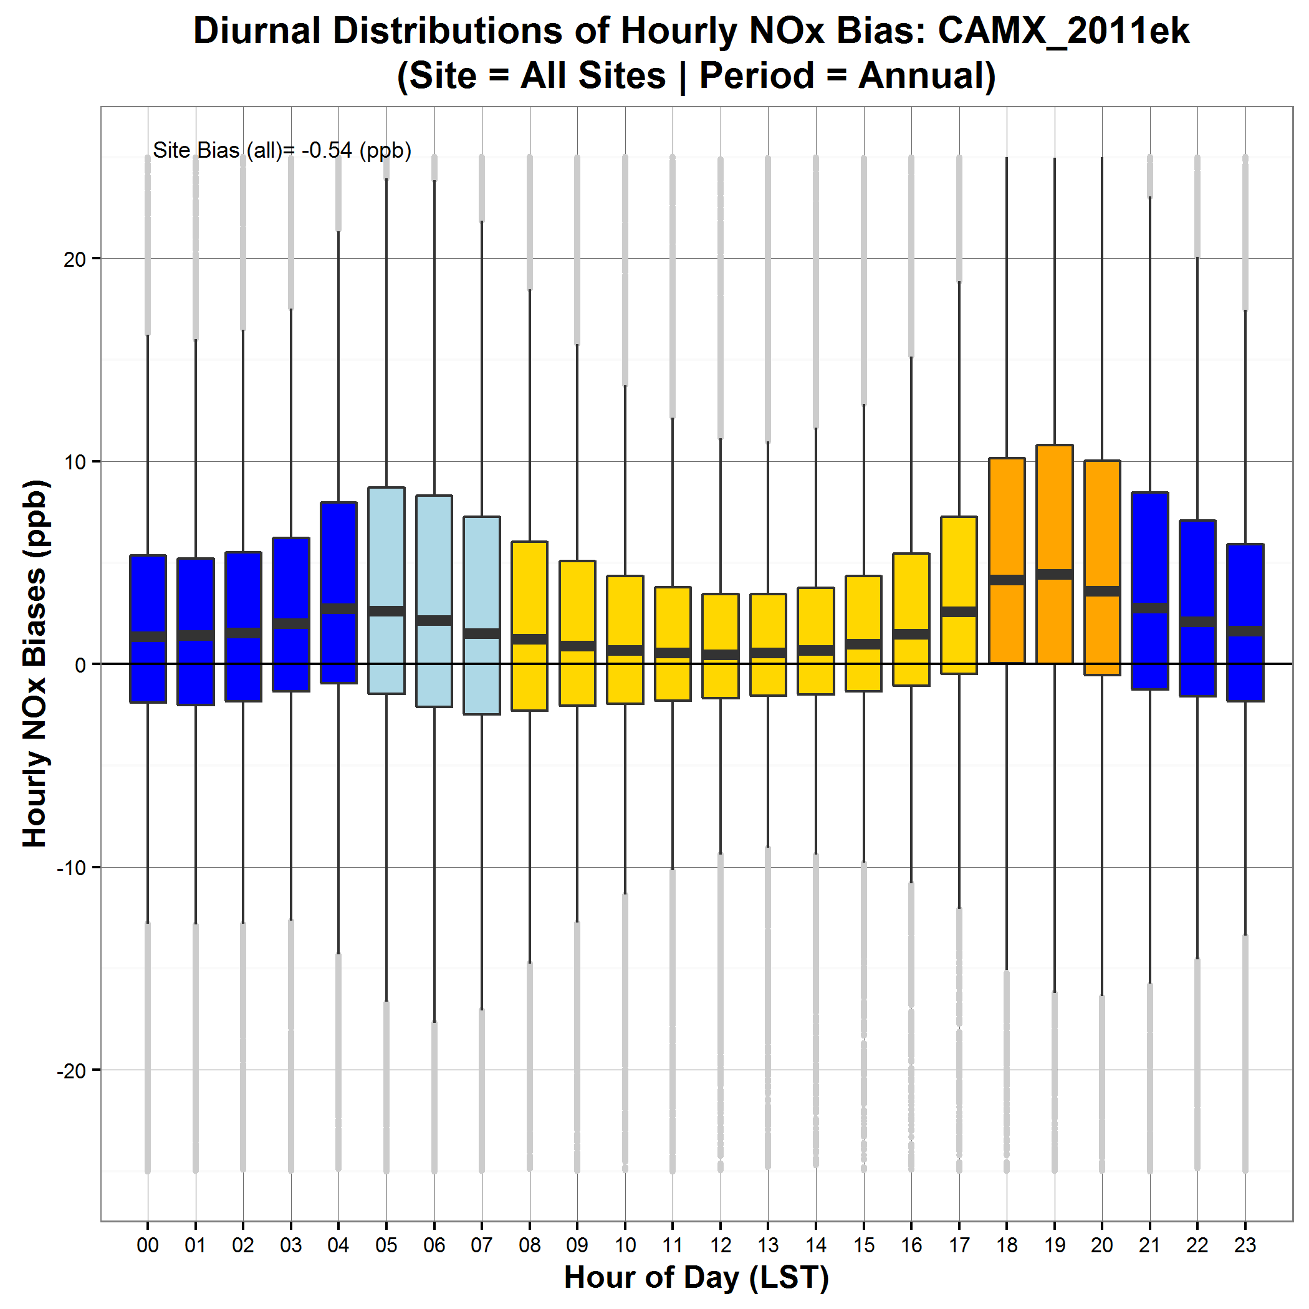
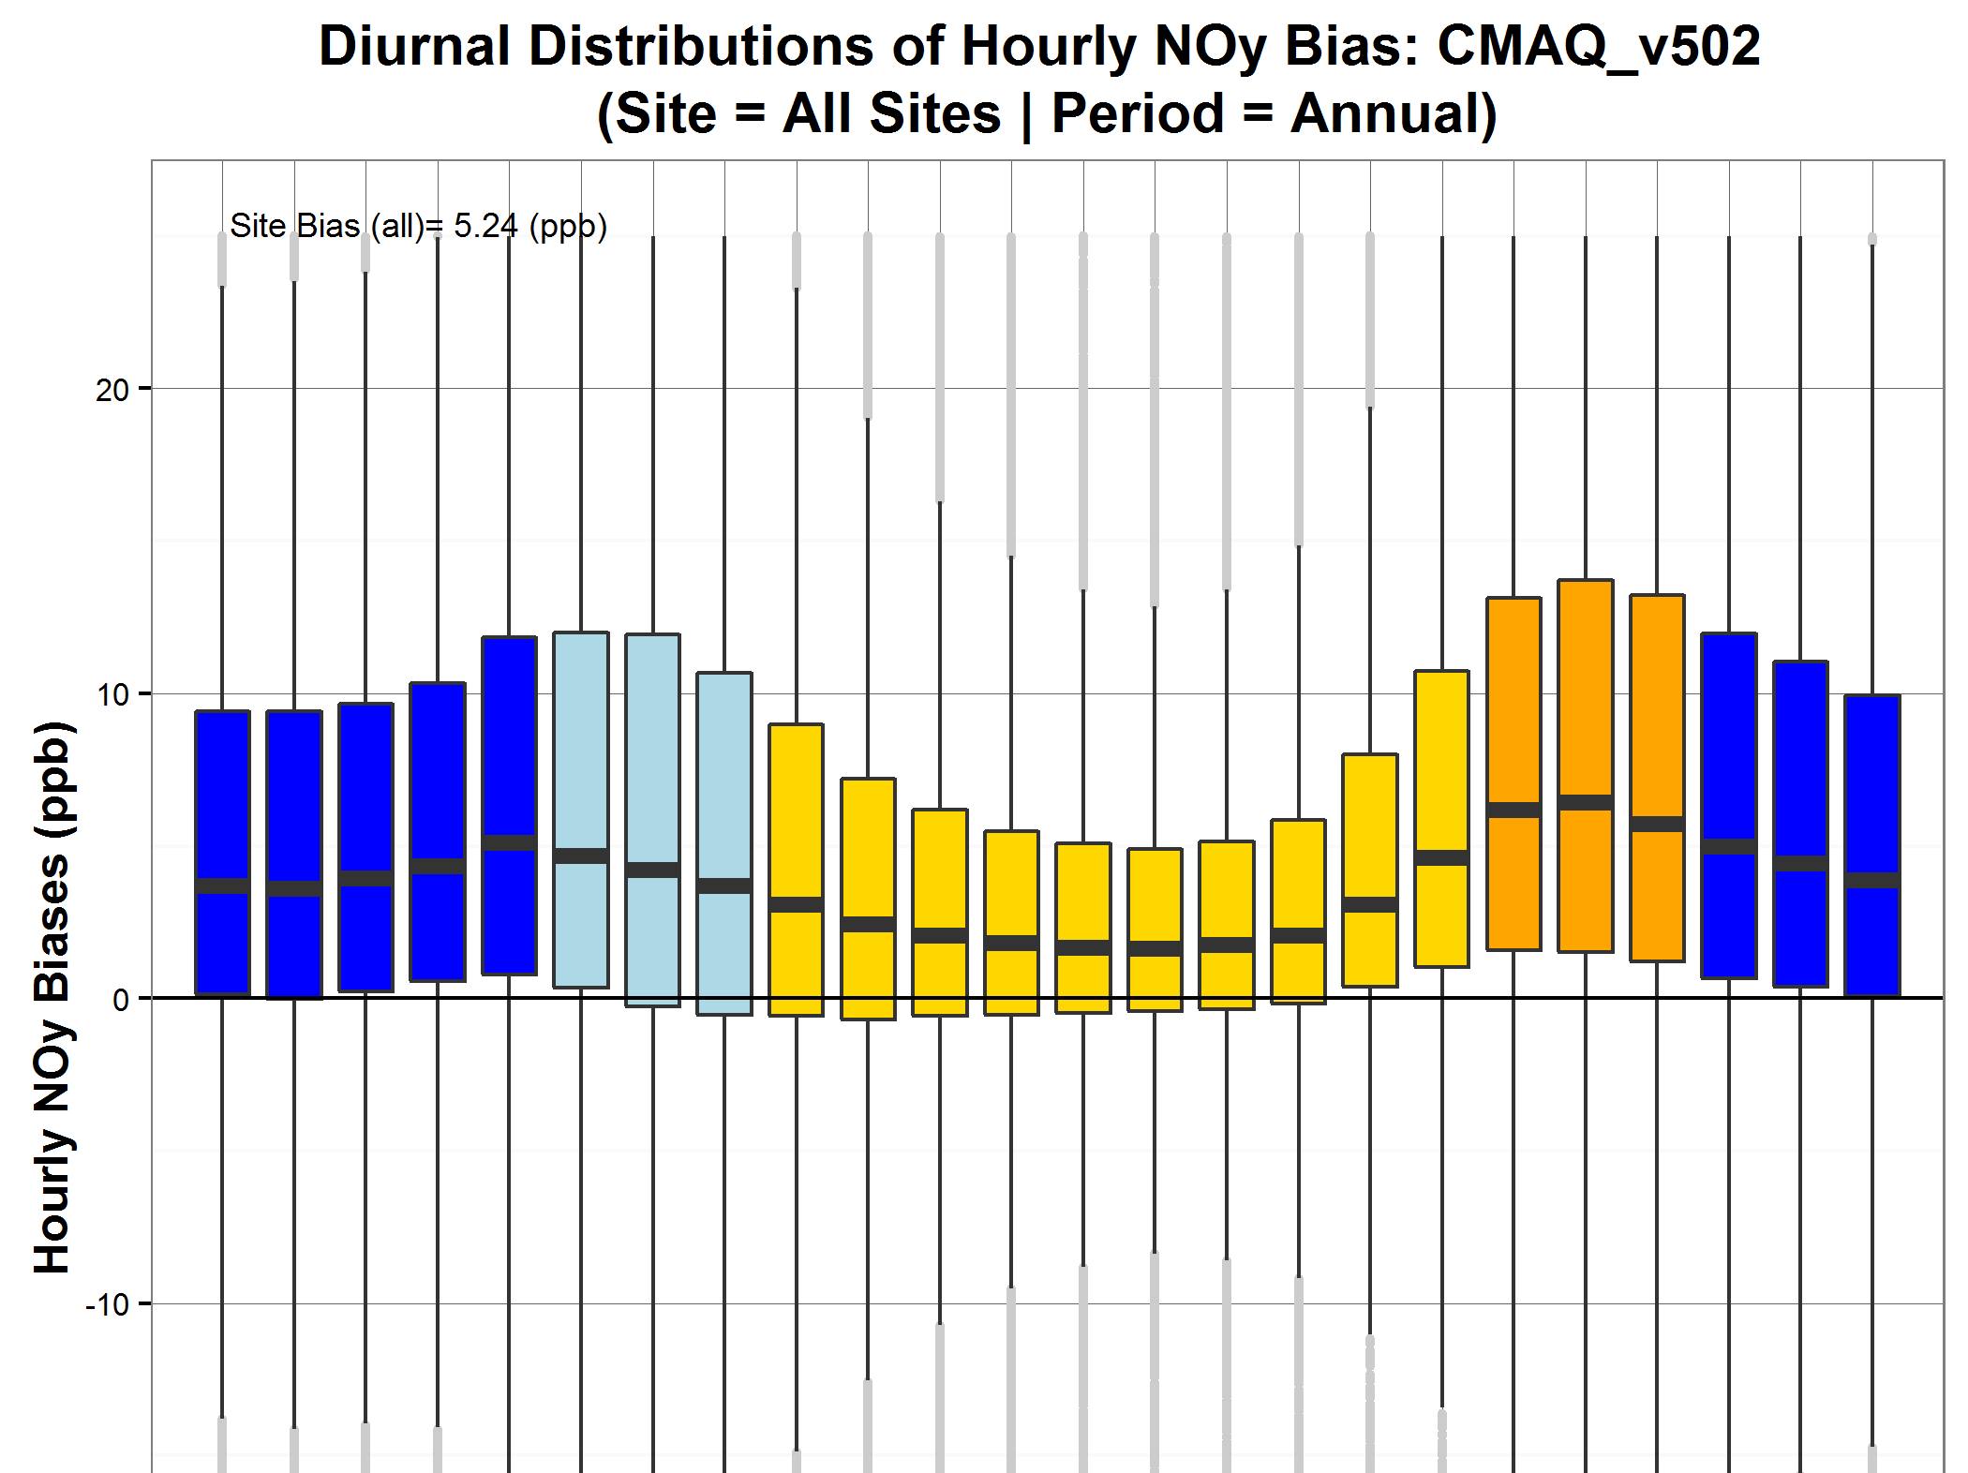
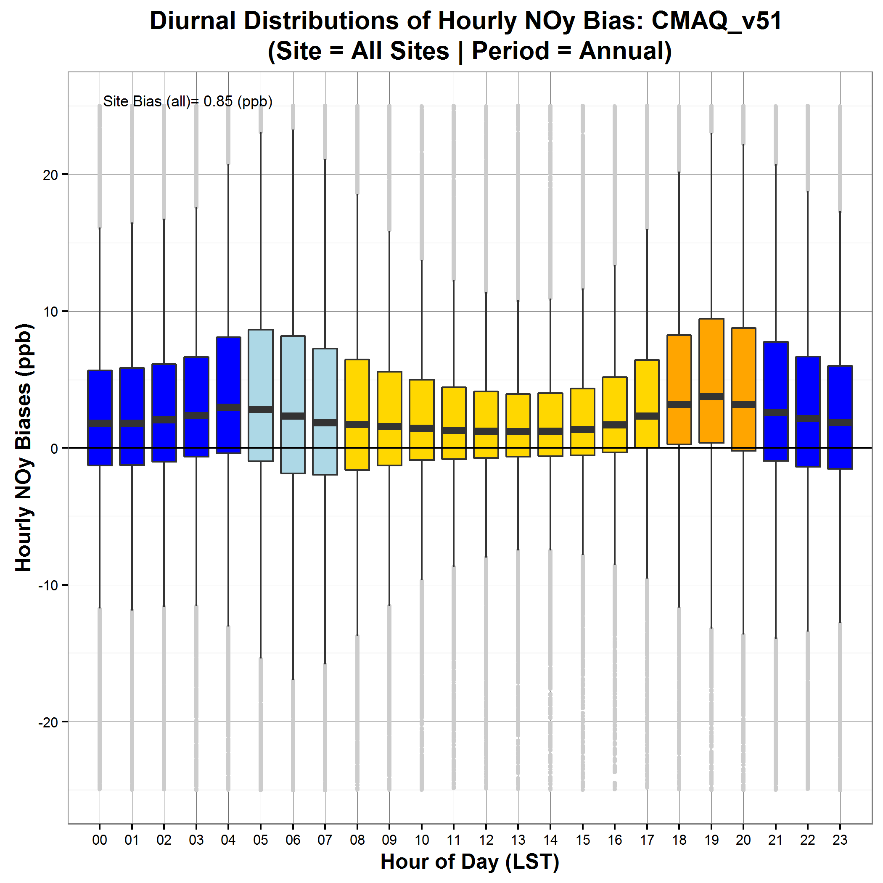
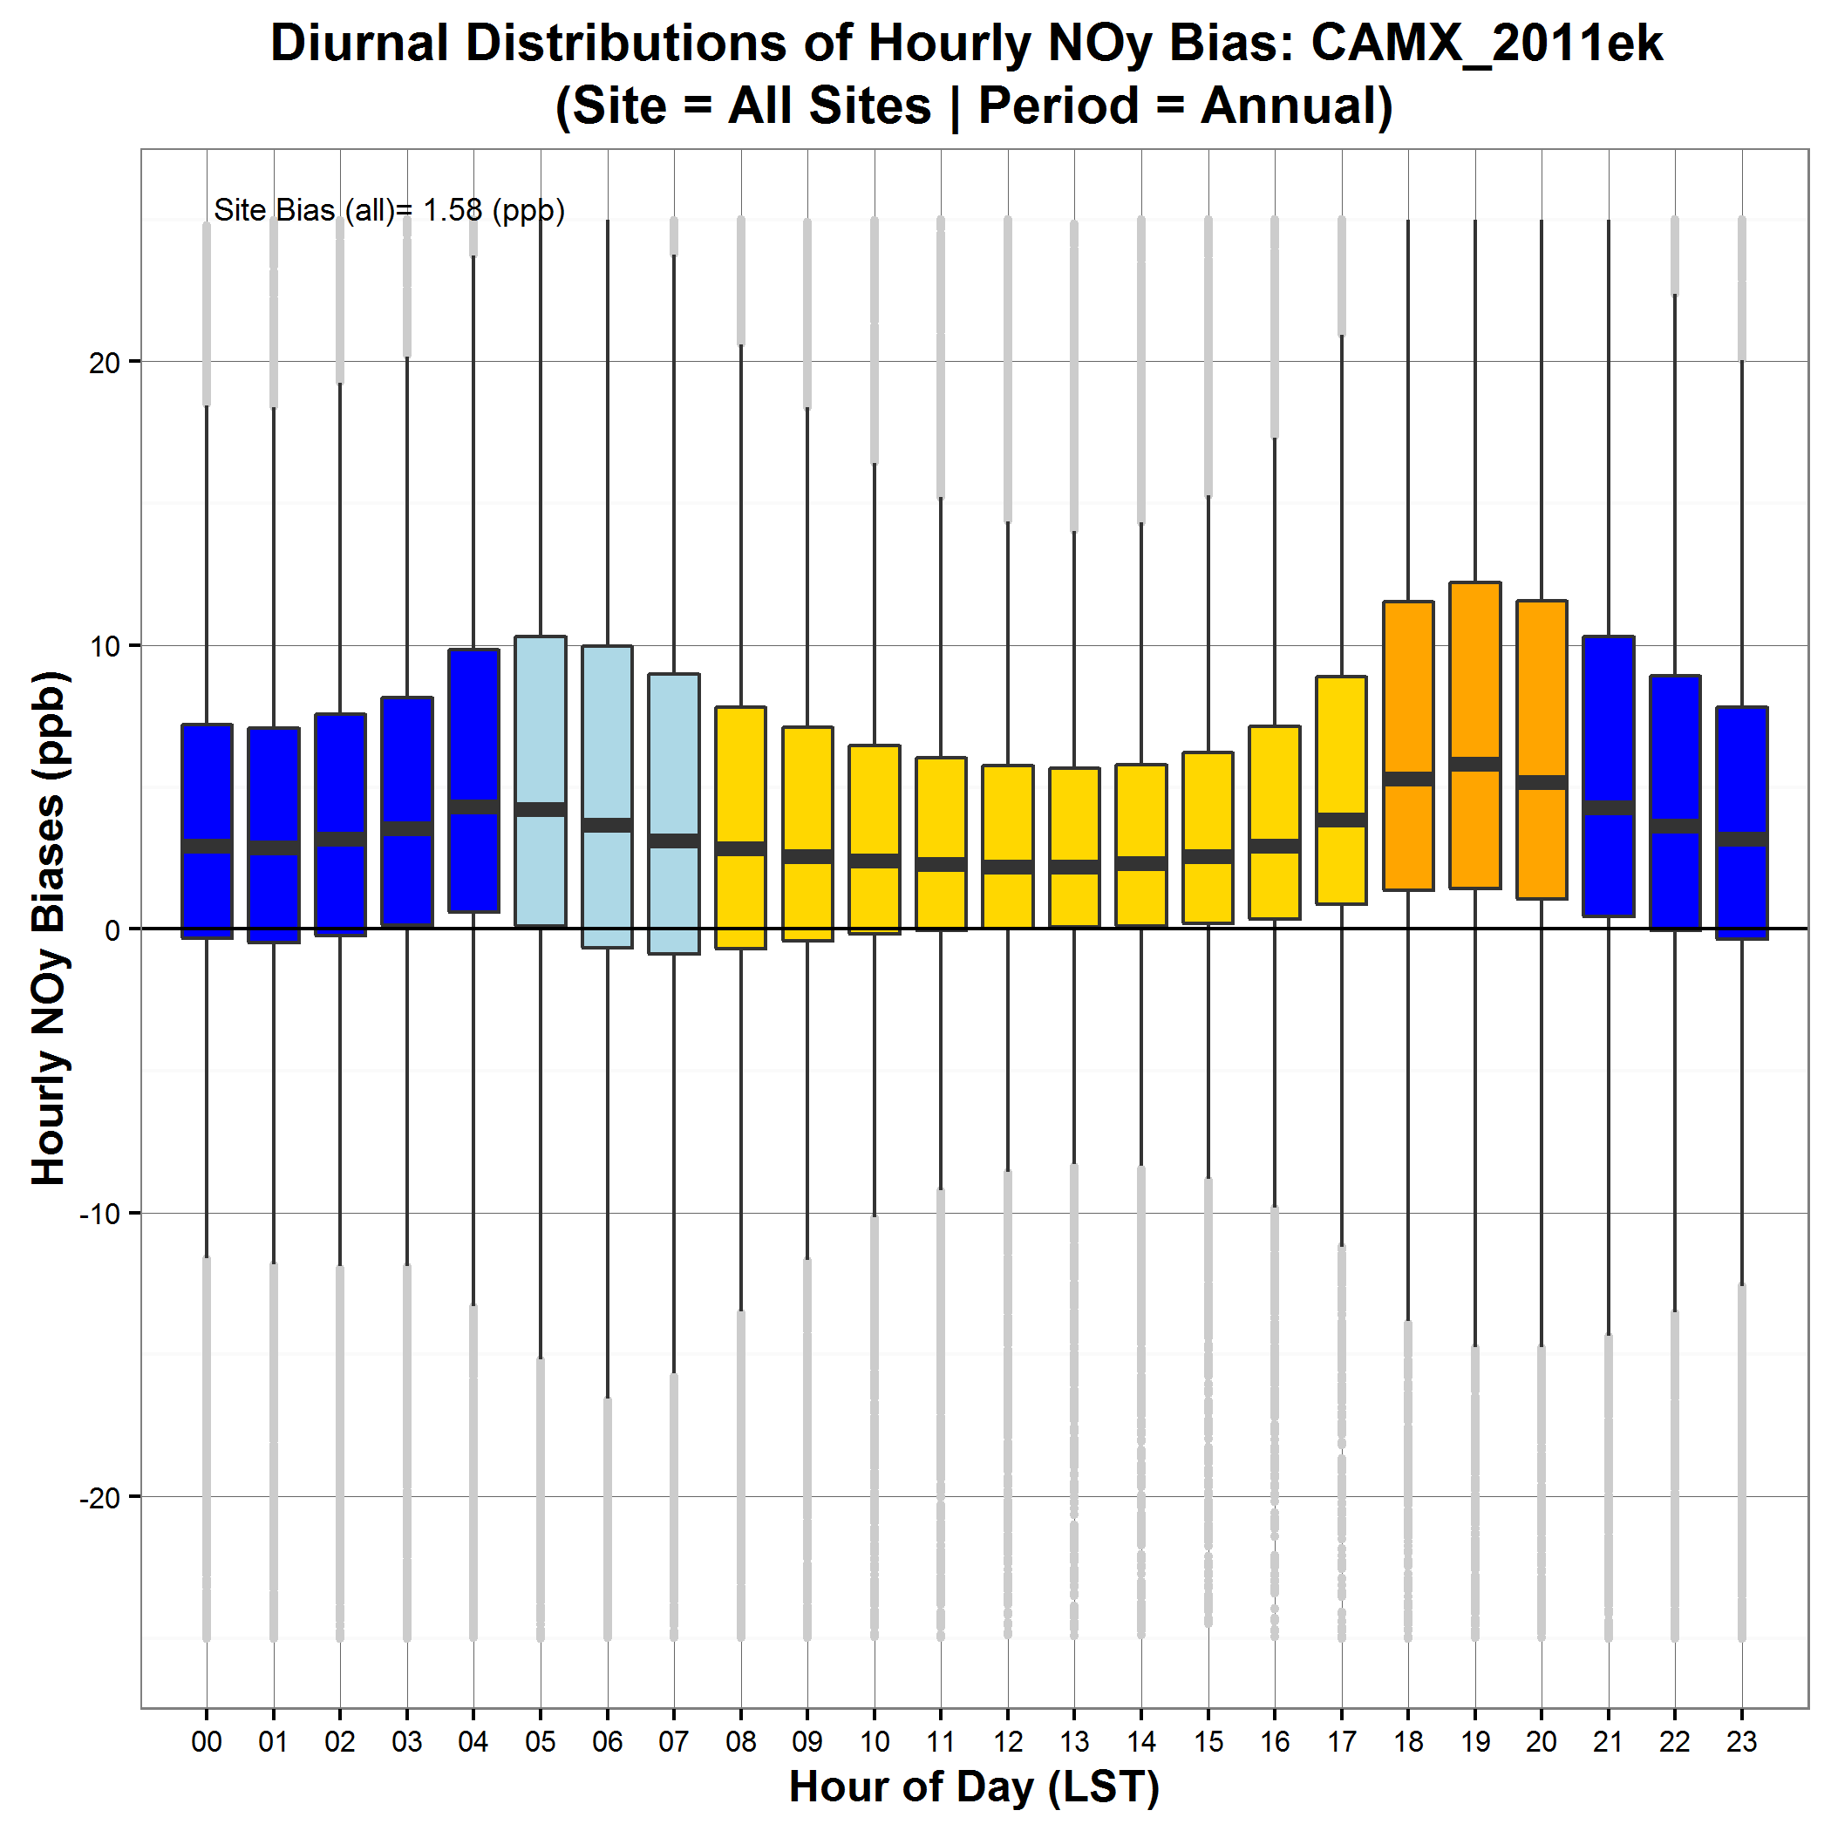
Current EPA 2011 CMAQ/CAMx NOx and NOy Evaluation
CMAQv5.0.2
NOx bias – all AQS sites
CMAQv5.1
NOx bias – all AQS sites
CAMx v6.2
NOx bias – all AQS sites
NOx is generally unbiased or under-predicted during daytime but is over-predicted in morning and evening transition hours and at night
NOy tends to be over-predicted by the models at all times of day
CMAQv5.1 has improved characterization of mixing in morning/evening transitions and at night compared to CMAQv5.0.2
NOx and NOy biases decrease in CMAQv5.1 versus CMAQv5.0.2
CAMx v6.2 biases in NOx and NOy generally fall between biases from CMAQv5.0.2 and v5.1
CMAQv5.0.2
NOy bias – all AQS sites
CMAQv5.1
NOy bias – all AQS sites
CAMx v6.2
NOy bias – all AQS sites
Notes:
CMAQv5.02 NOx bias: 3.1 ppb; CAMx v6.2 NOx bias: -0.5 ppb; CMAQv5.1 NOx bias: -1.4 ppb
CMAQv5.02 NOy bias: 5.2 ppb; CAMX v6.2 NOy bias: 1.6 ppb; CMAQv5.1 NOy bias: 0.9 ppb

Slide 4
Important Sources of NOx in the 2011 NEI
Largest emissions sectors of NOx in 2011 were:
Onroad
Nonroad
Electric Generating Units (EGUs)
Other point
Oil & Gas
Area
We aim to explore all possible sources of any errors in NOy model performance including the role of onroad mobile sources

Slide 5
Conceptual Framework
Spatial and Temporal Allocation
NOx emissions
Photochemical Model
Meteorology*: Mixing & Transport
Chemistry
Onroad Mobile
Nonroad Mobile
Local Activity
(Fleet mix, speeds, VMT, extended idle hours)
Electric Generating Units
Deposition
MOVES model
Default Activity
(e.g. driving cycles, starts/year, idle-hours/day)
Other Point Sources
Matching Species Defns, Grid Resolution, Kernel processing
Measurements
Emission Rates* (running, start and extended idle)
Area Sources
Satellite Retrieval Methods
Measurement Artifacts
Fires
Notes:
Figuring out if there is a problem with an individual piece of this system is not straightforward. Need to look holistically as all the processes that may impact the comparisons of model predications and measurements.

Slide 6
Multiple Organizations Contribute to this Process
EPA & States
Spatial and Temporal Allocation
NOx emissions
EPA Offices
Office of Air and Radiation (OAR)
Office of Transportation and Air Quality (OTAQ)
Office of Air Quality Planning and Standards (OAQPS)
Office of Atmospheric Programs (OAP)
Office of Research and Development (ORD)
States
Other Federal Agencies
NASA
NOAA
Academics
Onroad Mobile
EPA & States
Nonroad Mobile
Local Activity
(Fleet mix, speeds, VMT, extended idle hours)
States
Electric Generating Units
EPA & States
MOVES model
Default Activity
(e.g. driving cycles, starts/year, idle-hours/day)
EPA & States
EPA & CA
Other Point Sources
EPA & States
Area Sources
Emission Rates (running, start and extended idle)
EPA & CA
EPA & States
Fires

Slide 7
Multiple Organizations Contribute to this Process
Photochemical Model
EPA Offices
Office of Air and Radiation (OAR)
Office of Transportation and Air Quality (OTAQ)
Office of Air Quality Planning and Standards (OAQPS)
Office of Atmospheric Programs (OAP)
Office of Research and Development (ORD)
States
Other Federal Agencies
NASA
NOAA
Academics
Meteorology: Mixing & Transport
EPA, Other Federal Agencies, Academics & Others
Chemistry
Deposition
All Model Users
Matching Species Defns, Grid Resolution, Kernel processing
Measurements
States, EPA, Other Federal Agencies, Academics & Others
Measurement Artifacts
Satellite Retrieval Methods
Notes:
So the key point here, is not only do we have a complicated system with a lot of moving parts, we also have a lot of different groups who contribute to specific pieces of this system. Consequently we will have the best chance of identifying and addressing errors in this system if we work collaboratively across groups.

Slide 8
Detailed Emissions Information Needed for Regulatory Applications
Control programs differentially impact specific sources/fuels
To understand their impact, models need to predict the response of emissions to changes in those sources/fuels
For example, controls may impact diesel and gasoline emissions differently, so understanding the contributions from these two fuel types matters
Future year projections are an important aspect of regulatory modeling
Emissions projections are built from estimates of source category-specific emissions rates and projections of activity data, vehicle fleet mix and age distributions, energy demand and trends in fuel usage etc.
Improving projections requires understanding the nature of any biases in current inventory
Annual total NOx emissions are necessary but may not be sufficient informing control strategy decisions. We need to understand relationship of any emissions biases to:
Source category and subcategory
Temporal and spatial allocation
Emissions factors, activity data, fuel usage, age distribution etc

Slide 9
5 Key Questions Identified for Further Investigation by Cross-EPA Workgroup
What can we learn from EPA’s 2008-2011 Detroit and Las Vegas near-road measurement campaigns?
How do MOVES NOx estimates compare with other tunnel and roadside measurements?
How can we improve spatial and temporal allocation of mobile emissions?
How much can improvements in these allocations reduce modeled NOy bias?
What can we learn from in-depth diagnostic evaluation of photochemical modeling results using the most up-to-date versions of the modeling systems and inventories?
What are the strengths and pitfalls of using CO:NOy ratios for understanding emissions biases?
Can these ratios provide insight into the specific sources of NEI/model/measurement discrepancies?
Notes:
So in thinking about these issues, EPA formed a cross-office work group with members from OTAQ, OAQPS and ORD to further investigate NOy performance in the modeling system. The workgroup identified 5 key questions that we think we have the capability of answering in the next several years and that we hope will provide insight into specific causes for any model biases in Noy.

Slide 10
1. What can we learn from EPA’s 2008-2011 Detroit and Las Vegas near-road measurement campaigns?
Compare AERMOD predicted NOx concentrations to site measurements using emissions inputs from multiple MOVES scenarios
MOVES run with national defaults versus inputs specific to field data (fleet mix, speeds, and traffic volumes specific)
Evaluate impact on emissions totals and timing of emissions
Compare MOVES emissions estimates from these runs to county-level inputs used in EPA’s 2011 photochemical modeling platform for these two areas
Evaluate implications of best estimates of emissions vs national and county defaults for CMAQ NOx discrepancies
Poster by C. Owen in Emissions Inventories, Models, and Processes, Poster Session I (#22)
Notes:
The first question identified by the workgroup was what can we learn from two recent EPA near-road field campaigns that took place in Detroit and Las Vegas. To answer this question we are running MOVES with inputs specific to the field site locations and applying the AERMOD dispersion model to estimate local impacts of those emissions. We hope to be able to use comparisons between AERMOD NOx estimates and diurnal profiles with measured data to understand the accuracy of MOVES emissions estimates both with location-specific inputs and with national and county-level default inputs. Chris Owen had a poster on this topic on Monday and I encourage you to talk to him for more details.

Slide 11
2. How do MOVES NOx estimates compare with other tunnel and roadside measurements?
We are comparing MOVES emissions estimates with measured emissions from recent studies
Detailed emission rate evaluation
Individual vehicle measurements, evaluated by operating mode, vehicle class, technology, model year and age
Data: Denver Inspection/Maintenance Dynamometer Tests (2012+)
Data: University of Denver Remote Sensing Detection (RSD) studies: Chicago (2014), Tulsa (2013, 2016), Denver (2013), West Los Angeles (2013)
Localized composite emission rate evaluation
Requires data on fleet composition (car/truck mix, age distribution) and vehicle speeds and accelerations
Data: University of California-Berkeley studies on the Caldecott Tunnel, Oakland, CA (2006, 2010)
MOVES
Localized Composite Emission Rates
Tunnel, Roadside monitor data
Operating mode & fleet composition estimates
MOVES Emission Rates
Dynamometer,
RSD data
Notes:
The second question identified by the workgroup was “what can we learn from comparison of MOVES emissions outputs to other near-road or tunnel datasets?” These datasets fall into two general categories: First we have data on emissions from single vehicles with detailed information on the vehicle type, fuel and operating conditions. These datasets come from dynamometer tests as well as remote sensing detection that can measure emissions along a roadside from tailpipes of specific vehicles. This type of data can provide information on underlying emissions factors in MOVES. The second type of dataset comes from tunnel studies and represents aggregated emissions from all vehicles driving through the tunnel. This type of comparison provides information on the accuracy of combining emissions factors with default input assumptions about vehicle fleet mix and running conditions. This work is just getting underway and we hope to have results in the next few years. I encourage you to talk to Darrell Sonntag for more details on this project.

Slide 12
3. How can we improve spatial and temporal allocation of mobile emissions? How much can improvements in these allocations reduce modeled NOy bias?
As part of the development of the 2014 NEI we are incorporating updates and improvements to the spatial and temporal allocation of mobile emissions
Have already incorporated state-provided updates to temporal profiles
Working towards expanding use of county-level vehicle registration data
Incorporating FHWA estimates of average daily travel by road link to allocate emissions to grid cells rather than previous method of spatial allocation based on total miles of road present
Improving MOVES defaults for vehicle spatial distributions and temporal profiles for VMT and speed in part by using new hour-by-hour data from GPS-applications
Notes:
A third question is whether we can improve spatial and temporal allocations and ultimately how those improvements impact modeled NOy biases. This work is going on as part of the development of the 2014 NEI. As part of this process, EPA is incorporating new sources of information on spatial and temporal allocation of mobile sources to update our allocation profiles. This effort is being lead by Alison Eyth.

Slide 13
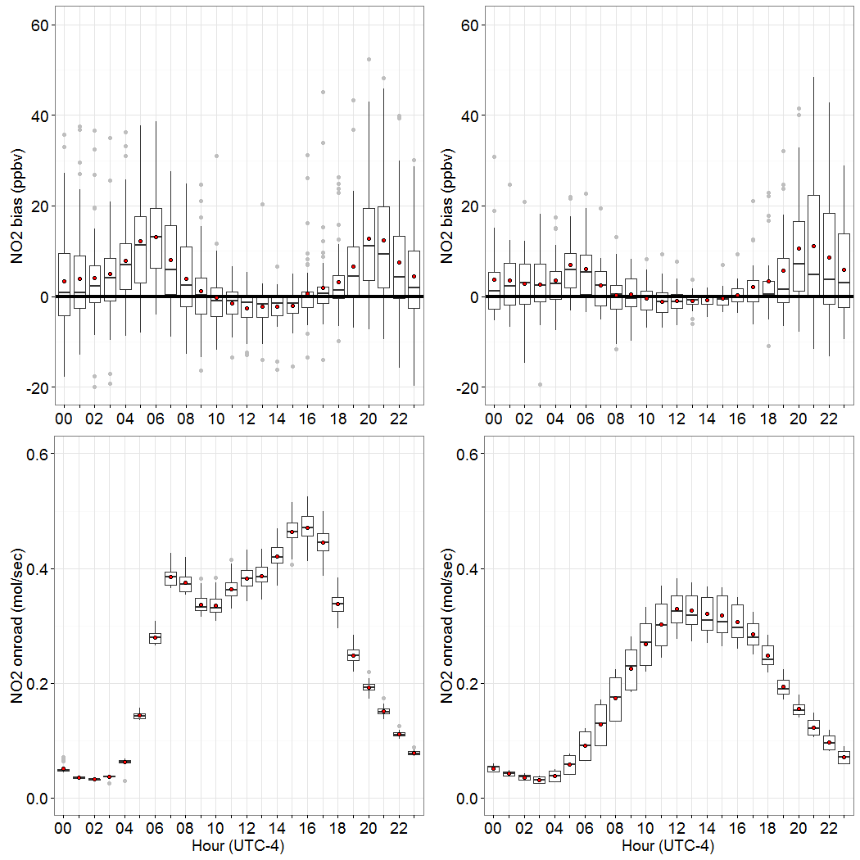
4. What can we learn from in-depth diagnostic evaluation of photochemical modeling results using the most up-to-date versions of the modeling systems and inventories?
Diurnal Boxplots for June-August 2011
Hourly data from AQS site/grid cell in DC
Analysis of model performance during Discover AQ Baltimore episode and in 6 other cities with AQS NOx monitors (DC, NYC, St. Louis, Houston, Denver, LA)
Compare CMAQ results to AQS ground measurements, air craft and LIDAR data
Evaluate differences in weekend vs weekday biases
Evaluate differences in biases across seasons
Use CMAQ source apportionment tool (ISAM) ) to investigate which source groups are most highly correlated with peak NO_{x} bias
In depth evaluation of emissions in grid cells surrounding each monitor evaluated above
Hourly emissions by source category
Comparison of temporal patterns in emissions versus temporal patterns in NOx bias
Comparison of bias patterns in locations using EPA’s MOVES mobile source emissions to those in locations using California’s EMFAC emissions
Poster by C. Toro in Model Evaluation and Analysis, Poster Session 2 (#31)
Weekday
Weekend
NO₂ bias (ppb)
NO₂ onroad (moles/sec)
Notes:
The fourth question is “what can we learn from an in depth diagnostic evaluation using the most up-to-date versions of modeling systems and inventories”. This work initially focused on model-measurement comparisons of the DISCOVER-AQ Baltimore field campaign but is being expanding to include evaluations using routine monitoring networks in other cities. In this evaluation we are taking a detailed look at the temporal relationship between model biases and emissions from different source categories. I encourage you to talk to Claudia Toro and look at her poster for more details.

Slide 14
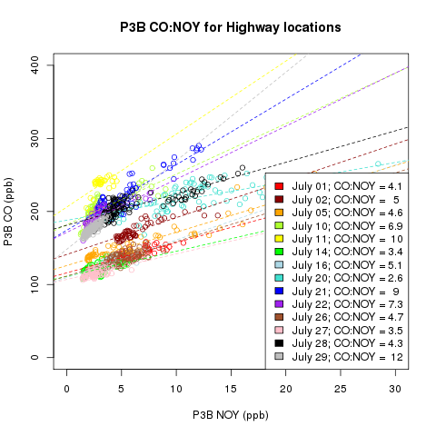
5. What are the strengths and pitfalls of using CO:NOy ratios for understanding emissions biases? Can these ratios provide insight into the specific sources of NEI/model/measurement discrepancies?
CO:NOy ratio is often used to evaluate NOx emissions because it controls for dilution effects
Initial focus on data from DISCOVER-AQ Baltimore campaign
Key questions
Is the CO:NOy ratio conserved from emissions to modeled concentration?
What factors drive day-to-day variability in CO:NOy in ambient atmosphere and in the model?
Can this variability provide additional insight into sources contributing to model bias (e.g. weekend/weekday effect)?
How do measured and modeled ratios compare in time and space?
CO:NOY (slope) from P3B aircraft measurements over highway locations near Baltimore on Different Days
Poster by H. Simon in Model Evaluation and Analysis Section, Poster Session 2 (#30)
Notes:
Finally, the fifth question we endeavored to address is what can we learn by comparing modeled and measured CO:NOy ratios. Other groups have used this type of comparison to evaluate emissions estimates and we wanted to better understand how to interpret this type of comparison and whether spatial and temporal patterns in model bias in this ratio could tell us anything about which emissions sources are driving this bias. I have a poster on this project and would be happy to talk to folks about it after this session.

Slide 15
Concluding Thoughts
Understanding the sources of modeled NOy bias is a complex problem which requires careful analysis of a multitude of potential driving factors
While top-down analysis can provide useful insights, it seems inappropriate to apply across-the-board adjustments to the inventory without understanding the nature of the problem and the potential differential impacts on various emissions sources as well as the spatial and temporal variability of these impacts
EPA is undertaking a cross-office effort to systematically understand the sources of modeled NOy biases and the role of mobile source emissions factors, activity and spatial/temporal allocations

Slide 16
Acknowledgements
OTAQ:
Chad Bailey
David Choi
James Warila
Molly Zawacki
ORD:
Wyat Appel
Luke Valin
Sue Kimbrough
OAQPS:
Sharon Phillips
Brian Timin
Kirk Baker
Jim Kelly
Jeff Vukovich

