Slide 1
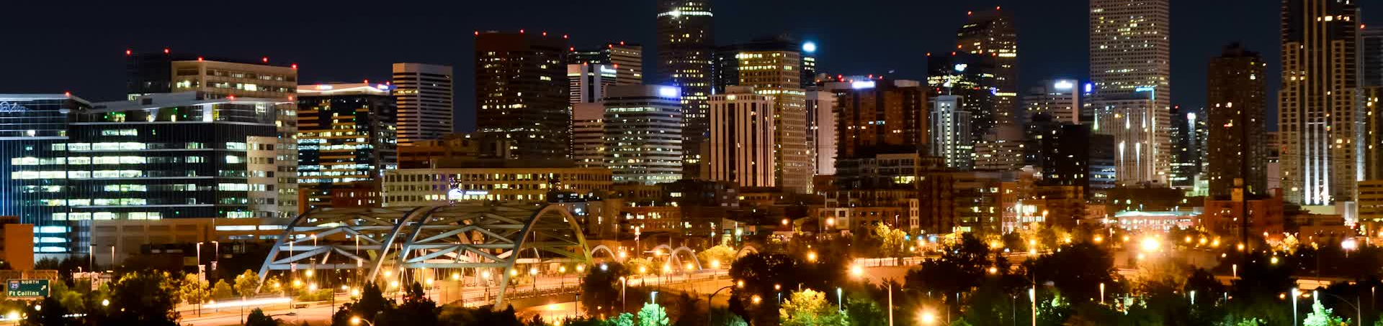
SMOKE-MOVES Processing
Incorporate travel Demand Model Data in Denver Ozone Modeling
Notes:
Alternative title slide. Image size: 6 cm x 25,4 cm or 227 x 960 pixels

Slide 2
Acknowledgement
Amanda Brimmer and Ken Lloyd– Denver Regional Air Quality Council
Dale Wells – Air Pollution Control Division (APCD), Colorado Department of Public Health and the Environment
Denver Regional Council of Governments
North Front Range Metropolitan Planning Organization
Notes:
Content slide

Slide 3
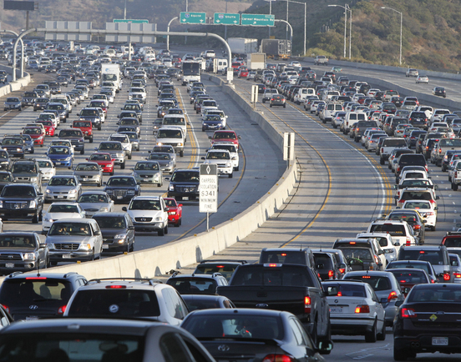
Outline
Motivation
Travel Demand Model (TDM)
Prepare TDM data for SMOKE-MOVES input
SMOKE-MOVES processing approach
MOVES2014 modeling
Develop spatial surrogates by time period
Spatial distribution comparison
Pros and cons
Notes:
Content slide, two columns with image. Image size: 8,46 cm x 10,76 cm or 320 x 407 pixels

Slide 4
Motivation
Denver SIP for the 1997 Ozone NAAQS developed on-road mobile emissions from link-based hourly vehicle activity and distribution data using CONCEPT
  Less HDDT in morning commute that reduced morning NO_{X} emissions and improved Denver ozone model performance
Denver Moderate Area SIP for the 2008 Ozone NAAQS uses latest emission modeling tool Motor Vehicle Emission Simulator (MOVES2014) to estimate on-road emission factors
  CONCEPT not compatible with MOVES2014 and no longer supported
Developed new technique using SMOKE-MOVES processing approach with link-based activity data to generate emissions for air quality modeling
  Use detailed link-level hourly traffic volume and trip starts data from Travel Demand Model (TDM)

Slide 5
Travel demand model
Predicts the state of transportation in the future and helps in making informed transportation planning decisions
Link-level (road segment) traffic volumes by time period (e.g. AM peak)
  Used to calculate hourly gridded VMT
Link-level speeds
Trip generation by Transportation Analysis Zone (TAZ) and time period
  Used to calculate trip starts surrogate by time period
Notes:
Keyword slide

Slide 6
Travel demand model
Two TDM networks within the Denver Metro/NFR nonattainment area
  Denver Regional Council of Governments (DRCOG)
  North Front Range Metropolitan Planning Organization (NFRMPO)
Inventory is broken out by six Highway Performance Monitoring System (HPMS) vehicle classes.
  Hourly vehicle mix from the automated traffic recorder (ATR) data

Slide 7
Prepare TDM data for SMOKE-MOVES input
Calculate hourly gridded VMT by source type
  Use link-level traffic volume and speeds data by time period from TDM
  Use hourly vehicle mix data from Automated Traffic Recorder (ATR) data
Processed data through Open Database Connectivity (ODBC) Transportation Inventory System (OTIS) developed by the APCD to calculate hourly gridded VMT
Notes:
Keyword slide

Slide 8
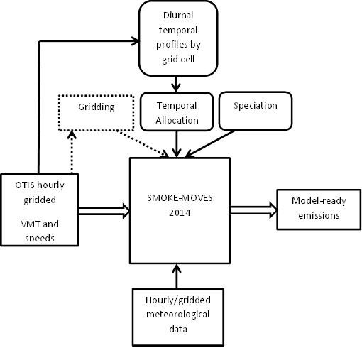
SMOKE-MOVES processing Approach
Treat each grid cell and speed class as a pseudo-county for rate-per-distance processing
Spatial surrogate are one-to-one mapping of a pseudo-county to respective grid cell.
Use CB6 speciated emission factors from MOVES2014

Slide 9
SMOKE-MOVES processing Approach
Calculate and apply diurnal temporal profiles by grid cell
Use day-specific hourly gridded WRF meteorological data
Off-network start exhaust emissions (rate-per-vehicle) are spatially allocated using surrogates developed based on trip starts

Slide 10
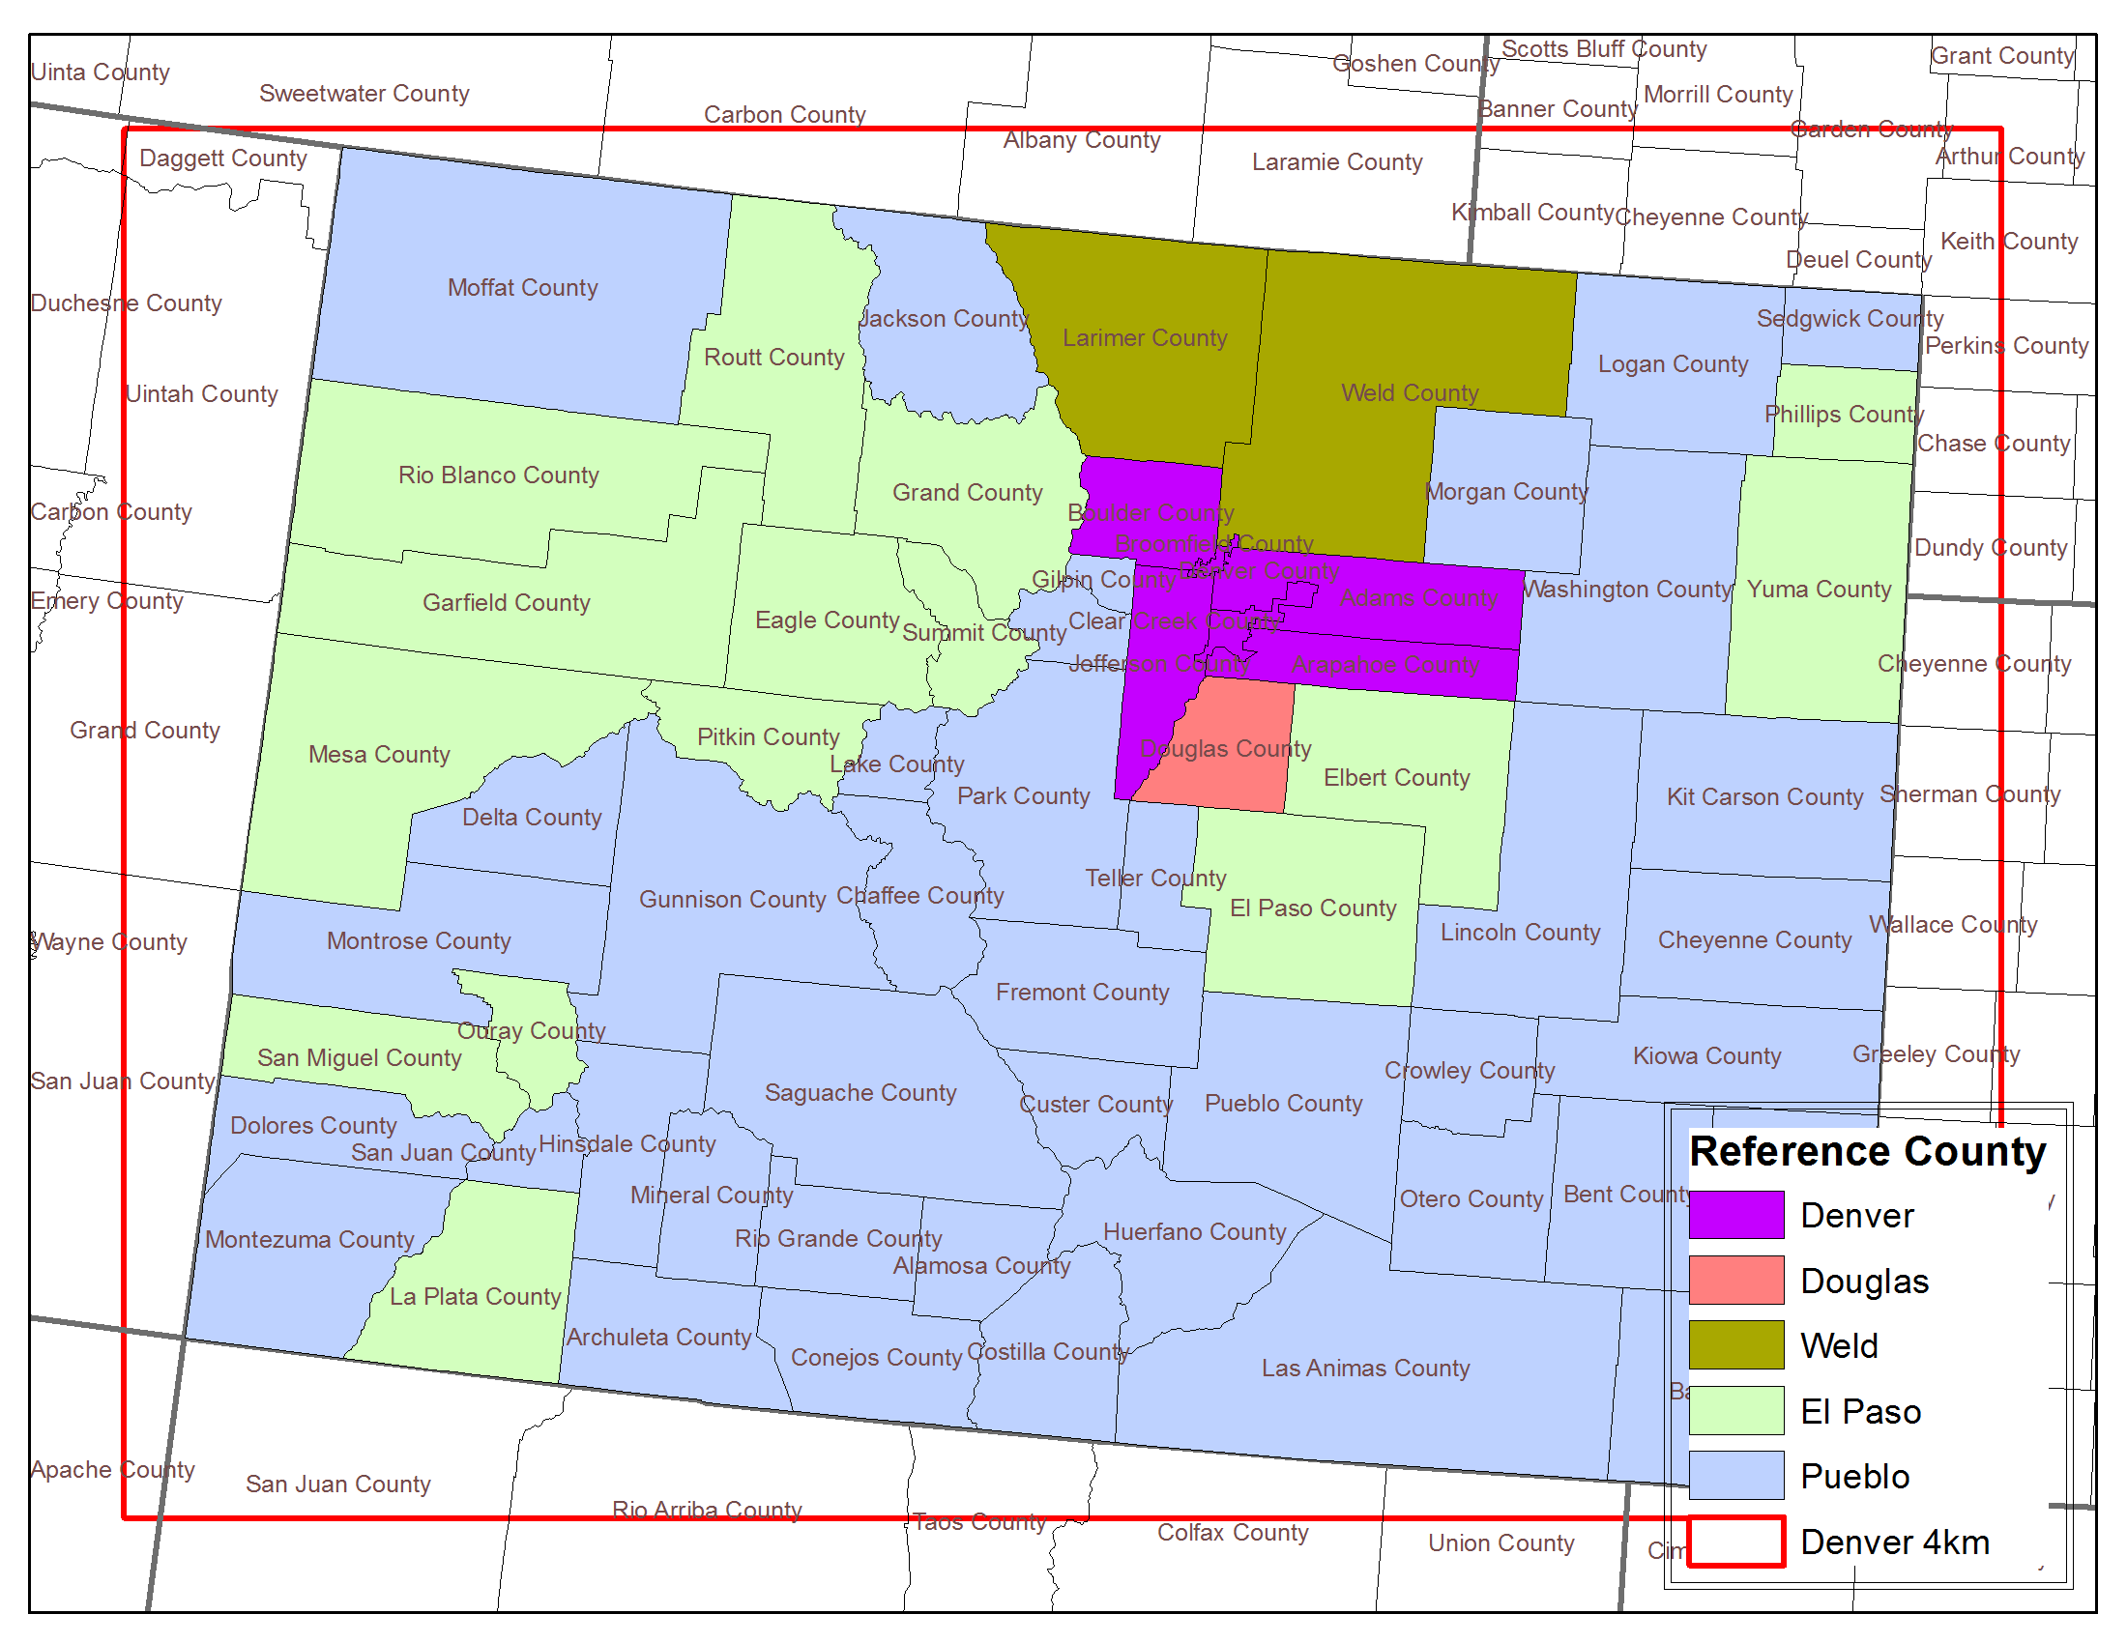
MOVES2014 modeling
Estimated emission factors for five reference counties in Colorado
Summer season emissions for 2011 and 2017
Modeled with local fuel parameters based on region wide sampling and applicable I/M program

Slide 11
Develop spatial surrogates by time periods
Trip generation by Transportation Analysis Zone (TAZ) and time period
Develop trip starts spatial surrogates by time period
  AM Peak, PM Peak, and Off Peak
SMOKE is not designed to apply spatial surrogates depending on the time period
Process SMOKE-MOVES for each time period and stitch various time periods together to develop Photochemical Grid Model (PGM) model-ready emissions
Notes:
Keyword slide

Slide 12
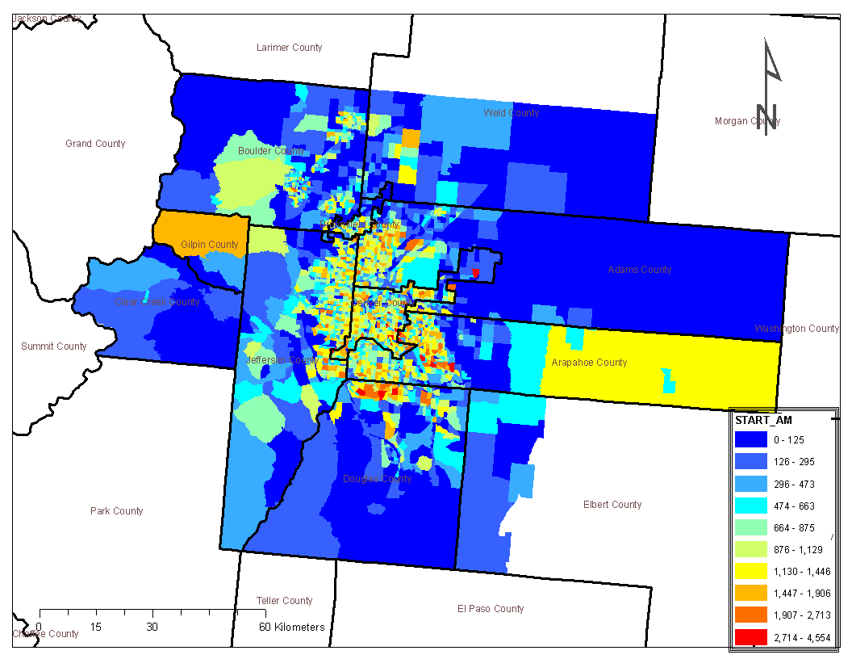
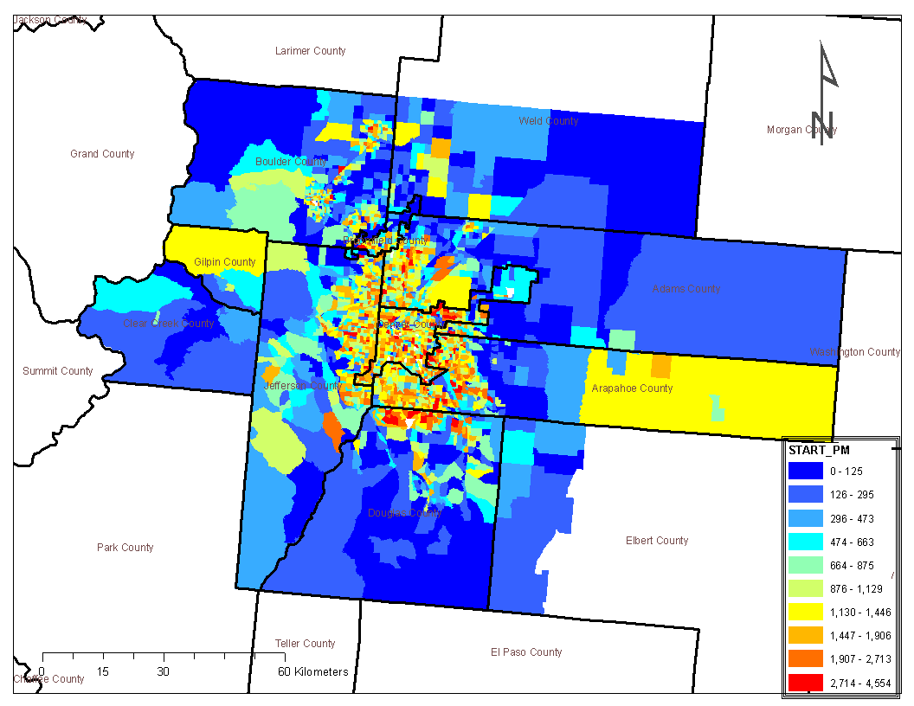
Develop spatial surrogates by time periods
AM Peak Period Trip Starts
PM Peak Period Trip Starts
  Urban core of metro Denver shows higher trip starts during PM peak hours
Notes:
Content slide, two columns with image. Image size: 8,46 cm x 10,76 cm or 320 x 407 pixels

Slide 13
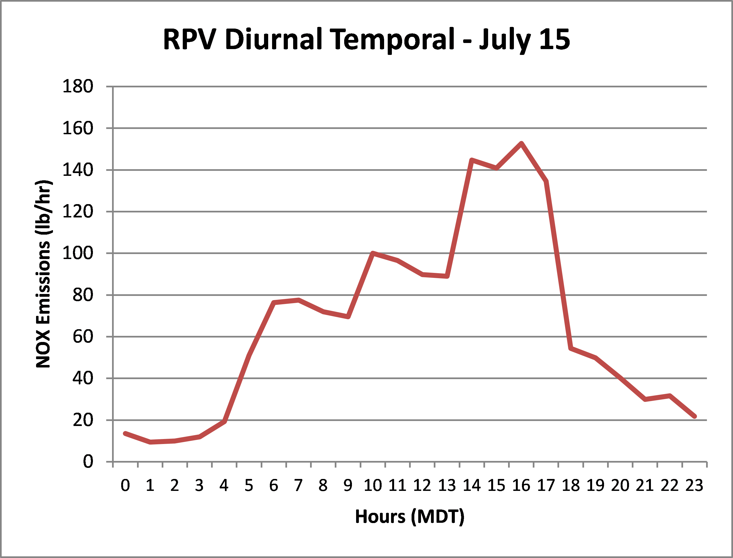
Develop spatial surrogates by time periods
Plot shows trip starts (RPV) NOx emissions diurnal variation for a grid cell over the urban core of metro Denver
Higher trip starts emissions during PM peak hours
Temporal pattern as expected. Most people live in suburbs and work in downtown

Slide 14
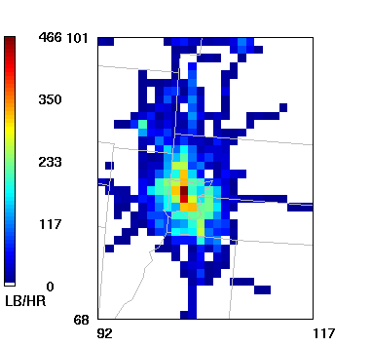
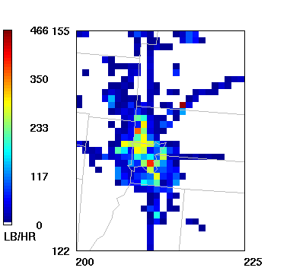
Spatial Distribution Comparison
Denver 4km NOx emissions
Urban core of metro Denver
4PM, July 15, 2011
Uses TDM data
WAQS 4km NOx emissions
Urban core of metro Denver
4PM, July 15, 2011
Uses EPA Modeling Platform data

Slide 15
Pros and cons
Advantages of using TDM data with SMOKE-MOVES processing
Use link-level traffic volume and speeds data
Use hourly vehicle mix data
Use trip starts spatial surrogate by time period
Use more local data than standard SMOKE-MOVES processing
Disadvantages of using TDM data with SMOKE-MOVES processing
Requires running SMOKE-MOVES in a non-standard fashion
Requires additional processing to prepare TDM data for SMOKE-MOVES input
Not a true link-level model that provides more detailed spatial and temporal resolution

Slide 16
Thank you
Notes:
Endslide

