Slide 1
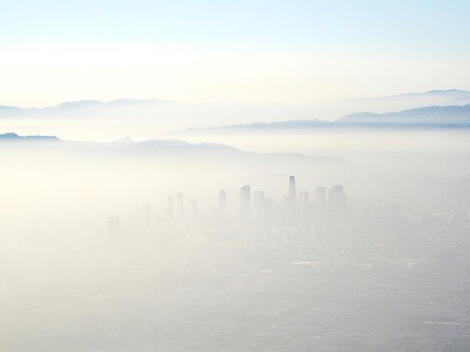

uncertainty in health impacts from climate policy due to natural variability
Rebecca Saari
Assistant Professor
Civil & Environmental Engineering
Y.F. Mei, E. Monier, F. Garcia-Menendez
CMAS Conference
Chapel Hill, NC, October 23, 2016

Slide 2
Connecting Policies to Air Quality Impacts
1-3: How does the type and scope of policy affect the distribution of costs and co-benefits from reductions in co-emitted pollutants?
4-5: What uncertainties, including climate feedbacks, affect these results?
2. Costs vs. Co-Benefits
Thompson et al. (2014)
Thompson et al. (2016)
Saari et al. (2015)
1. Policy Implementation
3. Impacts with Income
Saari et al. (in prep)
Saari et al. (submitted)
Policy
Air Quality
Human Health
Economic Benefits
4. Air Quality Impacts under Climate Change
5. Uncertainty in Health Impact Assessment
Garcia-Menendez et al. (2015)
Thompson et al. (2013) Saari et al. (in prep)
Saari et al. (in prep)
2
Notes:
I want to focus on one uncertainty in particular, related to two papers, one published and one in prep, that focuses on uncertainty from natural climate cycles, and how they obscure our policy efforts and bedevil our simulations

Slide 3
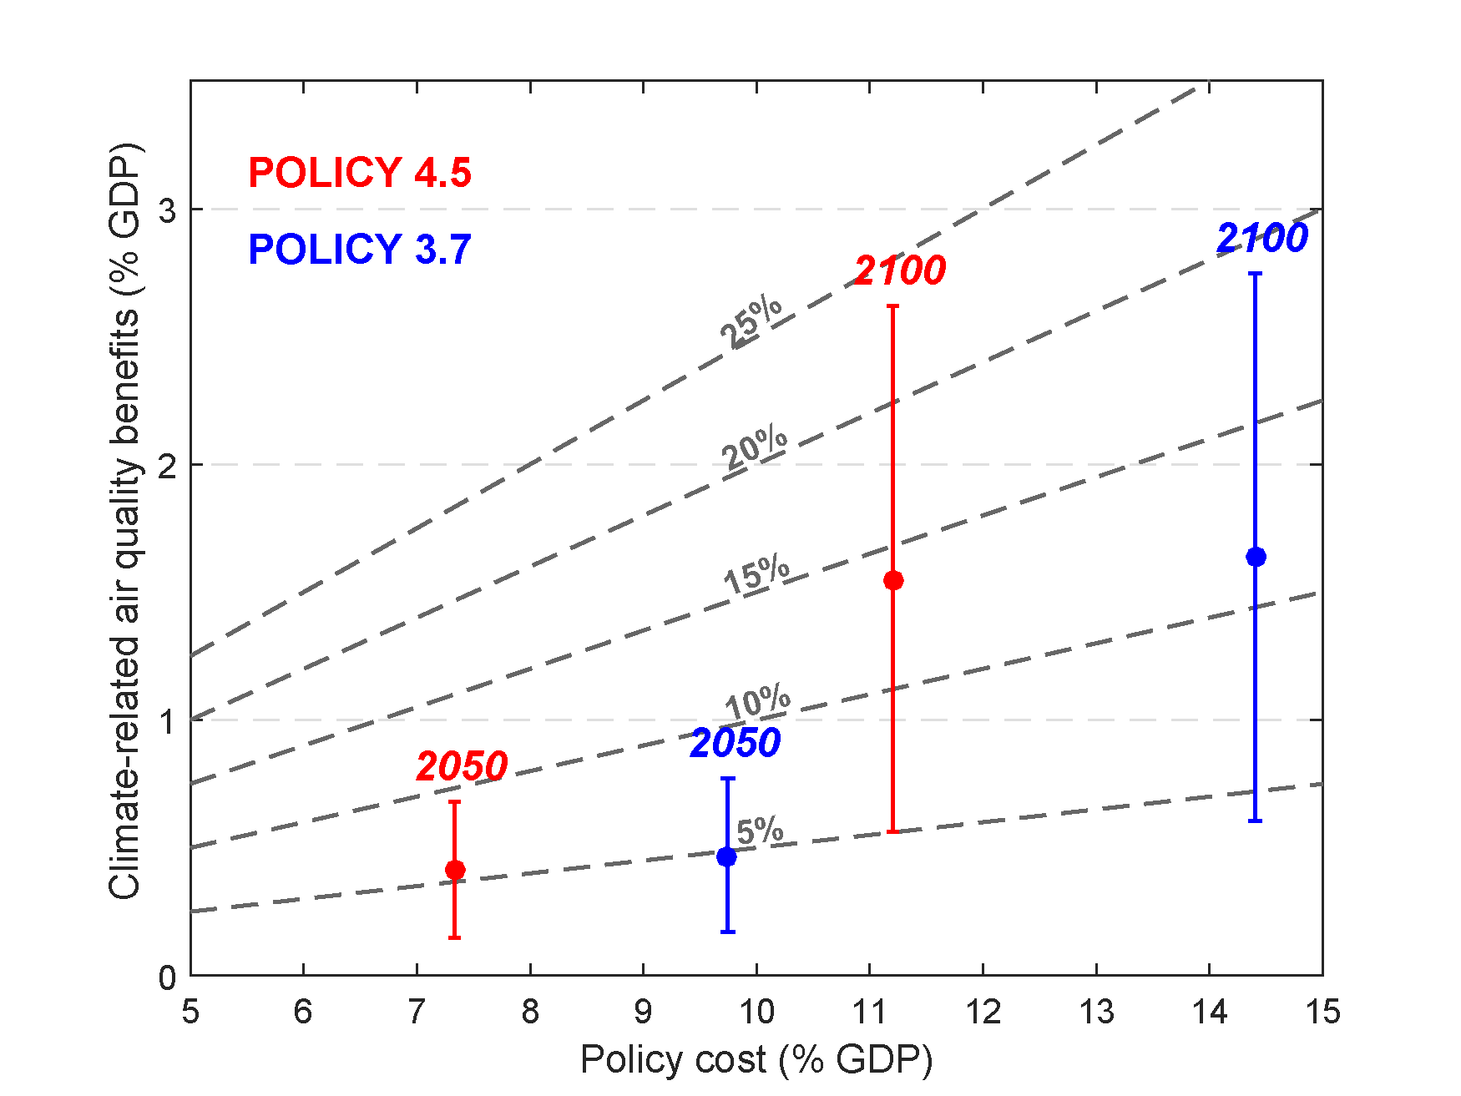
Air Quality Impacts under climate change
Policy cost & benefits from reduced mortality as fraction of REF scenario US GDP
Included in Policy
Co-Benefits from reducing co-emitted pollutants ~ 100-1000% of costs in 2030, but will reduce over time
Not Included
Benefits from reducing climate penalty are ~ 10% of costs, but are growing over time
Health uncertainty only! Natural variability?
3
Garcia-Menendez et al. (2015), ES&T.
Notes:
Climate policy affects air pollution by reducing co-emitted pollutants
Or by reducing the climate penalty, i.e. affecting the formation and transport of harmful pollutants
Generally, I believe the work that’s out there suggests that the co-emitted pollutants produce the bigger benefit, especially in the near term
We found that the effect of the climate penalty is increasingly important over time, and still represents a significant potential health benefit

Slide 4
Questions
What is the effect of natural variability on the health benefits of climate policy from reducing the climate penalty on air pollution?
Policy Relevance
What should policy-makers know about the potential impact of natural variability on adapting to the health impacts of climate change?
Modeling Relevance
How many simulation years are needed for mid and end of century estimates of climate penalty (and the resulting health impacts?)
4

Slide 5
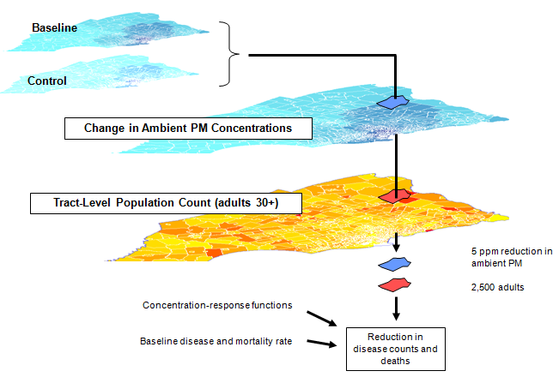
Modeling Approach
Air Quality
(IGSM-CAM)
Population
(BenMAP)
Valuation
(BenMAP)
Health Incidence
(BenMAP)
Policy
(EPPA)
New
Change in CO₂ Emissions
Change in Climate & Concentrations
Future Population Demographics
pollution
population
Concentration Response Functions
Future Health Incidence Rate
New Health Incidence Rate
Valuation (Cost of Illness, Lost Income, Contingent Valuation)
Economic Impact by Policy
5
Garcia-Menendez et al. (2015), ES&T, 49 (13) 7580-7588
Notes:
Modeling framework. Introduced in lit. global framework that aims to be self-consistent from the economic implementation of policy, down to effect on health and economy
Our baseline and policy assumptions are consistent across scenarios.

Slide 6
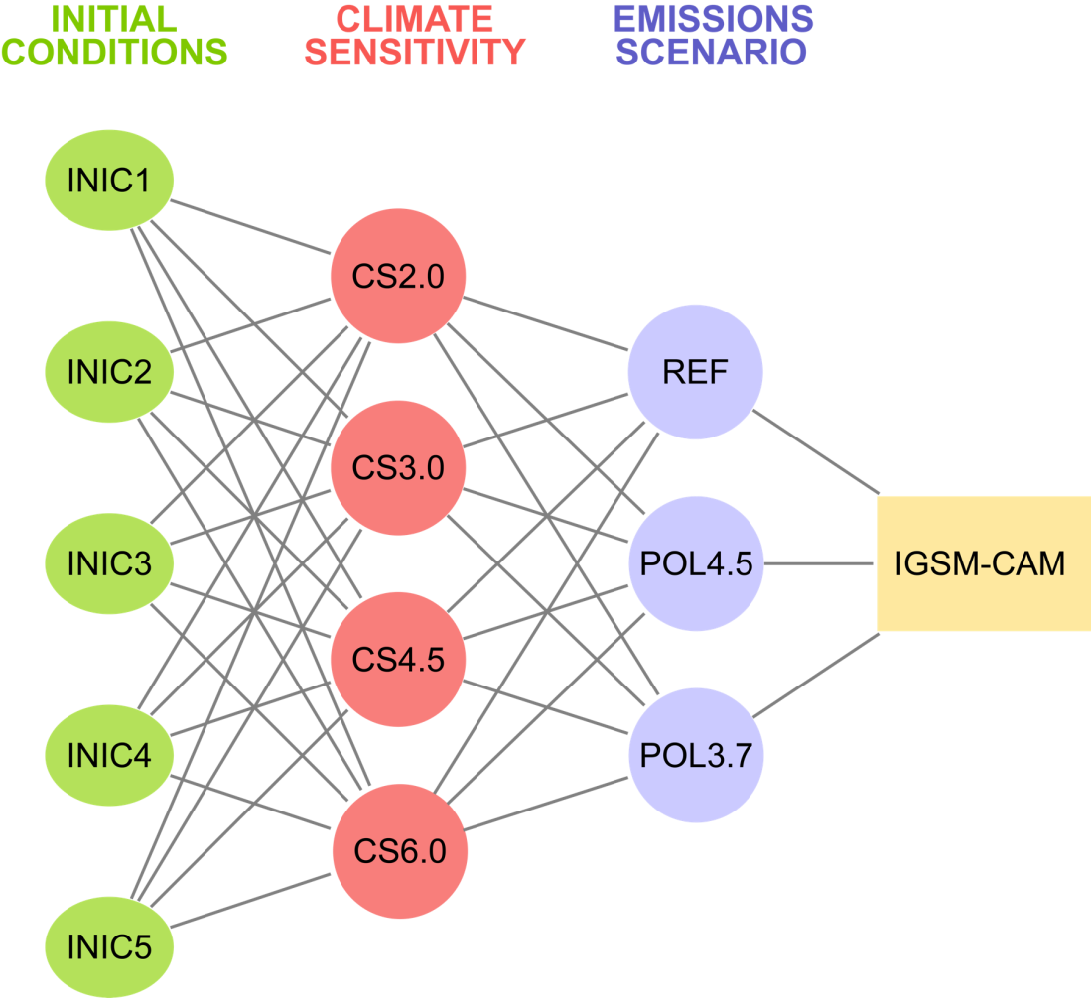
Ensemble simulation of 21st century climate change
Focus on the 3 main sources of uncertainty in climate projections:
Emissions-scenario uncertainty:
  Reference: No policy
  2100 radiative forcing = 9.7 W/m²
  Policy 4.5: Stabilization
  2100 radiative forcing = 4.5 W/m²
  Policy 3.7: Stringent stabilization
  2100 radiative forcing = 3.7 W/m²
Climate model response
  Climate sensitivity =
  2.0°C, 3.0°C, 4.5°C or 6.0°C
Natural variability
  Multidecadal simulations
  5 different initializations
6
Monier et al. (2015), Climatic Change, 131(1), 21-33
Notes:
Another strength is our ensemble. For the atmospheric modelling, we have developed an ensemble in order to study climate impacts, and the uncertainty. Specifically, in this work, we’re looking at natural variability
Importantly: 30 year simulations, and 5 ICS.
Most currently studies, according to Fiore et al. 2015, are 1 to 5 years, and are too short to isolate effect of natural variability. But we can make a reasonable attempt at this, here.
CIRA project, strength self-consistent scenarios,
exploring natural variability through multidecadal simulations, 5 Ics
Examining multiple impacts. See some of the results in the US EPA report Climate Change in the United States: Benefits of Global Action
So we, and previous authors, have shown that natural variability alone affects our predictions of mid-century climate change, but we haven’t examined how this affect the climate penalty on air pollution, or how that air pollution affects human health.

Slide 7
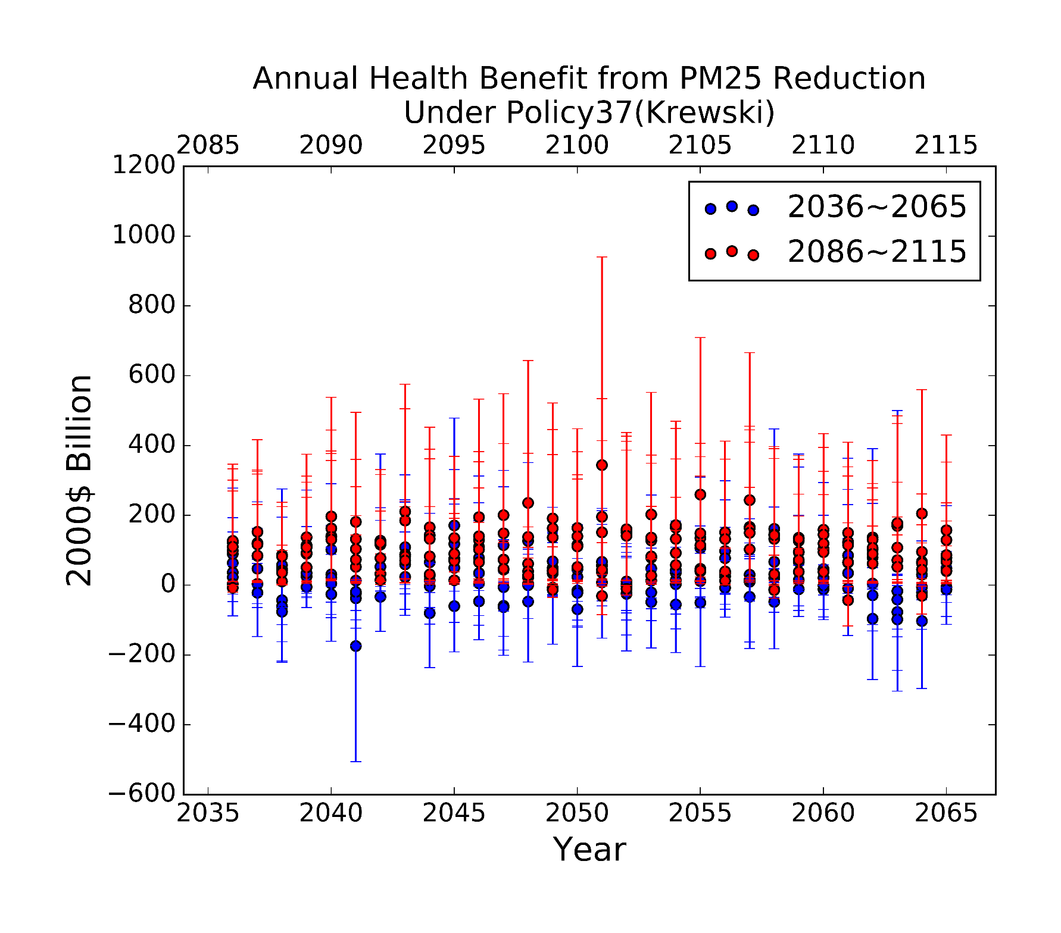
Annual variability over time
Variability across years, initial conditions, and uncertainty in health and valuation spans -$500 billion to $1000 billion annually
7
Notes:
If you’re using one year of simulation to estimate the climate penalty, it’s a bit like pulling a number out of a hat, that’s within about +- $1 trillion annually for these policies.
From those health outcomes for ozone and PM we can estimate the total benefits in each year, for our 30-year simulations
4 things going on here
Take one set of red dots here
5 dots = 5 IC, representing some decadal variability, some multidecadal
Bars = uncertainty in health response and valuations
Blue and red. Blue is mid century benefits, red is end of century, so see that annual benefits increase with time as climate system responds to policy
And, can look across these 30 years spans, and see interrannual variability
Overall range

Slide 8
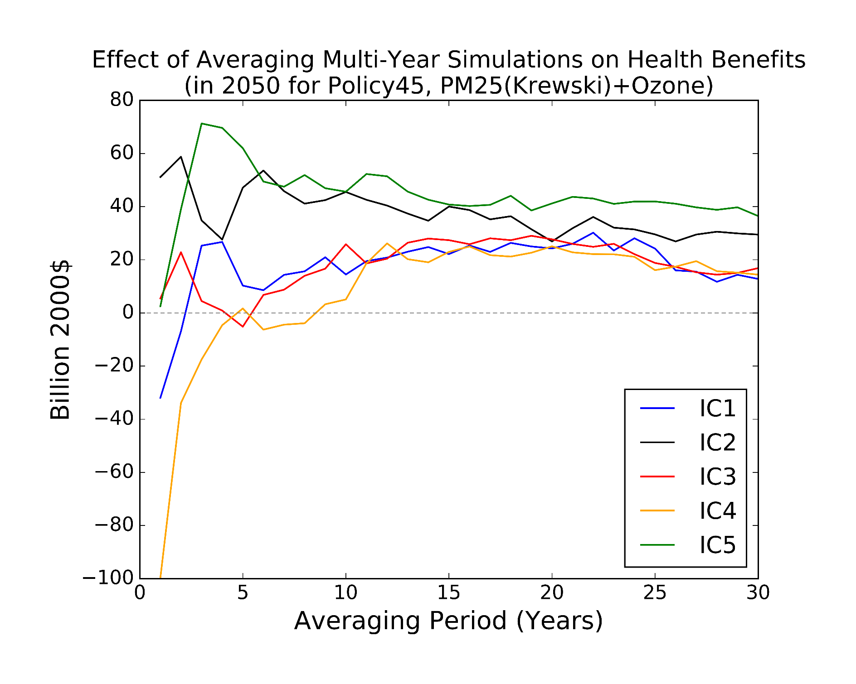
Multi-year averaging for health benefits
10 Years of Simulation Needed to Natural Climate Variability?
Using 1 year of simulation yields range of -$100 to $50 billion
annually
(Using 1 through 30 years of simulation for annual health benefits in 2050, Policy of 4.5 W/m²)
8
Notes:
Given that level of variability, it’s possible that current 1-5 year simulations of air quality are not sufficient to ascertain the effect of climate policy
We examined that.
If we want to est policy benefits in 2050, we have 30 years and 5 Ics, so 150 years worth of data
And we can take the average to smooth out this natural variability
That’s hwat we’ve do here
Estimating the annual benefits, from reduced ozone and PM, from our P45 policy
At first, we just use the year 2050, and you can see that, depending on the initial condition, we can get a very different answer on the effect of our policy, from -100 to 50 billion dollars.
Remember, current studies often use 1 year of simulation, some may use 5.
But this suggests that you need 10 years before you even cross zero
So it’s possible that our current approach could be leading us astray in a big way, where we don’t even know if it’s a benefit or loss.
Even 30 years, we are converging, but not completely, so there’s probably some multidecadal variability we aren’t capturing, but we’re doing a lot better
So, problem solved, just need 10 years of simulation, and you’ve got the sign right, and we’re done, right?

Slide 9
Multi-year averaging can reduce effect of natural variability on health benefits
Compounding Uncertainty
9
Notes:
So, in the last three plots, looking at the left-hand side, the shortest simulations, we went from a range of about -100 to 50, when we looked at different Ics
To -200 to 150 when we also thought about varying the year of interest
To +/400 billion in annual benefits, when we consider all three of these effects. So, with a single year simulation, I’d say we don’t have a great idea of what the health impact associated with reducing the climate penalty will be.
But, with 30 years, we are pretty confident that it’s at least positive
And here is the range from IC, or decadal variability, Year of Interest, like interannaul variability, and Health response. So, these are getting bigger because they’re compounding.

Slide 10
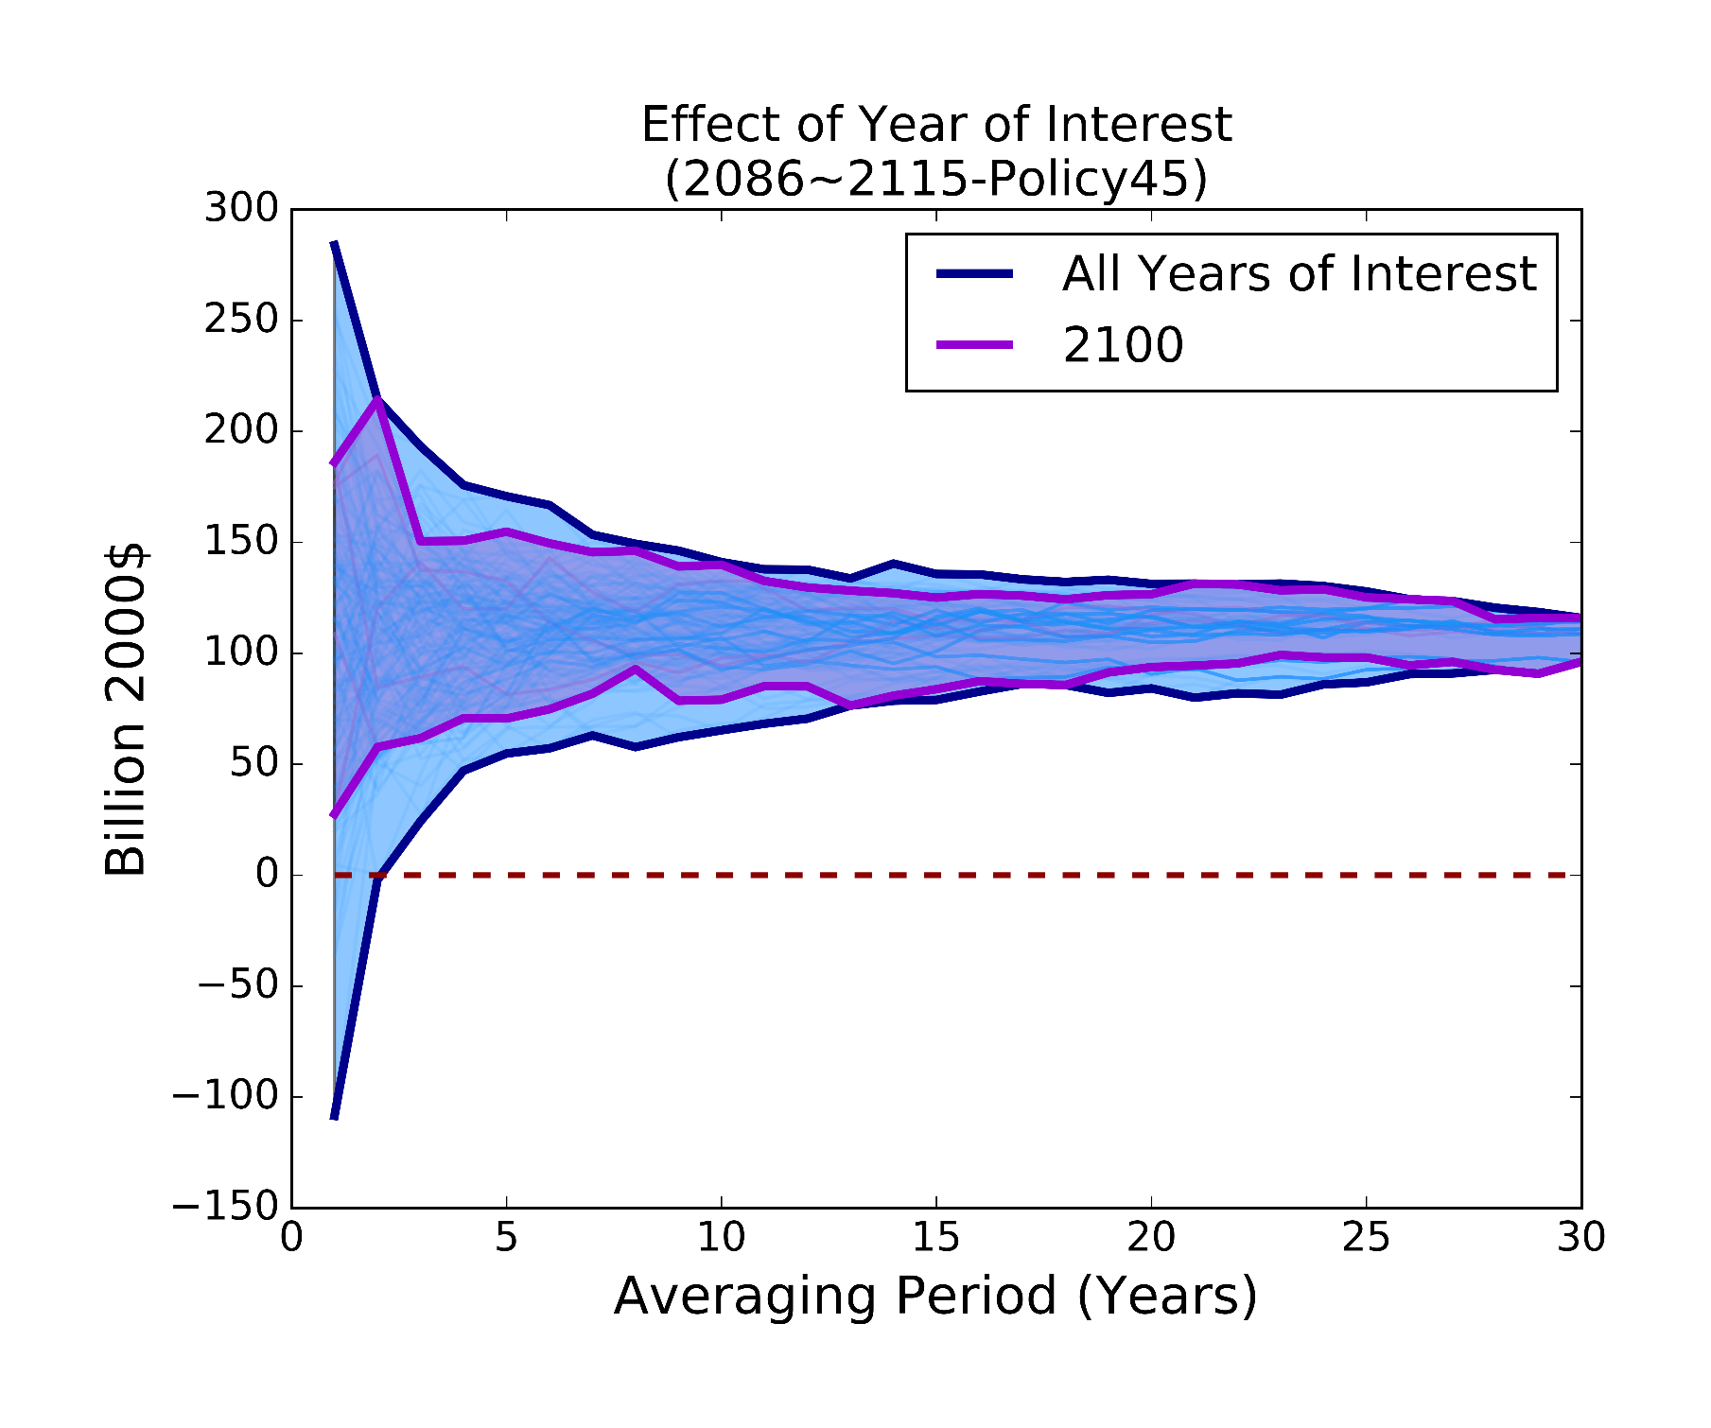
Choice of policy Year (2086 to 2115)
End-of-century
All simulations cross 0 after 2 years. There’s less variation across policy years
10
Notes:
Mid century is tough. But not all bad news, by end of century, we’re far more likely to see a positive effect of policy across all simulations.
All positive after 2 years, and by around 5 years, starting to hone in on 110 billion
But should we still keep going here? To 10 years maybe?

Slide 11
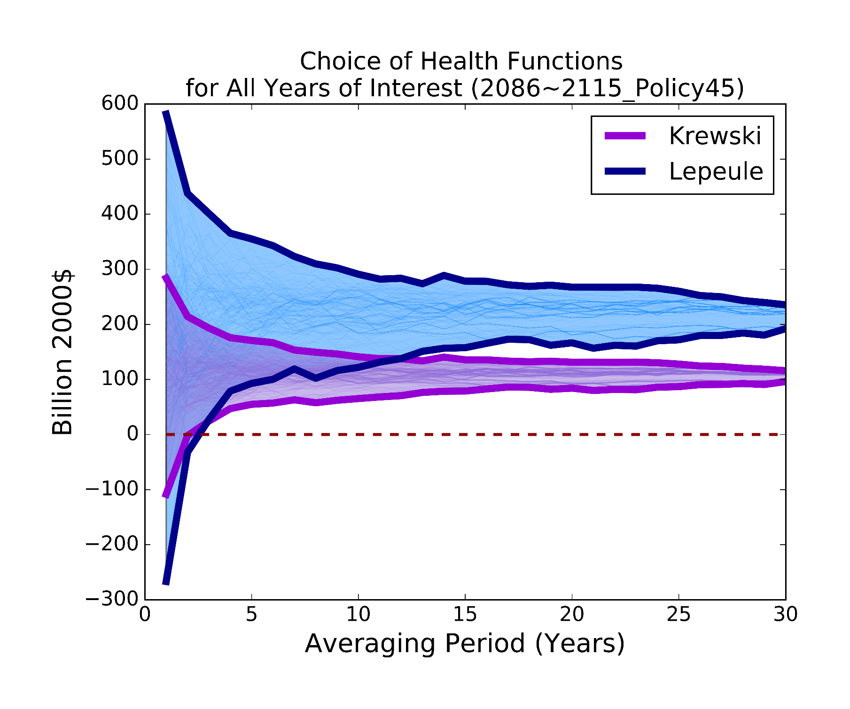
Choice of health response function: krewski vs. Lepeule 2100
Uncertainty from health response dominates natural variability after ~ 5 years of simulation
For end-of-century, 30-year simulations of health estimates using Krewski yield >$100 billion while Lepeule yield >$200 billion annually
11
Notes:
I would suggest, probably not worthwhile doing more than 5 years of simulation for end of century.
You can of course, but that’s when the uncertainty in the health response starts to dominate, and we see clear divergence here between these two estimates, and again, Lepeule will give you an estimate that’s around 200, while Krewski is 100.
So, at the end of century, your efforts to more accurate estimates of PM2.5 are going to be swamped by the choice of health function. So this other uncertainty dominates.

Slide 12
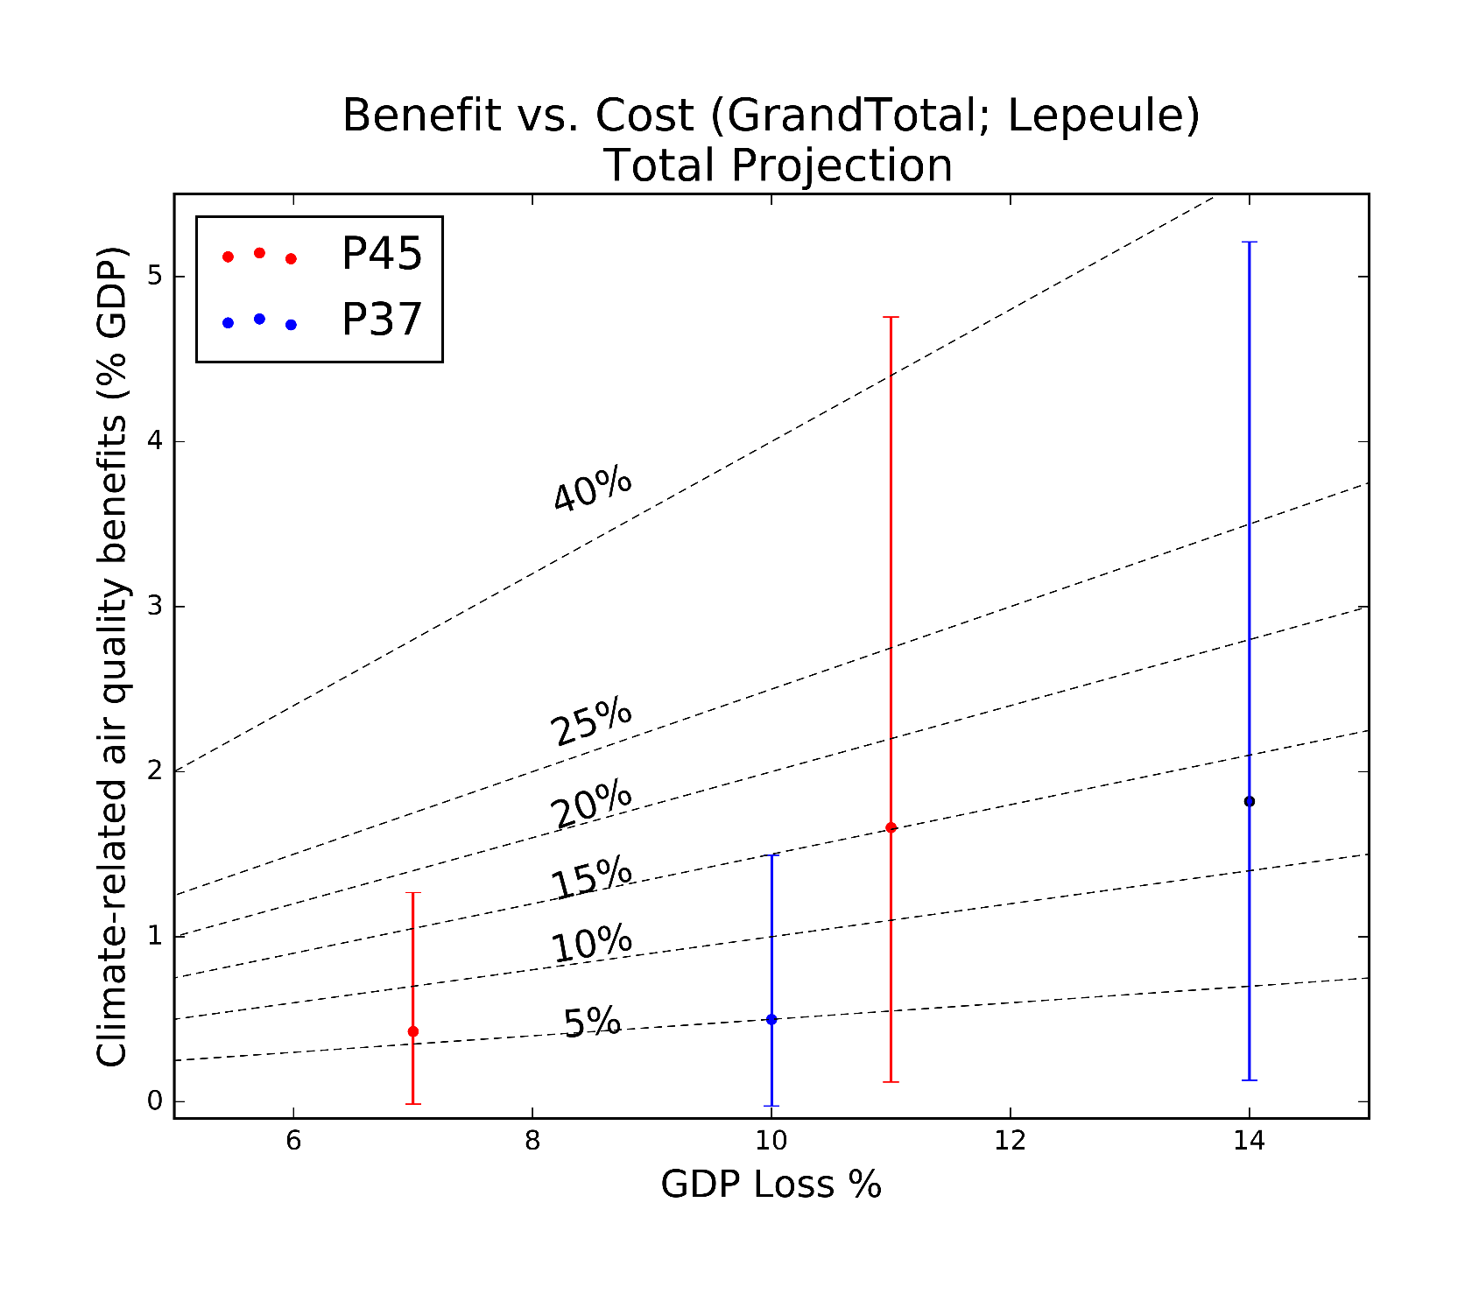
Benefits as a % of reference GDP (single year, 2050)
2100
2100
Cost offset up to 15% by 2050, 40% by 2100
Health and valuation uncertainty only
2050
2050
12

Slide 13
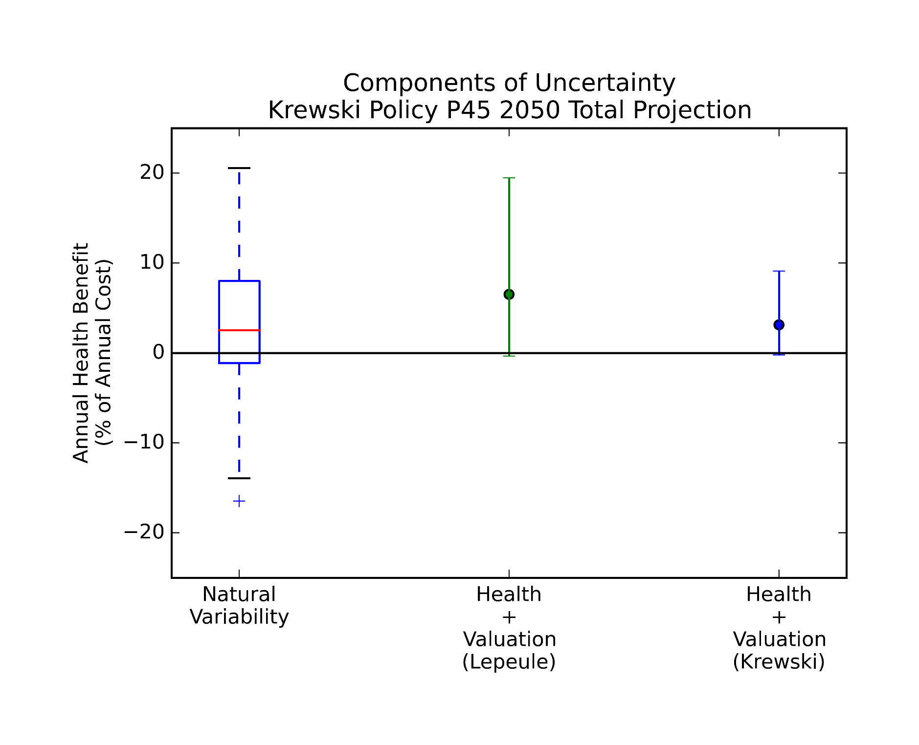
Components of Uncertainty (2050)
Mid-Century
Uncertainty from Natural Variability dominates uncertainty from health and valuation
Use 10 years of simulation!
13
Notes:
Climate policy affects air pollution by reducing co-emitted pollutants
Or by reducing the climate penalty, i.e. affecting the formation and transport of harmful pollutants
Generally, I believe the work that’s out there suggests that the co-emitted pollutants produce the bigger benefit, especially in the near term
We found that the effect of the climate penalty is increasingly important over time, and still represents a significant potential health benefit

Slide 14
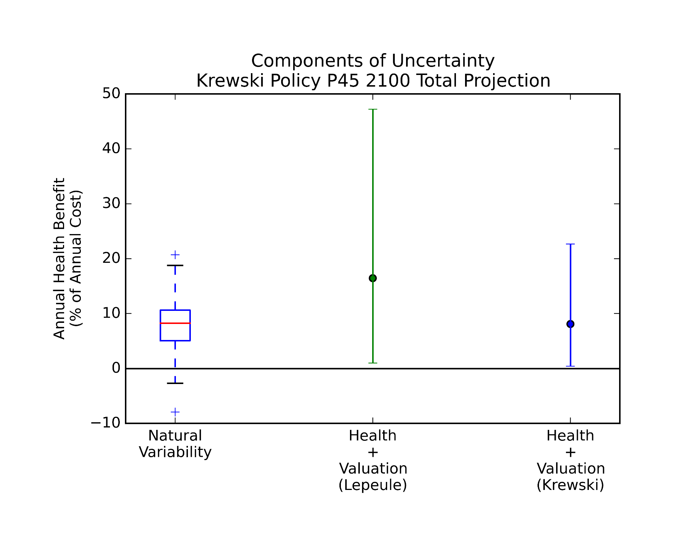
Components of Uncertainty (2100)
End of Century
Uncertainty from health and valuation
dominates that from natural variability
Current practice of 1-5 years is fine
14
Notes:
Climate policy affects air pollution by reducing co-emitted pollutants
Or by reducing the climate penalty, i.e. affecting the formation and transport of harmful pollutants
Generally, I believe the work that’s out there suggests that the co-emitted pollutants produce the bigger benefit, especially in the near term
We found that the effect of the climate penalty is increasingly important over time, and still represents a significant potential health benefit

Slide 15
CONCLUSIONS
For mid-century, need long (10 year) simulations, but for end-of-century, current practice may be fine, given uncertain health responses
For mid-century climate change, need to average longer simulations
10-year simulations cross 0
Longer simulations reduce effect of variability on benefit estimate
Single-year simulations have compounding uncertainty from variability and health responses that yield a range from -$400 to $400 billion annually
30-year simulations yield a range of $5-70 billion
For end-of-century climate change, the health and valuation uncertainty begins to dominate effect of natural variability
15

Slide 16
“Answers”
What is the effect of natural variability on the health benefits of climate policy from reducing the climate penalty on air pollution?
Policy Relevance
Current practice is potentially misleading, even in sign of impact from a changing climate
Modeling Relevance
In near-term studies, natural variability adds significant random error to climate penalty
This is reduced by 10-30 year simulations
For end-of-century, health and valuation uncertainty dominate
16

Slide 17

Acknowledgments
Helpful Input
Noelle E. Selin, Sergey Paltsev (MIT)
Funding
University of Waterloo, U.S. DOE Office of Science, the U.S. EPA STAR program, the MIT Energy Initiative Seed Fund with John Reilly, Noelle Selin, and Susan Solomon, the Martin Family Society of Sustainability Fellows, MITEI Total Energy Fellows, MIT Leading Technology Policy, and the MIT Joint Program on the Science and Policy of Global Change.
17

Slide 18
WORKS CITED
F. Garcia-Menendez, R.K. Saari, E. Monier, N.E. Selin, “Impacts of climate change and benefits of climate policy for U.S. air quality and health.” Environmental Science and Technology, 49 (13) 7580-7588 doi: 10.1021/acs.est.5b01324. (2015)
Monier E, Paltsev S, Scott J, Sokolov A, Reilly J (2015) Integrated economic and climate projections for impact assessment. Climatic Change, 131(1), 21-33, doi:10.1007/s10584-013-0892-3. [pdf]
18

Slide 19

For further information:
Rebecca K. Saari, PhD rsaari@uwaterloo.ca http://saarir.scripts.mit.edu/index/

Slide 20
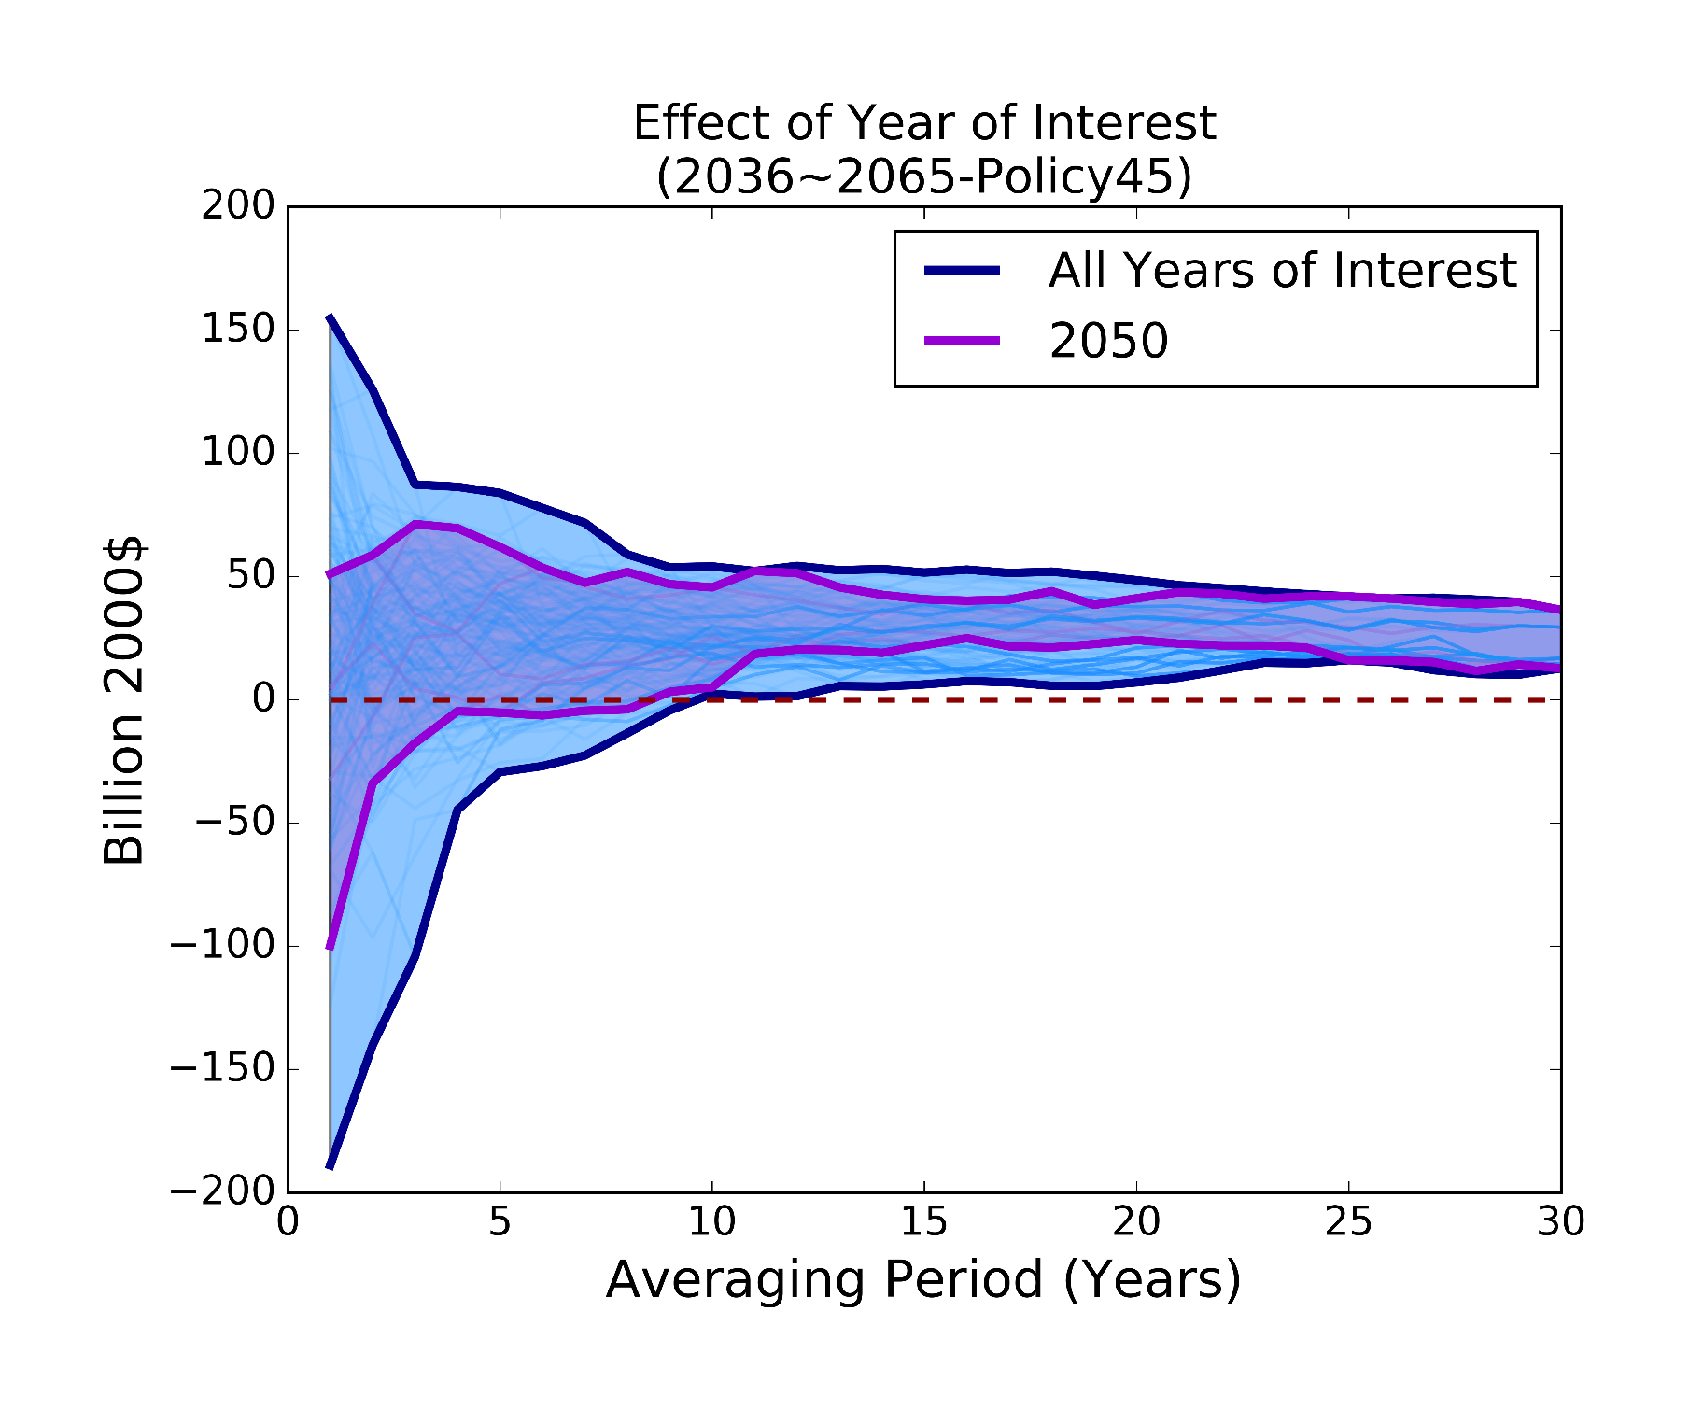
Choice of study Year (2036 to 2065)
Choice of study year doubles potential range in benefits with 1 year simulation
But still crosses 0 around 10 years
20
Notes:
Maybe not. It’s not as simple as that. Because that interannual variability matters a lot too, and we just picked 2050 as a nice round number. But if we’d pick 2049, or 2051, we’d have a very different story again.
In purple, those are the 5 lines for the year 2050 that we just saw on the previous slide.
If we consider all of the years in our 30 year period, this shows the effect of the policy target year. Some years look very good, $150 billion, others look very sad, $200 loss, so air quality getting worse.
And this effect of interannual variability is about double the range of our trying to account for some decadal variability with our initial conditions
So, we can potentially bias our policy estimate significantly just by picking a single nice round year to example, and then assuming all our annual benefits will look like that year. Not a robust strategy.

Slide 21
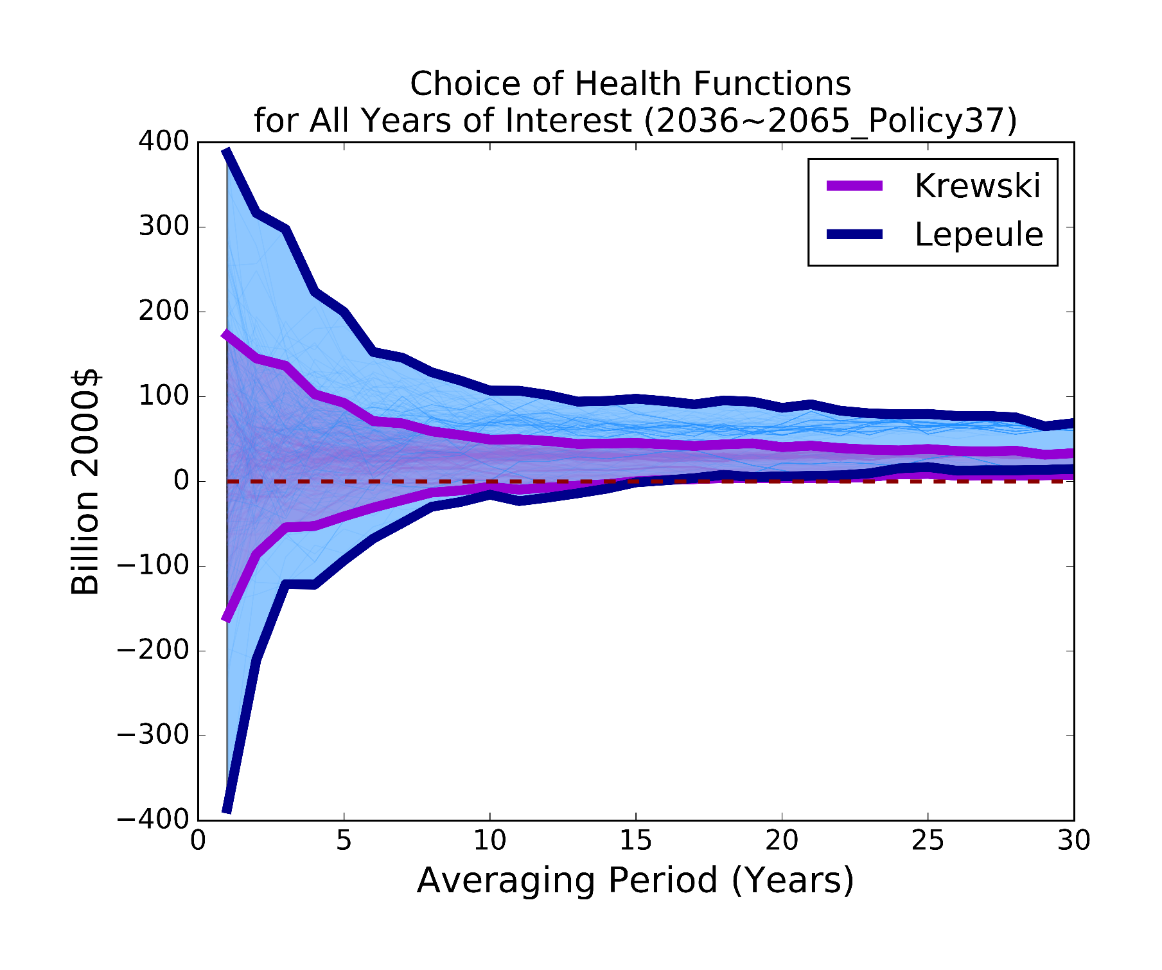
Choice of health response function: krewski vs. Lepeule 2050
Uncertainty from choice of health response function doubles initial range again
Still all cross around 10 years
21
Notes:
Aside from the climate itself, our human health response are also uncertain.
Two main studies to estimate effect of PM2.5 on mortality. If you consider them both, looks even worse for short simulations, bigger range in general,
The purple is the bigger range from the last plot.
and Lepeuple converges to a number that’s about twice as high, 50 instead of 25 billion annually
But still cross at 10 years

Slide 22
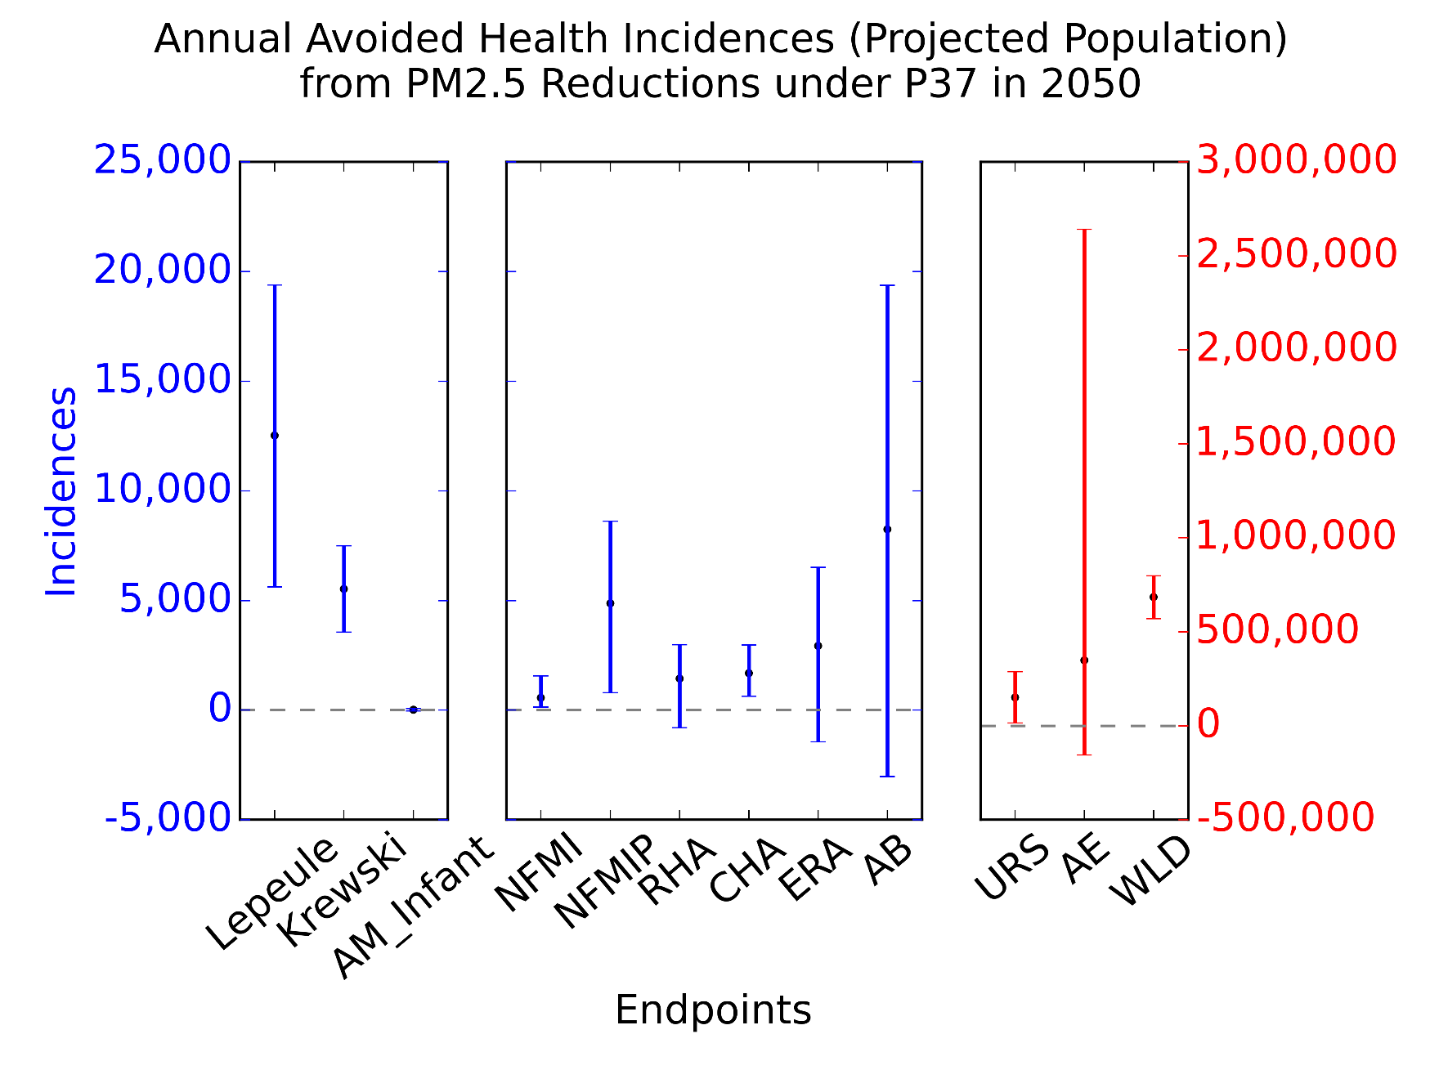
Annual avoided incidences for pm_{2.5} in 2050
Reduced incidences of mortality and morbidity
PM_{2.5}-related mortality and morbidity
(heart attacks, hospital admissions, respiratory symptoms, asthma exacerbation, lost work)
22
Notes:
99% of benefits are from reduced mortality risk. WTP just much higher. But now we also include impacts from NFMI, HA, resp symptoms, lost work.
NOT peer reviewed, initial findings, so, subject to change though they’ve been QA’d pretty carefully at this point
Ozone, for comparison, mortalities more like 1200, so larger effects from PM

Slide 23
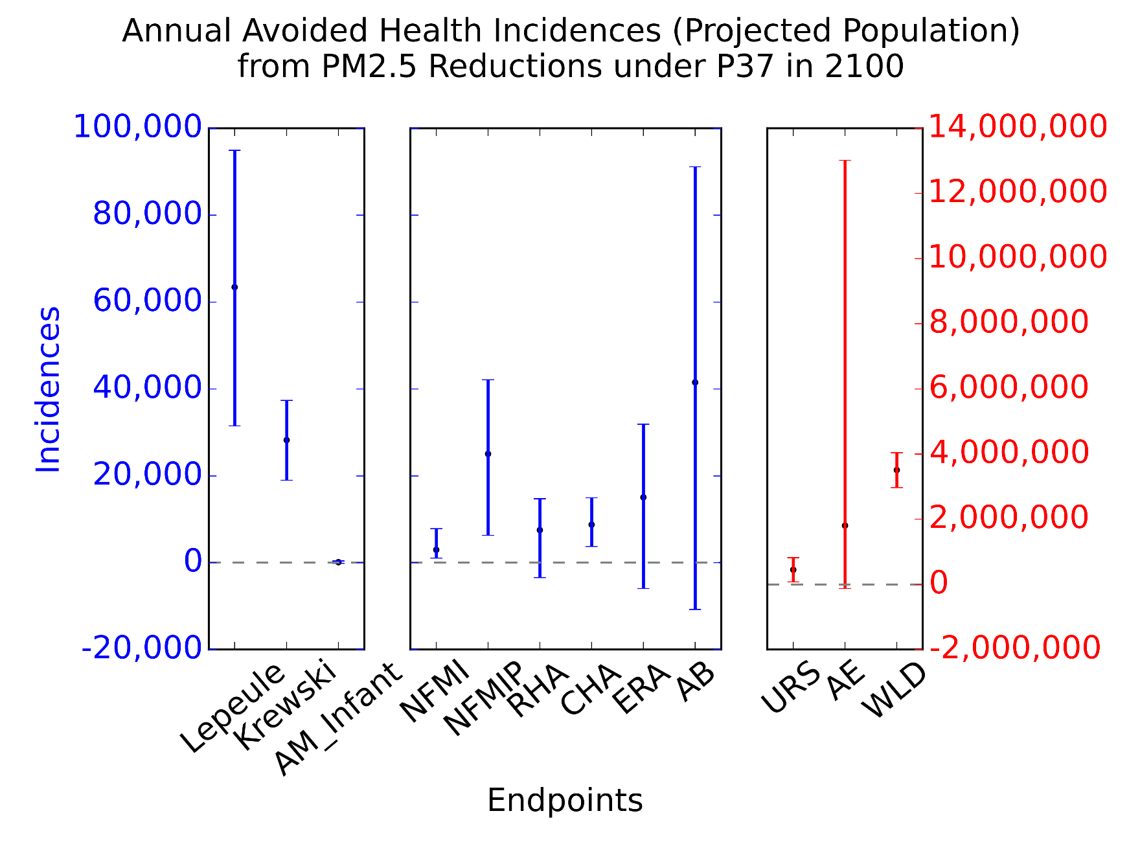
Annual avoided incidences for pm_{2.5} in 2100
Reduced incidences of mortality and morbidity
By 2100, avoided incidences increase by a factor of 4-5
23
Notes:
By 2100, annual health impacts about 4-5 times higher

Slide 24
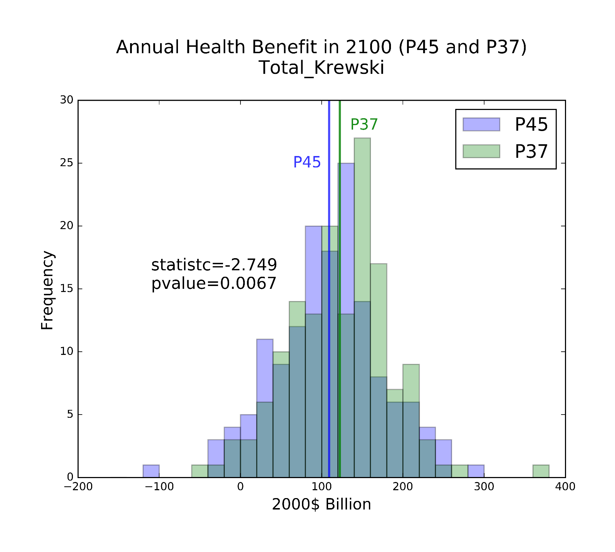
Variability in benefits across policies
Mean P37 > Mean45, overlap, but significantly different (p < 0.007)
P37 over 30 years, 5 ICs Mean of $120 million, P45 ~$110 million in 2100
Paired t-test shows means significantly different (p-value 0.0067)
(This is just the means of the health estimates!)
24
Notes:
Don’t know if I’ll have time for two policies

Slide 25
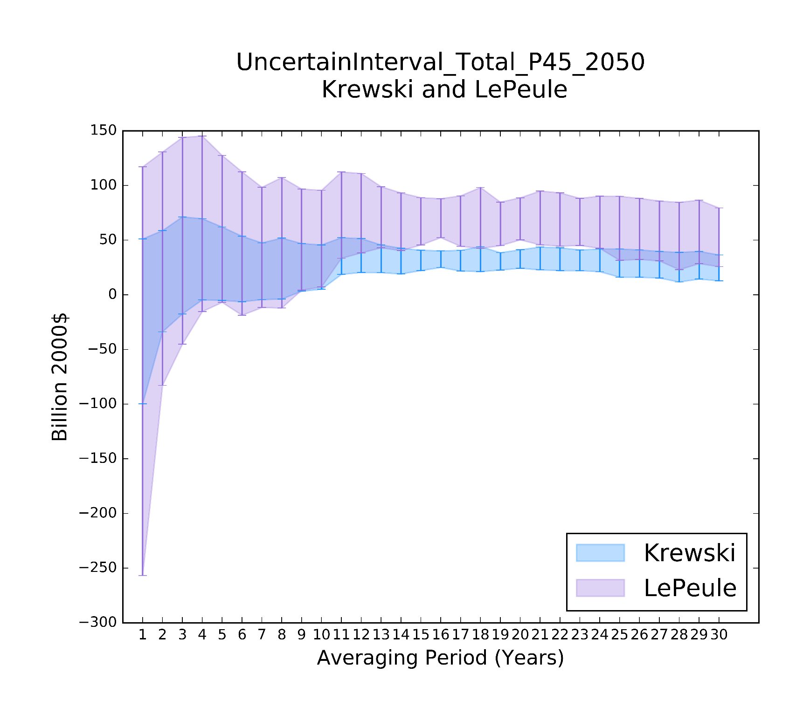
Averaging simulation years: krewski vs Lepeule 2050
But, health function choice doubles this range
For mid-century climate change, estimates for Krewski or Lepeule across 5 Initial Conditions overlap even for 30-year averages
25

