Slide 1
Emissions Reconciliation Analyses in California's South Coast Air Basin
Stephen Reid, Hilary Hafner, Yuan Du
Sonoma Technology, Inc.
Timothy French
Truck and Engine Manufacturers Association
15th Annual CMAS Conference
Chapel Hill, NC
October 24, 2016
620000-6539

Slide 2
Presentation Outline
Background and Objectives
Technical Approach
Previous Studies in California's South Coast Air Basin (SoCAB)
Key Findings
Conclusions

Slide 3
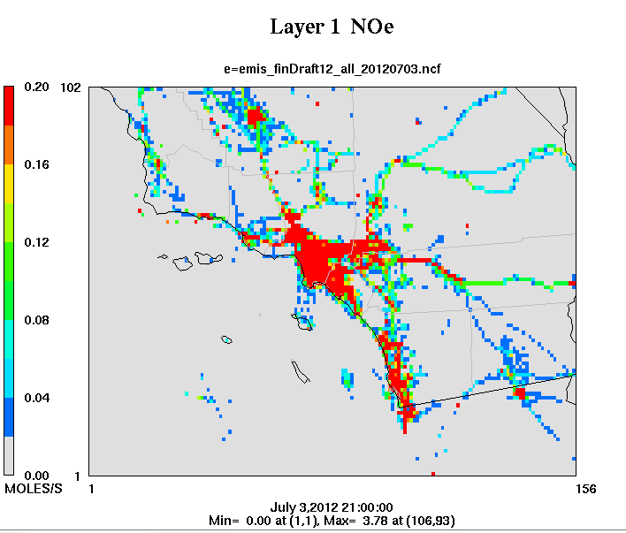
Emissions Reconciliation (1)
Background and Objectives
Emissions inventories are critical components of air quality management plans
Accurate emission inputs are
required for photochemical
modeling efforts
Emissions reconciliations help
to evaluate model-ready inventories by comparing
emission estimates with
ambient monitoring data

Slide 4
Emissions Reconciliation (2)
Background and Objectives
Focuses on pollutant ratios (e.g., VOC/NO_{x}) rather than the absolute magnitude of emissions
Most applicable to situations where the observed concentrations are dominated by local emissions
Rule of thumb: ambient- and emissions inventory-derived ratios that are within ±25 to 50% are considered to be in good agreement

Slide 5
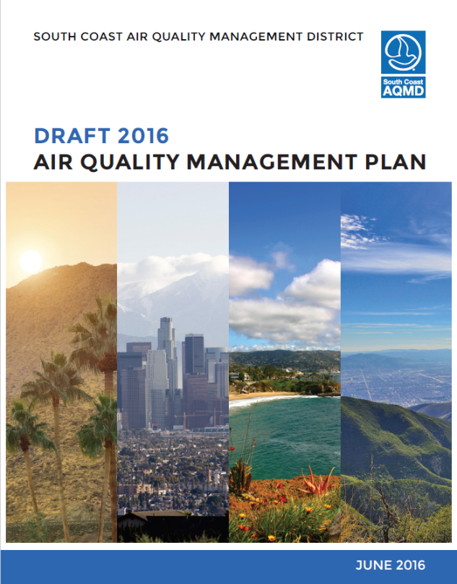
Objectives
Background and Objectives
Evaluate emissions data used for modeling done in support of the 2016 South Coast AQMP
Companion to dynamic model evaluation by Ramboll Environ
Key elements
  Ambient/emissions comparisons for 2012 baseline year
  Trends comparisons using backcast (1995, 2000, 2005, 2008) and projected (2015) inventories

Slide 6
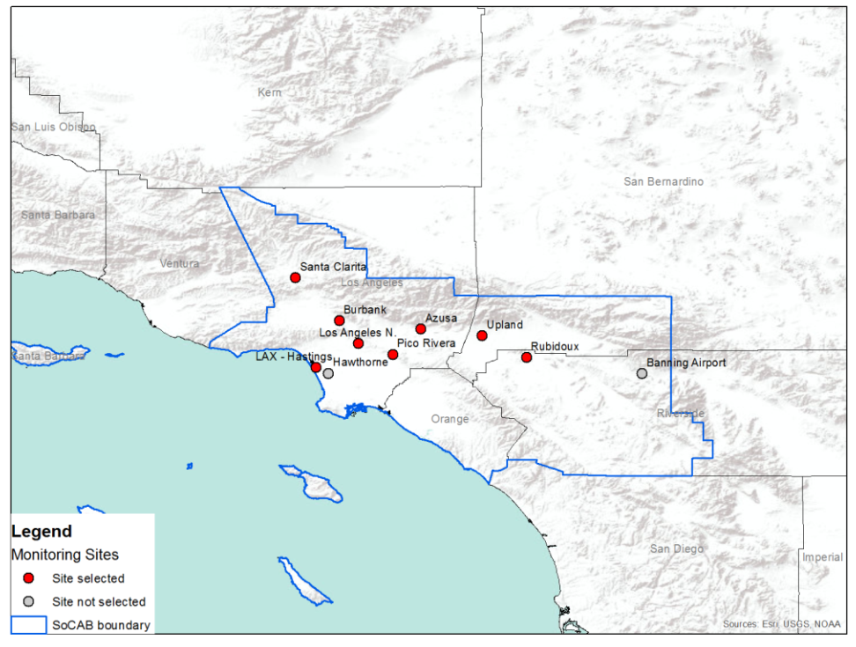
Ambient Monitoring Data
Technical Approach
Evaluated PAMS and other monitoring sites in the SoCAB
Identified eight sites with suitable data
Selected ozone season (May through October) data from early morning
hours (0500–0900 PST)
Validated and screened data

Slide 7
Emissions Inventory Data (1)
Technical Approach
Started with CMAQ-ready emissions inputs
  4-km grid resolution
  SAPRC07 chemical mechanism
Eliminated SAPRC07 species not detected by PAMS instruments (e.g., methane)
Converted VOC emissions to moles of carbon (moles-C) to match the PAMS data (reported as ppbC)

Slide 8

Emissions Inventory Data (2)
Technical Approach
Selected data from morning hours (0500-0900 PST) and grid cells of interest
Grid analysis zones for each monitoring site was defined based on average morning wind speeds

Slide 9
Ambient/Emissions Comparisons
Technical Approach
Compared historical trends in ambient pollutant concentrations and emissions inventory estimates
Calculated and compared trends in TNMOC/NO_{x} and CO/NO_{x} ratios for ambient concentrations and emissions inventory data
Sample trends plots shown for the Asuza site

Slide 10
SoCAB PAMS Analysis
Previous Studies
2005 STI analysis on behalf of SCAQMD¹
Ambient data from North Main site for summer mornings (0500-0800 PST)
ARB inventories for LA County, 1993-2001
Ambient VOC/NO_{x} ratios declining over time
Agreement between ambient- and emissions inventory-derived ratios improved over time

Slide 11
SoCAB Ozone Trends Analysis
Previous Studies
2013 DRI-led analysis followed up on two previous studies²
Ambient TNMOC/NO_{x} ratio twice as high as emission ratio in 1987
Agreement in 1997
Bar represent average results across all SoCAB sites
In 2009, ambient ratio increases relative to 1997, while emission ratio continues to decrease
Ambient ratio again twice as high as emission ratio

Slide 12
Ambient Monitoring Data Trends
Key Findings
Overall “glide path” shows decreases in pollutant concentrations over time
However, significant year-to-year variability occurs at some sites
Burbank
LANM

Slide 13
Trends Comparisons
Key Findings
Calculated average annual changes in concentrations and emissions from 1995 to 2015
Generally good agreement, although emissions trends do not capture potential site-specific variations over time

Slide 14
2012 Pollutant Ratios
Key Findings
Site | TNMOC/NOx |  |  | CO/NOx
 | Ambient | Emissions | Ambient/Emissions | Ambient | Emissions | Ambient/Emissions
Burbank | -- | -- | -- | 9.5 | 9.4 | 1.0
LAXH | 6.7 | 2.9 | 2.3 | -- | -- | --
LANM | 9.8 | 3.2 | 3.1 | 14.0 | 9.3 | 1.5
Pico Rivera | 5.4 | 3.2 | 1.7 | 8.1 | 8.9 | 0.9
Azusa | 10.0 | 3.9 | 2.6 | 10.5 | 8.1 | 1.3
Rubidoux | 5.9 | 2.8 | 2.1 | 10.1 | 6.7 | 1.5
Santa Clarita | 6.7 | 3.3 | 2.0 | 10.2 | 7.6 | 1.3
Average | 7.4 | 3.2 | 2.3 | 10.4 | 8.3 | 1.2

Slide 15
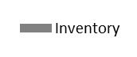
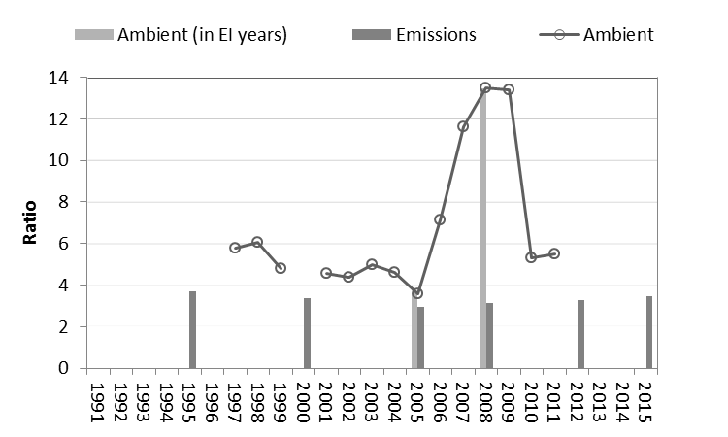
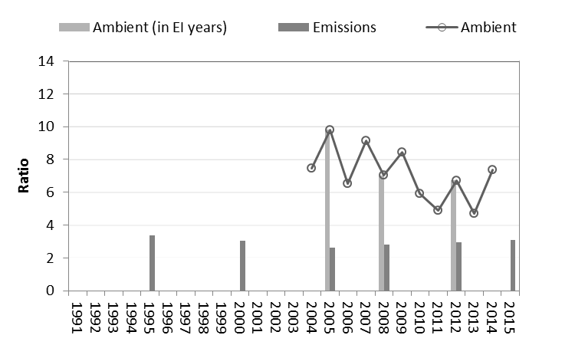
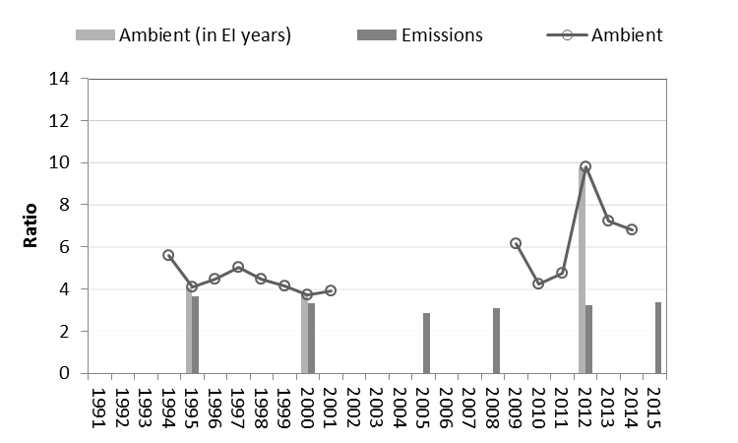
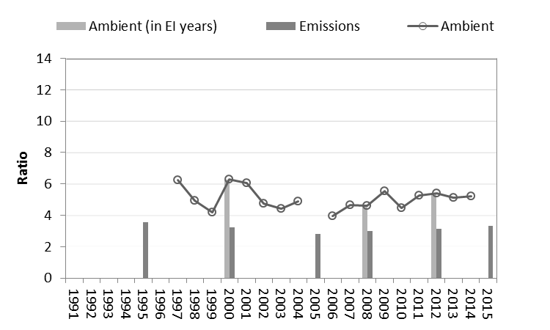
TNMOC/NO_{x} Ratios (1)
Key Findings
Burbank
LAXH
LANM
3.1x
Pico Rivera

Slide 16
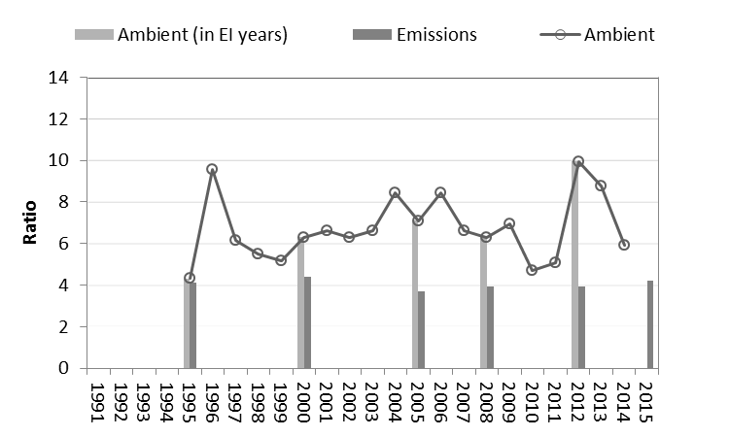
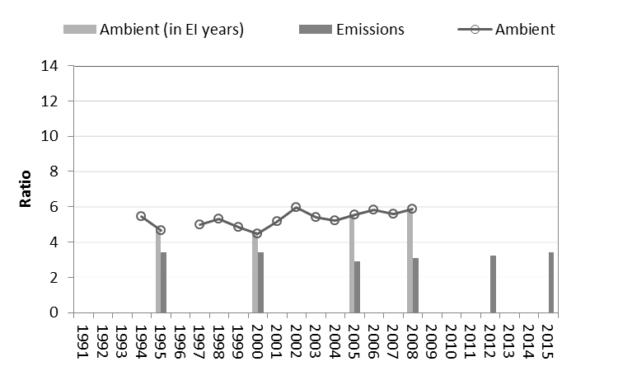
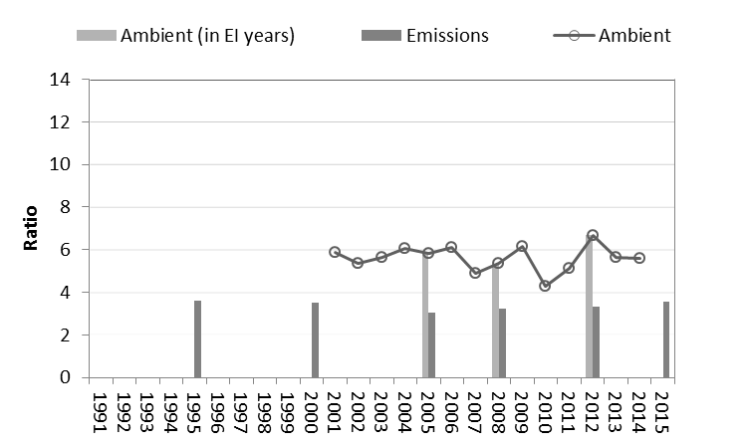

TNMOC/NO_{x} Ratios (2)
Key Findings
Azusa
2.6x
Upland
Santa Clarita
Rubidoux

Slide 17
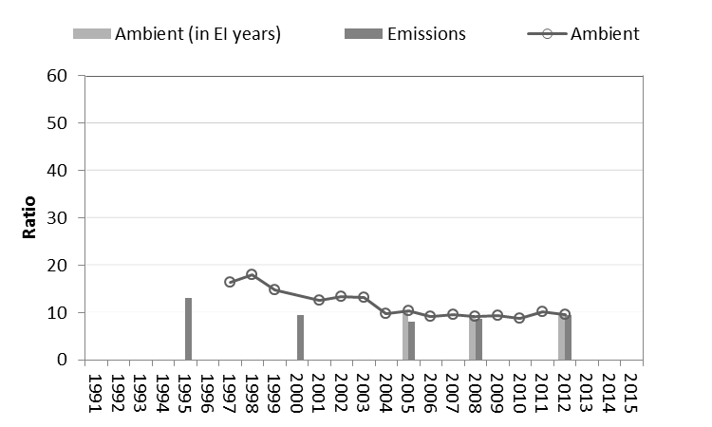
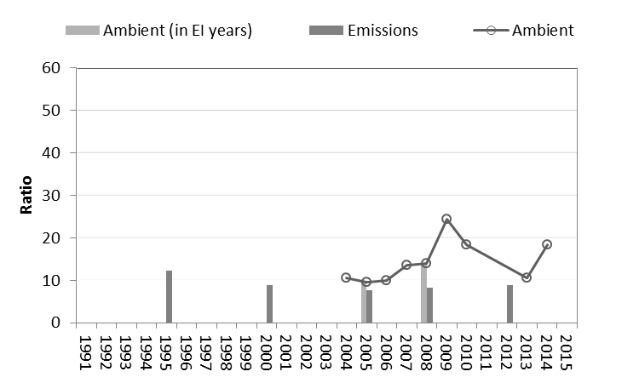
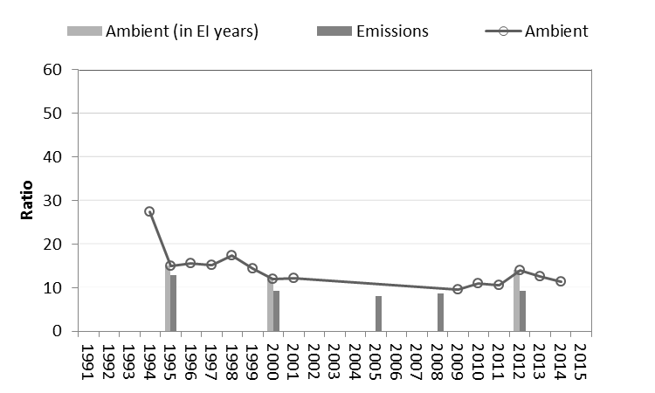
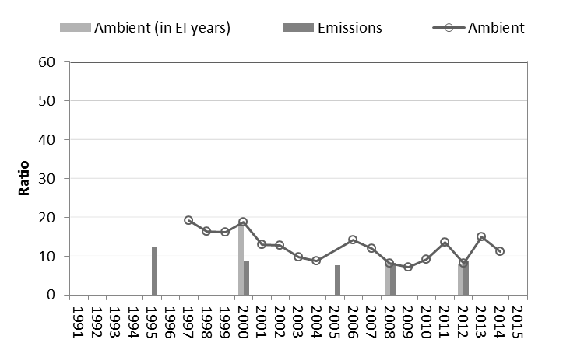
CO/NO_{x} Ratios (1)
Key Findings
Burbank
LAXH
LANM
Pico Rivera

Slide 18
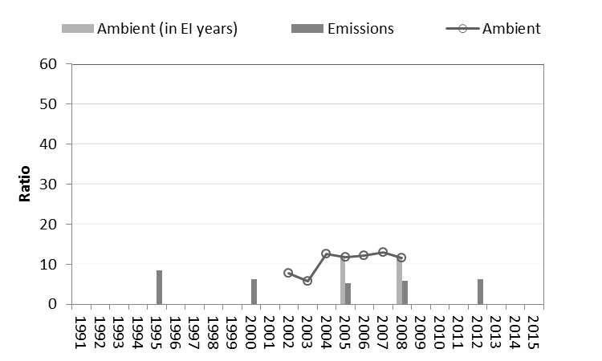
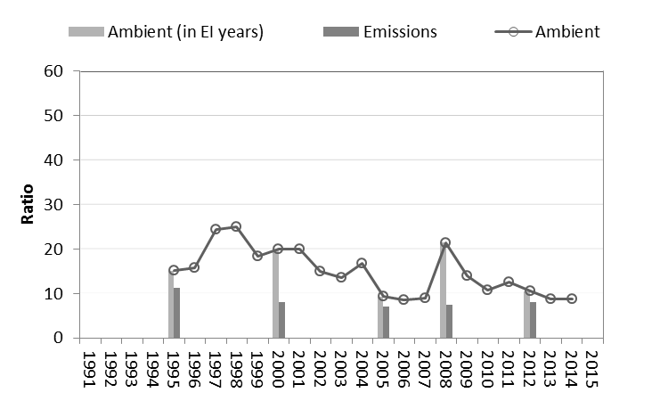
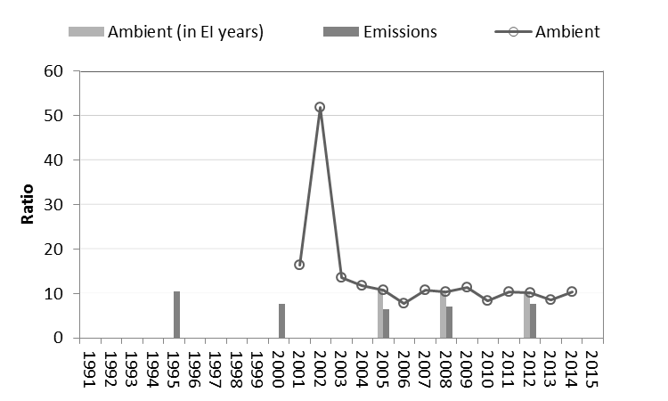
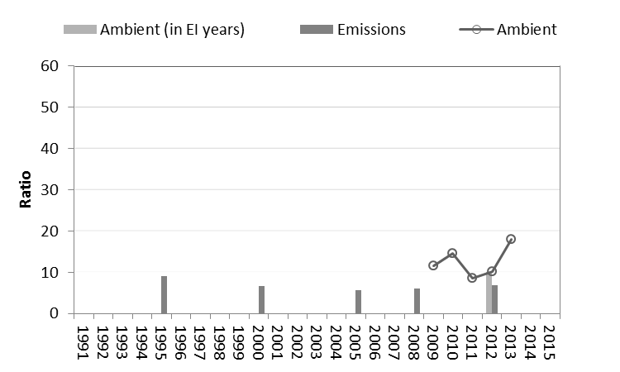
CO/NO_{x} Ratios (2)
Key Findings
Azusa
Upland
Santa Clarita
Rubidoux

Slide 19
Conclusions (1)
Trends analysis
  Overall decrease in ambient concentrations, with significant year-to-year variations
  General agreement between annual average reduction rates in ambient pollutant concentrations and emission inventory levels
TNMOC/NO_{x} ratios
  Consistently higher in the ambient monitoring data than in the emissions inventory data (by a factor of ~2 to 3 in 2012)
  Indicates that TNMOC emissions are under-estimated, NOx emissions are over-estimated, or both
  At some sites, agreement between ambient- and emissions-derived ratios less favorable in 2012 than in previous years

Slide 20
Conclusions (2)
CO/NO_{x} ratios
  Generally higher in the ambient data than in the emissions data
  Agreement is good (within 50%) for most sites and years
Potential emission inventory issues
  Temperature effects on evaporative emissions¹
  NO_{x} zero-hour emission rates and deterioration rates for heavy duty vehicles³

Slide 21

Contact
Stephen Reid
Manager, Environmental Modeling Division
sreid@sonomatech.com
707.665.9900
References
¹Chinkin L.R., Penfold B.M., Brown S.G., and Hafner H.R. (2005) Emission inventory evaluation and reconciliation in the South Coast Air Basin. Final report prepared for South Coast Air Quality Management District, Diamond Bar, CA, by Sonoma Technology, Inc., Petaluma, CA, STI-904045-2728-FR, August.
²Fujita, E. M., Campbell, D. E., Stockwell, W. R., and Lawson, D. R. (2013). Past and future ozone trends in California's South Coast Air Basin: Reconciliation of ambient measurements with past and projected emission inventories. Journal of the Air & Waste Management Association, 63(1), 54-69.
³Mandel J.R. and French T.A. (2016) Comments of the Truck and Engine Manufacturers Association on SCAQMD’s Draft 2016 Air Quality Management Plan. Submitted to the South Coast Air Quality Management District, August 19.
sonomatech.com @sonoma_tech

