Slide 1
Enhancements to Land Surface Processes for WRF/CMAQ
Limei Ran, Robert Gilliam, Jonathan Pleim, Ellen Cooter
ORD NERL/USEPA, Research Triangle Park, NC
UNC: Larry Band, Frank Binkowski, Conghe Song, Aijun Xiu, Adel Hanna, Jason West
EPA: Christian Hogrefe, John Walker, David Wong, Wyat Appel, Daiwen Kang

Slide 2
Outline of Presentation
Objective
Improved WRF/CMAQ with MODIS VEG
  New soil resistance for evaporation and O₃ dry deposition
  Coupled photosynthesis stomatal conductance approach
Simple irrigation scheme
Conclusions and future work

Slide 3
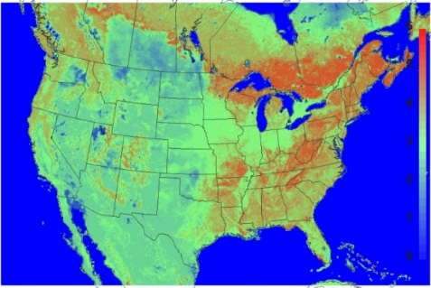
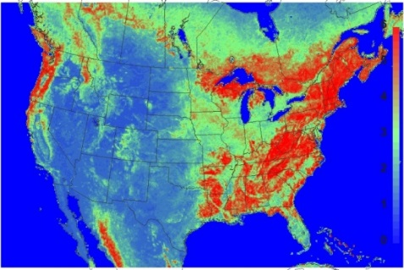
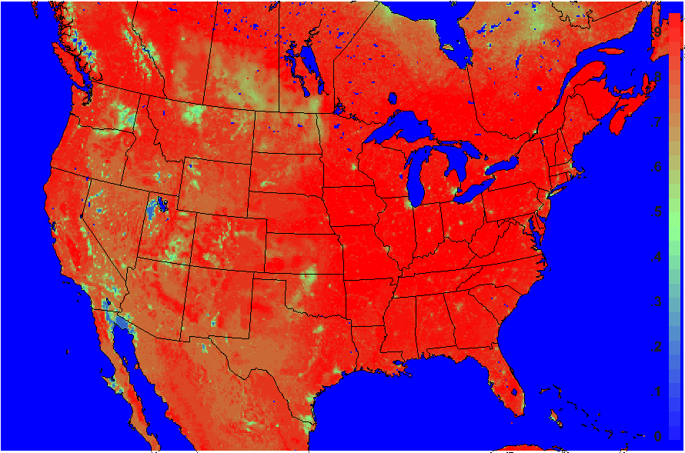
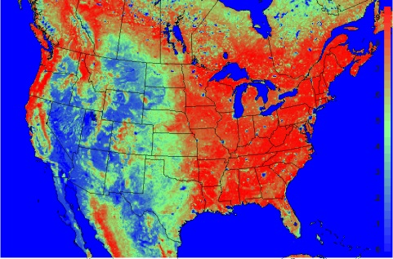
Problem Statements and Objectives
PX LSM (2006/08)
MODIS (2006/08)
Noah and PX LSMs: WRF/CMAQ
Vegetation Features:
  Stomatal conductance - big-leaf empirical Jarvis F
  Vegetation, surface albedo - LU look-up tables
  Plant phenology – simple F( time, deep-soil T)
  Limitations:
  Landscape changes and disturbances
  Dynamic responses to CO₂
  Coupling with vegetation productivity
LAI
VegF
(MODIS FPAR - fraction of absorbed photosynthetically active radiation is used as the surrogate for VegF). Assume that MODIS VEG is more realistic and accurate.
PX LSM intentionally exaggerates vegetation to reduce errors in 2m T and Q through its indirect soil nudging scheme
Objective:
Evaluate and improve WRF/CMAQ with PX LSM using satellite-derived land surface products (e.g. MODIS vegetation, albedo, and irrigation)

Slide 4
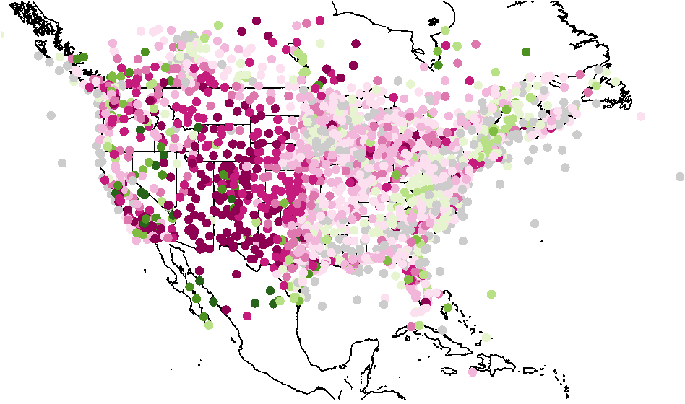
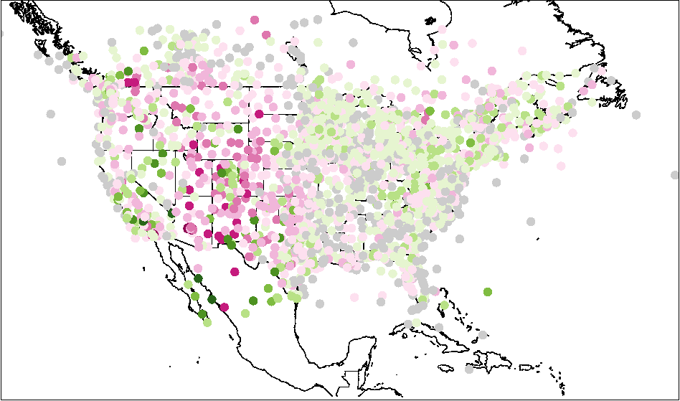
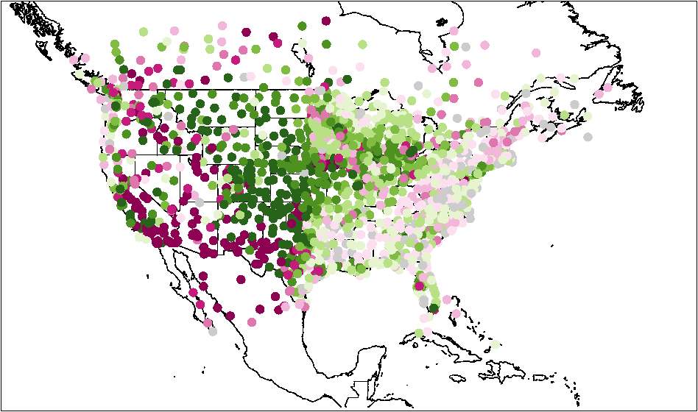
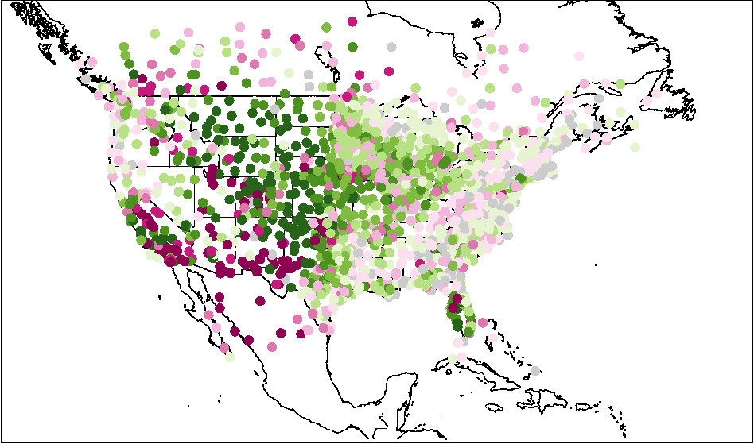
1. WRF/CMAQ with MODIS LAI/FPAR - Meteorology
Difference of Absolute Mean Bias (DAMB)
Aug 10 – Sept 9, 2006, WRF3.4/CMAQ5.0.1
1st step:
How does the current system perform with MODIS input?
  2nd step:
  How does an improved system perform (soil R, vegetation and PBL)?
Ori. WRF DAMB: MODIS – Base
Updated WRF DAMB: MODIS – Base
Better:
26.26% sites
Better:
55.83% sites
2 m T
2 m T
Sandy loam soil:
w_{fc}=0.195 m³ m⁻³, w_{sat}=0.435 m³ m⁻³
New soil resistance: [Sakaguchi and Zeng, 2009; Pleim et al., 2013]
Better:
63.74% sites
Better:
63.85% sites
2 m Q
2 m Q
More realistic MODIS LAI and VegF increase 2m T bias, decrease 2m Q bias
  issues in model physics (soil processes)
  [Ran et al., 2015, JGR-atm.]
Major improvement in 2m T – reduced warm bias in the west as well as east
2m Q has some improvement in the southwest

Slide 5
1. WRF/CMAQ with MODIS LAI/FPAR – Air quality
Daily max 8h average O₃
Aug 10 – 30, 2006
  2nd step (cont.):
  How does an improved system perform (soil R, vegetation and PBL)?
Daily Average Comparison, 10-30 August
Average Daily max 8h average O₃
Major high bias reduction (around 50%)
DAMB: Updated - Previous with MODIS input
Cross domain high bias reduction, particularly in the southwest
AQS Sites

Slide 6
1. WRF/CMAQ with MODIS LAI/FPAR – O₃
Updated WRF/CMAQ simulations: with/without MODIS
Monthly average statistics metrics for daily max 8h average O3
  2nd step (cont.):
  How does an improved system perform (soil R, vegetation and PBL)?
MODIS – Base
LAI, O3DepV(cm/sec) and O3(ppmV) in the surface layer for 20Z
Higher O₃ concentration in lower LAI areas from MODIS input due to lower O₃ deposition velocity
Improvement is needed in the CMAQ dry deposition model in sparsely vegetated areas
[Ran et al., 2016, JGR-atm]

Slide 7
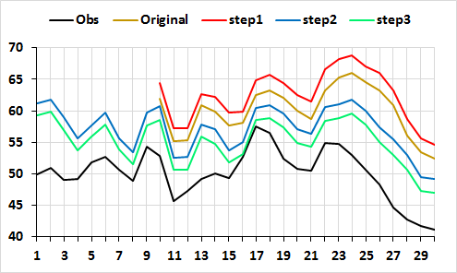
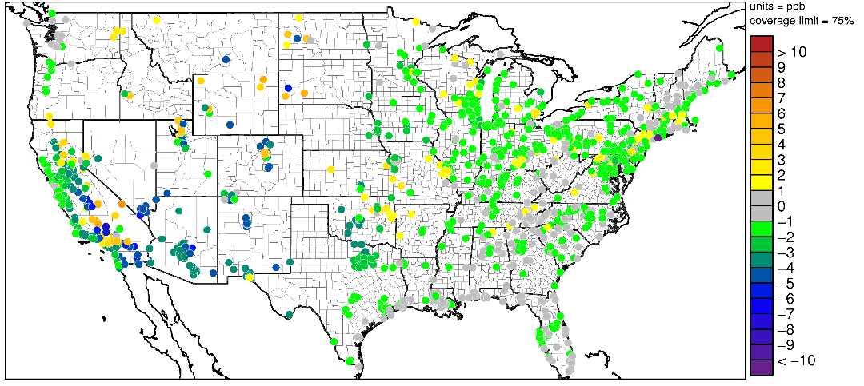
1. WRF/CMAQ with MODIS LAI/FPAR – O₃
Daily Maximum 8 h Average O₃
WRF3.4/CMAQ5.0.1 with MODIS Input
Daily Average Comparison, 2006/08
  3rd step:
  How does an updated CMAQ perform (a new R_{soilO3})?
New O₃ deposition resistance to bare soil
  Current CMAQ:
    R_{soilO3} = 666.7 s/m
  Updated CMAQ:
    R_{soilO3} = 200 + 300 W_{g} / W_{fc}
  [Mészáros et al., 2009, Biogeosciences; Massman, 2004, AE]
DAMB: Updated (3) - Previous (2) with MODIS input
AQS Sites
Bias reduction cross domain, particularly southwest - > sparsely vegetated land (average 2.1 ppb)

Slide 8
1. WRF/CMAQ with MODIS LAI/FPAR – Photosynthesis
Current PX Jarvis approach (PX Jarvis) [Noilhan and Planton, 1989; Pleim and Xiu, 1995]
Coupled photosynthesis-stomatal conductance model (PX PSN):
[Farquhar et al., 1980; Ball et al., 1987; Collatz et al., 1991 and 1992; Cox et al., 1999; Medlyn et al., 2005; Song et al., 2009; Evers et al, 2010; Clark et al., 2011; Bonan et al. 2011; Oleson et al., 2013]
  Leaf stomatal condutance
  Leaf photosynthesis
    A_{net} = colimitation (A_{c}, A_{j}, A_{e}) - dark respiration
          Three potential rates (C3 and C4) limited by:
          Rubisco (nitrogen related): A_{c}
          Light (photon related): A_{j}
          Transport of photosynthetic products for C3 plants and
          phosphoenolpyruvate (PEP) carboxylase limitation for C4 plants: A_{e}
  Sunlit-shaded leaf canopy scaling [Campbell and Norman, 1998; Goudriaan, 1977; Song et al., 2009]
Key parameters (PFTs):
V_{cmax} - maximum rate of carboxylation of Rubisco
K_{n}: foliage nitrogen decay coefficient
J_{max}: maximum electron transport rate
ε: quantum yield

Slide 9
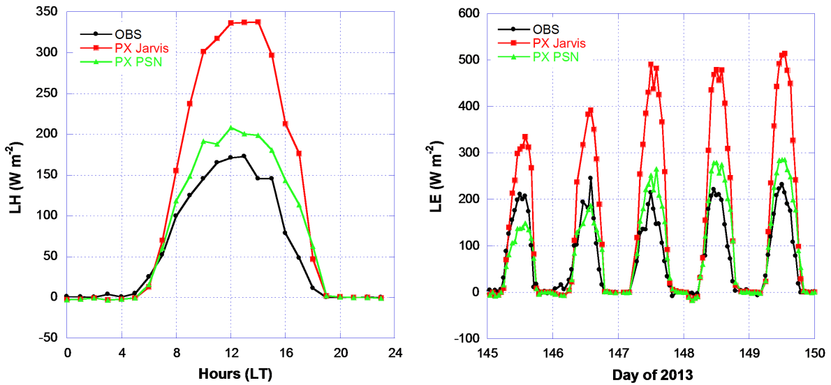
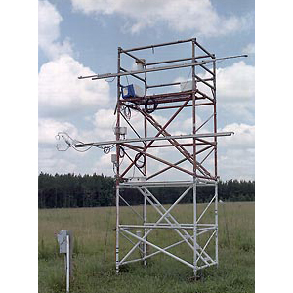
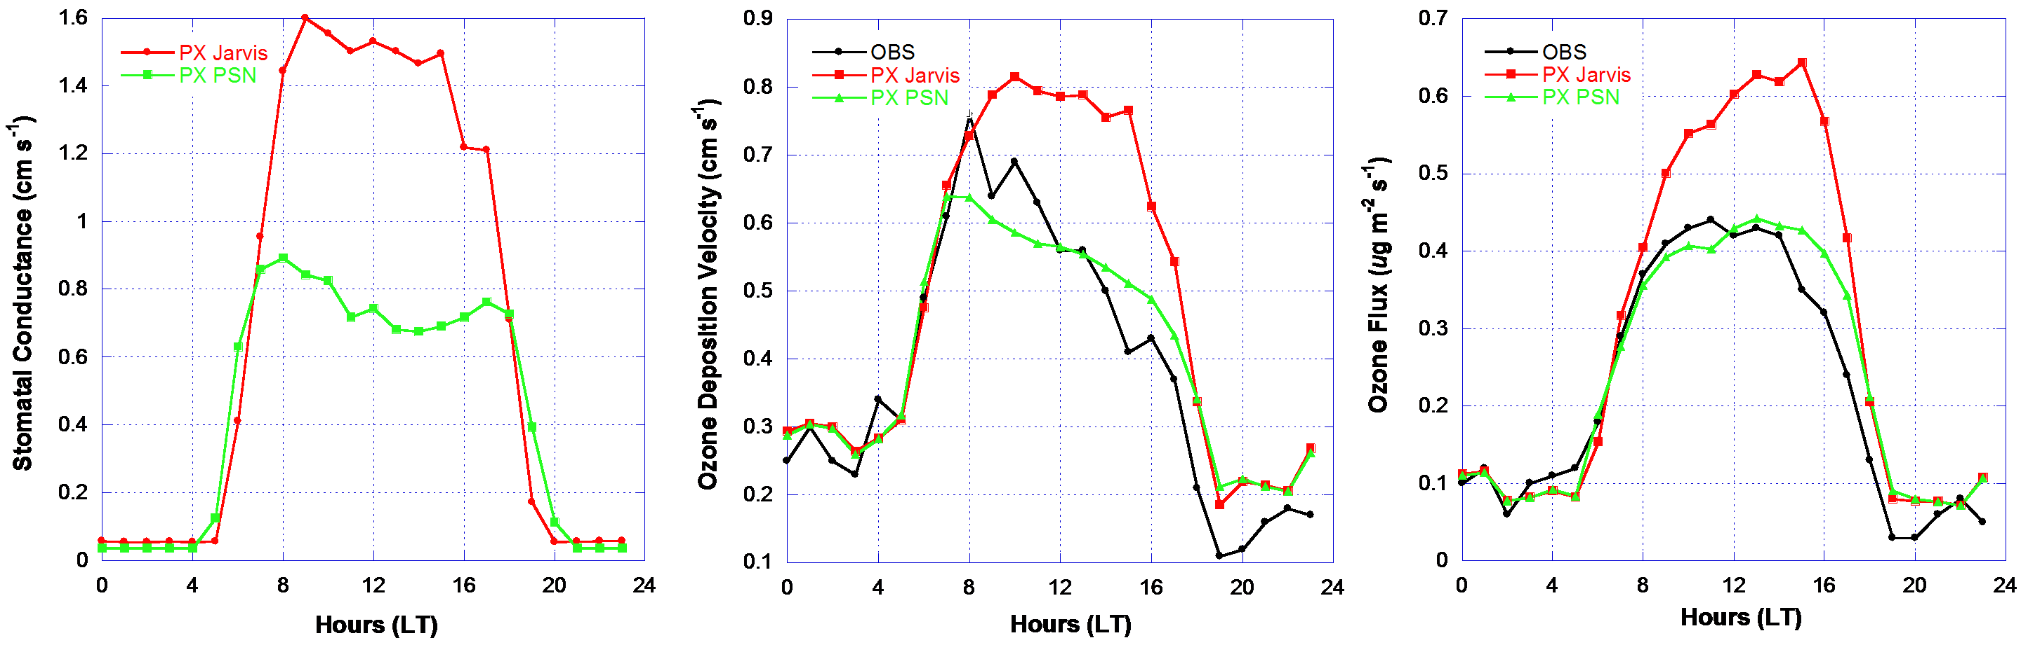
1. WRF/CMAQ with MODIS LAI/FPAR – Photosynthesis
Box model evaluation of latent heat and O₃ Flux
Duke Forest Open Field/US-Dk1
Diurnal median (left plot) and selected hourly (right plot) comparisons of LH for periods 17 May to 18 June and 18 to 28 September 2013. Hourly display is for 25 to 30 May 2013 (day 145 to 150). Canopy height = 1 m, LAI = 3, loam, soil moisture average top 5cm
C3 grassland (tall fescue)
Data courtesy:
John T. Walker at EPA
Both models overestimate LH with significant overestimation from PX Jarvis
Peak O₃ deposition velocity from the PX PSN is lower than OBS but the peak timing follows the observations well in the early morning
PX PSN performs much better in O₃ flux estimation
Diurnal median comparisons for estimated stomatal conductance (cm s⁻¹, left plot), ozone deposition velocity (cm s⁻¹, middle plot), and ozone flux (μg m⁻² s⁻¹, right plot).
[Ran et al., 2016 in review with JGR-atm.]

Slide 10
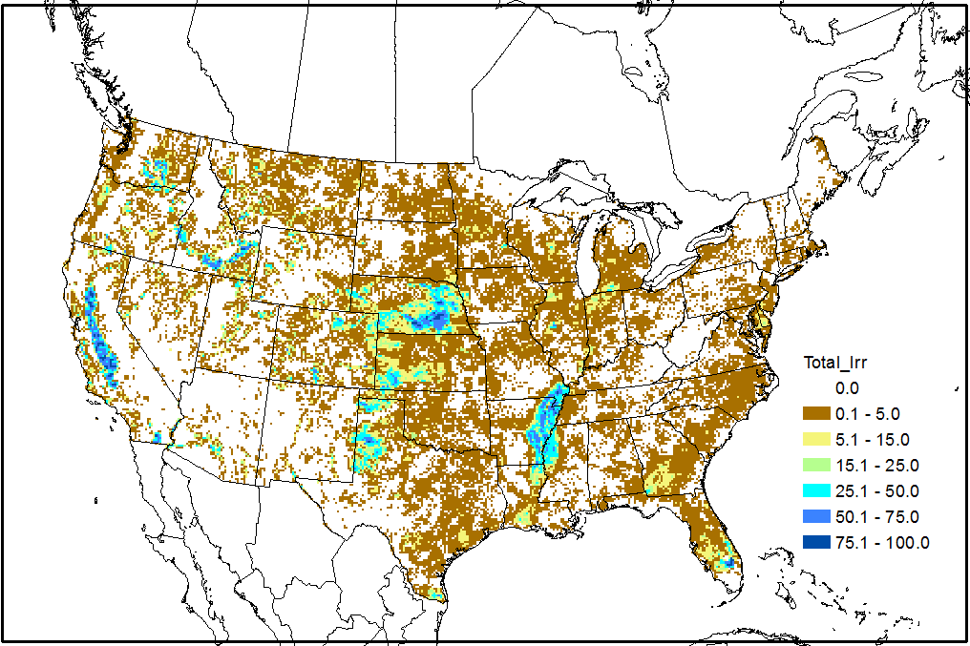
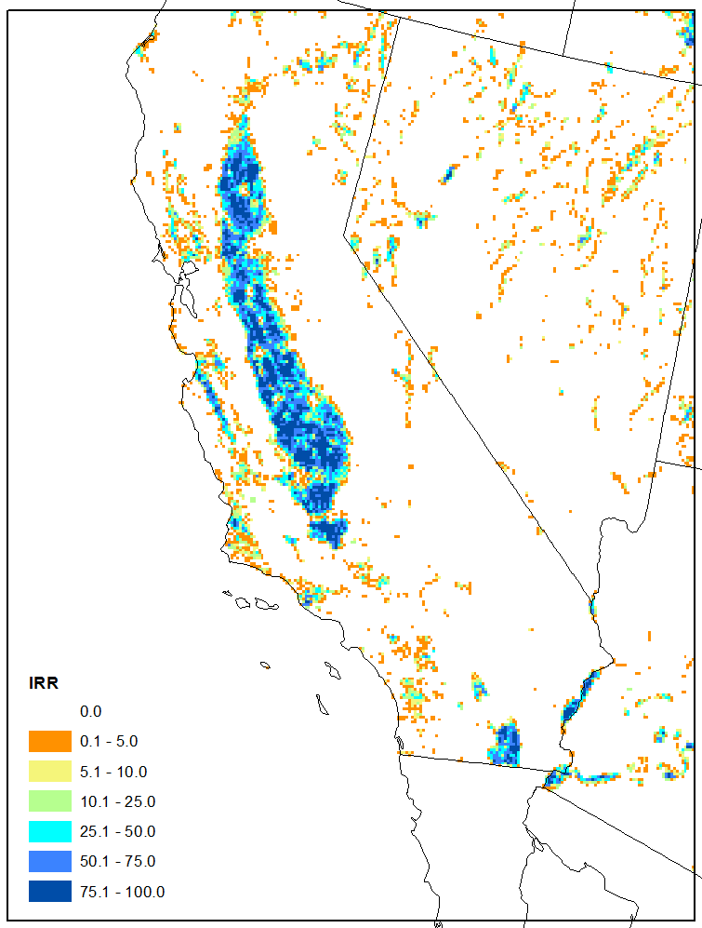
2. Updated WRF/CMAQ with MODIS LAI/FPAR
Irrigation Scheme
Irrigated crop/pasture percentage at 12km domain from 2011 NLCD and 2012 MIrAD
Current system
    PX WRF: No explicit treatment: crop, pasture
    FEST-C (for CMAQ bi-NH3) 21 crops: rainfed and irr.
    PX indirect soil nudging scheme
      Adjust soil conditions with 2m T and Q dynamically
      Has some dynamic response to irrigation
      [similar to ECMWF TESSEL, ISBA; Angevine et al., 2012, AMS]
Updated system
  MODIS Irr. Ag. Dataset (MIrAD-US) at 250m
  Max. allowable water depletion (SW_{m,} Hanson et al., 2004):
  Trigger irrigation when:
      SW_{m} < 0.5
      Solar radiation < 500 W/m² , morning (around 8am in CA, May-June)
      Irrigated grid area > 5%
      [Sorooshian et al., 2011, JGR; Ozdogan et al., 2010, AMS]
    W₂ = F (W₂, IrrF * SW_{fc})
Irrigated crop/pasture
percentage at 4km domain

Slide 11
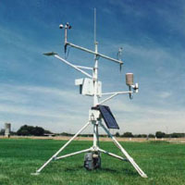
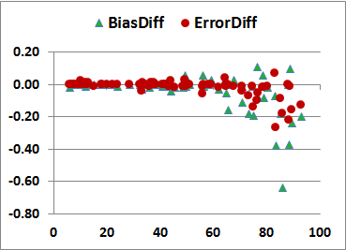
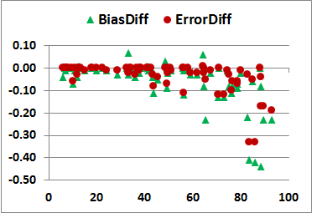
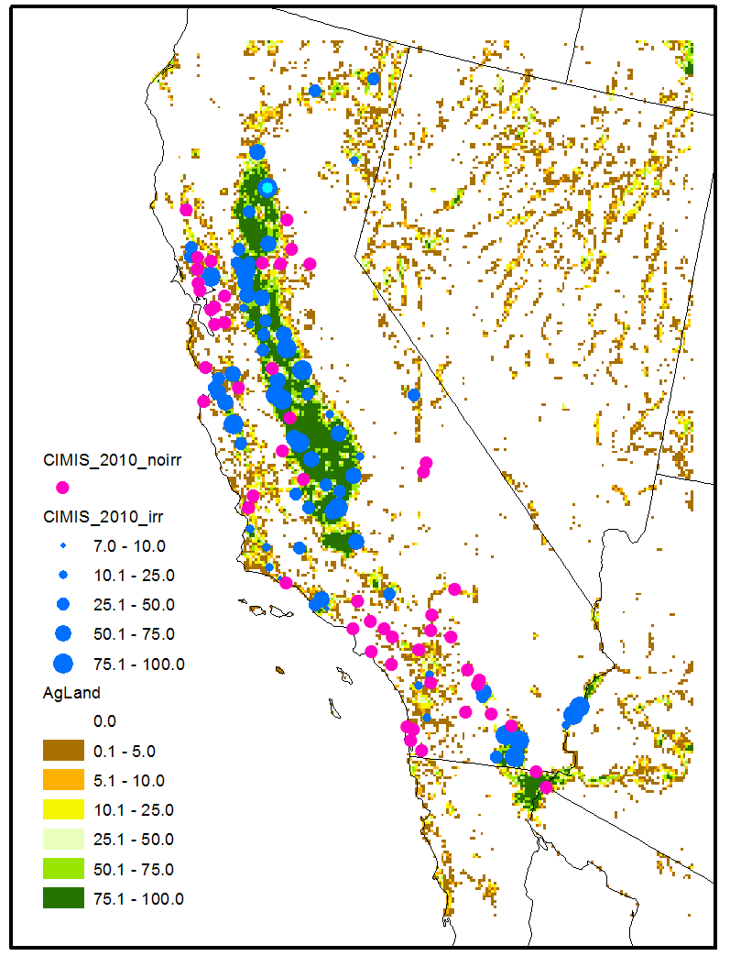
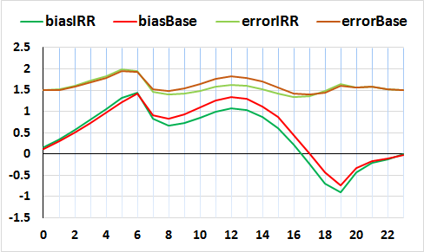
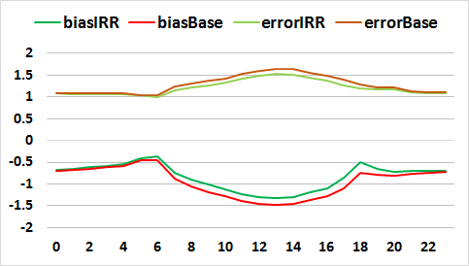
2. Updated WRF/CMAQ with MODIS LAI/FPAR – Irrigation Scheme: Meteorology
May 1 – June 30, CalNex 2010
Updated WRF3.4/CMAQ5.0.1 with MODIS, 4km
Site Metrics vs. Grid Irrigated Land Fraction
T2 (K)
Q2 (g/kg)
http://www.cimis.water.ca.gov/
California Irrigation Management Information System (CIMIS) Stations
Diurnal Metrics for Sites with Grid Irrigated Land > 50%
Sites in > 50% irrigated grid cells (34 sites) show bigger improvements.
scale and location

Slide 12
Conclusions and Future Work
Conclusions
  Updated WRF/CMAQ performs reasonable well with MODIS VEG
  The PX PSN performs much better in LH and O₃ flux estimation at Duke
  The irrigation scheme improves MET in areas with high irrigated land
Future Work
  Short-term: Evaluate the coupled WRF3.8/CMAQ5.2 with
  Soil R changes (evaporation and O₃), MODIS VEG, irrigation
  Long term: Improve vegetation modeling for WRF/CMAQ - FEST-C EPIC – SWAT (one biosphere ecosystem assessment)
  Implement the PX PSN for WRF
  Add natural vegetation to FEST-C
  Explore connecting FEST-C EPIC irrigation and LAI output to WRF/CMAQ

