Slide 1
Updating CMAQ secondary organic aerosol properties relevant for aerosol water interactions
Havala O. T. Pye¹
With contributions from:
Benjamin N. Murphy¹, Lu Xu², Ng L. Ng², Annmarie G. Carlton³, Hongyu Guo², Rodney Weber², Petros Vasilakos², K. Wyat Appel¹, Sri Hapsari Budisulistiorini⁴, Jason D. Surratt⁴, Athanasios Nenes², Weiwei Hu⁵, Jose L. Jimenez⁵, Gabriel Isaacman-VanWertz⁶, Pawel K. Misztal⁶, and Allen H. Goldstein⁶
¹US Environmental Protection Agency, Research Triangle Park, NC; ²Georgia Institute of Technology, Atlanta, GA; ³Rutgers University, New Brunswick, NJ; ⁴The University of North Carolina at Chapel Hill, Chapel Hill, NC; ⁵University of Colorado, Boulder, CO;
⁶University of California, Berkeley, CA
Office of Research and Development
National Exposure Research Laboratory, Computational Exposure Division
25 October 2016

Slide 2
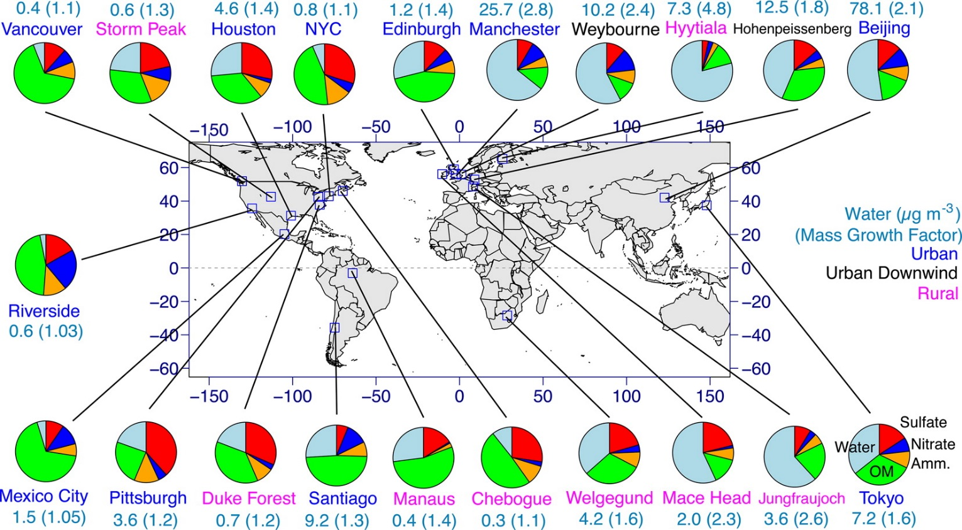
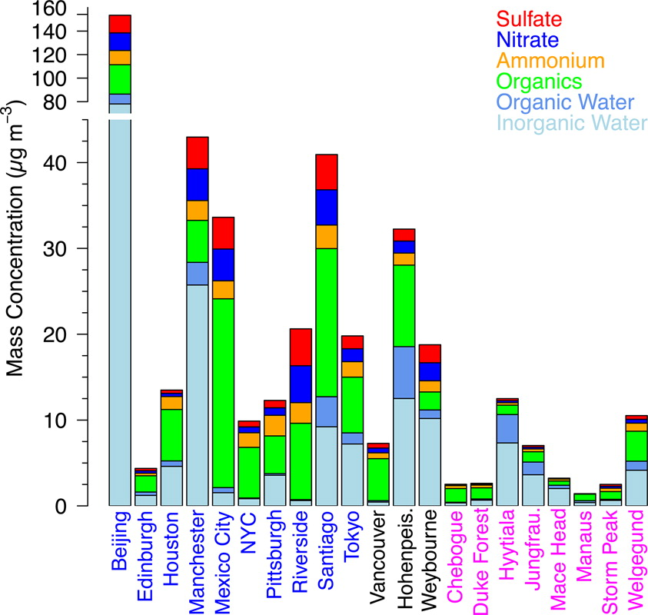
Aerosol Water is ubiquitous
Nguyen et al., 2016 ES&TL
Notes:
Aerosol water is a ubiquitous component of particulate matter mass as estimated here by Nguyen et al. The mass of aerosol water is often comparable in magnitude to that of organic aerosol (green) and sulfate (red). This aerosol water has contributions from both organic and inorganic components. Water associated with inorganic constituents is often dominant, but organic water is particularl

Slide 3
Models represent limited connections between
OA and aerosol water
Observed OA is largely water soluble as measured by PiLS instrument
SOA
soluble
Modeled OA generally does not involve water
Concentration during Southern Oxidant and Aerosol Study (SOAS) 2013 [μg m⁻³]
other SOA
Models are beginning to include SOA from IEPOX uptake onto aqueous aerosol:
CMAQ v5.1 (Pye et al., 2013 ES&T)
GEOS-Chem, research version (Marais et al., 2016 ACP)
aqueous SOA
insoluble
POA
POA
Obs
Obs
Model (CMAQ)

Slide 4
Models represent limited connections between
OA and aerosol water
SOA
soluble
Should traditional SOA interact with water?
Concentration during Southern Oxidant and Aerosol Study (SOAS) 2013 [μg m⁻³]
other SOA
aqueous SOA
insoluble
POA
POA
Obs
Obs
Model (CMAQ)

Slide 5
Determine a consistent set of properties for semivolatile SOA
Types of Aerosol in CMAQ:
Aerosol with direct water interaction
POA
Very low volatility SOA
Semivolatile SOA
Organic Aerosol in CMAQ v5.1

Slide 6
Specify a consistent set of properties: MW, OM/OC, C*, density

Slide 7
Implementing organic interactions with water
CMAQ includes water associated with inorganic compounds
Aerosol water has contributions from inorganic and organic constituents: W_{i} + W_{o}

Slide 8
Implementing organic interactions with water
CMAQ includes water associated with inorganic compounds
Aerosol water has contributions from inorganic and organic constituents: W_{i} + W_{o}
Organic compounds will interact with W_{i} when one liquid phase exists in the particle:
Occurs when RH>Separation RH (SRH)
You et al., 2013 ACP

Slide 9
LLPS simulation: Organic interaction with W_{i}
Parameterize SRH based on OM/OC
Determine liquid-liquid phase separation (LLPS) based on SRH and RH
Organic partitioning medium:
  Include W_{i} when RH>SRH
  W_{o} = 0

Slide 10
LLPS more common in urban areas, during the day
OM/OC
Percentage of time phase separated

Slide 11
LLPS more common in urban areas, during the day
OM/OC
Percentage of time phase separated
SOAS-CTR
Base Model
Observed
Local Hour

Slide 12
W_{o} > 0 simulation: Organic interaction with W_{o}
Parameterize hygroscopicity (κ) of organics based on OM/OC
Calculate water uptake using κ-Kohler theory
Organic partitioning medium:
  Do not include W_{i}
  Include W_{o}

Slide 13
W_{o} highest where OA is high
SOAS

Slide 14
Aerosol water interactions increase mean error

Slide 15
Aerosol water interactions increase mean error

Slide 16
γ ≠ 1 simulation: Implement deviations in ideality
Organic partitioning medium:
  Include W_{i} when RH>SRH
  Include W_{o} at all times
Consider deviations in ideality via an activity coefficient, γ, as a function of mole fraction of water in organic-rich phase

Slide 17
Specify a consistent set of properties: solubility
Activity Coefficient at Infinite Dilution in Water

Slide 18
Nonideal simulation improves mean bias, small increase in ME

Slide 19
Nonideal simulations: good OA speciation
AMS PMF factor: Less oxidized-oxygenated organic aerosol
Total Organic Aerosol
Particulate Organic Nitrates
local hour

Slide 20
Improvements in OA will improve aerosol water

Slide 21
Improvements in OA will improve aerosol water
γ ≠ 1 simulation

Slide 22
Summary
Water is an important component of PM_{2.5}
Many traditional SOA species are highly soluble
Water can influence the partitioning of compounds traditionally considered insoluble in models
  Organic aerosol takes up water according to RH
  Organic aerosol interacts with inorganic water
Deviations in ideality (solubility) must be considered
For more information, see our paper: Pye et al., 2016 ACPD
pye.havala@epa.gov

