Slide 1
CMAQv5.2 and Next Generation AQ Model
Jonathan Pleim and the CMAQ Development Team
Atmospheric Model Development Branch
Computational Exposure Division
National Exposure Research Laboratory
Office of Research and Development
U.S. Environmental Protection Agency
CMAS Conference
October 24, 2016

Slide 2
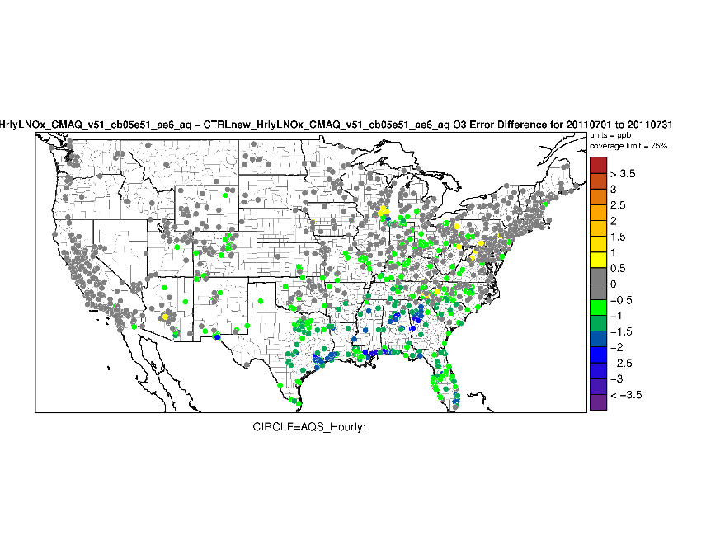

CMAQv5.2
Release schedule
  β-version released in October 2016: https://github.com/USEPA/CMAQ
  Final version in Spring 2017
New features
  Aerosols
    New SOA modeling (Talks by Havala Pye and Ben Murphy today)
    New wind-blown dust model (Talk by Hosein Foroutan this morning)
    New particle formation in research version (Ben Murphy poster)
  Gas Chemistry
    CB6 chemical mechanism w/ selected HAPs
    CRI mechanism in research version (Deborah Luecken)
    Halogen Chemistry (Golam Sarwar poster)
      Optional detailed mechanism (Sarwar et al., ES&T, 2015)
  Lightning
    NOx production (Talk by Daiwen Kang this morning)
    Assimilation of lightning data in WRF (Talk by Nick Heath - Wed)
  Instrumented models – DDM, Sulfur tracking (in final model)
  Strat-Trop ozone exchange for hemispheric configuration
  2-way coupled WRFv3.8-CMAQv5.2
Pasadena
$$\frac{dN}{d\log_{10}D_{p}}$$
O₃ MAE improvement w/ LTGA

Slide 3
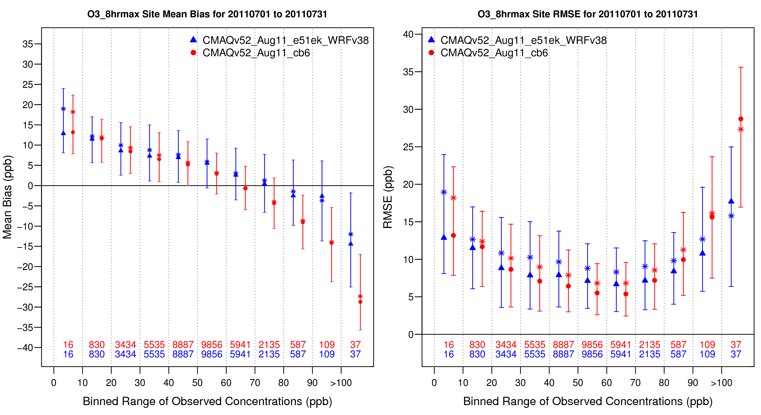
Gas-phase chemistry
Comparison of predicted Ozone in CMAQv5.2 with two mechanisms (CB05e51 and CB6r3)
CB6 predicts slightly lower ozone, with lower bias and error below ~80 ppb, increased bias and error above 80 ppb.
Courtesy of Deborah Luecken

Slide 4
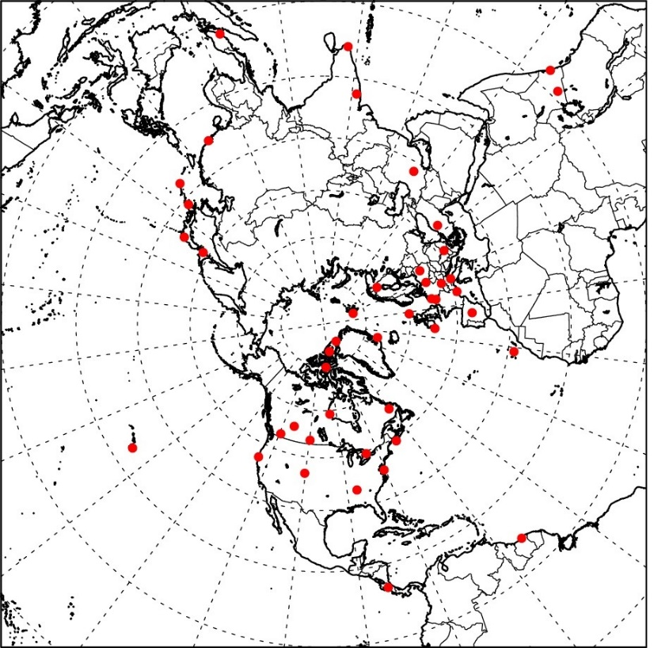
CMAQv5.2 Updates:
Stratosphere-Troposphere Exchange
Modeled O₃ specified by enforcing the condition of proportionality to Potential Vorticity: [O₃] = c•PV
Used recent CMAQ multi-decadal simulations to develop a robust relationship that varies spatially and temporally: O₃/PV = F(spatial) X G(temporal)
Used Observed O₃ data from 1990-2010 from 44 WOUDC sites
Xing et al, ACP, 2016

Slide 5
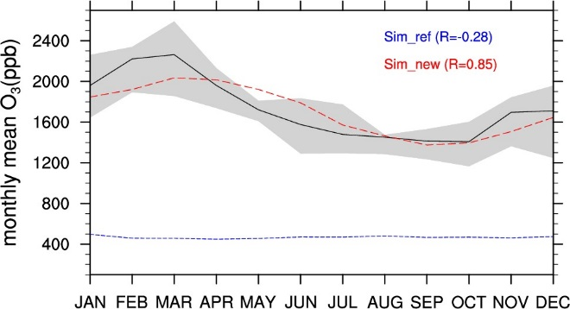
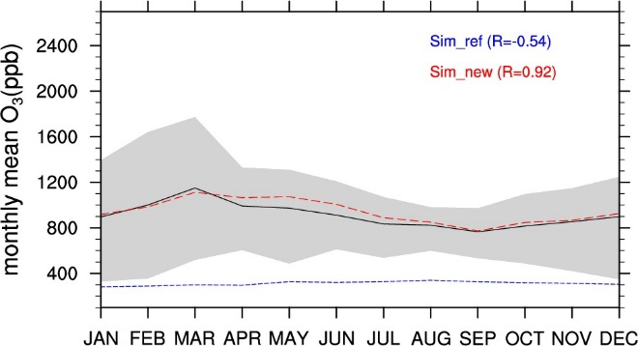
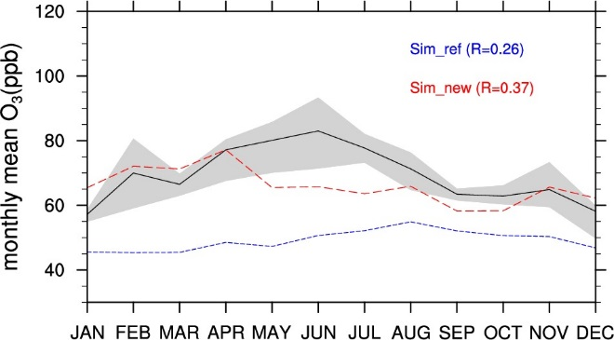
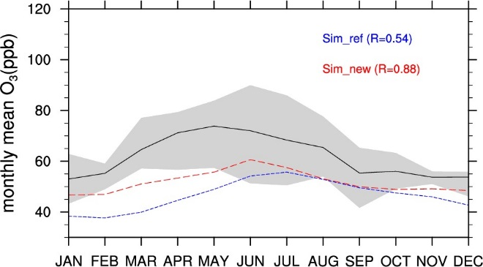
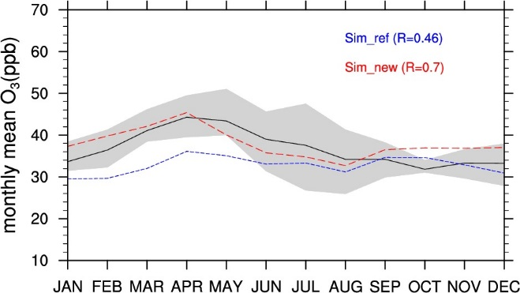
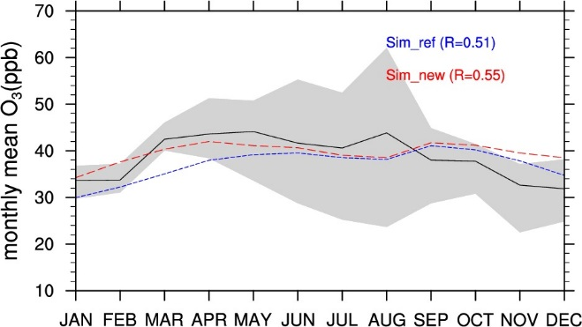
Comparison of Observed O₃ with Reference simulation and New PV scaling
High latitude sites (Lat >45° N)
Low latitude sites (Lat <45° N)
UTLS
P<100mb
Mid-Troposphere
300mb<P<500mb
PBL
P>800mb
Xing et al, ACP, 2016

Slide 6
Updates to WRF for AQ modeling
WRFv3.7 (2015 release)
  Updates to ACM2 PBL scheme
    Different K_{m} and K_{h} (Pr = K_{m}/K_{h} ≠ 1)
    New eddy diffusivities for stable conditions
  Updates to PX LSM :
    Reduced heat capacity of vegetation (WRFv3.7)
      Reduces predawn warm bias and post dawn cool bias
WRFv3.8 (2016 release)
    Further updates to stomatal conductance function for PAR (F1)
      New F1 reduces LE late in the day which delays evening transition to stable surface flux
    Revised Monin-Obukhov length calculation in pxsfclay to be more consistent w/ calculation in ACM2
WRFv3.9 (2017 release)
  MODIS LAI and VegFrac (fPAR) input (see Talk by Limei Ran this morning)
  New soil resistance for evaporation in PXLSM

Slide 7
Vision for Next Generation Model
The Next Generation model will be a 1-D AQ component coupled to meteorology models
  Chemical tracers to be transported in meteorology model
  Can couple to multiple Meteorology models
Three configurations of flexible systems:
  On-line global w/ seamless grid refinement (MPAS)
  Online regional (WRF-AQ)
  Offline regional (WRF-AQ with offline chem transport)
One dimensional AQ component
  Includes all vertical processes - vertical diffusion, advection, plume rise, gravitational settling, actinic flux
  All 0-D processes - gas, aerosol, aqueous chemistry
  Surface processes - biogenic emissions, dry dep/bidi, wind-blown dust
Transport in met models for online systems (adv, diffusion)
  Ensure mass conservation
  Consistency with met parameters
  Minimize numerical diffusion and dispersion
MPAS

Slide 8

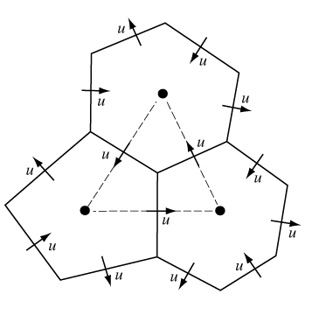
Fully-compressible, non-hydrostatic dynamics
Finite volume discretization on centroidal Voronoi (nominally hexagonal) grids
Single global mesh with seamless refinement to local scales
Latest version: MPAS 4.0 (released May 22, 2015)
MPAS uniform mesh (240 km)
MPAS non-uniform mesh (92km – 25km)
Refinement over CONUS

Slide 9
MPAS development for NGAQM
Mass conservation experiments
  Ensure mass conservation on non-uniform grids
Physics implementations
  ACM2 PBL model
  PX Land Surface Model
  PX surface layer scheme
Data assimilation
  Four dimensional data assimilation
  Soil moisture and temperature indirect assimilation
Dry air
Uniform
Non-uniform
Tracer2
Uniform
Non-uniform
Courtesy of Hosein Foroutan

Slide 10

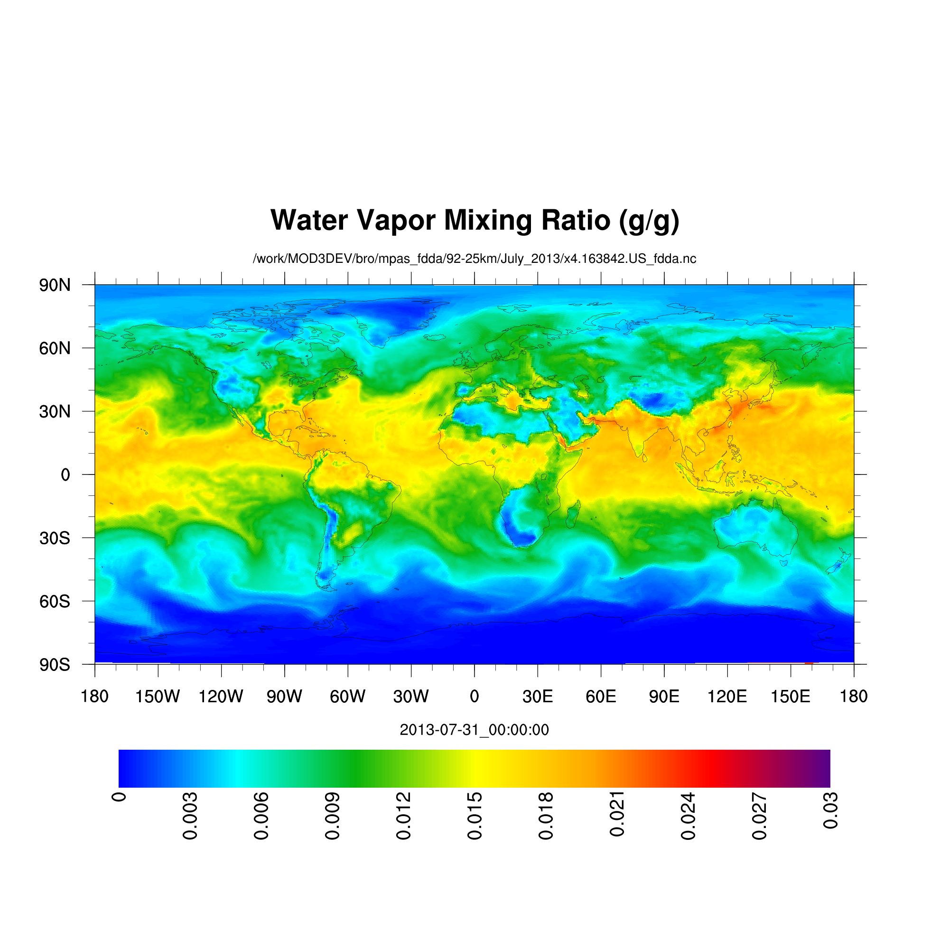
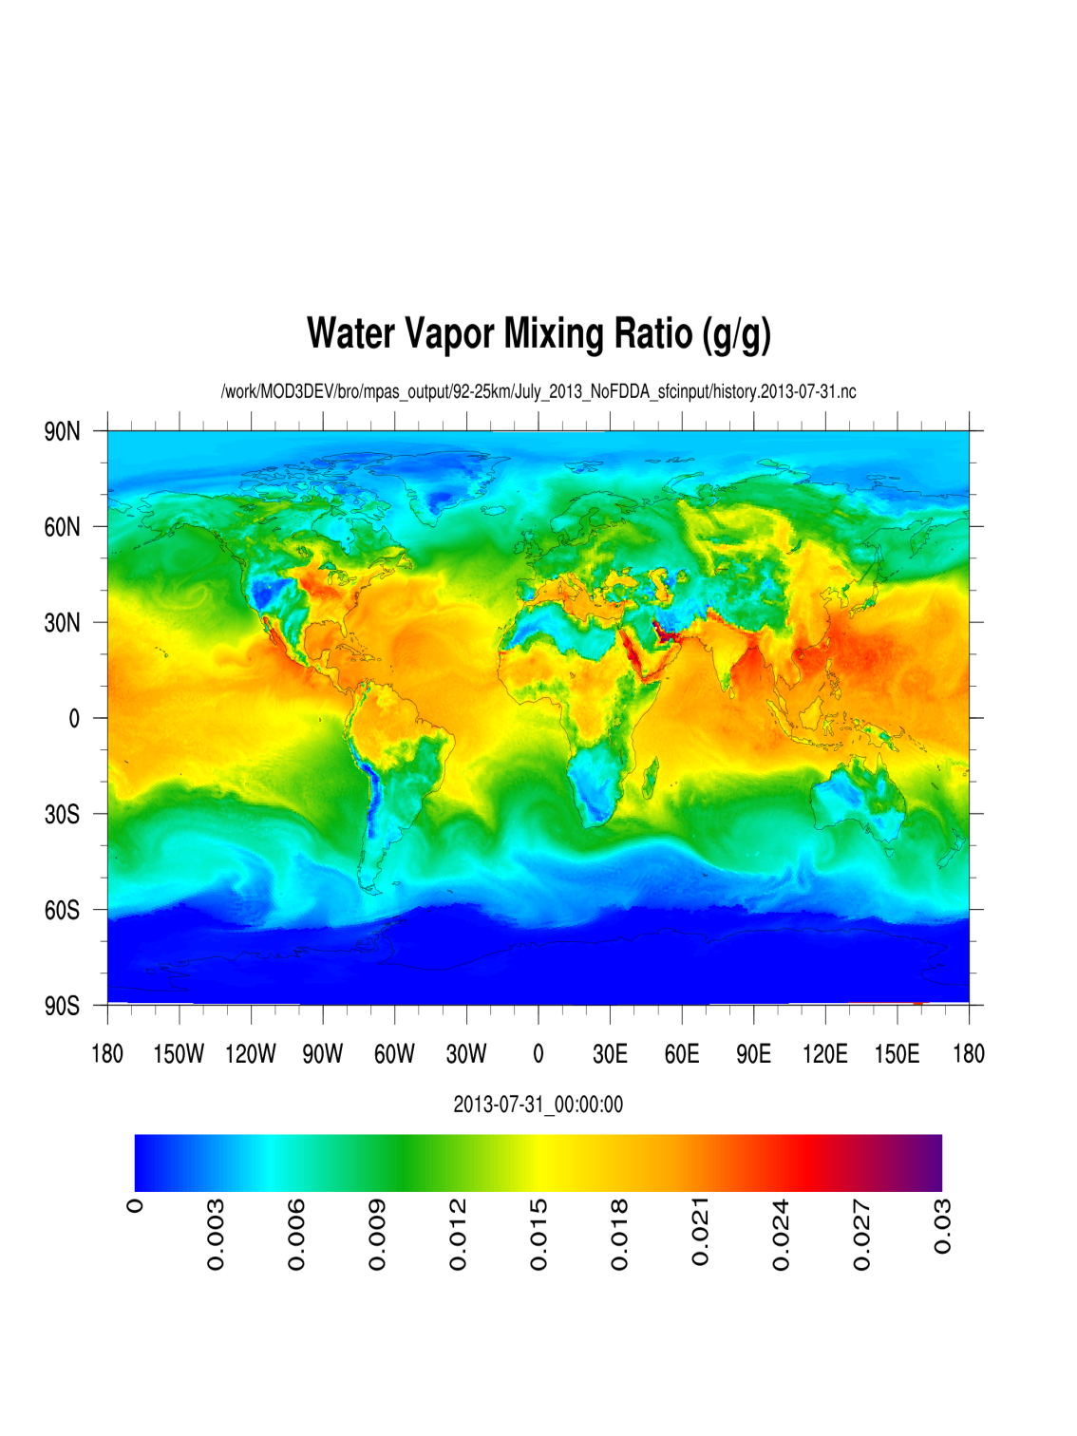
Without FDDA
FDDA Target (FNL) Simulation (+30 days)
Layer 1 Layer 1
Courtesy of Russ Bullock
Notes:
Slide 4 of 4 comparing MPAS without FDDA to target fields for humidity (1 minute for the series)

Slide 11
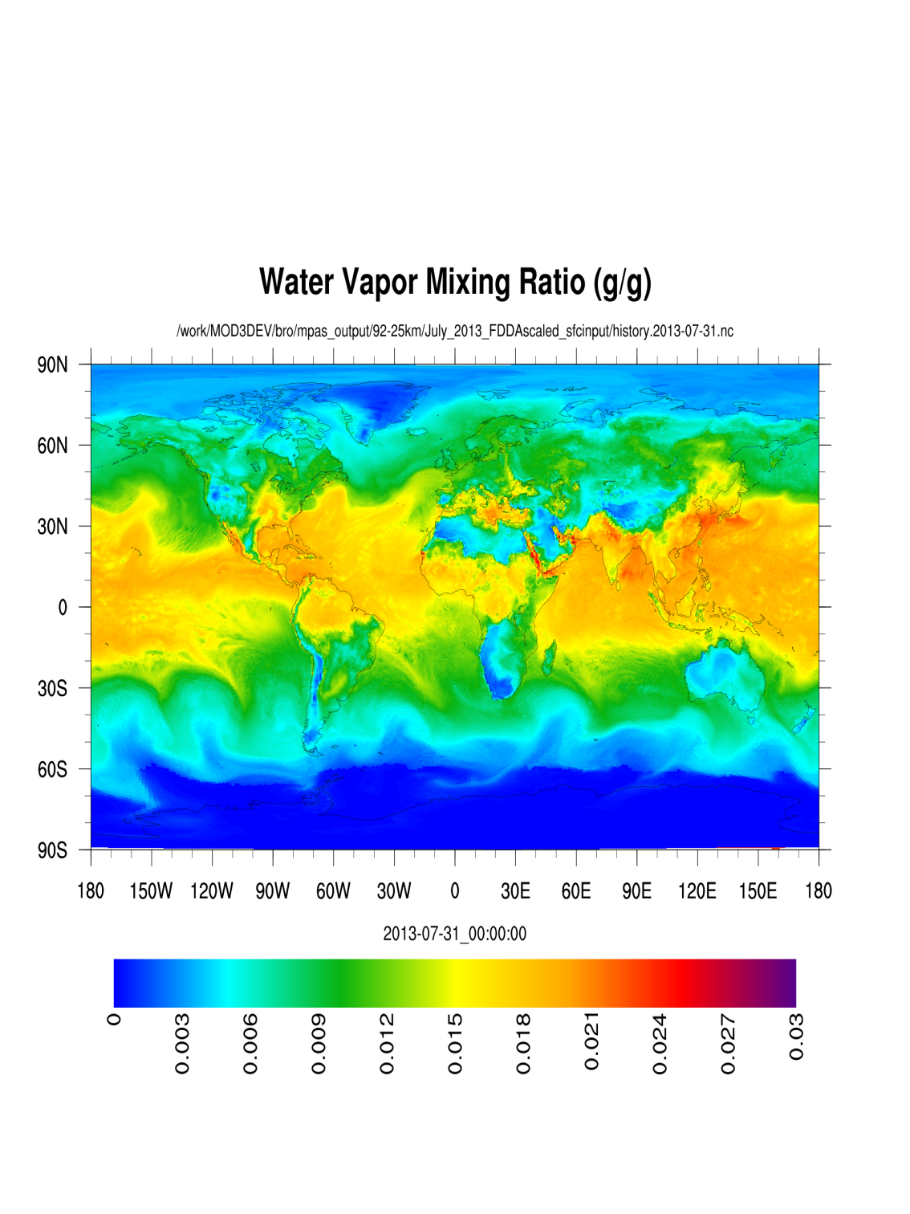
With FDDA
FDDA Target (FNL) Simulation (+30 days)
Layer 1 Layer 1
Courtesy of Russ Bullock
Notes:
Slide 4 of 4 comparing MPAS with FDDA to target fields for humidity (1 minute for the series)

Slide 12
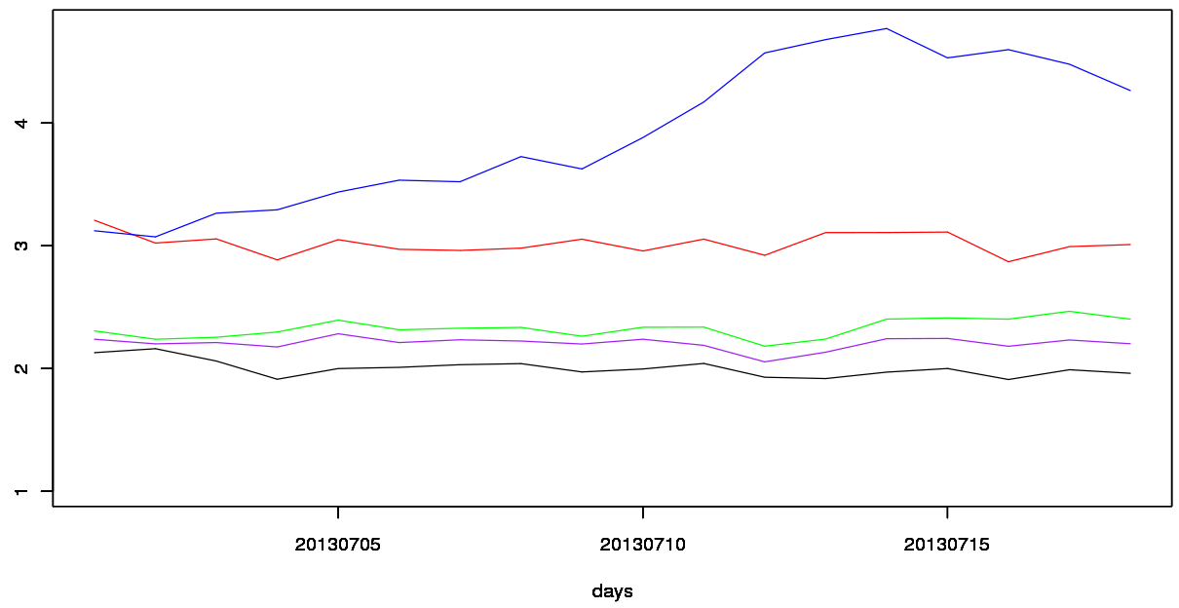
Daily 2-m Temperature RMSE (K) CONUS
MPAS NoFDDA NOAH-YSU-MO-KF
MPAS FDDA NOAH-YSU-MO-KF
MPAS FDDA PX-ACM2-PSL-KF
MPAS FDDA PX-ACM2-PSL-Tiedtke
WRF NRT PX-ACM2-PSL-KF
Courtesy of Rob Gilliam

Slide 13
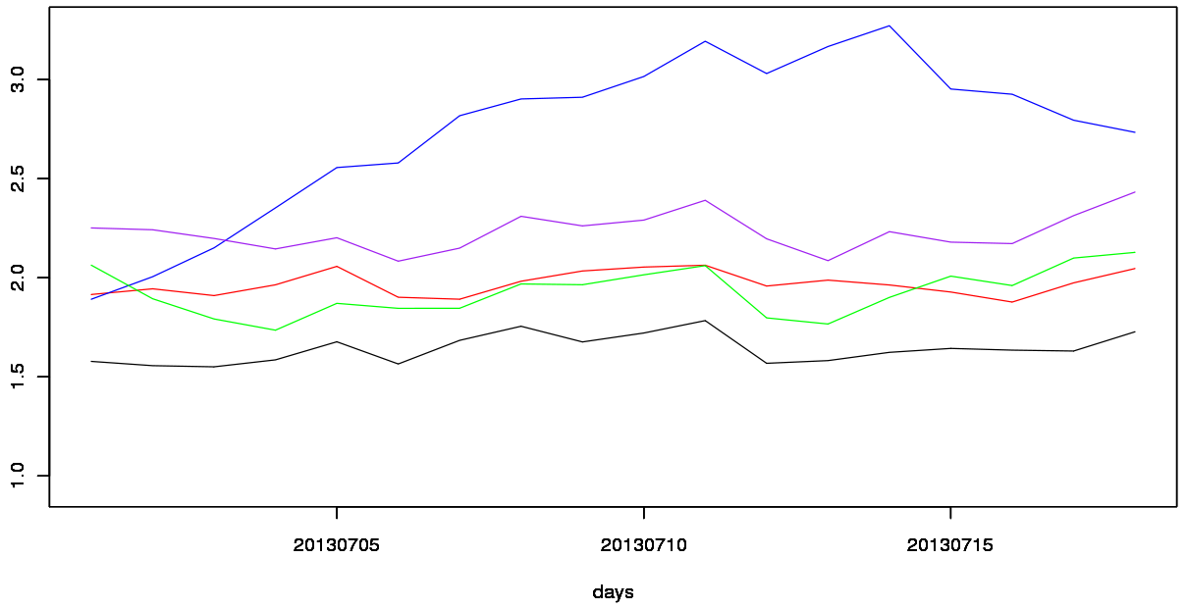
Daily 2-m Mixing Ratio RMSE (g kg⁻¹) CONUS
MPAS NoFDDA NOAH-YSU-MO-KF
MPAS FDDA NOAH-YSU-MO-KF
MPAS FDDA PX-ACM2-PSL-KF
MPAS FDDA PX-ACM2-PSL-Tiedtke
WRF NRT PX-ACM2-PSL-KF
Courtesy of Rob Gilliam

Slide 14
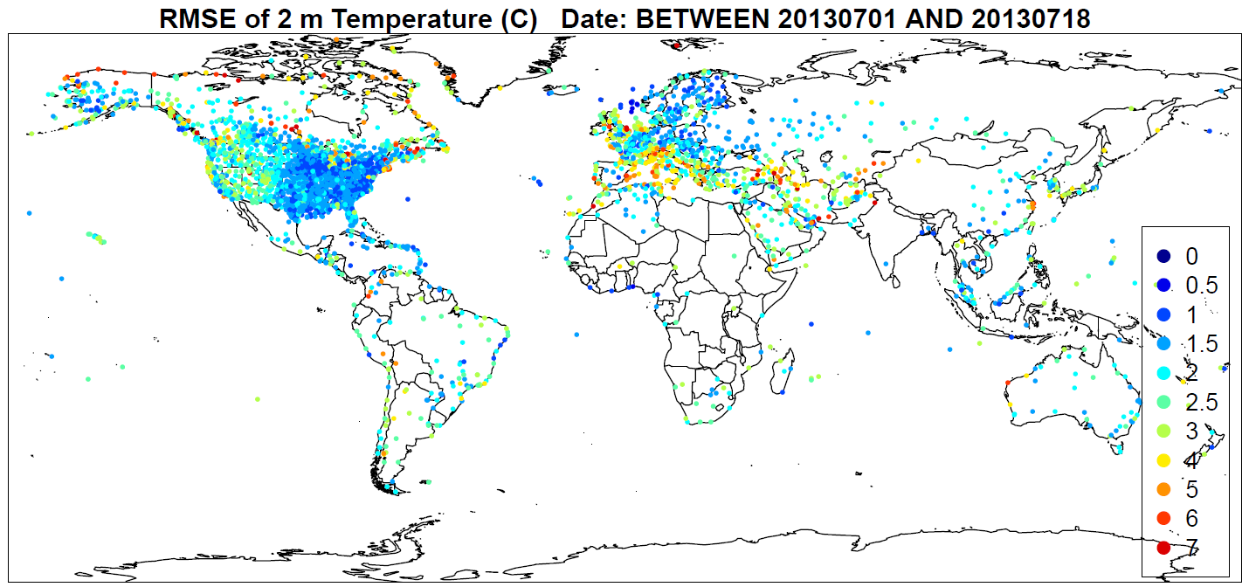
MPAS FDDA PX-ACM2-PSL-Tiedtke
Courtesy of Rob Gilliam

Slide 15
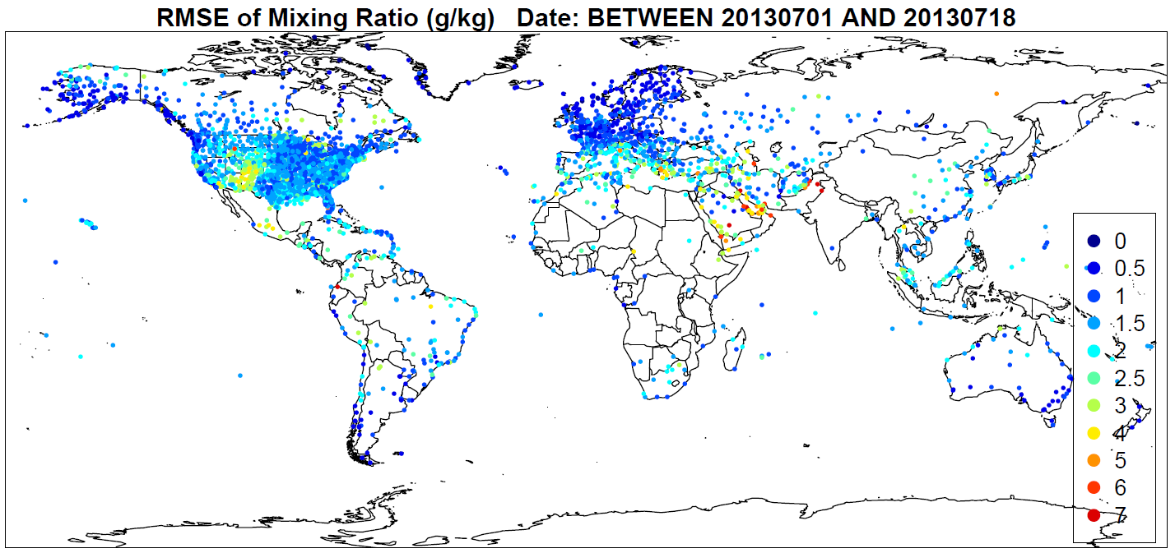
MPAS FDDA PX-ACM2-PSL-Tiedtke
Courtesy of Rob Gilliam

Slide 16
Next Steps
The Next Generation model will be a 1-D AQ component coupled to MPAS and WRF
  Further physics improvements in MPAS
    Update KF to include feedback to radiation
    Update PX LSM to use MODIS vegetation products (LAI, fPAR) and fractional hi-res LULC
  Developing new I/O system for AQ coupled to MPAS and WRF
  Model design for 1-D AQ component and coupler
Development of model science and algorithms will continue and expand to global scale
  Condensed mechanisms linked to a detailed chemical mechanism (e.g. MCM)
  Continue advances in organic aerosols and new particle formation
  Develop integrated cloud model w/ convective transport, microphysics, aqueous chem, aerosol-cloud interactions
  Emission process modeling for global coverage – (dust, biogenic, bidirectional flux, fires)
Continued support and updates to CMAQ until NGAQM is ready

