Slide 1
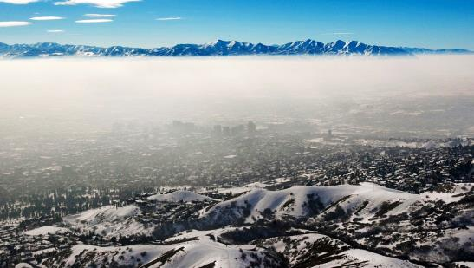

Improving Regional PM2.5 Modeling along Utah’s Wasatch Front
Chris Pennell, Nancy Daher
15th Annual CMAS Conference, 2016

Slide 2
Outline
Background
WRF
Modeling Platform
CAMx Modifications
Results
Past Work
What’s Next

Slide 3
Background
Wasatch Front
  80% of Utah population
  120 miles long, 5 miles wide
  Surrounded by mountains and lakes
Persistent wintertime inversions contribute to PM2.5 NAAQS exceedances
Utah is challenging to model
  Air stability sensitive to winds near mixing height
  Difficult to sustain inversions
Three Utah PM2.5 nonattainment regions
  Two in Wasatch Front; One in Cache Valley
We are simulating Jan 1 – 11, 2011 PCAPS period

Slide 4
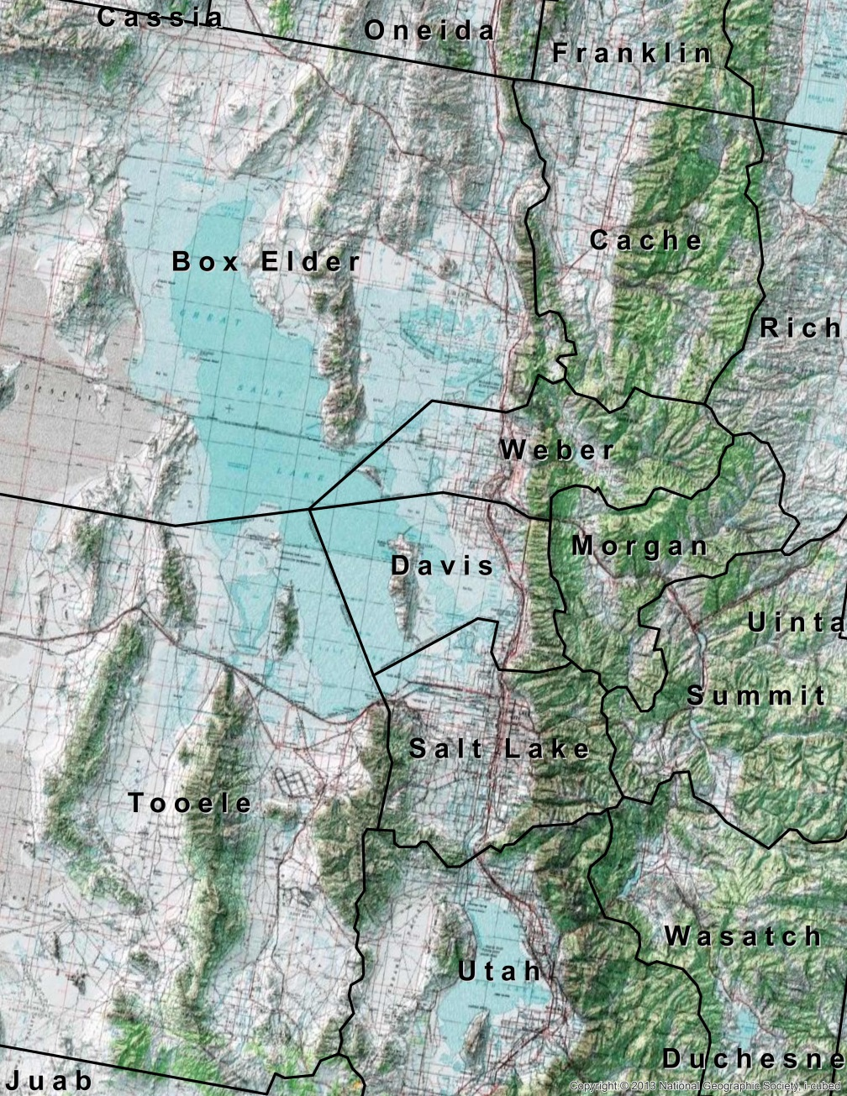
Logan
SLC
Lindon

Slide 5
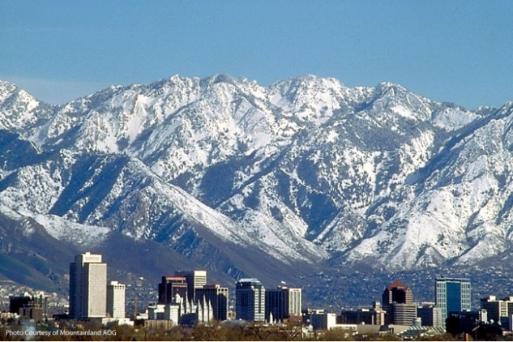
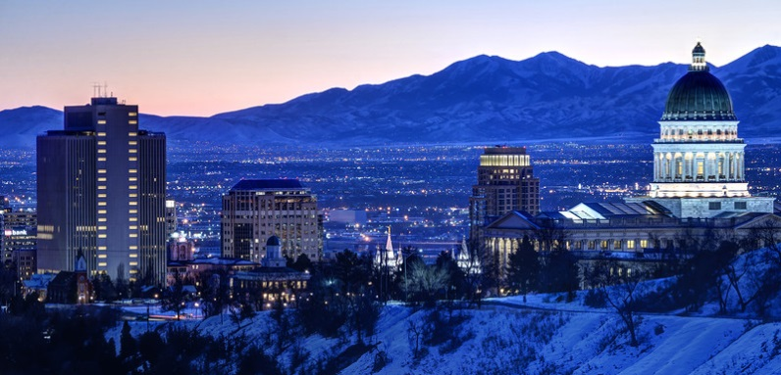
Logan
SLC
SLC, Looking East
Lindon
SLC, Looking West

Slide 6
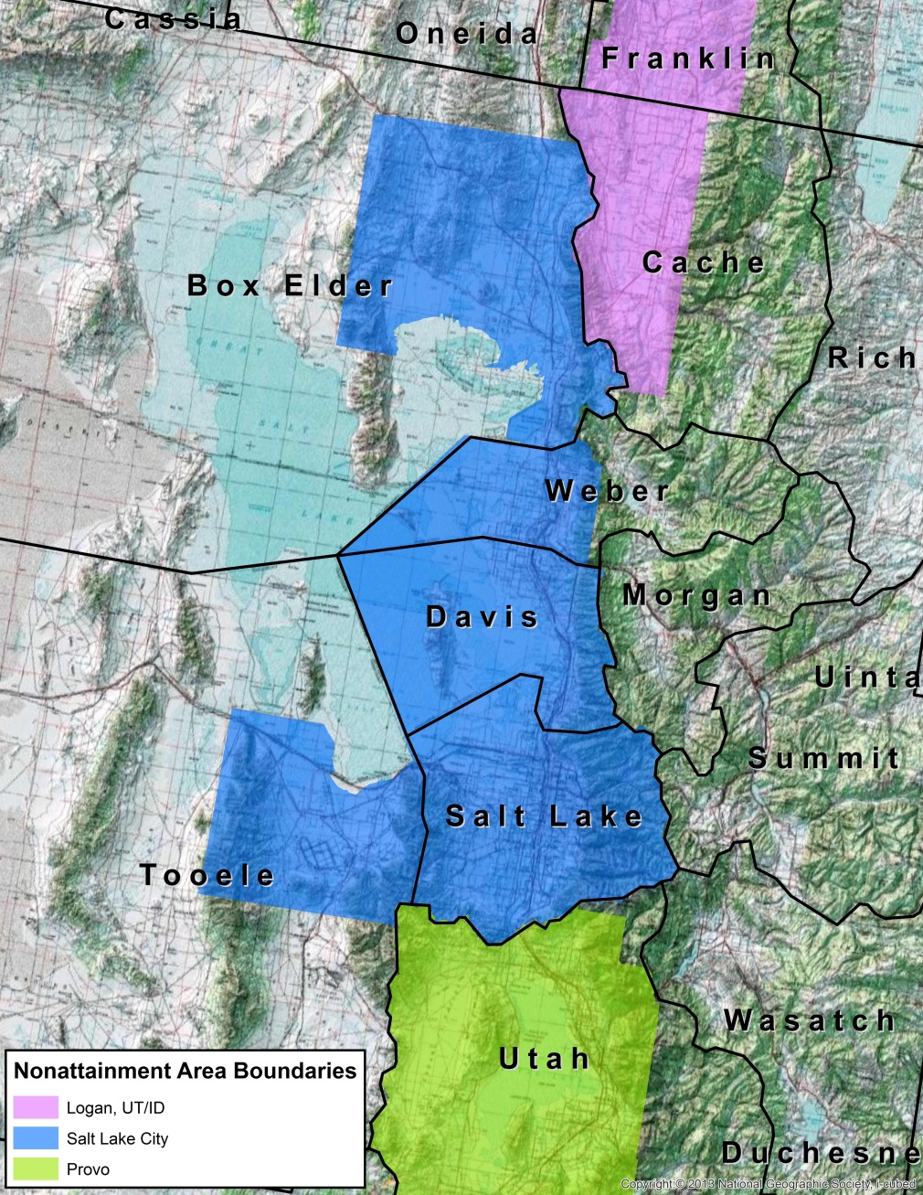
Logan
SLC
Lindon

Slide 7
WRF
Met modeling by Univ. of Utah (Foster, Crosman)
NLCD 2011 land use improvements to Great Salt Lake
Increased WRF albedo by changing:
  MAXALB (maximum albedo)
  SNUP (increased snow cover)

Slide 8
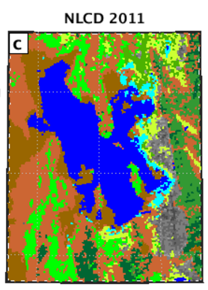
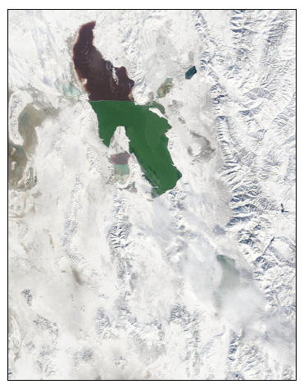
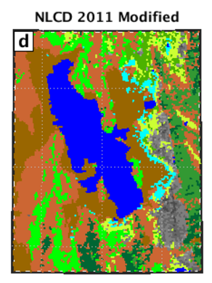
Images courtesy of Chris Foster and Erik Crosman, Univ. of Utah

Slide 9
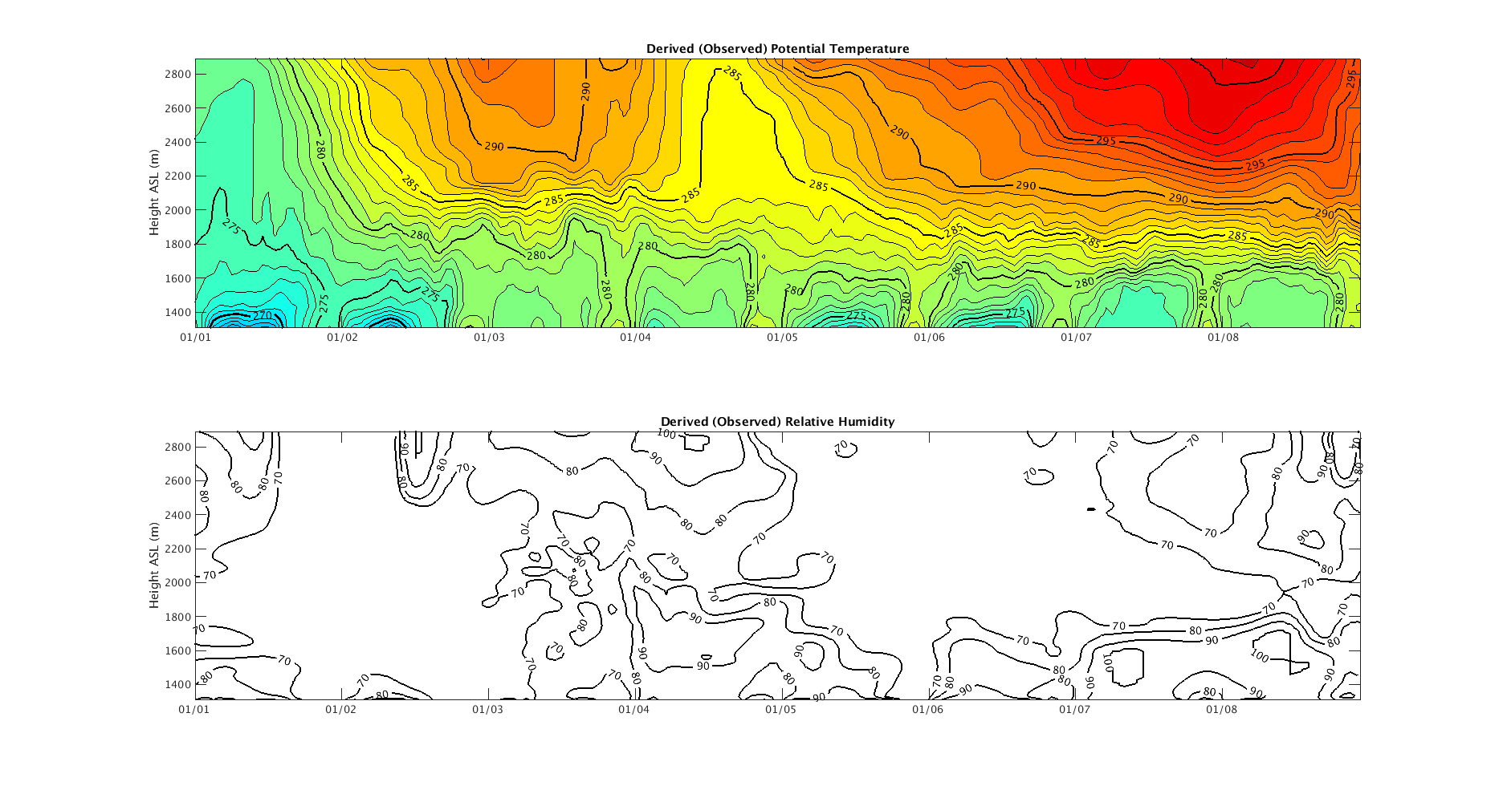
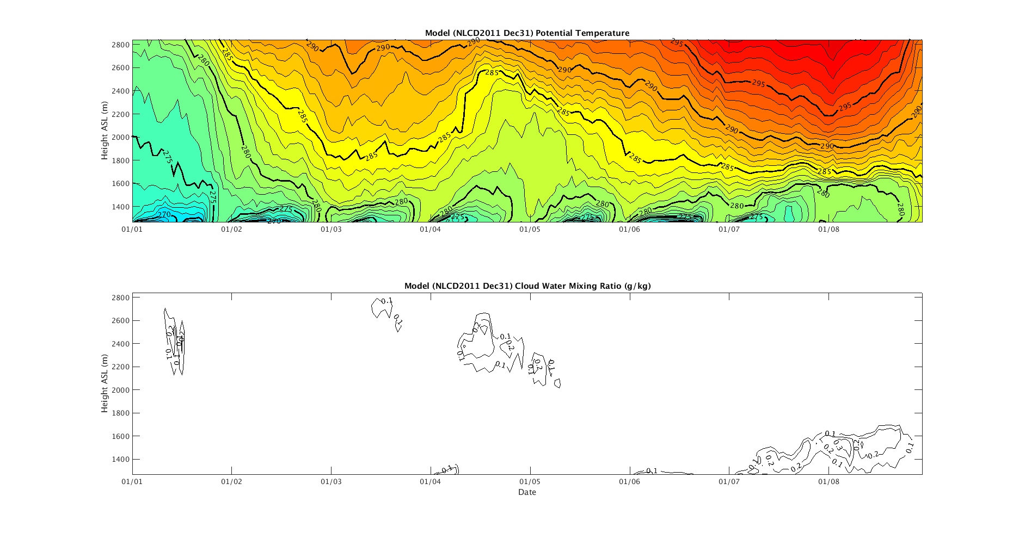
Observations
WRF
Images courtesy of Chris Foster and Erik Crosman, Univ. of Utah

Slide 10
Modeling Platform
CAMx 6.30
Two-way nesting (4 km, 1-33 km)
41 vertical layers (no collapsing)
CB6r3, CF
Zhang dry deposition scheme
Custom mods

Slide 11
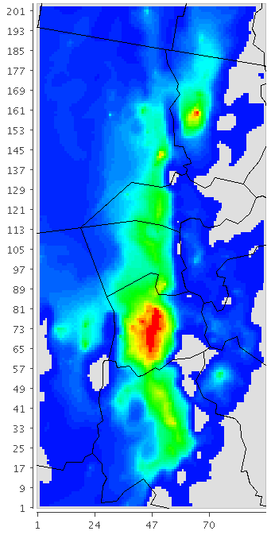
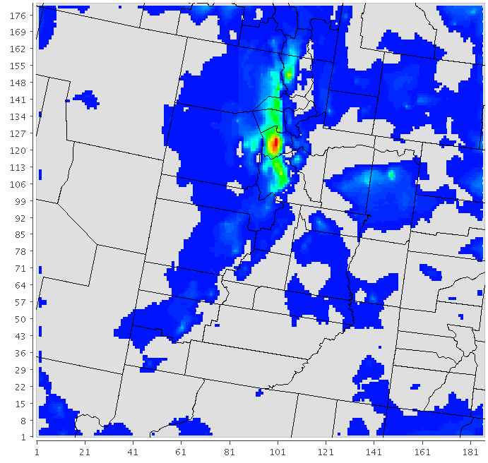
Two-way Nesting
1.33 km (201 x 90)
4 km (180 x 186)

Slide 12
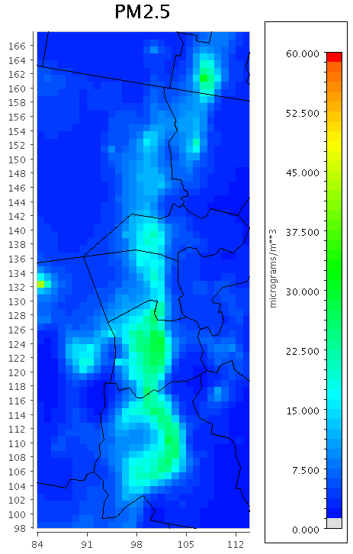
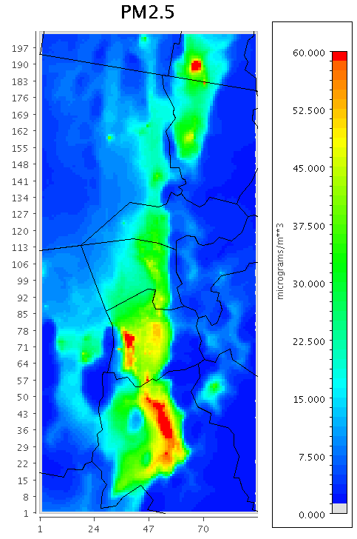
Jan 8th 24-hour UTC
4 km
1.33 km

Slide 13
CAMx Modifications
Urban snow cover fraction = 88%
  Increases surface albedo
  Increases ammonium nitrate
O3 deposition velocity = 0
  More O3 available for NH3, HNO3 oxidation
KVPATCH (Ramboll Environ)
  Increase minimum vertical diffusion coefficients
  Decreases POA

Slide 14
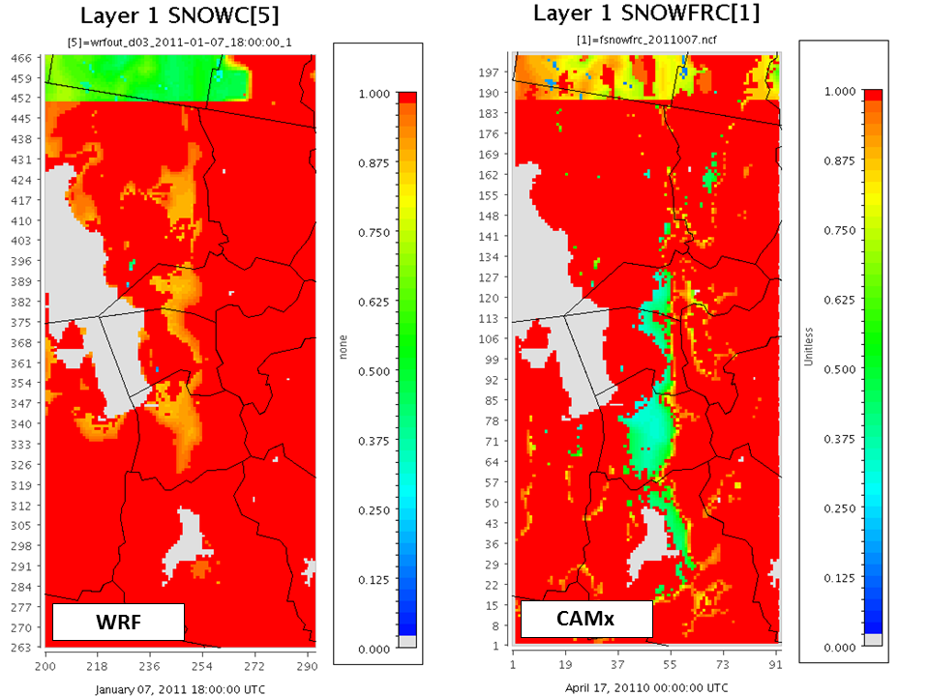
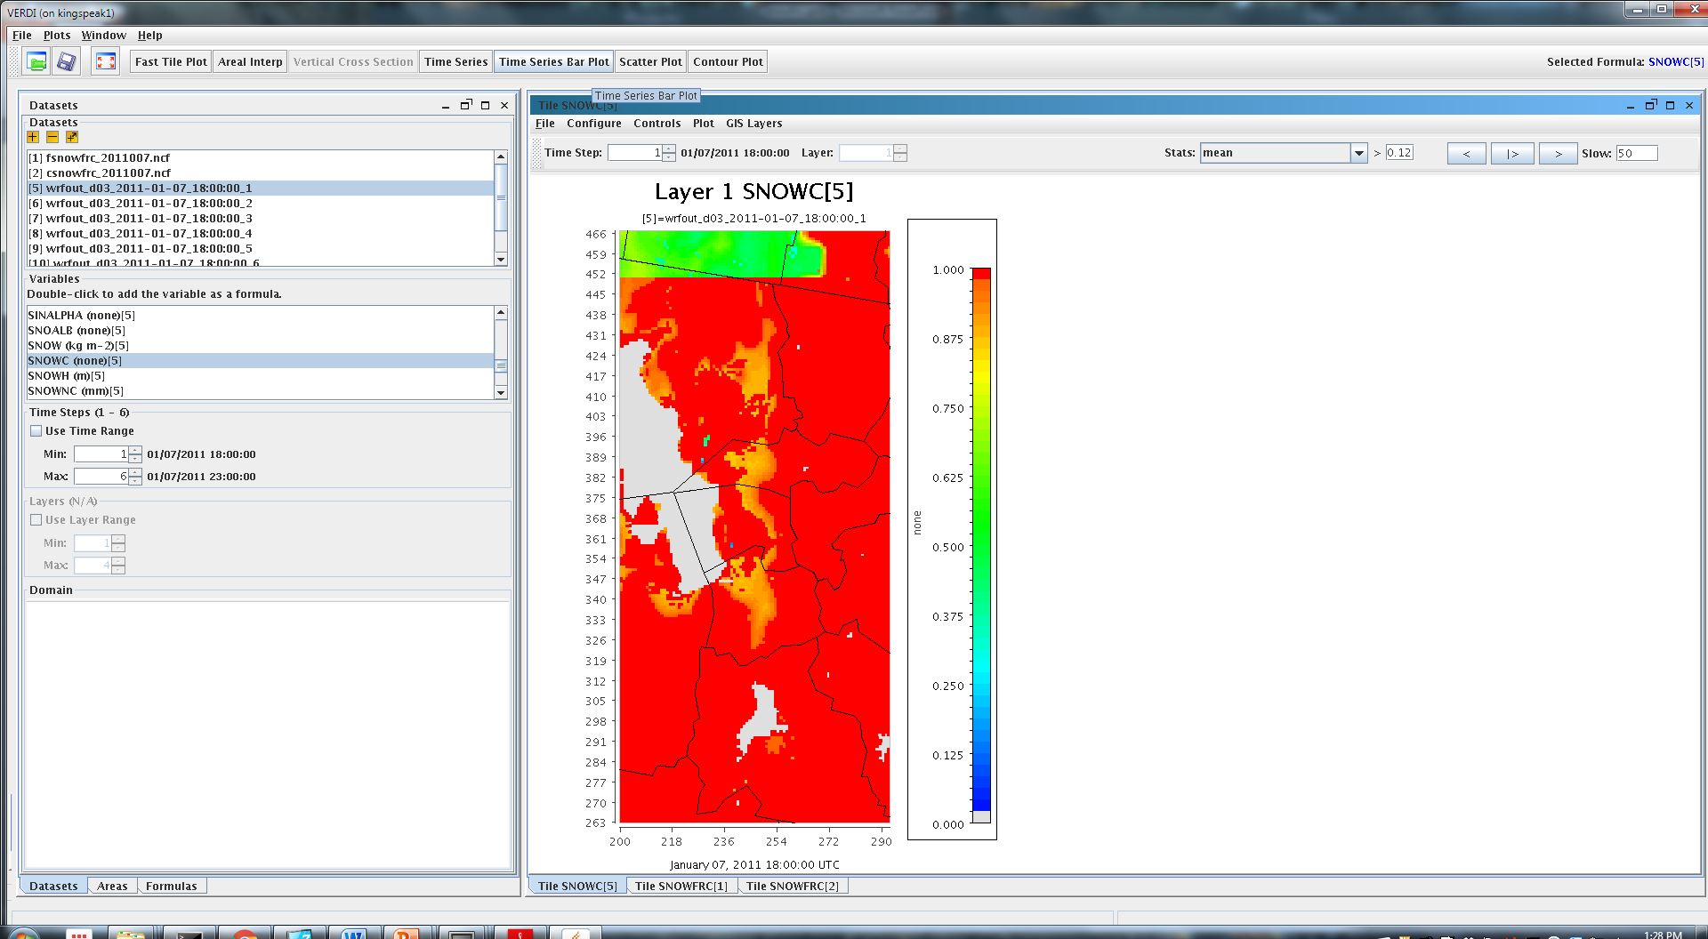
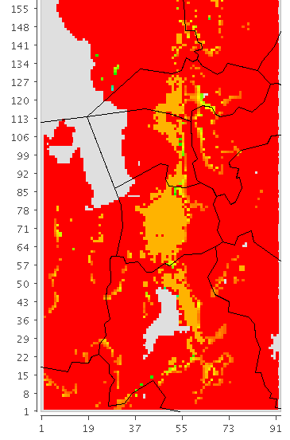
Snow Fraction
CAMx (base)
WRF
CAMx (mod)

Slide 15
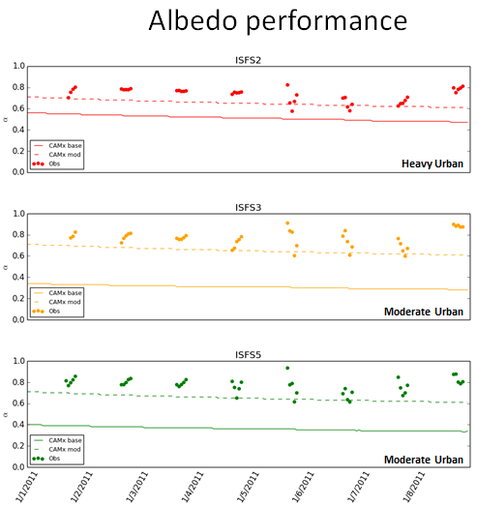
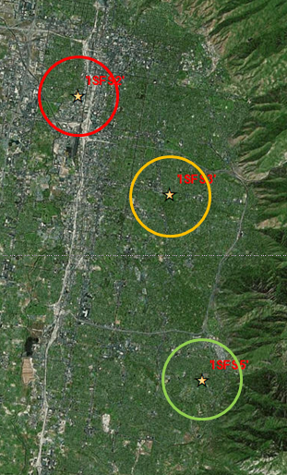
Monitor locations

Slide 16
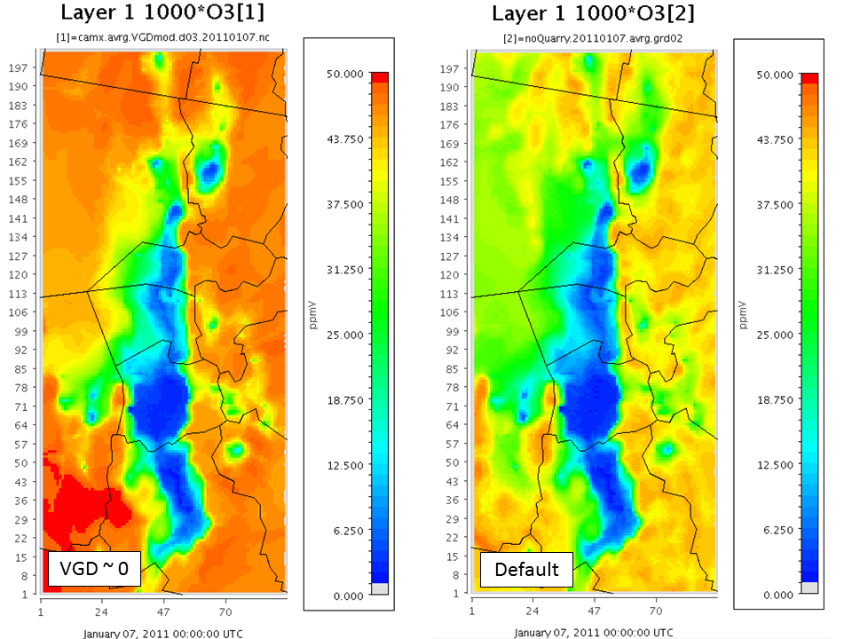
Ozone (ppb)
January 7, 2011 (24-hour mean UTC)

Slide 17
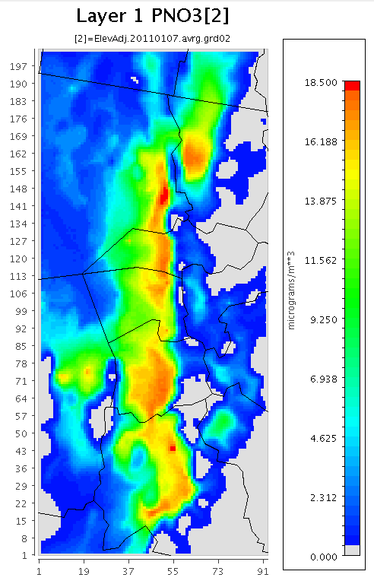

PNO3 (base)
PNO3 (mod)
PNO3 (mod)
January 7, 2011 (24-hour mean UTC)

Slide 18
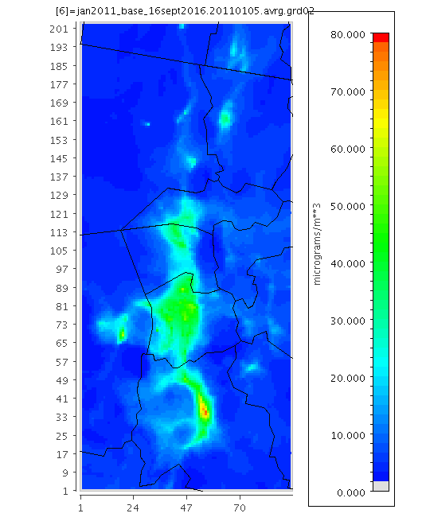

Simulated PM2.5 (Jan 5 – 10, UTC)

Slide 19
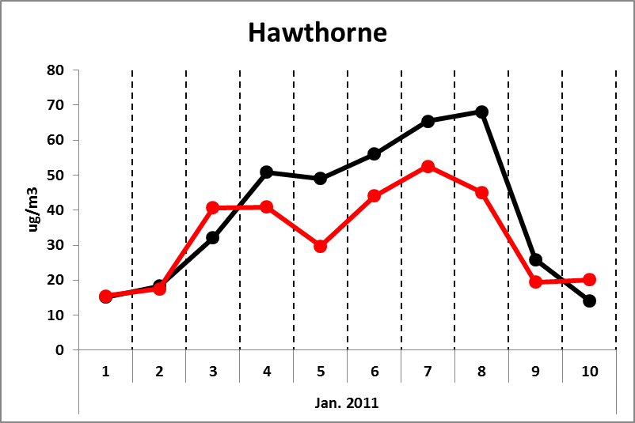
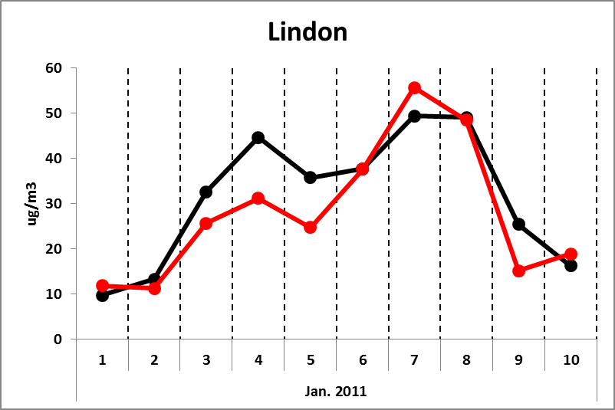
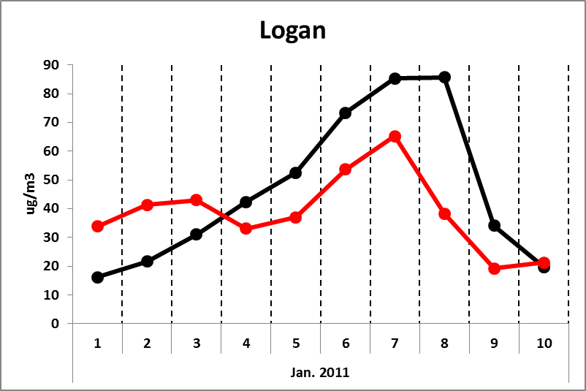
24-hour PM2.5 Concentrations
Measured
Modeled

Slide 20
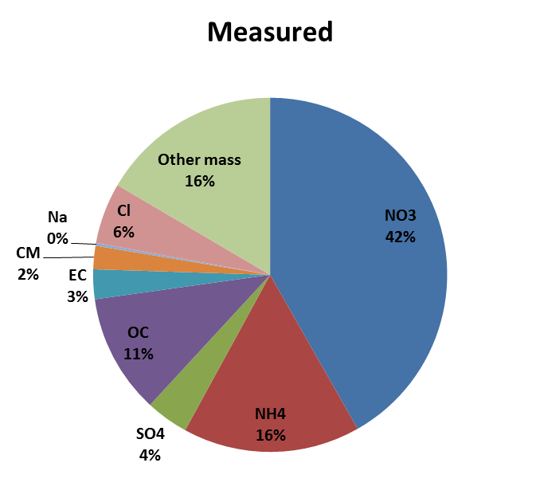
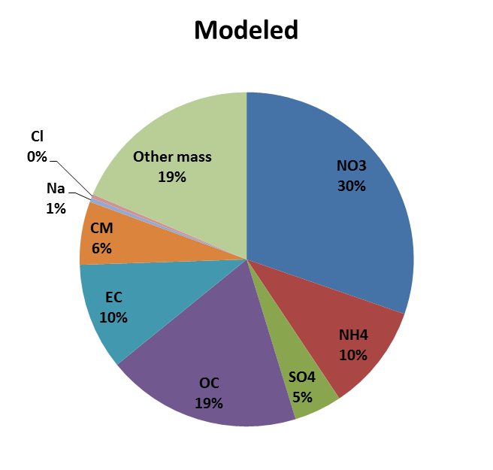
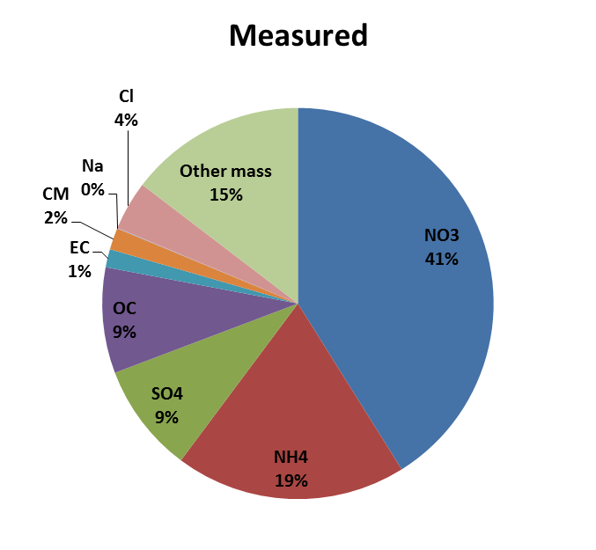
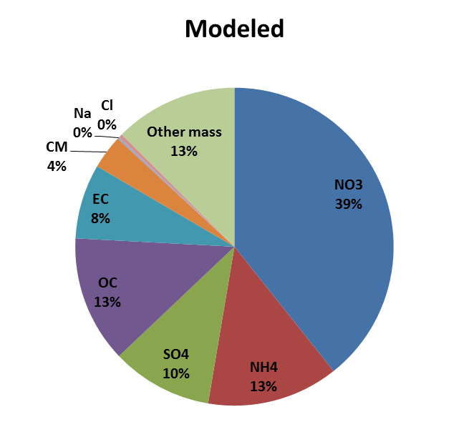
49.1 µg/m³
29.7 µg/m³
Hawthorne
(Salt Lake City)
Jan. 5th
65.4 µg/m³
52.6 µg/m³
Jan. 7th

Slide 21
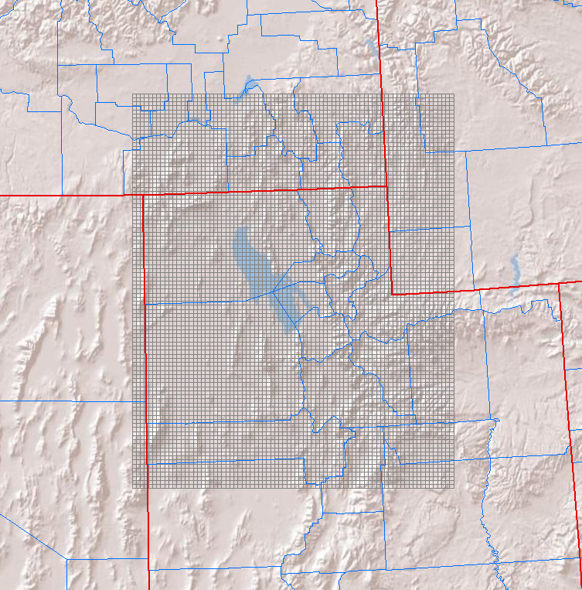
Past Work
CMAQ 4.7
1 grid at 4 km resolution
14 collapsed layers
Vertical advection off
CB05, AERO5
CMAQ 4 km domain

Slide 22
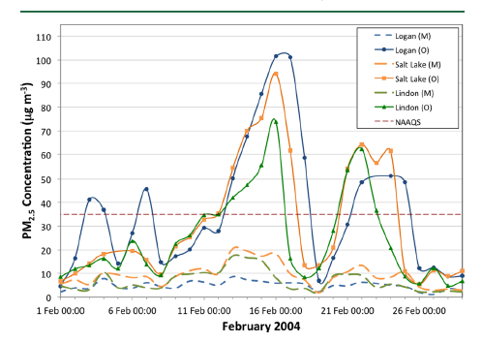
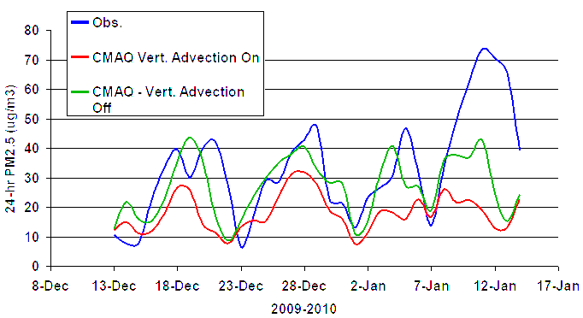

36 km
UDAQ 2016, 1.33 km
Turbulent Fluxes and Pollutant Mixing during Wintertime Air Pollution Episodes in Complex Terrain, Holmes et al. 2015
UDAQ 2014, 4 km

Slide 23
Acknowledgements
Erik Crosman, Chris Foster (Univ. of Utah)
Gail Tonnesen (EPA)
Chris Emery (Ramboll Environ)

Slide 24
END

Slide 25
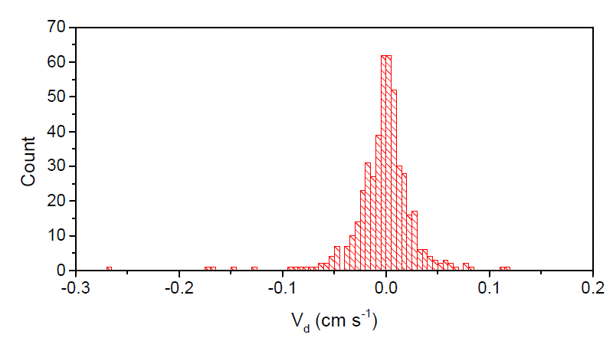
Histogram of ozone deposition velocity calculations for the snow-covered period
(early February) inclusive of both nighttime and daytime data. Mean and median ozone
deposition velocity were -0.002 and 0.0 cm s-1
OZONE DEPOSITION VELOCITY DURING SNOW-COVERED AND NON-SNOWCOVERED
PERIODS BY EDDY COVARIANCE - Detlev Helmig et al.

