Slide 1



IMPROVING AIR QUALITY MODELING PERFORMANCE AND CAPABILITIES
IN BOGOTÁ, COLOMBIA
Jorge E. Pachón*, Boris Galvis, María Paula Pérez,
Jhonathan Ramírez, Luisa Castro, Cesar Palacios
Universidad de La Salle, Centro Lasallista de Investigación y Modelación Ambiental CLIMA
Bogotá, Colombia
Barron Henderson, Robert Nedbor-Gross
University of Florida, Gainesville, FL, USA
15th Annual CMAS Conference, Chapel Hill, NC, October 24-26, 2016

Slide 2
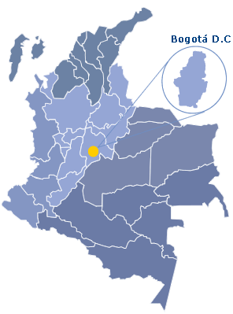
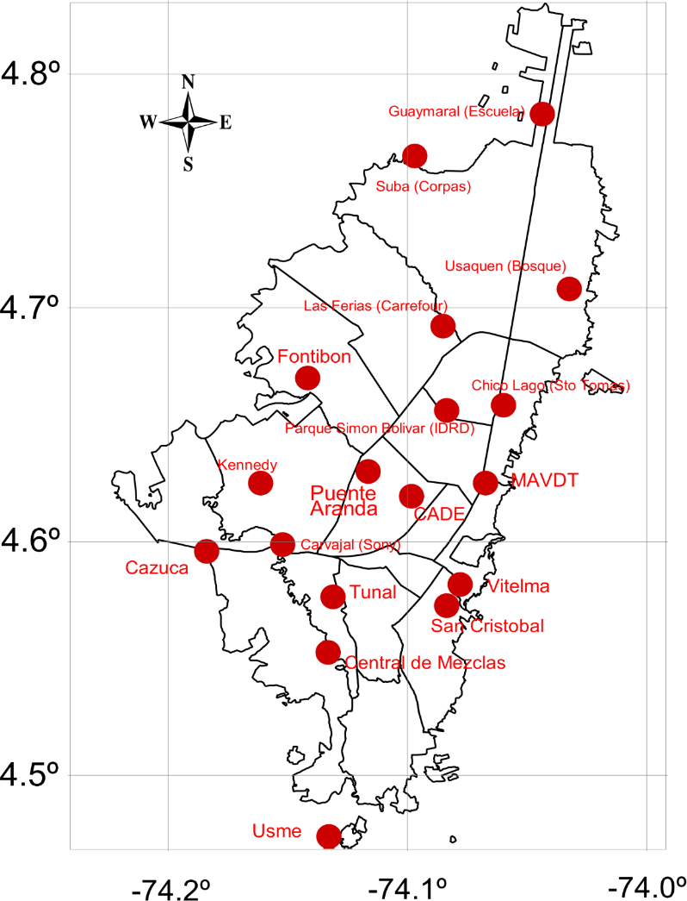
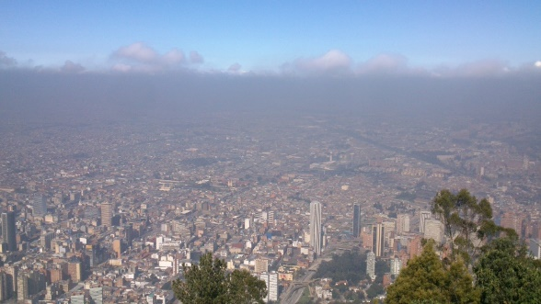
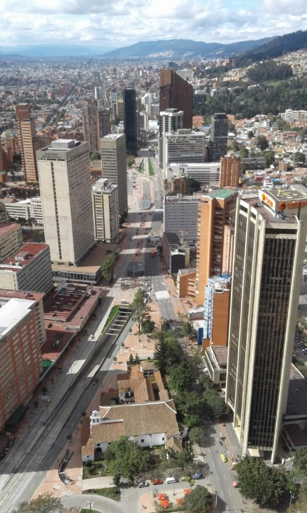
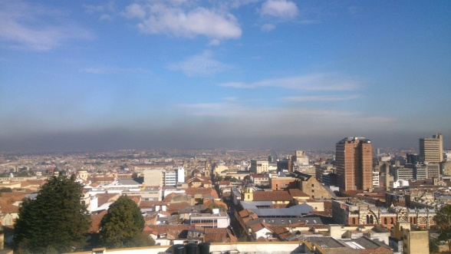
INFORMATION ABOUT BOGOTA
Population (2014) approximately 8 million
Area: 1587 km²
2,600 m.a.s.l.
Motorization rate (avg): 130 vehicles per 1000 inhabitants.
frequent thermal inversions led to bad air quality
Air quality monitoring network operates since 1997. Records of PM10, PM2.5, CO, NOx, SO₂, O₃.

Slide 3
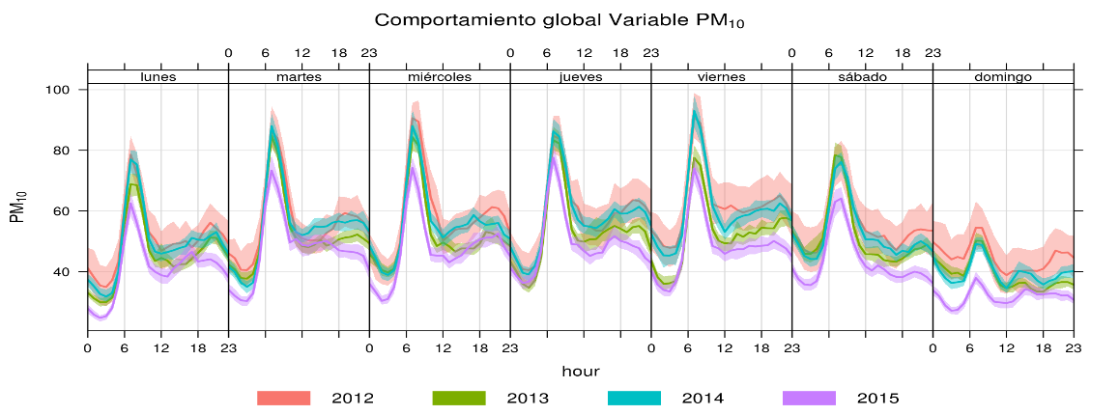
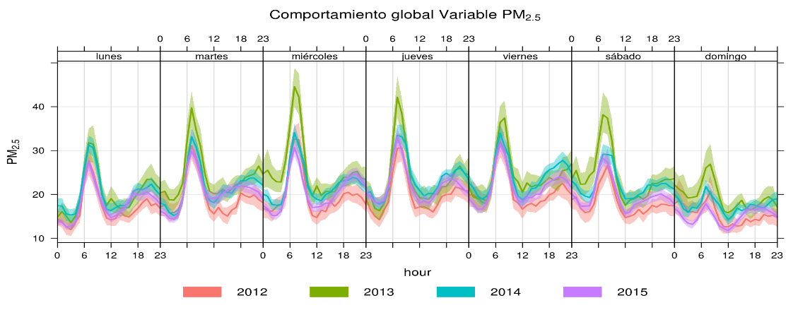
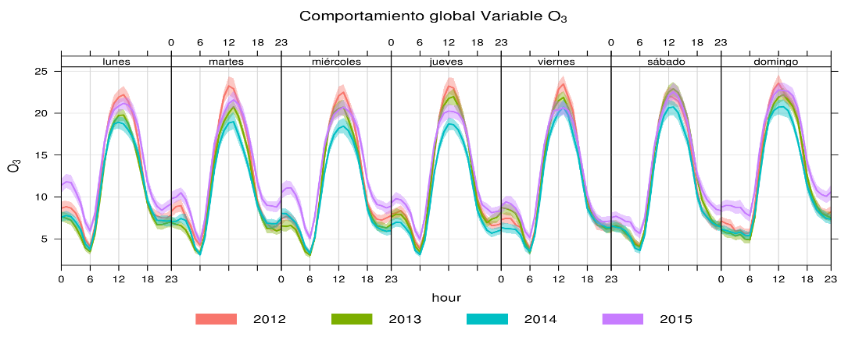

AIR QUALITY IN BOGOTA
PM10 (ug/m³)
PM2.5 (ug/m³)
only 1 station
O₃ (ppb)

Slide 4
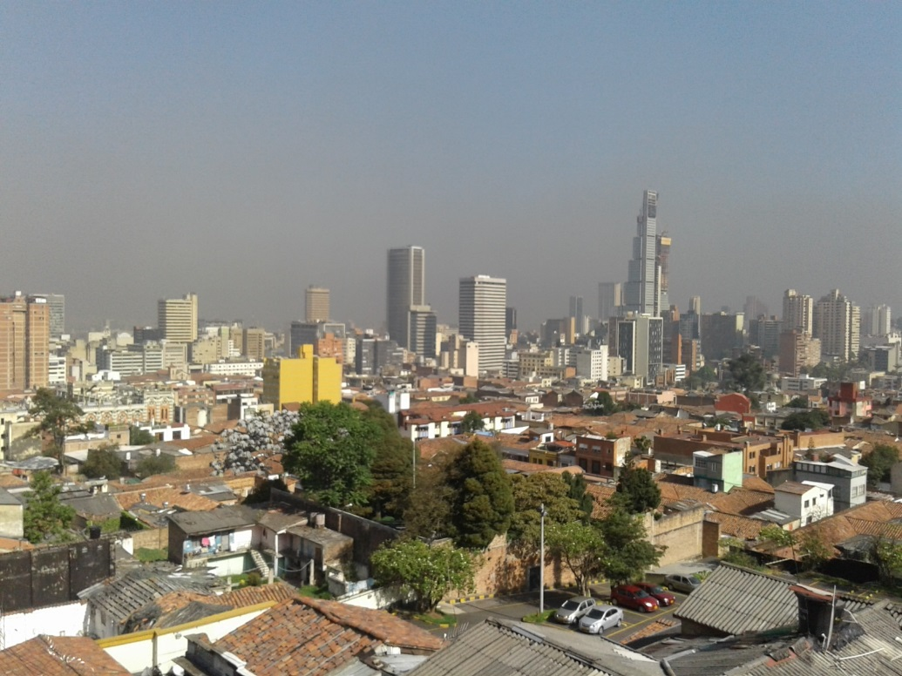
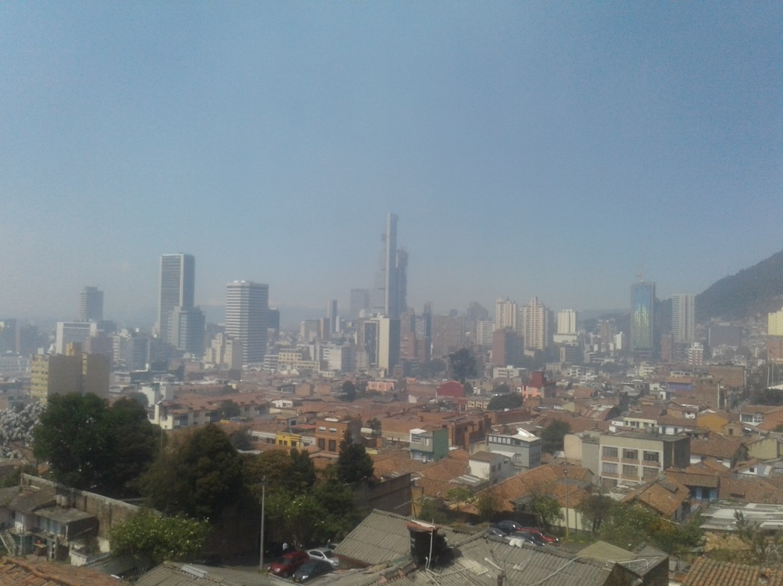
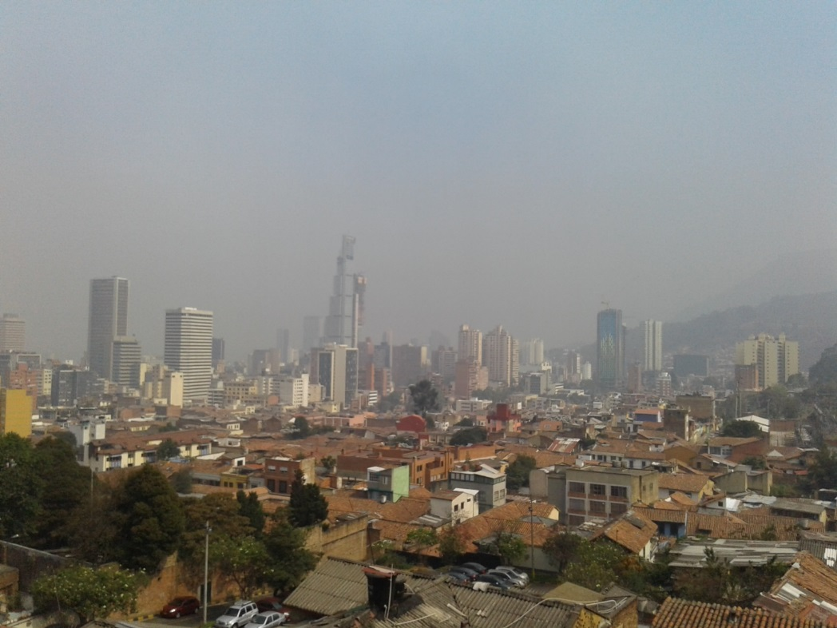
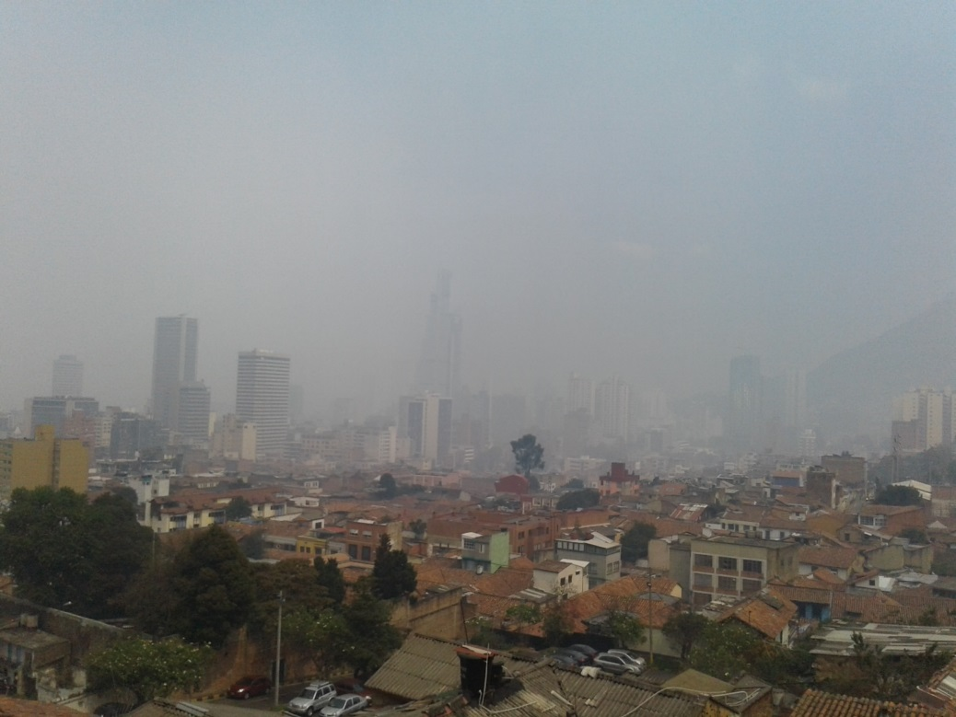
01/01/16 9am
01/02/16 1pm
why are we interested in air pollution in Bogota?
02/02/16 10am
02/02/16 11am
haze produced by wildfires and strong stagnant conditions in January 2016

Slide 5



BACKGROUND
In 2012, Bogotá implemented a CMAQ based air quality (AQ) modeling system.
The model performed satisfactorily but needed adjustments on meteorology predictions and emission inventories.
In the last years, our efforts have focused on improving modeling results and capabilities with the following activities:
  Updating emission inventories for mobile, point and area sources
  Improving estimates of resuspended particle matter from paved and unpaved roads - see Perez et al., APR 2016
  Adjusting mobile source emission factors to consider fleet turnover and changes in fuel characteristics – see Ramirez´s poster on 10/24 at 4.10pm
  Using different terrain databases to improve meteorological performance – see Nedbor-Gross´ talk on 10/26 at 4.50pm
  Developing an emission pre-processor compatible with the photochemical model – see Perez´s poster on 10/24 at 4.10pm

Slide 6
UPDATING OF EMISSION INVENTORIES
Emission from mobile, point, and area sources were updated from the base year (2008) to the modeling years (2012 - 2014).
1
TEMPORAL AND SPATIAL DISAGREGGATION
Emissions were disaggregated hourly to 1x1 km in a inner domain of 64x64 km including Bogota and surroundings.
2
SELECTION OF MODELING EPISODE
Based on the analysis of air quality records, two modeling periods were chosen: Feb. 15 (±10 days for dry period) and Oct. 15 (±10 days for wet period) 2012. JFM and OND in 2014.
3
IMPLEMENTATION OF WRF-CMAQ
WRF and CMAQ were implemented for the modeling episode and in four domains, the inner one including Bogota and surroundings. ICs and BCs from global models.
4
EMISSION REDUCTION STRATEGIES
Emissions reduction strategies in 2020/2030 were tested for mobile, point and area sources to identy the most cost-effective program.
5

Slide 7
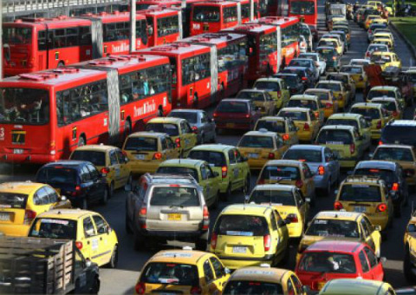
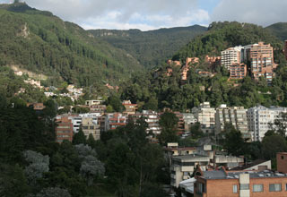
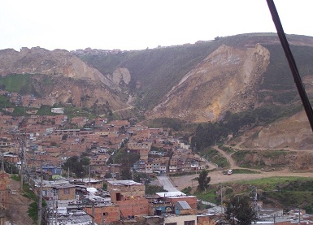
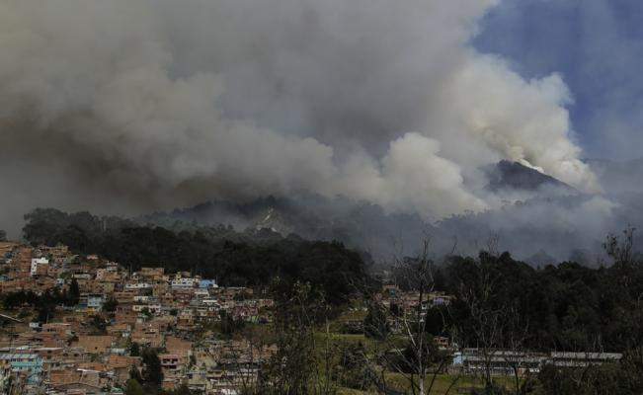
UPDATING EMISSION INVENTORIES
MOBILE
AREA
RESUSPENDED
DUST
WILDFIRES
Mobile sources contribute with >90% of NOx, CO, CO₂
emissions and direct and indirect PM10 emissions.
Notes:
Jhonathan, por favor señalar donde encuentro los archivos para editar la grafica en Excel, verificar que éstas sean las emisiones 2014. incluir PM2.5 en la tabla y totalizar

Slide 8
MOBILE SOURCE EMISSIONS
Buses and trucks contribute with more than 60% of PM emissions.
VP: passenger vehicles; CC: trucks and pick-ups; T: taxis; M: motorcycles;
MB: microbus; B: bus; TM: Transmilenio (BRT); ESP: school and tourism buses; C: trucks
Temporal mobile profiles - weekday
Temporal mobile profiles - weekend
Notes:
Jhonathan, por favor señalar donde encuentro los archivos para editar la grafica en Excel, incluir PM10
Profe: En el Dropbox en noveno entregable subi un Excel “graficas total emisiones todas las fuentes”

Slide 9
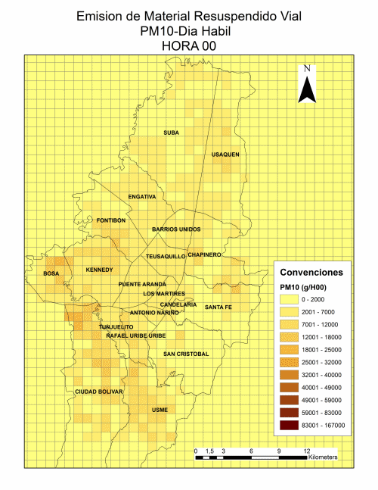
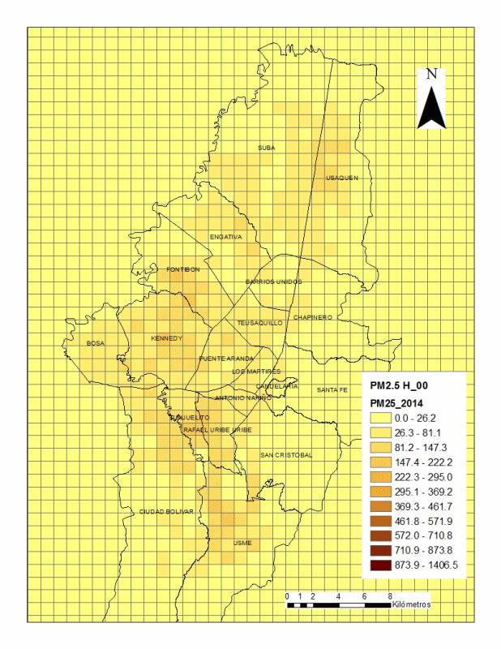
Mobile PM2.5
Resuspended PM10
Spatial and temporal desaggregation - PM
Notes:
Jhonathan, Luisa, la animacion de las emisiones es mucho mas rapida en mobiles que resuspendido, homogenizarlas
Ya estan homogeneizadas

Slide 10
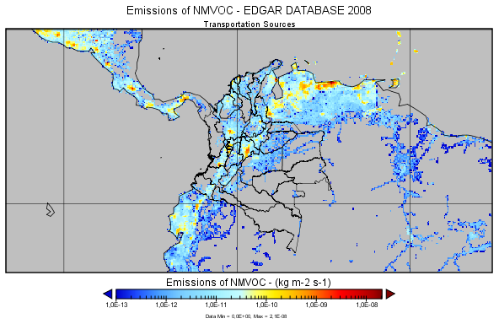
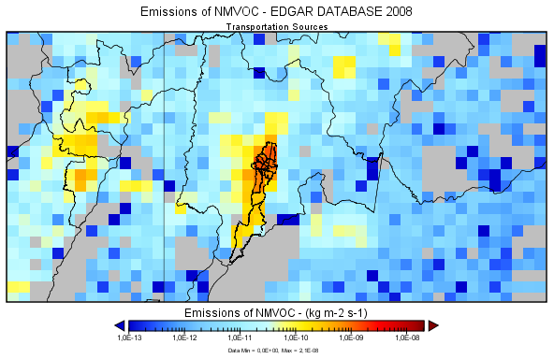
MODELING DOMAIN
Emissions: d04 from local estimation; d01, d02 and d03 from EDGAR
WRF - ICs, BCs from GFS-NCEP, using the default physics options for WRF
CMAQ – d01: ICs, BCs from GEOS-Chem; d02,d03,d04: ICs from GEOS-Chem; BCs from parent domain
Vertical structure: 29 layers
Equatorial Mercator Projection
 | Origin (km) |  | Resolution(km) |  | #Cells
Domain | X | Y | Δx | Δy | X | Y
d01 | 251759.250 | -1578187. | 27 | 27 | 179 | 154
d02 | 2123759 | 158812.062 | 9 | 9 | 94 | 76
d03 | 2522759.5 | 413813.469 | 3 | 3 | 82 | 67
d04 | 2622759.250 | 483812.062 | 1 | 1 | 64 | 64
Notes:
MaPaula, verificar que la información sea correcta

Slide 11
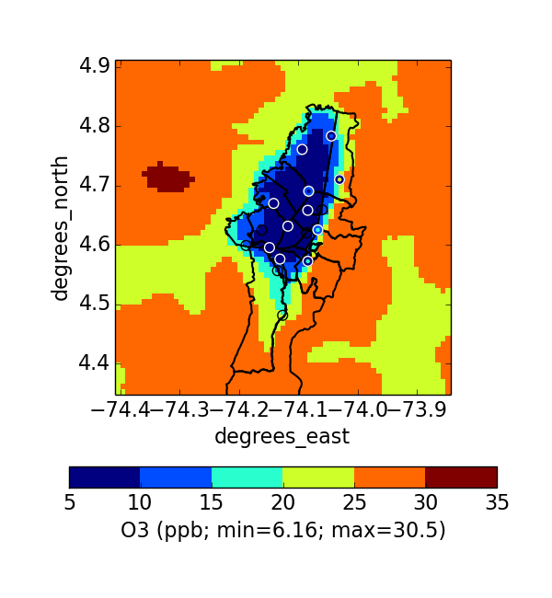
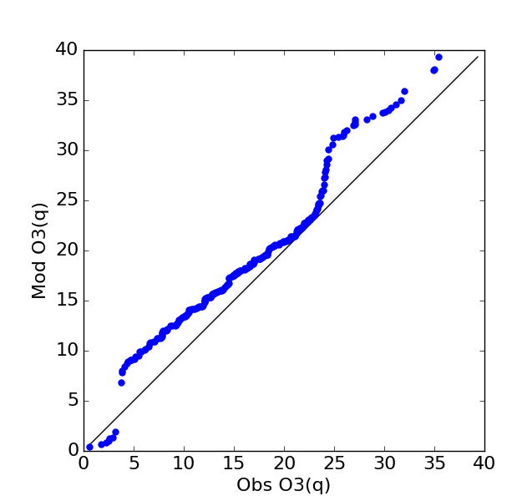
Modeling results in 2012 - Ozone
Model
Ozone
Good Agreement
Obs
Ozone is well predicted, but not a problem.
United States NAAQS: 70 ppb

Slide 12
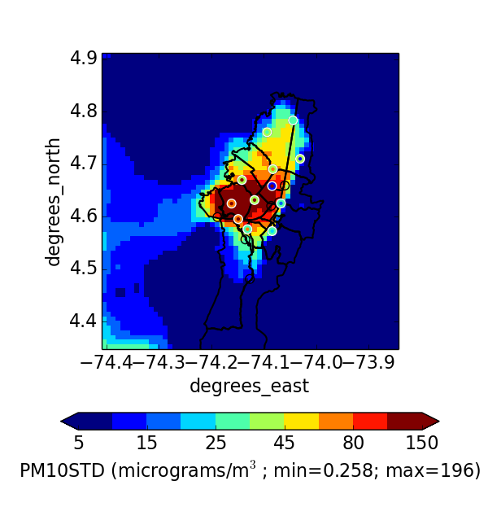
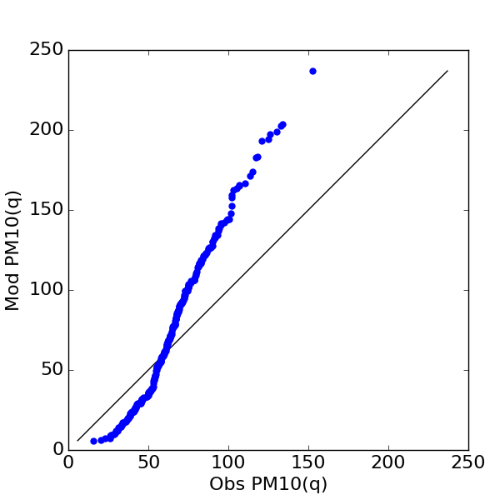
Modeling results in 2012 – PM10
Model
PM10 “Fixed”
Use of adjustment factors
PM10 “Fixed”
Obs
Coarse particles needs refinement

Slide 13
What did we learn from AQ modeling?
PM emissions from mobile and point sources are not enough to explain ambient PM concentrations observed in the city (PM10 average 52 ug/m³, PM2.5 average 20 ug/m³ for 2014).
Resuspended dust emissions might account for such missing PM fraction. Prior to 2012 no emission inventory in the city had accounted for resuspended dust.
Resuspended roads
Resuspended building
Tire and break wear
3,000 ton/yr
10,938 ton/yr
Notes:
Barron, do we have a graph that shows PM concentrations modeled without RPM? So that we can show low levels of ambient PM?

Slide 14
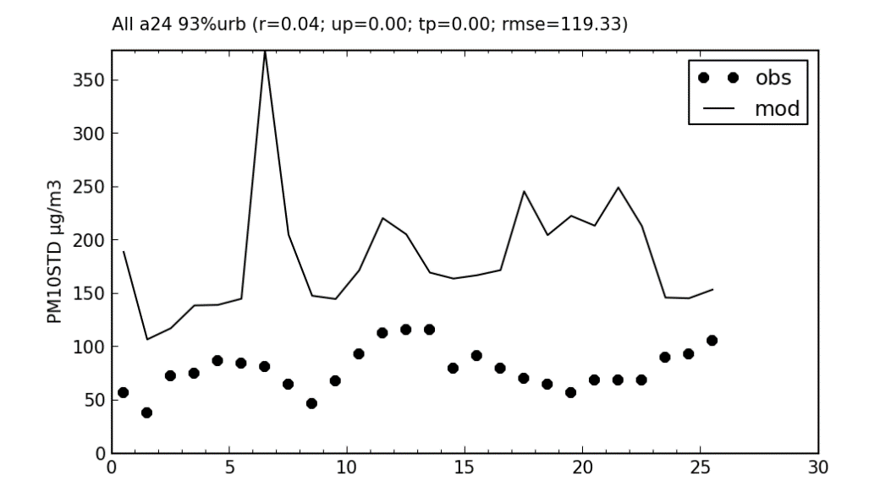
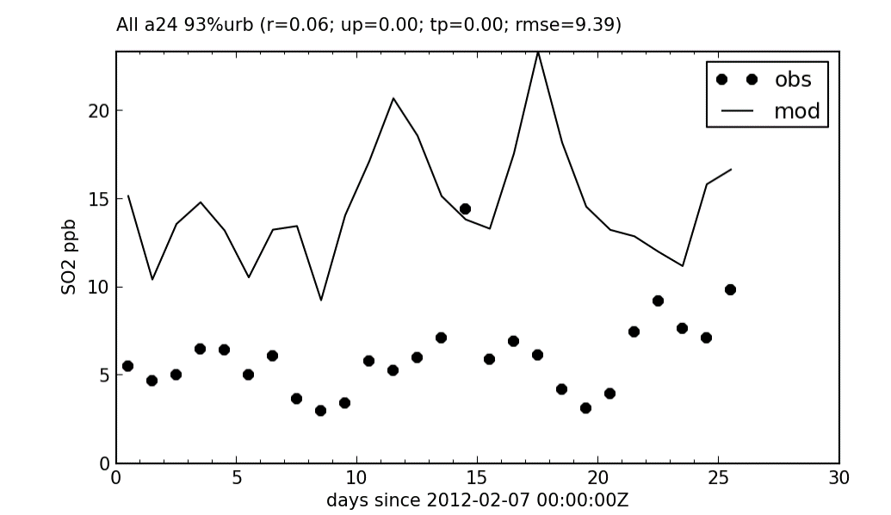
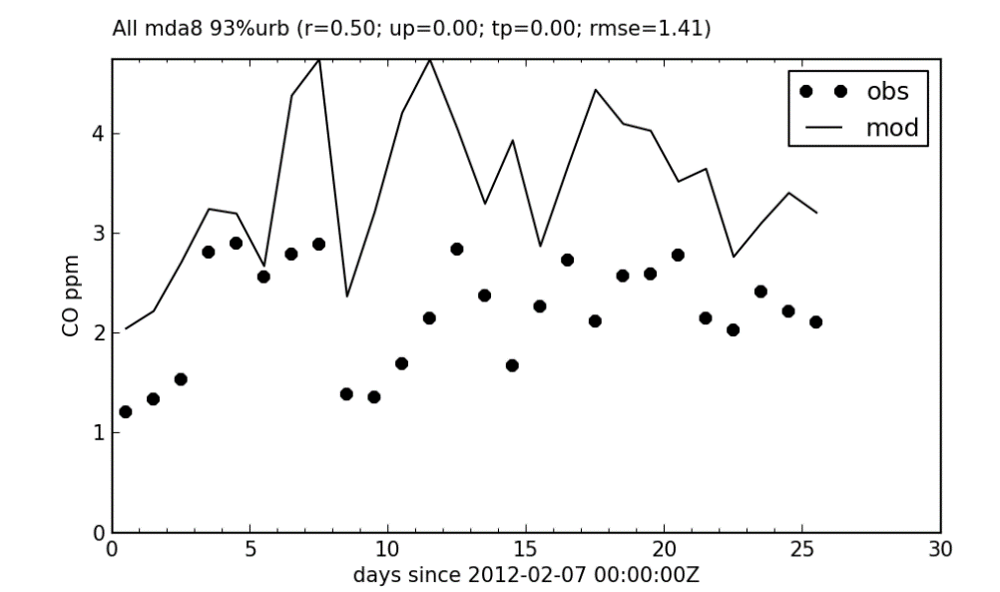
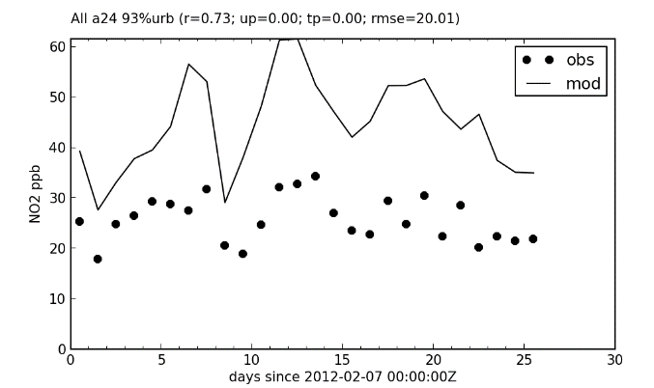
What did we learn from AQ modeling in 2012?
The first inventory of resuspended dust emissions resulted in overestimation of PM concentrations for the 2012 modeling year.
SO₂, CO and NO₂ emission inventories also resulted in overestimation of ambient concentrations in 2012.
PM10 OCT
SO₂ OCT
NO₂ OCT
CO OCT
Notes:
Problema con el perfil nocturno night bias, no se hizo el promedio de 3 capas

Slide 15
IMPROVING EMISSION ESTIMATES
Determine dust loadings (Cs)
Interpolate Cs to all roads
Estimate EFs from EPA AP-42, Chap. 13
Construct dust emission inventories
PM underestimation
Include resuspended dust emissions
PM
overestimation
Adjust
resuspended dust emissions
Revise Cs interpolation
Assign temporal variabilty to RPM
Apply mitigation factors
SO₂ overestimation
Adjust EFs for SO₂
MOVES
New EFs estimated considering:
Vehicular fleet age and activity (AADT)
Speed bins
Passenger vehicles and public buses renovation
Lower sulfur content in fuels
Stricter controls for VOC emissions
CO
Overestimation
Adjust EFs for CO
NO₂ overestimation
Adjust EFs for NO₂

Slide 16
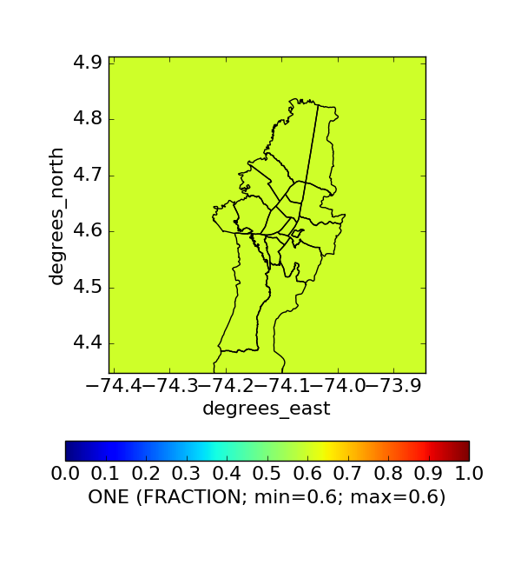
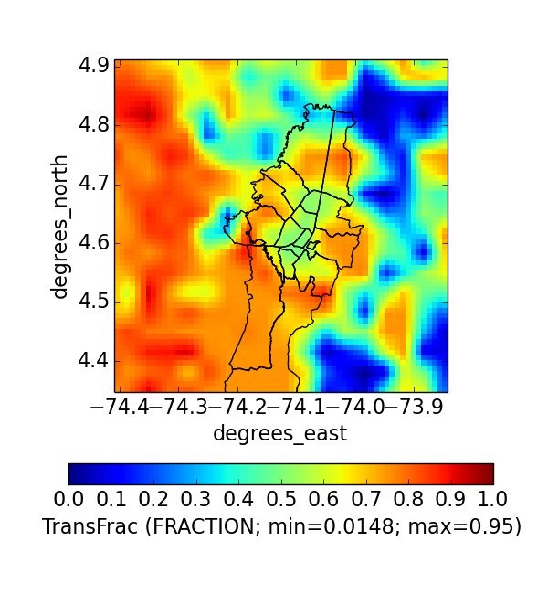
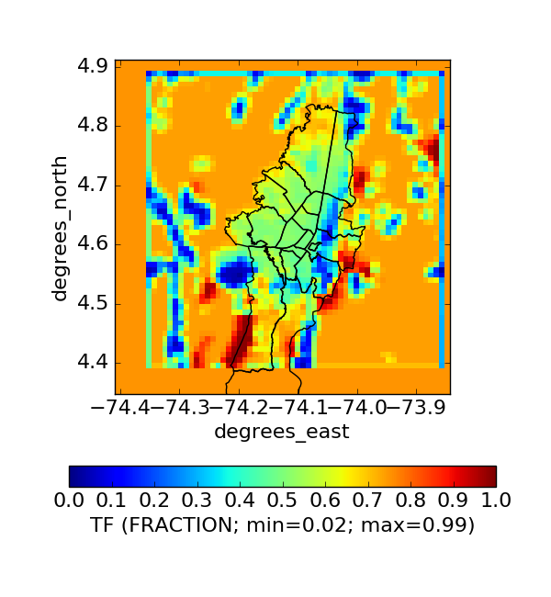

RESUSPENDED DUST ADJUSTMENT
Natural mitigation factor adjustment for re-suspended particulate
matter emission inventory
Source | Period | 2014 Hourly based fractions |  | Time invariant | Effective reduction
 |  | p_{(x,t)} | h_{(x,t)} | f_{x}
Paved Roads | JFM | 0.87 | 1.0 | 0.62 | 0.41 Emission reduction over the year for both sources
 | OND | 0.86
Unpaved Roads | JFM | 0.91 | 0.96
 | OND | 0.91 | 0.93
$$\overline{f_{x}}$$
Avg
0.59
2012 project 60% adjustment factors
Recently Published International Database (~60%)
This Project Local Database (~60%)
see more at Perez et al., APR, 2016
Notes:
MaPaula, reemplzar la figura de la derecha, creo tu tienes una donde no se ve el corte

Slide 17
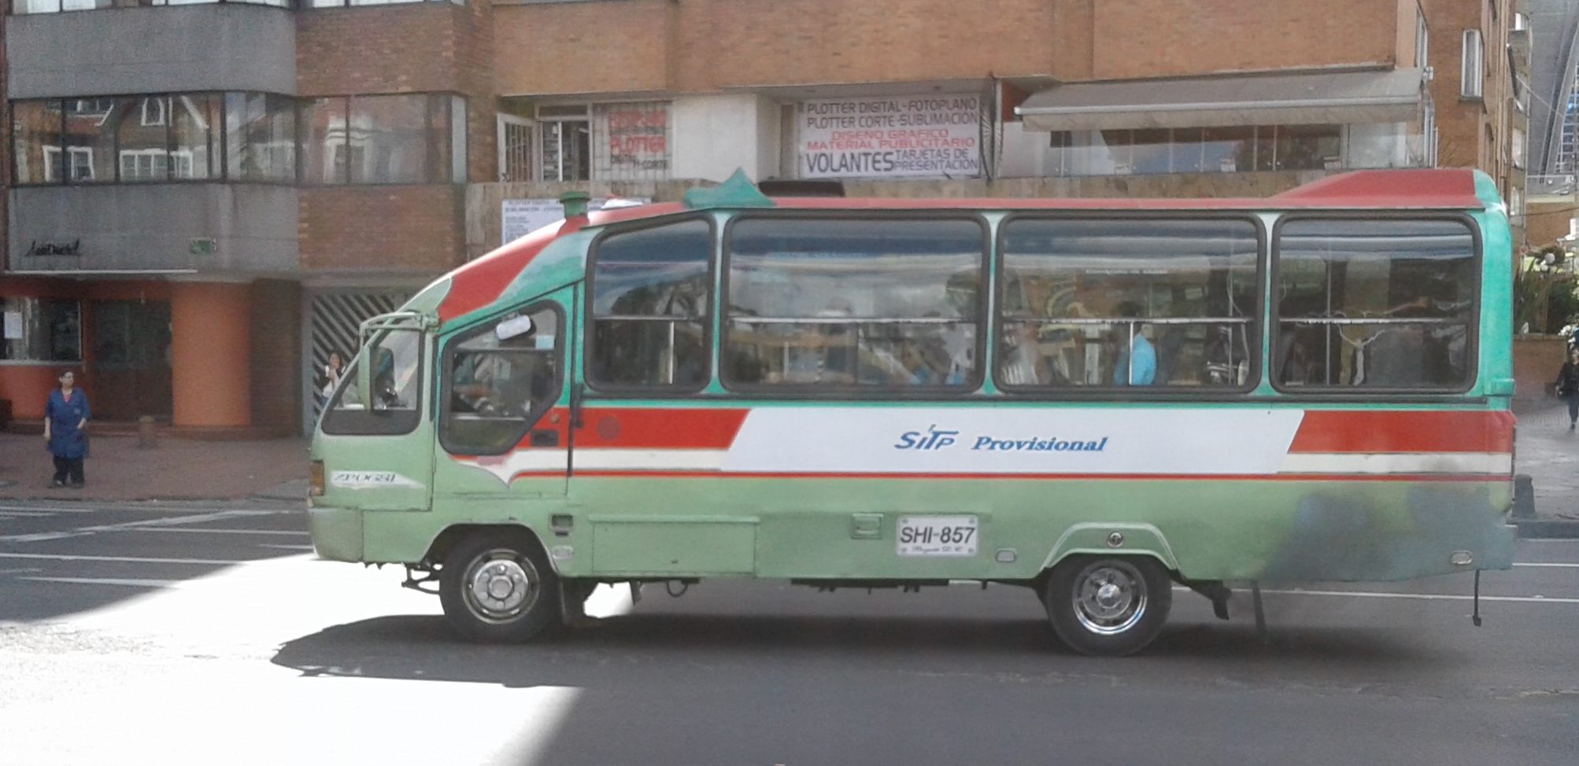
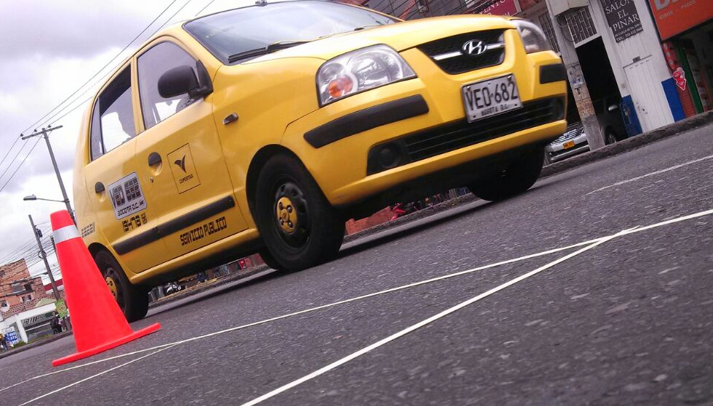
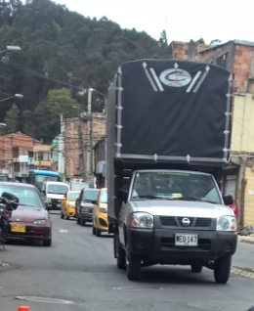
MOVES IMPLEMENTATION
MAIN CHALLENGES
MAIN RESULTS
Fleet equivalence between Colombia and US (type, size, power, emission control technologies, driving patterns).
New EFs reflect reflect changes in fuel quality and fleet turnover.
Tire and break wear emissions
PM EFs take into account vehicle age
CO and SO₂ chages due to new EFs
see more at Ramirez´s poster on 10/24 at 4.10pm

Slide 18
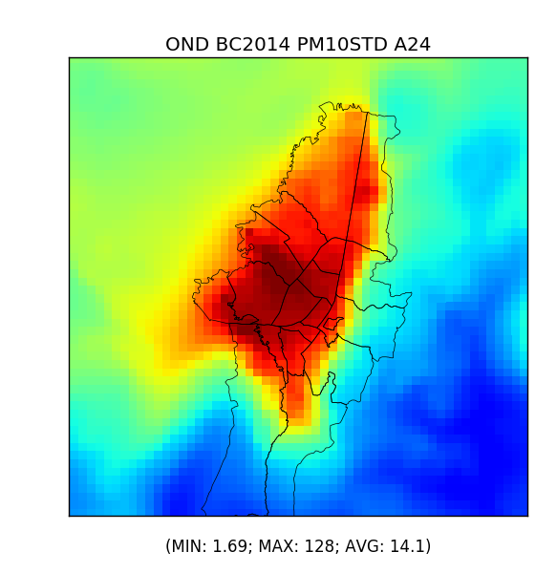
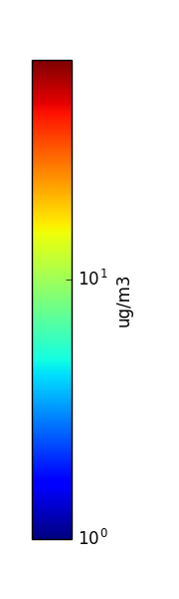
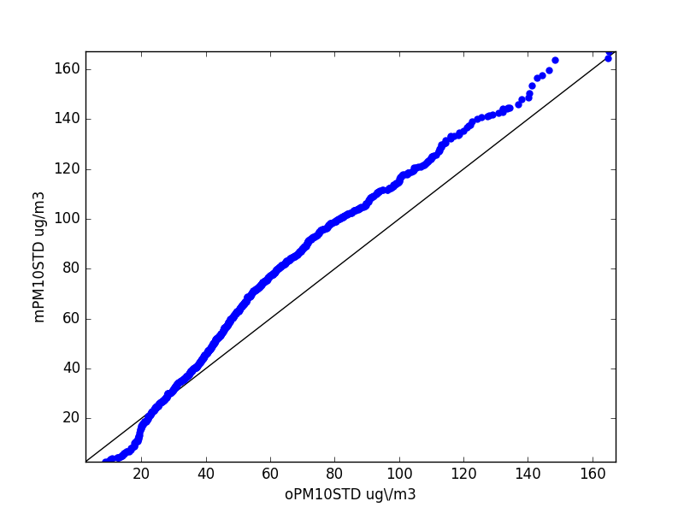
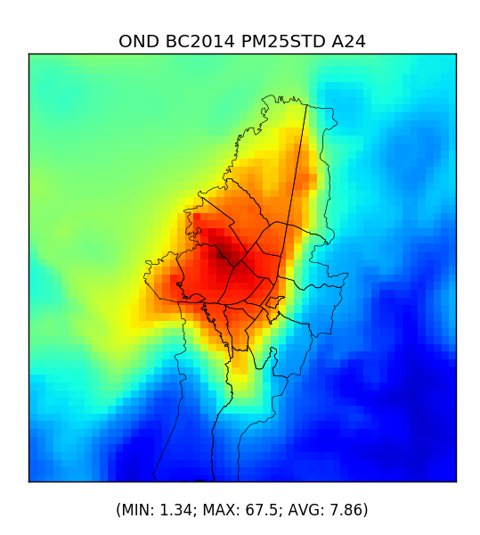
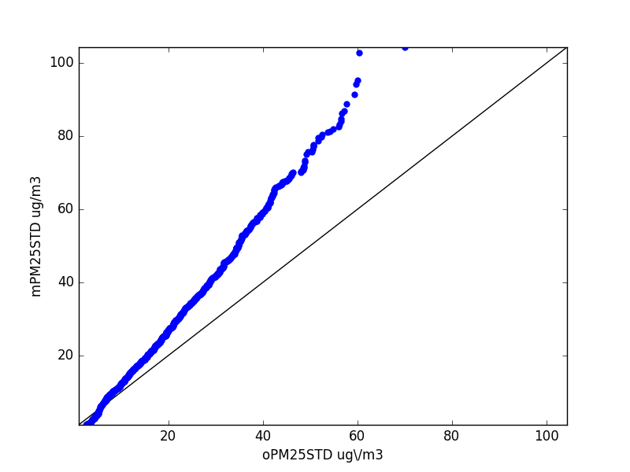
MODELING RESULTS – 2014
AVG 66.9 ug/m³
PM10
OND
PM10 slightly high biased in OND
MAX 128 ug/m³
PM2.5
AVG 31.8 ug/m³
OND
PM2.5 is slightly high biased for low concentrations, but the bias increases for higher concentrations
MAX 67.5 ug/m³
AVG of modeling values observed at air quality stations; MAX of modeling values across the whole domain
Quantile-quantile plots for a24 PM10 with observations on the x-axis and model concentrations on the y-axis
Notes:
Robbie,
Q-Q plot for PM10 only for January and October, update with JFM and OND. Do these results include three-layer modeling average?
Answer: I updated the QQ plots wth full JFM and OND. Yes, they include the 3-layer averaging
MAX in spatial plots differ from MAX Q-Q plots??
Answer: The maxes differ because the spatial plots are time means and the QQ plots have all of the a24 values for each day.

Slide 19
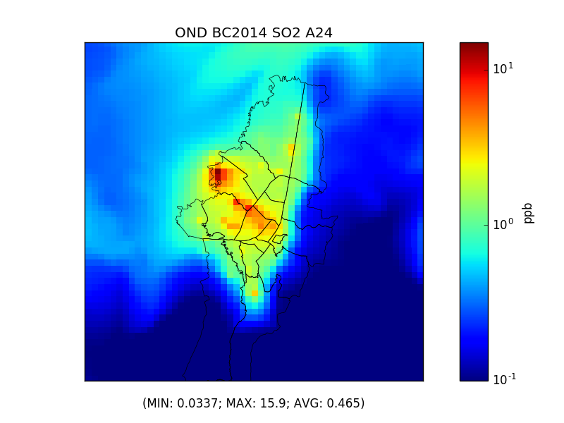
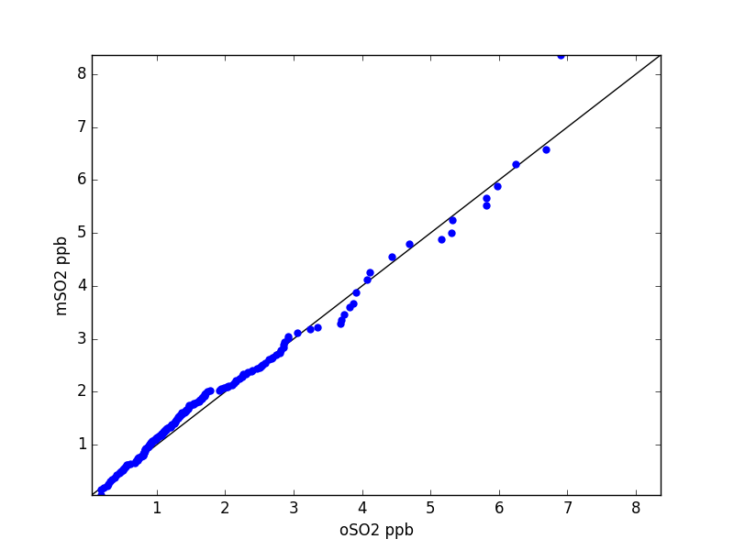
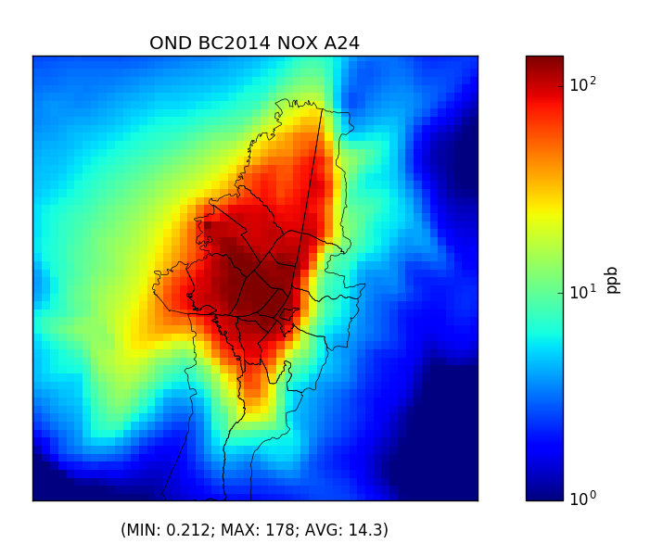
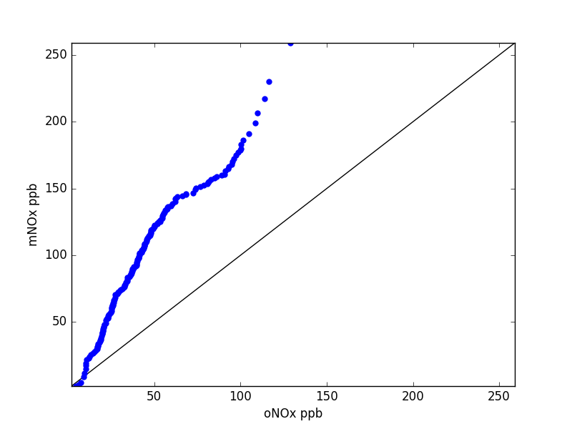
MODELING RESULTS
AVG 1.64 ppb
OND
SO₂
SO₂ is slightly low biased
MAX 15.9 ppb
AVG 14.3 ppb
OND
NO_{x}
High bias for Nox
probably overestimation of emissions
MAX 178 ppb
AVG of modeling values observed at air quality stations; MAX of modeling values across the whole domain
Quantile-quantile plots for a24 NOx with observations on the x-axis and model concentrations on the y-axis
Notes:
Robbie,
Add spatial plot for 2014
Answer: Spatial plots added.
Q-Q plot for PM10 only for January and October, update with JFM and OND. Do these results include three-layer modeling average?
Answer: I updated the QQ plots wth full JFM and OND. Yes, they include the 3-layer averaging
MAX in spatial plots differ from MAX Q-Q plots??
Answer: The maxes differ because the spatial plots are time means and the QQ plots have all of the a24 values for each day.

Slide 20
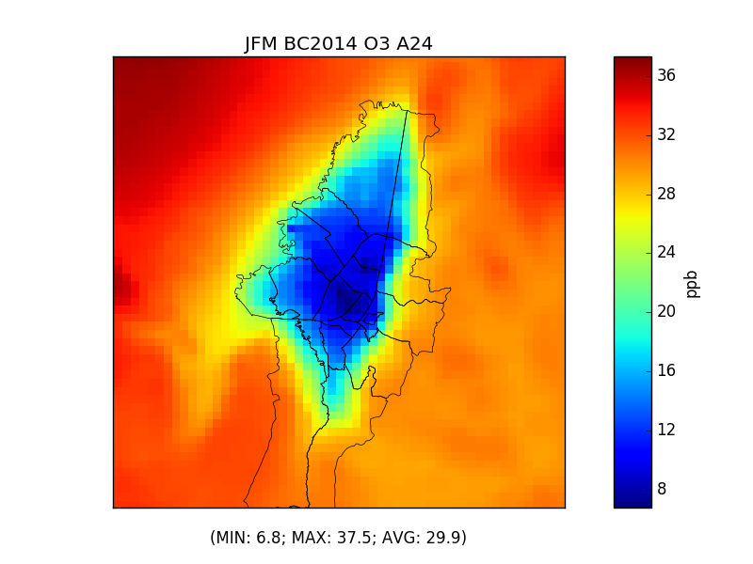
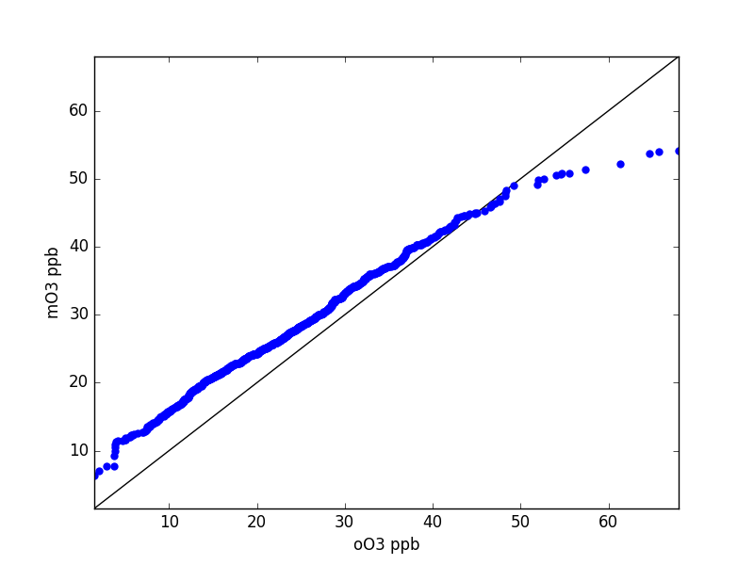
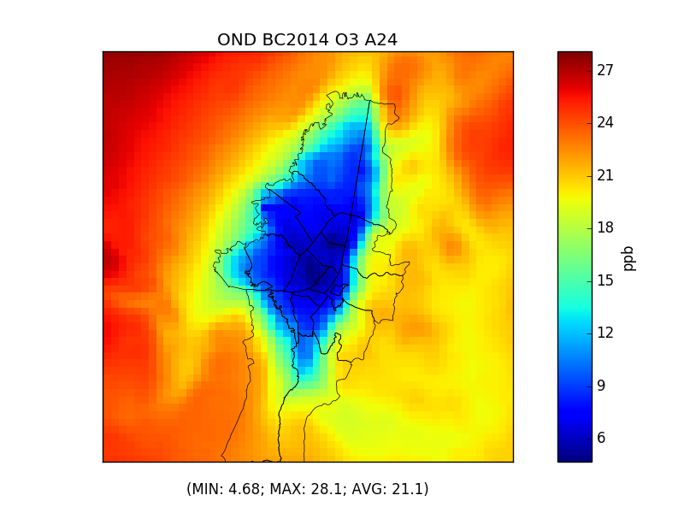
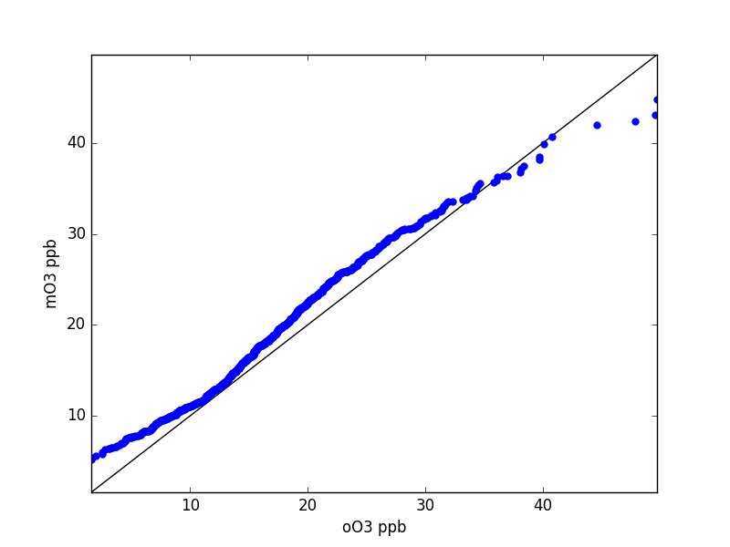
MODELING RESULTS – O₃
JFM
2014
AVG 34.6 ppb
The simulation shows strong performance for both periods, with a slight high bias for the both periods. Bias increase for large concentrations.
MAX 37.5 ppb
AVG 27.8 ppb
OND
Larger O₃ concentrations in JFM
MAX 28.1 ppb
AVG of modeling values observed at air quality stations; MAX of modeling values across the whole domain
Quantile-quantile plots for mda8 O₃ with observations on the x-axis and model concentrations on the y-axis
Notes:
Robbie,
Add spatial plot for 2014
Answer: Spatial plots added.
Q-Q plot for PM10 only for January and October, update with JFM and OND. Do these results include three-layer modeling average?
Answer: I updated the QQ plots wth full JFM and OND. Yes, they include the 3-layer averaging
MAX in spatial plots differ from MAX Q-Q plots??
Answer: The maxes differ because the spatial plots are time means and the QQ plots have all of the mda8 values for each day.

Slide 21
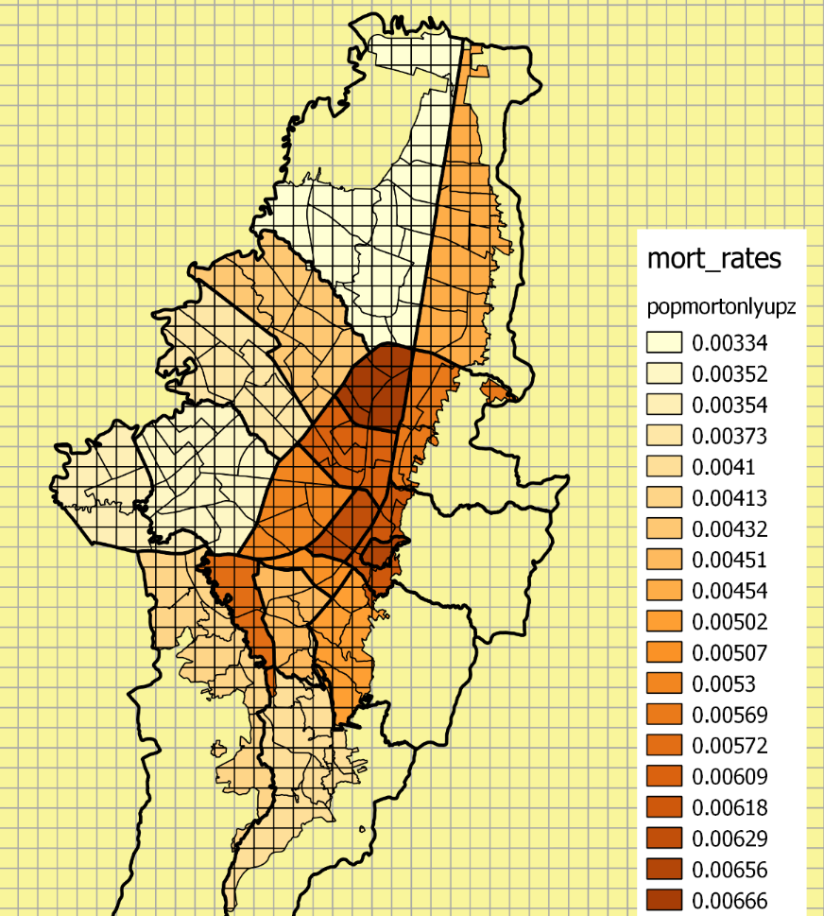
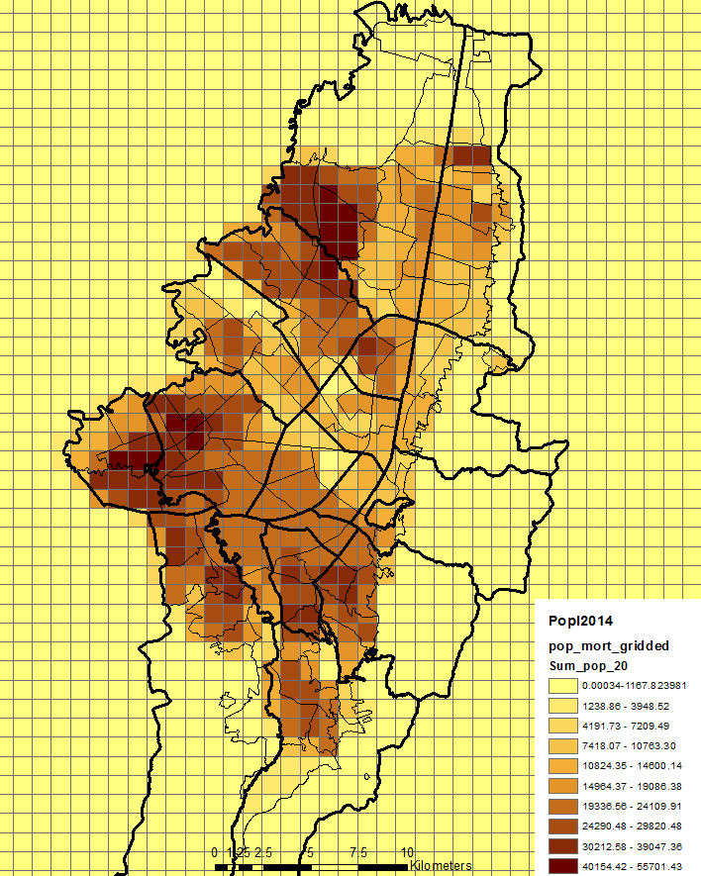




HEALTH IMPACT ESTIMATION
$$∆Mort= y_{O}×pop×\%peopleabove30yr ×\left(1−e^{−β∆X}\right)$$
$$y_{O (LOCALITY)}$$
X
$${population}_{GRID(UPZ,LOCALITY)}$$
$$\left[\frac{deaths}{hab}\right]$$
$$\left[hab\right]$$
Tot pop: 7’759,974
RR
All-cause mortality
6% (4-8%)
increase
10 ug/m³ PM2.5
(Krewski et al, 2009)
52% pop>30
X
X
RR
Respiratory diseases
4% (1.3-6.7%)
increase
10 ppb O₃
(Jerrett et al, 2009)
Fuente(SDP, 2010) – Tasas brutas de mortalidad 2005-2010
Fuente (SDP, 2010) – Proyección de población por UPZ 2014

Slide 22
Cost of air pollution in Bogota in 2014
Pollutant |  | Estimated mortalities | (WTP USD in million)
PM2.5 (Krewski et al, 2009) | All-cause mortality | 1746 (1195-2270) | $1,002.765 ($686.314 - $1,303.710)
 | Respiratory | 629 (298-934) | $361.248 ($171.148 - $536.416)
 | Cardiovascular | 1050 (838 -1248) | $603.038 ($481.281 - $716.753)
O₃ (Jerrett et al, 2009) | Respiratory | 152 (51-249) | $87.297 ($29.290 - $143.006)
Deaths from all cause by PM2.5 represent 1.1% of the Bogota's GDP.
VSL for Colombia expressed as WTP per person: $574,321.51 USD projected from (Castillo et al., 2010).
Notes:
MaPaula, por favor completar este cuadro y la información restante

Slide 23
CONCLUSIONS
In the last years, we have significantly improved Bogota’s air pollutant emission estimates considering resuspended dust and changes in fuel quality and vehicle fleet renovation.
The implementation of CMAQ have become a great opportunity to revise emission estimates and adjust them to the proper level.
CMAQ represents a great potential to optimize costs / benefits related with air pollution in Bogota.

Slide 24
RESEARCH NEEDS IN BOGOTA
Chemical compostion of ambient and resuspended PM. Unknown sources: erosion, break and tire wear, surface abrassion, dust.
Reconciliation of high and low resolution emission inventories, especially NOx and CO.
Determination of the PBL mixing depth to solve night-time biases.
PM forecasting system and set up early warnings to protect public health.

Slide 25
AKNOWLEDGMENTS
This project has been funded under different contract and agreements awarded to Universidad de La Salle: contract 1467 of 2013 awarded by Secretaría de Ambiente de Bogotá; contract 241 of 2015 awarded by Colciencias; collaboration agreement 5224377 of 2015 between Ecopetrol and ULS.
We thank all the organizations and people that have contributed in different ways to this project.

Slide 26
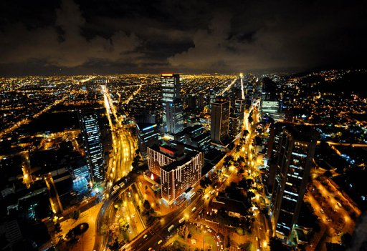
THANKS!
QUESTIONS?

