Slide 1
Modeling the Impacts of Prescribed Burns for Dynamic Air Quality Management
Talat Odman
School of Civil and Environmental Engineering
Georgia Institute of Technology
2016 CMAS Conference
Regulatory Modeling and SIP Applications
October 25, 2016

Slide 2




Acknowledgements
Daniel Chan
Di Tian
Michael Chang, Yongtao Hu, Rushabh Sakhpara, Aditya Pophale, Ran Huang
RD83521701

Slide 3
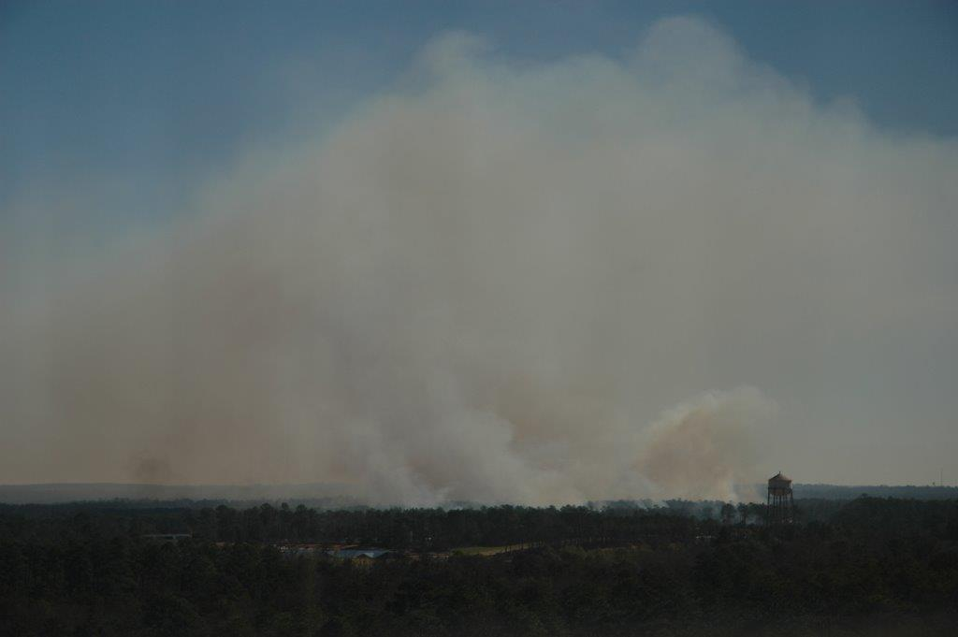
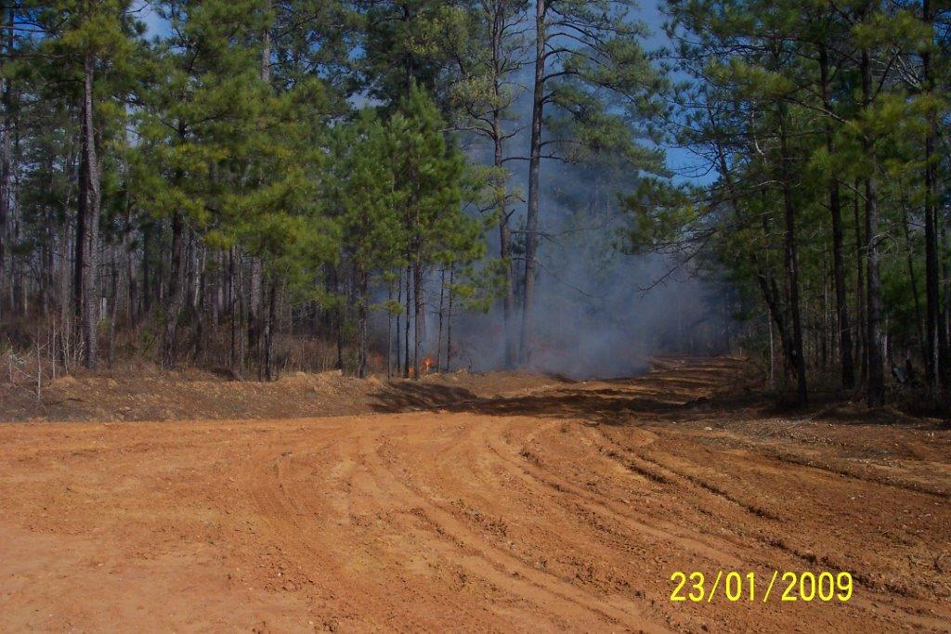
Prescribed burning, the preferred land management tool in the Southeast, is a large source of PM.
Prescribed burning (PB) is practiced to improve native vegetation and wildlife habitat, control insects and disease, and reduce wildfire risk.
According to 2011 National Emission Inventory, 15% of PM2.5 emissions in the US (820 Gg) are from PB, second largest source after wildfires (18% 0r 995 Gg)
In the Southeast, PB is the largest source of PM2.5 emissions (20% 0r 210 Gg)
Georgia
Fort Benning, Georgia
23/01/2009
Notes:
The US Environmental Protection Agency (EPA) 2011 National Emission Inventory (US EPA 2013) reported that 15% (8.4108 kg) of PM2.5 (i.e. particulate matter less than 2.5 mm in aerodynamic diameter) emissions in
the US are attributable to prescribed burning, and 27% of PM2.5 emissions from prescribed burning originate from the southeastern US. Prescribed burning emissions remain one of the most prominent sources of PM2.5 in the south-eastern US, and will become an increasing fraction as other sources are controlled.

Slide 4
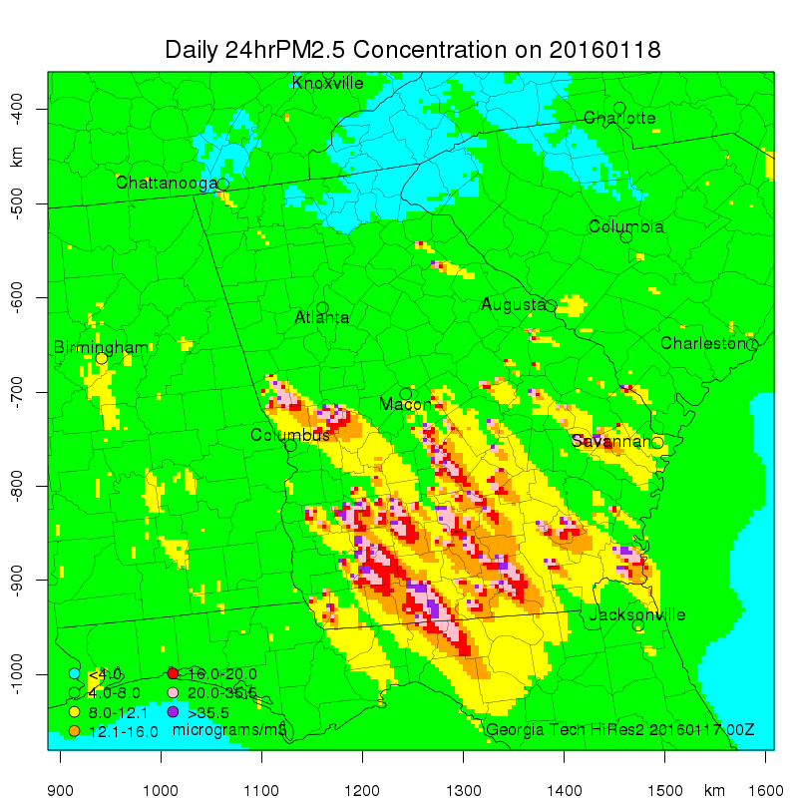
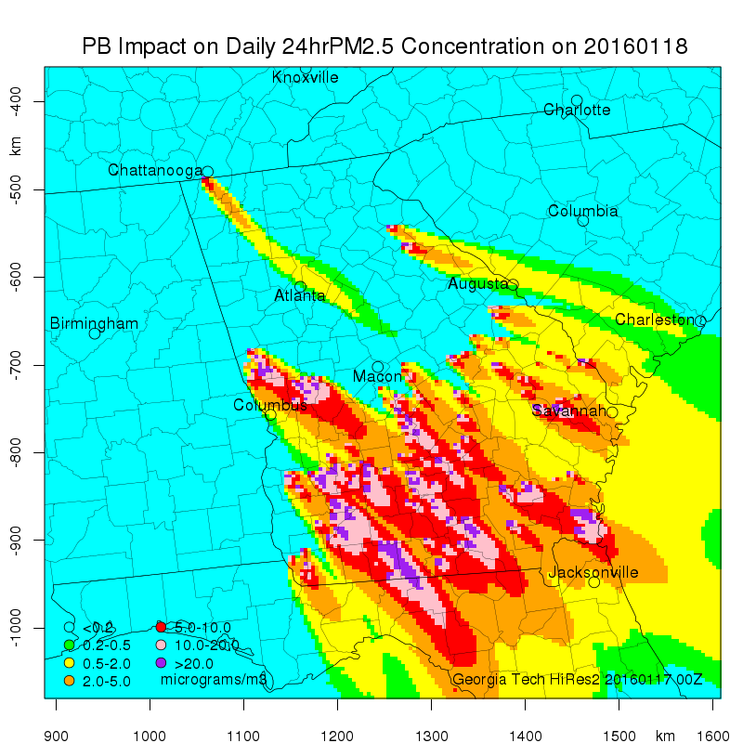
Dynamic management of PB is easy relative to other emission sources.
Burn/no-burn decisions are made daily.
PB impact forecasts can be used in decision making.
PM_{2.5}
PB Impact
Burn Area
Thomas County
PM2.5 | 75 μg/m³
PB Impact | 70 μg/m³
Burn Area | 1400 acres
https://forecast.ce.gatech.edu

Slide 5
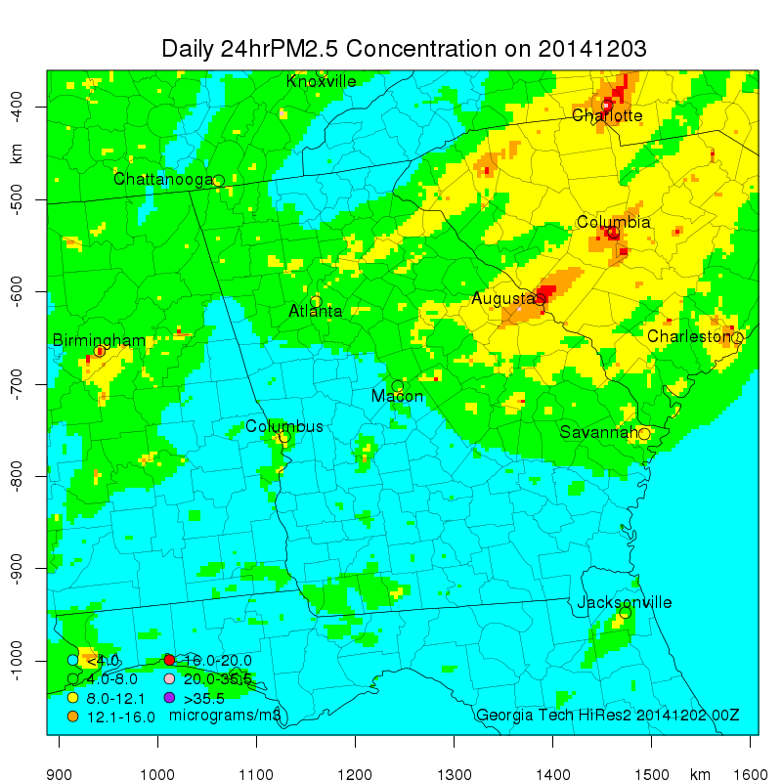
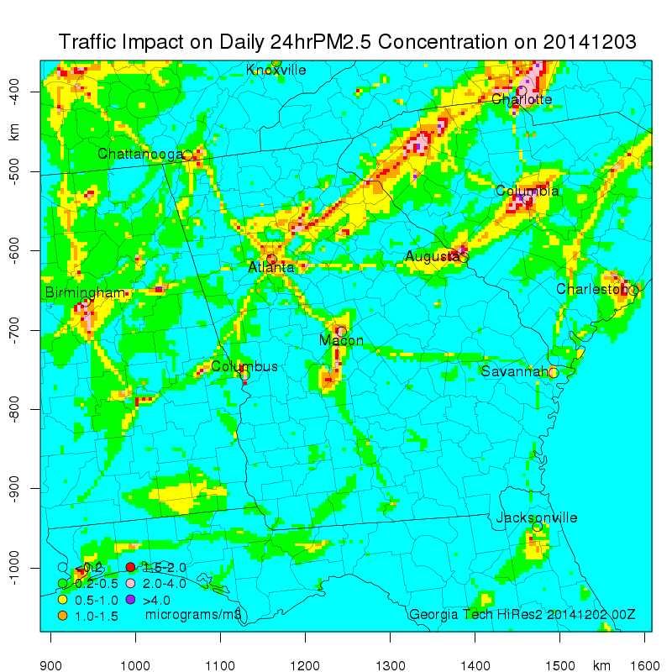
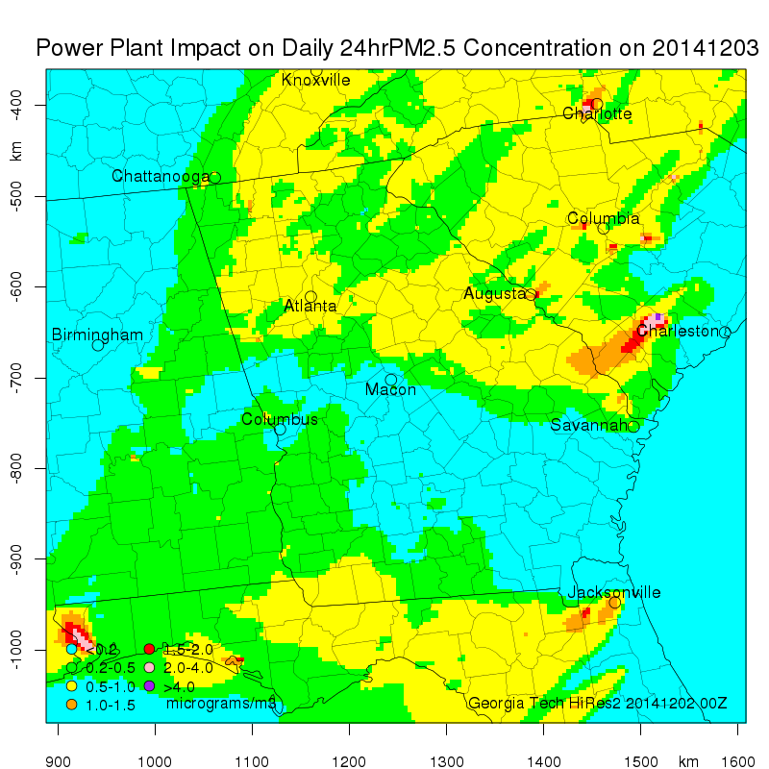
Hi-Res2 Air Quality and Source Impact Forecasting System (https://forecast.ce.gatech.edu)
Updated Hi-Res with 2011 NEI, WRF3.6.1 and CMAQv5.02
72-hour forecasts at 4-km resolution in/around Georgia
Source impact forecasting using the Decoupled Direct Method, DDM-3D
PM_{2.5}
Traffic Contribution
Power Plant Contribution
(The scales for PM_{2.5} and the contributions are different)

Slide 6
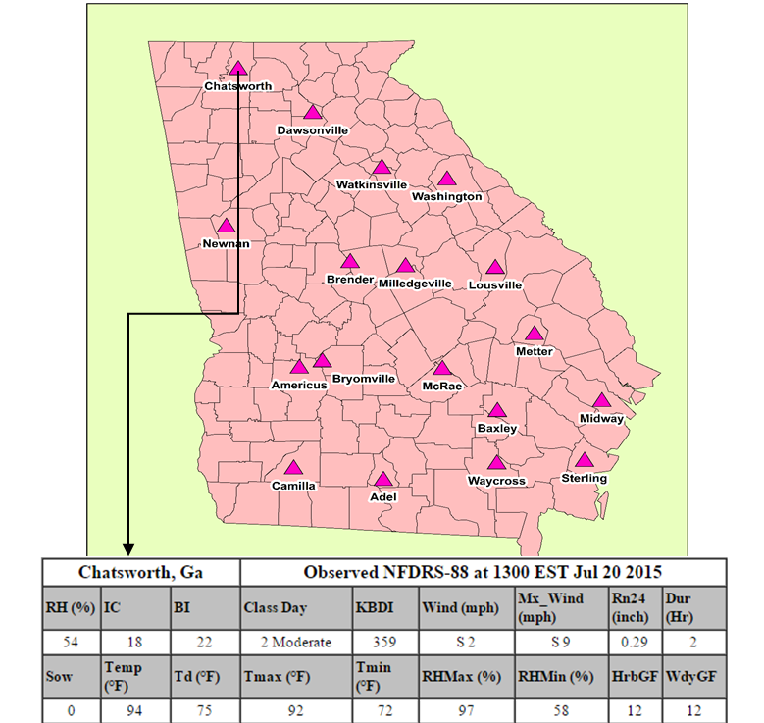
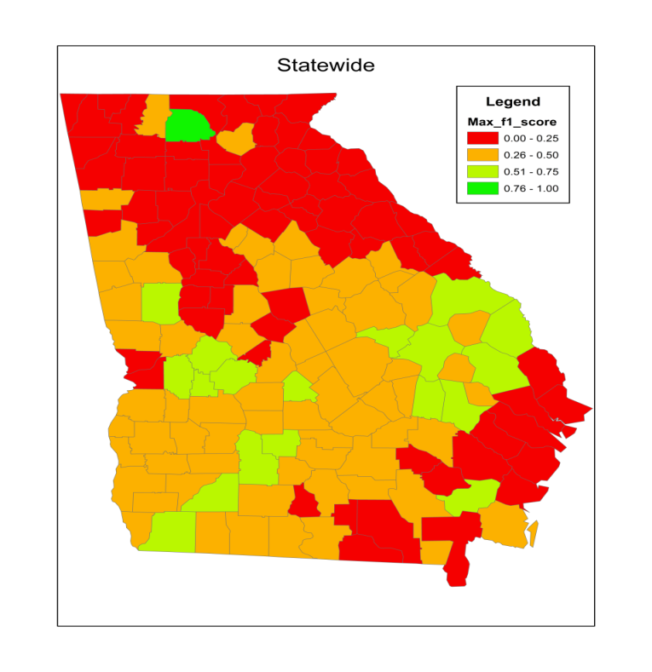
The burn forecasting tool is a decision tree model using fire weather and burn permit data.
The model was trained with 2010-14 meteorological data at 18 fire weather stations in Georgia and burn permit data for each county.
The weather forecast is used to predict if tomorrow will be a burn day in any county.
2015 Burn Forecast Evaluation:
F1 Score
Notes:
We analyzed the relation between permitted burn acreage for 2010-2014 and observations at 18 fire weather stations in Georgia.
Burn acreage depends on rainfall, temperature, RH, KBDI (drought) and wind speed.
F1 Score: $\text{Harmonic} \text{mean} \text{of} \text{precision} \text{and} \text{recall} \frac{Precision×Recall}{(Precision+Recall)/2}$ where precision is $\frac{True Positives}{True Positives + False Negatives}$ and recall is $\frac{True positives}{True Positives + False Positives}$

Slide 7
A bottom-up method for estimating prescribed burn (PB) emissions
For each county, the average daily total burn area and typical burn sizes are calculated from permit records. The number of burns is determined and those burns are randomly distributed to managed lands.
Burn emissions are estimated for forecasted burns using:
Burn emissions are distributed to the vertical layers of the CMAQ model based on plume rise calculations.
  Fuel Characteristic Classification System (FCCS) fuelbed maps for fuel loads,
  Fuel moisture forecasts for fuel consumption, and
  Emission factors for Southeast USA fuels.

Slide 8
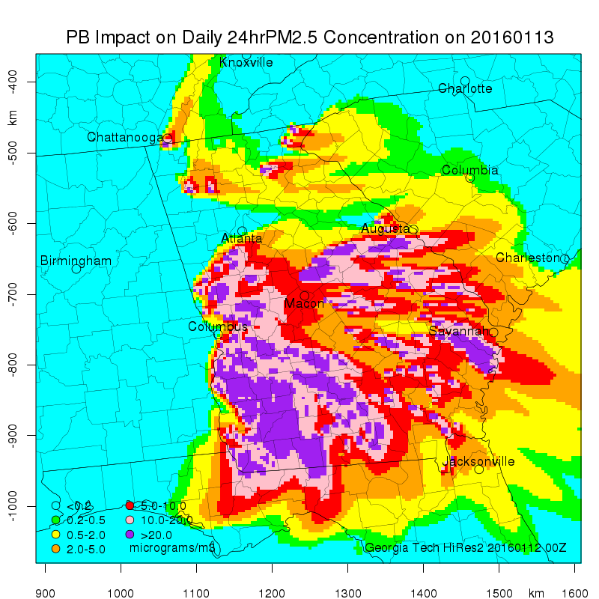
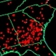
Satellite fire & smoke analyses are used for evaluating the PB forecasts.
We compare our forecast qualitatively to the Hazard Mapping System Fire and Smoke Analysis by NOAA.
We give each day’s forecast a rating based on the agreement in location and density of fires.
January 13, 2016: Rated very good
Notes:
Note that we only forecasts burns for Georgia.

Slide 9
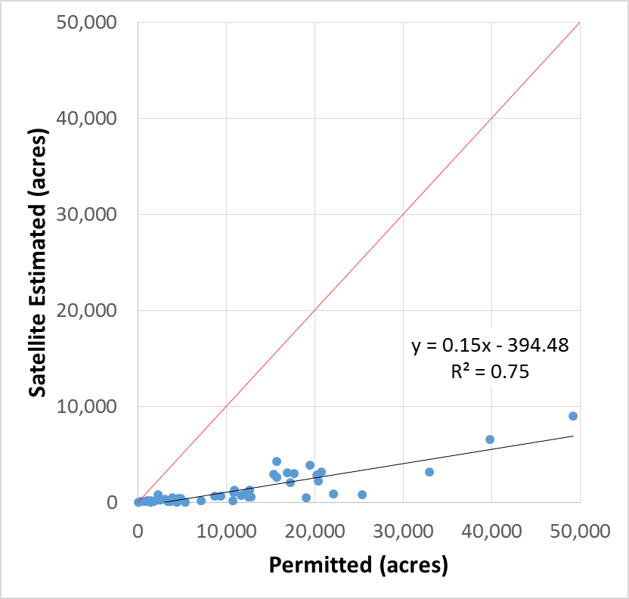
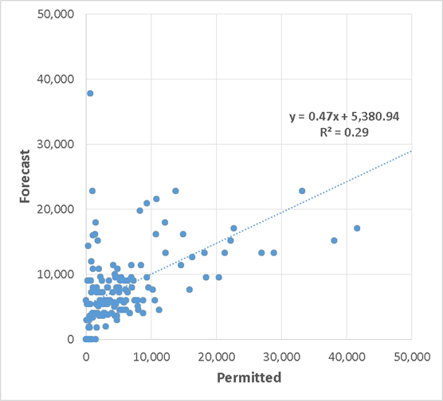
Burn areas from satellites and permit records are used for quantitative forecast evaluation.
We compare our burn area forecasts to:
  Burn areas provided by NOAA’s Biomass Burning Emission Product for North America blended from GOES-E, GOES-W, MODIS, and AVHRR.
  Burn areas permitted by the Georgia Forestry Commission
Satellite vs Permits
Forecast vs Permits
Notes:
Daily total burn areas in Georgia according to the the Biomass Burning Emission Product from NOAA satellites versus the burn areas permitted by the Georgia Forested Commission for the 2015 burn season (January – April, 2015)

Slide 10
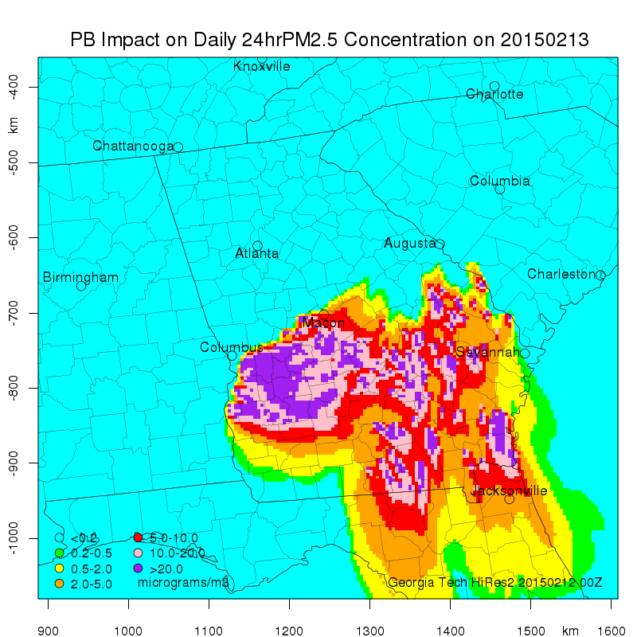
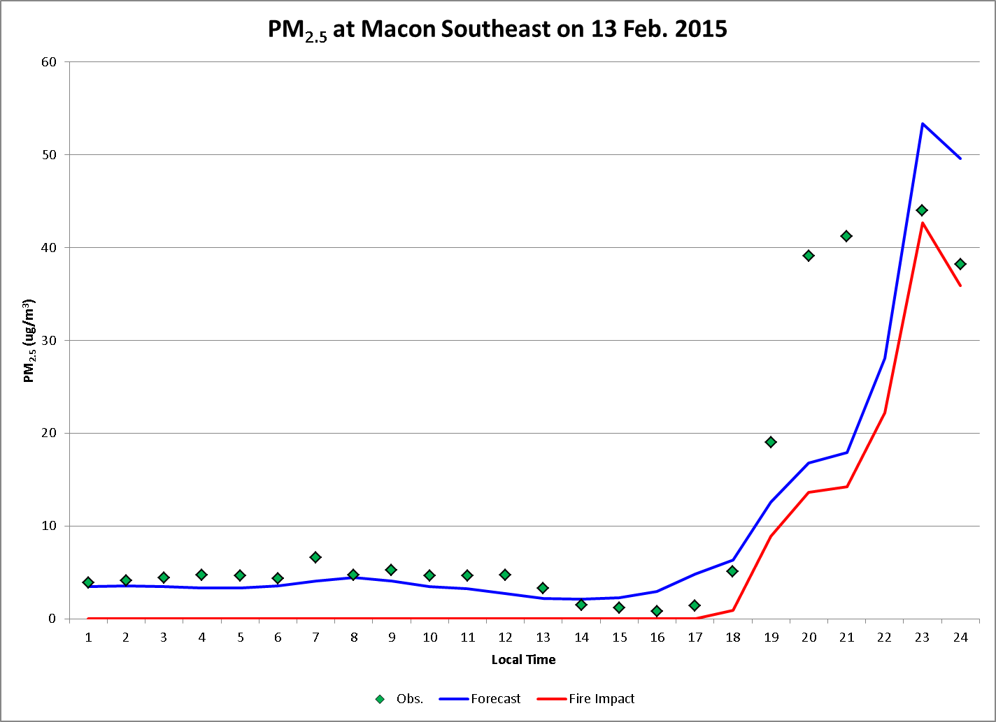
Ground-level PM_{2.5} observations are used for evaluating the impact forecasts.
A perfect hit (true positive)
Notes:
In district 2-N burn day is correctly predicted but acreages overpredicted by a factor of 2.5 (4440 ha vs 1720 ha) but they are accurate in some counties. Burn days in district 3 (Macon Bibb County is at the southwest tip of District 3, neighboring district 2-N) are missed.

Slide 11
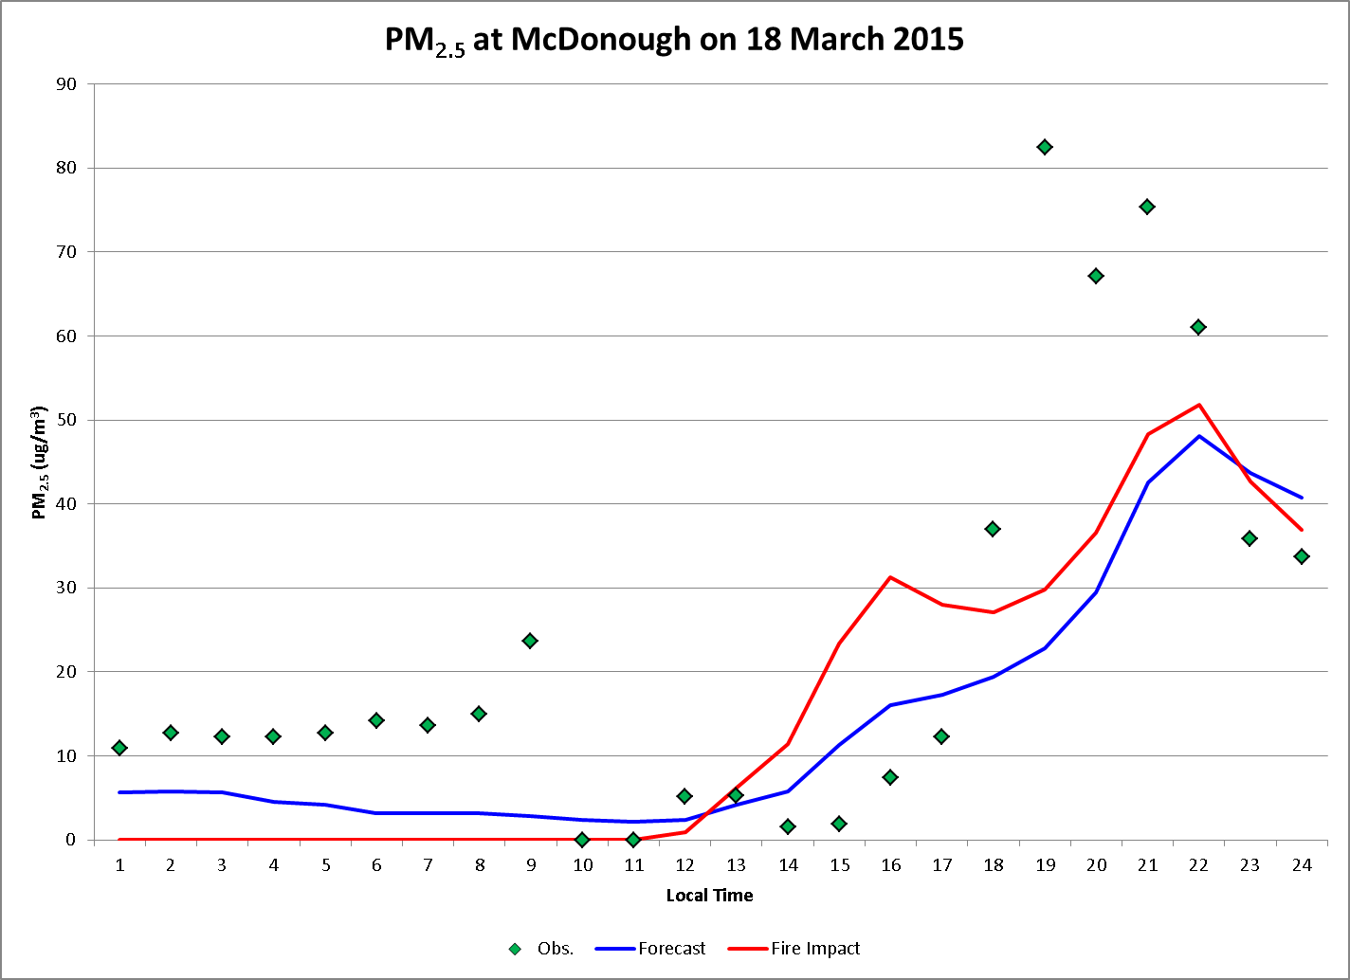
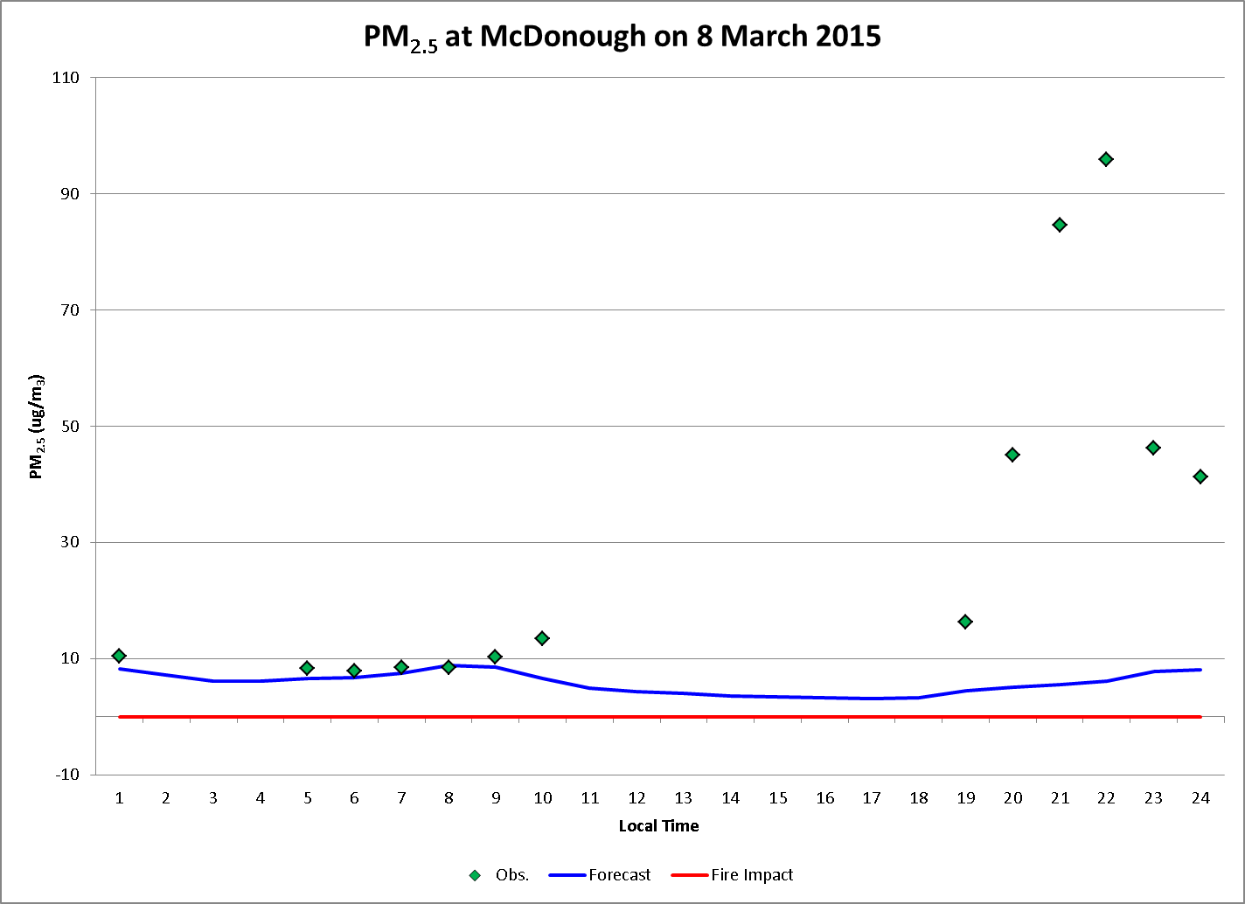
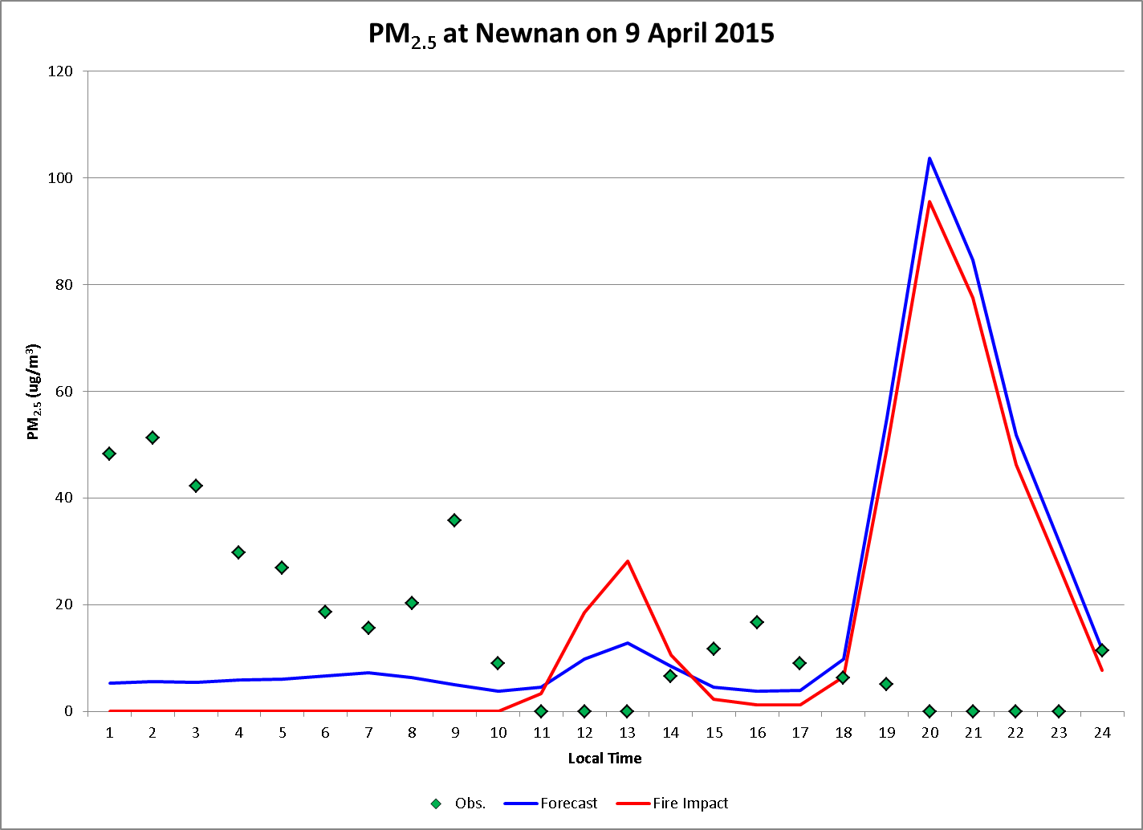
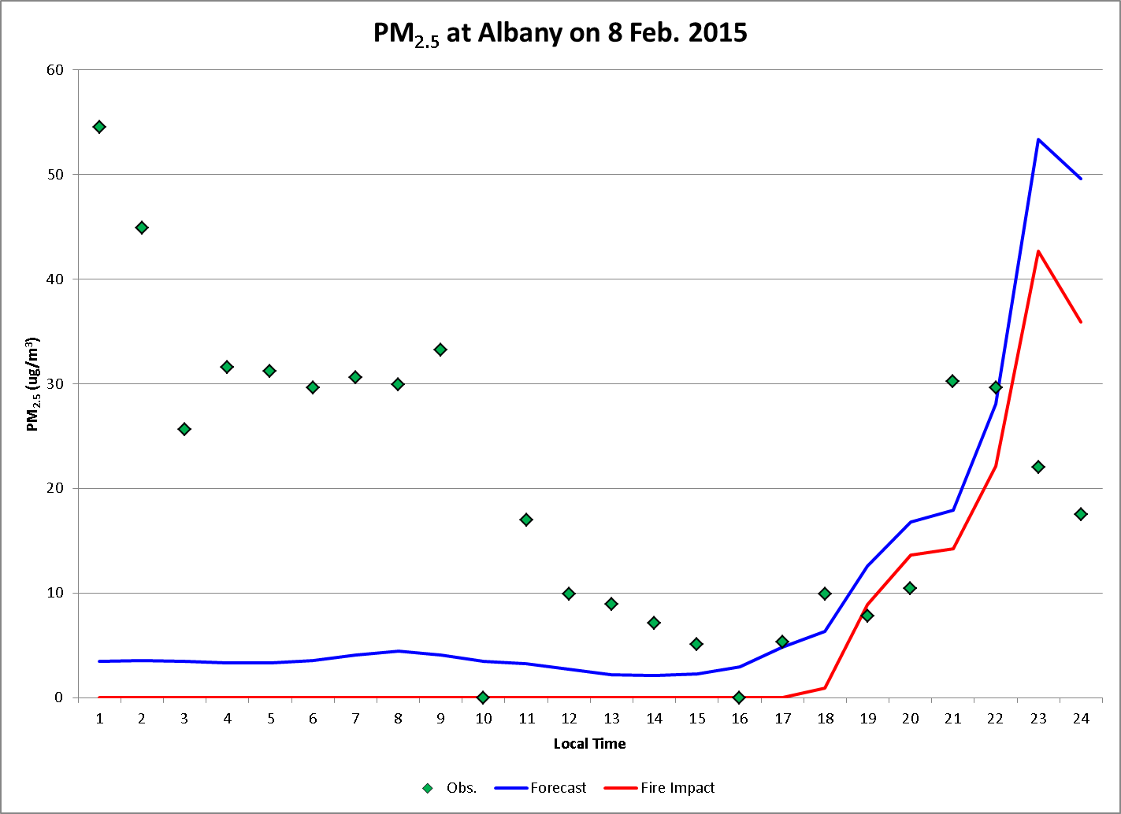
There is room for improvement.
A miss (false negative)
A false alarm (false positive)
Another hit but underestimate
Another hit but overestimate

Slide 12

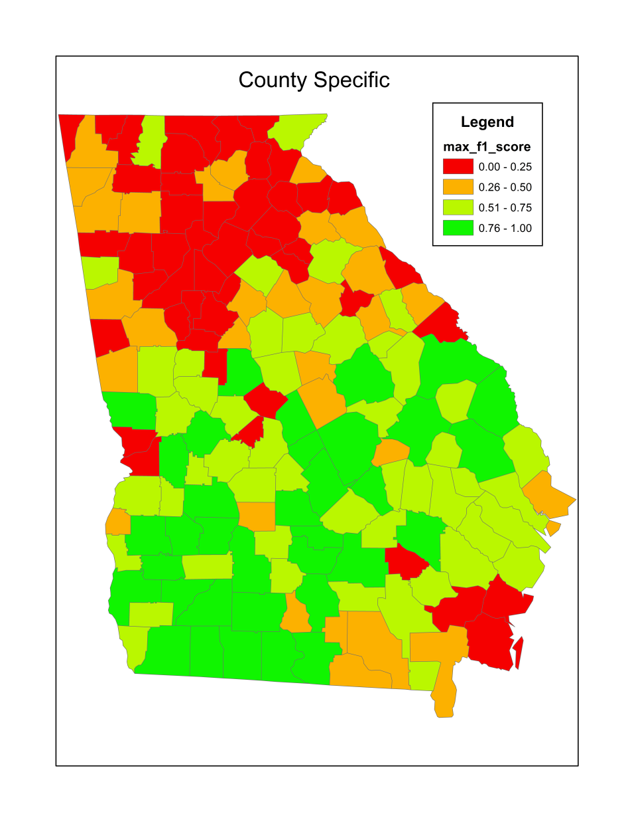
County-specific models perform much better than a single, statewide model.

Slide 13
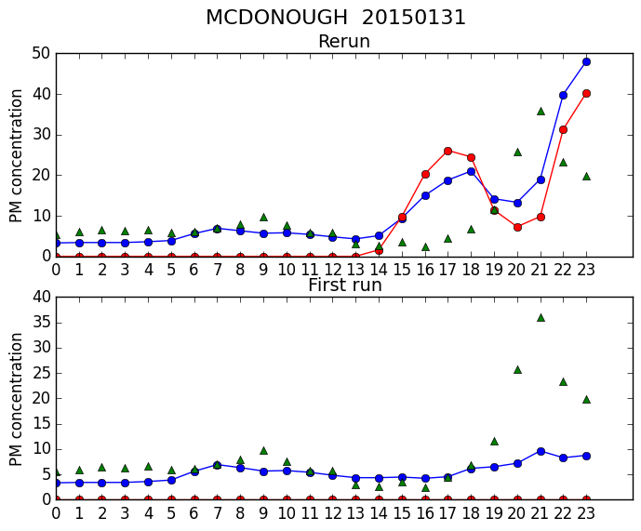
Improved burn forecasts lead to better burn impact forecasts.

Slide 14
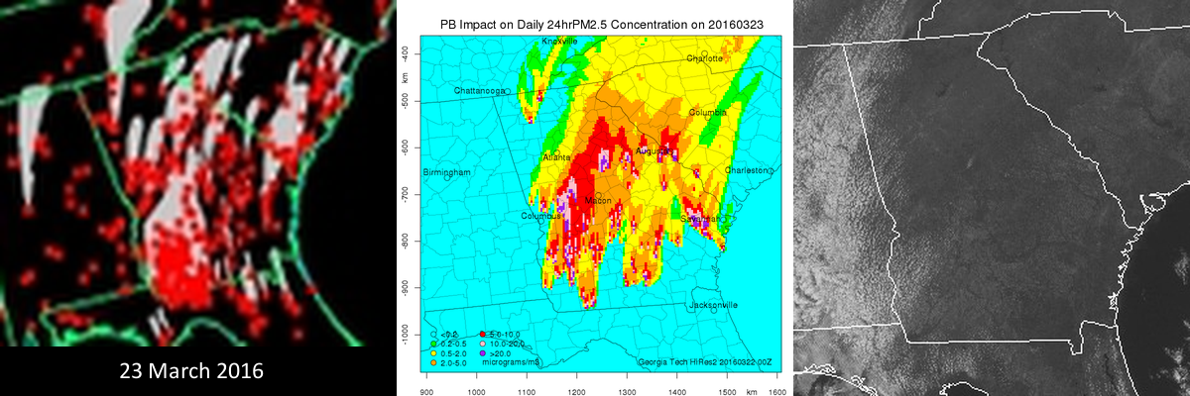
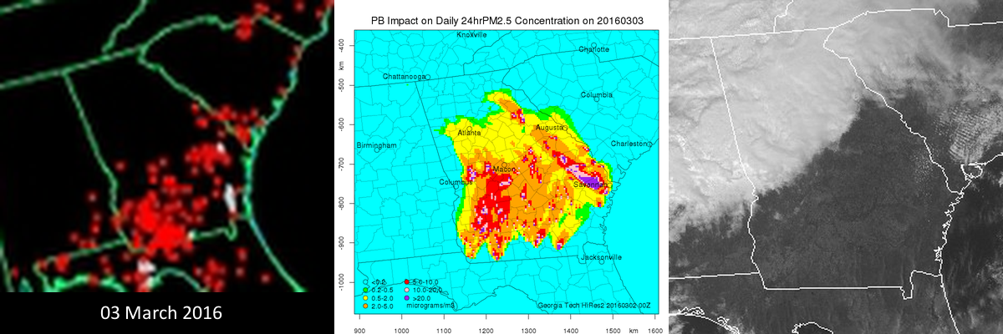
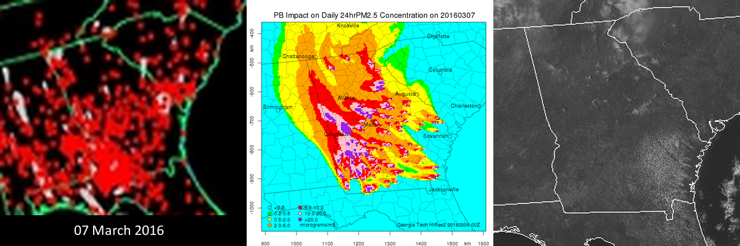
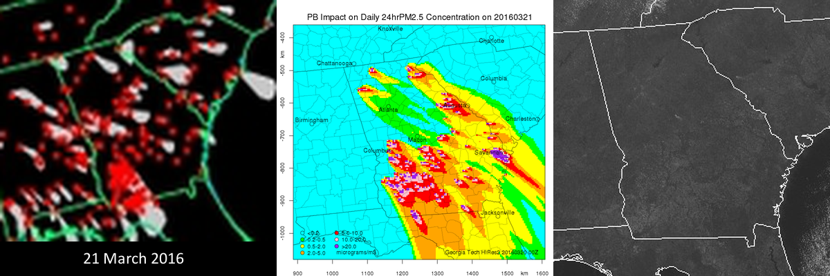
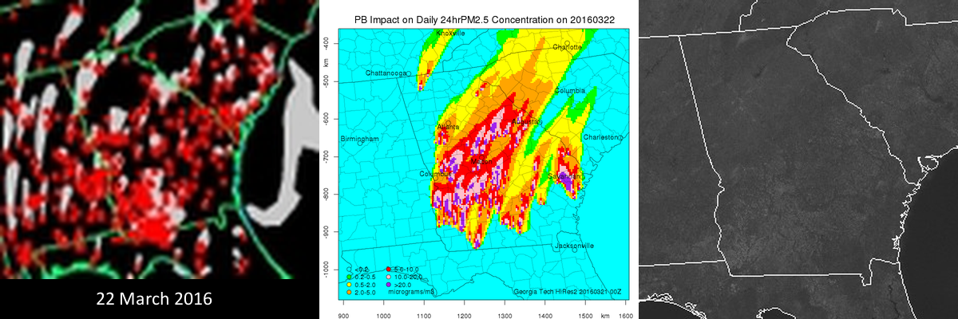
Burn/no-burn forecasts were encouraging in 2016.
Fire & Smoke from Satellite
Cloud Cover from Satellite
Our Burn Impact Forecast

Slide 15
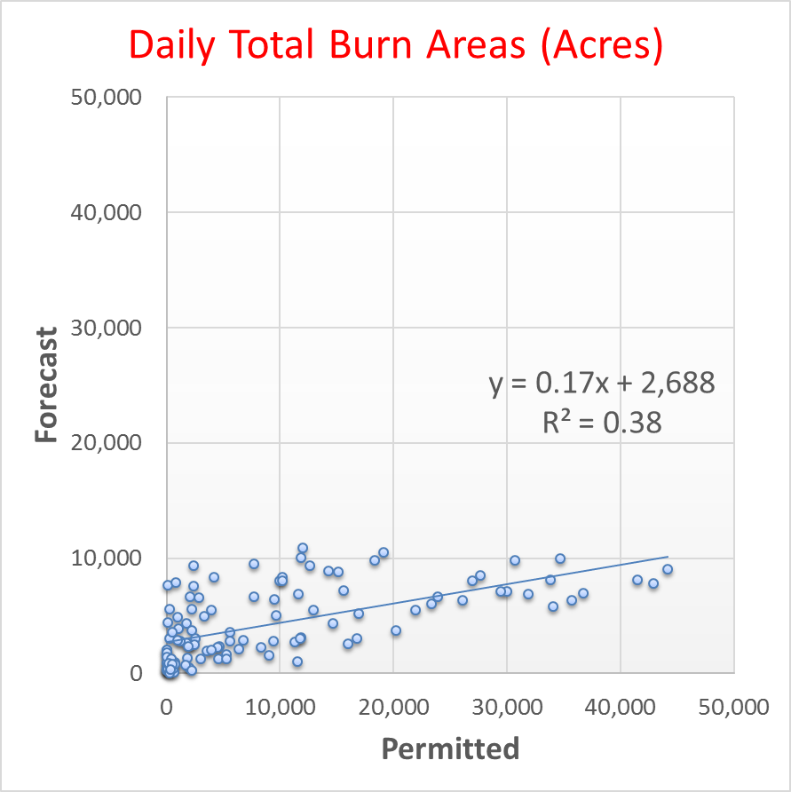
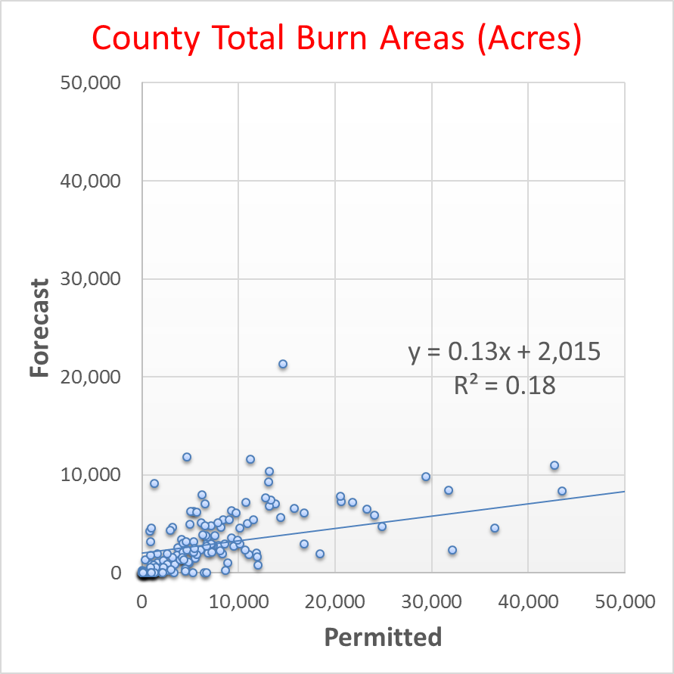
However, burn areas were underestimated.
1,265,000 acres permitted vs. 480,000 acres forecast

Slide 16
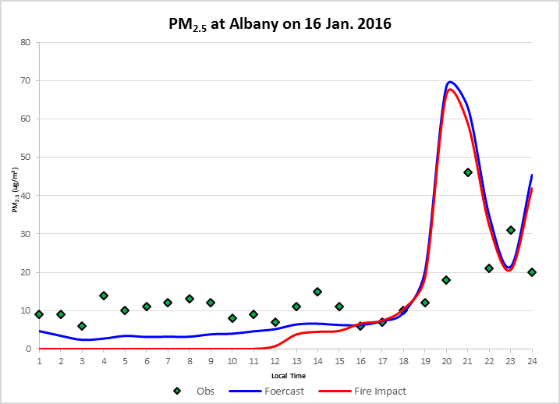
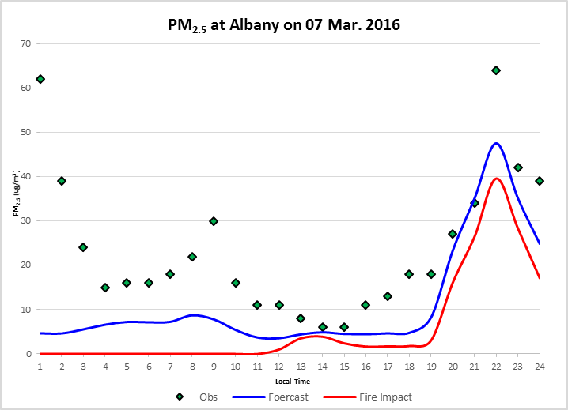
Several burn impacts were forecast correctly.
A hit but overestimate
Another hit but underestimate

Slide 17
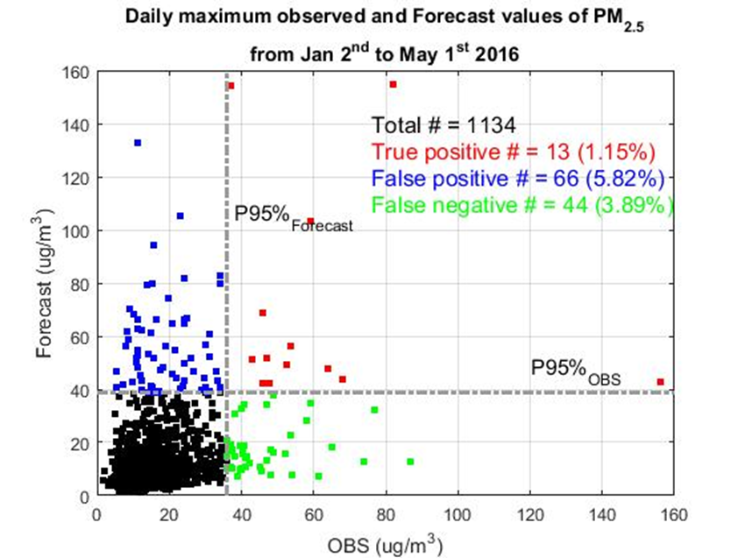
The smoke impact forecast displayed significant skill in 2016.
Equitable Threat Score = 11%

Slide 18
Summary & Conclusions
We are forecasting source impacts using the Hi-Res2 air quality forecasting system (https://forecast.ce.gatech.edu).
Forecasting PB impacts is beneficial not only for air quality management but for land/forest management as well.
We are forecasting burn activity for accurate PB impact forecasts.
  County-specific regression models yield much more accurate burn forecasts in 2016 than the statewide model used in 2015.
Evaluation of the forecasted PB impacts is difficult.
  Satellites do not always see the low-intensity prescribed burns.
  Only a few cases of PB impacts are observed at the ground monitoring sites.

Slide 19
Future Research
Make the burn impact forecast more useful for dynamic burn/air quality management
  How many acres can be burned in each district/county without causing any air quality issues?
  Computing the impact of burns in each district/county is computationally too demanding.
  A quick and inexpensive solution may be partitioning the total impact to upwind burns using Gaussian plume modeling
Expand the forecast to other states in the Southeast (JFSP)
Use inexpensive sensor packs to detect burn impacts in unmonitored areas of the Southeast (NASA H-AQAST)

