Slide 1
Can machine-learning features identify fitness of meteorology simulations for application to air quality?
Robert Nedbor-Gross
Barron H. Henderson
Jorge E. Pachon

Slide 2
Problem with Common Practice
A Traditional Model Performance Evaluation (tMPE) uses thresholds of acceptable error/bias to evaluate model performance
Threshold values come from a synthesis of previous studies
Does being within the synthesis imply fitness for any region?
Thresholds assert how models tend to do, not how good they are
Problem is that it’s unknown if being outside of a threshold means a model is unfit
Bias from literature
v
v
Model Bias/error
Synthesis
(mostly simple regions)
Complex
regions
New complex region

Slide 3
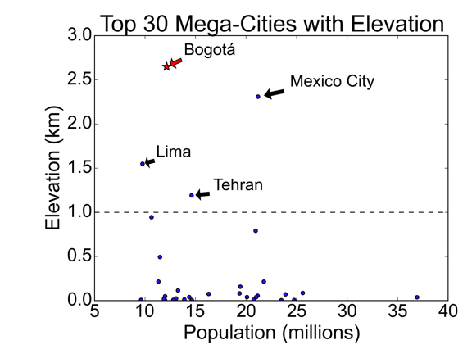
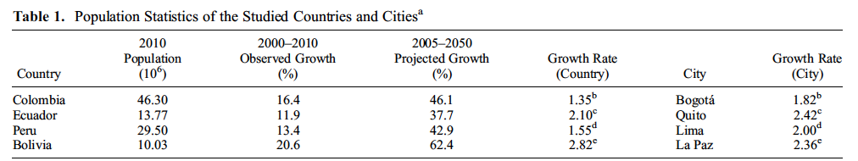
Relevant to developing world
Models fail threshold analyses in complex terrain regions, despite reproducing air quality driving features
  Gebhart et al. 2014; Reboredo et al. 2015
More regions in complex topography will need modeling in the future
(Buytaert and De Bièvre 2012).
Notes:
Replace this slide with complexity figure:
High elevation sites have this roblme, citations, moe failure
They will experience thisin devolpoing coutnries

Slide 4
Proposing an alternative
If thresholds don’t work, what does?
Features can be quantified with a cluster analysis and evaluated with a Feature-based Model Performance Evaluation (fMPE) - details to follow
  Davis, J.M., B.K. Eder, D. Nychka, and Q. Yang, 1998
Hypothesis – a model’s ability to represent important features is a better estimate of model fitness for air quality modeling

Slide 5
Possible Outcome 1
Both evaluations lead to meaningfully different Populations
Suggests tMPE and fMPE are both indicators of strong air quality model performance
Model Bias
v
Pass
tMPE
Fail
tMPE
Pass
fMPE
Fail
fMPE

Slide 6
Possible Outcome 2
Only fMPE populations are meaningfully different
Suggests tMPE is not an indicator of air quality model performance
Suggest fMPE predicts air quality model performance
Model Bias
v
Pass
tMPE
Fail
tMPE
Pass
fMPE
Fail
fMPE

Slide 7
Possible Outcome 3
Only tMPE Populations are meaningfully different populations
Suggests fMPE is not an indicator of air quality performance
Suggest tMPE predicts air quality model performance
Model Bias
v
Pass
tMPE
Fail
tMPE
Pass
fMPE
Fail
fMPE

Slide 8
Possible Outcome 4
Neither evaluations Lead to meaningfully different populations
Suggests neither method works
We need another form of evaluation
Model Bias
v
Pass
tMPE
Fail
tMPE
Pass
fMPE
Fail
fMPE

Slide 9
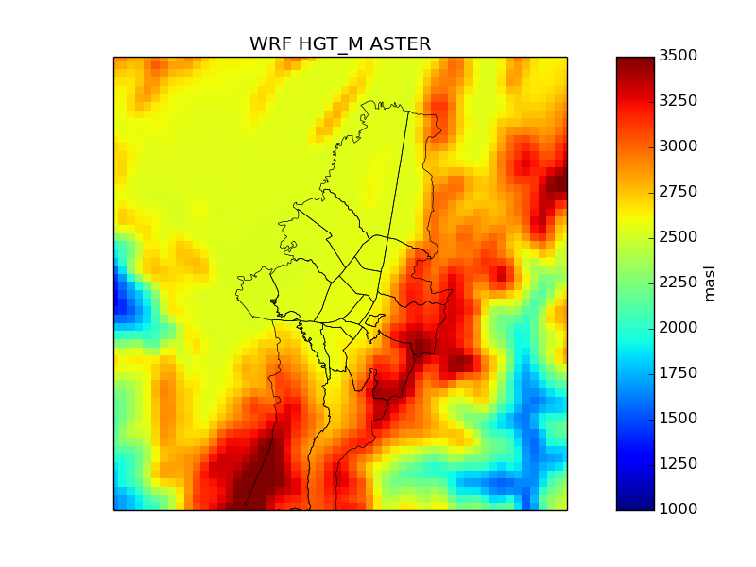
Case Study: Bogotá, Colombia
Emerging air pollution issues
  In need of modeling
Complex topography challenges a tMPE
Emission reductions strategies are being evaluated, so modeling is needed

Slide 10
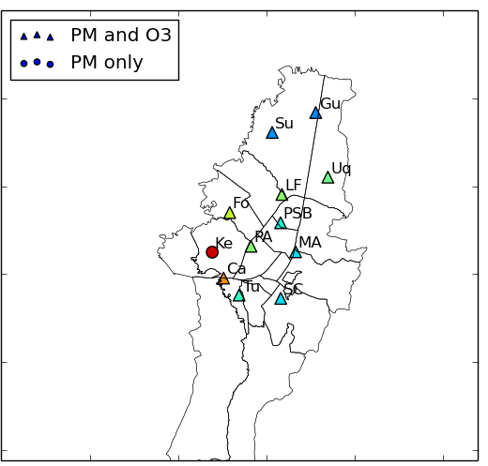
Classifying observed features
Observations for 2012
0
1
2
3
k-Means Cluster Analysis:
Input: Observational vectors, number of clusters k (prescribed or gap-statistic)
Output: k centroids representative cluster characteristics
observed
data points
centroids
Notes:
Mention Biran eters add citation

Slide 11
k-Means Clustering
Features exist in multiple dimensions (n>>2)
Example: n=2
Notes:
I’m walking you through how the computer does this.

Slide 12
k-Means Clustering
Select 4 points as centroids
k centroids are selected from the dataset at random
Values are assigned to a centroid it is closest to
Centroids are adjusted to be the means of the clusters
If the centroids changed repeat steps 2 and 3
Repeat until points can’t be reassigned, and the means has converged

Slide 13
k-Means Clustering
Assign data points to centroids
k centroids are selected from the dataset at random
Values are assigned to a centroid it is closest to
Centroids are adjusted to be the means of the clusters
If the centroids changed repeat steps 2 and 3
Repeat until points can’t be reassigned, and the means has converged

Slide 14
k-Means Clustering
Adjust Centroids to be the means
k centroids are selected from the dataset at random
Values are assigned to a centroid it is closest to
Centroids are adjusted to be the means of the clusters
If the centroids changed repeat steps 2 and 3
Repeat until points can’t be reassigned, and the means has converged

Slide 15
k-Means Clustering
Repeat Until Done
k centroids are selected from the dataset at random
Values are assigned to a centroid it is closest to
Centroids are adjusted to be the means of the clusters
If the centroids changed repeat steps 2 and 3
Repeat until points can’t be reassigned, and the means has converged

Slide 16
k-Means Clustering
Complete when centroids can’t be adjusted anymore
Machines can do this for multiple dimensions
k centroids are selected from the dataset at random
Values are assigned to a centroid it is closest to
Centroids are adjusted to be the means of the clusters
If the centroids changed repeat steps 2 and 3
Repeat until points can’t be reassigned, and the means has converged

Slide 17
Observational Vectors
In Bogotá, morning and afternoon winds are important for air quality (SDA 2009)
  Morning WS,WD (6-11am)
  Afternoon WS,WD (noon-4pm)
Also included: max temperature, max mixing height, station average specific humidity, solar radiation, pressure
  were not impactful due to lack of variability in Bogota
Of 11 sites, 6 had enough data available for clustering
Dimensions: 6 sites x (8 vars – 3 missing pressure + 1 mix_height) = 36

Slide 18
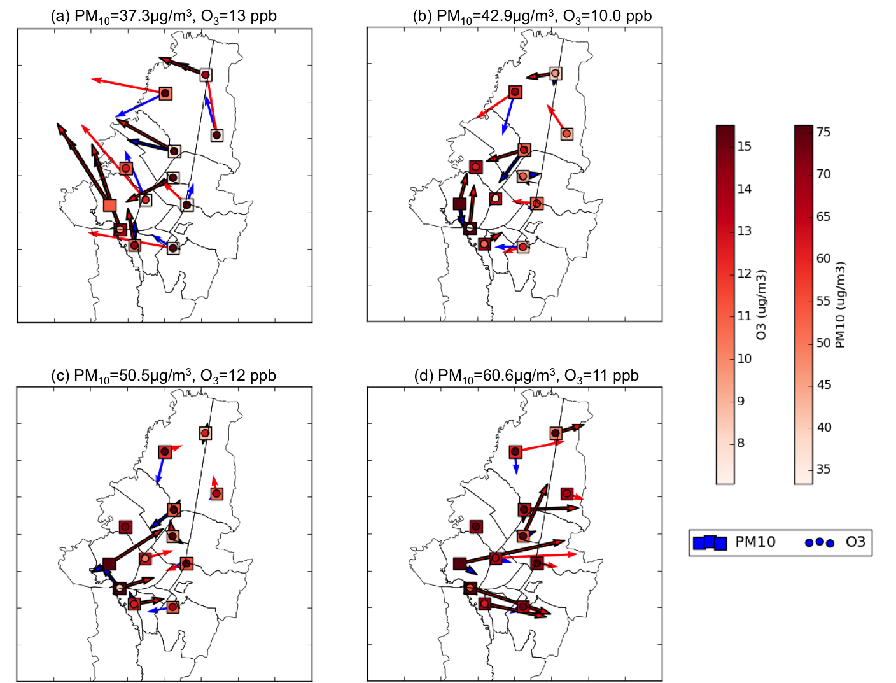

Identified Clusters
Particulate Matter (<10µm) Concentrations
Low: 37 µg/m³
Mid-low: 43 µg/m³
Occurrences
Cluster | 2012
Low | 92
Mid-Low | 60
Mid-High | 73
High | 69
Mid-high: 50 µg/m³
High: 61 µg/m³

Slide 19
2. Simulate and Evaluate Meteorology with tMPE and fMPE
  Nedbor-Gross, R., B.H. Henderson, J.R. Davis, J.E. Pachon, A. Rincon, O.J. Guerrero, &F. Grajales (2016). "Comparing Standard to Feature-Based Meteorological Model Evaluation Techniques in Bogotá, Colombia.” Journal of Applied Meteorology and Climatology, (In Press)
Notes:
Paper accepted

Slide 20
Simulating Meteorology
Weather Research and Forecasting (WRF) Model (Skamarock et al. 2008)
Five physics configurations (DF, NG, BL, AC, GP)
Simulated two 25 day periods for 2012 (50 days)
Also simulated two 3 month periods for 2014 (180 days)
Periods chosen based on air pollution

Slide 21
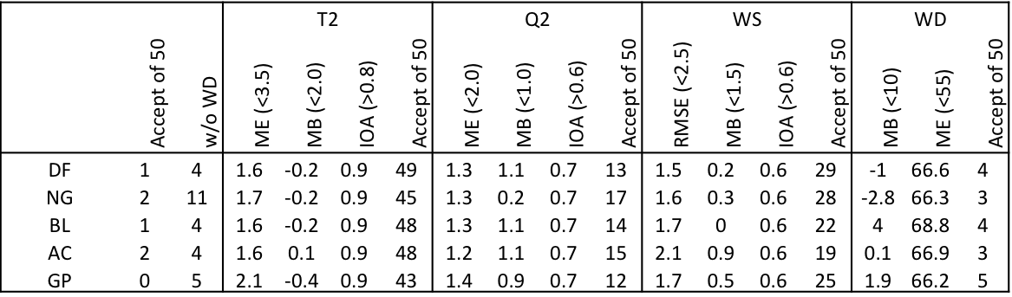
tMPE Results
For a day to “pass” it requires joint acceptability
Acceptability - thresholds are all passed for a variable
Overall acceptability considers multiple variables
Thresholds based on Emery et al. 2001; McNally et al. 2009

Slide 22
tMPE Summary
Temperature, wind speed are acceptable
Specific humidity was improved with more accurate terrain and soil classification
tMPE showed failure for wind direction
  Leading to overall tMPE failure
This failure is a demonstration of the problem
tMPE does not say if air quality driving features were reproduced
Can an fMPE?

Slide 23
Model Data Clustering
Model data points need to be assigned to a cluster

Slide 24
Model Data Clustering
Model data points need to be assigned to a cluster

Slide 25
Model Data Clustering
Determine which clusters the model data belong to

Slide 26
Null Hypothesis: Model is random
Cluster distribution will not be representative of observations

Slide 27
Results for 2012 Best Configuration
Cluster | Observed Days | Modeled Days
L | 6 | 3
mL | 4 | 6
mH | 13 | 4
H | 16 | 26
P-value=0.00135
Model assigns most days to H cluster
Model assigns 30 days to combined mH and H days, 29 observed
9 modeled L and mL, 10 observed
Model day assignment is accurate 38.4% of days (4% acceptable days from tMPE)

Slide 28
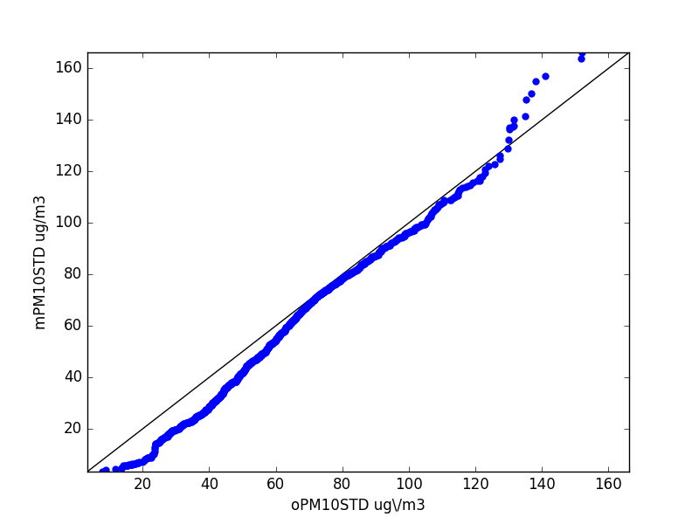
Future Work: MPE Correlation with AQ Model Success
Meteorological simulations have been categorized
  tMPE: 4% pass, 96% fail
  fMPE: 38% pass, 62% fail
CMAQ has been applied to Bogotá and evaluated
AQ model performance will be compared between categories
  O3 NMB/NME
  PM2.5 FMB/FME
Quantile-Quantile Plot
Accurate distribution from CMAQ
Notes:
We this idea of being near clusters or not, but we need a post-evaluation of the goodness of fit.
When I’m donre I can quantitivatve judge a reasonable fit.

Slide 29
Summary
Proposing an fMPE can measure meteorology simulation fitness for air quality modeling
fMPE will be useful in complex terrain regions that are unique
  These regions will need more modeling studies in the future
For Bogotá, a k-means cluster analysis can classify important features for air quality
With best possible physics and surface data tMPE is passed 4% of the time compared to 38% passed by an fMPE
  This was shown for 50 simulation days in 2012
CMAQ has been applied in Bogotá with success
Last step: Determine which of the four possible outcomes occurs to understand if either tMPE or fMPE lead to successful air quality modeling

Slide 30
Citations
Buytaert, W., and B. De Bièvre. 2012. “Water for Cities: The Impact of Climate Change and Demographic Growth in the Tropical Andes.” Water Resources Research 48 (8): W08503. doi:10.1029/2011WR011755.
Davis, J. M., B. K. Eder, D. Nychka, and Q. Yang, 1998: Modeling the effects of meteorology on ozone in Houston using cluster analysis and generalized additive models. Atmos. Environ., 32, 2505-2520, doi:10.1016/S1352-2310(98)00008-9
Emery, Chris, Edward Tai, and Greg Yarwood. 2001. “ENHANCED METEOROLOGICAL MODELING AND PERFORMANCE EVALUATION FOR TWO TEXAS OZONE EPISODES.” Final Report 31984–11. 12118 Park 35 Circle Austin, Texas 78753: The Texas Natural Resource Conservation Commission. http://www.tceq.state.tx.us/assets/public/implementation/air/am/contracts/reports/mm/EnhancedMetModelingAndPerformanceEvaluation.pdf.
Gebhart, Kristi A., William C. Malm, Marco A. Rodriguez, Michael G. Barna, Bret A. Schichtel, Katherine B. Benedict, Jeffrey L. Collett, and Christian M. Carrico. 2014. “Meteorological and Back Trajectory Modeling for the Rocky Mountain Atmospheric Nitrogen and Sulfur Study II.” Advances in Meteorology 2014 (May): e414015. doi:10.1155/2014/414015
Kumar, Anikender, and Nestor Rojas. 2015. “Statistical Downscaling of WRF-Chem Model: An Air Quality Analysis over Bogota, Colombia.” In EGU General Assembly Conference Abstracts, 17:13722. http://adsabs.harvard.edu/abs/2015EGUGA..1713722K.
Gilliam, Robert C., and Jonathan E. Pleim. 2010. “Performance Assessment of New Land Surface and Planetary Boundary Layer Physics in the WRF-ARW.” Journal of Applied Meteorology and Climatology 49 (4): 760–74. doi:10.1175/2009JAMC2126.1.
McNally, D.E. 2009. “12km MM5 Performance Goals.” presented at the Ad-Hoc Meteorology Group, June 25. http://www.epa.gov/scram001/adhoc/mcnally2009.pdf.
Nielson-Gammon, John W. 2001. “Initial Modeling of the August 2000 Houston-Galveston Ozone Episode.” Report to the Technical Analysis Division 19. Texas Natural Resource Conservation Commission.
Reboredo, Beatriz, Raúl Arasa, and Bernat Codina. 2015. “Evaluating Sensitivity to Different Options and Parameterizations of a Coupled Air Quality Modelling System over Bogotá, Colombia. Part I: WRF Model Configuration.” Open Journal of Air Pollution 4 (2): 47.
SDA/Secretaria Distrital de Ambiente de Bogota. 2009. “INFORME ANUAL DE CALIDAD DEL AIRE DE BOGOTÁ AÑO 2008 Red de Monitoreo de Calidad Del Aire de Bogotá D.C.” Bogotá, Colombia.
Skamarock, William, Klemp, Joseph, Dudhia, Jimy, Gill, David, Barker, Dale, Wang, Wei, Huang, Xiang-yu, and Duda, Michael. 2008. “A Description of the Advanced Research WRF Version 3.” doi:10.5065/D68S4MVH.

Slide 31
Questions?

Slide 32
MPE Correlation with AQ Model Success
In a complex region, a tMPE will have a low passing rate
An fMPE will have a higher passing rate
  Mesoscale features are more likely to be reproduced
AQ model performance can be compared between passed on failed days for each MPE
  O3 NMB/NME
  PM2.5 FMB/FME
What are the possible outcomes?

Slide 33
Overview
What is the problem with threshold-based model performance evaluations (MPE’s)?
Can an evaluation based on meteorological features be an alternative?
How can different types of MPE’s correlate with AQ modeling success?
An ideal case study: Bogotá, Colombia
Identifying important meteorological features in Bogotá, using cluster analysis
Results from threshold and feature-based evaluation techniques

