Slide 1
Organic Aerosol Sources and Partitioning in CMAQv5.2
Benjamin N. Murphy
Matthew Woody, Jeff Young and Havala O. T. Pye
National Exposure Research Laboratory, US Environmental Protection Agency
Office of Research and Development
National Exposure Research Laboratory; Research Triangle Park, NC
2016 CMAS Annual Meeting

Slide 2
Organic aerosol background
Organic aerosol in the atmosphere:
is a significant contribution to mass throughout the world
is becoming relatively more important for PM_{2.5} predictions as PM sulfate and nitrate concentrations fall
has been shown to evaporate with dilution from near-source to ambient conditions
(Lipsky et al., Environ Sci Technol, 2006, Grieshop et al., ACP, 2009, May et al., Atmos. Environ, 2013)
is primarily comprised of oxygenated compounds
(Ng et al., ACP, 2010; Zhang et al., Anal Bioanal Chem, 2011)
Organic aerosol in CMAQv5.1:
is dominated by primary, nonvolatile organic mass
underestimates the response of OA to photooxidation in urban areas (Woody et al., ACP, 2016)
overestimates OA observations in winter (due to high POA concentrations)
underestimates OA observations in summer (due to low SOA concentrations)
Primary Secondary
OA OA

Slide 3
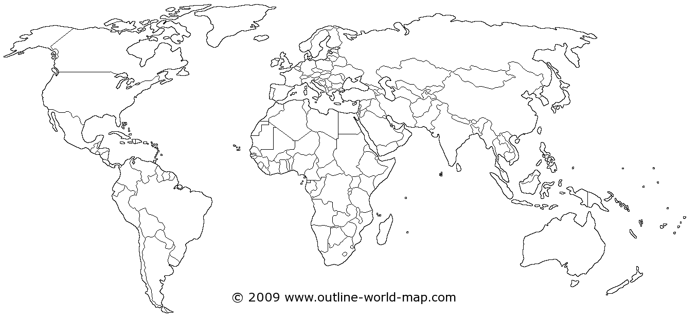
A sample of chemical transport models that have considered semivolatile POA
United States
Robinson et al., Science, 2007
Lane et al., AE, 2008
Shrivastava et al., JGR, 2008
Murphy et al., JGR, 2010
Ahmadov et al., JGR, 2012
Koo et al., AE, 2014
Hodzic et al., GRL, 2014
Jathar et al., ACP, 2015
Woody et al., ACP, 2016
Europe
Hodzic et al., ACP, 2010
Fountoukis et al., ACP, 2011
Murphy et al., ACP, 2012
Bergström et al., ACP, 2012
Karnezi et al., 2015
Ciarelli et al., ACP, 2016
Asia
Matsui et al., ACP, 2014
Zhao et al., Sci. Reports, 2016
Mexico
Tsimpidi et al., ACP, 2010
Shrivastava et al., JGR, 2011
Shrivastava et al., JGR, 2013
Global
Farina et al., JGR, 2010
Pye and Seinfeld, ACP, 2010
Jathar et al., ACP, 2011
Jo et al., AE, 2013
Spracklen et al., ACP, 2013
Tsimpidi et al., GMD, 2014
Tsigaridis et al., ACP, 2014
Notes:
Many studies have looked at this in various domains
A few have done winter studies
They all find better results when treating semivolatile POA
Have to include some other source in their model to overcome underprediction – usually aging of anthropogenic SOA

Slide 4
Sources of uncertainty in OA formation parameterizations
POA evaporation in CTMs causes massive underprediction of total OA
Where does the missing SOA come from?
nvPOA
svPOA
VOC Emissions
Toluene, Xylene, Benzene,
Alkanes, Alkenes, etc
VOC Emissions
Toluene, Xylene, Benzene,
Alkanes, Alkenes, etc
Potential Combustion SOA (pcSOA)
3
1
·OH, O₃,
NO₃·
Missing Vapors from Chamber Walls
IVOC
·OH, O₃,
NO₃·
·OH
SOG
Semivolatile POA
SOG
·OH
SV-POG
Aged SOG
LV-POG
2
4
Organic-Water Interactions
POA
SOA
SV-POA
SOA
Aged SOA
LV-POA
SOG – secondary organic gas
LV-POG – low volatility primary organic gas
SV-POG – semivolatile primary organic gas
IVOC – intermediate volatility organic compounds
Both of these configurations are available in CMAQv5.2

Slide 5
Organic aerosol updates
Semivolatile POA:
  Consistent with 1.5-Volatility Basis Set implementation (Koo et al., Atmos. Environ., 2014)
  POA aging:
    Explicit functionalization and fragmentation
    k_{OH} = 4 x 10⁻¹¹ cm³ molec⁻¹ s⁻¹
Volatility Distribution for POA Emissions
Volatility - C*(298 K) µg m⁻³ |  | ≤ 0.1 | 1 | 10 | 100 | 1000
POA Emissions Factor |  | 0.09 | 0.09 | 0.14 | 0.18 | 0.5
LVOC SVOC IVOC
  Potential Combustion SOA (pcSOA):
pcVOC
+ OH
pcSOA_{vapor}
EF =
9.6 g pcVOC/ gPOA
k_{OH} =
1.25 x 10⁻¹¹
cm³ molec⁻¹ s⁻¹
(C* = 10⁻⁵ µg m⁻³)
emissions
pcSOA_{particle}
Inspired by the “SIMPLE” method:
Spracklen et al., 2011
Hodzic and Jimenez, 2011
Hayes et al., 2015
Woody et al., 2016
Sensitivity Suite: EF [g pcVOC / g POA] = 6.5 – 12
k_{OH} [cm³ molec⁻¹ s⁻¹] = 1.0 – 2.0 x 10⁻¹¹

Slide 6
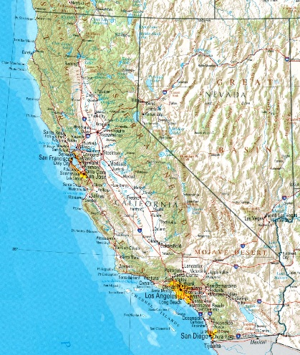
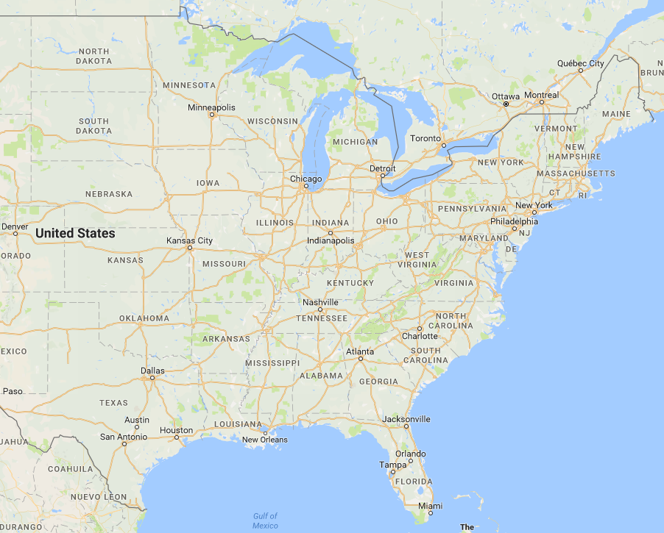
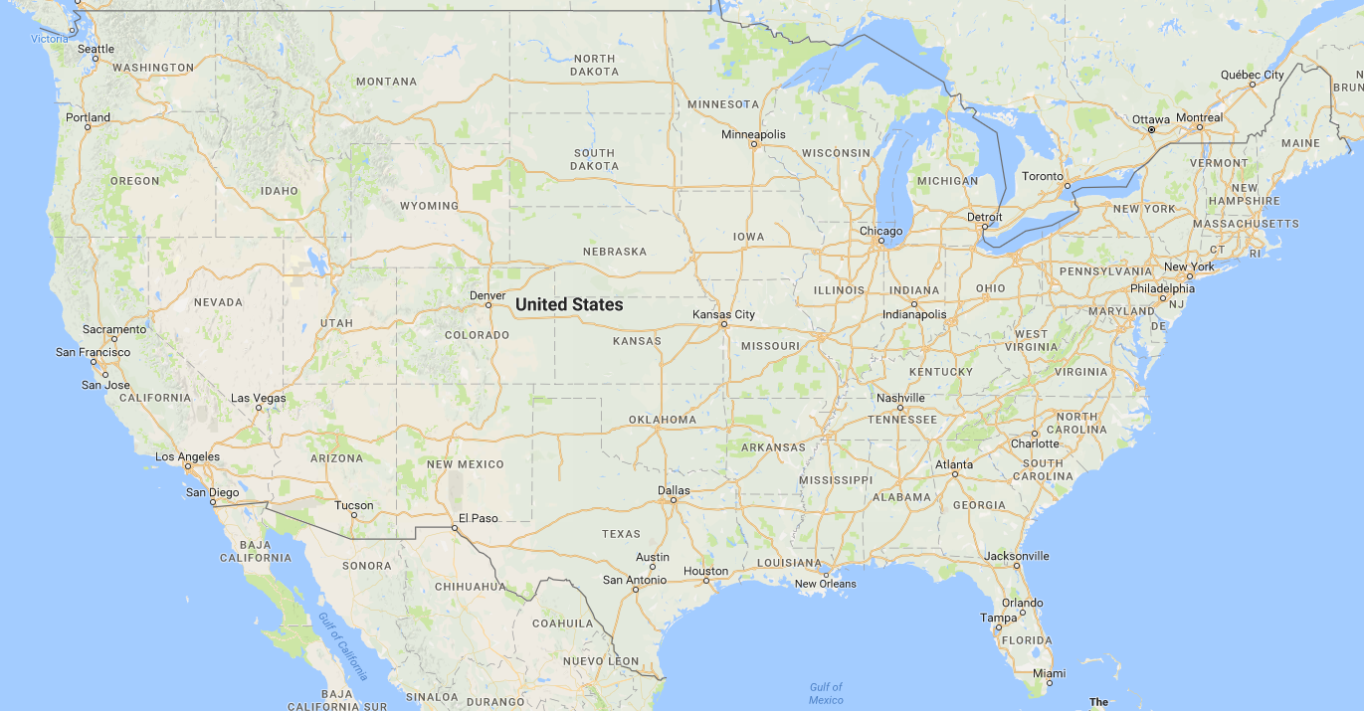
Evaluated new model against observations in several domains
California at the Nexus of Air Quality and Climate Change (CalNex):
May-June 2010
Pasadena, CA
Bakersfield, CA
Carbonaceous Aerosol and Radiative Effects Study (CARES):
June 2010
Sacramento, CA
Cool, CA
Southern Oxidant and Aerosol Study (SOAS):
May-June 2013
Centreville, AL
Look Rock, TN
4 km
12 km
12 km
CMAQ Configuration:
t-SOA: Odum method with yields from Griffin et al. (1999)
Anthropogenic Emiss: NEI 2011
Biogenic Emiss: BEIS 3.14
Continental US:
CSN, IMPROVE, SEARCH
Jan-Dec, 2011
Jan, July 2002

Slide 7
Diel-averaged profiles at continuous observation sites
California Domain
Eastern US Domain
Obs
nvPOA
svPOA (BASE)
svPOA (Low pcVOC Emission)
svPOA (High pcVOC Emission)

Slide 8
Base module captures extent of oxygenation and inferred volatility distribution
Pasadena (CalNex)
m_{obs} = 0.146
m_{base} = 0.103
m_{nvPOA} = 0.007
≤
LVOC SVOC
Saha et al., Quantifying the volatility of organic aerosol in the southeastern U.S., ACPD, 2016

Slide 9


Performance sensitivity to pcSOA parameters
12
10
8
6
12
10
8
6
CalNex/CARES Sites:
Normalized Mean Bias Factor (NMBF) and Normalized Mean Error Factor (NMEF) calculated for data pairs at each site and then aggregated together.
$$\frac{EF(pcVOC)}{EF(POA)}$$
Yu et al., Atmospheric Science Letters, 2006.
1 1.5 2 x10⁻¹¹
1 1.5 2 x10⁻¹¹
CONUS Jan/July 2011:
Optimal Case: Low Emission Factor, Base Reaction rate (LEBR)
NMBF and NMEF calculated for data pairs at each site and month and then aggregated together.
12
10
8
6
12
10
8
6
$$\frac{EF(pcVOC)}{EF(POA)}$$
1 1.5 2 x10⁻¹¹
1 1.5 2 x10⁻¹¹

Slide 10
CONUS domain:
Annual (Jan-Dec) 2011 summary

Slide 11
Seasonal and regional performance indicators for CONUS 2011 simulation

Slide 12
Seasonal and regional performance indicators for CONUS 2011 simulation

Slide 13
Year-to-year trends
Missing residential wood burning emissions

Slide 14
2011 and 2002 bias correlations with observed pollutants at CSN sites during summer
Aerosol-water interactions?
Organic nitrates?

Slide 15
Take-Home Points and Next Steps
CMAQv5.2 predicts more realistic partitioning and photochemical dependence of OA formation
  Wintertime OC overprediction is nearly resolved (statistically)
  Diel-averaged profiles in urban conditions are faithfully reproduced. Performance is enhanced in nearly all US regions and seasons in 2011 scenario
  The model does not capture decrease in summertime urban daily-averaged OC concentrations from 2002 to 2011
  See talk by Wyat Appel: Wednesday at 9:50 for the effect on PM_{2.5}
The OA representation will be continually updated with emerging science in order to improve accuracy and reduce the contribution of pcSOA
  Explicit IVOC emissions and yields
  Refine biomass burning OA with insights from field observations
  Revised SOA yields accounting for chamber wall losses of low volatility vapors
  Organic-water interactions
  Constrain vertical predictions with aircraft and remote sensing data

Slide 17


Unbiased symmetric metrics
Normalized mean bias factor
Normalized mean error factor
Yu et al., Atmospheric Science Letters, 2006.

Slide 19
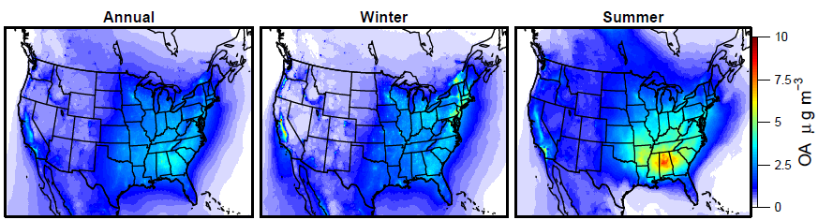

Slide 20
Annual Winter Summer

Slide 21
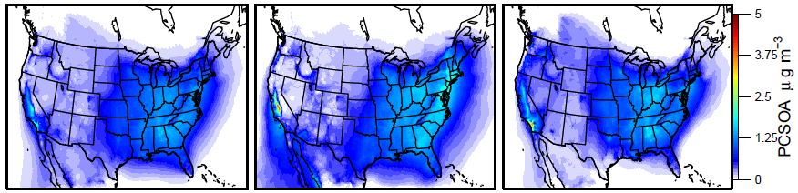
Annual Winter Summer

Slide 22
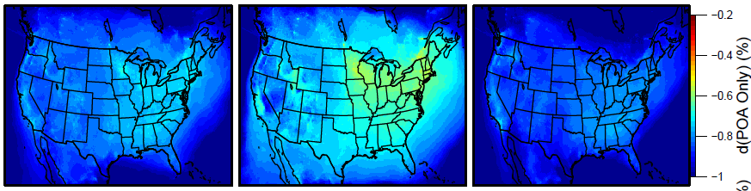
Change in POA
Annual Winter Summer

Slide 23
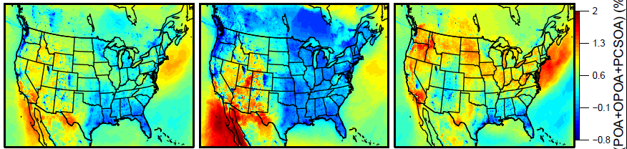
Change in POA vs [POA + Recycled POA + pcSOA]
Annual Winter Summer

Slide 24
References
Koo et al., 1.5-Dimensional volatility basis set approach for modeling organic aerosol in CAMx and CMAQ, Atmos. Environ., 2014.
Ryerson et al, The 2010 California research at the nexus of air quality and climate change (CalNex) field study, Journ. Geophys. Res., 2013.
Woody et al., Understanding sources of organic aerosol during CalNex-2010 using the CMAQ-VBS, Atmos. Chem. Phys., 2016.
Yu and Luo, Modeling of gaseous methylamines in the global atmosphere: impacts of oxidation and aerosol uptake, Atmos. Chem. Phys., 2014.
Zaveri et al, Overview of the 2010 carbonaceous aerosols and radiative effects study (CARES), Atmos. Chem. Phys., 2012.

Slide 25
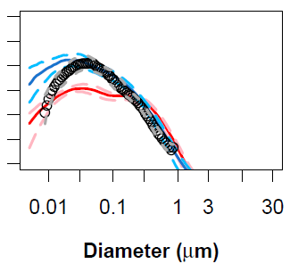

CMAQ-NPF: New particle formation in CMAQ
Features:
Dedicated aerosol nucleation mode
New condensation sink calculation for treating sub-10 nm particles
SEVEN simultaneously occurring NPF pathways
  Binary H₂SO₄-H₂O (Vehkamaki et al., 2002)
  Ternary H₂SO₄-NH₃-H₂O (Almeida et al., 2013)
  H₂SO₄-Amine (Olenius et al., 2013)
  Organic-H₂SO₄ (Paasonen et al., 2010)
  Pure Organic (Kirkby et al., 2016)
  Ion-mediated H₂SO₄ (Yu et al., 2009)
  Ion-mediated Organic (Kirkby et al., 2016)
  Performance:
Observations
CMAQ-NPF
CMAQv5.2
Size distributions during CalNex and CARES
Pasadena
Bakersfield
Sacramento
Cool
1 x 10⁶
10,000
100
1
$$\frac{dN}{d\log_{10}D_{p}}$$
Median (and 25-75 percentiles) over noon to early evening hours

