Slide 1
Recent Updates to the Canadian Operational Regional Air Quality Deterministic Prediction System
Michael Moran, Sylvie Gravel, Verica Savic-Jovcic, Alexandru Lupu, Radenko Pavlovic, Alain Robichaud, Paul Makar, and Qiong Zheng
Environment and Climate Change Canada
26 Oct. 2016 15th CMAS Conference, Chapel Hill, North Carolina

Slide 2
Background
The Canadian Air Quality Prediction Program at Environment and Climate Change Canada (ECCC) is a 17-year-old program that has evolved from issuing O₃-only forecasts for eastern Canada to issuing O₃, NO₂, and PM_{2.5} forecasts for all of Canada (+ the continental U.S. and Alaska)
The ECCC operational AQ forecast system is called the Regional Air Quality Deterministic Prediction System (RAQDPS)
The GEM-MACH in-line meteorology/chemistry model has been used in the RAQDPS since Nov. 2009 to produce twice-daily, 48-hour, continental-scale forecasts of O₃, NO₂, PM_{2.5}, and Air Quality Health Index (AQHI)

Slide 3
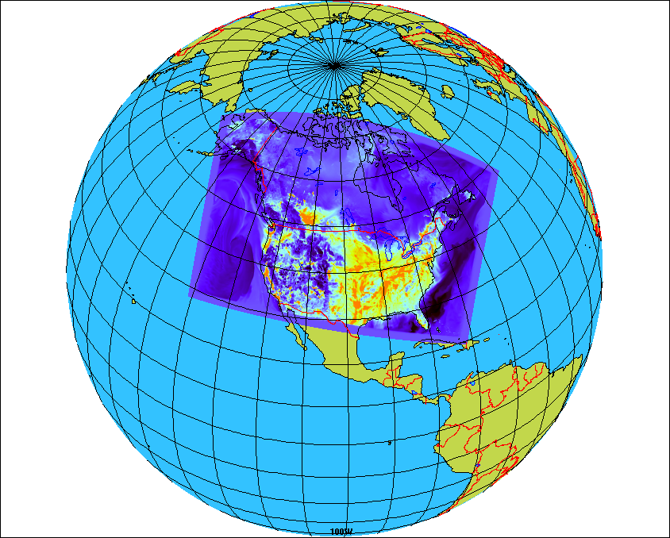
Overview of the ECCC RAQDPS
The core of the RAQDPS is the GEM-MACH chemical weather model, an in-line meteorology‒chemistry model
GEM-MACH version 1 in operation since 2009; replaced by version 2 this year (2016)
Regional grid covers much of North America
10 km horizontal grid spacing
80 vertical levels with lid at 0.1 hPa (~10 levels in 1st km above surface)
One-way coupling (meteorology affects chemistry) for operational version
Full representation of oxidant and aerosol chemistry processes:
gas-, aqueous- & heterogeneous chemistry mechanisms
aerosol dynamics
dry and wet deposition (including in- and below-cloud scavenging)
2-bin sectional representation of PM size distribution (i.e., 0-2.5 and 2.5-10 μm) with 8 chemical components
Notes:
3
Regional yet more than 37 million sq km

Slide 4
Two Recent Updates to the RAQDPS
There have been 16 updates to the operational RAQDPS since 2009 (from RAQDPS001 to 017); some updates were major while others were minor; each update must be shown to improve (or maintain) model performance and each must be approved by an ECCC internal committee
One important recent update was the release in June 2015 of RAQDPS013, which introduced a new set of emissions files [see weblink http://collaboration.cmc.ec.gc.ca/cmc/cmoi/product_guide/docs/changes_e.html#20150611_raqdps]
A second set of significant releases (RAQDPS015, RAQPS016, RAQDPS017) was made in 2016 to upgrade to the next generation of the GEM-MACH model [see http://collaboration.cmc.ec.gc.ca/cmc/cmoi/product_guide/docs/changes_e.html#20160907_raqdps016]

Slide 5
2015 Update to RAQDPS Input Emissions
Newer emissions inventories
were used
Old emissions (SET0)
Canada: 2006 v1 (without construction sector)
USA: 2012 projection (based on 2005 NEI)
Mexico: 1999
Updated emissions (SET2.1.1)
Canada: 2010 v1
USA: 2011 v1
Mexico: 1999 (no change)

Slide 6
Percentage Differences in National Annual Emissions Of Criteria Air Contaminants Between SET2.1.1 and SET0
Country | SO₂ | NO_{x} | VOC | NH₃ | CO | PM_{2.5} | PM₁₀
Canada | -30 | -9 | -6 | -15 | -6 | -4 | 16
U.S. | -48 | 8 | -1 | -3 | -6 | -5 | -11
Notes:
http://iweb.cmc.ec.gc.ca/~arqpmik/Emissions/Inventories/2010_Canadian_CAC_EI/Canada2006_2009_2010_4July2012.xls

Slide 7
Many Improvements to Emissions Processing Methodology for Canada
New Canadian population and dwelling spatial surrogates based on 2011 census replaced older versions based on 2006 census
New Canadian spatial surrogates for residential wood combustion, on-road mobile sources, airports, marine pleasure craft, and others
Land-use-dependent transportable fraction used to scale fugitive dust emissions for near-source capture in place of simple 0.25 factor
New temporal profiles for major point sources
New library of PM speciation profiles and addition of some VOC speciation profiles
Removal of emissions from closed facilities

Slide 8
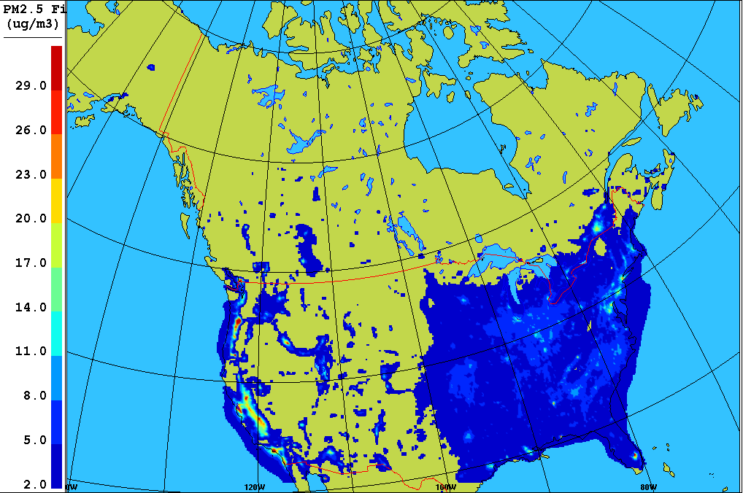
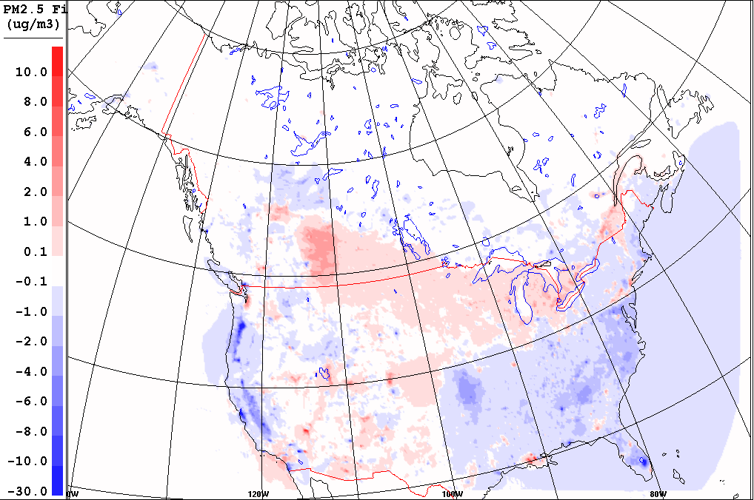
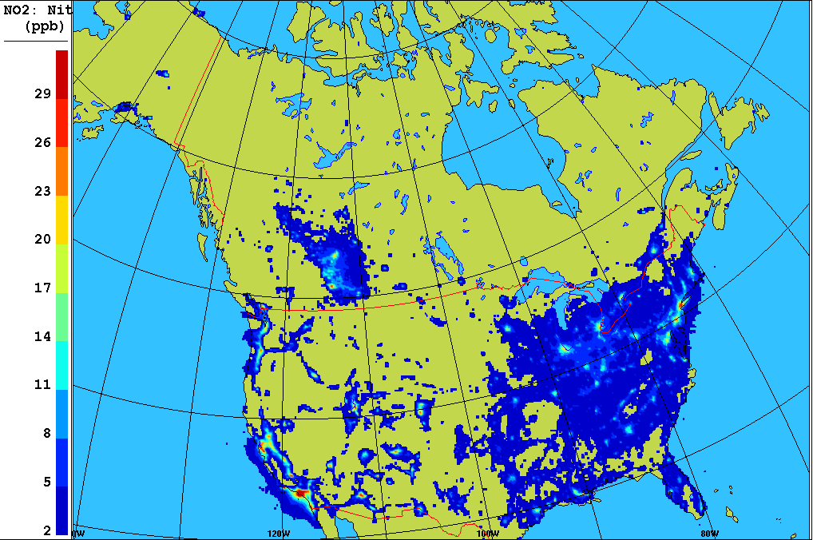
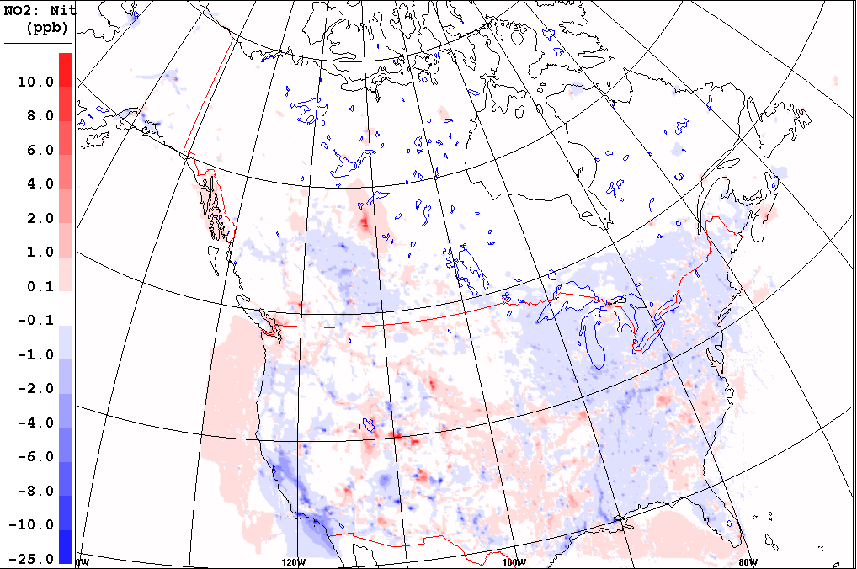
Impact of Revised Emissions on Winter 2014 Mean PM_{2.5} (µg/m³) and NO₂ (ppbv) Concentrations
SRPDQA (OPS)
DIFF =SRPDQA(SET2.1.1) – SRPDQA(OPS)
PM_{2.5}
NO₂

Slide 9
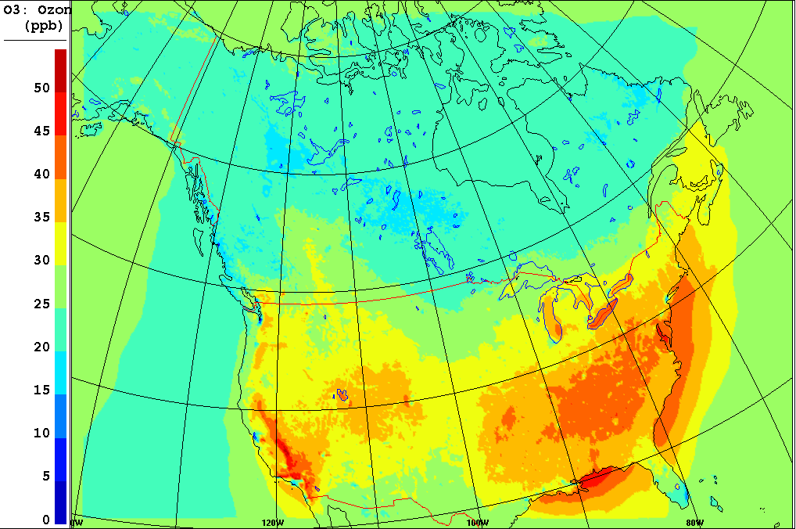
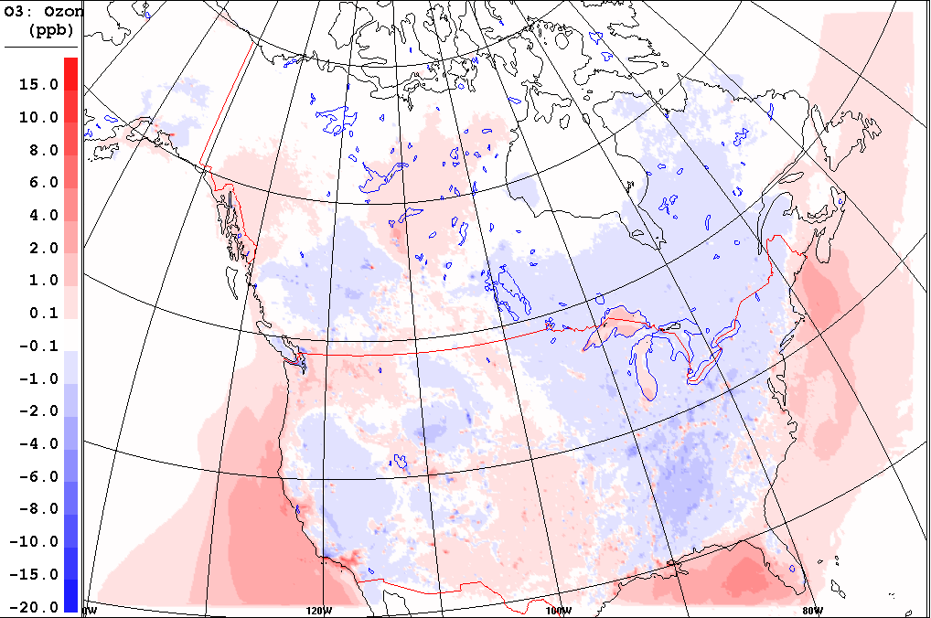
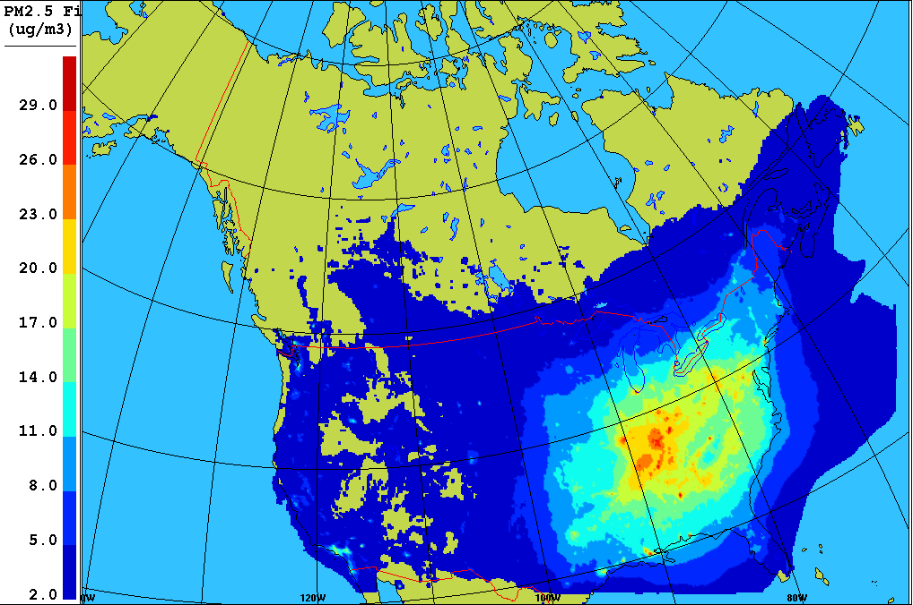
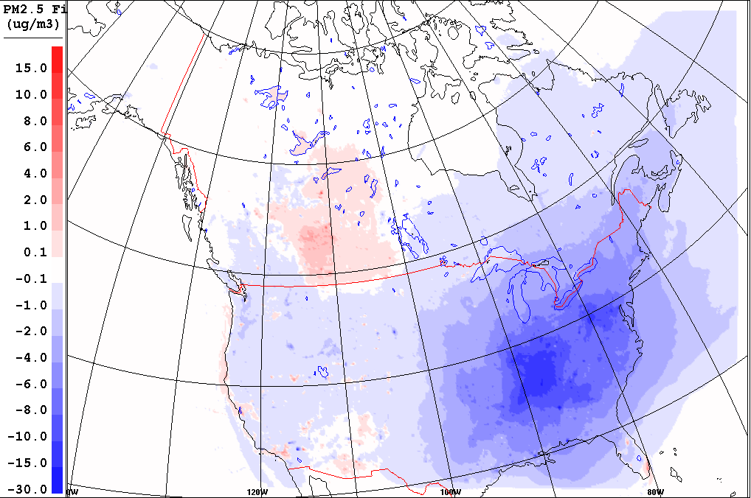
Impact of Revised Emissions on Summer 2014 Mean O₃ (ppbv) and PM_{2.5} (µg/m³) Concentrations
SRPDQA (OPS)
DIFF =SRPDQA(SET2.1.1) – SRPDQA(OPS)
O₃
PM_{2.5}

Slide 10
Objective Scores (MB, R, URMSE) for Winter & Summer 2014 for NO₂, O₃, PM_{2.5}
WINTER 2014
SUMMER 2014
Statistical Impact of Emissions Update
Overall improvement of scores, especially for the winter period
Reduction in problems with PM_{2.5} overpredictions for Canadian urban areas
MONTRÉAL
Observé
GM-OPS
GM avec SET2.1.1

Slide 11
2016 Updates to Forecast Model: GEM-MACH v2 vs. GEM-MACH v1 (1)
With respect to GEM model, GEM-MACH v2 is:
Based on GEMv4 (new version of NWP model) vs. GEMv3
Uses new GEM vertical coordinate (log-hydrostatic-pressure)
Uses new GEM staggered vertical discretization
Uses different model level for surface concentrations (level 80 at surface for G-Mv1 vs. level 80 at 20 m for G-Mv2)
Has different thickness of lowest model layer (20 m for G-Mv1 vs. 40 m for G-Mv2)
Uses updated subgrid-scale orographic blocking scheme
Uses GEM vertical diffusion scheme for chemical tracers (changed for increased harmonization)

Slide 12
New Vertical Discretization
GEM-MACH v1
GEM-MACH v2
T, φ, u, v, w, tracers
Τ, q, w, tracers
T, φ, u, v, w, tracers
φ, u, v
T, φ, u, v, w, tracers
Τ, q, w, tracers
φ, u, v
T, φ, u, v, w, tracers
Τ, q, w, tracers
Τ, q, w, tracers
T, φ, u, v, w, tracers
φ, u, v
φ, u, v
T, φ, u, v, w, tracers
Τ, q, w, tracers
T, φ, u, v, w, tracers
φ, u, v
Τ, q, w, tracers
T, u, v, w, tracers
Τ_{s}, q_{s}
Regular Grid
Charney-Phillips Grid
Notes:
12

Slide 13
GEM-MACH v2 vs. GEM-MACH v1 (2)
New set of climatological chemical lateral boundary conditions (seasonal 1D vertical profiles in G-Mv1 vs. seasonal 3D mean fields in G-Mv2 from MOZART4)
Call to sea-salt emissions operator moved in operator sequence
Adoption of new limited-area-model version of new GEM mass-conserving advection scheme for tracers
Corrections to gas-phase dry deposition scheme to include leaf-area-index (LAI) scaling in some surface resistance terms
Fixes to surface emissions and gas-phase dry deposition bugs & numerous minor corrections and improvements

Slide 14
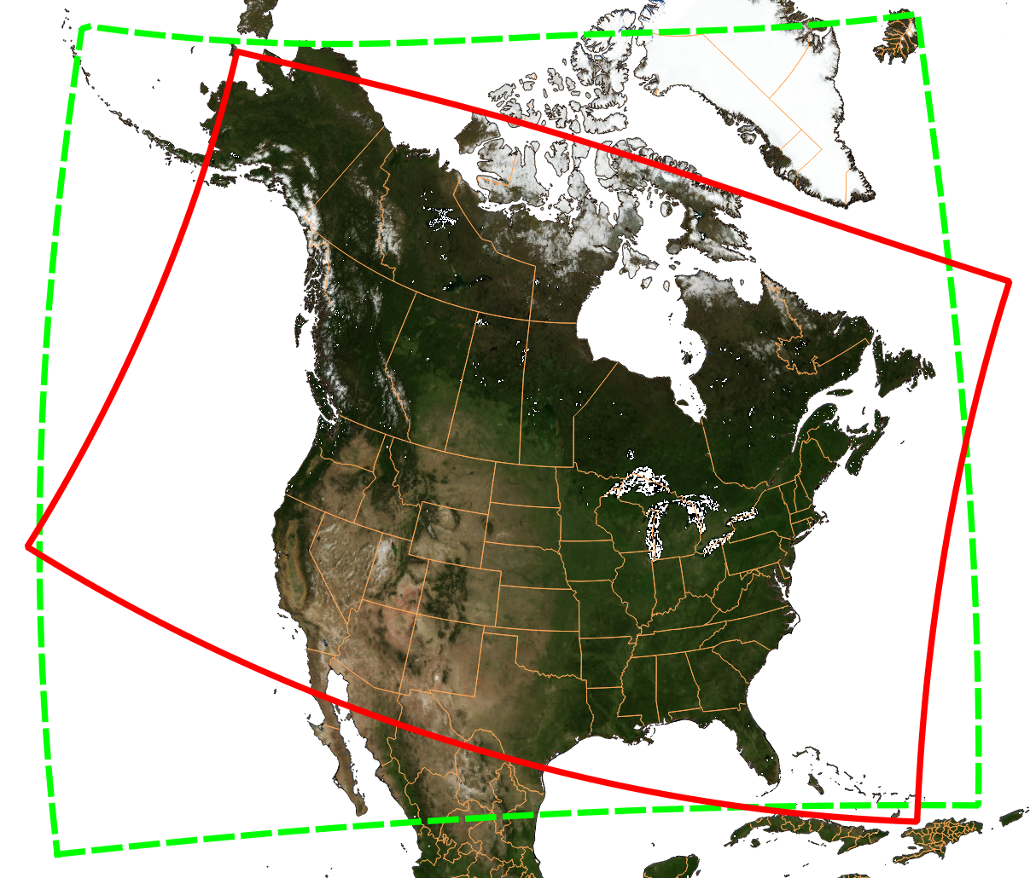
Change in Forecast Domain from GEM-MACHv1 to GEM-MACHv2

Slide 15
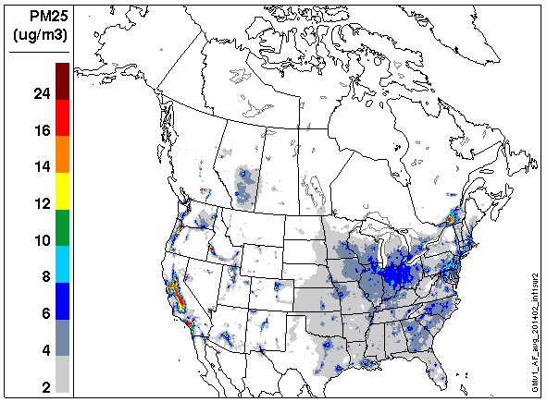
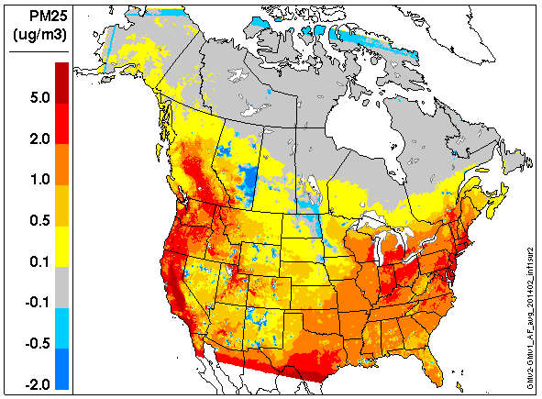
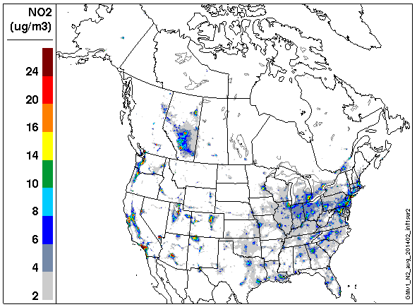
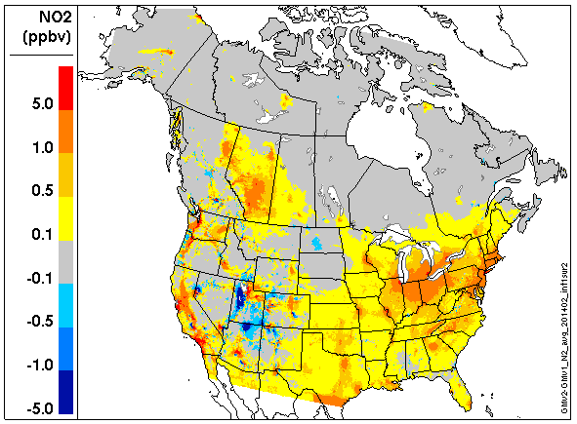
Impact of New Model Version on Winter 2014 Mean PM_{2.5} and NO₂ Concentrations
GMv1 (OPS)
DIFF =GMv2 – GMv1(OPS)
PM_{2.5}
NO₂

Slide 16
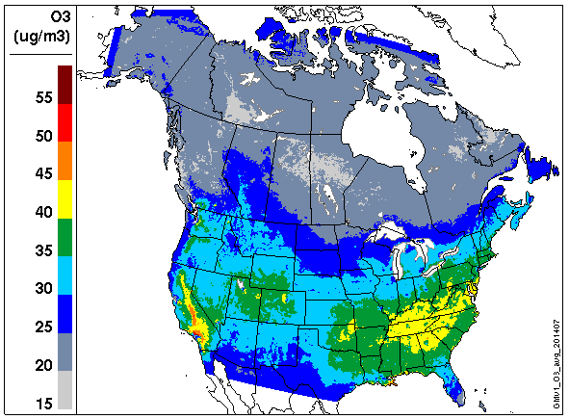
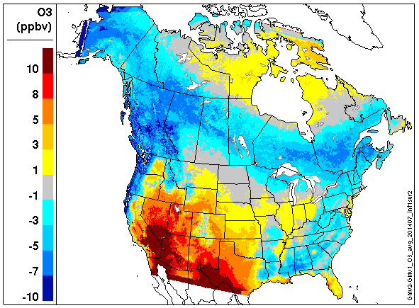
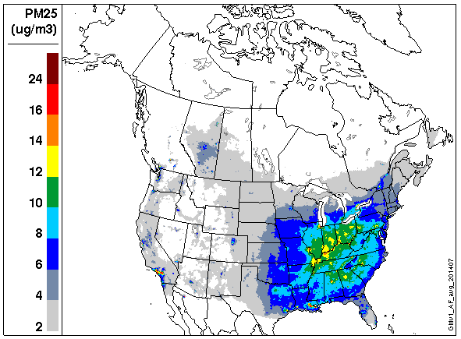
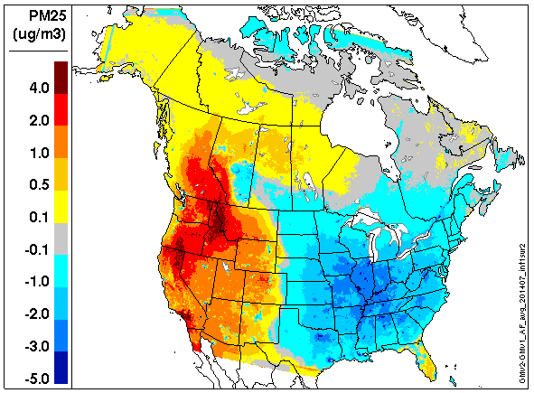
Impact of New Model Version on Summer 2014 Mean O₃ and PM_{2.5} Concentrations
GMv1 (OPS)
DIFF =GMv2 – GMv1(OPS)
O₃
PM_{2.5}

Slide 17
Objective Scores (MB, R, URMSE) for Hourly Forecasts (NO₂, O₃, PM_{2.5})
WINTER 2014
SUMMER 2014

Slide 18
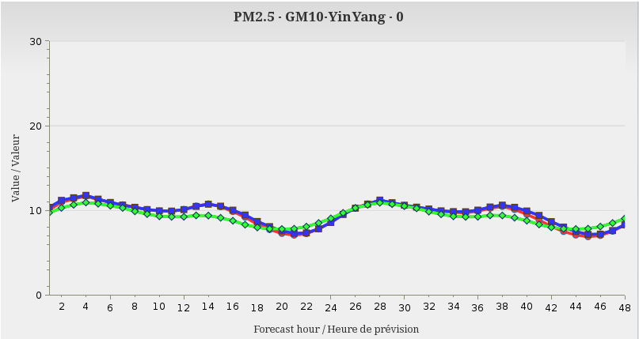
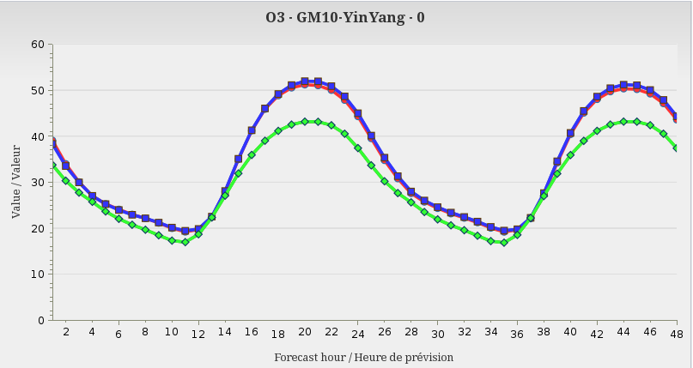
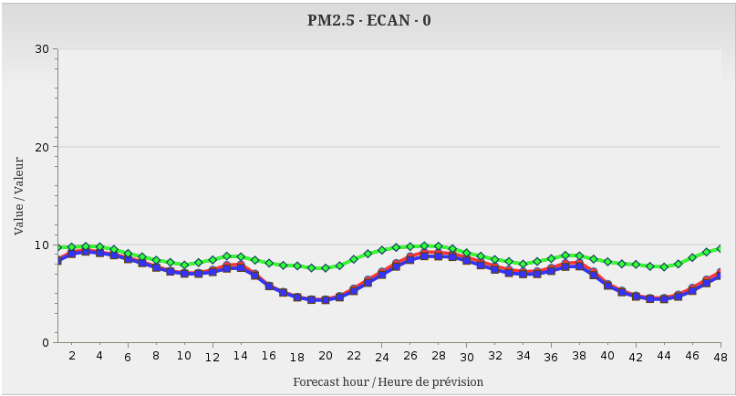
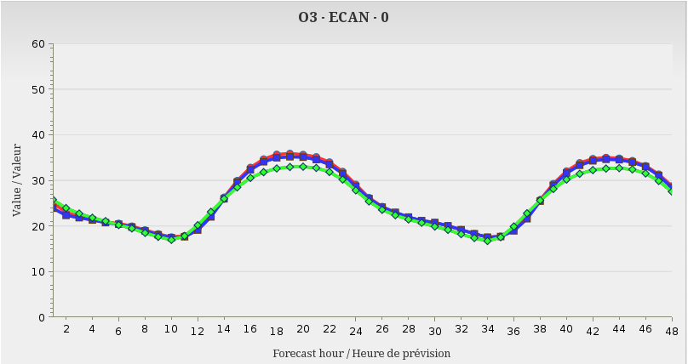
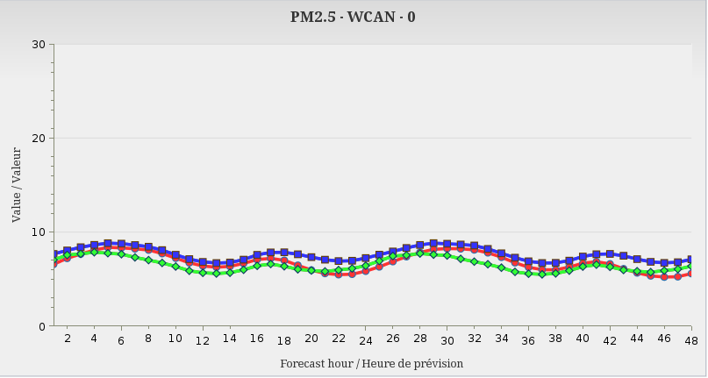
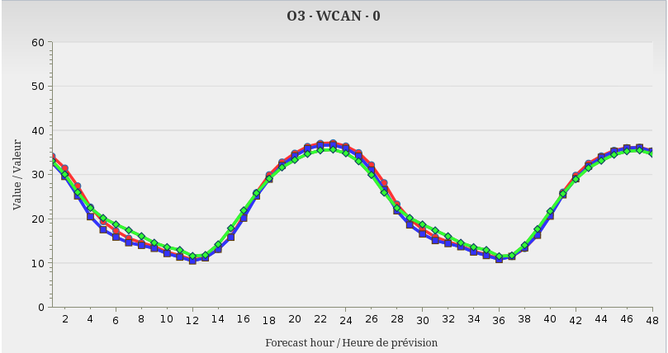
48-hour Season-Mean Hour-of-Day Concentrations
SRPDQA015
SRPDQA016
Observed
Winter – PM_{2.5}
Summer – O₃
G-M Domain
G-M Domain
Eastern Canada
Eastern Canada
Western Canada
Western Canada

Slide 19
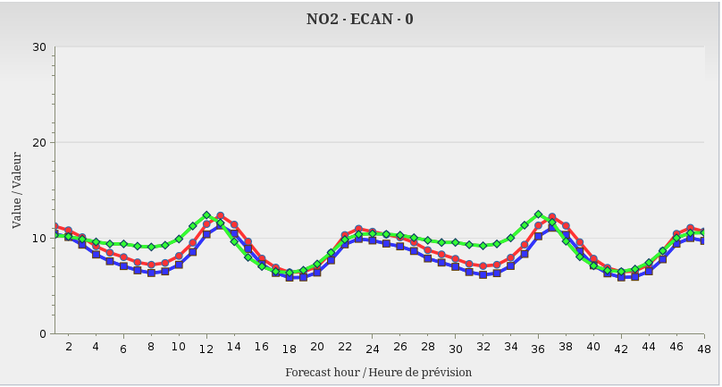
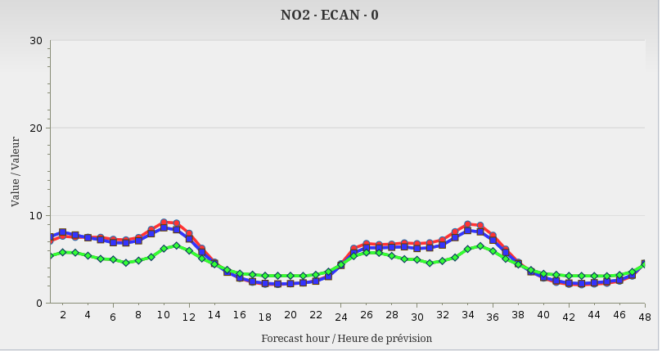
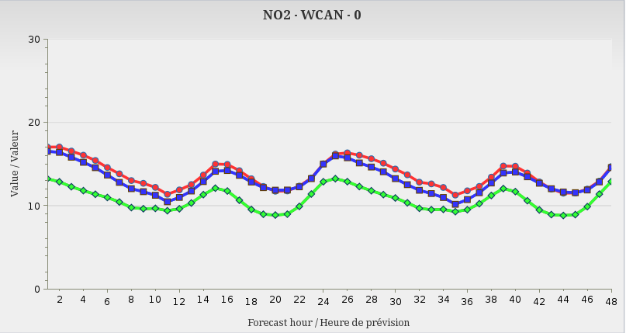
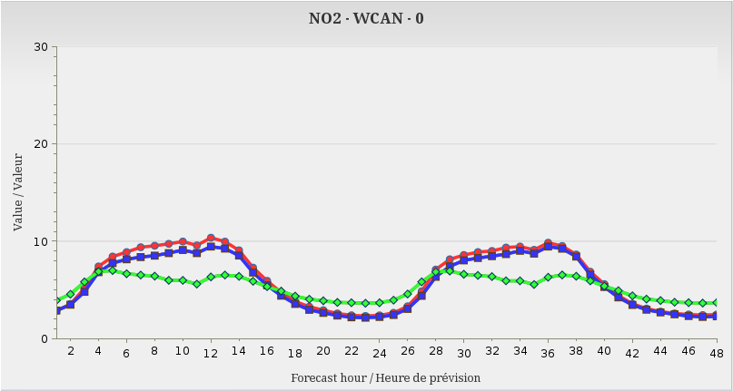
48-hour Season-Mean Hour-of-Day Concentrations
SRPDQA015
SRPDQA016
Observed
Winter – NO₂
Summer – NO₂
Eastern Canada
Eastern Canada
Western Canada
Western Canada

Slide 20
Summary
The ECCC operational Regional Air Quality Deterministic Prediction System (RAQDPS) has been updated 16 times since 2009
One major update in 2015 introduced new input emissions based on newer inventories (2010 Cdn, 2011v1 U.S.) and improved emissions processing methodology
Another major update in 2016 upgraded the GEM-MACH chemical weather model from version 1 to version 2: changes included (1) new vertical discretization, (2) new mass-conserving semi-Lagrangian advection scheme, (3) updated gas-phase dry deposition scheme, (4) new tracer vertical diffusion, (5) new chemical lateral boundary conditions, and (6) correction of surface emissions error

Slide 21
Thank you for your attention!

Slide 22
Current RAQDPS “Ecosystem”
RDAQA
GDPS
RDPS
RAQDPS
(or FireWork)
UMOS-AQ

