Slide 1
Air Pollution Externalities and Energy Choices: Linking Electricity Dispatch, Air Quality and Health Impact Models
Michael D. Moeller,
Frank Felder, Kirk Baker, Annmarie G. Carlton
Notes:
Demonstrate an integrated approach to assess and monetize air externalities in the context of energy decisions to promote a more full cost accounting of energy choices.

Slide 2
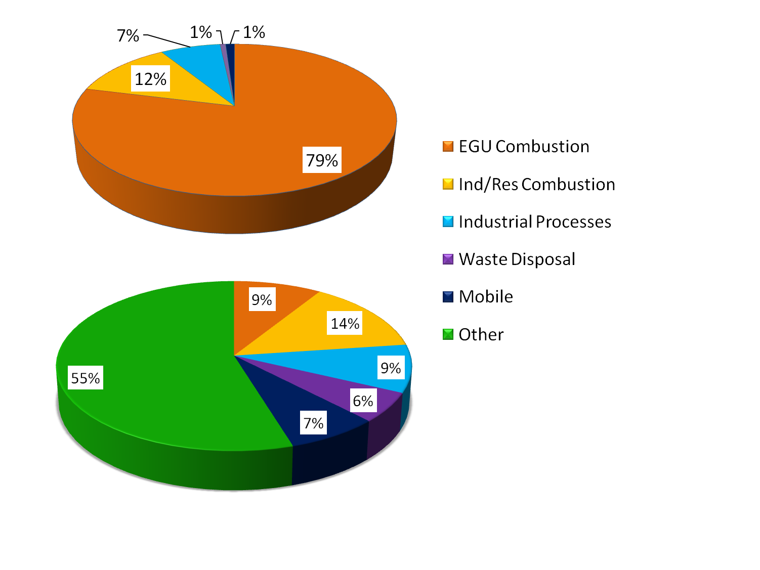
EGU emissions affect AQ & Health
Northeast 2014 SO₂
Negative AQ impacts impart societal health costs
- $100 Billion/yr (CATF, 2010)
These costs are external to EGU Fuel and O&M costs
EGU generation & emissions controlled largely by regional reliability dispatch needs and market factors
Northeast 2014 PM_{2.5}
Notes:
- primarily PM_{2.5}, O₃
-Estimated 13,200 deaths due to particulate matter in 2010
-7,500 in 2014 updated study

Slide 3
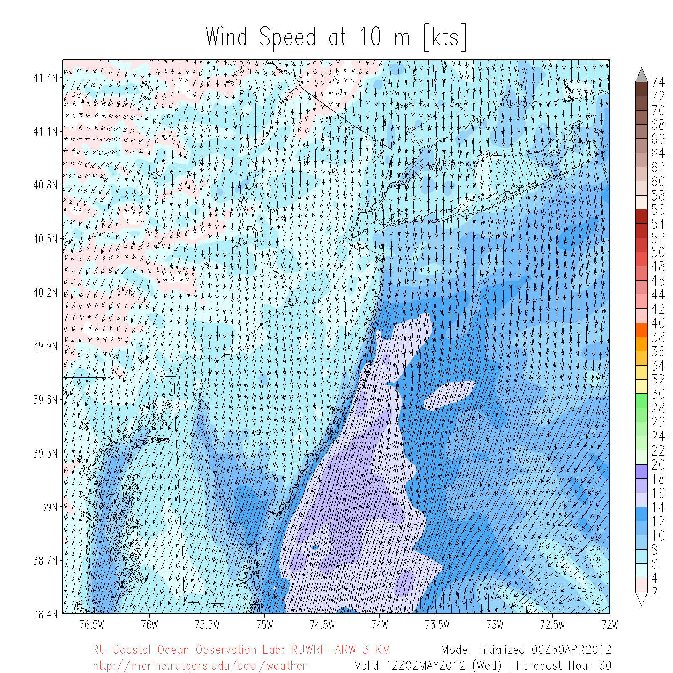
EGU emissions impacted by energy choice
NJ Off-Shore Wind Farm (OSW)
- 3,000 MW Wind Turbine Installation
- Hourly power output using WRF-ARW 2013 winds
- 0.75 km resolution
WRF output courtesy of RU, IMCS
Notes:
Wind farm scenarios pending before the BOEM … picked scenario with highest likelihood of success
https://marine.rutgers.edu/~nstrands/bpu/RU-BPU-Offshore-Study-Final-Report-June21-FINAL.pdf

Slide 4
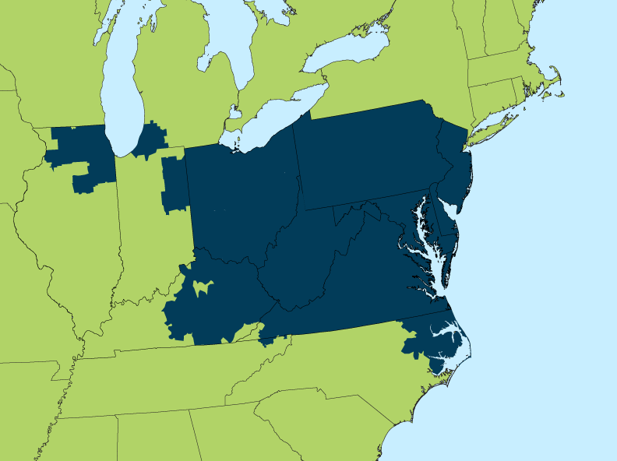
DAYZER: hourly electricity dispatch
PJM Interconnection: largest RTO manages reliability for 13 states & 61 million people
Forecasts hourly locational clearing prices and congestions costs using fuel prices, demand projections, unit outages, emission permit costs and generator characteristics.
Notes:
Day-Ahead Locational Market Clearing Prices Analyzer
Delaware, Illinois, Indiana, Kentucky, Maryland, Michigan, New Jersey, North Carolina, Ohio, Pennsylvania, Tennessee, Virginia and West Virginia) and the District of Columbia.

Slide 5
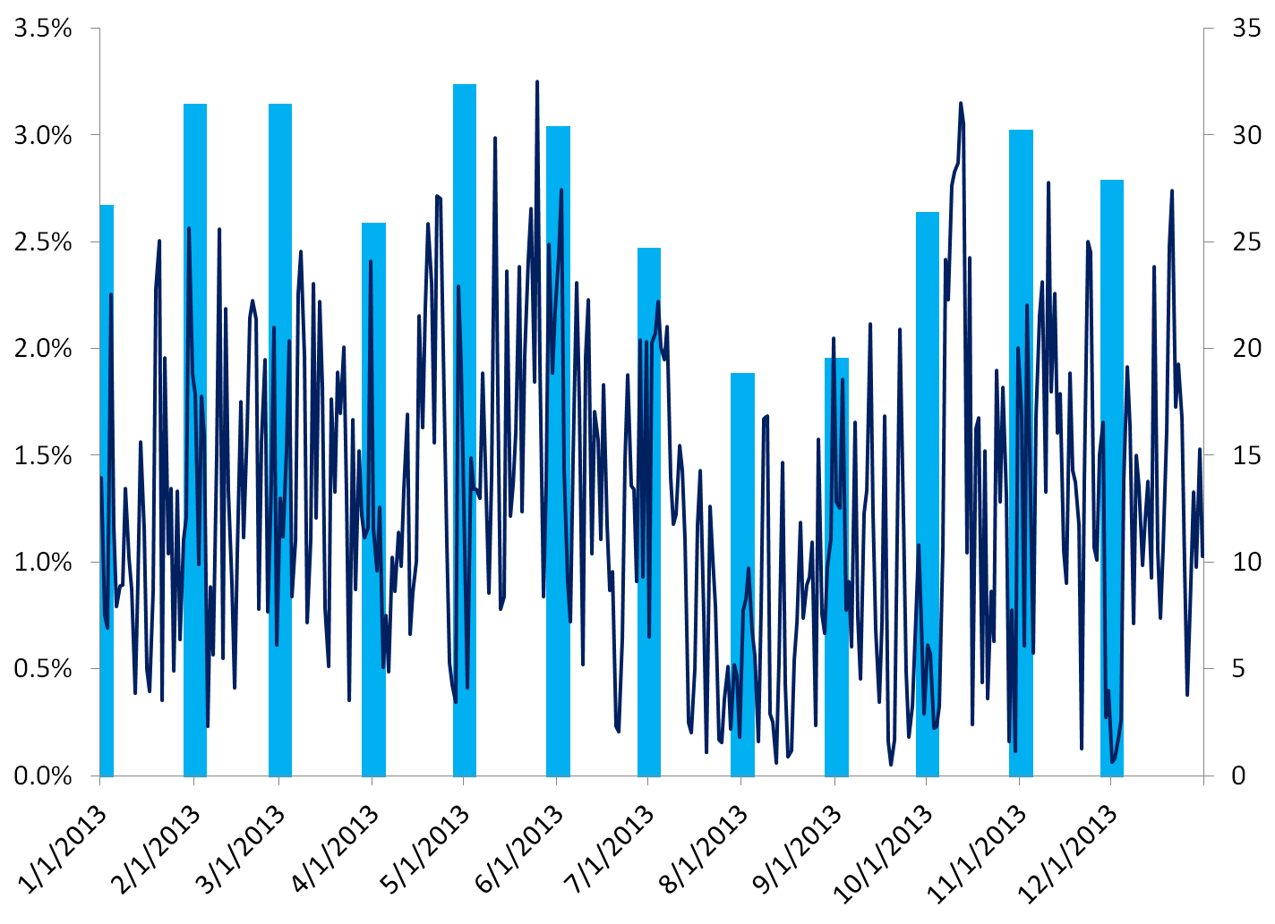
Windfarm Ouput
% PJM Dispatch from OSW
Monthly GWh Output

Slide 6
Overall Project Goal
Area
Sources
Speciation Matrix
Meteorology
Model (WRF)
Biogenic Sources (BEIS)
Gridding Matrix
CMAQ
Model-ready Emissions
CMAQ Simulation and Analysis
BenMAP
Health and
Valuation
SMOKE Merge
Mobile Sources (MOVES)
Hourly
Emissions Inventory
growth/controls
Point Sources (incl. EGUs)
Layer Assignment
DAYZER
Emissions Processing
Legend
Data set
Calculation
Model

Slide 7
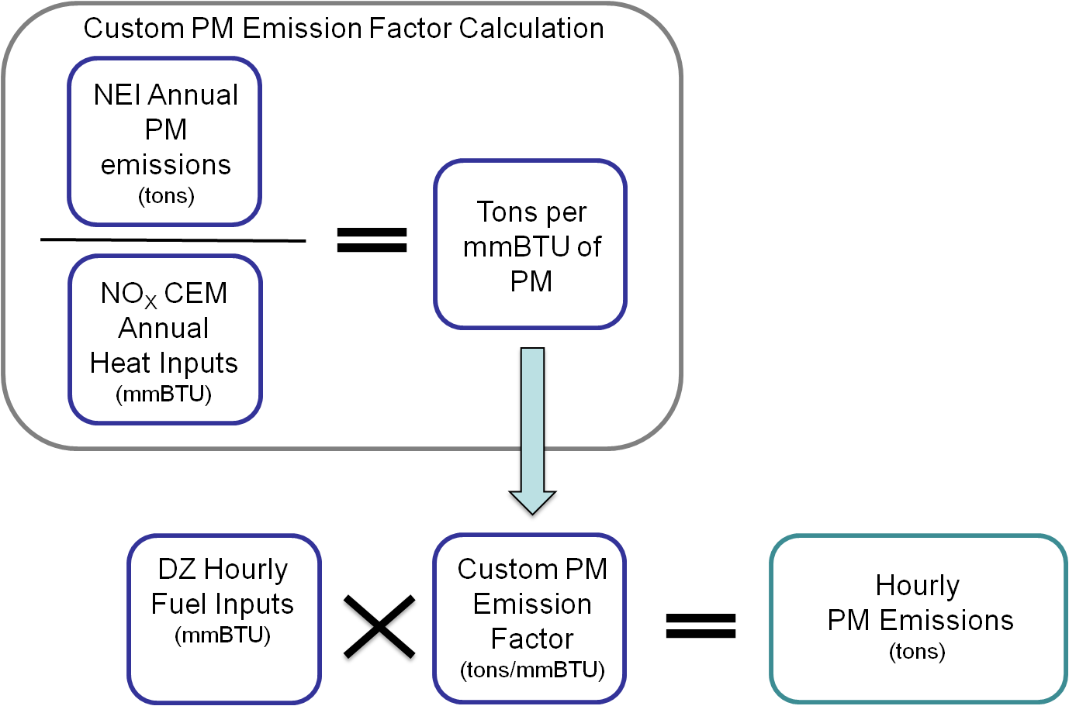
Emission Calculation
Transform DAYZER fuel usage (mmBTU) to hourly emission data for CMAQ (tons/hour)
EGU specific emission factors: SO₂, NO_{x}, CO, PM_{2.5}, PM₁₀ and VOCs
2011 CEM Heat Inputs and NEI

Slide 8
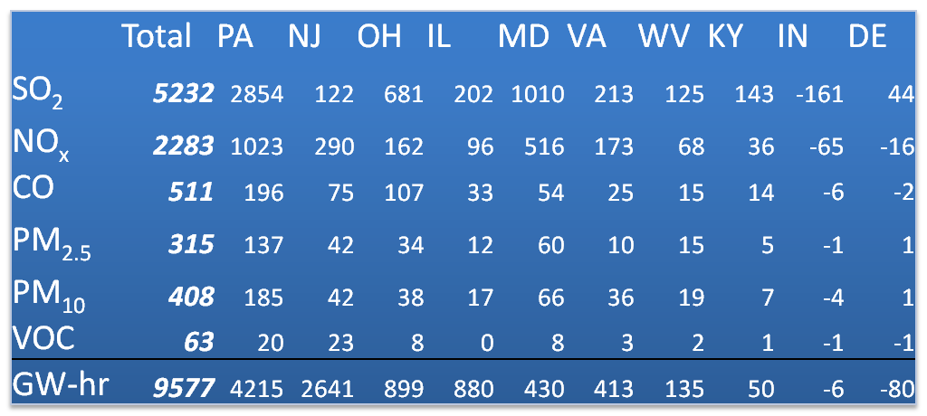
Emission Differences (tons/yr) for OSW scenario
Annual totals for 2013
Notes:
NJ imported about 10% of its power in 2013
SO2, PM Reduction represents the equivalent of taking out a unit equivalent of about 200/5000 of the dirtiest emitter (PTIPM)
Want people to take away: sometimes there are increases, changes in dispatch
*typically* NJ experienced the largest changes in electricity generation but PA experienced the largest changes in [AQ]
KY, MD, OH, VA, WV “boring” … b/c it’s what you would expect

Slide 9
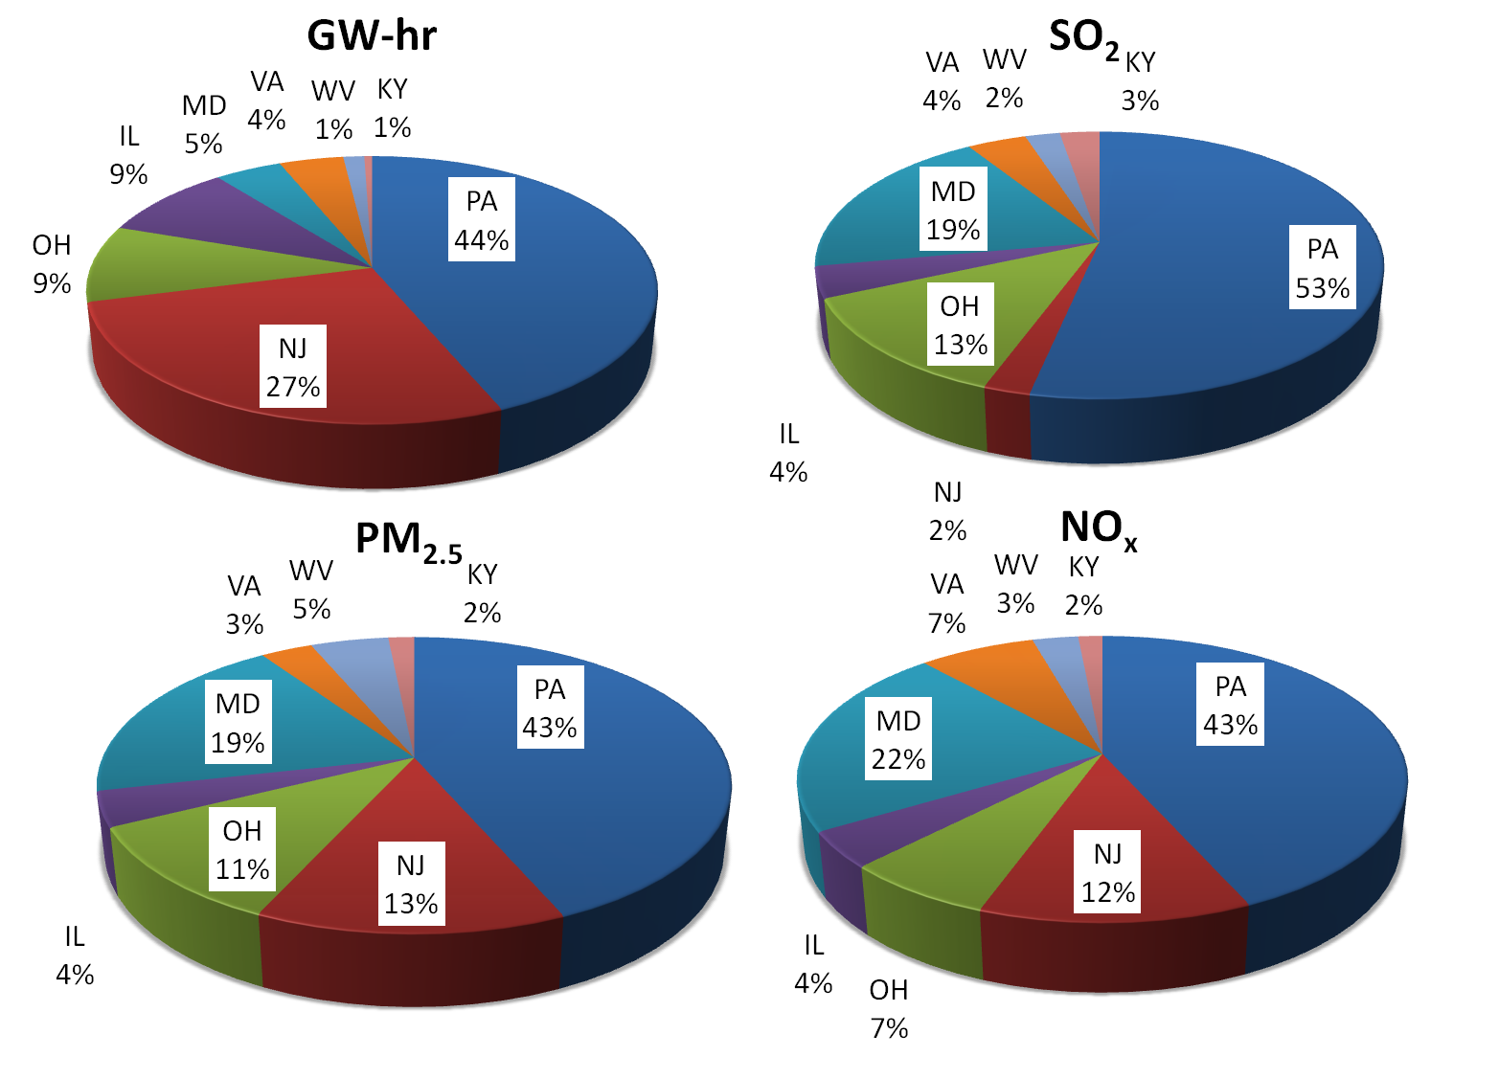
State Reduction Distribution

Slide 10
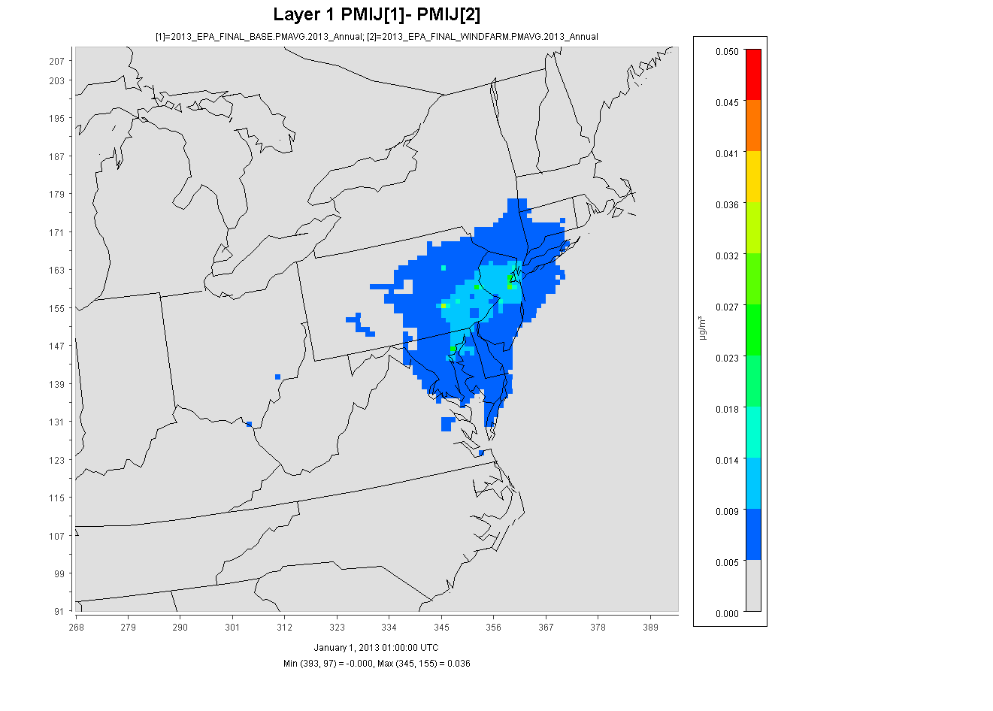
CMAQ 2013 PM_{2.5} Annual Average
0.05
0.025
0
µg/m³

Slide 11
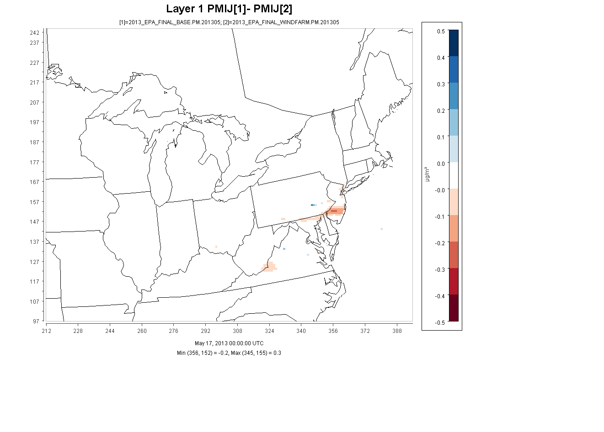
CMAQ 2013 PM_{2.5} Hourly May 17 - 31
0.5
0.25
0
-0.25
-0.5
µg/m³

Slide 12
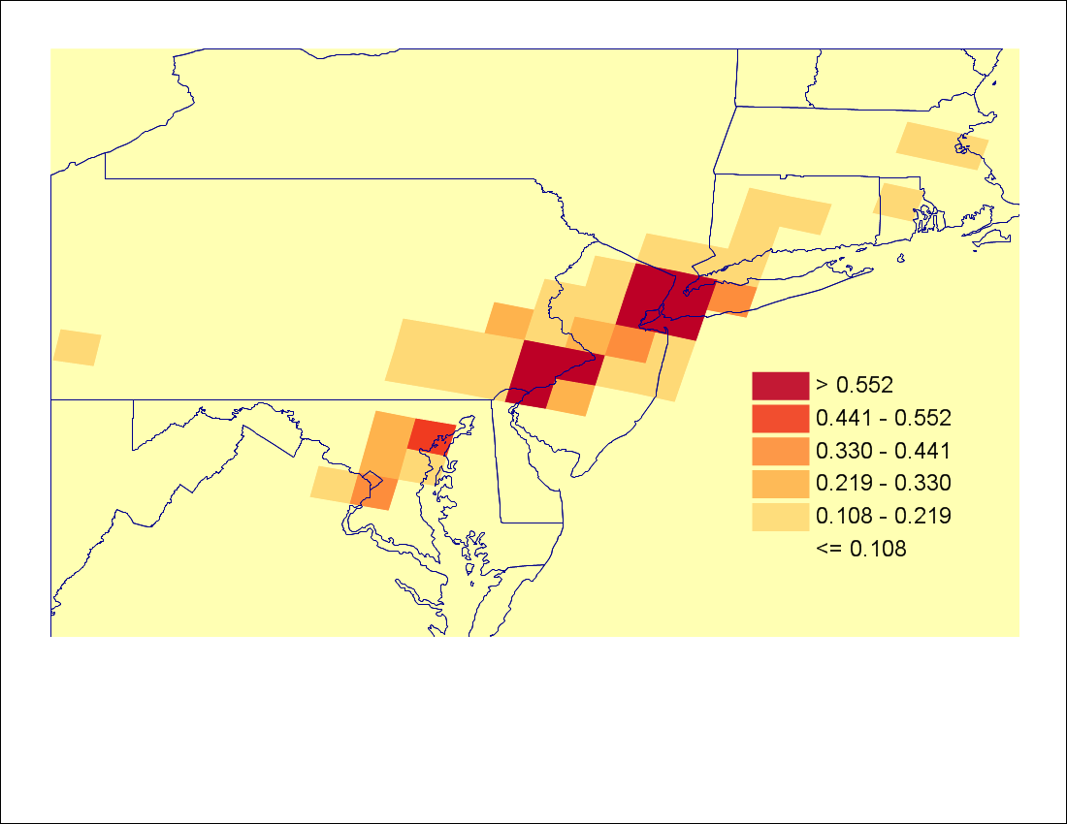
2013 Average PM_{2.5} Change in Mortality Incidence
Notes:
Important to note: BenMap employs functions of *24 hour average* PM2.5 … but health impacts can happen over much shorter time scales and this is lost in this (and other) analyses employing Ben Map so when we say it’s a lower bound incidence it’s not hyperbole

Slide 13
Health Benefits and Valuation
2013 Average PM2.5 Concentration Incidence and Valuation
Mortality, All Cause health function from Krewski et al. (2009)
Value of a Statistical Life (VSL) set at EPA Standard $5.5 million
Impact | Valuation
Reduced Mortality, All Cause | $154,729,005
Reduced Morbidity | $5,244,258
Fossil-fueled electricity generation not profitable without human health subsidy (Rodgers, 2016)
Notes:
Krewski – same coefficient as Pope et al.
The American Cancer Society (ACS) Cancer Prevention Study II (CPS-II)
ACS cohort to 18 years (1982 to 2000)
The cohort for the current study consists of approximately 360,000 participants residing in areas of the country that have adequate monitoring information on levels of particulate matter with an aerodynamic diameter of 2.5 µm or smaller (PM2.5) for 1980 and about 500,000 participants in areas with adequate information for 2000.
Long-term average exposure variables were constructed for PM2.5 from monitoring data for two periods: 1979–1983 and 1999–2000
cohort has been restricted to include only those who resided in U.S. metropolitan areas within the 48 contiguous states
Laden et al 2012 – Based off reanalysis of Harvard 6 cities study: Coeffecient about 3 times higher
Based off of eastern and midwestern cities:
Mass.,Tenn.,Ohio,Missouri,Wisconisin and Kansas
About 9,000 participants
Reduced Morbidity from: Asthma, Bronchitis Exacerbation, Respiratory & Cardiovascular Hospital Admission and Work Loss Days
-12 Impacts in total
-Selected 1-day symptom WTP studies
-COI at 3% DR

Slide 14
Total Societal Benefits
In addition, CO₂ Emissions reduced by 4.8 million tons
Using Social Cost of Carbon set at $36 per ton using 3% discount rate
Impact | Valuation
Reduced CO₂ Emissions | $172,800,000
AQ Health Benefits | $159,973,263
Total Societal Annual Benefit | $332,773,263
Does not include other societal benefits: Ozone, Agriculture, Methane etc
OSW Cost Estimate: $12 Billion
Lifetime: 20 – 25 years

Slide 15
Conclusions & Future Directions
- AWC overall small penetration of renewables into PJM generation
Fossil fuel use for electricity production and air pollution emissions are reduced in PJM due to AWC
episodic localized increases from local production
PJM-wide improvements in AQ
episodic localized disbenefits
Explore uncertainty in health estimates as uncertainty in pay back periods
Different health functions,
Different depreciation/discount rates

Slide 16
Acknowledgements
Gene Shan for DAYZER simulations
National Science Foundation, OCE141958, EaSM-3: Regional decadal predictions of coupled climate-human systems
National Science Foundation, #1242155
Caroline Farkas
Model developers

Slide 17
SUPPLEMENTAL SLIDES

Slide 18
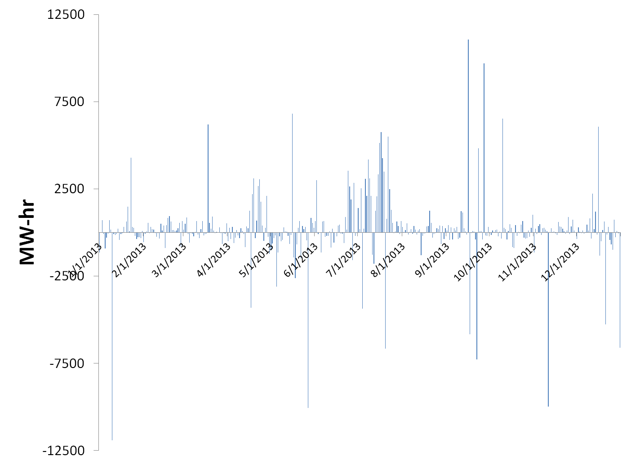
Windfarm Difference in Daily Dispatch

Slide 19
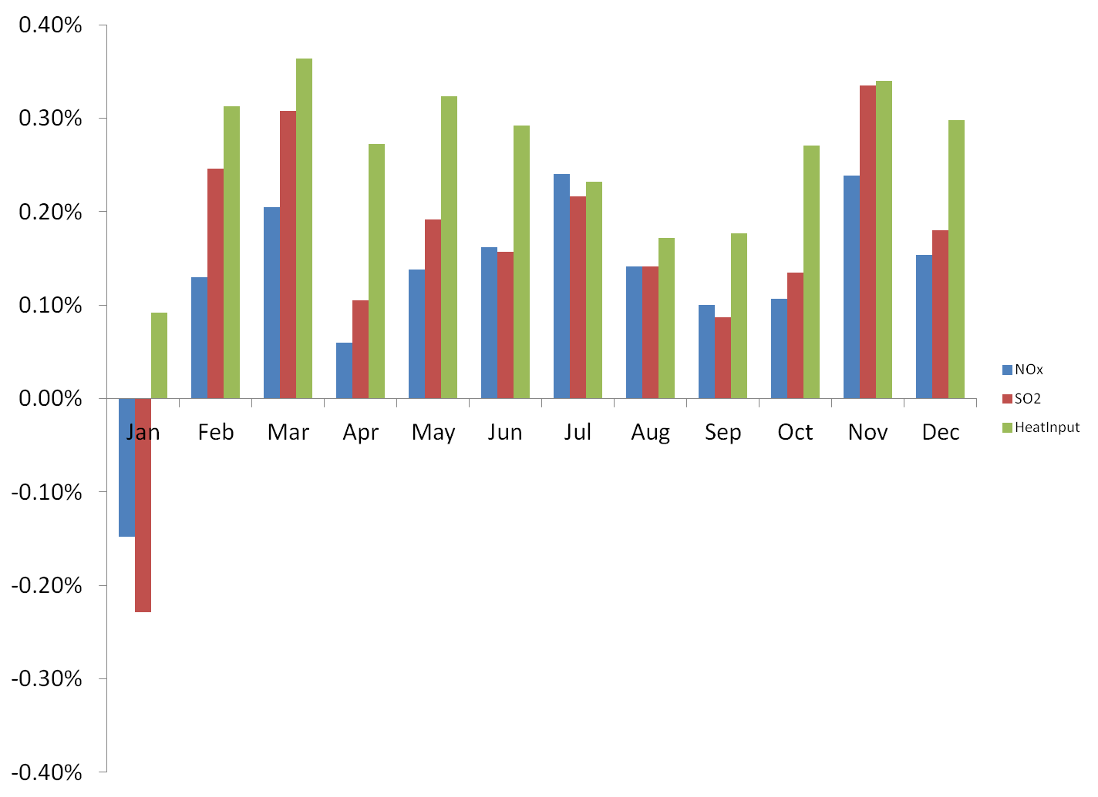
Monthly % Analysis of Basecase – Windfarm

Slide 20
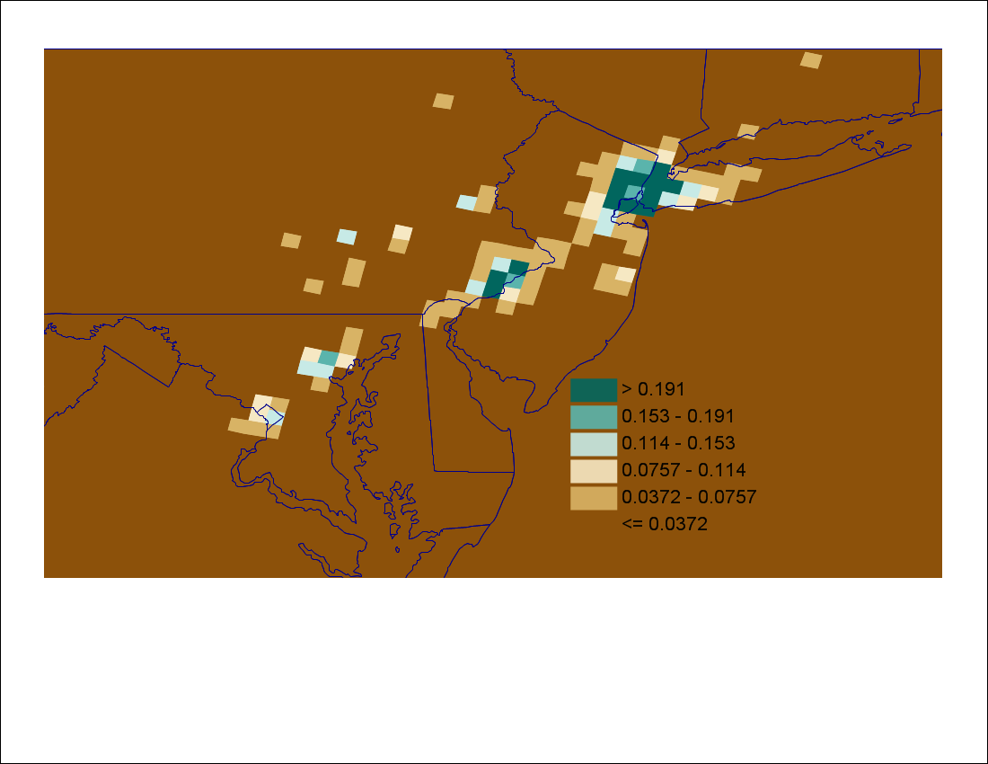
2013 Average PM_{2.5} Change in Mortality Incidence
Notes:
Important to note: BenMap employs functions of *24 hour average* PM2.5 … but health impacts can happen over much shorter time scales and this is lost in this (and other) analyses employing Ben Map so when we say it’s a lower bound incidence it’s not hyperbole

Slide 21
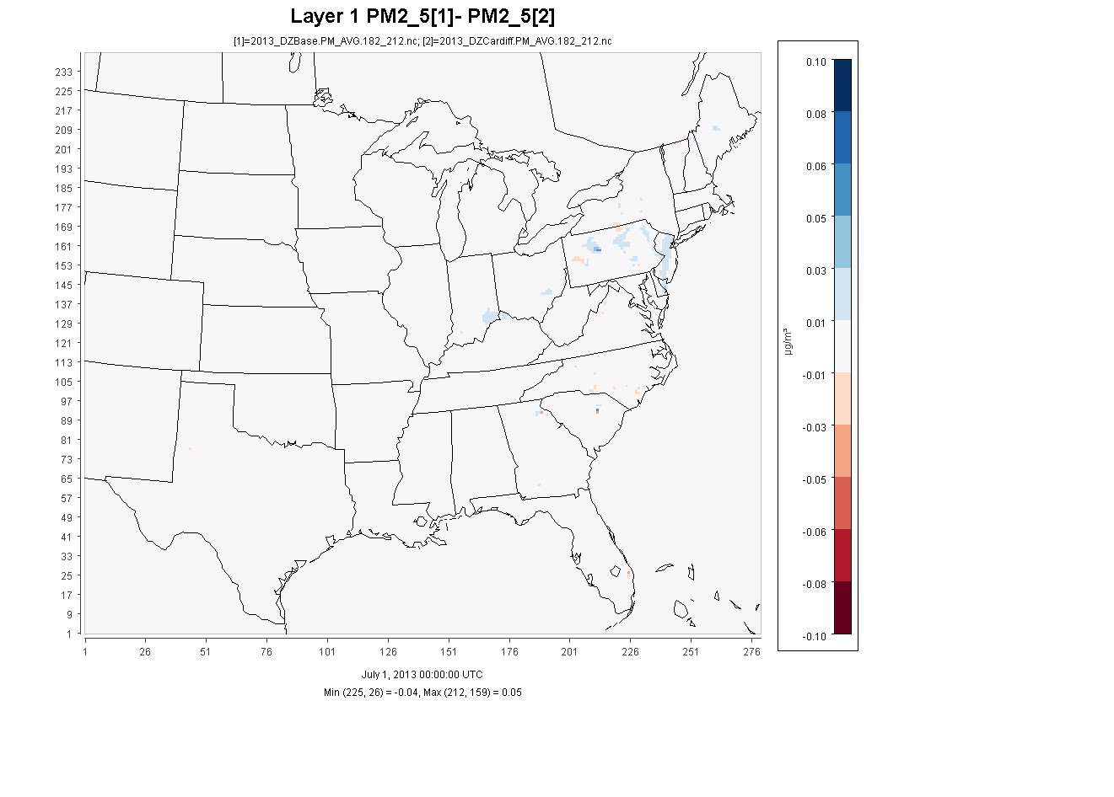
CMAQ July 2013 PM_{2.5} Daily Averages
0.1
0.05
0
-0.05
-0.1
µg/m³
Notes:
Animated gif of monthly average plots

Slide 22
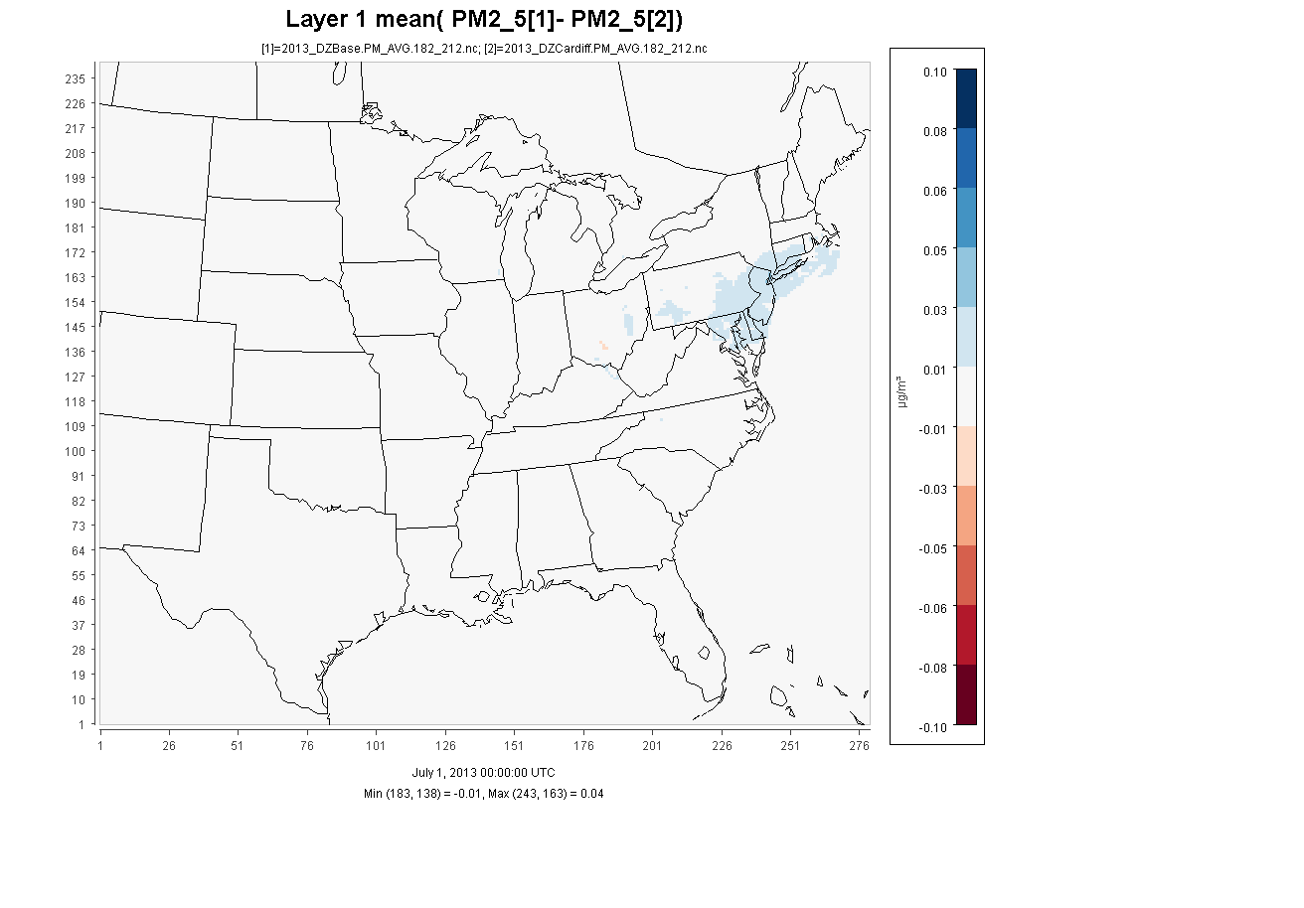
CMAQ July 2013 PM_{2.5} Monthly Average
0.1
0.05
0
-0.05
-0.1
µg/m³

Slide 23
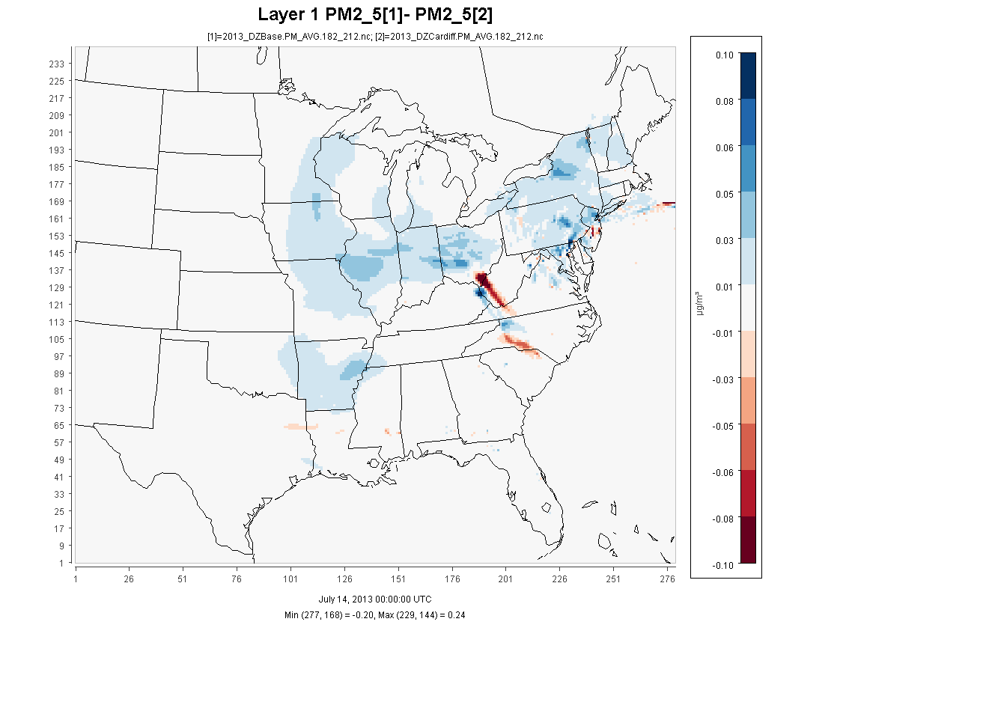
CMAQ July 2013 PM_{2.5} Hourly Maximum Decrease
0.1
0.05
0
-0.05
-0.1
µg/m³

Slide 24
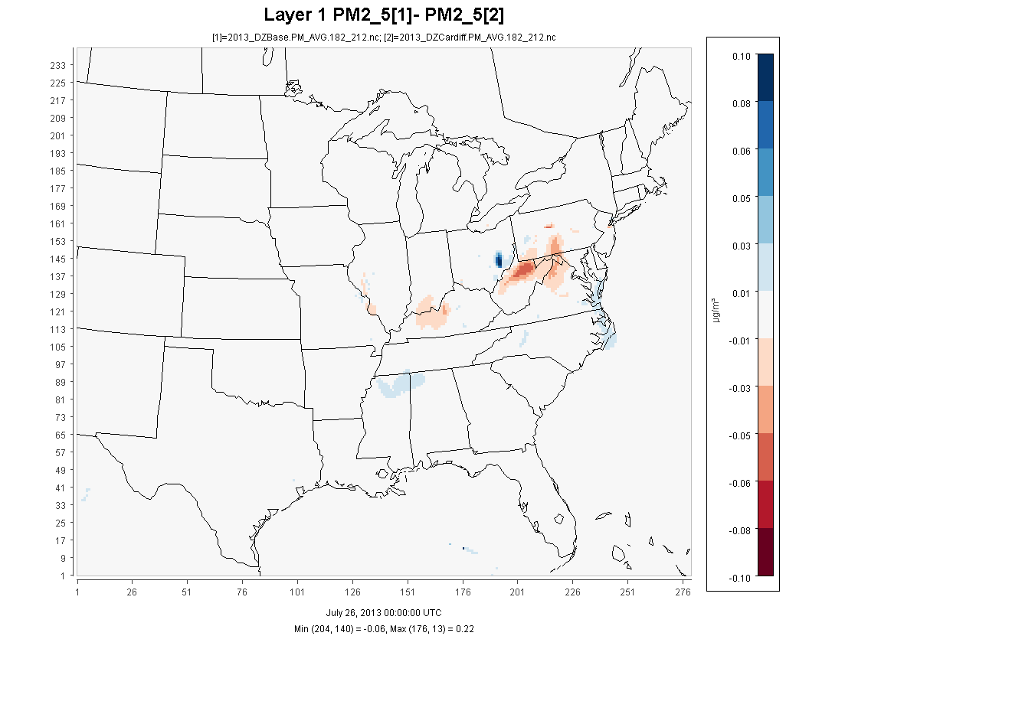
CMAQ July 2013 PM_{2.5} Hourly Maximum Increase
0.1
0.05
0
-0.05
-0.1
µg/m³

Slide 25
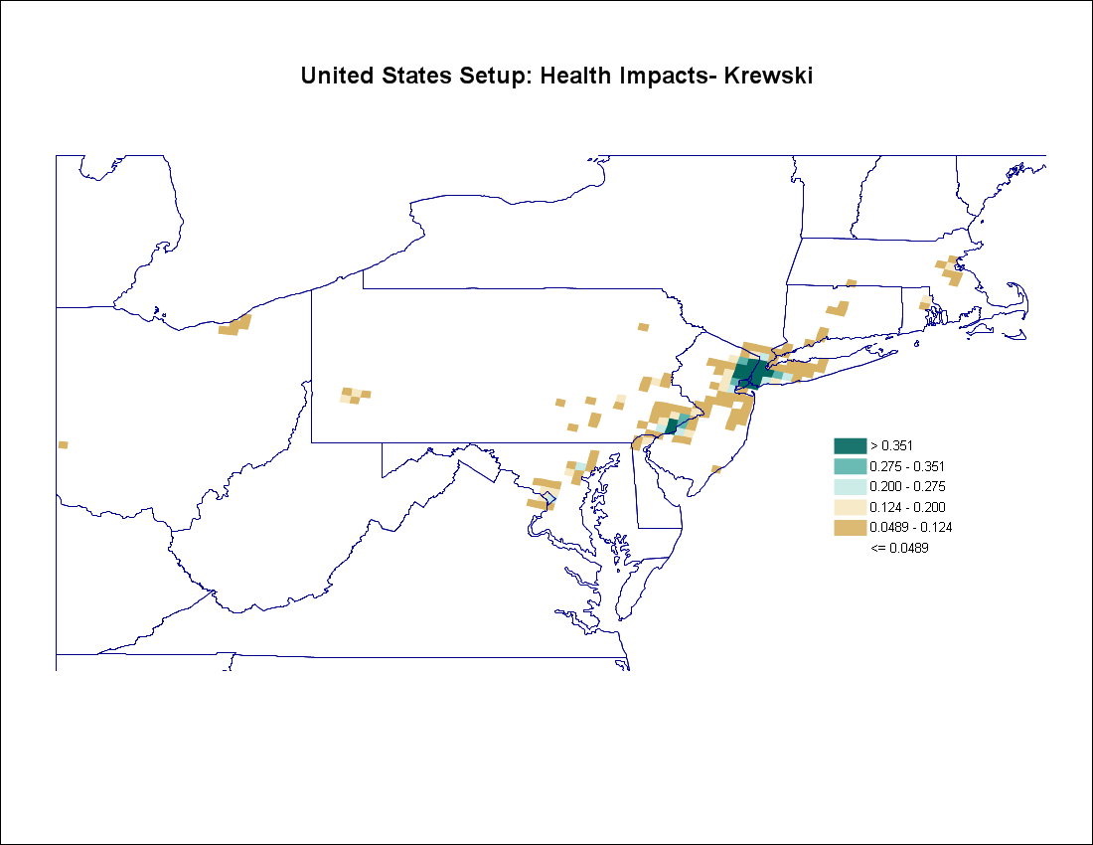
July 2013 Average PM_{2.5} Change in Mortality Incidence
Notes:
Important to note: BenMap employs functions of *24 hour average* PM2.5 … but health impacts can happen over much shorter time scales and this is lost in this (and other) analyses employing Ben Map so when we say it’s a lower bound incidence it’s not hyperbole

Slide 26
Health Benefits and Valuation
July 2013 Average PM2.5 Concentration Incidence and Valuation
Mortality, All Cause health function from Krewski et al. (2009)
Value of a Statistical Life (VSL) set at EPA Standard $5.5 million
Cost of AWC = $$
Impact | Annual Incidence | Valuation
Increased Mortality, All Cause | -0.45 | -$2,499,861
Reduced Mortality, All Cause | 47.73 | $256,100,043
Total Mortality, All Cause | 47.27 | $260,010,181
Fossil-fueled electricity generation not profitable without human health subsidy (Rodgers, 2016)
Notes:
Krewski – same coefficient as Pope et al.
The American Cancer Society (ACS) Cancer Prevention Study II (CPS-II)
ACS cohort to 18 years (1982 to 2000)
The cohort for the current study consists of approximately 360,000 participants residing in areas of the country that have adequate monitoring information on levels of particulate matter with an aerodynamic diameter of 2.5 µm or smaller (PM2.5) for 1980 and about 500,000 participants in areas with adequate information for 2000.
Long-term average exposure variables were constructed for PM2.5 from monitoring data for two periods: 1979–1983 and 1999–2000
cohort has been restricted to include only those who resided in U.S. metropolitan areas within the 48 contiguous states
Laden et al 2012 – Based off reanalysis of Harvard 6 cities study: Coeffecient about 3 times higher
Based off of eastern and midwestern cities:
Mass.,Tenn.,Ohio,Missouri,Wisconisin and Kansas
About 9,000 participants

Slide 27
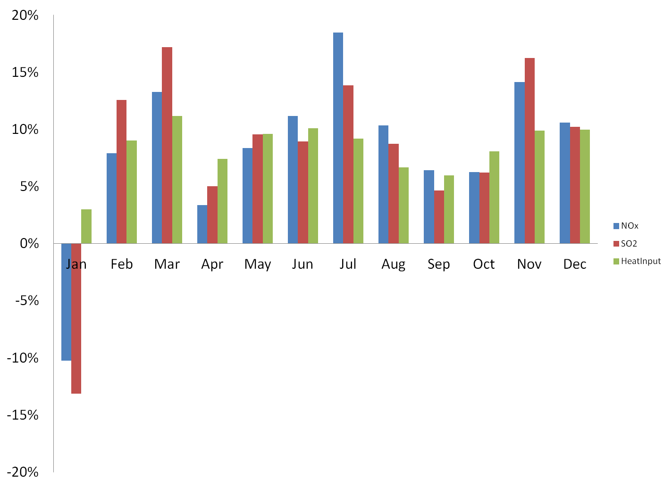
Monthly % Analysis of Basecase – Windfarm Differences

Slide 28
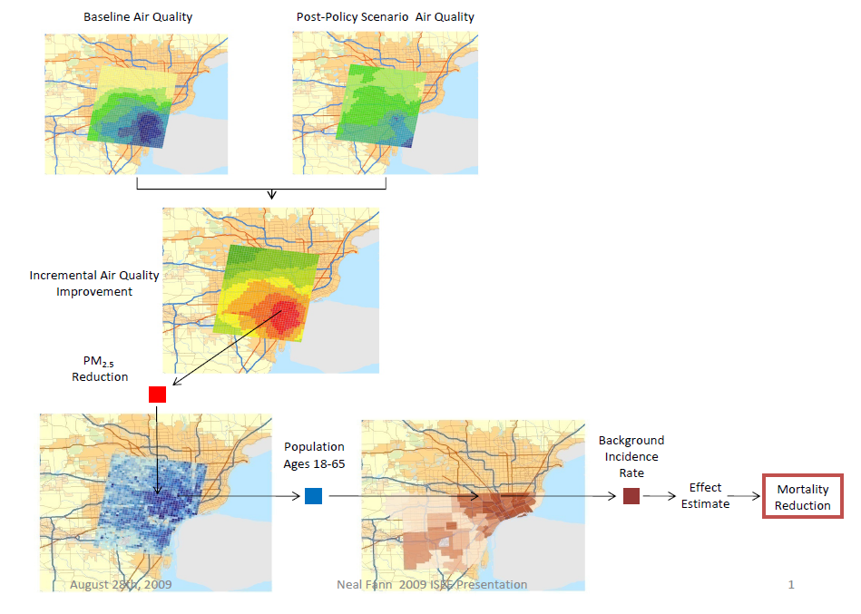
Evaluate health benefits and savings using the Environmental Benefits Mapping and Analysis Program (BenMAP)

Slide 29
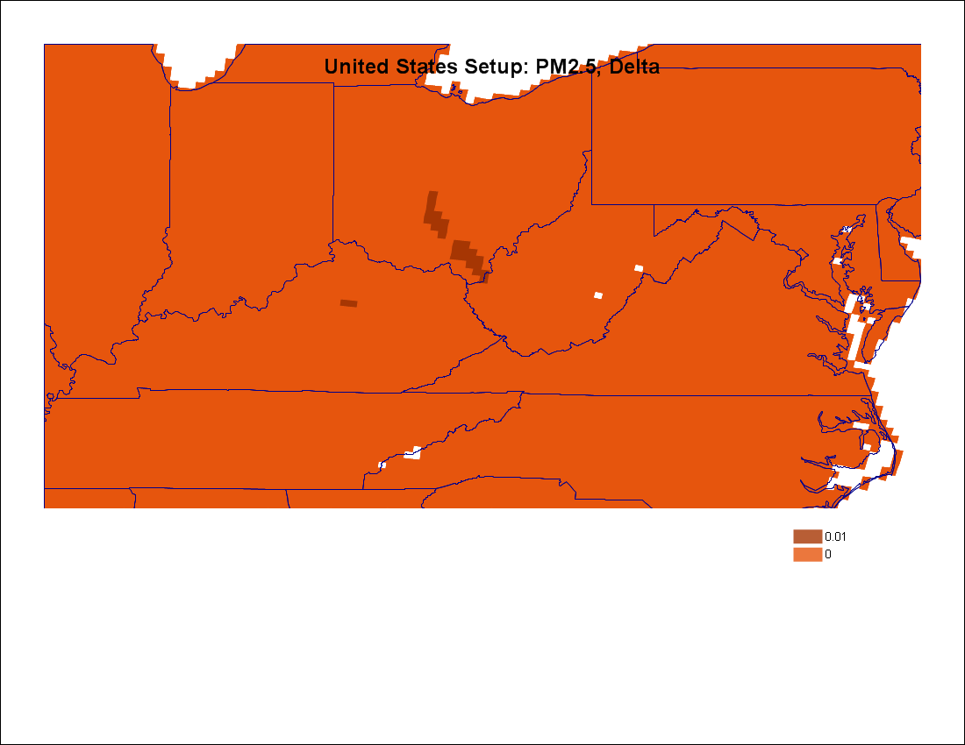
July 2013 Average PM2.5 Increases in Concentration

Slide 30
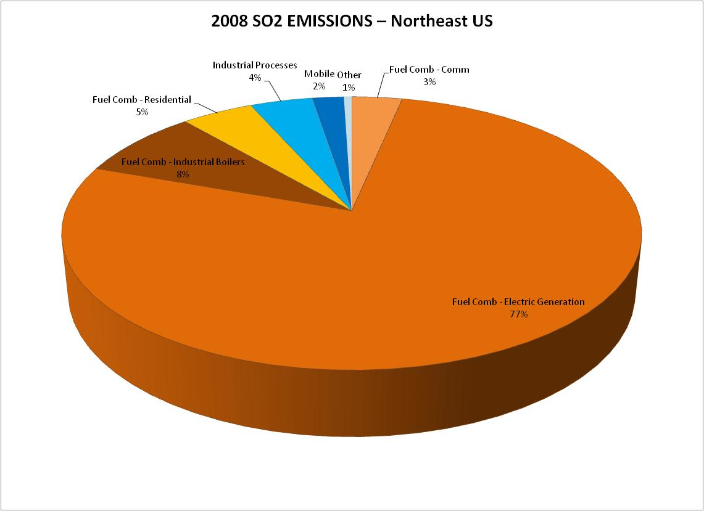

Slide 31
Notes:
Pay attention to EGU slice
Point out for the PJM REGION (not national)

