Slide 1
Evaluation of Operational and Experimental CMAQ
Ozone and PM http://www.emc.ncep.noaa.gov/mmb/aq
Jeff McQueen, Jianping Huang, Ho-Chun Huang,
Perry Shafran, Geoff DiMego – NCEP/EMC
Pius Lee, Li Pan, Daniel Tong –NOAA/ARL
Ivanka Stajner, Sikchya Upadhaya – NWS/STI
Amanda Sleinkofer – Millersville University
October 26, 2016

Slide 2
CMAQ weaknesses Identified
Overprediction of ozone in Eastern U.S. in Summer
  Especially along coastal cities (NYC, DC, Cleveland)
  →Update National Emission Inventory point sources to 2011 (project to 2016)
  → Reduce NOx emissions based on OMI satellite and AQS surface trends
  → Update CMAQ chemistry/biogenic emissions to EPA V5.0.2
Underprediction of particulate matter (PM) in Summer and near wild-fires
  → Update 9 year old USFS BlueSky smoke emission system
  → Introduce 24 h pre-analysis cycle to correct fire time mismatch with CMAQ initial time
Underprediction of Ozone and PM when strong fires are present outside CMAQ domain
  → Test NGAC full aerosol predictions for CMAQ lateral boundaries (delayed)
Overprediction of PM during winter-time stagnation episodes (cold, stable)
→ update emissions/chemistry as in bullet 1
Notes:
Problem with handling of marine boundary layer…not enough mixing ?

Slide 3
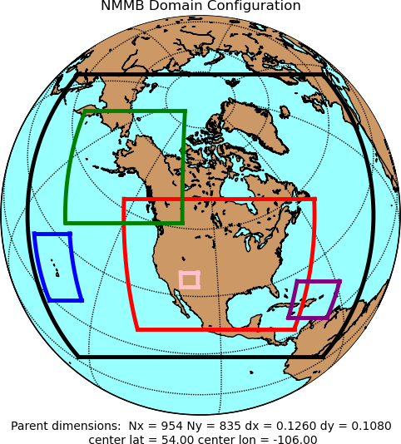
NAM Forecast System - Version 4 (Q2FY17)
Resolution Changes
  CONUS (4 km) and Alaska (6 km) nests → 3 km
  Sync AK and CONUS On-Demand Fire Weather nests → 1.5 km
Select Model Changes
  Updated microphysics → Improved stratiform precip., better anvil reflectivity, Reduced SW under clouds, reduce warm season 2-m T warm bias
  More frequent calls to physics → Physics/dynamics more in sync
  Improve effect of frozen soil on transpiration and soil evaporation → Improve cold season 2-m T/Td biases
  Adjustment to convection in 12 km NAM → Improve QPF
  Modify latent heat flux treatment → Improve visibility along CA coast
Data Assimilation:
  DA cycles for 3 km CONUS and AK nests → Much less ‘spin-up’ time
  Use of Lightning and Radar Refectivity-derived temperature tendencies in initialization
    Improved short-term forecasts of storms at 3 km
    Improved 00-12 hr QPF
  New satellite radiances, satellite winds → Improved Inital Conditions
DA
3 km
1.5 km
12 km
DA
DA: Data Assimilation Cycle
Courtesy Eric Rogers, EMC
Notes:
In addition to CMAQ, Several important NAM changes were made

Slide 4
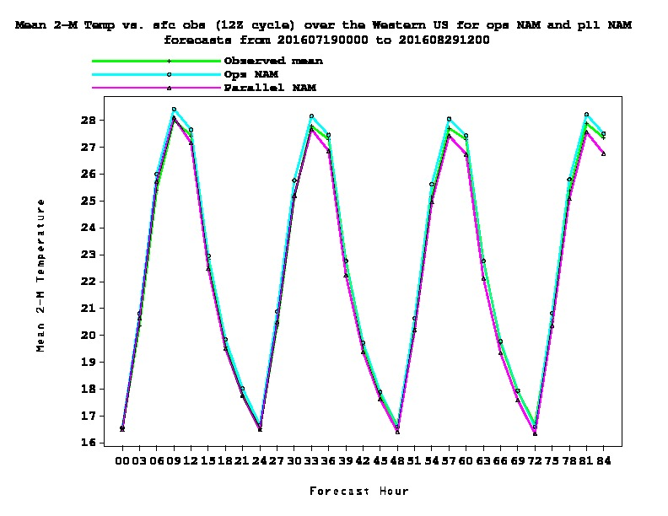
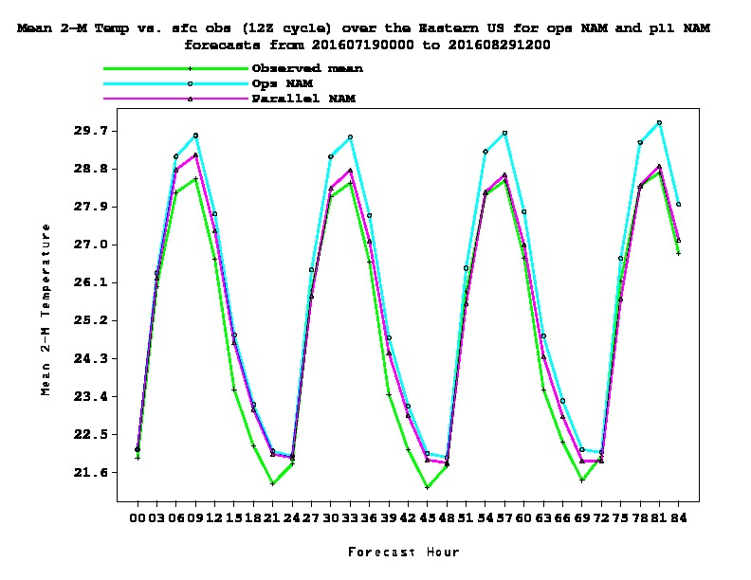
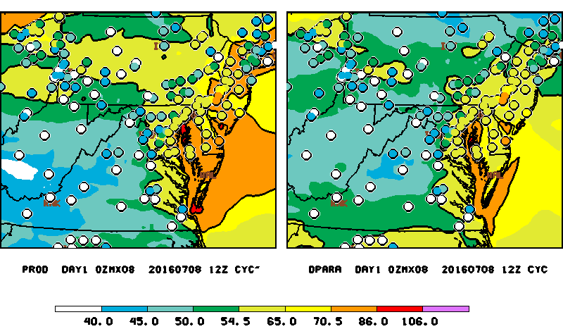
Upcoming NAM Q2FY17 Upgrade
WEST
EAST
2 m Temperature
NAM - CMAQ V4.6
NAM-X - CMAQ V4.6
Notes:
Improved 2 m temperature from reduced short wave under clouds and improved O3 esp in Eastern US
Ozone Overprediction reduced in PA, NJ

Slide 5
July 2016 NRT CMAQ V4.6 vs V5.0.2
1 h avg Diurnal Ozone
WEST
EAST
CMAQ V5.0.2 NAM-X: improvement in ozone over-prediction over the East
WEST
CMAQ V5.0.2 NAM-X: Strongest underestimate over West
Meteorological impact nearly as large as CMAQ/Emissions upgrade
Notes:
Overall statistics averaged by forecast hour for July 2016 Dashed red line v5.02 best over east
But more underprediction in the west (wild fire impact again ??)
Still strong overprediction at night
Look at the dashed blue line…why did the new nam overpredict over Western U.S. → lower pbl ??, less cloudiness

Slide 6
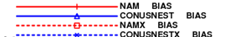
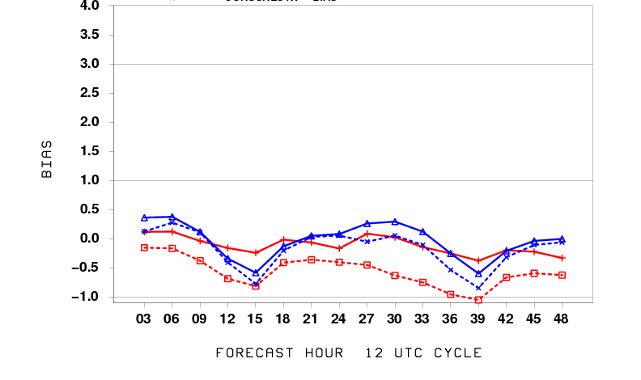
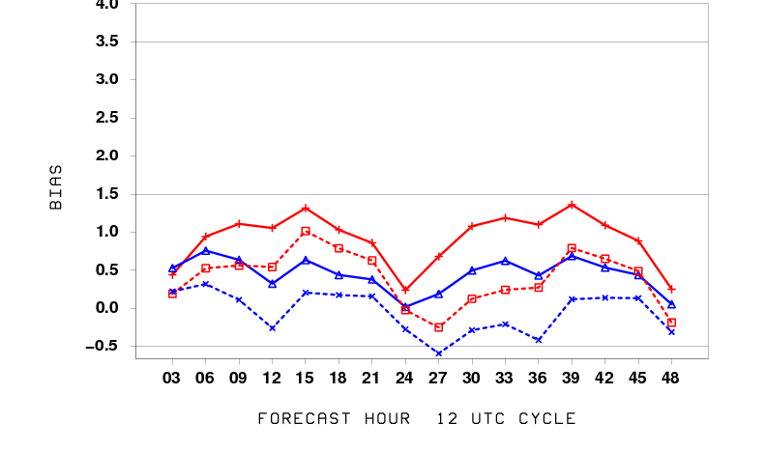
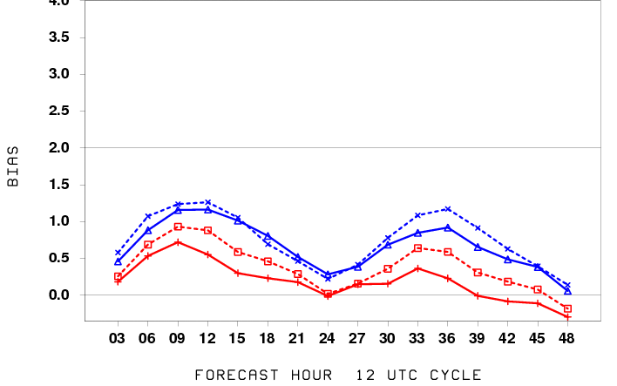
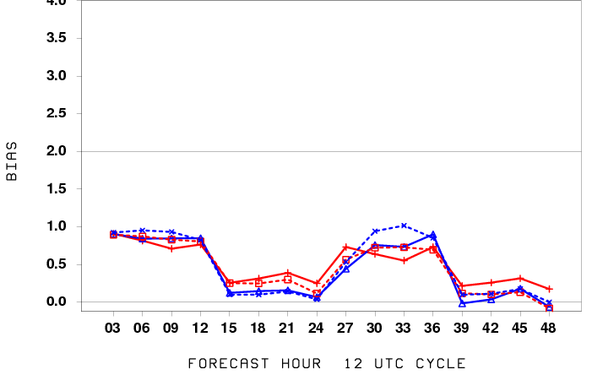
NAM vs NAM-X diurnal Bias
July 2016
Temperature
(deg. C)
East
West
Dewpoint
(deg. C)
Warm bias in East reduced with NAM-X correlates well with ozone improvements
Cold bias in West
Moist bias over East and West esp with 4km Nest
Notes:
Over east averge t erroro reduced with NAM-X resolution increase alone show similar improvement in temp
Cold bias with NAMX over west…look at winds/pbl/cloud cover

Slide 7
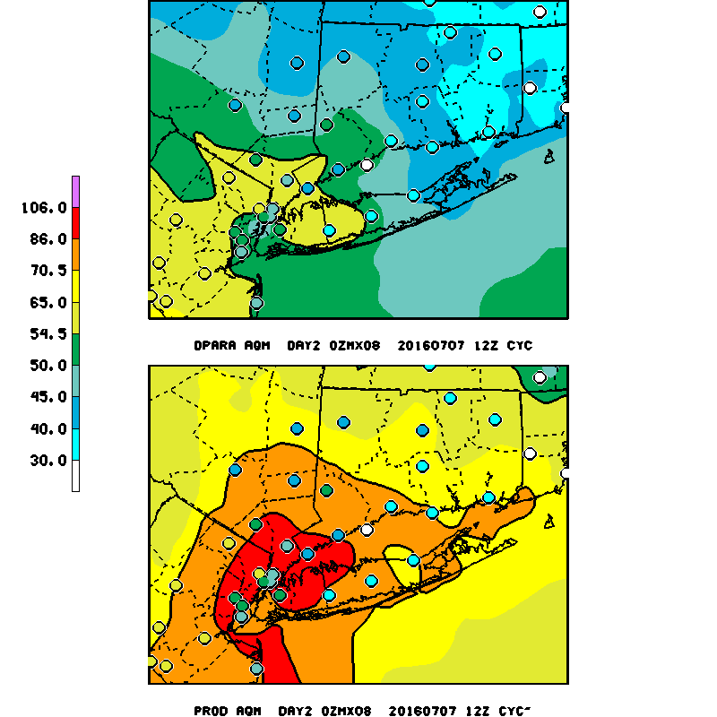
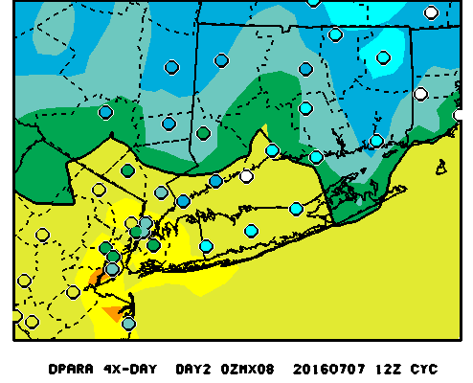
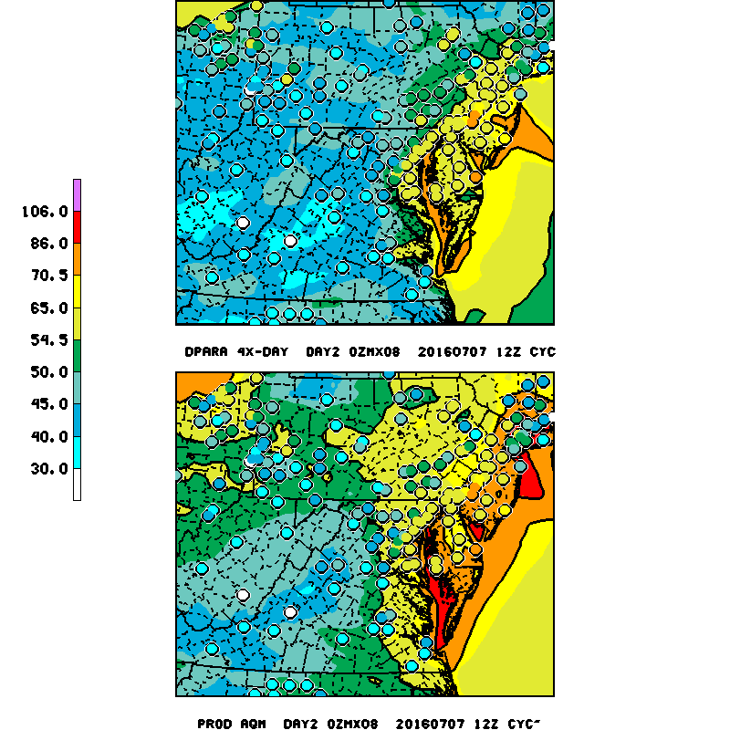
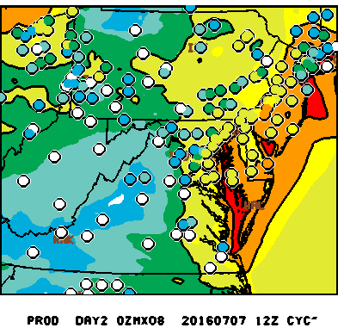
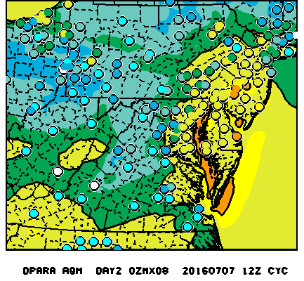
Summer 2016 False Alarm
July 07, 2016 12Z run Day 2 8h Max ozone forecast
Oper-NAM
Oper - NAM-X
V5.0.2 NAM-X
Use of NAM-X provides improved forecasts over NY Metro area
Notes:
Ozone Observations are colored circles with code yellow, code orange indicating poor aq
V4.75 NAM-X : influence of NAM meteorology
Good improvement over NY, NJ, Delmarva
It appears that most of the reduction in ozone is due to meteorology
V5.0.2 : influence of CMAQ 5.0.2

Slide 8
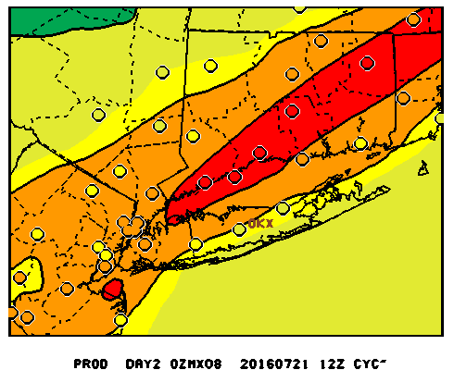
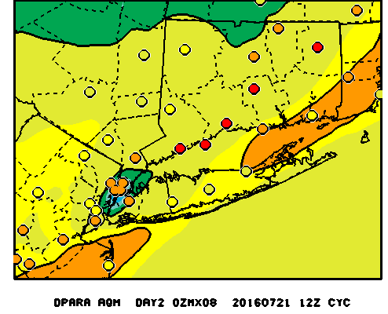
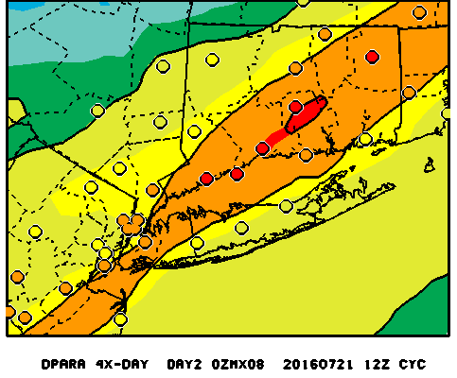
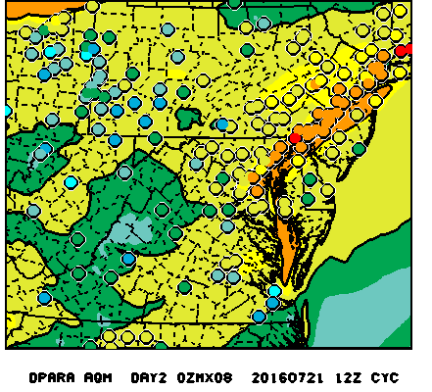
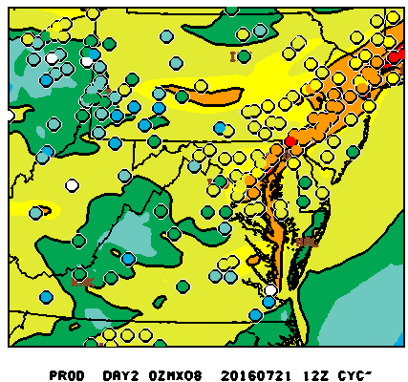
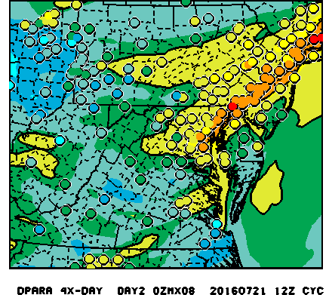
Summer 2016 NRT prediction
July 21 , 2016 12Z run Day 2 8h Max ozone forecast
Oper - NAM
Oper NAM-X
V5.0.2 NAM-X
NAM-X CMAQ V5.0.2 results in best forecast
Use of NAM –X Oper strong underprediction
Notes:
Ozone Observations are colored circles with code yellow, code orange indicating poor aq
Here the NAM-x run did worse over NYC with the V5.0.2 and NAM-X best
Likely the NAM-X incr cloud cover hurt the forecast

Slide 9
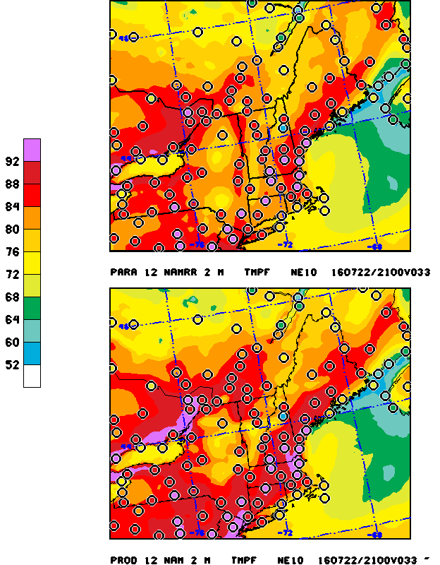
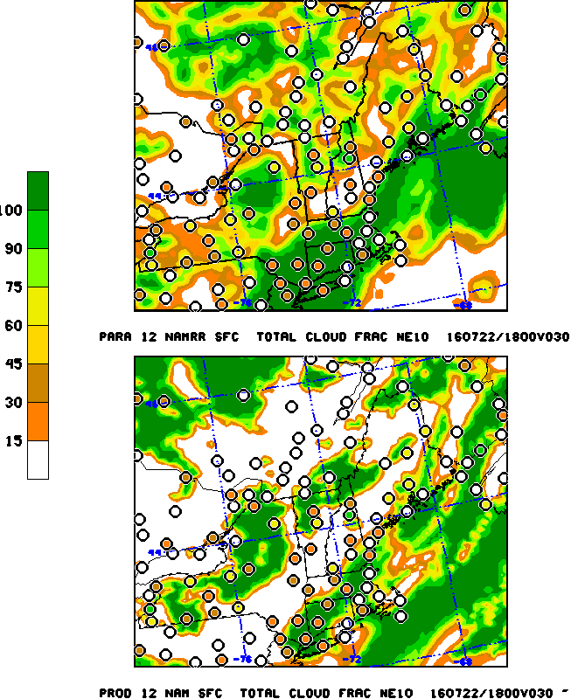
Summer 2016 NRT prediction
July 21 , 2016 12Z run 33h NAM vs NAM-X
NAMX
2m Temp
% cloud cover
NAM
NAM-X too cool and cloudy for this case
Notes:
Met for this case shows the NAM-X to be too cool and cloudy obs >92, forecast 10-15 degrees too cool

Slide 10
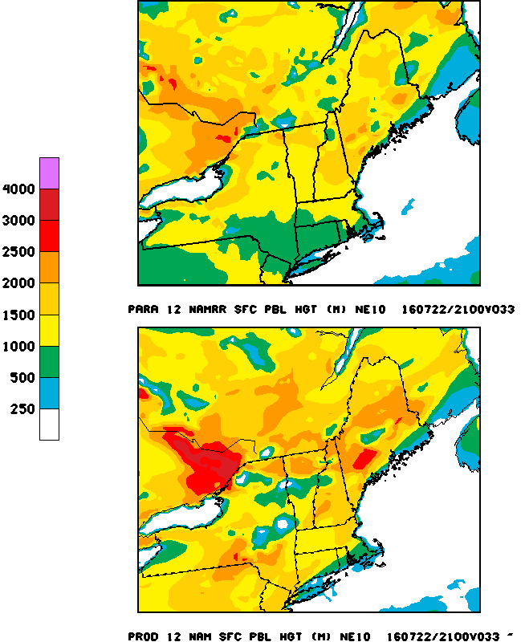
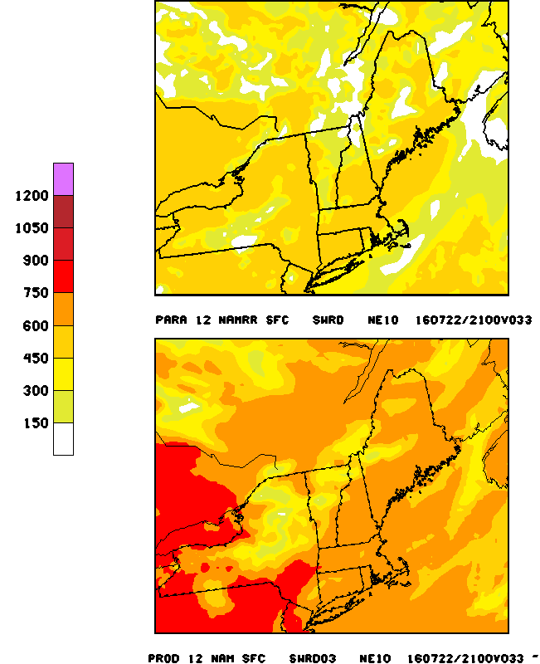
Summer 2016 NRT prediction
July 21 , 2016 12Z run 33h NAM vs NAM-X
PBL Hgt (m)
Downward SW Rad (W/m2)
NAMx lower PBLH, less incoming SW
Notes:
Too much cloudiness resulted in much lower PBL and less SW
Pbl <500-1000 m compared to 1-2 km in operational NAM
ACTION: add PBL height fvs verification

Slide 11
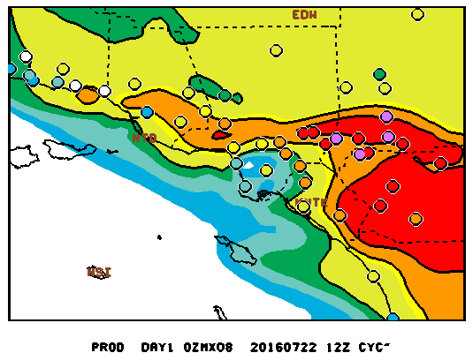

Summer 2016 NRT Prediction
July 22, 2016 12Z run Day 2 8h Max ozone forecast
V5.02 more ozone formation in NOx saturated California
http://www.emc.ncep.noaa.gov/mmb/aq/cmaq/web/html
Notes:
Looking at western u.s. behavior….we see improvement in VOC limited areas of LA basin......believe Reduced Nox helps performance

Slide 12
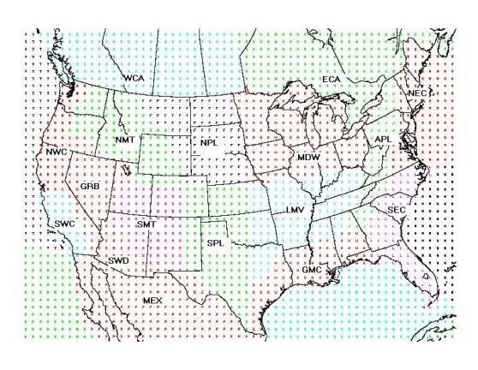
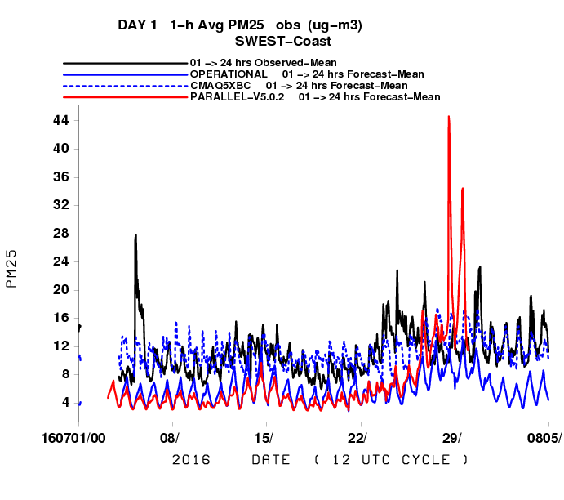
JULY 2016 NRT Prediction
1 h avg PM : South West U.S. Fires
South West Coast
Underprediction (except Bias corr) in general BUT :
Overprediction of wild fire smoke events in AM
  No diurnal emissions profile used
Notes:
Oper and v5.0.2 para strong underprediction esp in late afternoon early evening. Dashed blue line bias correction has good agreement overally but bcan miss exceptional events. The overprediction primarily in the early morning when dumping too much smoke into a shallow boundary layer

Slide 13
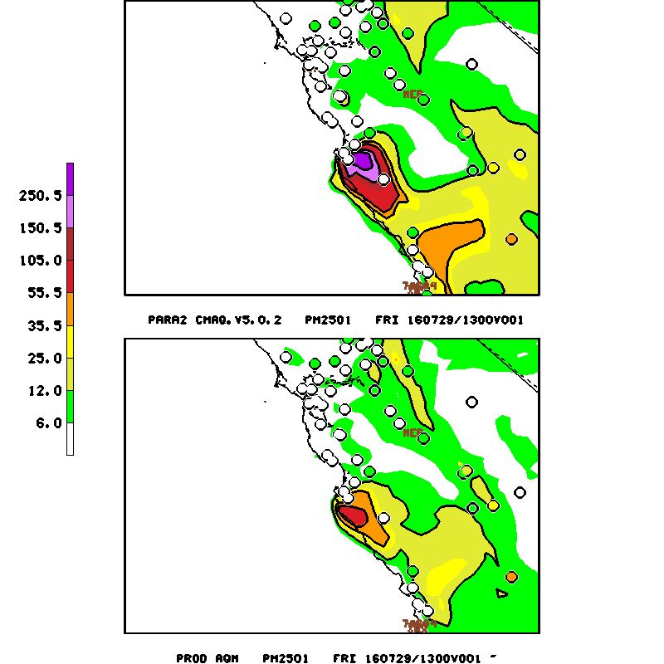
July 29, 2016 Big Sur Fire forecast and comparison to PM measurements
Smoke Emissions
- Location
Magnitude
Ejection height
Diurnal evolution
Notes:
Timing of emissions incorrect or too much emitted in early morning

Slide 14
Summary
  V5.0.2 Ozone w/ reduced NOx emissions
    Improvement correcting over-prediction esp along coasts
      Long Island Sound, Lake Erie/Michigan and Ohio Coastline
    Much improved for Southwest and marginal or non-exceedences
    Missed exceedences in NE
  PM
    Positive impact near forest fires
      Updated BlueSky and 24 h pre analysis run
      Underprediction when external sources (Saharan dust, Canadian fires) are impacting CONUS
      Emission timing and ejection height uncertainties
  Updated NAM alone strongly improves ozone fcst
    Amount of incoming radiation and temperature under clouds critical for photolysis, biogenic emissions, mixing

