Slide 1

2014 National Emissions Inventory
Rich Mason
EPA Office of Air Quality Planning and Standards
Air Quality Assessment Division
15th Annual CMAS Conference, Chapel Hill NC
Emissions Inventories, Models and Processes Session
October 24, 2016

Slide 2
Overview
2014 National Emissions Inventory (NEI)
  Goals, Basic Background, Timeline & EPA and reporting agencies roles
  Technical improvements since 2011 NEI
  Summary comparisons to 2011 NEI
  Next steps

Slide 3
NEI Goals
Complete
Represents the year of the inventory
Uses best available information
Transparent - includes the emissions origin
(who provided, factor, activity, method)
Timely
Notes:
Complete: A comprehensive and detailed estimate of air emissions of criteria pollutants, criteria precursors, and hazardous air pollutants from air emissions sources. NEI includes detailed point and process-level estimates for industrial sources, point source for wildfire and prescribed burning, and county-level totals for disperse source types including residential, mobile, biogenic, and other source types.

Slide 4
NEI Basics
The full NEI is on a 3-yr cycle (e.g. 2008, 2011, 2014)
  Point sources (facility-process for ~87,000 facilities)
  Nonpoint and mobile sources (county-process)
  Fires (daily/point)
  Biogenic soil and vegetation (county)
States, locals, and tribes (SLTs) are required to submit CO, SOX, NOX, VOC, PM10, PM2.5, NH3,and Lead.
  Basis is National Ambient Air Quality Standards (NAAQS) parts of the Clean Air Act (CAA)
  Use major source emissions thresholds for “point”. SLTs can go lower.
Hazardous Air Pollutants (HAPs) and Greenhouse Gases (GHGs) can also be voluntarily submitted
  EPA augments the data to make HAPs more complete
  Toxics Release Inventory helps (but only as facility-total stack and fugitive, not process)
  GHG emissions provided for fires and mobile data categories only –not provided in point and nonpoint inventory due to reconciliation issues
EC (Black Carbon), OC (Organic Carbon) and Diesel PM are computed by EPA and for the first time, are provided in the 2014 NEI.

Slide 5
NEI Timeline for the 2014 NEI
Release reporting code updates and point emission factors
Opportunities
to coordinate
Quality Assurance (QA), Feedback, & Augment
2015
2016
2017
Use and Review
QA
Use
EPA
Develop and release emissions tools/methods
2014 NEI v1
Corrections & improvements
2014 NEI v2
Emissions Year Ends
Prepare Emissions
SLT Submission Deadline
Review and Comment/Submit
States/Locals/
Tribes
Industry Reports to SLT
Review and Comment
Industry

Slide 6
SLT and EPA roles for NEI
EPA creates and provides emissions factors and methods
SLTs are responsible for providing the emissions estimates and choosing the methods to apply
  Required data fields in the Air Emissions Reporting Rule (AERR, 40 CFR Part 51, Subpart A)
We allow SLTs to meet their obligations by accepting EPA estimates where we have them
In general, when we “build” the NEI, SLT data used preferentially over EPA-generated data
Emissions Inventory System (EIS) assists EPA and SLTs in building and quality assuring the NEI
EPA is responsible for final quality control and ensuring that the inventory meets goals of NEI and needs for use by EPA and others

Slide 7
2014 NEI Nonpoint Approach Updates
Each sector has a database or a spreadsheet of EPA defaults that SLTs can review
New NOnpoint Method ADvisory (NOMAD) Committees:
  Oil and gas, residential wood combustion (RWC), dust, gasoline distribution, agricultural ammonia, mercury categories, and overall nonpoint
  Generally well-attended, improved collaboration resulted in tools more useful to SLTs
Nonpoint survey added
  More transparency on what SLTs intend to submit for nonpoint
  SLTs can indicate which sectors they are accepting EPA estimates
  Helps with point vs. nonpoint expectations
  Generates informed discussion between EPA and SLTs
  Documents SLT use of EPA estimates

Slide 8
2014 NEI v1 Nonpoint Sectors Improved
Oil and Gas
Residential Wood Combustion (RWC)
Livestock and fertilizer ammonia
Agricultural burning
Industrial, commercial, institutional fuel combustion
Solvents
Asphalt paving
Open burning
Biogenics
Added backyard barbeque emissions

Slide 9
2014 NEI v1: Oil & Gas and RWC Improvements
Oil and Gas Updates
  New version of Tool includes Subpart W (activity data and GHG-reporting coordination) and differentiates conventional vs unconventional processes
  More comprehensive and detailed source coverage (SCCs)
  Improved Emissions Factors to counties
  Improved reconciliation to point submittals
  Better alignment with OAP GHG EI and GHG RP factors and activity data
Residential Wood Combustion Updates
  New appliance profiles and burn rates based on Census Region/Division & climate zones regression analysis of EIA survey data
  Improved Urban/Rural distribution of appliances, burn rates based on census block/tract information
  Corrected VOC Emission Factor for pellet stoves
  Incorporated information from OR and MN surveys to improve appliance profiles
  Includes retirement rates for some appliances
  Improved reporting features and flexibility for SLTs to revise input assumptions

Slide 10
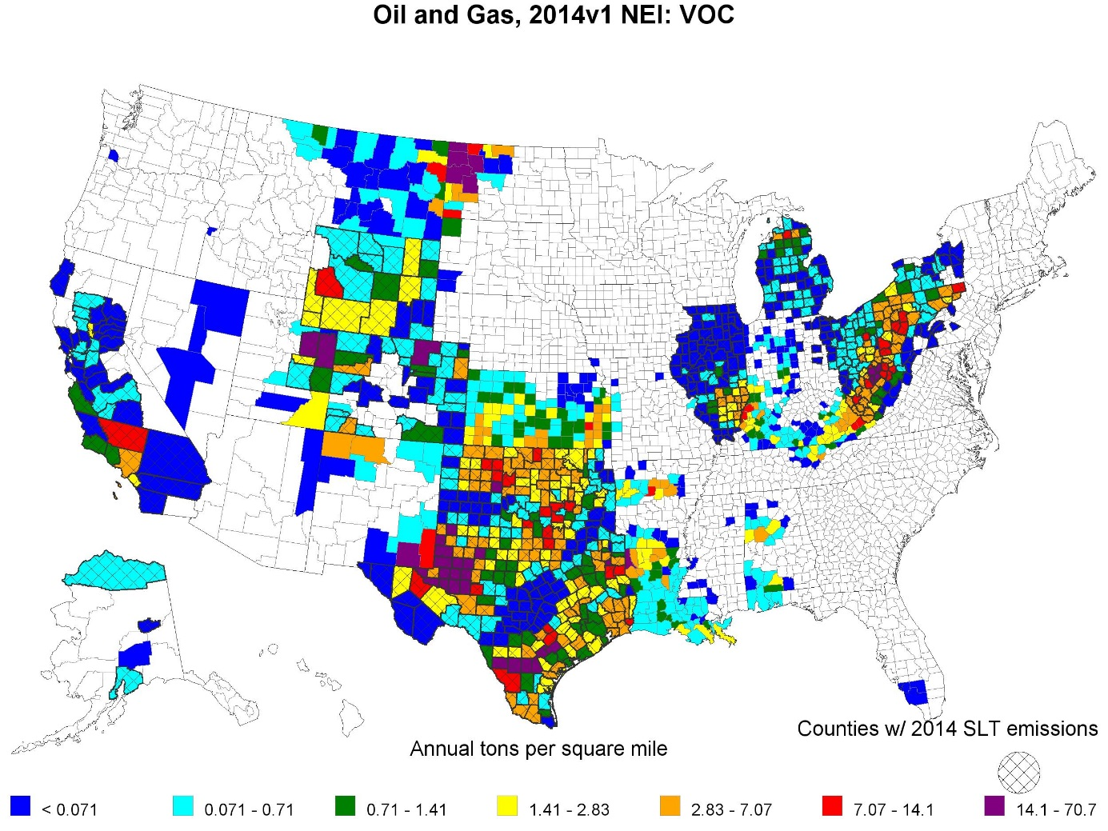
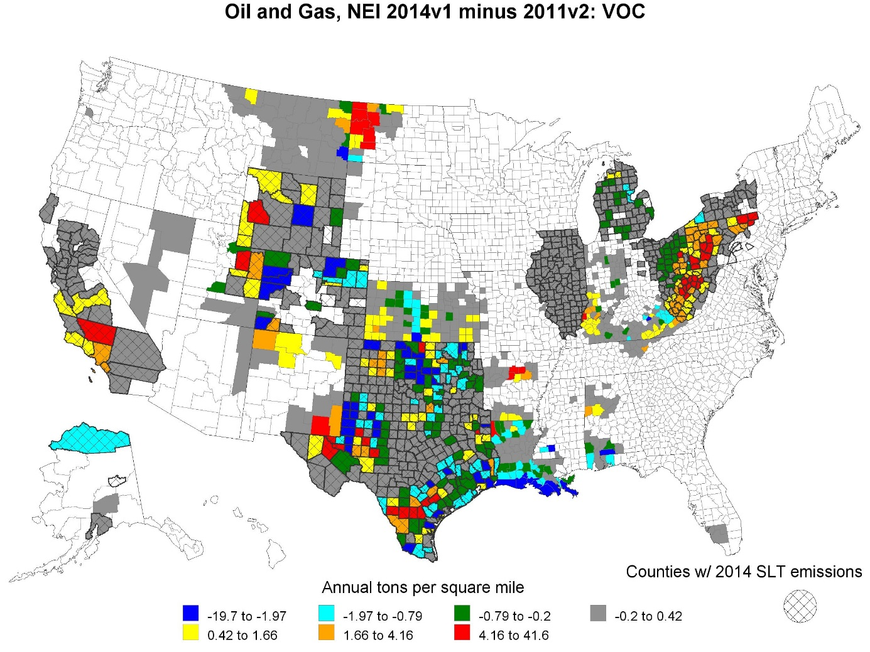
NEI Oil & Gas VOC
2014 (left), 2014 minus 2011 NEI (right)

Slide 11
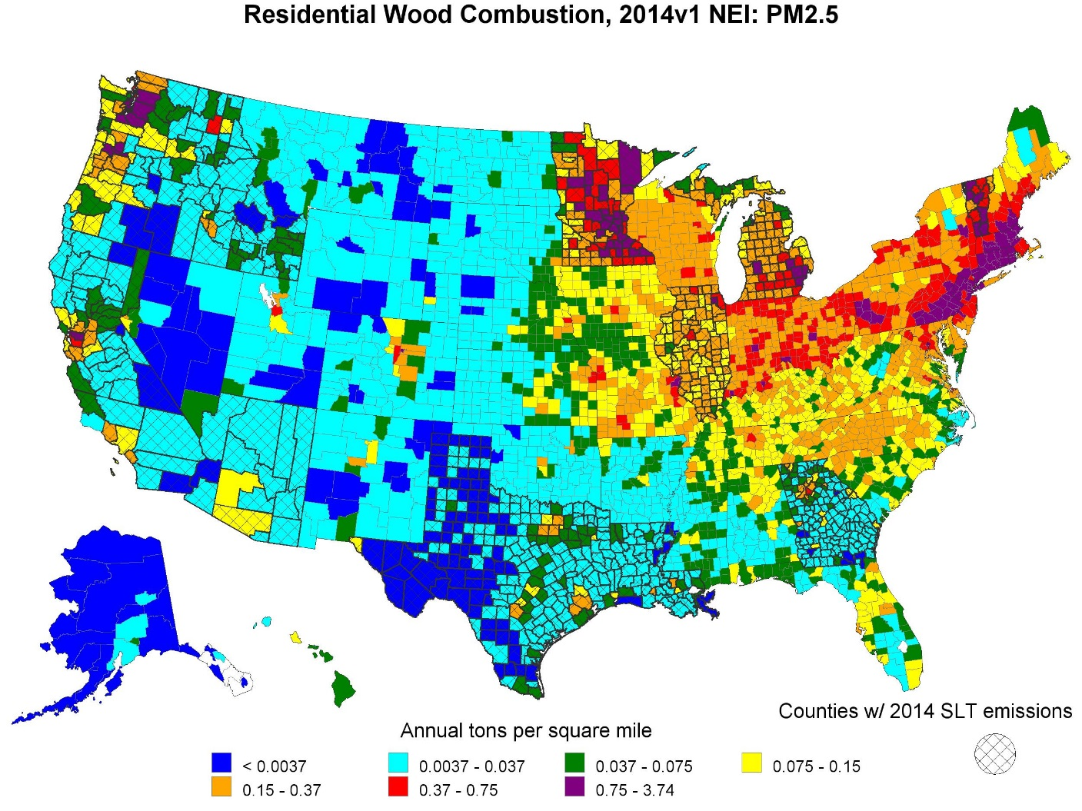
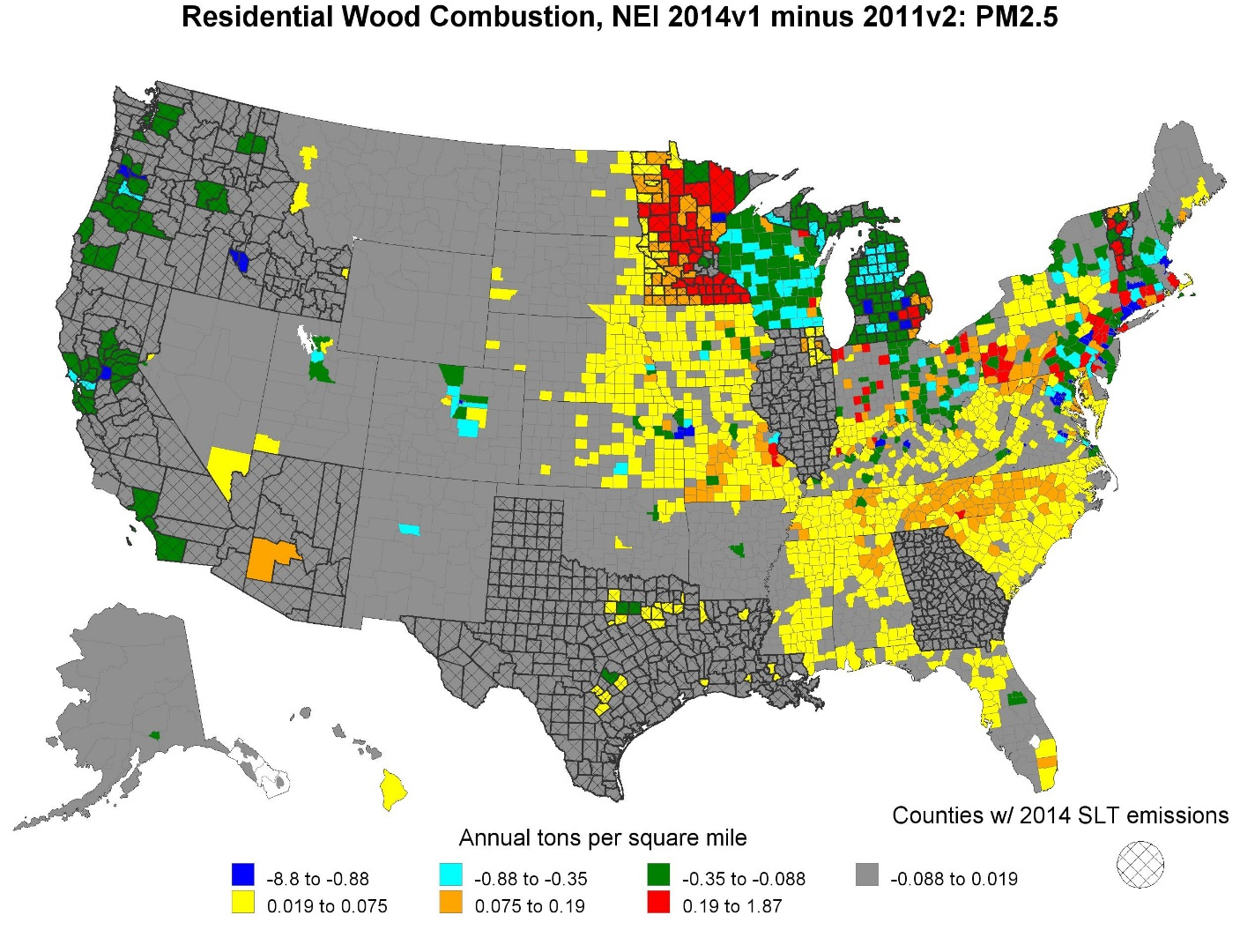
Residential Wood Combustion PM2.5
2014 (left), 2014 minus 2011 NEI (right)

Slide 12
2014 NEI v1: Nonpoint, Ag-related Improvements
Agriculture Sectors –New methodologies
  Livestock: Coupled 2014 meteorology/2012 (latest available) USDA activity data and process-based Farm Emission Models for most animal types
  Fertilizer: “Bi-directional flux” approach with coupled 2014 meteorology/air quality model/land use models
  Tilling: Improved pasture land assumption, refined silt content estimates
Ag Burning
  Algorithm took into account past NEI comments –eliminating most of the false detects that occurred in the 2011 NEI
  Accounting for snow cover
  New method allows intra-annual and annual changes in crop land use
  Now includes grass/pasture burning –will ensure no double-count w/ wildland fires
Ag Pesticides: now includes HAPs

Slide 13
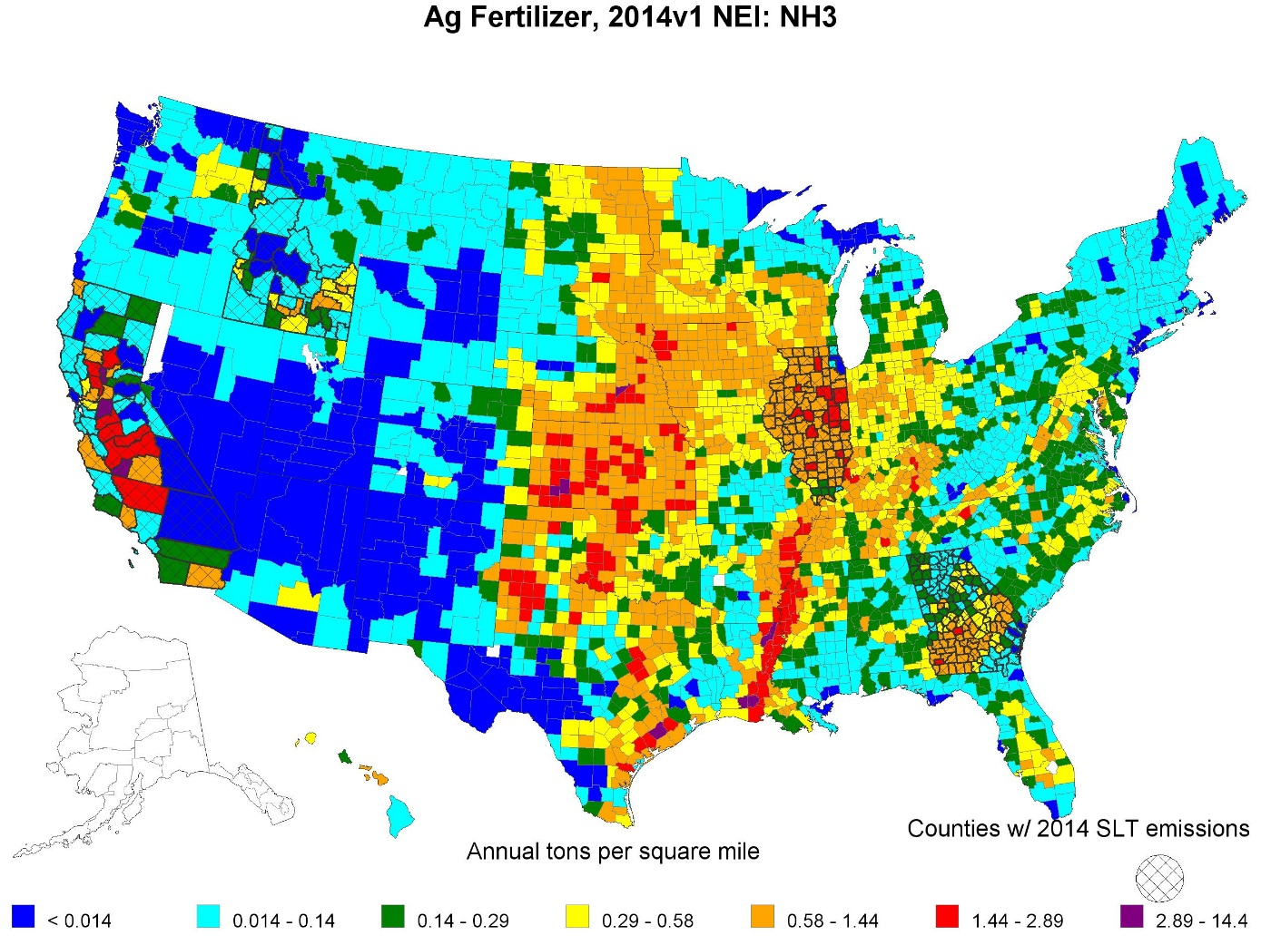
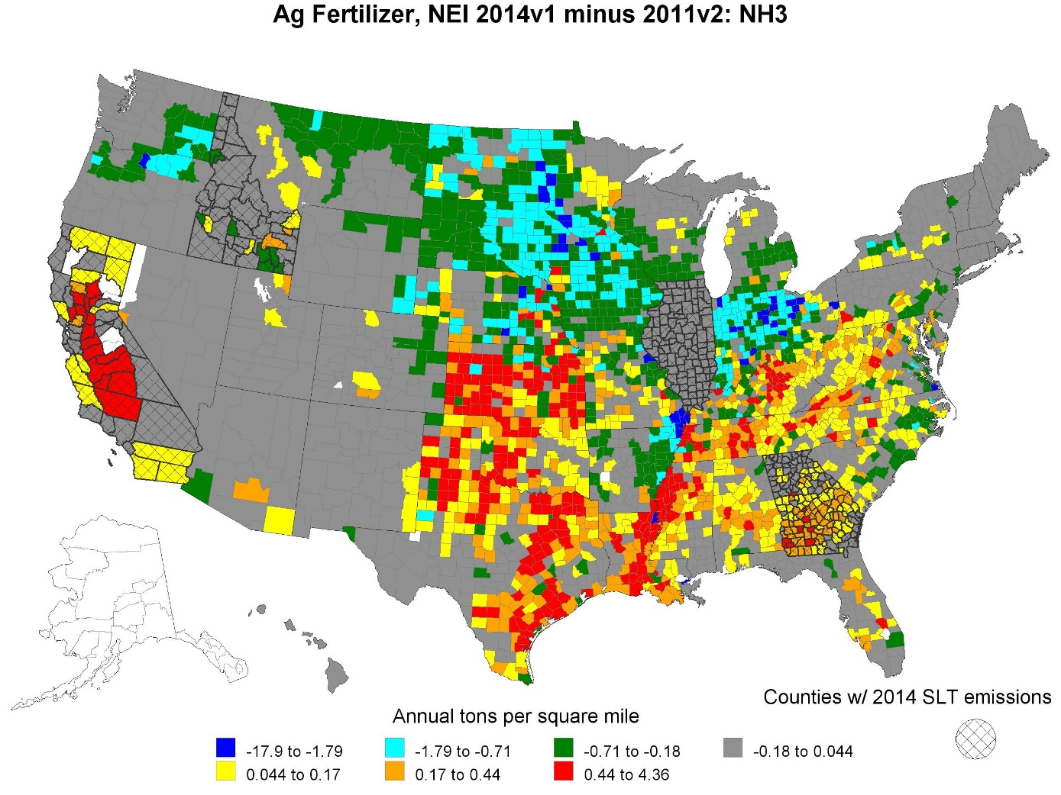
Fertilizer NH3
2014 (left), 2014 minus 2011 NEI (right)

Slide 14
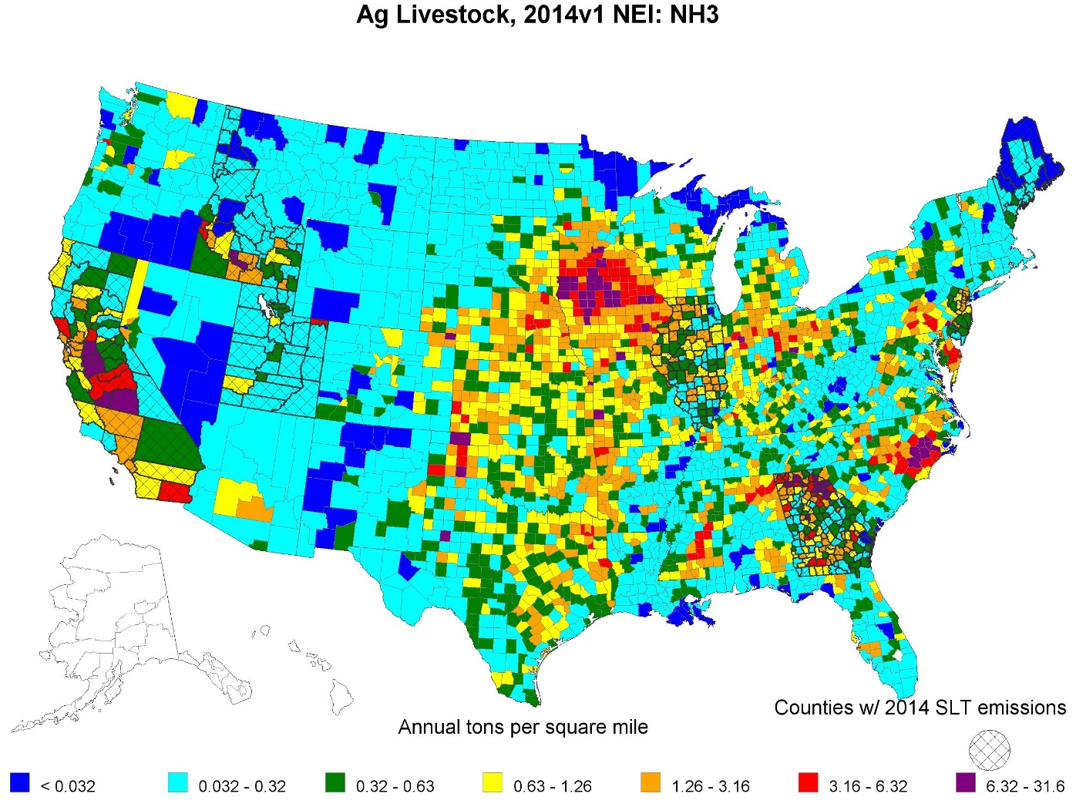
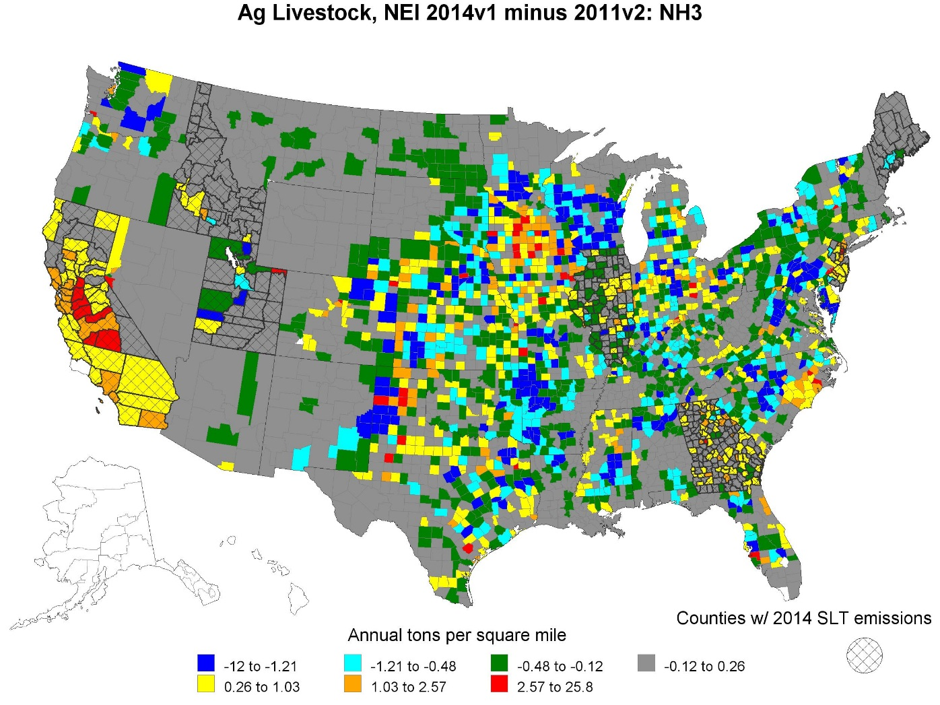
Livestock NH3
2014 (left), 2014 minus 2011 NEI (right)

Slide 15
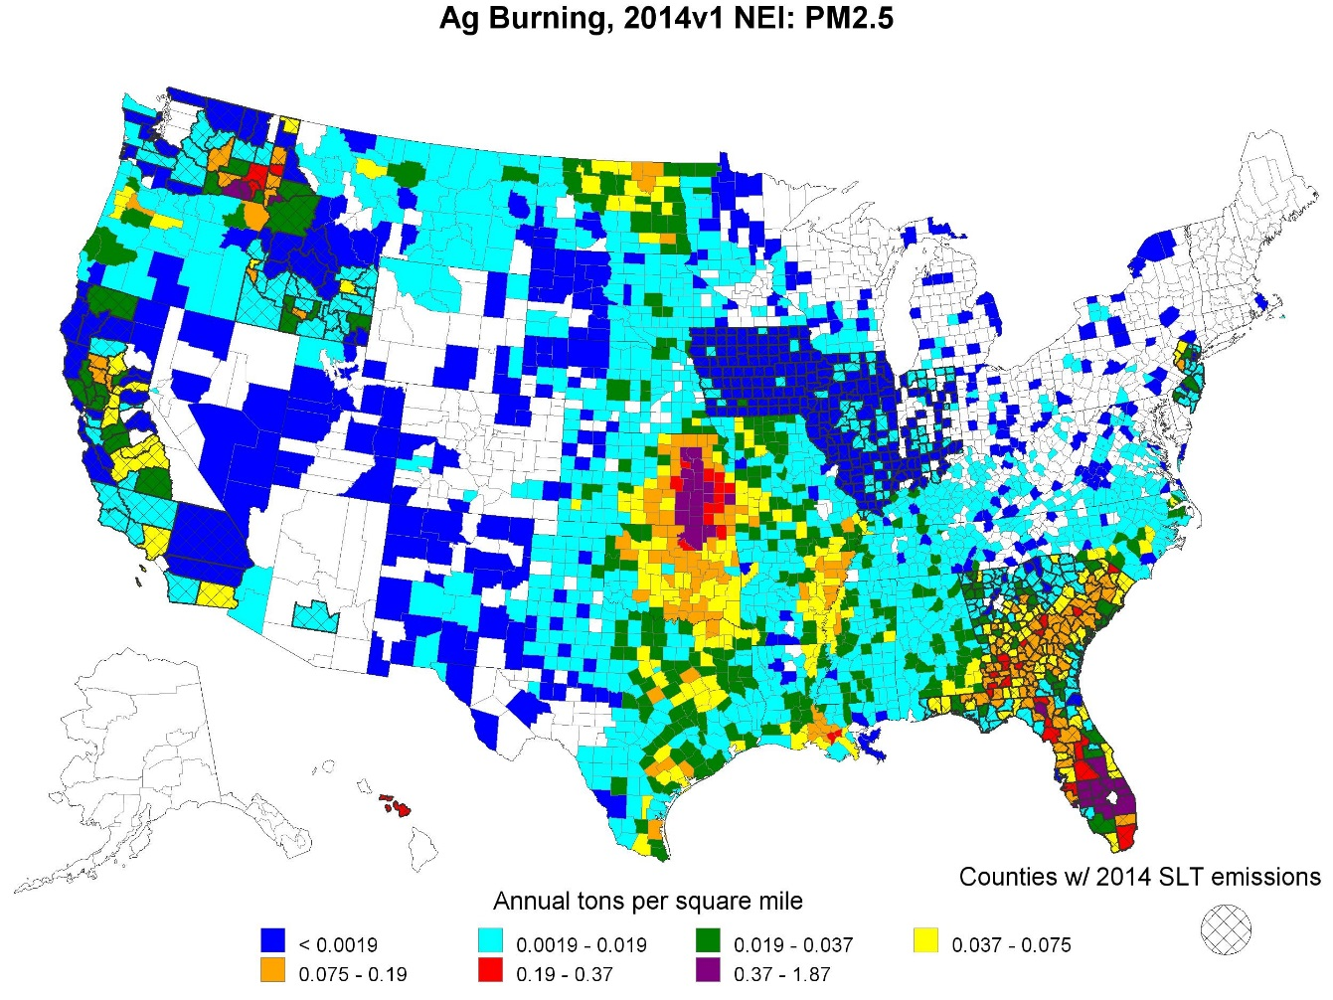
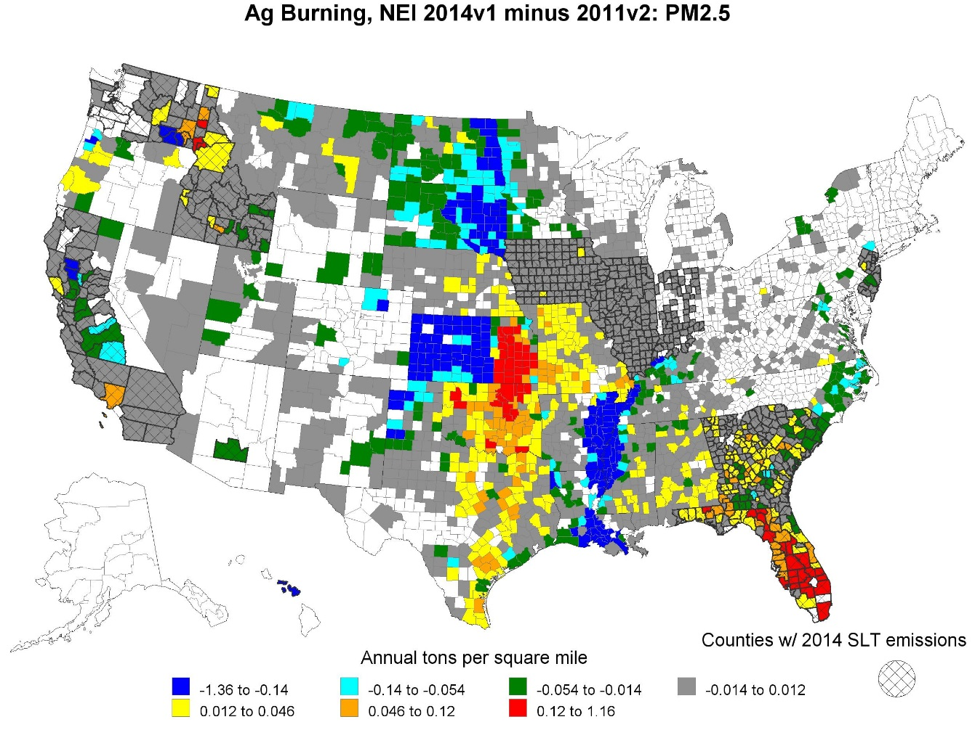
Ag Burning PM2.5:
2014 (left), 2014 minus 2011 NEI (right)
2014 NEI v1: new EPA/ORD method, including new grass/pasture land SCCs; accounts for snow cover, filter-out false-detects.
2011 NEI v2: included LADCO zero-out and lacked grass/pasture SCCs

Slide 16
2014 NEI v1:
Other Nonpoint Improvements
ICI Fuel Combustion (new)
  Improved point reconciliation with point submittal
  Updated boiler/engine split
  Customizable input parameters for sulfur and ash contents and Commercial/Industrial splits
Solvents (new)
  Improved point reconciliation with point submittal
  Updated VOC and HAP Emission Factors
  SLT customization
Asphalt Paving
  New emission factors via recent asphalt consumption data and composition information from product safety sheets
  Activity data via utilization measure for paved roads via FHWA
  New HAPs, small VOC increase cutback, large increase emulsified
Backyard BBQ: new ~ 13K tons PM2.5
Open Burning: EFs, urban classification
Biogenics: New BELD4.1 land cover

Slide 17
2014 NEI v1 Wild and Prescribed Fires Updates
Total emissions split into smoldering and flaming (composition of PM and VOC expected to be different)
Using a published US Forest Service study, updated several key HAPs and added a few (naphthalene, acrylonitrile)
EPA’s call for “activity” data resulted in over 30 agencies submitting these data
  For the 2014 v1 inventory, we used all activity data that was submitted including Fire Emissions Tracking System (FETS) data for Western states

Slide 18
2014 NEI v1 Mobile Sector Updates
AERR update makes 2014 the first NEI year where mobile model inputs are required rather than emissions (except California)
Onroad:
  Continued improvements in default inputs and MOVES¹ model
  Using SLT-submitted inputs where provided
  Uses SMOKE²-MOVES to be consistent with EPA modeling platform
Nonroad:
  NONROAD model incorporated into MOVES
  2014 NEI v1 is first national application (except California)
  Using SLT-submitted inputs where provided
1 – MOtor Vehicle Emissions Simulator 2 – Sparse Matrix Operator Kernel Emissions

Slide 19
NEI trends updated with 2014 NEI v1

Slide 20
2014v1 and 2011v2 NEI PM2.5

Slide 21
2014v1 PM Species and EC (Black Carbon) Contributions
Fires
Nonroad
Mobile
Highway
Vehicles
Fuel
Combustion
Miscellaneous
/ Other
Industrial Processes

Slide 22
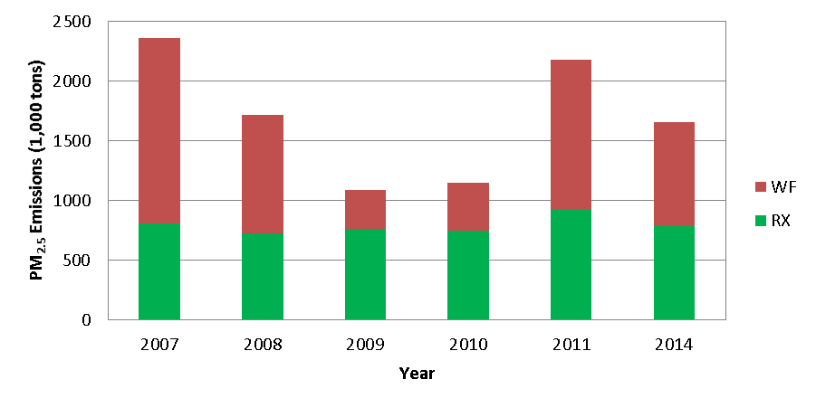
2007 – 2014 Fires PM_{2.5} Trend
Contiguous U.S.; 2008, 2011, and 2014 use state/local activity data where other years use default satellite-based data

Slide 23
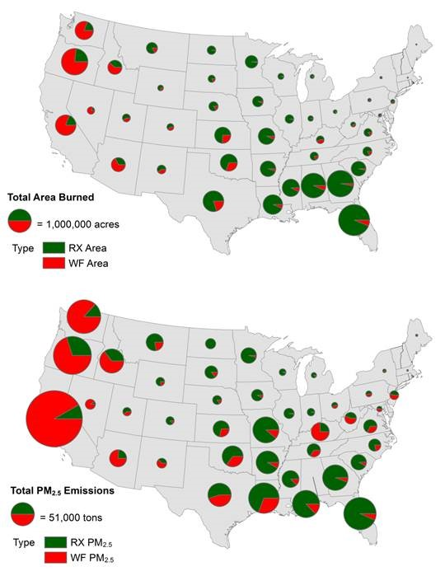
2014v1 EPA-estimated Wildfires and Prescribed Burning Acres Burned and PM2.5 emissions

Slide 24
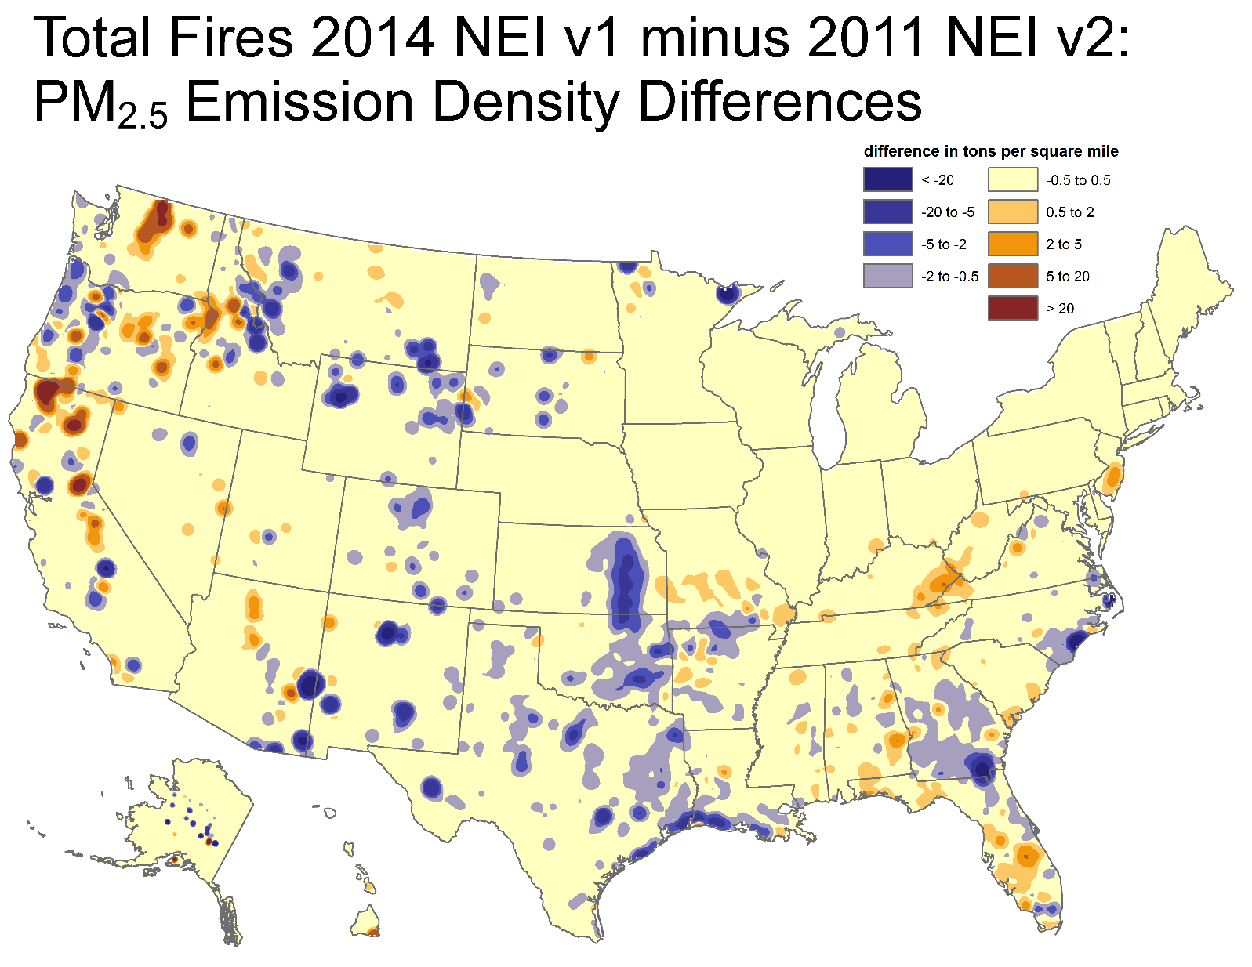
Total Fires 2014v1 minus 2011v2 NEI: PM2.5 Emission Density
-Similar methods 2011 vs 2014
-Largest decreases in areas w/ wet seasons
-2014 was a lower activity year for wild, less
change for prescribed fires
-Removed rangeland fires in KS & OK to Ag
Burning sector

Slide 25
NEI Next Steps
Complete Technical Support Document on version 1
Publish ag burning methods in the literature
NATA review focusing on high risk facilities
Continue improvements on nonpoint and mobile sectors as resources allow during 2017
Publish 2014 NEI version 2 in summer, 2017
“LEAN” event for Nonpoint sources: focus on streamlining the process and improving interactions with SLTs for the 2017 NEI.

Slide 26
Likely Changes for 2014v2 NEI
New emissions factors for RWC, ICI Fuel Combustion, Oil & Gas
Revised activity data for Oil & Gas, Hg sources, Dust sources, Commercial Cooking, Stage I Gasoline Distribution, Pesticides, Residential Heating
Revised methodology for ICI Fuel Combustion (county-level sulfur content), Hg sources, Open Burning, Backyard BBQs
New category: Composting
NATA and non-NATA edits to Point and Nonpoint sources from SLTs
New Onroad & Nonroad inputs
Will incorporate comments on EVENTS (fires) inventory as resources allow

Slide 27
Questions?
NEI website:
https://www.epa.gov/air-emissions-inventories/national-emissions-inventory
2014 NEI Data
Includes Sector and Tier query tool and other summary data
2014 NEI Documentation
Includes all supporting materials and coming soon, the Technical Support Document for 2014v1 NEI

