Slide 1
Emissions Uncertainty Inventory and Modeling Framework: Case Study of Residential Wood Combustion
Rabab Mashayekhi, Shunliu Zhao, Sahar Saeednooran, Amir Hakami
Department of Civil and Environmental Engineering, Carleton University, Ottawa
Richard Ménard, Michael Moran, and Junhua Zhang
Air Quality Research Division, Environment and Climate Change Canada

Slide 2
Why is emissions uncertainty quantification important?
Impacts downstream applications of air quality models (AQMs), where costly decisions are made based on models’ “best estimates”
Identifies priorities for improving emissions estimates
Why a case study for Residential Wood Combustion (RWC)?
Provides proof of concept for emissions uncertainty framework
Known to have a high level of uncertainty
Important source of PM, VOCs in the U.S. and Canada during the cold months
Create an Inventory of uncertainties consistent with the emission inventory

Slide 3
Bottom-up approach for uncertainty assessment
GRIDDING (spatial surrogates)
TEMPORAL ALLOCATION (temporal profiles)
CHEMICAL SPECIATION (chemical profiles)
AQM-ready emissions:
Hourly
Gridded
Speciated
Emissions Inventory
(Annual, Total area emission)
SMOKE EMISSION PROCESSOR

Slide 4
Bottom-up approach for uncertainty assessment
GRIDDING (spatial surrogates)
TEMPORAL ALLOCATION (temporal profiles)
CHEMICAL SPECIATION (chemical profiles)
AQM-ready emissions:
Hourly
Gridded
Speciated
Emissions Inventory
(Annual, Total area emission)
SMOKE EMISSION PROCESSOR
Uncertainty in all should be considered

Slide 5
RWC Inventory calculation for U.S.
Emission = ACTIVITY X EMISSION FACTOR
(Mass of wood)
(Mass of pollutants/mass of wood)
(Volume of wood) X (Wood density)
(Number of appliances) X (Burn Rate) X (Climate adjustment)
(Occupied housing units) X (Appliance Fraction)

Slide 6
Sources of data for U.S
Emission = ACTIVITY X EMISSION FACTOR
(Mass of wood)
(Mass of pollutants/mass of wood)
AP-42 documents
(Volume of wood) X (Wood density)
U.S. Forest Service, Timber Products Output
(Number of appliances) X (Burn Rate) X (Climate adjustment)
U.S. Department of Agriculture
Commercial Buildings Energy Consumption Survey
(Occupied housing units) X (Appliance Fraction; divided into main, secondary, pleasure purposes)
2010 U.S. Census
American Housing Survey (U.S. Census Bureau)

Slide 7
Sources of data for Canada
Emission = ACTIVITY X EMISSION FACTOR
(Mass of wood)
(mass of pollutants/mass of wood)
AP-42 documents
(Volume of wood) X (wood density)
TNS, 2012 Canadian Fact survey
(Number of appliances) X (Burn Rate)
TNS, 2012 Canadian Fact survey
TNS, 2012 Canadian Fact survey

Slide 8
Characterizing uncertainties in each input
Inventory parameters
Spatial surrogates
Temporal profiles
Chemical speciation profiles

Slide 9
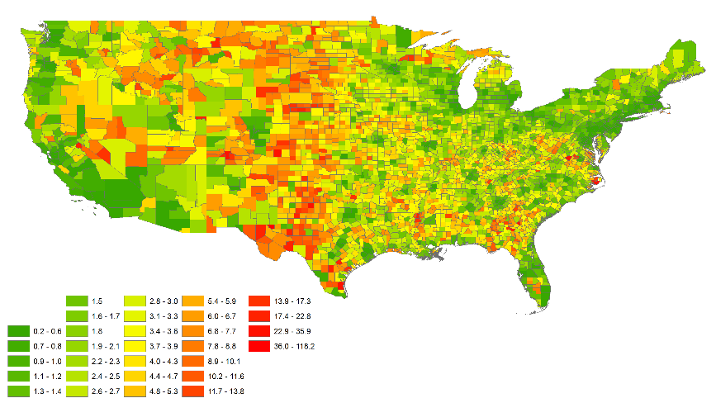
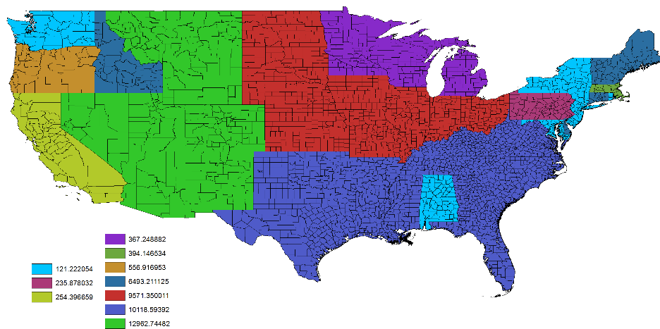
Characterizing uncertainties (inventory parameters for the U.S.)
Occupied housing: Marginal error at 95% confidence interval (CI)
Appliance fraction: Sampling error at 95% CI
Climate adjustment: Assumed certain
Burn rate: Sampling error at 68% CI
Wood density: Sampling error at 68% CI
Emission Factor: Quality rating (A-E)
Inventory parameters
Spatial surrogates
Temporal profiles
Chemical speciation profiles
Housing units (error%)
SD, Appliance Fraction

Slide 10
Characterizing uncertainties (inventory parameters for Canada)
Number of Appliance: Assumed 30%
Burn rate: Sampling error at 68% CI
Wood density: Sampling error at 95% CI
Emission Factor: Quality rating (A-E)
Inventory parameters
Spatial surrogates
Temporal profiles
Chemical speciation profiles

Slide 11
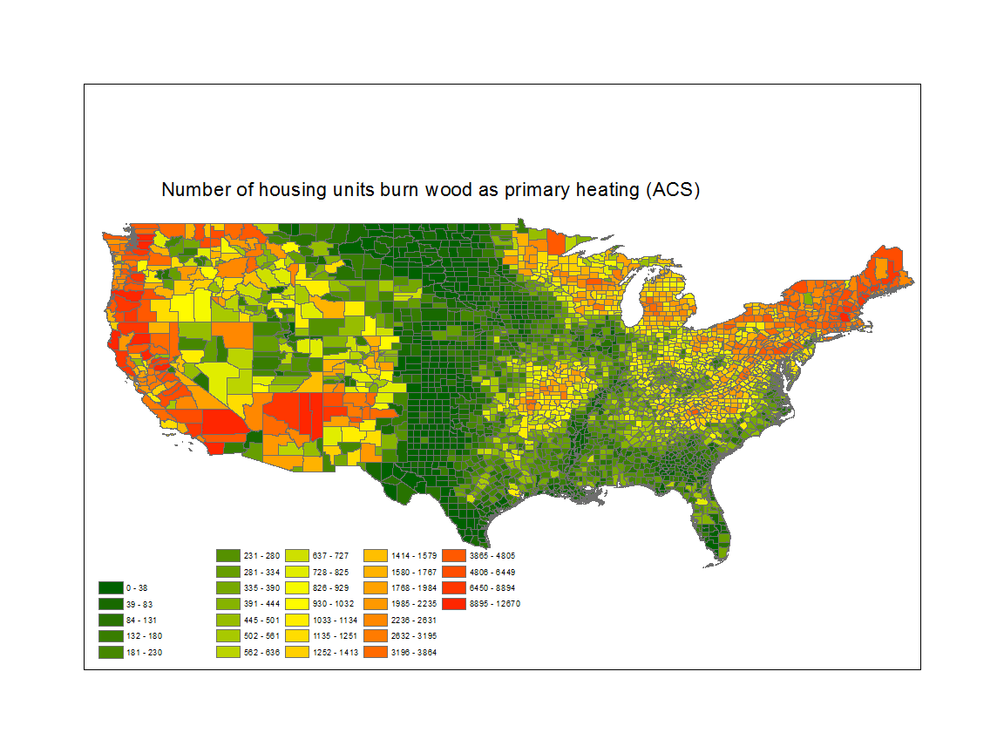
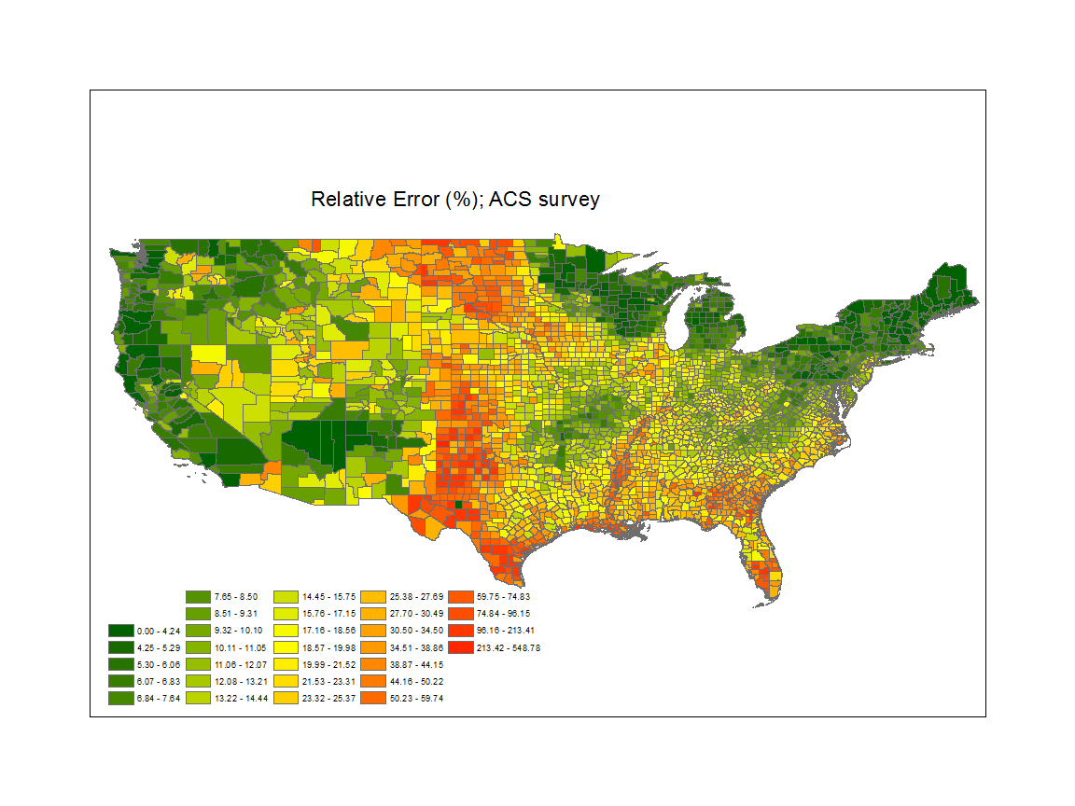
Characterizing uncertainties (RWC surrogates in the U.S)
Number of houses burn wood as primary heating source
Inventory parameters
Spatial surrogates (marginal error reported in U.S. Census American Community Survey (ACS))
Temporal profiles
Chemical speciation profiles
Relative Error (%)

Slide 12
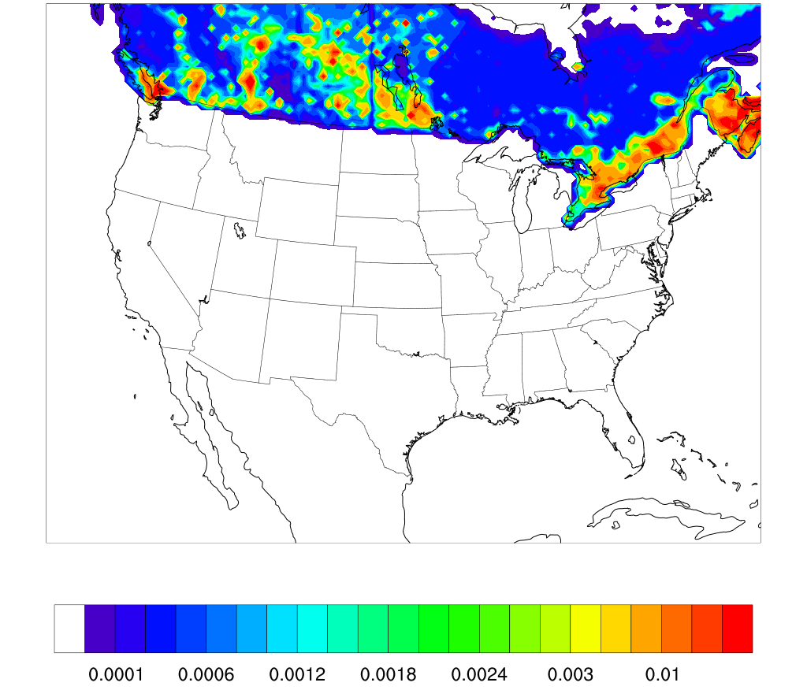
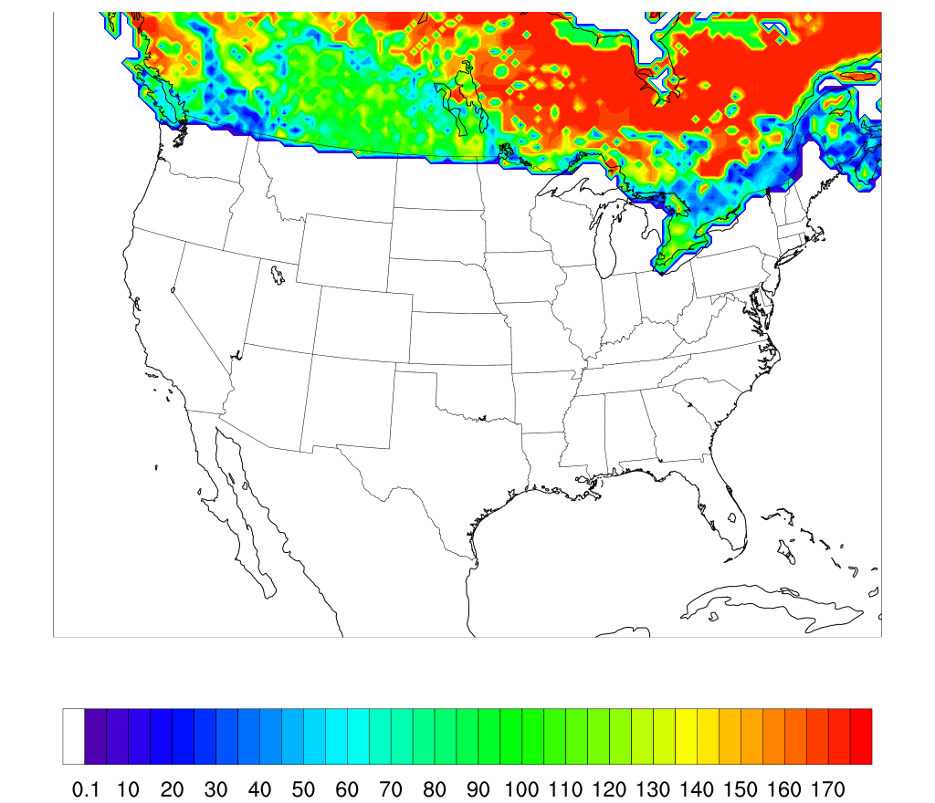
Characterizing uncertainties (RWC surrogates in Canada)
Inventory parameters
Spatial surrogates (standard deviation using 3 different surrogates used to allocate Canadian RWC)
950A: combination of forest and dwellings
950B: intersection of forest and dwellings
951: RWC from HES and EUS surveys
Mean
Relative Error (%)

Slide 13
Characterizing uncertainties in each input
Inventory parameters
Surrogates
Temporal profiles
Chemical speciation profiles
We do not have any uncertainties reported in literature
For each temporal and speciation profile, each single coefficient is assigned a standard deviation assuming a 30% uncertainty
Suggestions are welcome!

Slide 14
Propagating uncertainties
Monte Carlo simulations
Sampling code is External to SMOKE
Latin Hypercube Sampling (LHS) generates a set of 100 random realizations (other set sizes were also tested)
Normal distribution is assumed for each parameter

Slide 15
Results
Resolution: CONUS, 36 km
SMOKE version: v3.7
Episode: February 1st, 2011
Chemical speciation: ADOM gas-phase mechanism and 12-bin aerosol representation (GEM-MACH)

Slide 16
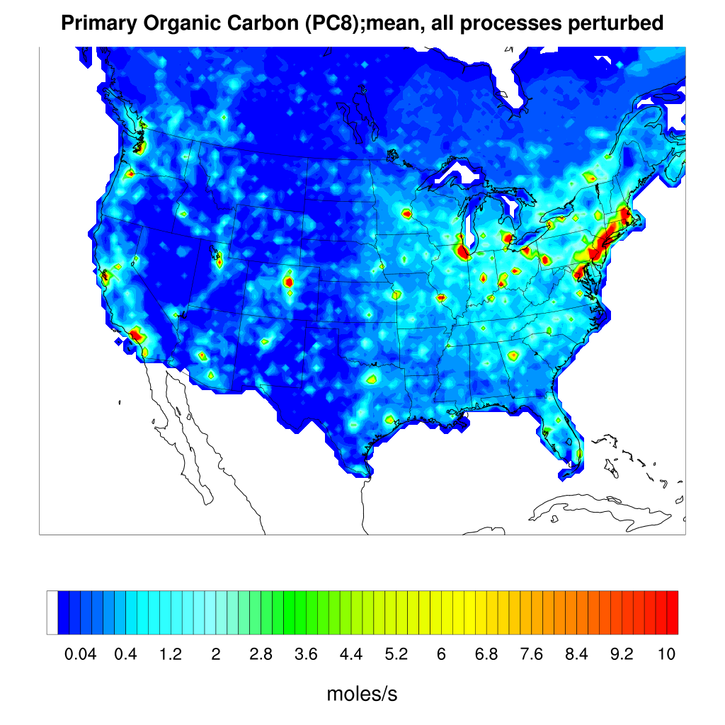
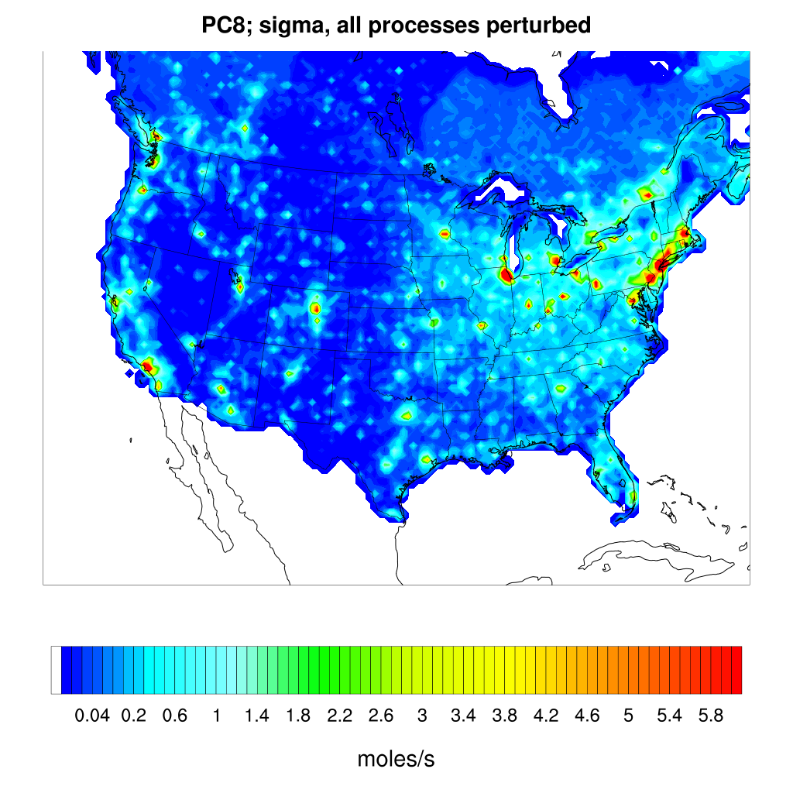
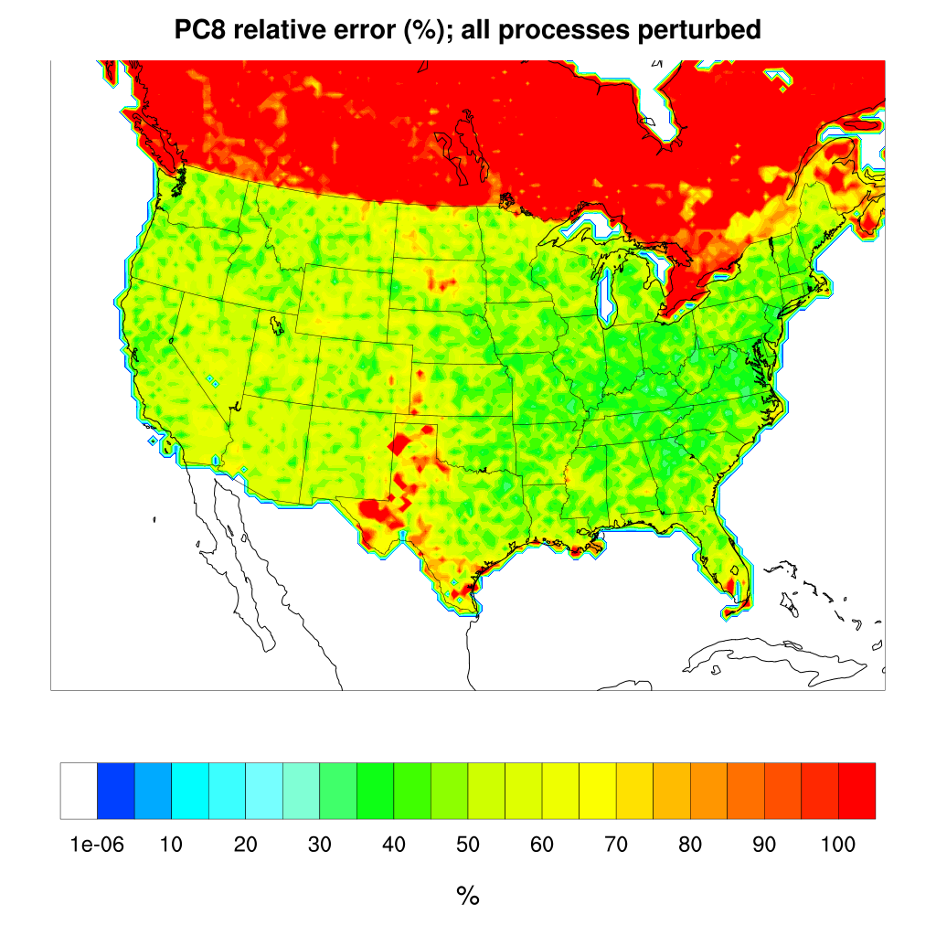
Results (All processes perturbed; 100 realizations)
Primary Organic Carbon (PC8) emission, February 1st, 18 UTC
Mean; 100 realizations
Standard Deviation; sigma
Relative error(%), sigma/mean
0.04
10
0.04
5.8
0
100
g/s
g/s
%
Higher uncertainty over Canada
Indication of high values over central U.S.

Slide 17
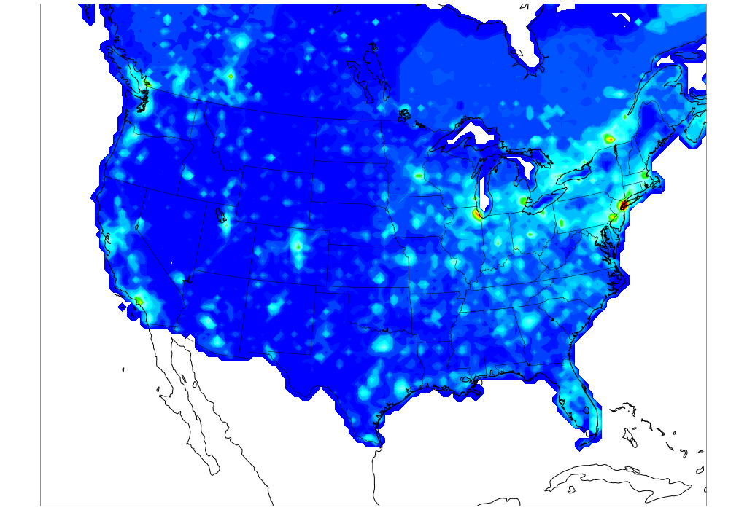
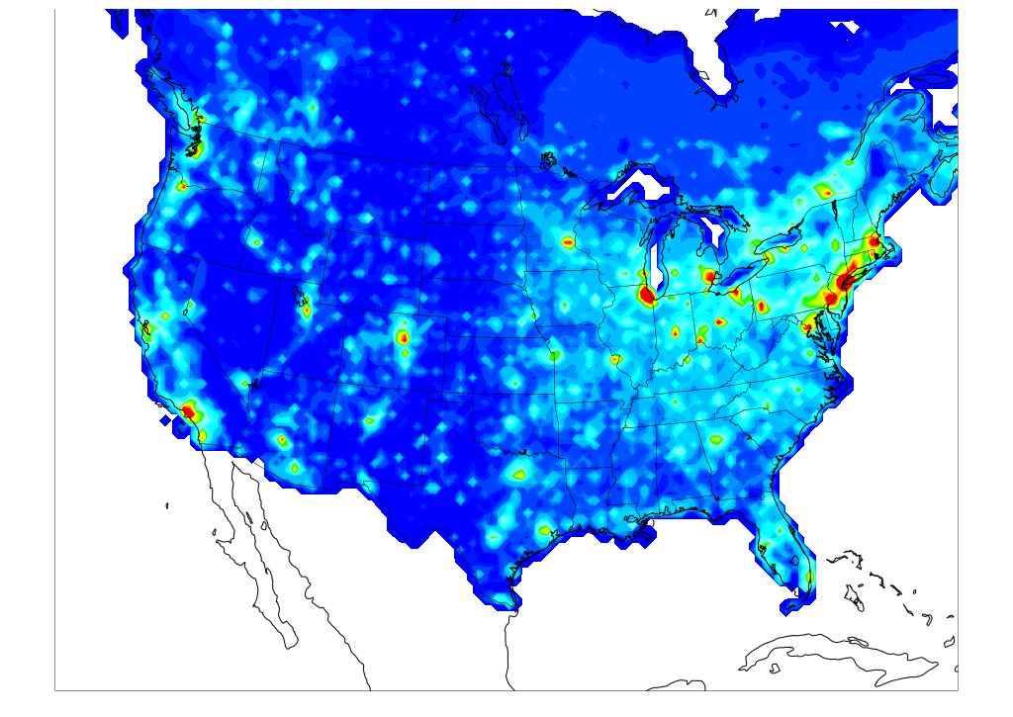

Contribution of inventory and spatial uncertainty in overall uncertainty (Standard Deviation (σ))
Primary Organic Carbon (PC8) emission, on February 1st at, 18 UTC
σ: All processes perturbed
σ: All processes perturbed except inventory
σ: All processes perturbed except surrogates
g/s
Excluding the inventory perturbation decreases the total standard deviation

Slide 18
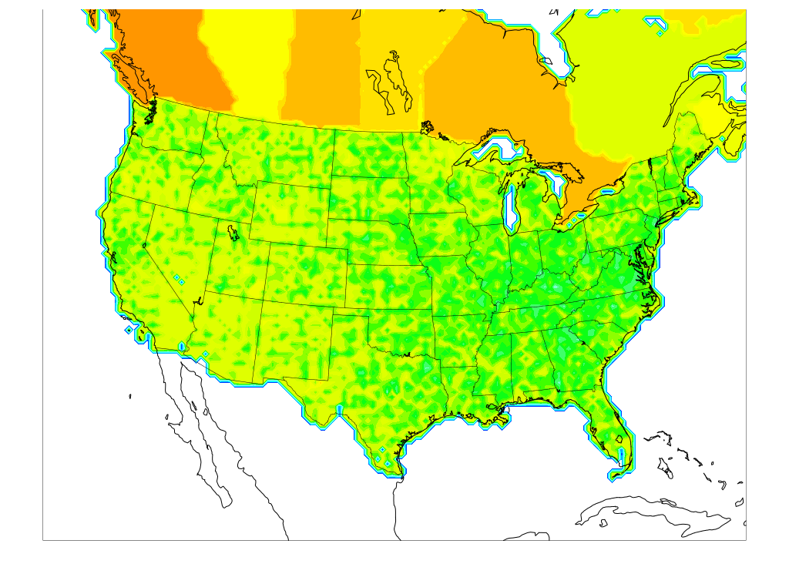
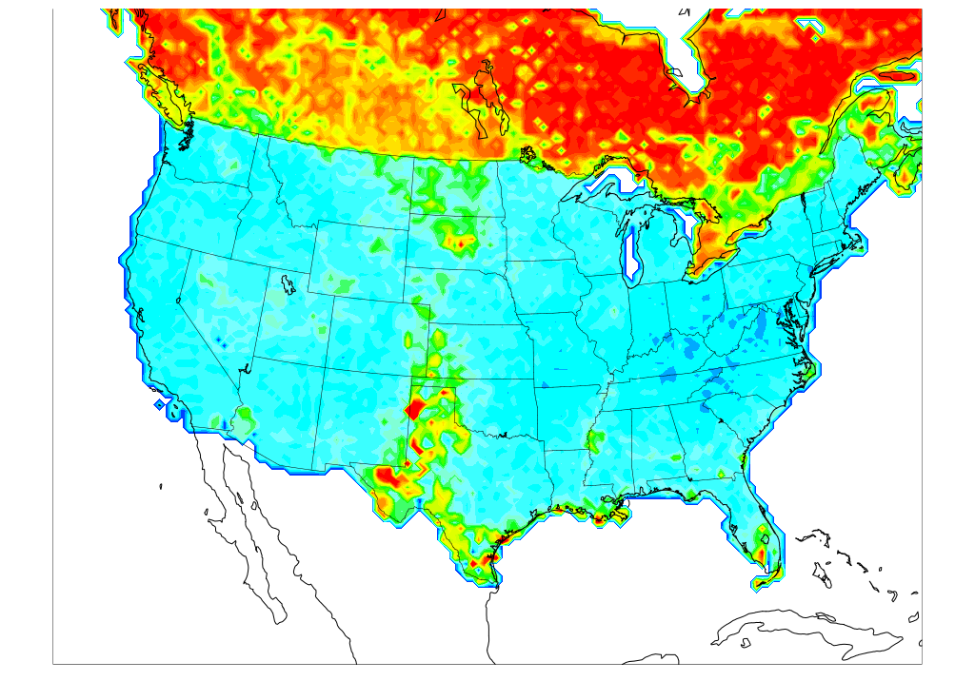
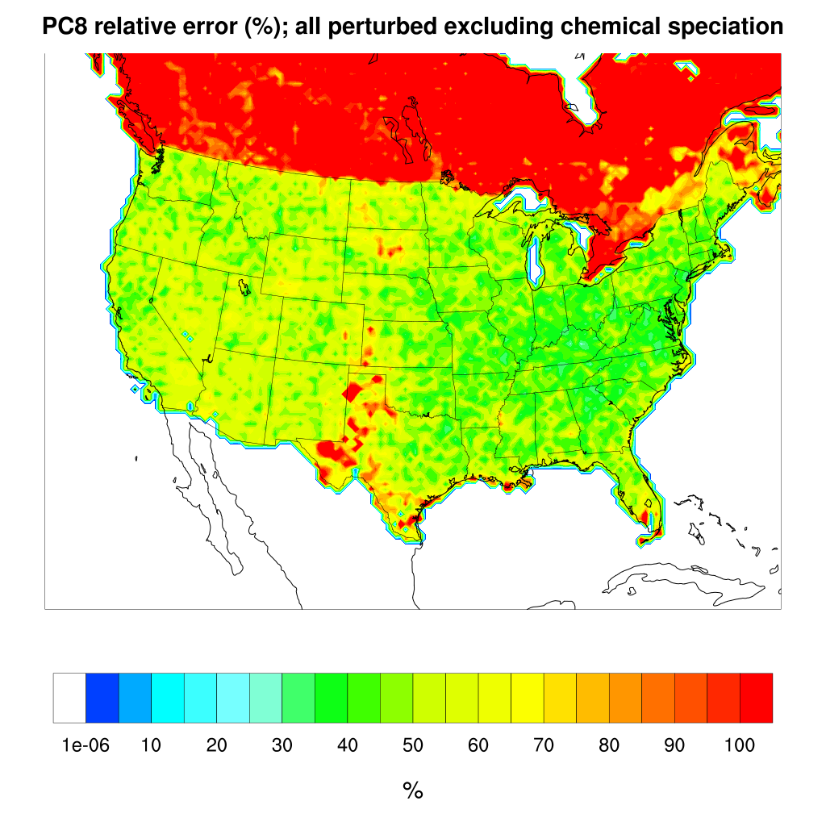
Contribution of inventory and spatial uncertainty in overall uncertainty (Relative Error (%))
Primary Organic Carbon (PC8) emission, on February 1st at, 18 UTC
All processes perturbed except surrogates
All processes perturbed
All processes perturbed except inventory
Excluding surrogate perturbation:
Reduces the uncertainty in Canada
removes the high uncertainty in central U.S.

Slide 19
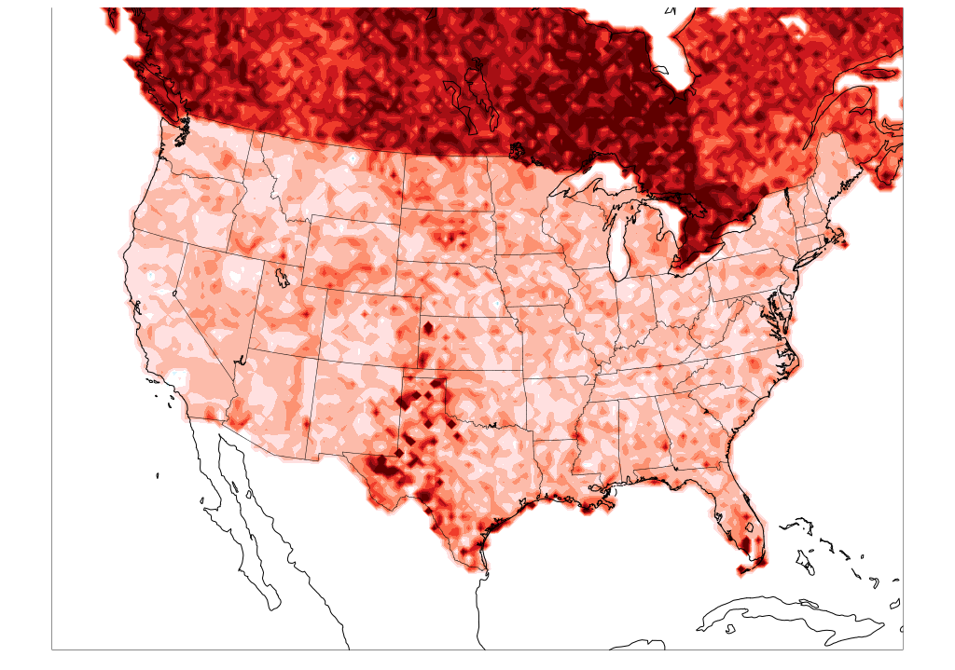
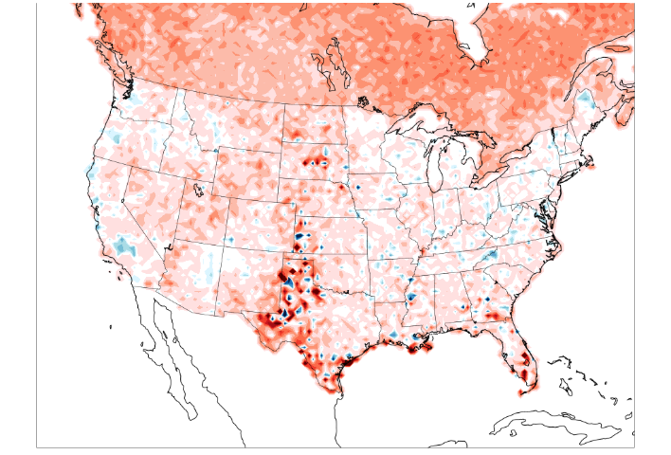
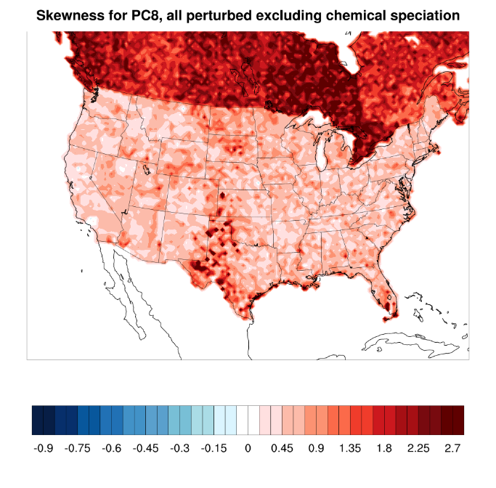
Contribution of inventory uncertainty in shape of distribution (Skewness; measure of symmetry)
Primary Organic Carbon (PC8) emission, on February 1st at, 18 UTC
All processes perturbed
All processes perturbed except inventory

Slide 20
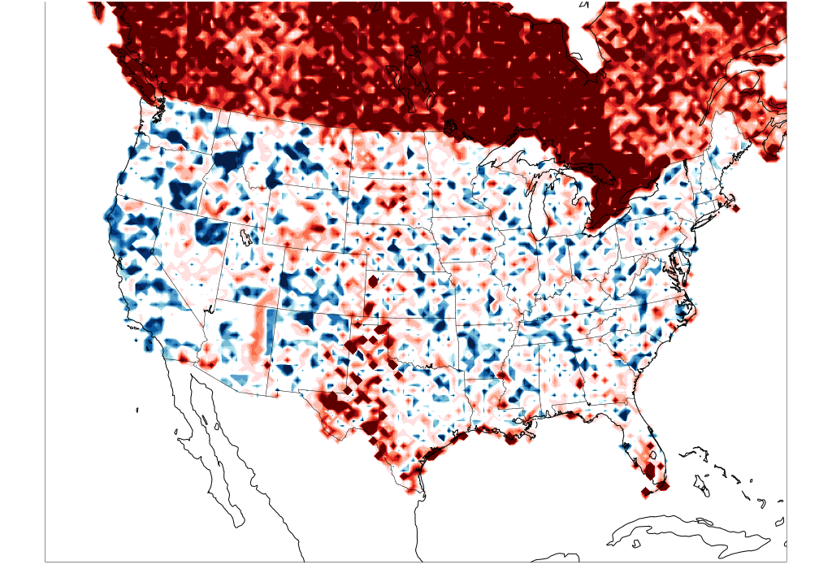
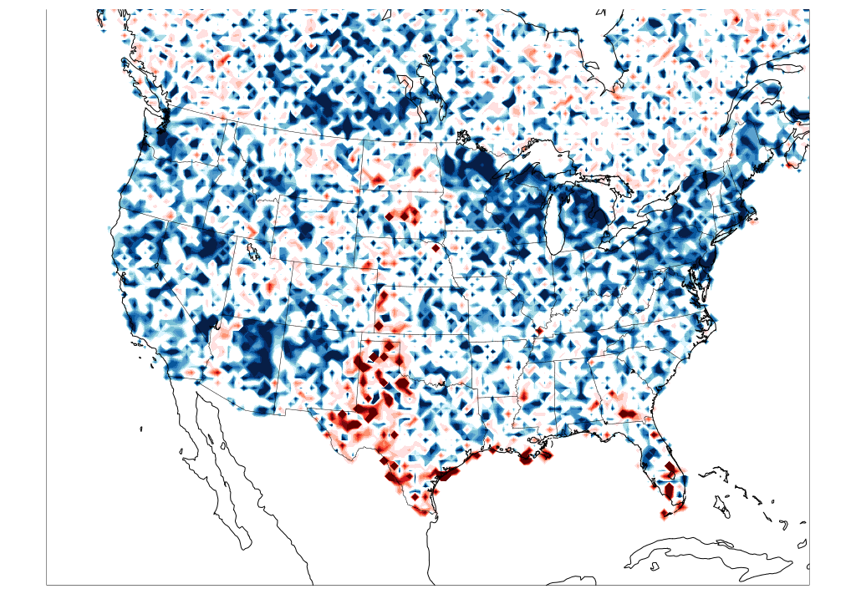
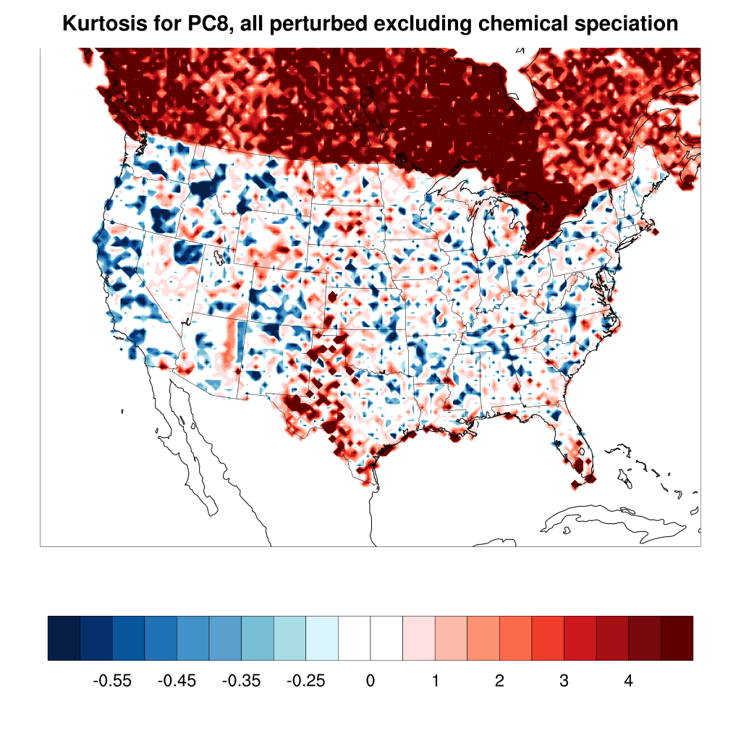
Contribution of inventory uncertainty in shape of distribution (Kurtosis; measure of the sharpness of the peak of distribution)
Primary Organic Carbon (PC8) emission, on February 1st at, 18 UTC
All processes perturbed
All processes perturbed except inventory
Excluding inventory perturbation:
Removes the positive kurtosis in Canada

Slide 21
Main Findings:
Emission Inventory is a significant contributor to overall RWC uncertainty
Uncertainty in inventory has also important impact on shape of distribution (both symmetry and sharpness of distribution)
Higher uncertainty in Canada is due to more uncertain input data, especially for inventory parameters, and larger reporting jurisdictions

Slide 22
By applying this framework we can:
Generate a set of random realizations of model-ready emission input files, propagate through CTMs
Provide an effective means for formal quantification of uncertainties in emissions from other source sectors
Identify gaps in available information for raw emission uncertainty

Slide 23
Future steps
Refining RWC emission estimation by including all wood appliance types (e.g. outdoor appliances)
Expanding the framework to other emission sectors (e.g. Road dust)
Propagating emission uncertainties through AQMs (e.g. GEM-MACH)

Slide 24
Acknowledgement
Thanks to Environment Canada for providing funding for this project

Slide 25
THANK YOU

Slide 26
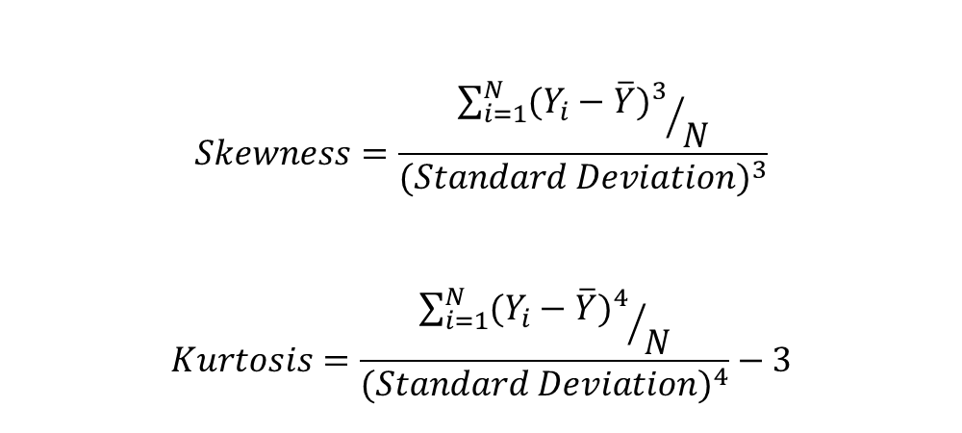
Shape of distribution: Skewness and Kurtosis
$$Skewness=\frac{{\sum_{i=1}^{N}{{(Y_{i}−\overline{Y})}^{3}}}/N}{{(Standard Deviation)}^{3}}$$
$$Kurtosis=\frac{{\sum_{i=1}^{N}{{(Y_{i}−\overline{Y})}^{4}}}/N}{{(Standard Deviation)}^{4}}−3$$

Slide 27

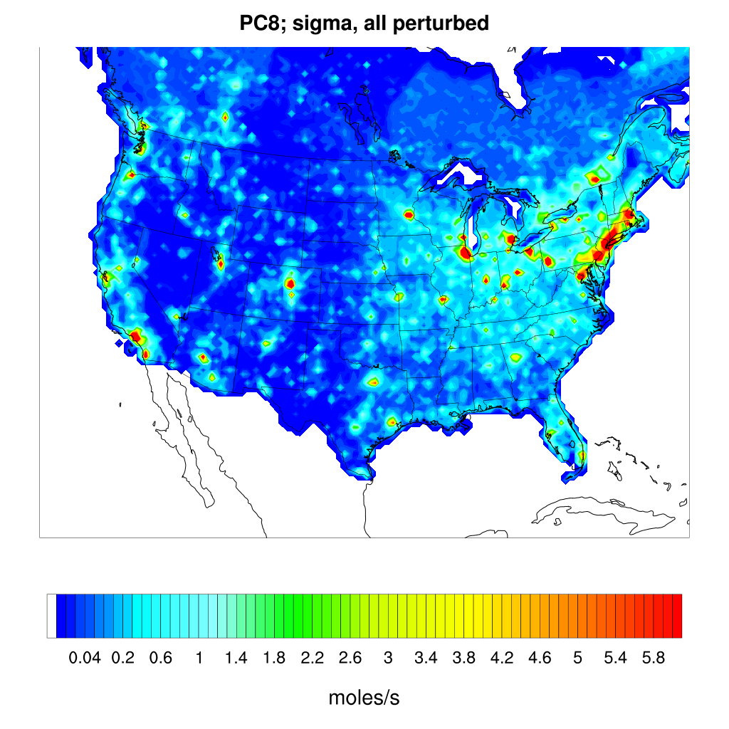
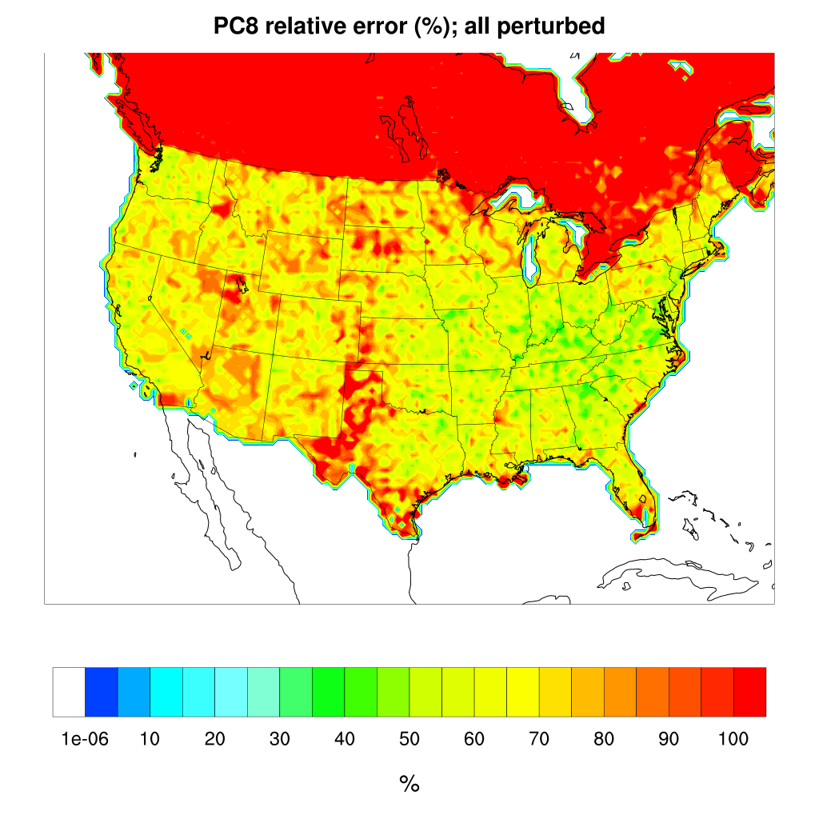
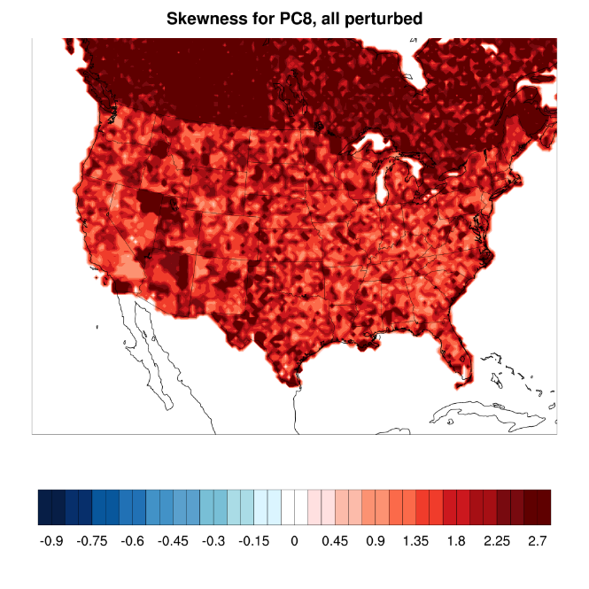
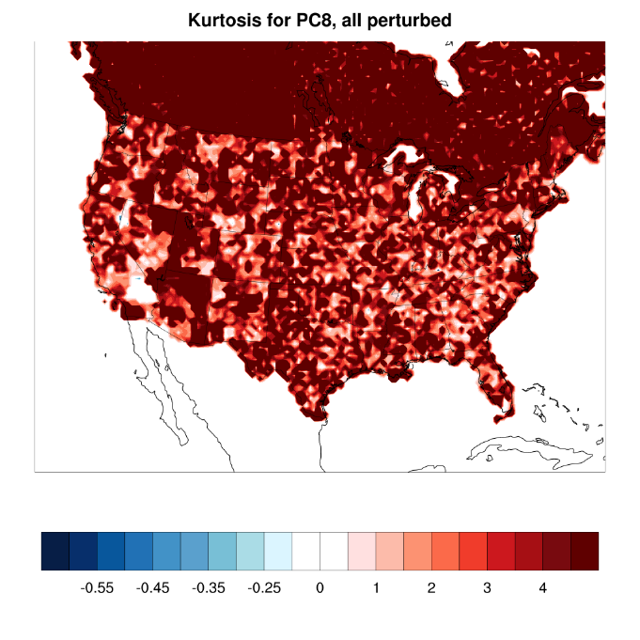
Sensitivity test: Log normal assumption and 50% uncertainty in temporal uncertainty

Slide 28
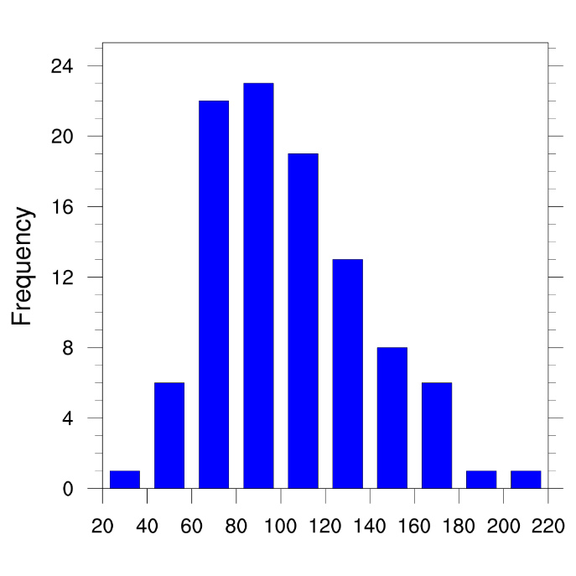
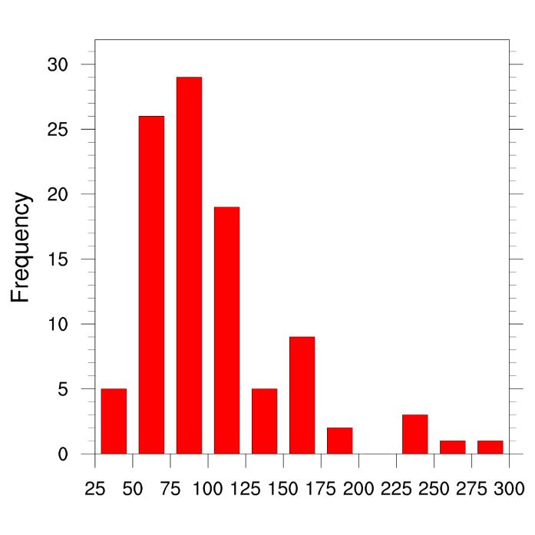
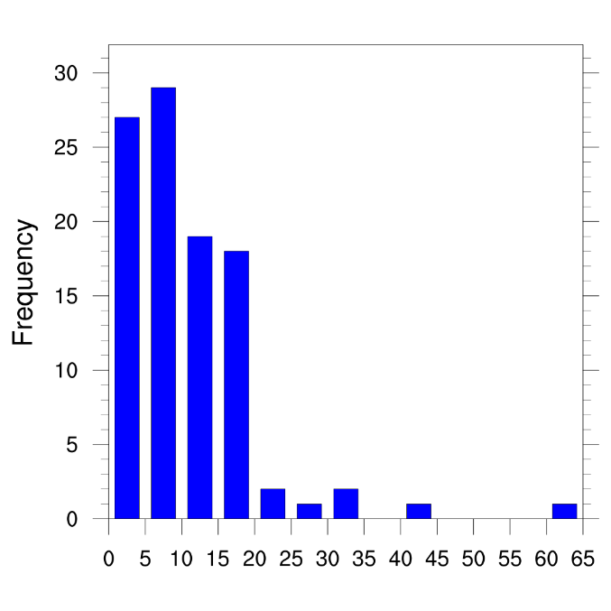
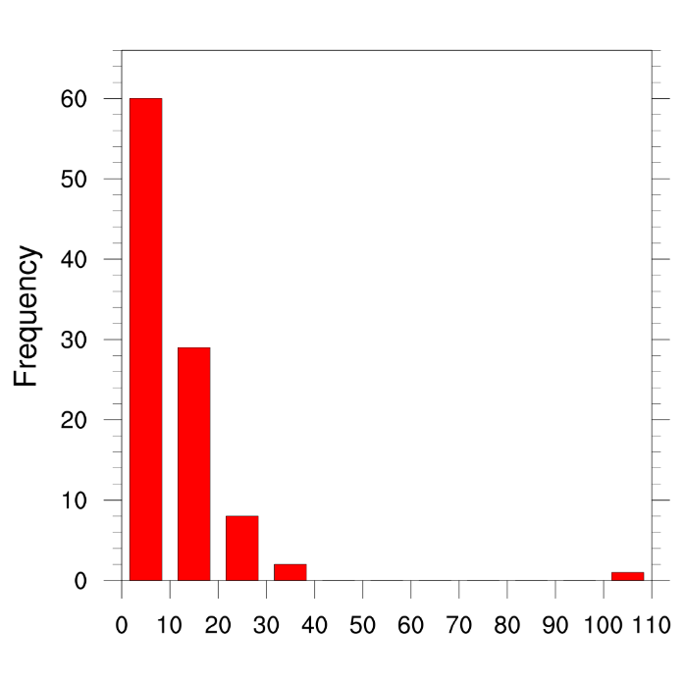
Normal vs Log normal assumption
(100 Realizations)
Location 1, Normal
Location 1, Log Normal
Loc#2
Loc#1
Location 2, Normal
Location 2, Log Normal

Slide 29
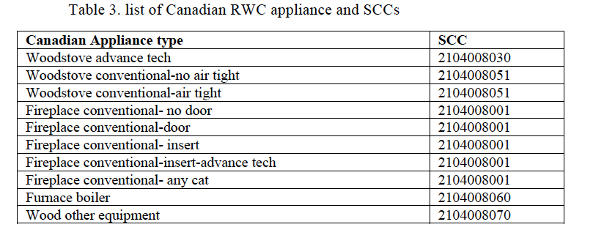

Slide 30
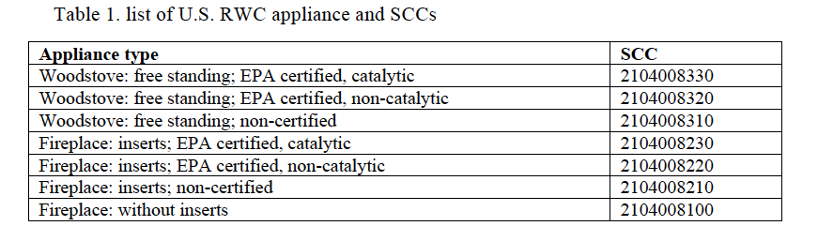

Slide 31
